Slide 1
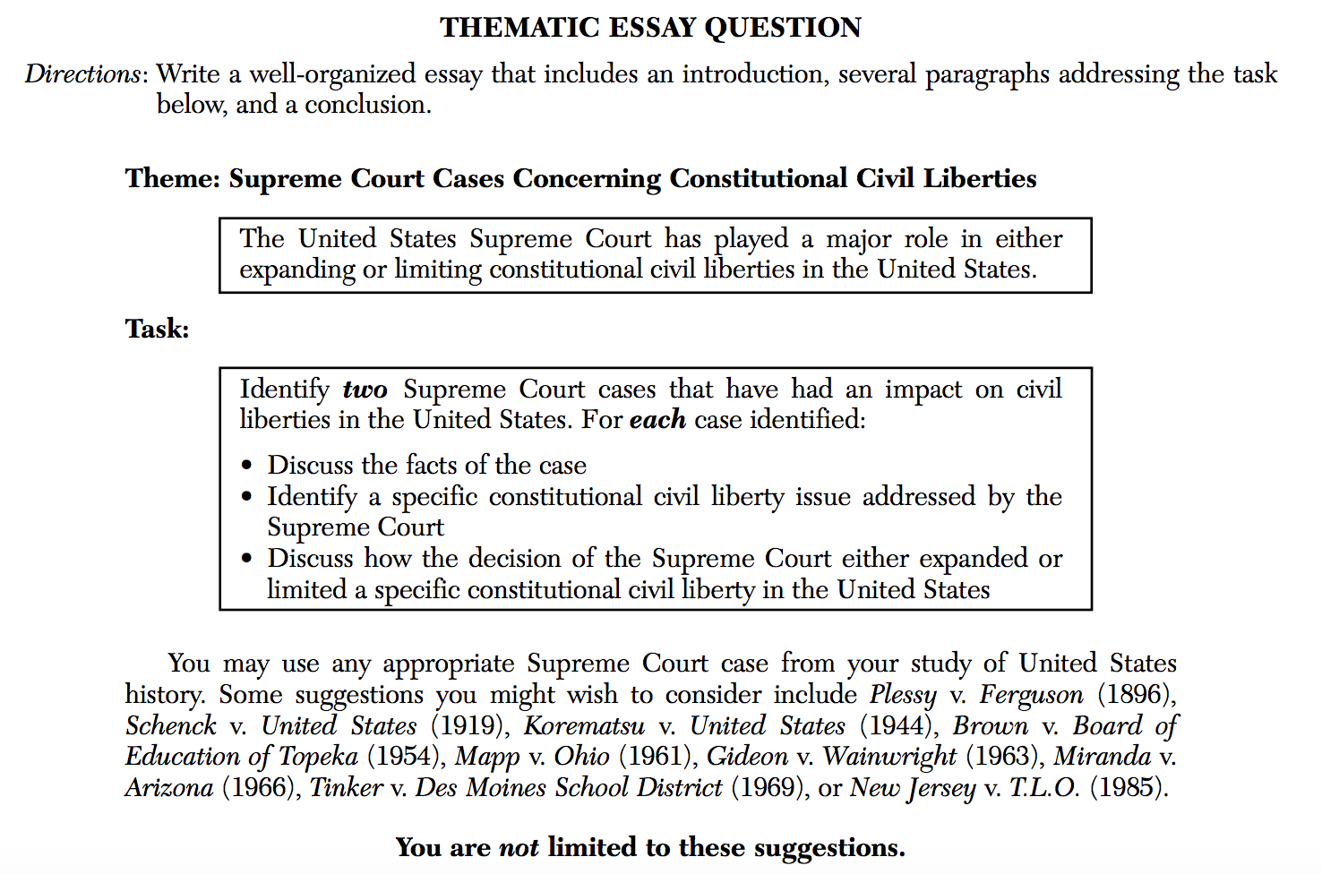
DO NOW: Look at the following Regents thematic essay question…how many parts do you have to write to?

Slide 2
How can we best complete a the thematic essay on the US History Regents?
Major US Thematic Essay Topics:
1. Change/Turning Points
2. Civic Values and Laws
3. Constitutional Principles
4. Culture and Intellectual Life
5. Diversity and Equality
6. Economic Systems
7. Foreign Policy
8. Geography
9. Government Branches
10. Human Systems in Society
11. Immigration and Migration
12. Presidential Actions and Decisions
13. Science and Technology
14. Supreme Court Cases
15. Individuals, Groups, and Institutions
16. Reform Movements
Guidelines for writing a Thematic Essay:
Develop all aspects of the task
Show a thorough understanding of the theme
Support the theme with relevant facts, examples, details, and information
Shows an ability to analyze, evaluate, compare, and/or contrast the theme
Is well developed and uses a clear plan of logical organization, including an introduction and a conclusion that are beyond a restatement of the theme

Slide 3
TEND TO BE THE MOST COMMON, BUT NOT ALWAYS…
1. Court Cases are important. Go into the exam knowing 3 Court Cases REALLY WELL. Especially Plessy and Brown vs. Board of Education. Even if the essay isn't on court cases, you can still use a court case to answer something like "Turning Points" or "Civil Rights of Minorities." Know the Amendments for the cases too, as it's good outside info ... plus, Amendments has been used before as a thematic.
2. Geography - How geography influences the US and decisions we make!
3. KNOW AT LEAST 2 SIGNIFICANT LAWS/ACTS (or more!) - Government legislation and its impact is key. Good ones include: Pure Food and Drug Act, Social Security Act, and the Civil Rights Act, etc.
4. Technology - Transcontinental Railroad, Television, Radio, Internet.

Slide 4
TEND TO BE THE MOST COMMON, BUT NOT ALWAYS…
5. Reform Movements - This is great for Change. So, the Progressive Era reacts to Industrialization. Abolition, Suffrage, Prohibition and Temperance, and Civil Rights also work. Also, know the writers. If it's on the Progressive Era, then use muckrakers such as Upton Sinclair. If it's abolition, know writers such as Harriet Beecher Stowe (Uncle Tom's Cabin).
6. KNOW AT LEAST 2 WARS/CONFLICTS - Wars can be used for Foreign Policy, Turning Points, Change, and Conflict. Also wars are good for Presidential decisions such as dropping the atomic bomb in WWII, or suspending habeas corpus in the Civil War.
7. Limitation of Rights - Know 2 of the following REALLY well: Native American Removal, Japanese Internment (and Korematsu case), and Slavery.

Slide 5
THEMATIC ESSAY TIPS
Tip #1: Depth
Let's assume you have the following part of a question:
Explain the circumstances behind 1 Supreme Court Case.
a) "Separate but Equal and Jim Crow laws led many to challenge segregation laws." Times were changing."
b) "After the 1896 Plessy v. Ferguson decision, "separate but equal" was seen as Constitutional. Even though the 14th Amendment said that all should be treated the same under the law, segregated schools, restaurants, and drinking fountains prevailed in the South. In 1954, Linda Brown and others challenged segregation in schools. Civil Rights had become an important issue of the day, as already Jackie Robinson was playing baseball and President Truman had integrated the army so African Americans and whites could fight side-by-side."
Both correct, but B offers specifics, history, and context!

Slide 6
Tip #2: Choose what you can write a lot about!
This might sound ridiculous, but write about what you know the MOST ABOUT!
After the essay question, the Regents will offer you different options as to what you can write about (though you are not limited to their choices). For instance, if the essay is on "Technology Bringing Change," then choose what you can write the most on.

Slide 7
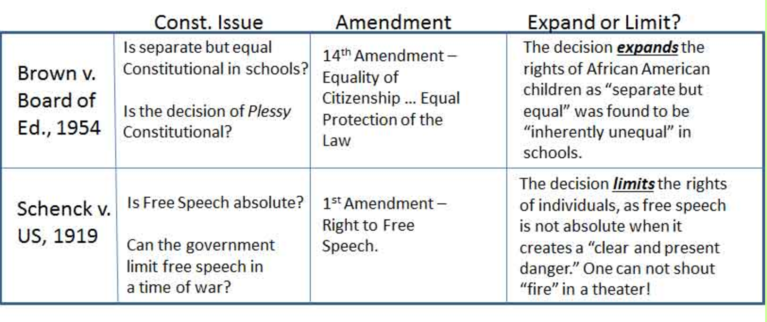
Tip #3: Answer every bullet equally!
The question will give you 2-3 bullets to answer. If you write 10 pages on one bullet, and nothing on the others ... that's bad! Don't forget to answer every part. Let's say you get a question that says
Choose two Supreme Court Cases:
- Describe the Constitutional Issue of the court case.
- Explain the Amendment involved.
- Discuss how the court case either expanded or limited rights.
How many things are you being asked to answer??

Slide 8
Tip #4: Be Careful!
NOTE: Sometimes the thematic says ... "You can not write on certain topics."
Make sure you read the bold words! On a 2014 Court Case essay, you couldn't write about Brown v. Board of Education because it was in the DBQ!

Slide 9
YOUR JOB FOR TODAY
Each group will be assigned a common thematic essay question from a previous US History Regents exam.
In your small groups, I want you to OUTLINE your assigned thematic essay according to the model below.
Each outline should include details and outside information that you would add into your essay if this was the day of the Regents exam.
When all groups are finished, we will hang up the outlines around the room, and everyone will have an opportunity to walk around (take a picture) and use the outline to study from!
Thematic essay THEME: ________________________________________________
2 focuses of your essay | Task 1 | Task 2 | Task 3 (if necessary)
Historical event #1:
Historical event #2:

