Slide 1
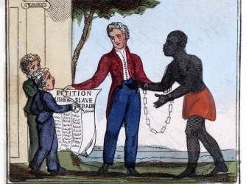
AIM: How did the abolitionist movement develop and expand during the 1800s?

Slide 2
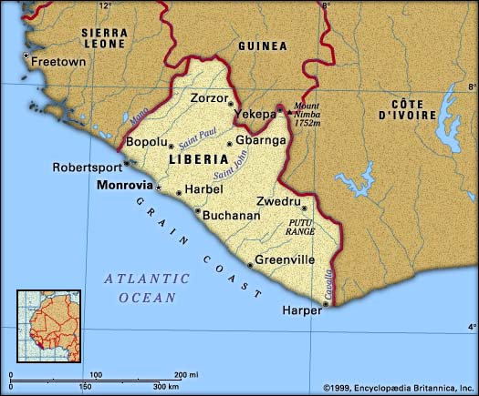
The antislavery movement…where did it BEGIN?
1817 - American Colonization Society
Transporting free slaves to Africa
Politicians? THUMBS UP
Racist whites wanted them OUT!
12,000 African Americans settled in Liberia

Slide 3
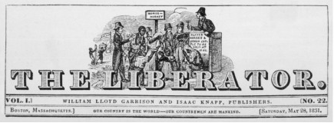
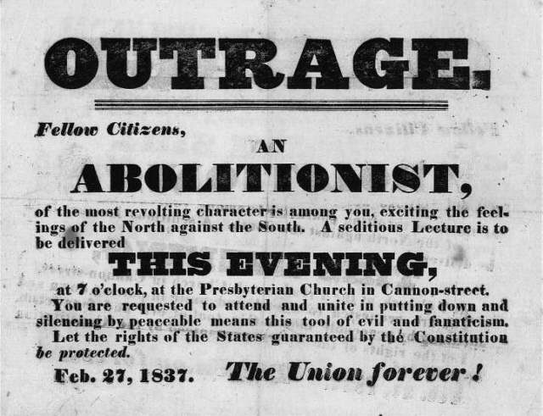
The Abolitionist Movement takes shape
The efforts to end the institution of slavery in America
Strongest in the north, led by free African Americans, women, and educated people
A “Grassroots Effort”
American Antislavery Society = “no Union with slaveholders!”

Slide 4
Violent Abolitionism
White southerners were always scared of a possible slave REVOLT…but some saw ending slavery as a POSSIBILITY…
NAT TURNER’S REBELLION (1831)
Nat Turner, a slave from Virginia, believed that God had told him to END SLAVERY
While you watch: What were the results of Nat Turner’s Rebellion?
VIDEO

Slide 5
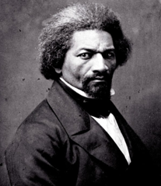
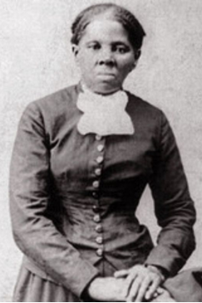
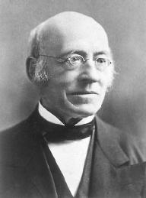
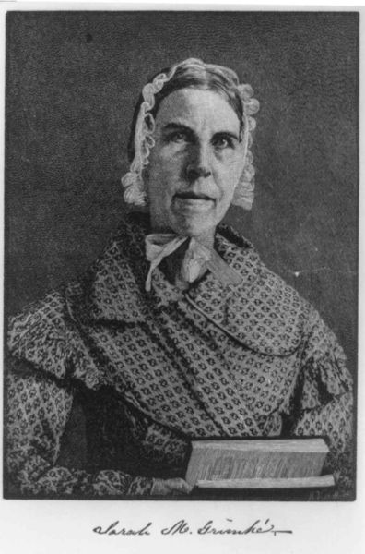
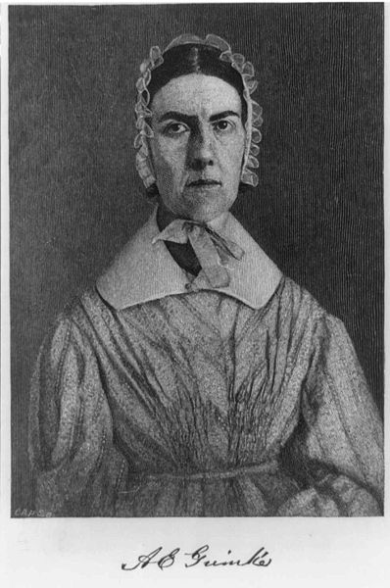
The Abolitionist Movement
Famous Abolitionists:
Frederick Douglass (escaped slave)
William Lloyd Garrison (newspaper publisher)
Harriet Tubman (escaped slave)
The Grimke Sisters (slave owning family from South Carolina)
Sojourner Truth (freed slave)

Slide 6
AIM: How did American romanticism and the arts have an effect on future reform movements in the United States?

Slide 7
MUSEUM WALK REACTION
Famous Abolitionists:
Frederick Douglass (escaped slave)
William Lloyd Garrison (newspaper publisher)
Harriet Tubman (escaped slave)
The Grimke Sisters (slave owning family from South Carolina)
Sojourner Truth (freed slave)
VIDEO
VIDEO
VIDEO

Slide 8
The Second Great Awakening
“Spiritual Reform From Within” [Religious Revivalism]
Other “movements” plated a role too…
Social Reforms & Redefining the Ideal of Equality
Temperance
Abolitionism
Education
Asylum & Prison Reform
Women’s Rights

Slide 9
THE FERMENT OF REFORM
Transcendentalism
(European Romanticism and Idealism)
REJECT organized church authority
Artistic expression more important than the pursuit of wealth
INDIVIDUALISTIC

Slide 11
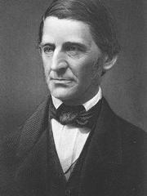
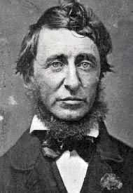
Transcendentalist Intellectuals/Writers
from Concord, Massachusetts
Ralph Waldo
Emerson
Henry David
Thoreau
Don’t imitate European culture
Resistance to Civil Disobedience (1849)
Create an entirely new and original American culture
Walden (1854)
Advocated nonviolent protest/civil disobedience
“The American Scholar” (1837)

Slide 12
The Transcendentalist Agenda
Give freedom to the slaves.
Give well-being to the poor and the miserable.
Give learning to the ignorant.
Give health to the sick.
Give peace and justice to society.
Gavin DeGraw
“I Don’t Want To Be”
Can you find the Transcendentalist lyrics?
GAME
TIME

Slide 13
> Brook Farm > New Harmony > Oneida Community > Mormons > Shakers
UTOPIAN SOCIETIES
Utopian movements with the common vision to remake society in a “more perfect way”
Communal characteristics
Separate from mainstream society

Slide 14
Brook Farm

Slide 15
Oneida Community (NY)
Rejected traditional family and marriage values
All residents were married to all other residents
“Sinful experiment of ‘free love’!"
Sexual behavior was monitored to prevent abuse.
Children raised communally
Liberation from the demands of male lust.
Prospered by selling
HIGH QUALITY SILVERWARE!

Slide 16
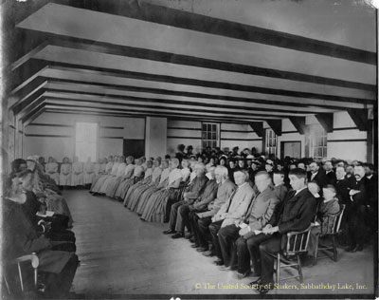
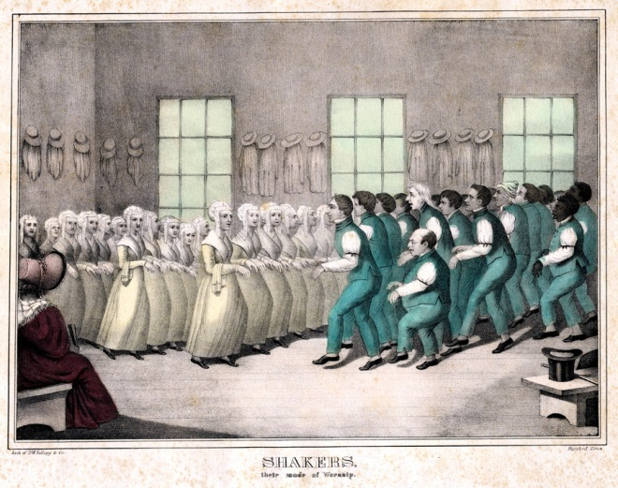
Shakers
Religious extremists
Re-defined traditional sexuality
“Shaking” ecstatic movement- would “shake themselves free from sin” while performing a loud chant.
Shaker Dance VIDEO!
A view of Shaker Meeting from 1885. A photographer from the Poland Spring Hotel took this image. The Shakers are seated in the front benches. The spectators and guests from the Poland Spring Hotel are in the back rows.

Slide 17
While America was undergoing an era of major change…there were many problems lying under the surface. These social ills were attacked many social reformers…
Major reform movement existed in the following areas…
Women’s Rights
Temperance
Public Education
Mental Health Reform and Prison Reform

