Slide 1
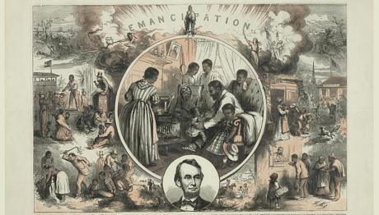
UNIT 8: Reconstruction
Aim: Which plan for Reconstruction was the best, following the Civil War?

Slide 2
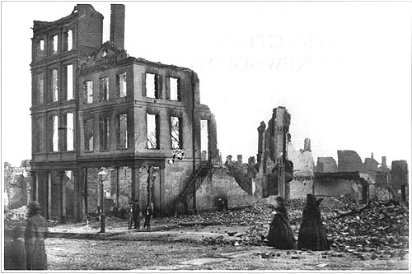
The state of the South after the Civil War

Slide 3
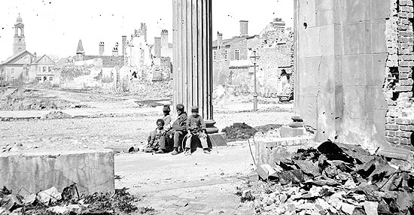
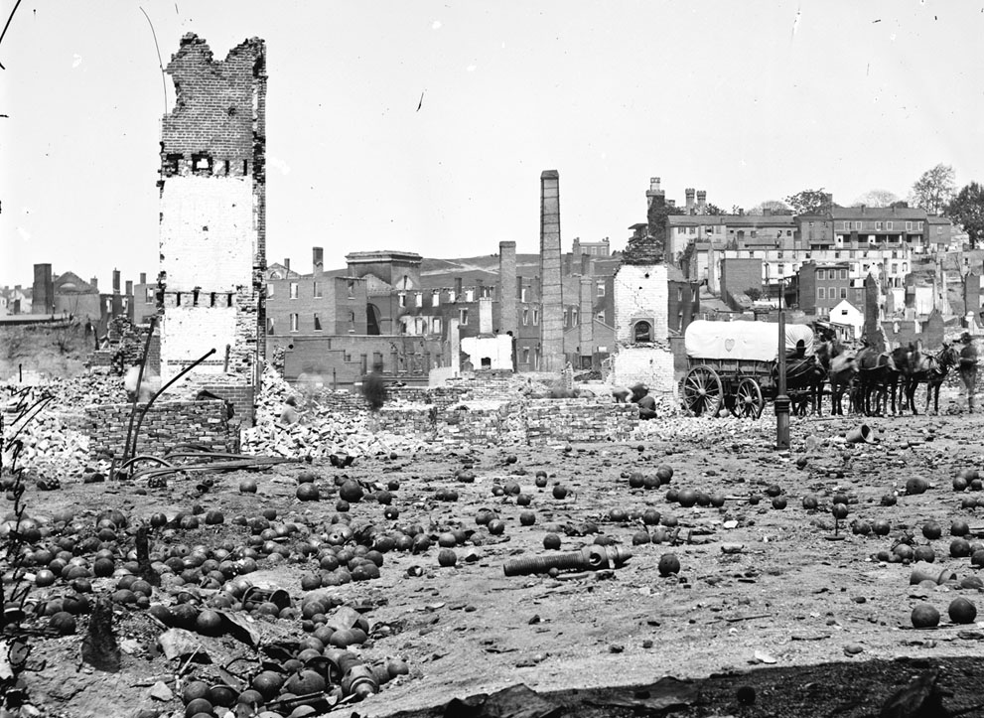

Slide 4
Reconstruction (1865-1877)
When the North won the Civil War in 1865, the era of Reconstruction began
Should the president, as commander-in-chief, be in charge?
What branch of government is in charge of Reconstruction?
How should the
North bring the
South back into
the Union?
Reconstruction refers to the era from 1865 to 1877 when the U.S. gov’t addressed bringing the South back into the Union after the Civil War & the treatment over former slaves in America
“Old South” based on cotton farming with blacks as workers?
Quickly, to show Americans that they are willing to forgive?
Should freed blacks be given the right to vote?
Should Congress be in charge because the Constitution gives it power to let territories in as states?
“New South” with textile factories & railroads with paid labor?
Slowly, to make sure the South doesn’t try to secede again?
How do you protect blacks against racists whites in the South?
How should the
North rebuild
the South after
its destruction during the war?
How should the
North integrate
and protect
newly-emancipated black freedmen?

Slide 5
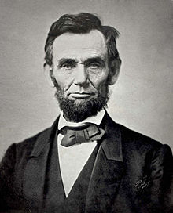
Reconstruction 1865 – 1877
The time period when the USA was reunited and the south was rebuilt.
A plan was necessary to organize the reunification.
Lincoln started the plans.
1865 – 13th Amendment – abolished slavery
Quote Analysis: Read the quote from Lincoln’s Second Inaugural Address
Based on the quote, What do you think Lincoln’s plan was for Reconstruction? Explain by citing evidence from the quote.

Slide 6
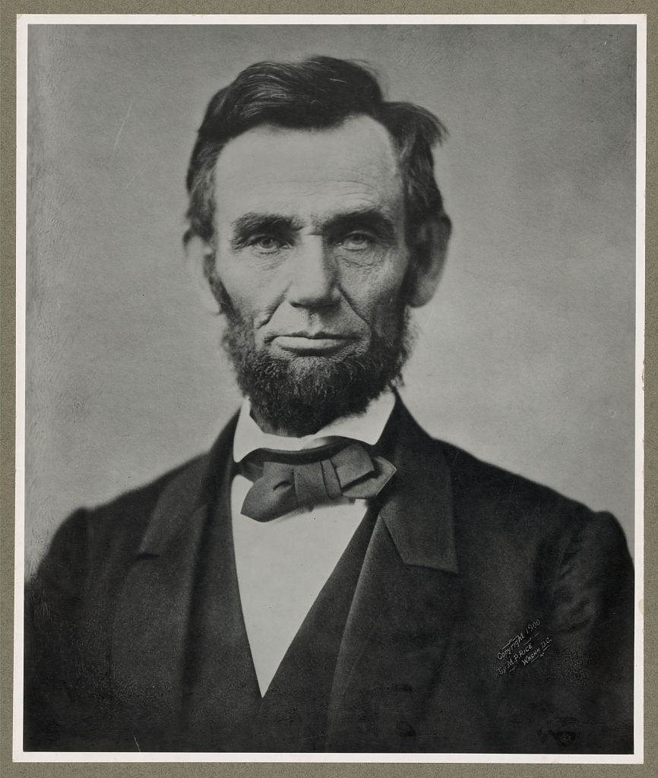
“With malice toward none, with charity for all, with firmness in the right as God gives us to see the right, let us strive on to finish the work we are in, to bind up the nation's wounds, to care for him who shall have borne the battle and for his widow and his orphan, to do all which may achieve and cherish a just and lasting peace among ourselves and with all nations.”
- Abraham Lincolns 2nd Inaugural Address
What do you think Lincoln’s plan was for Reconstruction?

Slide 7
President Lincoln’s Plan (during the Civil War)
10% Plan
A state could RE-ENTER the Union when:
Must take an oath of allegiance to the U.S.
Must abide by emancipation
Lincoln did NOT consult Congress regarding Reconstruction.
Decided to grant pardons (forgiveness) to all but the highest ranking military and civilian Confederate officers.
Republican Congress REJECTED Lincoln’s plan:
Radical Republicans in Congress wanted black male suffrage added & feared that Confederate leaders would take charge in the South because getting 10% to take an oath was TOO EASY!
Did it work out?

Slide 8
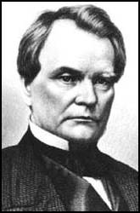
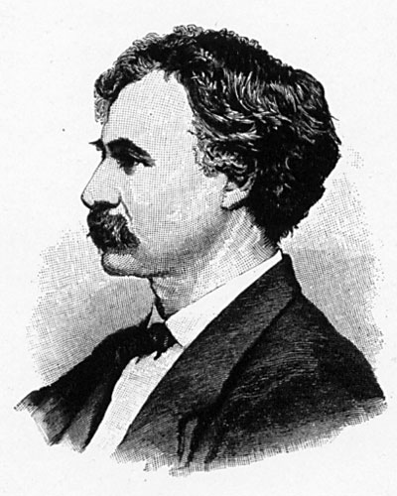
Congress responds to the 10% Plan
Wade-Davis Bill (1864)
“Radical Republicans”
50% of voters from a state to take a loyalty oath
ONLY non-Confederates to vote for a new state constitutions (NO ONE who had fought for the Confederacy)
Senator Benjamin Wade (R-OH)
Congressman Henry W. Davis (R-MD)

Slide 9
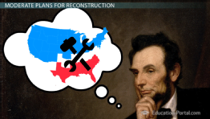
President Lincoln’s Plan (during the Civil War)
1864 → “Lincoln Governments” formed in Louisiana, Tennessee, Arkansas
WEAK and DEPENDENT on the Northern army
BUT many Republicans in Congress thought Lincoln’s plan was too generous towards the South

Slide 10
Regents Practice
A major reason the Radical Republicans opposed President Abraham Lincoln’s Reconstruction plan was that his plan
a) demanded payments from the South that would have damaged its economy
b) postponed the readmission of Southern States into the Union for many years
c) granted too many rights to formerly enslaved persons
d) offered amnesty to nearly all Confederates who would swear allegiance to the United States

Slide 11
Wade-Davis Bill (1864)
Lincoln VETOED this bill = TOO HARSH on the South…
DID NOT
LIKE
President Lincoln
Wade-Davis Bill

Slide 12
Regents Practice
Which statement most accurately describes President Abraham Lincoln’s plan for Reconstruction after the Civil War?
a) Southerners should be made to pay for their rebellion.
b) The Union should be restored as quickly as possible.
c) African Americans should be given free land.
d) War damages should be collected through military occupation.

Slide 13
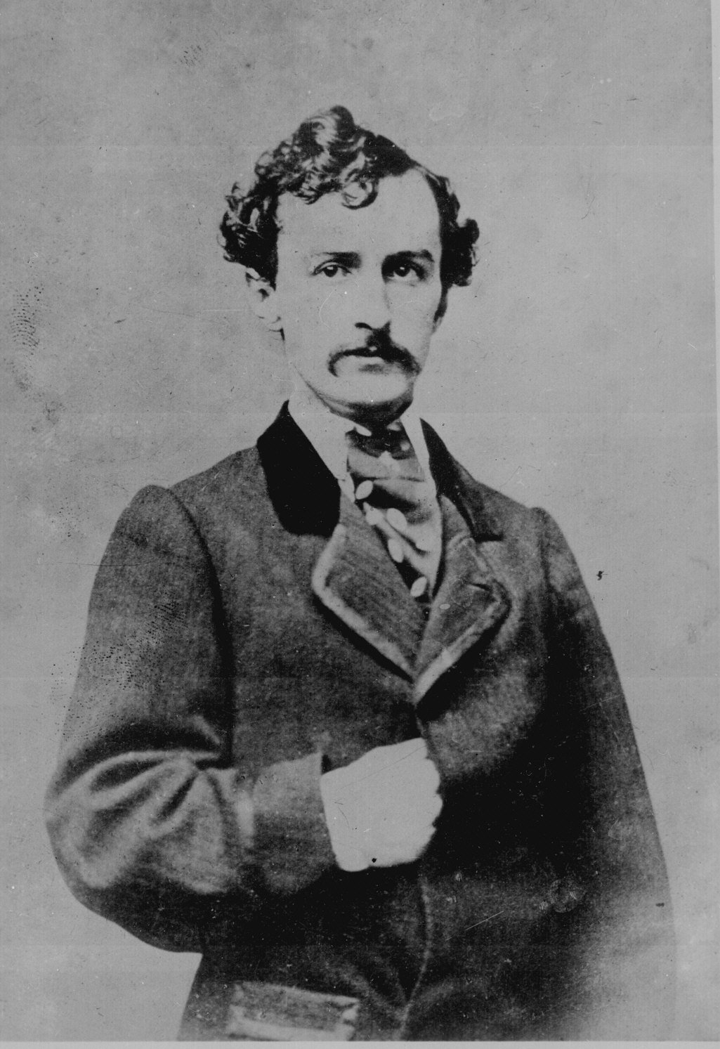
John Wilkes Booth
Don’t Copy this slide!
He was a racist and Southern sympathizer during the Civil War
He hated Abraham Lincoln
Booth blamed Lincoln for all the South's ills after the war
BOOTH WANTED REVENGE!!!!
Wanted to kidnap Lincoln, take him to Richmond (the Confederate capital), and hold him in return for Confederate prisoners of war.

Slide 14
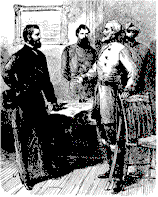
Don’t Copy this slide!
A Big Change of Plans…
General Robert E. Lee surrenders to General Ulysses S. Grant at Appomattox (War is over)
Two days later Lincoln spoke from the White House to a crowd gathered outside. Booth was present as Lincoln suggested in his speech that voting rights be granted to certain blacks
Infuriated, Booth's plans now turned in the direction of assassination

Slide 15
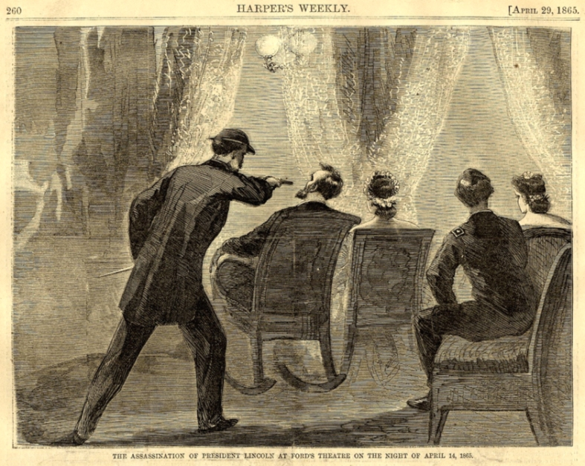
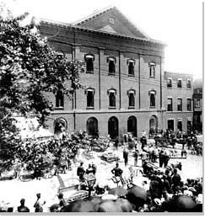
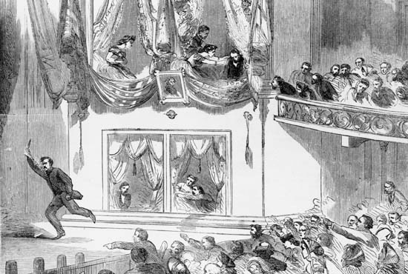
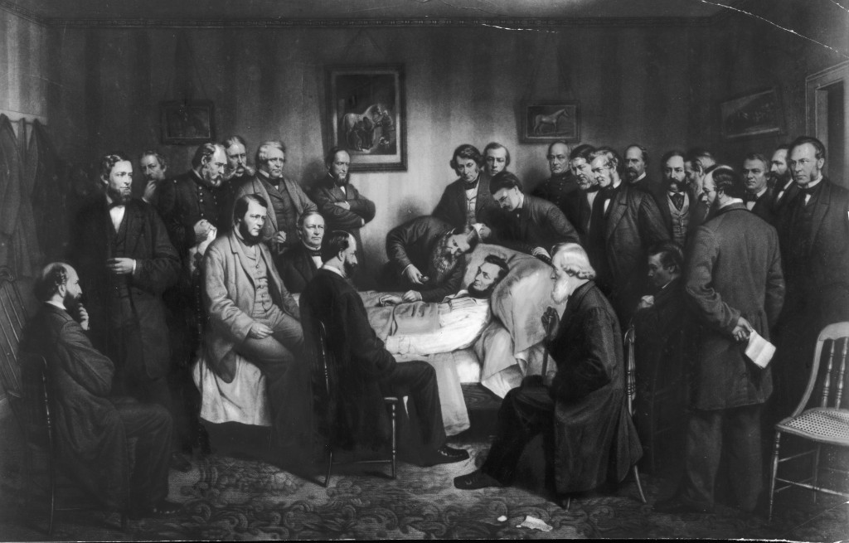

Slide 16
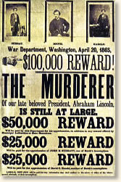
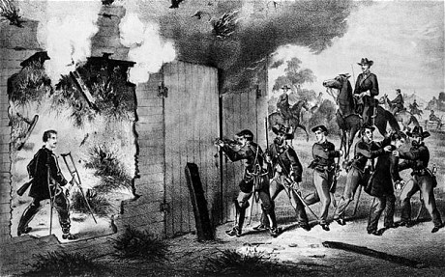
Booth is KILLED!

Slide 17
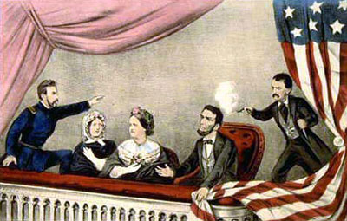
With the death of Lincoln…what would the ramifications be for the nation?
Do you think Lincoln could have guided us through Reconstruction successfully?

Slide 18
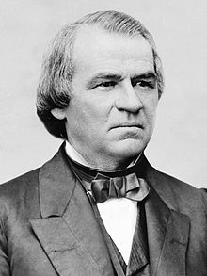
Johnson becomes President
Don’t Copy this slide!
Lincoln was assassinated FIVE DAYS after Southern surrender
Andrew Johnson became the President.
He was a Democrat from the South.

Slide 19
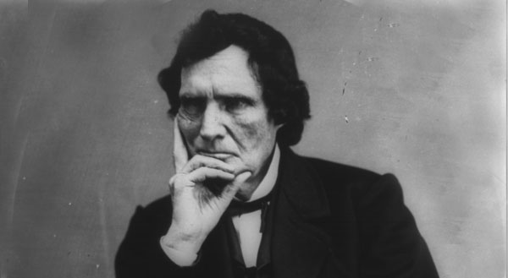
Reconstruction 1865 – 1877
Don’t Copy this slide!
Johnson had his own plans for
Reconstruction!
And, Congress, filled with Radical Republicans, tried to make their own plan for Reconstruction at the same time!

Slide 20
Which plan for Reconstruction was the best?
With ONE partner read over the proposed plans for Reconstruction of Lincoln, Johnson, and Radical Republicans (notes and worksheet)
Make a 3-Column chart where you record the parts of each plan:
Plans for Reconstruction
Lincoln Johnson Radical Republicans

Slide 21
Which plan for Reconstruction was the best?
Plans for Reconstruction
Lincoln Johnson Radical Republicans
Which plan is BEST for the nation at this time?
10% Plan
Pardons to Confed’s - oath & accepted emancipation – EXCEPT ex-Confed leaders
State gov’t reestablished by US when 10% took oath of loyalty
“Lincoln govt’s”
REUNITE the UNION QUICK!
JUST LIKE LINCOLN, bring the south back in!
Worth more than $20,000? Pardon from Johnson HIMSELF
HESITANT to provide protection to newly freed black men!
PUNISH the south for secession!
Former Confederates would NOT be able to vote
PROTECTION TO FREED BLACK MEN
Lincoln and Johnson are TOO LENIENT
REVENGE!
Freed male slave gets 40 acres of land/$100 to build house

Slide 22
EXIT ASSESSMENT
Answering the Aim: Which plan for Reconstruction was the best, following the Civil War?

