Slide 1
Today’s AIM: Why did the delegates of the Constitutional Convention have trouble coming to a compromises over their significant differences?
EQ: 1) How did the Virginia Plan and New Jersey Plans differ? How were they similar?
2) Where do we see effects of each plan in our government today?

Slide 2
PERIOD 3: 1754-1800
Key Concept of Today’s Lesson:
3.2 (II) C) Delegates from the states participated in a Constitutional Convention and through negotiation, collaboration, and compromise proposed a Constitution that created a limited but dynamic central government embodying federalism and providing for a separation of powers between its three branches.

Slide 3
PERIOD 3: 1754-1800
Key Concept of Today’s Lesson:
3.2 (II) D) The Constitutional Convention compromised over the representation of slave states in Congress and the role of the federal government in regulating both slavery and the slave trade, allowing the prohibition of the international slave trade after 1808.

Slide 4
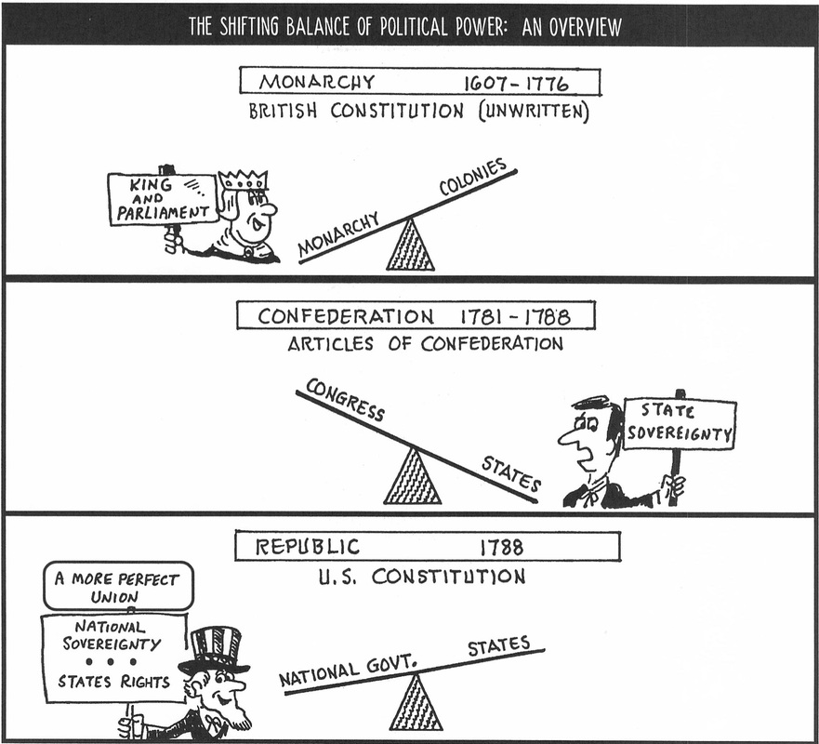
Shifting
the
Balance

Slide 5
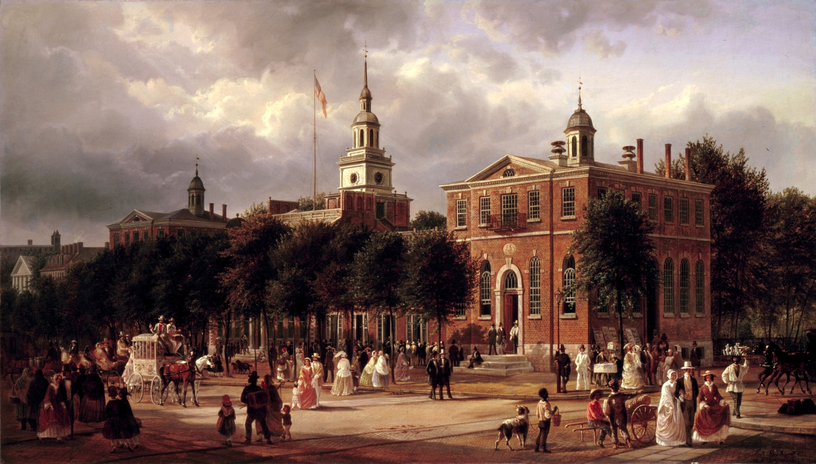
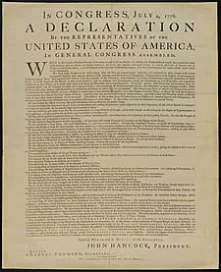
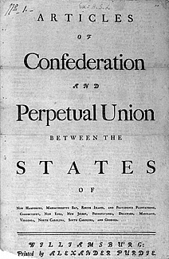
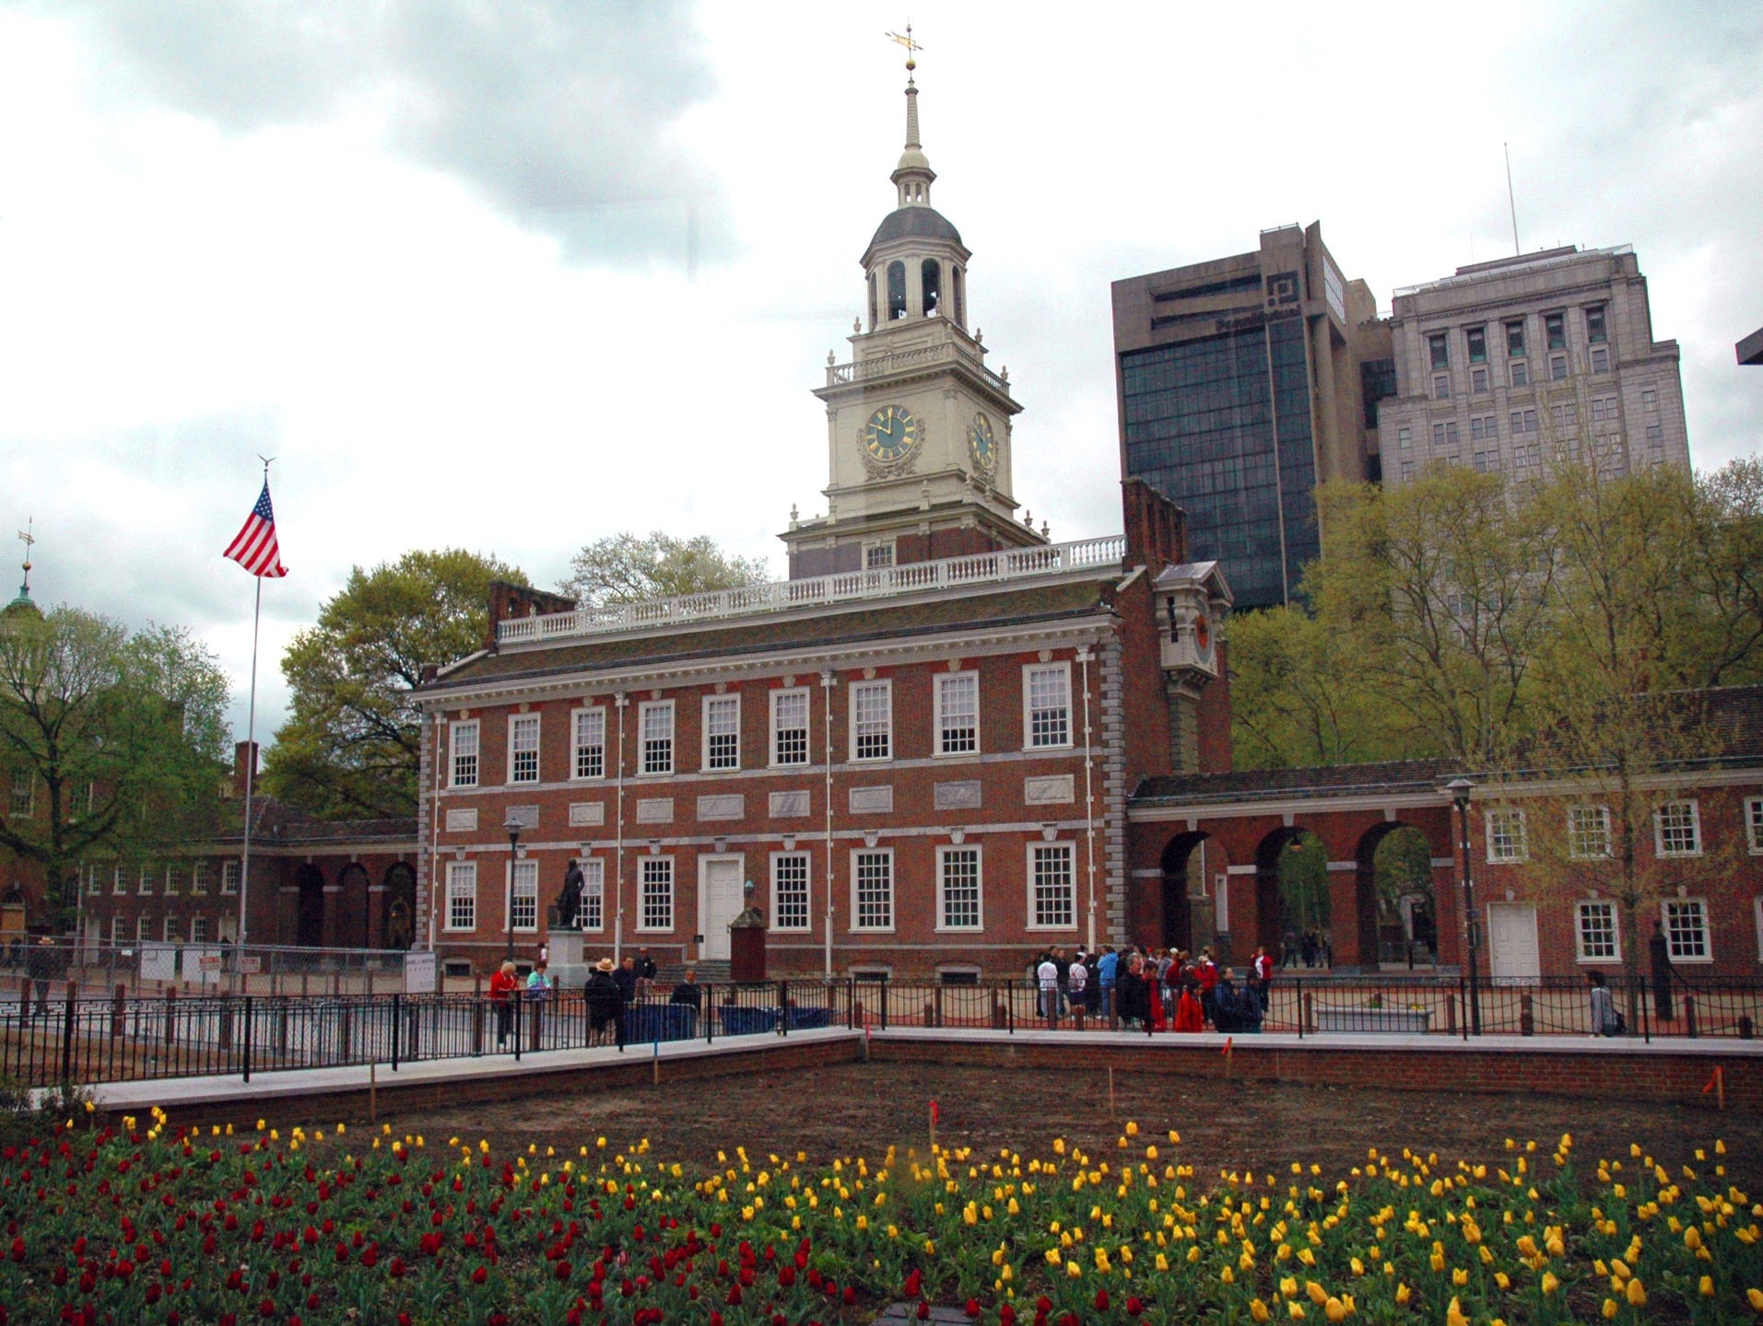
We’re BACK! Independence Hall – Philadelphia, PA
What else was drafted HERE?

Slide 6
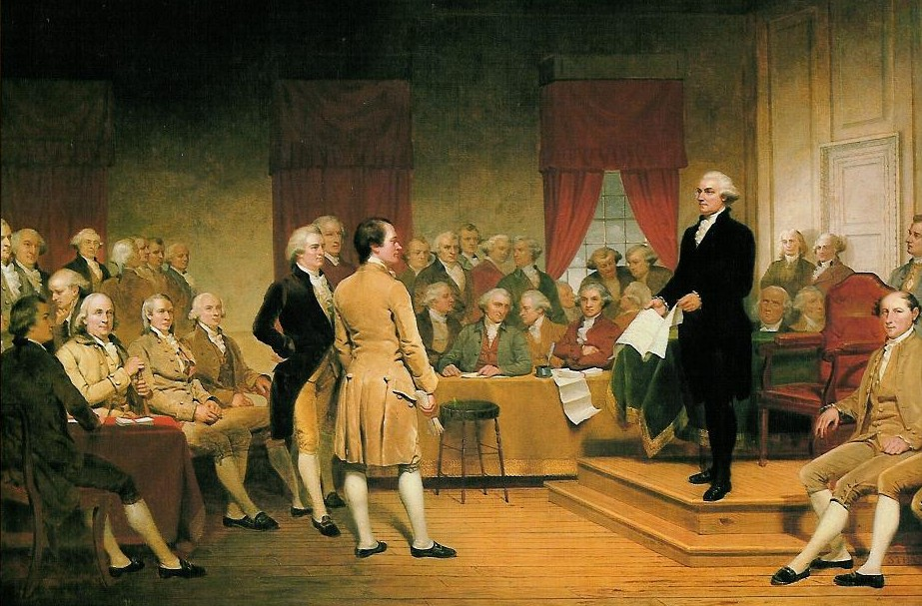
The Convention Meets
The Constitutional Convention (Philadelphia - May 1787)
REVISE the A of C
Rhode Island?
55 delegates/13 states (white, males, college-educated)
George Washington = LEADER
Why were the meetings kept a SECRET?
MAJORITY RULE was used to make decisions, not unanimous vote – WHY?

Slide 7
Who was there? Who wasn’t? (TAKE A PIC!)
WAS there…
VS.
WASN’T there…
George Washington (chairperson)
Benjamin Franklin
James Madison
Alexander Hamilton
Govenor Morris
John Dickinson
All from different states
Common goal = STRENGTHEN the young nation
John Jay
Thomas Jefferson
John Adams
Thomas Paine (diplomatic business abroad)
Samuel Adams
John Hancock (NOT chosen as delegates)
Patrick Henry (REFUSED growth in federal power!)

Slide 8
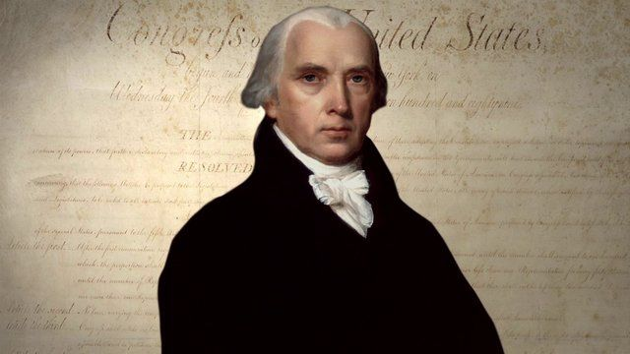
Who was going to become
the “Father of the Constitution”?
Madison was a NATIONALIST
Wanted a BRAND NEW document
Hamilton agreed!
New constitution = system of CHECKS AND BALANCES
James
Madison!

Slide 9
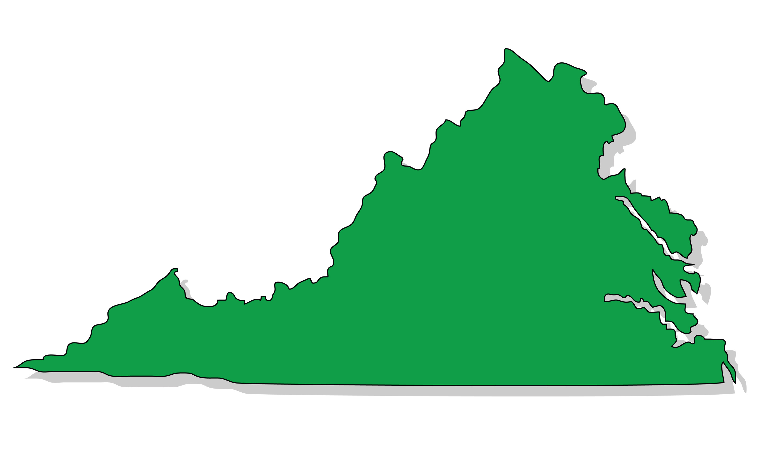
Analysis Activity: Based off of the Articles FAILURE and images below, what do you think is going to be the first order of business at the convention?
VIRGINIA
NEW JERSEY

Slide 10
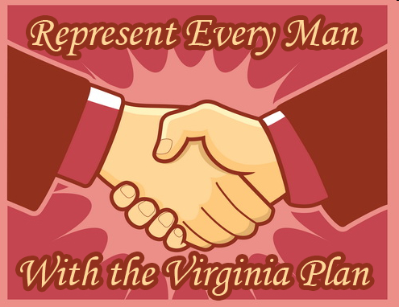
Virginia Plan
Created by MADISON and Edmund Randolph
1. TWO houses – BICAMERAL
2. Membership - state’s population
(more people = more votes)
3. President, courts, and congress = stronger central government
4. 3 branches of government
5. LARGE states LOVE it!

Slide 11
New Jersey Plan
Proposed by William Patterson
ONE house - UNICAMERAL
Membership – EQUAL for ALL states
Similar to the A of C but with more powers – tax and trade
3 branches of government
SMALL states LOVE it!

Slide 12
Today’s AIM: How did disagreements among states lead to the Constitution being called a “Bundle of Compromises”?
EQ:
1) What did the Great Compromise, the 3/5th Compromise, and the Slave Trade Compromise accomplish that was different than the Articles of Confederation?
2) How did these compromises solve major issues for the future?

Slide 13
PERIOD 3: 1754-1800
Key Concept of Today’s Lesson:
3.2 (II) C) Delegates from the states participated in a Constitutional Convention and through negotiation, collaboration, and compromise proposed a Constitution that created a limited but dynamic central government embodying federalism and providing for a separation of powers between its three branches.

Slide 14
PERIOD 3: 1754-1800
Key Concept of Today’s Lesson:
3.2 (II) D) The Constitutional Convention compromised over the representation of slave states in Congress and the role of the federal government in regulating both slavery and the slave trade, allowing the prohibition of the international slave trade after 1808.

Slide 15
Problem – Representation in Congress
How would representation be determined in the new Congress?
Large States
Small States
Large population
Small population
Want more representatives
Afraid of being out-numbered
Support the Virginia Plan of rep’s apportioned by population
Support the NJ Plan of one rep per state

Slide 16
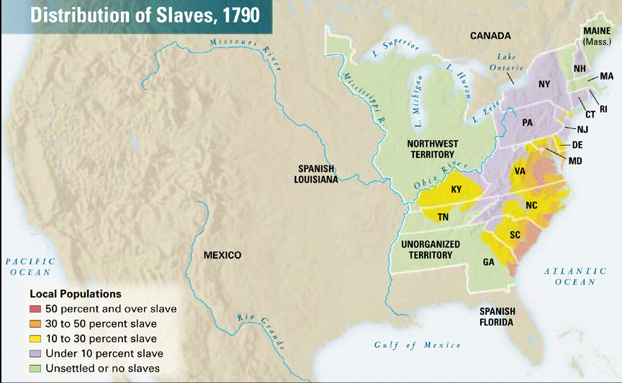
Southern Slave States vs. Northern Free States

Slide 17
Problem – Representation and Slavery
How would slaves be counted for the purposes of representation and taxation?
Southern States
Northern States
High population of slaves
Fewer slaves
Want to count ALL slaves for the purpose of representation
Don’t want to count slaves – at all!
Want to tax slave owners for their slaves (property)
Don’t want to be taxed for their slaves (property)

Slide 18
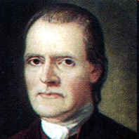
The Great Compromise/Connecticut Compromise
A bicameral legislature = two house congress
Made up of a Senate and House of Representatives
Large States
Small States
Roger
Williams
Like that representation will be apportioned by population in the House of Representatives
Like that there will be TWO senators from each state in the Senate
They will have more rep’s in one house
They will have equality in one house
Both sides had to give a little to get a little – this is the nature of compromise!

Slide 19
ARTICLE I
Section 2
Representatives and direct taxes shall be apportioned among the several states which may be included within this union, according to their respective numbers, which shall be determined by adding to the whole number of free persons, including those bound to service for a term of years, and excluding Indians not taxed, three fifths of all other Persons.
- 3/5th Compromise
Who will be counted fully?
Free people and servants
“All other persons”
Who will be counted as three-fifths?
Slaves!
Who are “all other persons”?
Why didn’t the framers (“founding fathers” and creators of the Constitution) use the term slaves?
Because they were ashamed of the issue and were afraid the word would (tarnish) the document.

Slide 20
The Three-Fifths Compromise
Southern States
Northern States
1 slave = 3/5 of a person
Or, every five slaves would count as three “people” in the census
ALL slaves weren’t counted
Taxes can be collected for owning slaves. Therefore, more money will go into the treasury
(they get MORE rep’s)
So, both sides get something but…
Does this solve the issue of slavery in the US?

Slide 21
Compromising with Slavery
Despite the contradiction slavery posed, Southerners threatened to leave the USA anytime the slave question was discussed
As a compromise for the South, the slave trade could continue to 1808 & runaway slaves returned
“Great as the evil is, a dismemberment of the Union would be worse.”
—James Madison
Notes:
23

Slide 22
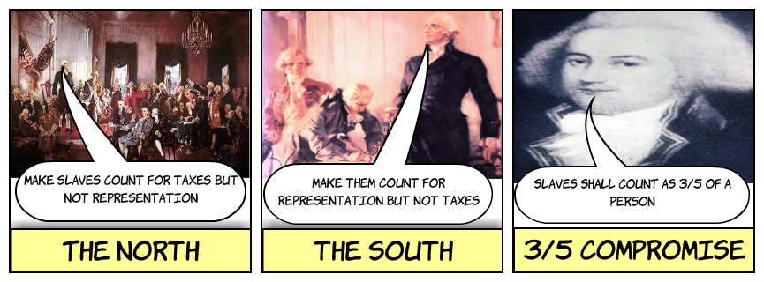
The 3/5th Compromise did NOT mean that enslaved African Americans would be allowed to vote or their interests be represented in Congress...
Like Native Americans, they were excluded from participating in government

