Slide 1
The Modern Civil Rights Movement (1954-1965)

Slide 2
Two kinds of segregation
de jure segregation
Segregation by law
Common in the South
Laws forbid African-Americans from attending the same church, using the same swimming pool, eating in restaurants, or marrying White people.
de facto segregation
Segregation without laws
Common in the North
Housing discrimination made segregation in the North.
White community groups did not allow non-Whites to live in White neighborhoods.
Every ethnic group had its own part of town.

Slide 3
The Modern Civil Rights Movement (1950s)

Slide 4
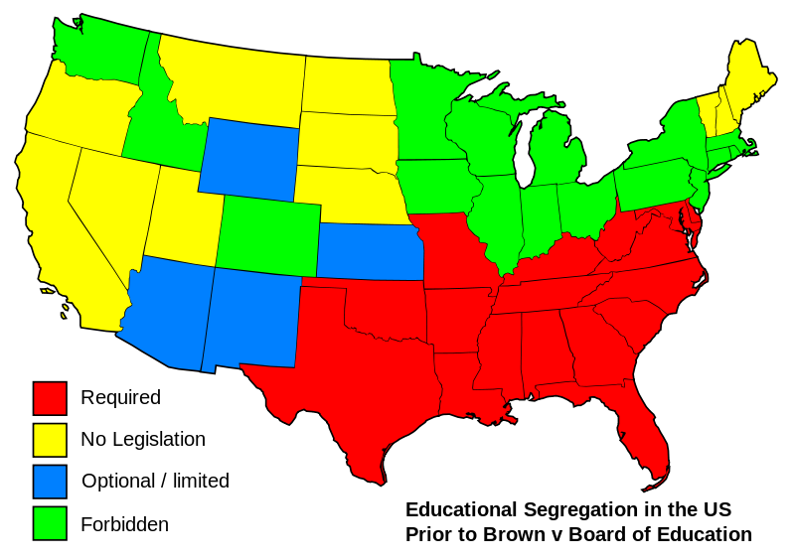
The Struggle Over Civil Rights
Segregated school districts spend 10 times more on white students than black students
The modern Civil Rights movement began in 1954 with the Supreme Court decision Brown v Board of Education of Topeka, Kansas
The NAACP took the lead in civil rights; Segregated schools became their primary target
Their strategy was to use lawsuits to challenge that segregation violated the 14th Amendment
NAACP attorneys successfully challenged discrimination in university admissions for graduate programs too
Notes:
The NAACP 1st targeted unfair university graduate admissions

Slide 5
Brown v. Board of Education (1954)
The Topeka school district denied Linda Brown from attending a white school 4 blocks from her house
NAACP lawyer Thurgood Marshall used the 14th Amendment to attack public school segregation
Marshall argued that even “equal” schools, if separate, imply that black children are inferior to whites

Slide 6
Brown v. Board of Education (1954)
The Supreme Court’s unanimous decision ruled “separate facilities are inherently unequal”
Chief Justice Earl Warren stated that segregation violated the “equal protection clause” of the 14th Amendment
The decision overturned the Plessy v Ferguson (1896) “separate but equal” precedent

Slide 7
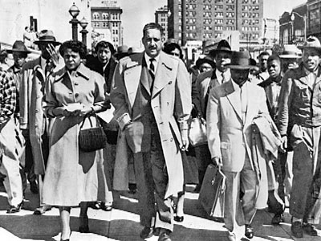
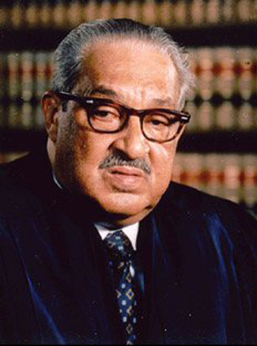
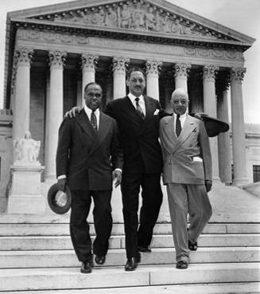
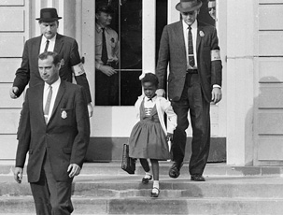
Thurgood Marshall & his NAACP legal team
Thurgood Marshall’s success in Brown made him the most famous black lawyer in the U.S.; In 1967, he became the 1st black justice appointed to the Supreme Court
Linda Brown

Slide 8
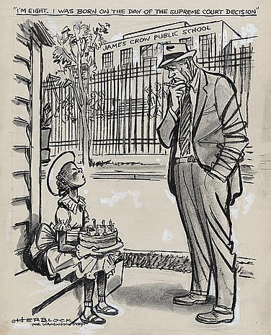
Brown decision
“All deliberate speed”
Significant integration did not begin until mid/late 1960s

Slide 9
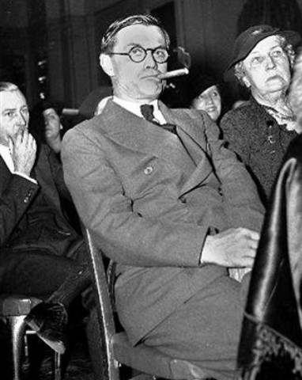
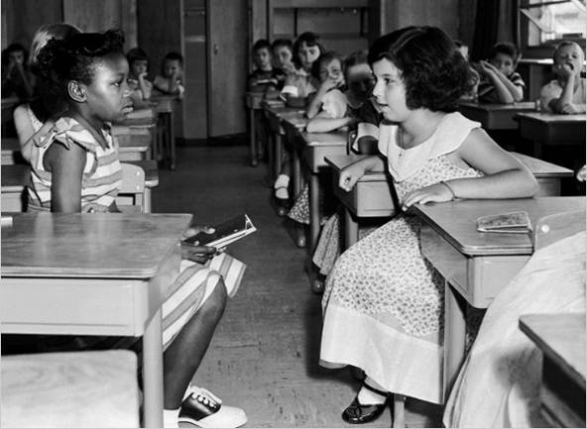
Resistance to Brown
“The people of Georgia will not comply with the decision of the court… We're going to do whatever is necessary in Georgia to keep white children in white schools and colored children in colored schools."

Slide 10
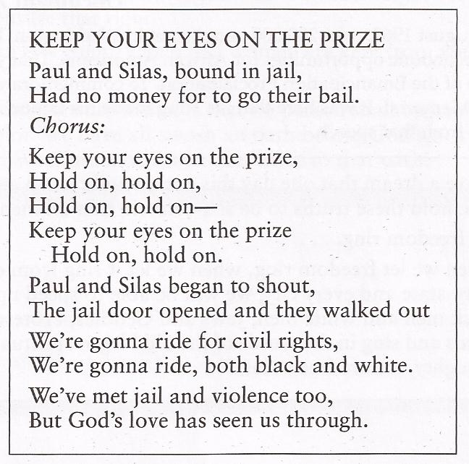
Songs of the Civil Rights Movement
In the song lyrics, what does “the prize” refer to?

Slide 11
Desegregating schools is not so easy!
In 1957, President Eisenhower was forced to support integration of schools
Arkansas governor Orval Faubus called the National Guard to keep black students from enrolling in Little Rock’s Central High School!
Eisenhower sent the Army to force integration for the black students (the “Little Rock Nine”)
Clip

Slide 12
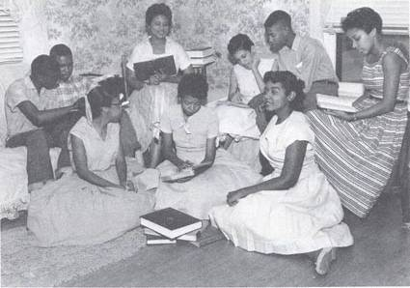
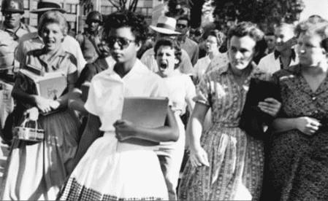
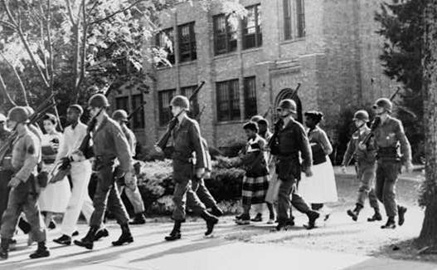
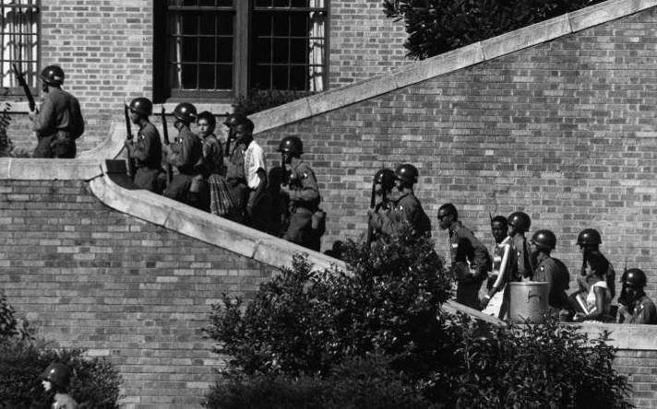
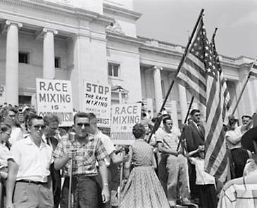
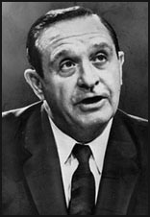
Integrating Central High School in Little Rock, Arkansas (1957)
Arkansas Governor Orval Faubus
The “Little Rock Nine”

Slide 13
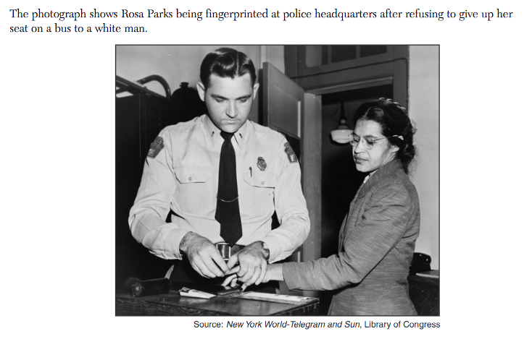
December 1, Rosa Parks refused to give up her seat on a bus
What did Rosa Parks refuse to do that led to the situation shown in the picture?

Slide 14
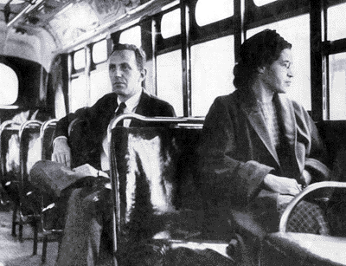
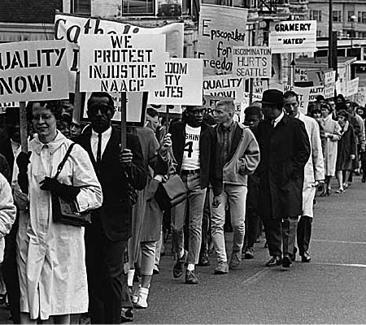
Montgomery Bus Boycott (1955)
Rosa Parks’ actions transformed the movement
NAACP began preparing a legal challenge
Rise of Martin Luther King Jr.: urged non-violence
SCLC
Bus boycott lasted a YEAR!
In 1956 the Supreme Court ruled the Montgomery bus segregation law was unconstitutional
“Freedom is never voluntarily given by the oppressor; it must be demanded by the oppressed.”

Slide 15
The Modern Civil Rights Movement (1960s)

Slide 16
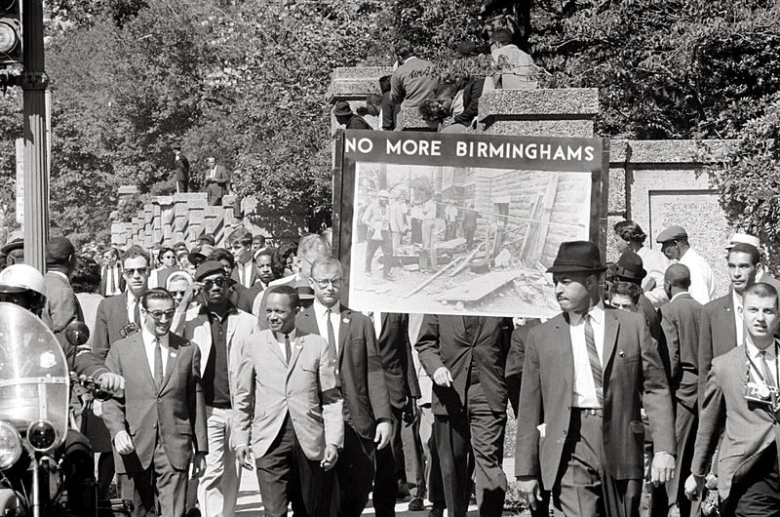
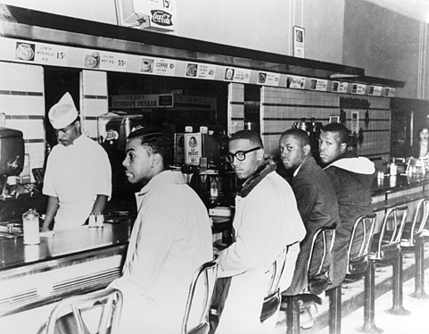
Sit-ins and Freedom Rides
Greensboro, North Carolina sit-in (February 1, 1960)
4 black students sat at a segregated counter of a Woolworth’s 5 and Dime Store
As the week progressed, more students joined in
Inspired sit-ins across the country
Congress of Racial Equality (CORE)
“Freedom riders” wanted to challenge segregation on interstate buses in the South
Wanted to force the Justice Department to enforce desegregation laws
Birmingham, Alabama
Freedom Riders were attacked by a white mob
September, 1961 – ICC enforced the ban on segregation
VIDEO

Slide 17
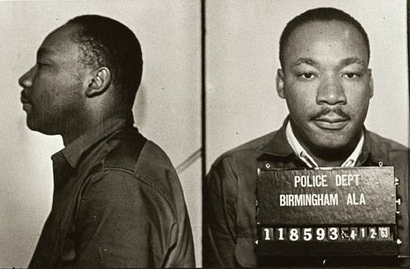
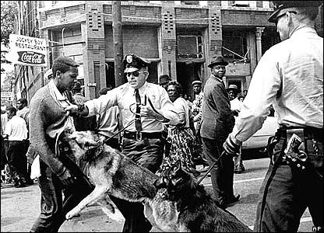
Focus shift to Birmingham, Alabama
Martin Luther King, Jr.
Arrested for protesting
Letter from Birmingham Jail (1963)
Drew on Thoreau’s and Gandhi’s ideas of civil disobedience
“an individual who breaks a law that conscience tells him is unjust, and who willingly accepts the penalty of imprisonment in order to arouse the conscience of the community over its injustice, is in reality expressing the highest respect for law.”

Slide 18
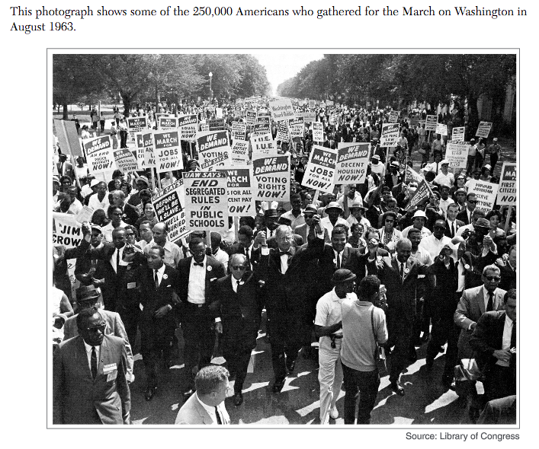
What were GOALS of this movement?

Slide 19
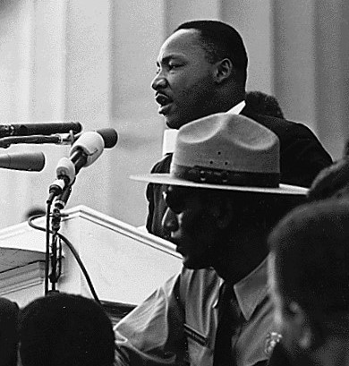
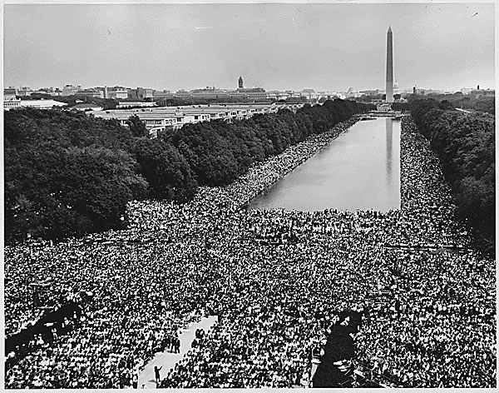
King’s March on Washington (August, 1963)
To put pressure on Congress to pass the new civil rights bill
Drew more than 200,000
MLK- “I have a dream” speech
One of the largest political demonstrations
A model for peaceful protest

Slide 20
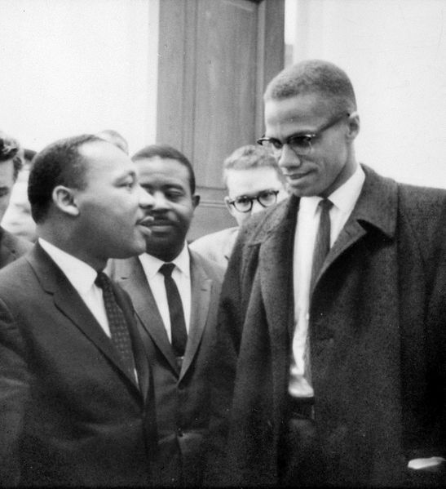
MLK Jr. and Malcolm X
MLK Jr.:
Civil disobedience
Believed black could be American AND African
Major goal was desegregation
“Love thy enemy”
Like WEB DuBois
Malcolm X:
Born Malcolm Little, became a member of the Nation of Islam
Advocated “black revolution” and black separatism – Black Muslims
Appealed to frustrated African Americans
“The ballot or the bullet” – DIRECT ACTION
Like Booker T. Washington

Slide 21
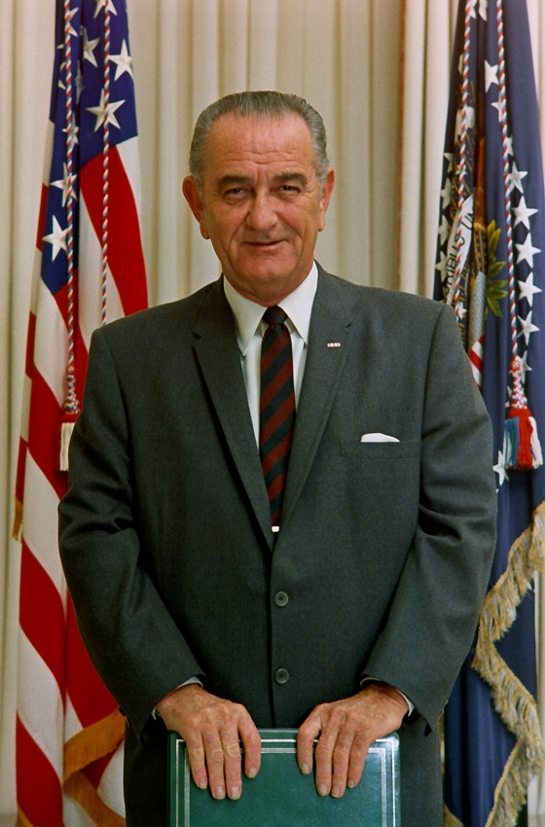
Civil Rights Act of 1964
Same requirements for black & white voters
Prohibits discrimination in public accommodations
Withholding of federal funds from discriminatory programs and businesses
Bans discrimination based on race, sex, religion and national origin by employers & unions; creates EEOC

Slide 22
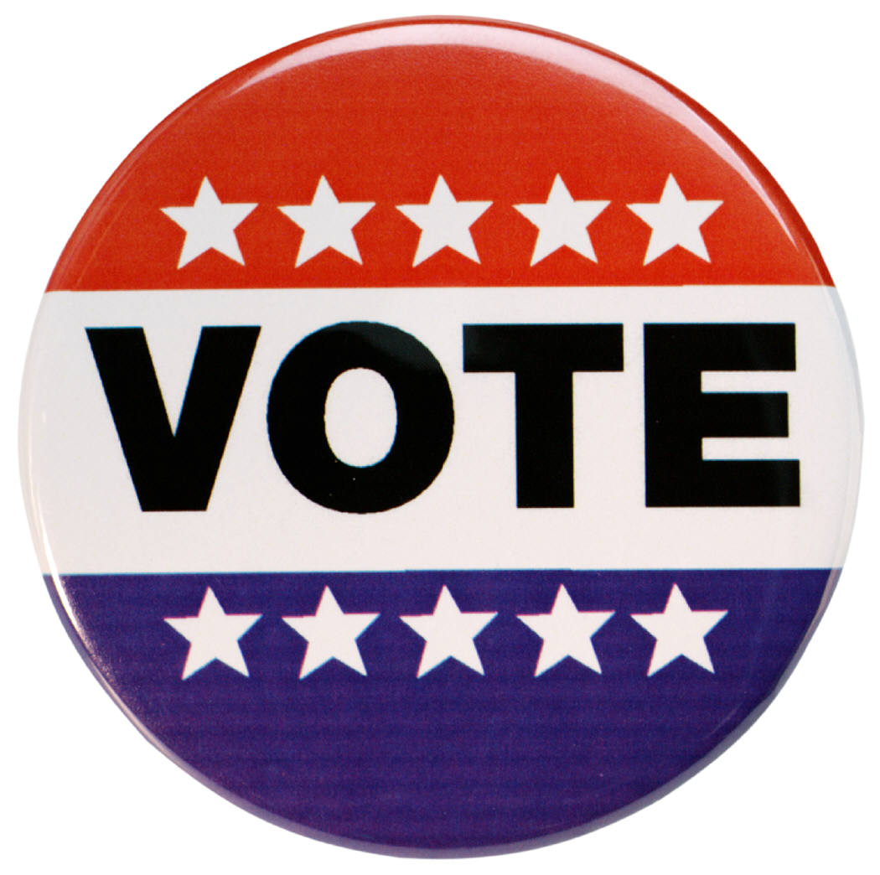
Voting Rights Act of 1965
Federal officials may register voters when local offices block African Americans
Eliminated literacy tests

Slide 23
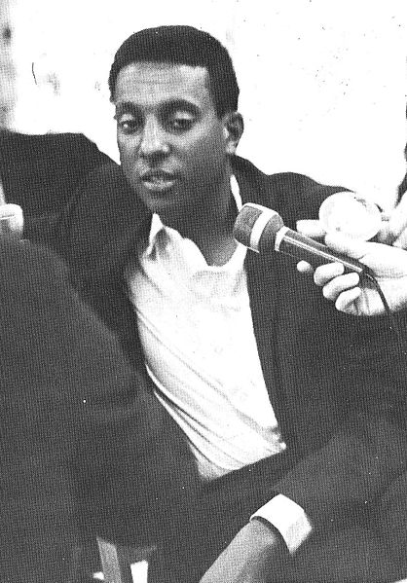
Important Organizations to know…
Southern Christian Leadership Conference (SCLC)
Student Nonviolent Coordinating Committee (SNCC)
Helped register blacks to vote in Mississippi (5% were registered in 1964)
Later, under the leadership of Stokely Carmichael, SNCC focused on black power
Black Panthers (1966):
Advocated the arming of blacks against white police

Slide 24
How did the African American freedom struggle influence other social movements of the 20th century?
On your worksheet packets

Slide 25
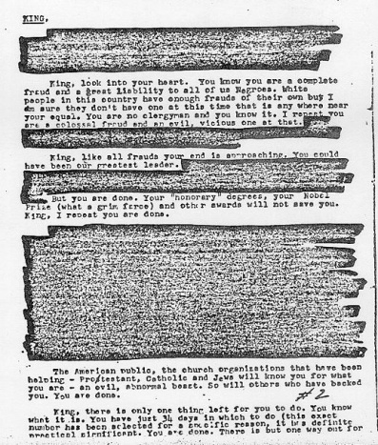
KING, In view of your low grade... I will not dignify your name with either a Mr. or a Reverend or a Dr. And, your last name calls to mind only the type of King such as King Henry the VIII...
King, look into your heart. You know you are a complete fraud and a great liability to all of us Negroes. White people in this country have enough frauds of their own but I am sure they don't have one at this time anywhere near your equal. You are no clergyman and you know it.
King, like all frauds your end is approaching. You could have been our greatest leader. You, even at an early age have turned out to be not a leader but a dissolute, abnormal moral imbecile.
King, there is only one thing left for you to do. You know what it is.

Slide 26
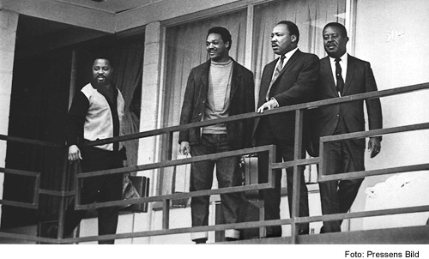
The Assassination of Martin Luther King Jr. (April 4, 1968)
King became aware that economic issues must be part of the civil rights movement.
King went to Memphis, Tennessee to help striking sanitation workers. He led a march to city hall.
James Earl Ray shot and killed King as he stood on the balcony of his motel.
Within hours, rioting erupted in more than 120 cities. Within three weeks, 46 people were dead, some 2,600 were injured, and more than 21,000
were arrested.

Slide 27
Civil Rights Act of 1968
Written as a follow-up to the Civil Rights Act of 1964
Created to enforce equal housing opportunities for all races (AKA Fair Housing Act)
You cannot refuse to rent or sell a house to anyone, anywhere, based upon their race, religion, national origin, and gender (since 1974)
“a federal crime to “by force or by threat of force, injure, intimidate, or interfere with anyone … by reason of their race, color, religion, or national origin.”

Slide 28
The Summer of ‘68
Both the Vietnam War and the anti-war movement were peaking. Martin Luther King Jr. had been assassinated in the spring, igniting riots across the country.
Devoted to improving civil rights, Robert F. Kennedy (younger brother of JFK) was perceived by many to be the only person in American politics capable of uniting the people.

Slide 29
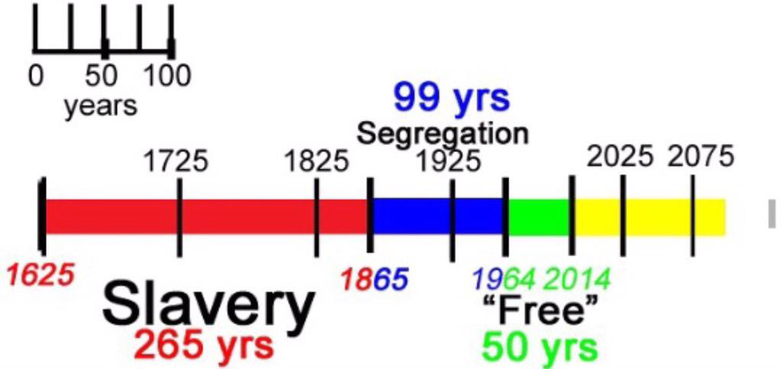
Racial Segregation Timeline

Slide 30
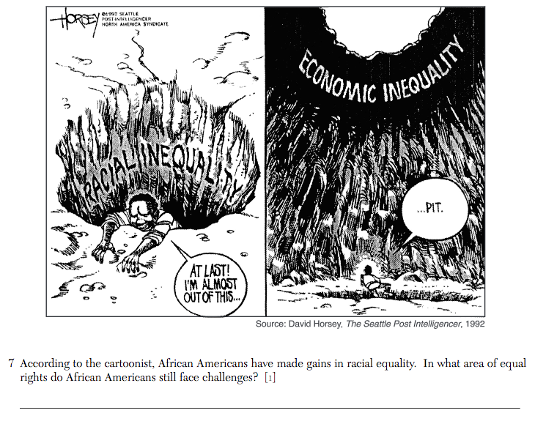

Slide 31
Could we be in a 3rd civil rights movement TODAY?
(SYNTHESIS)
President Obama elected as 44th President of the US – culmination of all efforts of prior activists
Black Lives Matter movement
In response to overuse of police power post 9/11 (use of police force)
Eric Garner
Ferguson, Missouri (fatal shooting of Michael Brown)

