Slide 1
Today’s AIM:
What were the significant causes & effects of U.S. western expansion in the 1840s?

Slide 2
Trends in Antebellum America: 1800-1860
Greater democracy & the return of the two-party system
Emergence of a national market economy
Increase in federal power
New intellectual & religious movements
Social reforms
Further westward expansion
Temperance, Abolition, Women’s Rights, Cult of Domesticity, Education & Asylum Reform
Transcendentalism
Universal white manhood suffrage
Democrats vs. Whigs
Second Great Awakening
American System: transportation, tariff, 2nd BUS
Rise in industry, urbanization, immigration
Jefferson’s purchase of Louisiana
Jackson’s use of the veto
“King Cotton,” commercial farming, slave vs. paid labor systems

Slide 3
While we move on…keep these questions in the back of your mind…
ESSENTIAL QUESTIONS:
What benefits did the United States face by expanding into the West in the 1840s?
What negatives might the U.S. face because of this expansion?
Notes:
Lesson Plan for Friday, October 24, 2008: Warm-up question, Tyler & Polk videos, Manifest Destiny notes

Slide 4
Image Analysis
Examine the image on the next slide & answer these questions:
What point might the artist be making about the American West?
What type of American traveled West? Was this an easy journey?
Why would Americans make the journey into the West?

Slide 5
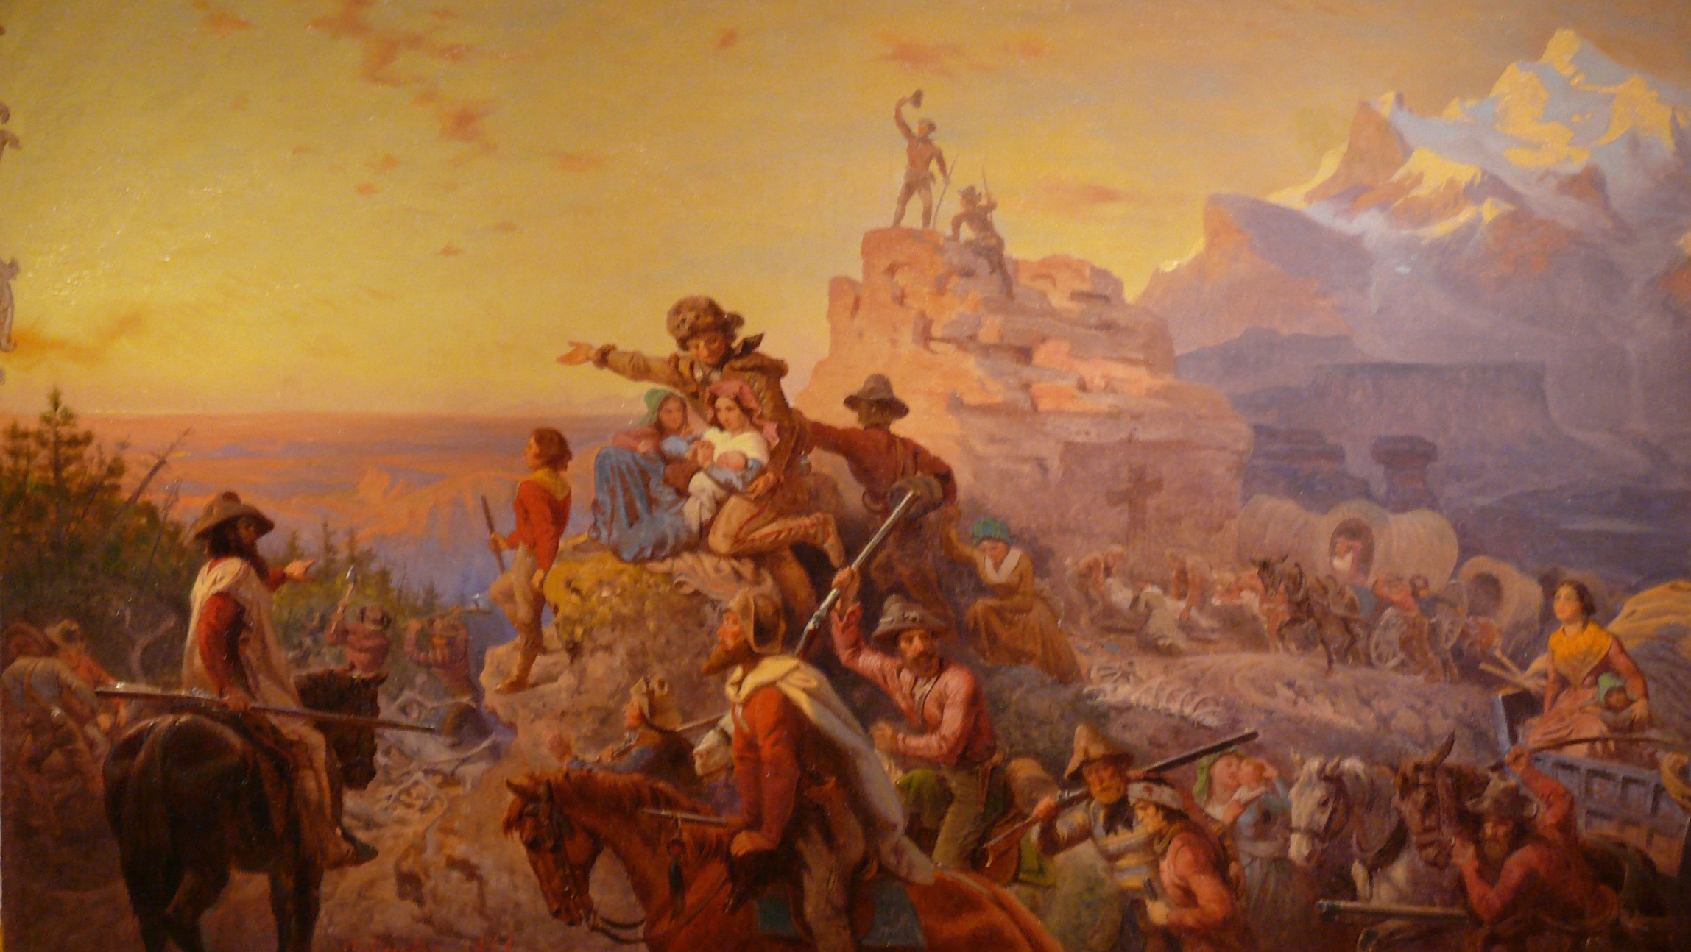
“Westward the Course of Empire” by Emanuel Leutze

Slide 6
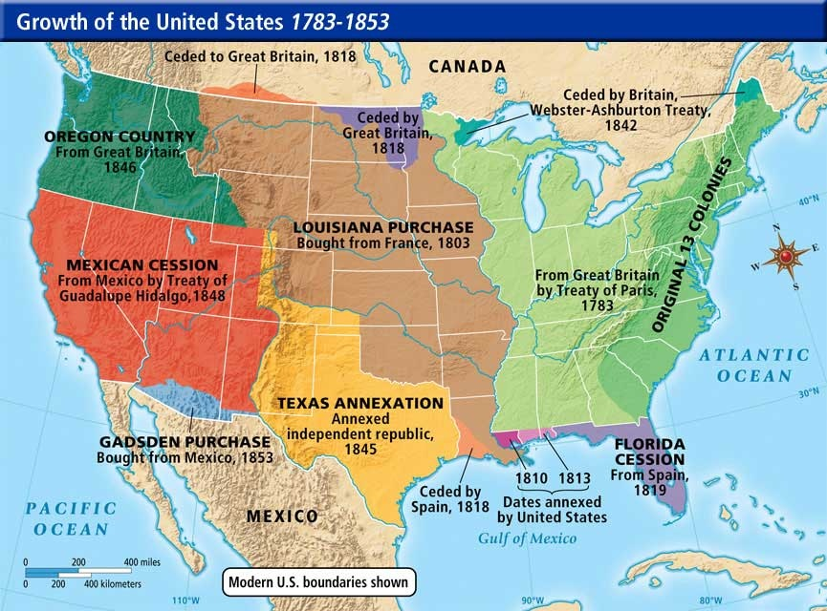
Manifest Destiny
We need some “elbow room”:
Texas, Oregon, & California

Slide 7
Manifest Destiny
The spread of settlers beyond U.S. borders led to widespread calls for annexation of newly-settled lands
The term “Manifest Destiny” was 1st used in 1845 by newspaper editor John O’Sullivan, who said:
God wants the USA (“His chosen nation”) to become stronger
Expansion of American democracy & economic opportunities were a good thing
“We are the nation of human
progress, and who will, what
can, set limits to our onward march?”
- John O’Sullivan

Slide 8
“American Progress” by John Gast, 1872
It was our “obvious fate” as Americans!
God wanted the USA to expand from ocean to ocean

Slide 9
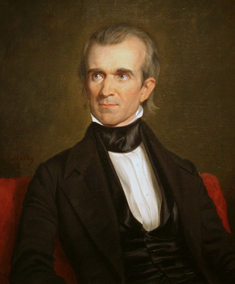
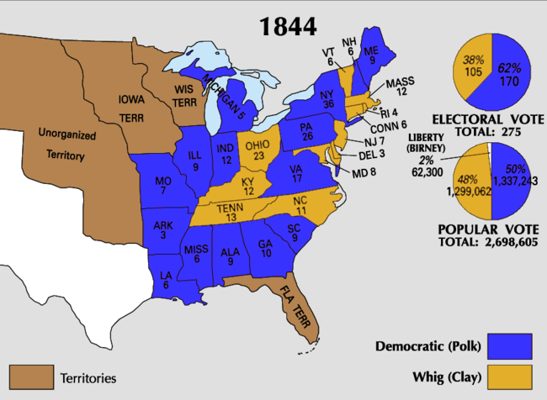
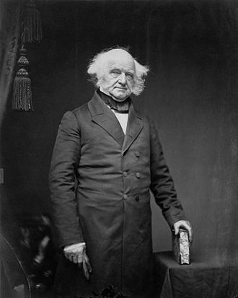
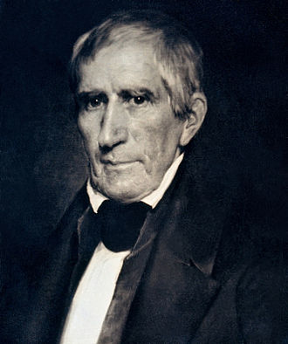
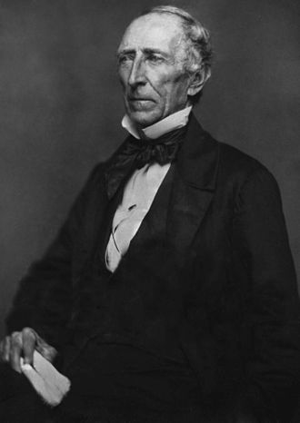
Ladies and Gentlemen, our next President!
11th President of the United States
Youngest president ever (at the time – 49)
“Young Hickory”
WHIG PARTY
HATED Jackson and his Democratic Party
Congress > Presidency
LOVED modernization, and banking
James K. Polk

Slide 10
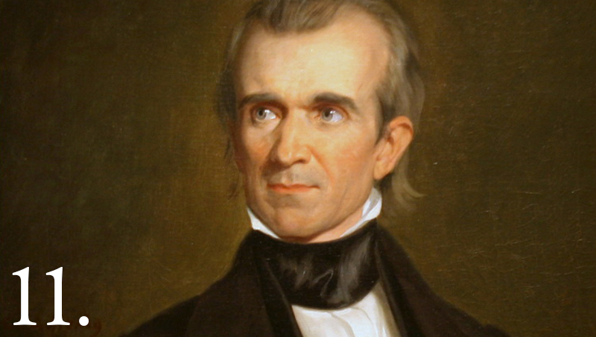
James K. Polk
While you listen: What role did James Polk play fulfilling Manifest Destiny?

Slide 11
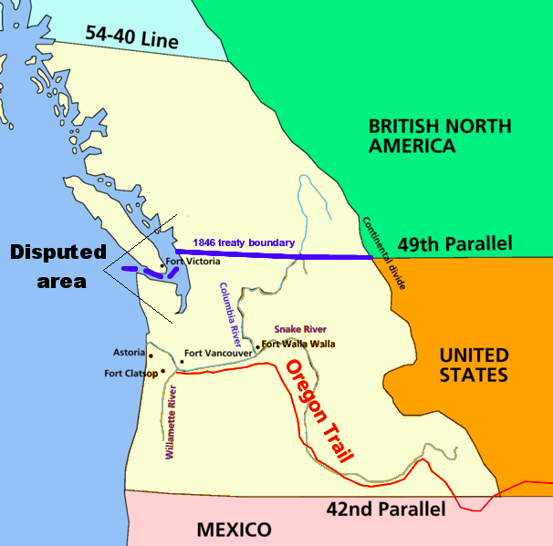
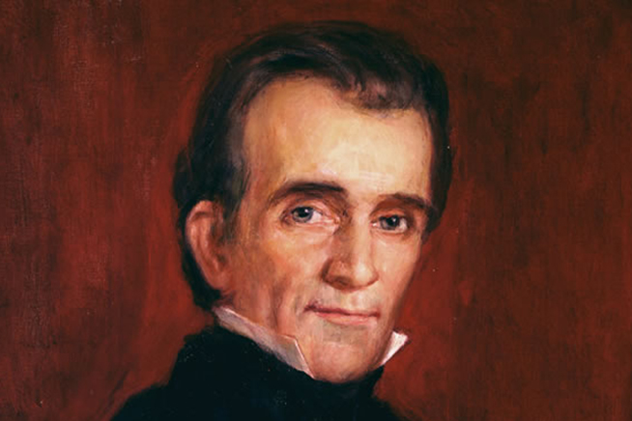
Oregon Acquisition
Polk’s 1844 campaign slogan: “Fifty-Four Forty or FIGHT!”
Loved by westerners and southerners
Oregon Country
Britain, rather than fight, lets settle this territory and we’ll take the lower part, no problem!

Slide 12
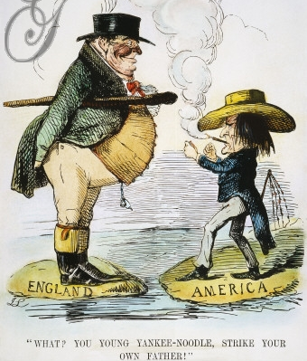
The Oregon Boundary Dispute
But, the USA & England compromised & divided Oregon along 49th parallel in 1846
Oregon residents demanded the entire territory: “54º40’ or fight!”
In 1846, President Polk notified Britain that the U.S. wanted full control of Oregon

Slide 13
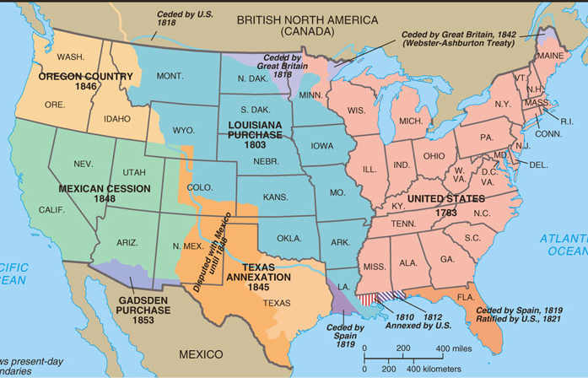
Territorial Expansion by Mid-19th Century
Benefits of Oregon: the U.S. gained its 1st deep-water port in the Pacific & Northern abolitionists saw Oregon as a balance to what would be slave-state Texas

Slide 14
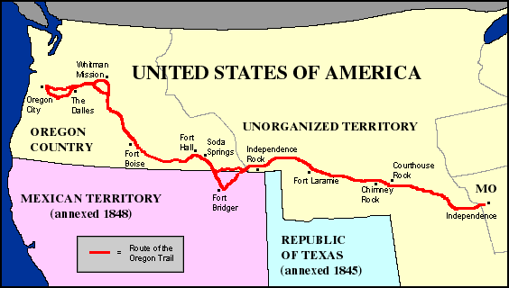
“Life on the Oregon Trail” Excerpt #1
“Pioneers along the Oregon Trail averaged 15 miles per day, almost exclusively on foot, for nearly 6 months.”

Slide 15
“Life on the Oregon Trail” Excerpt #2
“Covered wagons dominated traffic on the Oregon Trail. The typical wagon was about 11 feet long, 4 feet wide, and 2 feet deep, with bows of hardwood supporting a bonnet that rose about 5 feet above the wagon bed. With only one set of springs under the driver's seat and none on the axles, nearly everyone walked along with their herds of cattle and sheep.”

Slide 16
“Life on the Oregon Trail” Excerpt #3
“A typical day started before dawn with breakfast of coffee, bacon, and dry bread. The wagon was repacked in time to get underway by 7 o'clock. At noon, they stopped for a cold meal of coffee, beans, and bacon. Then back on the road again. Around 5 in the afternoon, they circled the wagons for the evening. The men secured the animals and made repairs while women cooked a hot meal of tea, boiled rice, and bacon.”

Slide 17
“Life on the Oregon Trail” Excerpt #4
“When the Trail got crowded (in 1849 and later) camping became more difficult. The biggest problem was finding fuel for the campfires. Soon trees were scarce and there was only one alternative: buffalo dung. No one liked collecting it, but it did burn and gave off a consistent odorless flame.”

Slide 18
“Life on the Oregon Trail” Excerpt #5
“Weather-related dangers included thunderstorms, hailstones, lightning, tornadoes, & high winds. The intense heat of the deserts caused wood to shrink & rims to fall of axles. The pioneers’ lips blistered and split in the dry air, and their only remedy was to rub axle grease on their lips. River crossings were often dangerous: even in slow currents & shallow water, wagon wheels could be damaged by rocks or become mired in the muddy bottom.”

Slide 19
“Life on the Oregon Trail” Excerpt #6
“Nearly 1 in 10 who set off on the Oregon Trail did not survive. The two biggest causes of death were disease and accidents. The worst disease was cholera, caused by unsanitary conditions. People in good spirits in the morning could be dead by evening. Symptoms started with an intense stomach ache, then came diarrhea and vomiting causing dehydration. If death did not occur within the first 12 to 24 hours, the victim usually recovered.”

Slide 20
“Life on the Oregon Trail” Excerpt #7
“Indians were usually the least of the pioneers’ problems. Tales of hostile encounters far overshadowed actual incidents. Indian conflicts occasionally resulted from trigger-happy emigrants who shot at Indians for target practice. A few massacres were highly publicized. The Ward Train was attacked by Shoshones who tortured & murdered 19 emigrants.”
The Oregon Trail

Slide 21
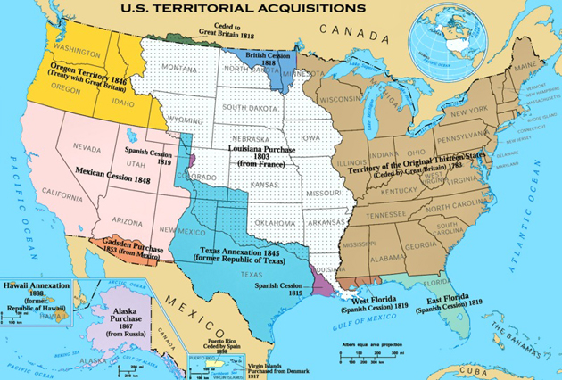

Slide 22
Overland Immigration to the West
Between 1840 & 1860, more than 250,000 people made the trek westward

Slide 23
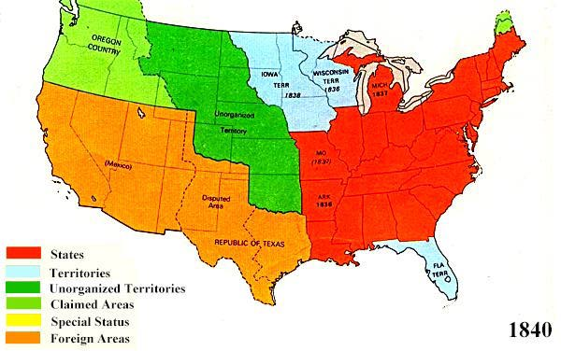
We’re BACK to MAINE:

Slide 24
Territorial Expansion by Mid-19th Century
Canada
In 1839, fighting broke out between lumbermen in Maine & Canada over the disputed Maine border
Webster-Ashburton Treaty (1842):
The U.S. received ½ the disputed land
Established a clear border in Maine

Slide 25
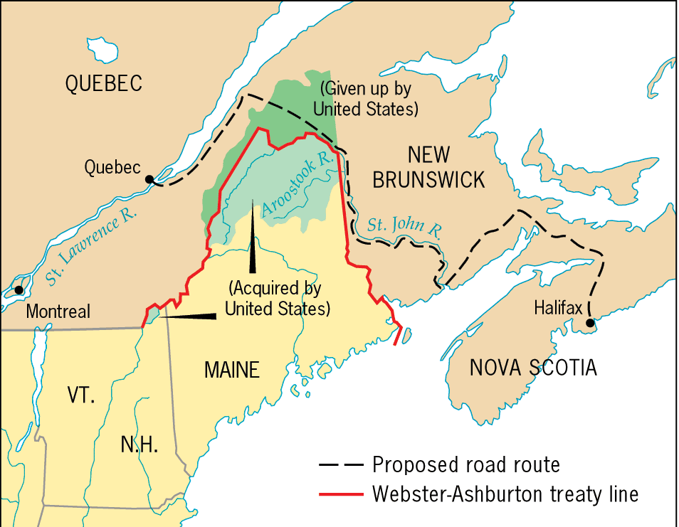
Maine Boundary Settlement, 1842
The Aroostook War (“Lumberjack’s War”) was fought over lumbering in disputed territories
And that’s the end of that! No more Maine issues

Slide 26
TONIGHT’S HOMEWORK
DUE TOMORROW
Open my website (www.mrdemarcoshistory.weebly.com)
Under category “HOMEWORK”, complete the “Mexican-American War primary accounts” reading and THEN the chart
They will be titled: Primary Accounts Excerpted from Howard Zinn’s People’s History of the United States
You will be reading, “Opposition to Mexican American War Viewpoint”, “Pro-Mexican War Viewpoint”, and “Mexican Viewpoint”
Please PRINT OUT BOTH worksheets and bring them into class COMPLETED

Slide 27
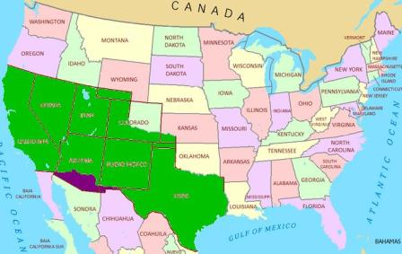
Today’s AIM:
How did the concept of the “West” change from 1800 to 1860?

Slide 28
Territorial Expansion by Mid-19th Century
Texas
In 1821, Mexico won independence from Spain
The new Mexican government opted for a free-trade policy with USA
Thousands of U.S. speculators moved to Texas

Slide 29
The Texas Revolution
In the 1820s, Mexico encouraged U.S. immigration to Texas but problems emerged between “Anglos” & the new Mexican gov’t
“Texans” never fully accepted Mexican rules
In 1834, Santa Anna became dictator & was viewed as threat to Texans’ interests
An armed rebellion broke out in 1835, led by Stephen F. Austin
“Texans” ignored the Mexican ban on slavery
“Texans” refused to convert to Catholicism
“Texans” refused to pay import duties
“Texans” wanted self-rule like in the U.S.
Notes:
,, &
Texans not allowed self-rule

Slide 30
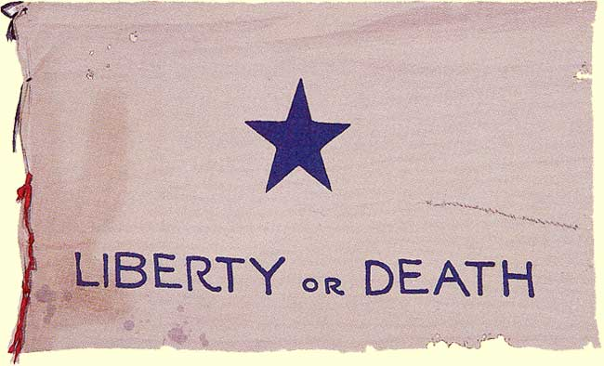
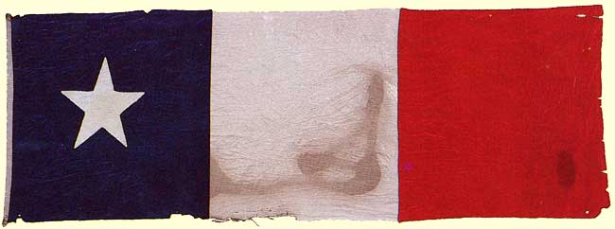
The Republic of Texas (1836-1845)
1836 - Texans declared their independence from Mexico & wrote a national constitution
But the war for independence still had to be fought

Slide 31
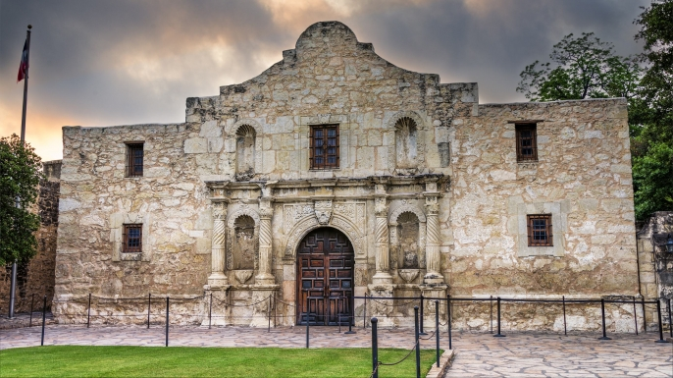
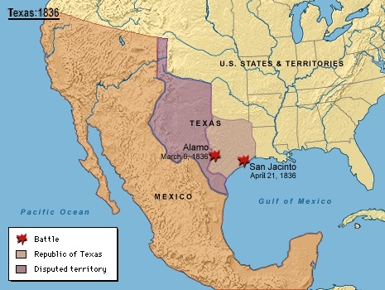
While you watch: What happened at the Alamo?
Take notes on your own…
VIDEO

Slide 32
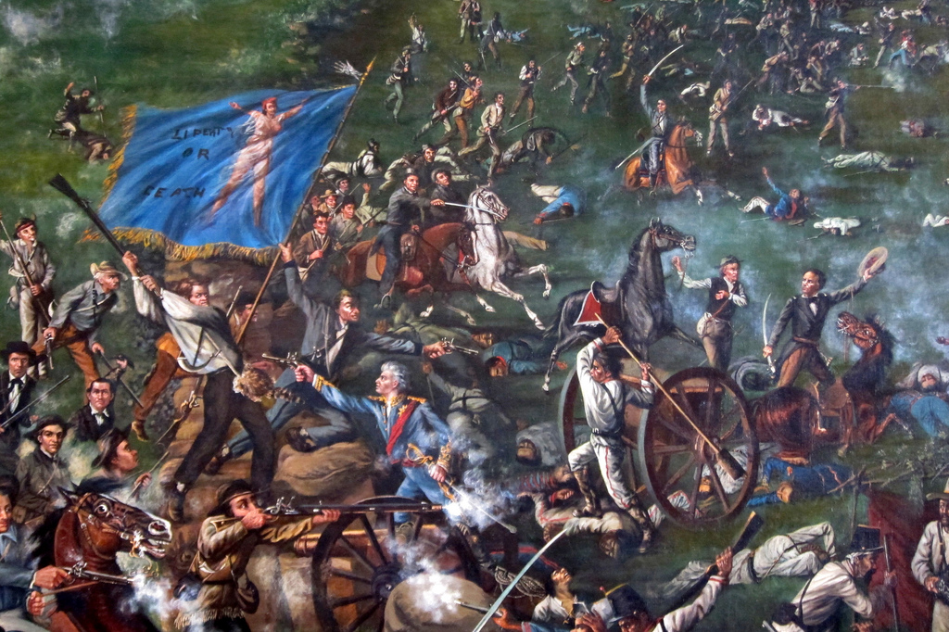
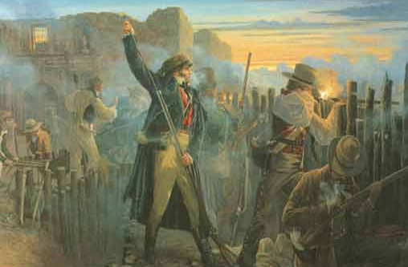
The Battle of the Alamo
Davey Crockett’s Last Stand
General Antonio Lopez de Santa Anna recaptures the Alamo

Slide 33
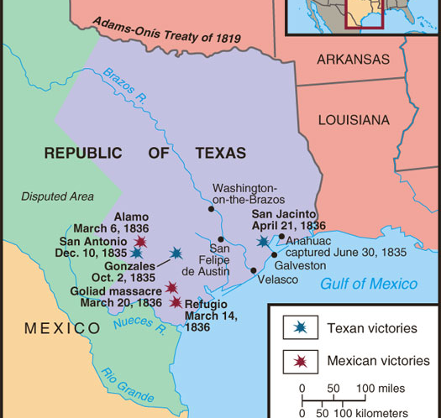
Texans were defeated at the Alamo
In May 1836, Santa Anna recognized Texas’ independence & its territory to the Rio Grande
But…Texans won at San Jacinto & captured General Santa Anna

Slide 34
The Republic of Texas
Sam Houston = 1st president of the Republic of Texas & asked the U.S. to make Texas a state
Previous presidents REFUSED to annex Texas…WHY?
Texas was GREAT…it offered free land grants to U.S. settlers
Texas’ population soared from 30,000 to 142,000 by 1845

Slide 35
President Tyler and Texas
DON’T
COPY
In 1844, President Tyler called for the annexation of Texas:
Congress didn’t want it!
Tyler was not nominated in the 1844 election
BUT right before his presidency was over, he got congressional approval calling for the annexation of Texas
Texas officially became a state on December 29, 1845

Slide 36
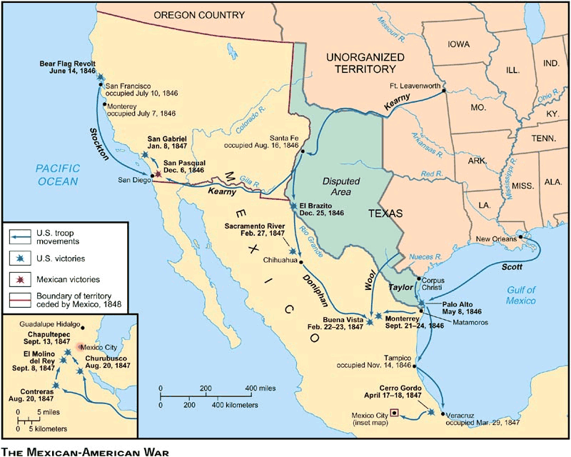
Mexican-American War
Causes of the Mexican War:
Annexation of Texas
US wants California and New Mexico too!
Where’s the Mexico-Texas border? (we said it was along the RIO GRANDE)

Slide 37
LAST NIGHT’S HOMEWORK…
1. Opposition to Mexican American War Viewpoint
2. Pro-Mexican War Viewpoint
3. Mexican Viewpoint
Analysis Question (write responses BELOW primary source comparison CHART)
How do the accounts differ? Use specific quotes to support your evidence.
What do the various primary resources reveal about differing viewpoints on the Mexican American War?

Slide 38
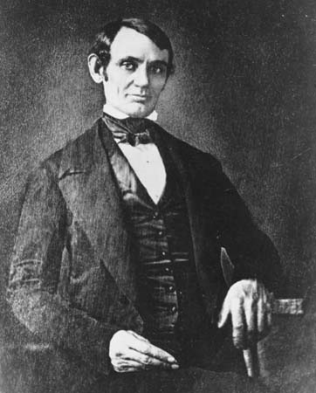
1846 – Mexican army crossed the Rio Grande and captured an American army patrol, KILLING 11!
A young Congressman from Illinois named Abraham Lincoln lashed out against the war, calling it immoral, pro-slavery, and a threat to the nation's republican values.
In Congress, he demanded that President Polk identify the precise spot on which Mexicans had "shed American blood on American soil." One of Lincoln's constituents branded him "the Benedict Arnold of our district," and he was denied re-nomination by his own party.
DON’T
COPY
FUN FACT:
Dissent even made its way to the battlefield. A group of enlisted Irish-Catholic Americans, shocked by the desecration of Catholic churches, deserted to the Mexican side, formed the San Patricio Battalion, and fought against the American army.

Slide 39
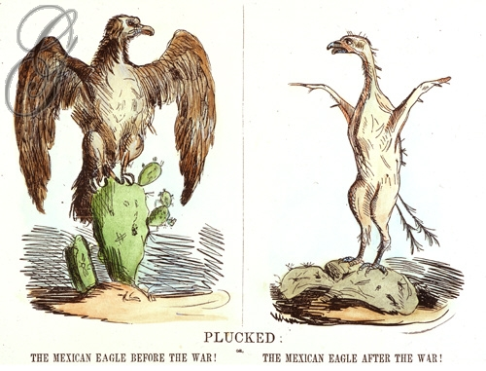
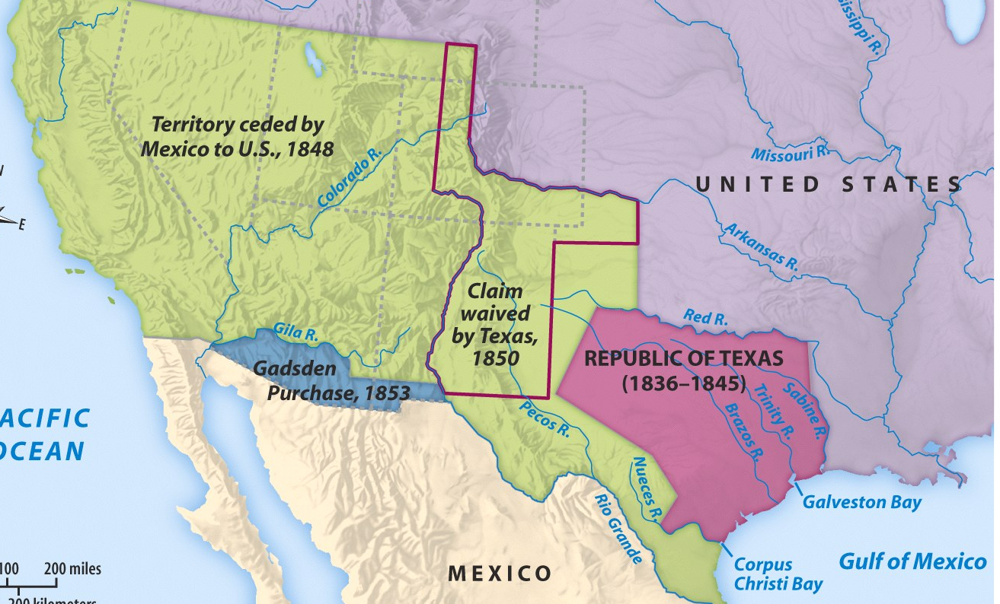
Ending the Mexican War
In 1848, U.S. & Mexico ended the war with the Treaty of Guadalupe Hildalgo:
Added the Gadsden Purchase in 1853 to build a southern transcontinental railroad
The U.S. grew 20% by adding the Mexican Cession (present-day NM, AZ, CA, Utah, NV, & parts of CO & WY)
VIDEO
The Rio Grande became the recognized U.S. southern border

Slide 40
ACTIVITY: Should we have declared war on Mexico?
With the person next to you, review your notes from today’s lesson and answer the question: Would you have supported the controversial war with Mexico?
Then, with your partner create a two column chart listing the reasons FOR or AGAINST going to war with Mexico.
Try to keep the reasons in the context of the times in terms of how Americans would have felt in the 1840’s. Discuss what we have just reviewed in the lesson.
FINISH FOR HOMEWORK
IF NOT DONE IN CLASS ☺

