Slide 1
Today’s AIM: How did Hamilton’s financial plan lead to disputes within Washington’s cabinet?
EQ:
Why did Hamilton create a financial plan for the nation?
What were the pro’s and con’s of creating a national bank in the US?
Why did Jefferson despise Hamilton’s financial plan so much?

Slide 2
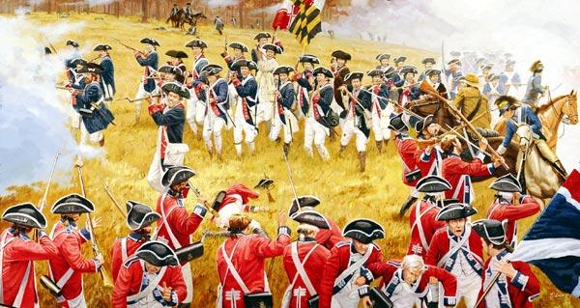
Mucho Economic Problems in the USA
Nation’s finances a wreck
War Debts
Private citizens loaned money to the government
State governments had their own wartime debts
US debt in 1789 = $52 million
Current US debt…want to see?
How do we fix it?

Slide 3
Mucho Economic Problems in the USA
Must repay debts to win the respect of both foreign nations and its own citizens
Demonstrate responsibility with money
Could hamper lending relations in the future

Slide 4
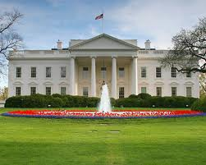
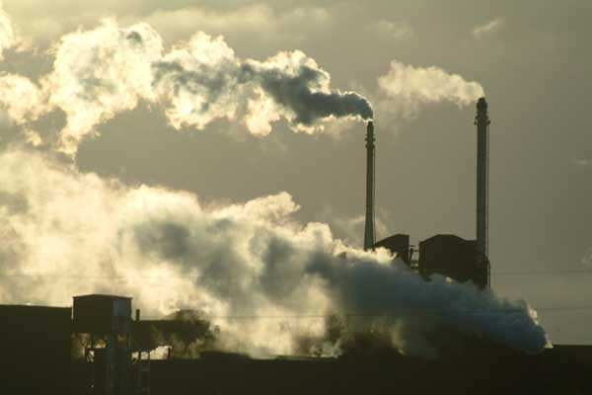
Hamilton’s Financial Plan
Strengthen central government
Government should encourage business and industry
Strived to get wealthy merchants and manufacturers on his side

Slide 5
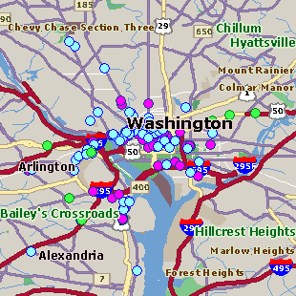
Hamilton’s Financial Plan
1st Report on Public Credit
Pay off all war debts
Raise government revenues
Create a national bank
Wanted National government to pay off the war debts of the states (“assumption”)
Most southern states had paid theirs off and did not want to help northern states to pay off theirs
Compromise of 1790 – the nation’s capital would be located in the South (Residence Act 1790)

Slide 6
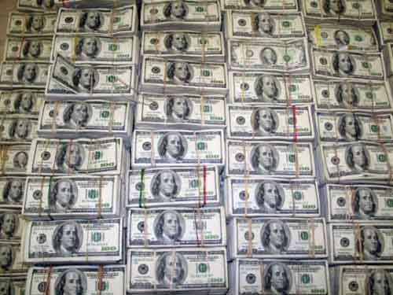
Hamilton’s Financial Plan
Favored TARIFFS
Raises money for the government
Encourages growth of American industry
Create a national bank
Safe place to keep money
Issue loans
The financial plan…
SMART or STUPID?

Slide 7
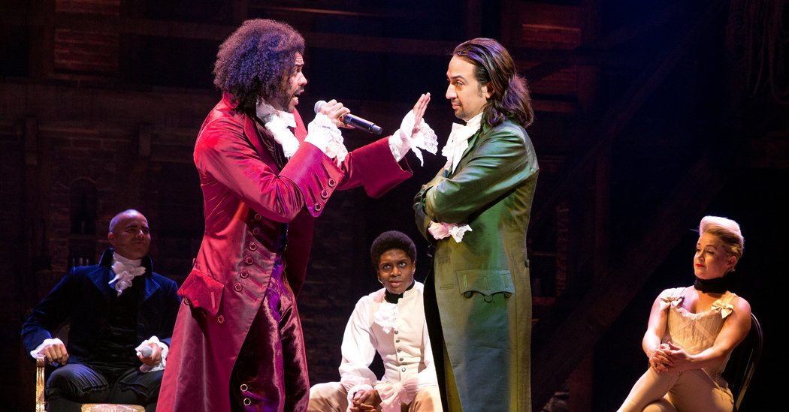
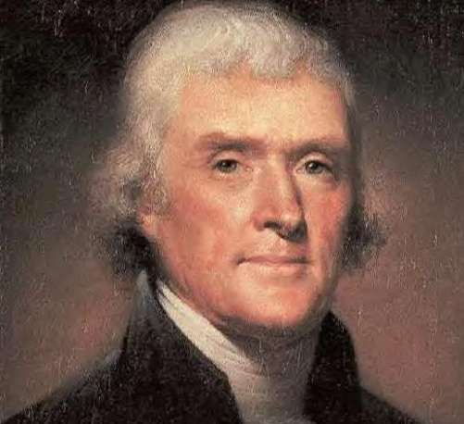
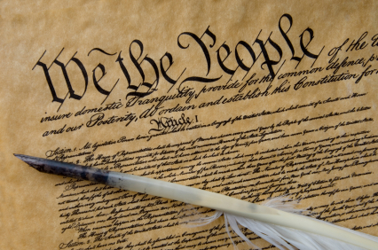
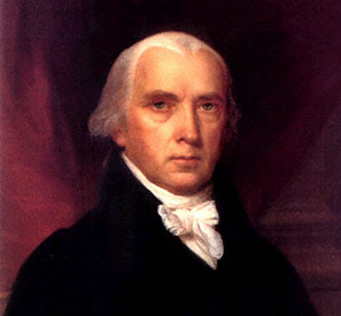
Interpreting the Constitution
Not all people were in agreement with Hamilton
The meaning of the Constitution was debated!
What was Jefferson’s
problem with Hamilton?

Slide 8
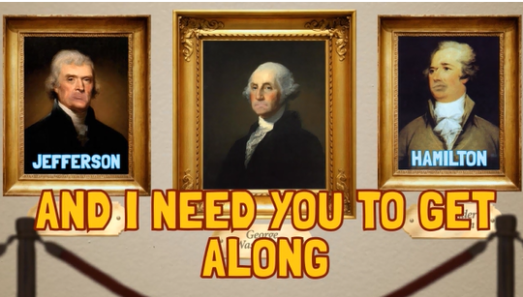
We’ll take a deeper look into how this rivalry created political parties, and affected Washington’s presidency on Wednesday…

Slide 9
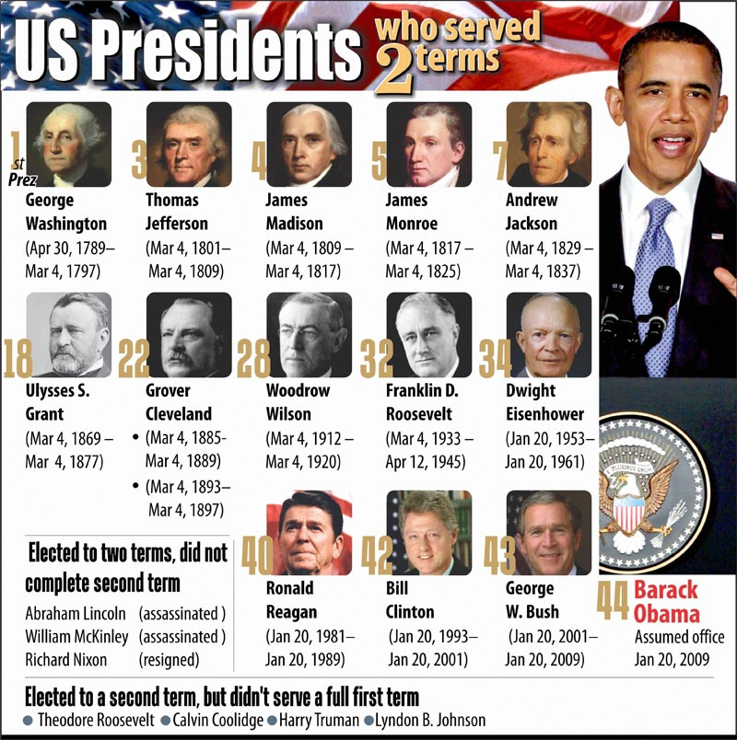
Lets discuss:
Do you believe two terms (8 years) is a good maximum for a President to serve? Why or why not?

Slide 10
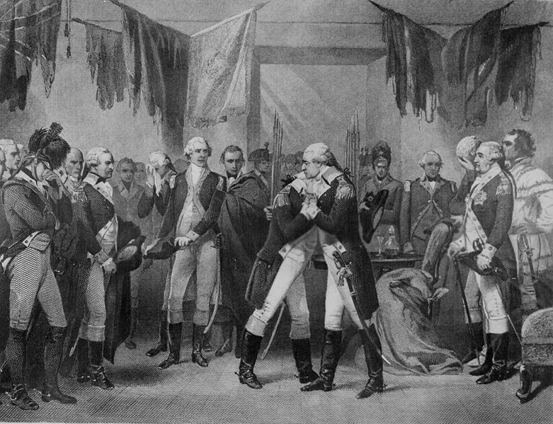
END of PERIOD 3: 1754-1800
The Start of a New Nation
AIM: How did the
creation of political parties
lead to Washington’s farewell?

Slide 11
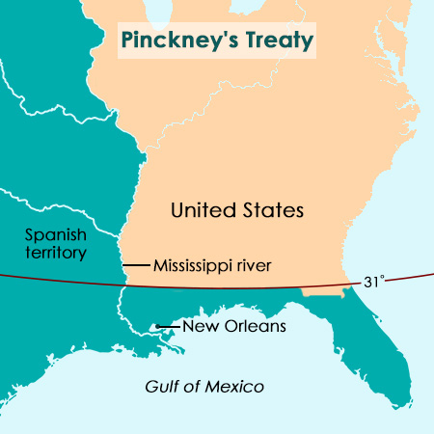
2 More DOMESTIC Issues for GW
Pinckney Treaty (1795)
Thomas Pinckney
Americans travel freely along Mississippi River
Americans could store goods
Port of New Orleans
Free of customs duties
Southern boundary of U.S. at 31st parallel

Slide 12
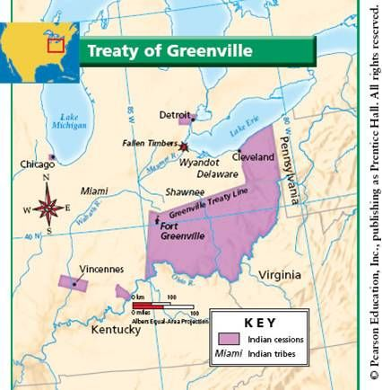
2 More DOMESTIC Issues for GW
2. American Indians
Settlers moving west towards Ohio Valley and BEYOND
Northwest Confederacy invades!
Natives think Brits will aid, but they don’t
Battle of Fallen Timbers
Treaty of Greenville (1795)
Surrender claims in Ohio Territory
Open up to settlement (Ohio, Indiana)

Slide 14
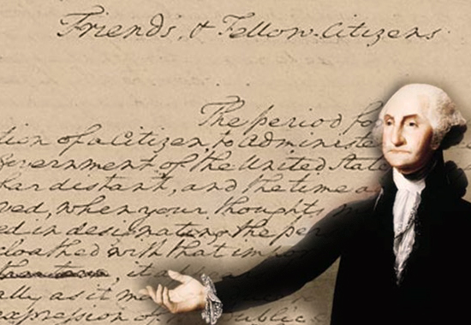
Who said it?
1) “Elections are coming up, and it’s time for you to decide who is to be trusted with the position of President of the United States of America. It also seems to be a good time to let you know that I’m not going to be one of the ones that you will be choosing from.”
2) “Please be assured that this has not been an easy decision for me. I have weighed my choice against the duty each person has for their country. Now, don’t get me wrong. I thank you for your trust so far. I just think me quitting is a good idea on all counts.”
3) “I’ve been president twice now, and I didn’t want to do it either time. I tried to quit the first time, but the country was in trouble and everyone around was begging me to abandon the idea of quitting.”
4) “I am excited just thinking about my last day in office, but I feel a deep sense of gratitude to my dear country for all the honors it has bestowed upon me.

Slide 15
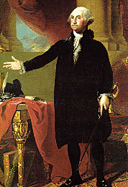
The Farewell Address, 1797
“It serves always to distract the public councils and enfeeble the public administration. It agitates the community with ill-found jealousies and false alarms; kindles the animosity of one part against another; foments [incites] occasionally riot and insurrection. It opens the door to foreign influence and corruption.”
Based on the quote, what do you think “IT” is? Explain.

Slide 16
The Farewell Address, 1797
In his Farewell Address Washington gave his final advice:
1) DON’T FORM POLITICAL PARTIES!
2) REMAIN NEUTRAL
3) DON’T MAKE PERMANENT FOREIGN ALLIANCES!
4) NO SECTIONALISM!

Slide 17
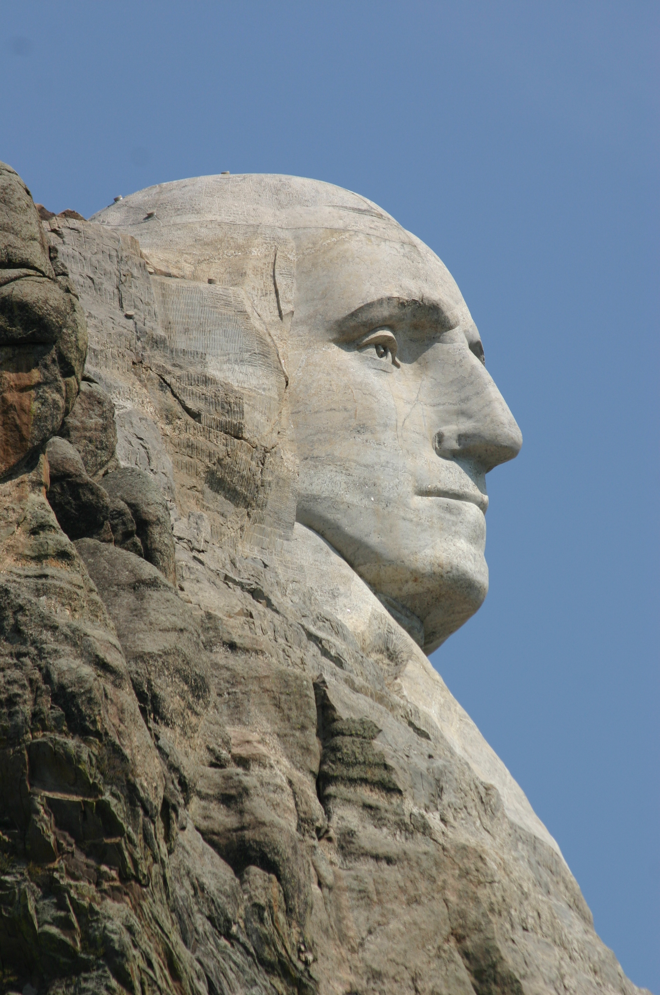
Washington’s Legacy
Political parties already formed
TWO-TERM Presidency even though Constitution had no limit
Two-term tradition continued until 1940! (FDR won election to a 3rd term)
22nd Amendment (1951) = two-term limit in the Constitution

Slide 18
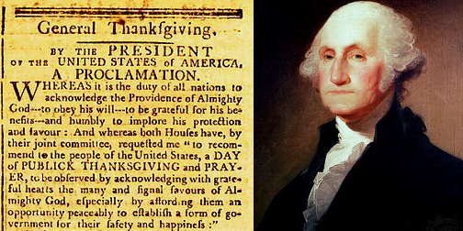
Anyone know how Thanksgiving REALLY began?
Designated November 26 of 1789 as a national day of thanksgiving to recognize the role of fortune in creating the new United States and the new federal Constitution…
Abraham Lincoln made it an official holiday on the last Thursday of November
FDR makes it a federal holiday in 1939 to boost economy!

Slide 19
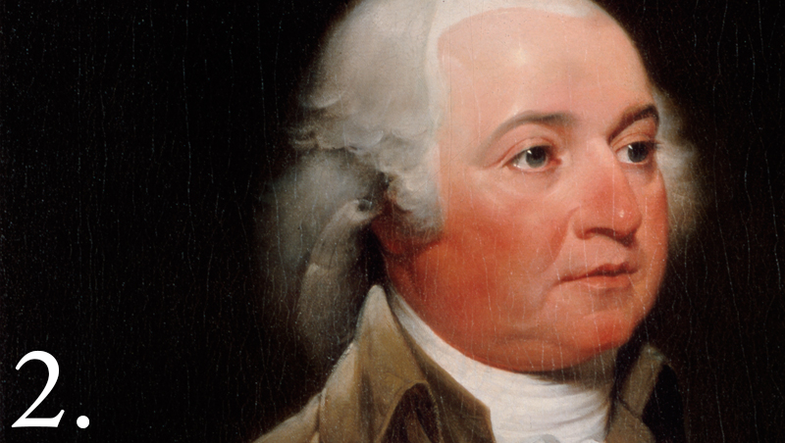
END of PERIOD 3: 1754-1800
The Start of a New Nation
AIM: How can we evaluate John Adams’ overall legacy as President? (1797-1801)

Slide 20
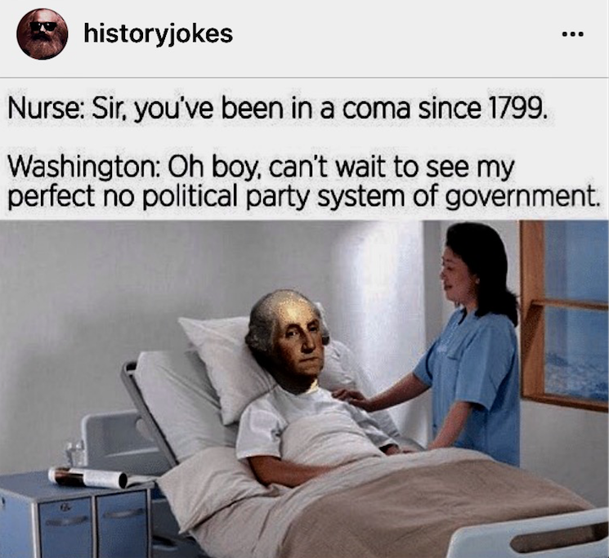
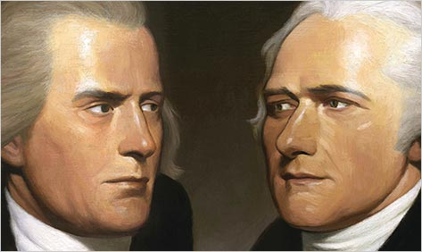
At this very moment…
Democratic-
Republicans
Federalists
DRAMA

Slide 21
America’s First Political Parties
Democratic-Republicans
Federalists
Thomas Jefferson
(Jeffersonians)
Alexander Hamilton
(Hamiltonians)
Farmers and average citizens (South & West)
Wealthy and educated citizens (North, especially New England)
Strict Constructionist (interpretation of the Constitution)
Loose Constructionist
(interpretation of the Constitution)

Slide 22
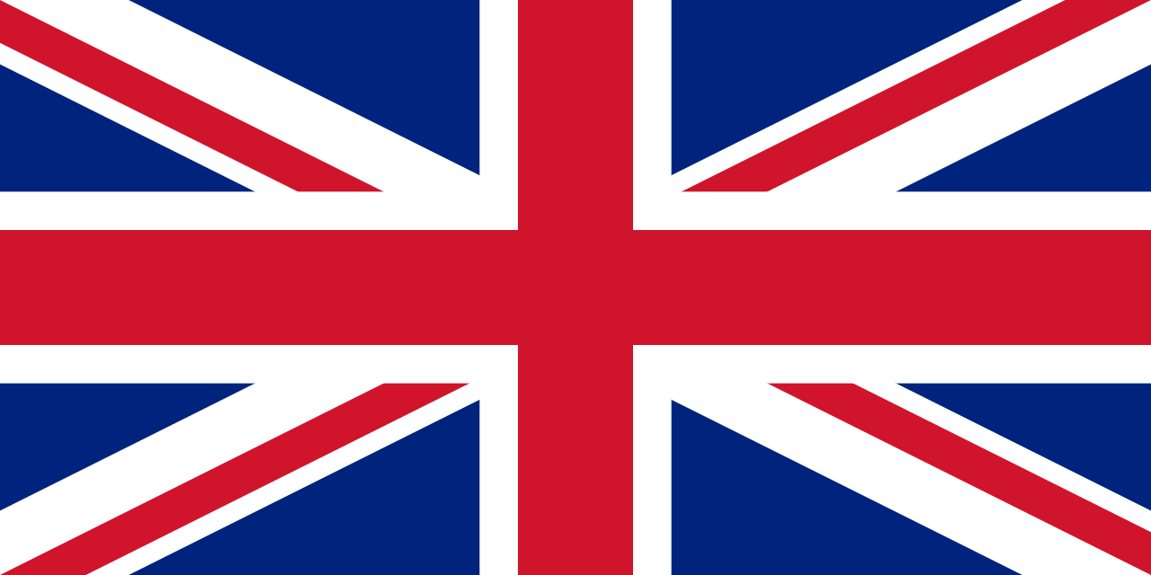
America’s First Political Parties – cont’d
Democratic-Republicans
Federalists
Supports state banks
Supports the National Bank
Supports the French in foreign affairs
Supports the British in foreign affairs

Slide 23
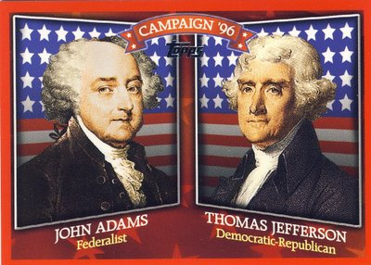
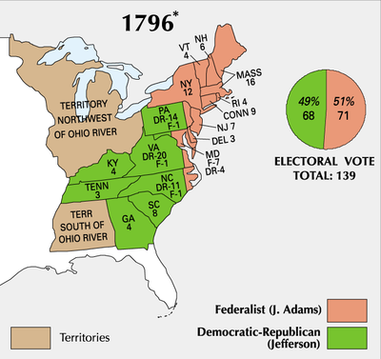
Adams 71, Jefferson 68, and Pinckney 59.
Jefferson is Vice-President.
Does not trust Hamilton and Pinckney.
How were the votes divided? What do you think the division indicates?
Notes:
How were the votes divided? What do you think the division indicates?

Slide 24
Presidential Rankings: C-Span Survey, 2009
Abraham Lincoln Franklin Roosevelt George Washington Theodore Roosevelt Harry Truman John Kennedy Thomas Jefferson Dwight Eisenhower Woodrow Wilson Ronald Reagan Lyndon Johnson James Polk Andrew Jackson James Monroe | 15. Bill Clinton 16. William McKinley 17. John Adams 18. George H.W. Bush 19. John Quincy Adams 20. James Madison 21. Grover Cleveland 22. Gerald Ford 23. Ulysses Grant 24. William Taft 25. Jimmy Carter 26. Calvin Coolidge 27. Richard Nixon 28. James Garfield
29. Zachary Taylor
30. Benjamin Harrison
31. Martin Van Buren
32. Chester Arthur
33. Rutherford Hayes
34. Herbert Hoover
35. John Tyler
36. George W. Bush
37. Millard Fillmore
38. Warren Harding
39. William Harrison
40. Franklin Pierce
41. Andrew Johnson
42. James Buchanan
Why is he ranked #17?

Slide 25
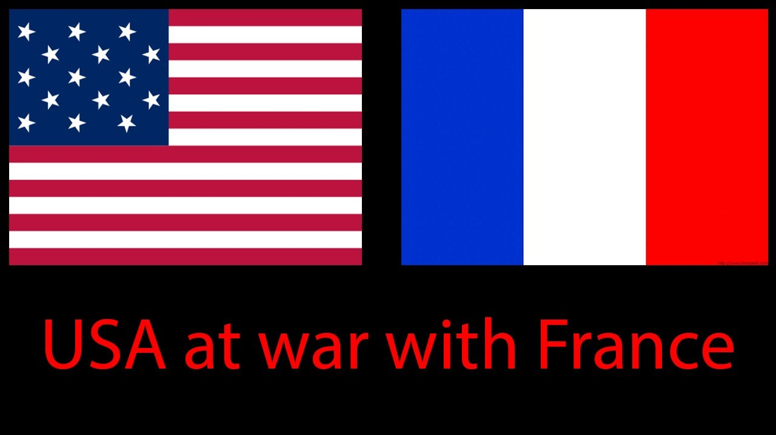
Adams dealt with a “war” as soon as he took office…
The "Quasi-War"
Revolutionary France attacks American shipping to influence the election and hurt Britain
France wants the special privileges that Britain gained from Jay's Treaty to END!
Saw it as an initial step towards a U.S. alliance with Britain
Saw it as flagrant violation of Franco-American Treaty of 1778
Adams wanted to AVOID war, so he sent officials to Paris to negotiate with their government...

Slide 26
The XYZ Affair
1797 - John Marshall, Charles Pinckney, and Elbridge Gerry sent to negotiate PEACE
Met by secret agents known as X, Y, and Z
XYZ demanded a BRIBE of $250,000 and a loan to the French of $10 million before the Americans could even see the Foreign Minister Talleyrand
This made Americans MAD and it became known as the XYZ AFFAIR…
FAILURE!
American ships and French ships begin to ATTACK each other!
Federalists want Congress to DECLARE WAR to restore American honor!
"Millions for defense, but not one cent for tribute!"

Slide 27
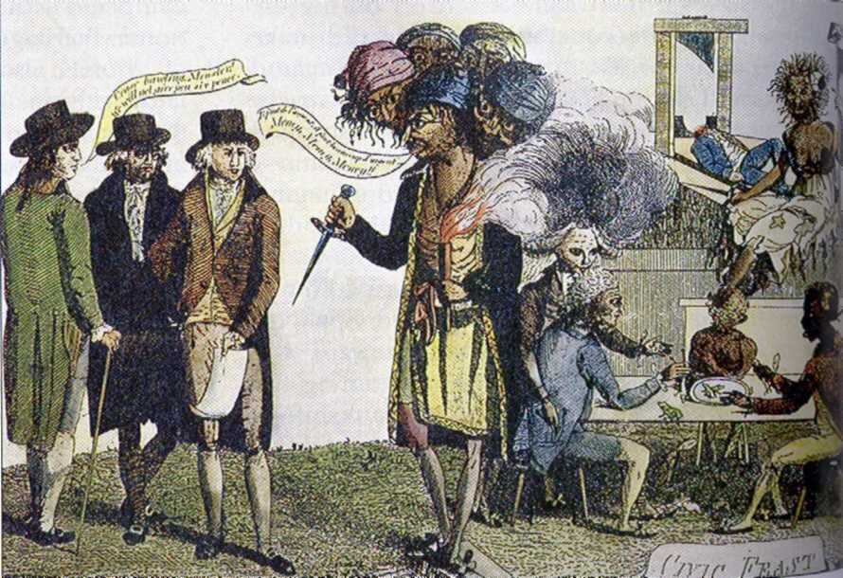
Analyze this cartoon...
The XYZ affair - Refusing the Paris Monster
'Cinque-Tetes or the Paris Monster', cartoon satirizing the XYZ Affair, 1797
caricature refers to French requests for bribes to Charles Maurice de Talleyrand-Perigord (1754-1838), French Foreign Minister and an enormous loan to France;

Slide 28
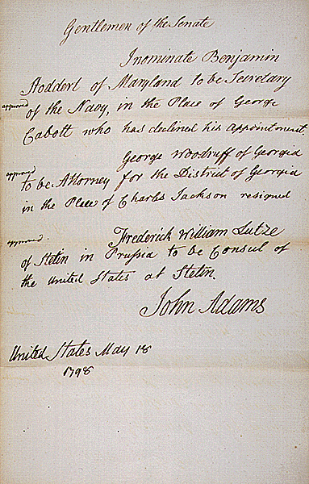
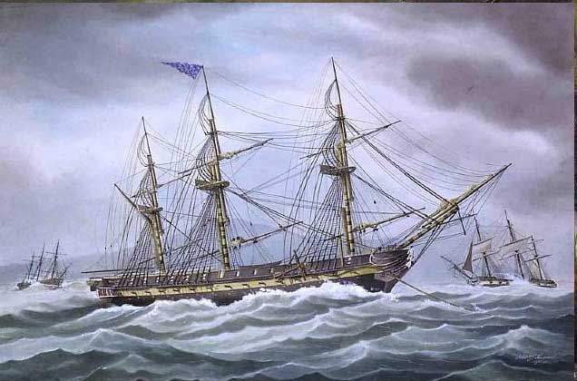
War hysteria sweeps the US!
Congress ends the French alliance
Creation of a US NAVY!
Washington comes out of retirement to lead the American forces
American privateers attack French shipping boats

Slide 29
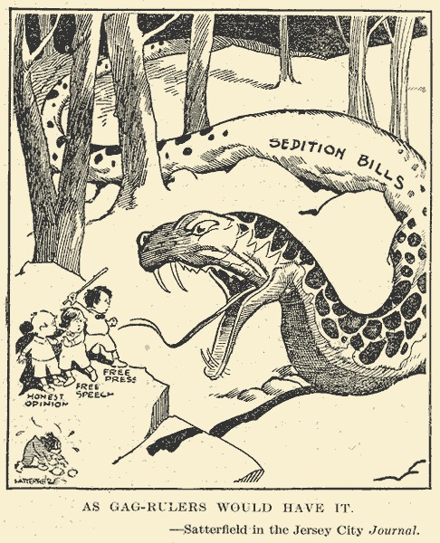
Look at this political cartoon...
What effects was Congress’ next law going to have on Americans?

Slide 30
Favor or Oppose?
Naturalization Act
Alien Act
Alien Enemies Act
Sedition Act

Slide 31
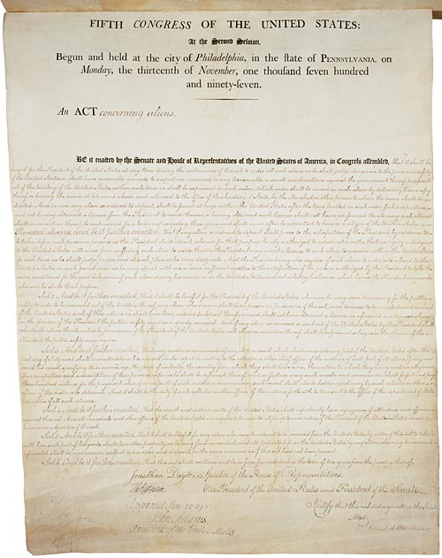
American response to the XYZ Affair…
Naturalization Act
Eligibility for citizenship increased from 5 to 14 years – couldn’t vote for Democratic-Republicans
Alien Act
President can expel all aliens deemed "dangerous to the peace and safety of the United States."

Slide 32
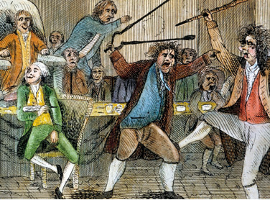
The Sedition Act
Made it a crime to "impede the operation of any law."
Illegal to publish or speak any "false, scandalous, and malicious" criticism of high government officials
FINES and IMPRISONMENT!
A Fight in Congress
Over the
Sedition Act

Slide 33
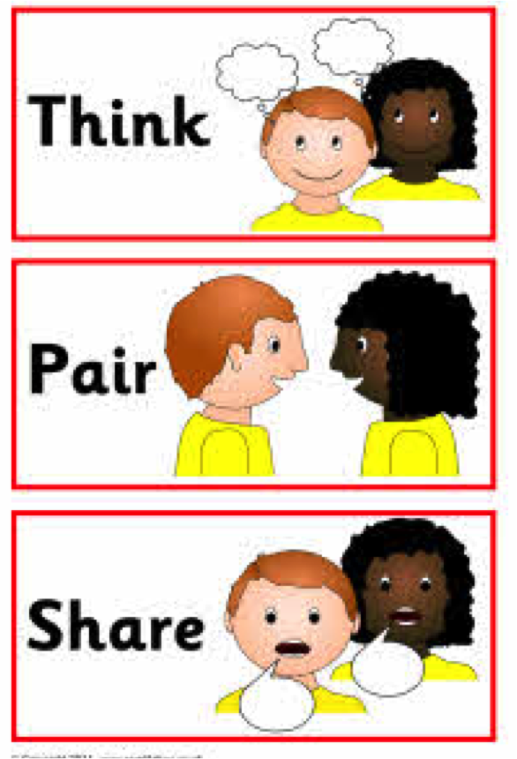
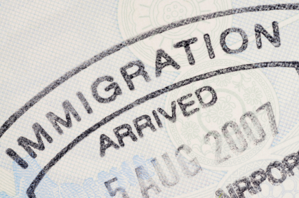
Why do you think the Federalists increased restrictions on immigrants?
What similar patterns do you know from our nation’s history? Today?
Notes:
Quell dissent

