Slide 1
Aim: How did the Emancipation Proclamation impact and help eventually end the Civil War?
"all persons held as slaves within any States, or designated part of the State, the people whereof shall be in rebellion against the United States, shall be then, thenceforward, and forever free."

Slide 2
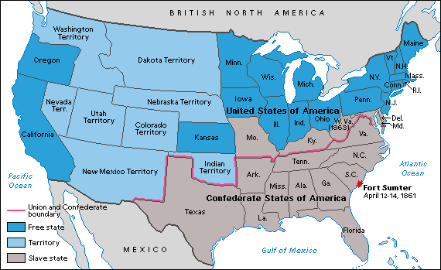
The Emancipation Proclamation
Take out your writing assignment (“Should Lincoln have issued the Emancipation Proclamation?”) –
What was it and what did it do?
a. An executive order
b. Only freed slaves in the SOUTH!
c. Didn’t free slaves in the border states!
Did NOT free all slaves in the United States! It declared free only those slaves living in states not under Union control.
William Seward, Lincoln's secretary of state, commented, "We show our sympathy with slavery by emancipating slaves where we cannot reach them and holding them in bondage where we can set them free."

Slide 3
How would you feel about the Emancipation Proclamation if you were…
(1) a slave owner from Texas?
“The slaves are free? Not in my state their not. Abraham Lincoln isn’t my President anymore, so I don’t have to listen to the Emancipation Proclamation. I only have to free my slaves if the Confederates lose the war.”
(2) a slave owner from Missouri?
“I knew it was a good idea for us to stay in the Union! I get to keep my slaves, just like the slave owners in Kentucky, Maryland, and Delaware get to keep theirs.”

Slide 4
How would you feel about the Emancipation Proclamation if you were…
(3) an abolitionist from Massachusetts?
“Hmmm…the Emancipation Proclamation is a good start, but it doesn’t go far enough. Slavery should be ended in all the states, not only the one’s in rebellion against the Union!”
(4) Abraham Lincoln?
“I wish that I could free the slaves in all of the states immediately. However, if I free the slaves in the border states, they may switch to the Confederacy, and I can’t allow that to happen. Anyway, nobody is really free until we’re able to defeat those Confederate rebels!”

Slide 5
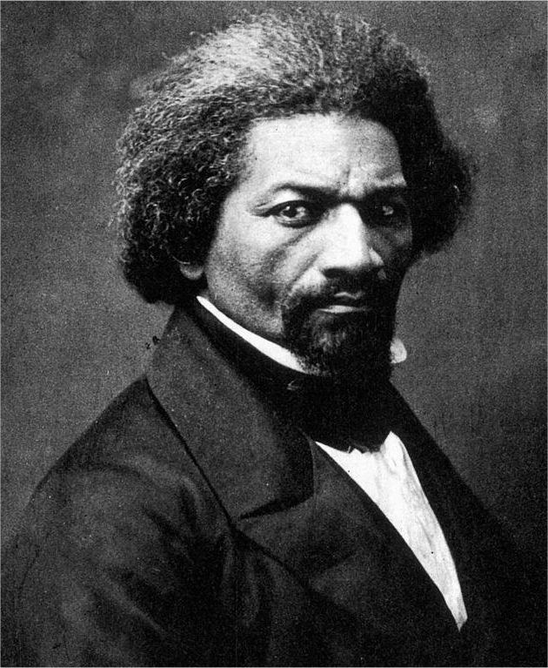
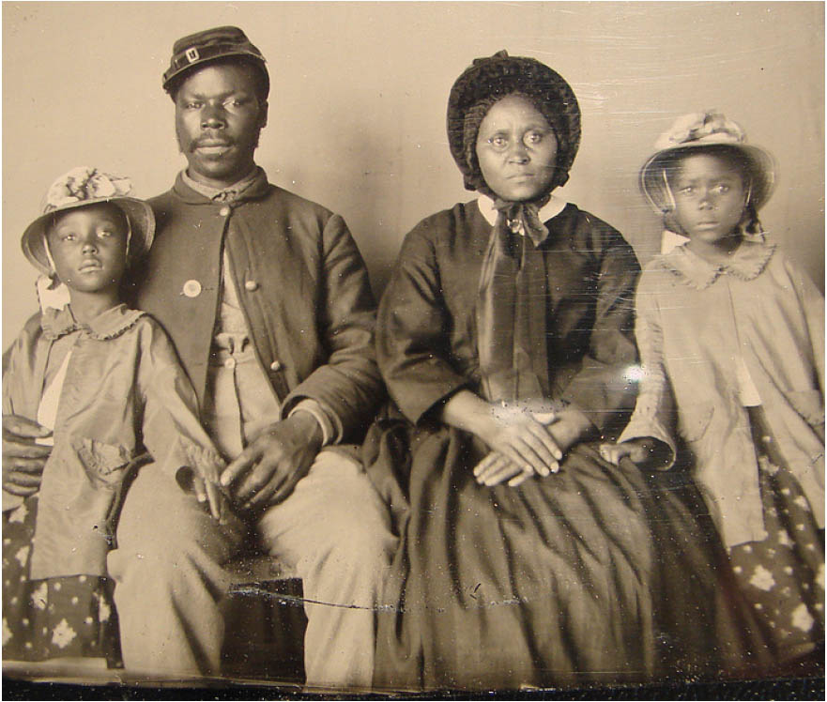
While you watch: How did the Emancipation Proclamation change the purpose of the Civil War from then on?
VIDEO
34:40
It gave the North a new reason fight the Civil War!
And it also inspired African Americans
from the South to come fight for the Union!
“Once let the black man get upon his person the brass letters, U.S.;...and a musket on his shoulder and bullets in his pocket, and there is no power on earth which can deny that he has earned the right to citizenship.”

Slide 6
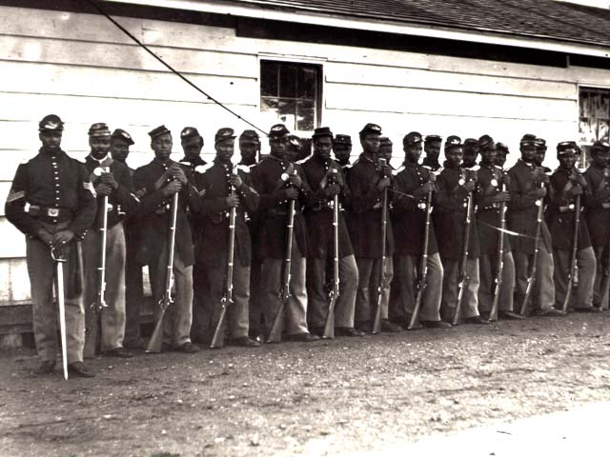
African Americans HELP the Union effort
The 54th Massachusetts Infantry consisted mostly of African Americans.
In July 1863, this regiment of soldiers led a heroic charge on South Carolina’s Fort Wagner.
About 18,000 African Americans served with the Union army.
They received $10 a month, and white soldiers got $13.

Slide 7
Lincoln expands Presidential powers
Review REGENTS week assignment #3:
What is habeas corpus?
Why did Lincoln suspend habeas corpus?
Can you think of any other relevant examples of presidents expanding their powers?
Relevant Connections:
Korematsu v. US (1944) – internment of Japanese Americans
Patriot Act (2001) – protection against foreign enemies
National Defense Act (2011) – authorizes “indefinite detentions of US citizens designated as enemies by executive” including anyone who “substantially supports Al-Qaeda/Taliban”
Notes:
http://www.globalresearch.ca/the-suspension-of-habeas-corpus-in-america/5311701
Patriot Act 2001 – “the president is authorized to use all necessary and appropriate force against nations, organizations or persons who have planned, authorized, committed or assisted the terrorist attacks of the 11th of September 2001…”
The authorization itself is preceded by a foreword stating: “it is recognized that the President has the authority under the Constitution to dissuade and defend against acts of international terrorism against the United States.” G. Bush regularly used this phrase to justify the violations of constitutional rights of US citizens. President Obama has adopted the same interpretation in order to deny the innovative nature of a law which enables him to do away with Habeas Corpus for any US citizen.

Slide 8
The END of the Civil War!
Sherman’s March to the Sea
General Sherman marched his troops through Georgia.
Destroyed cities, crops, animals, bridges, and rail lines belonging to the Confederacy.

Slide 9
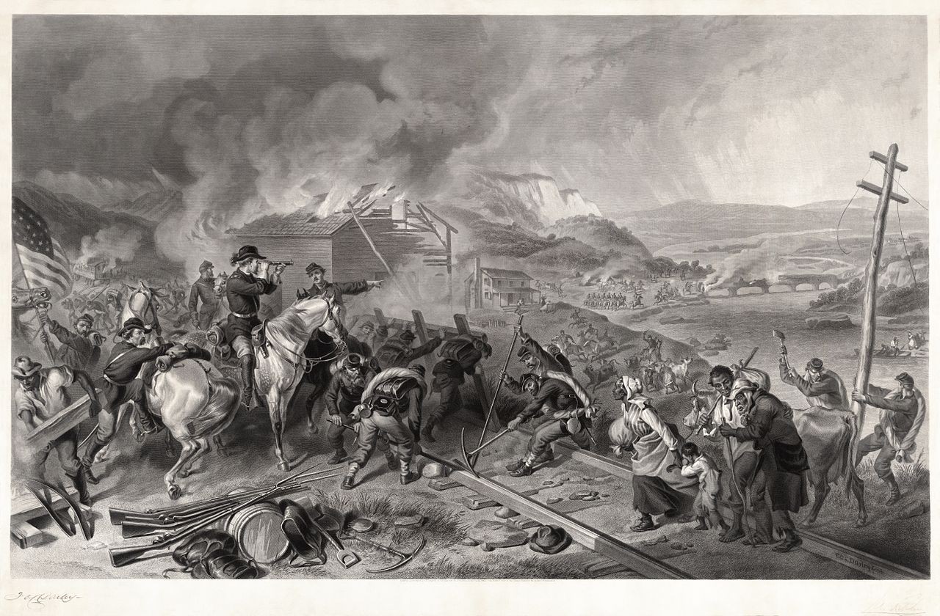
Sherman’s March to the Sea

Slide 11
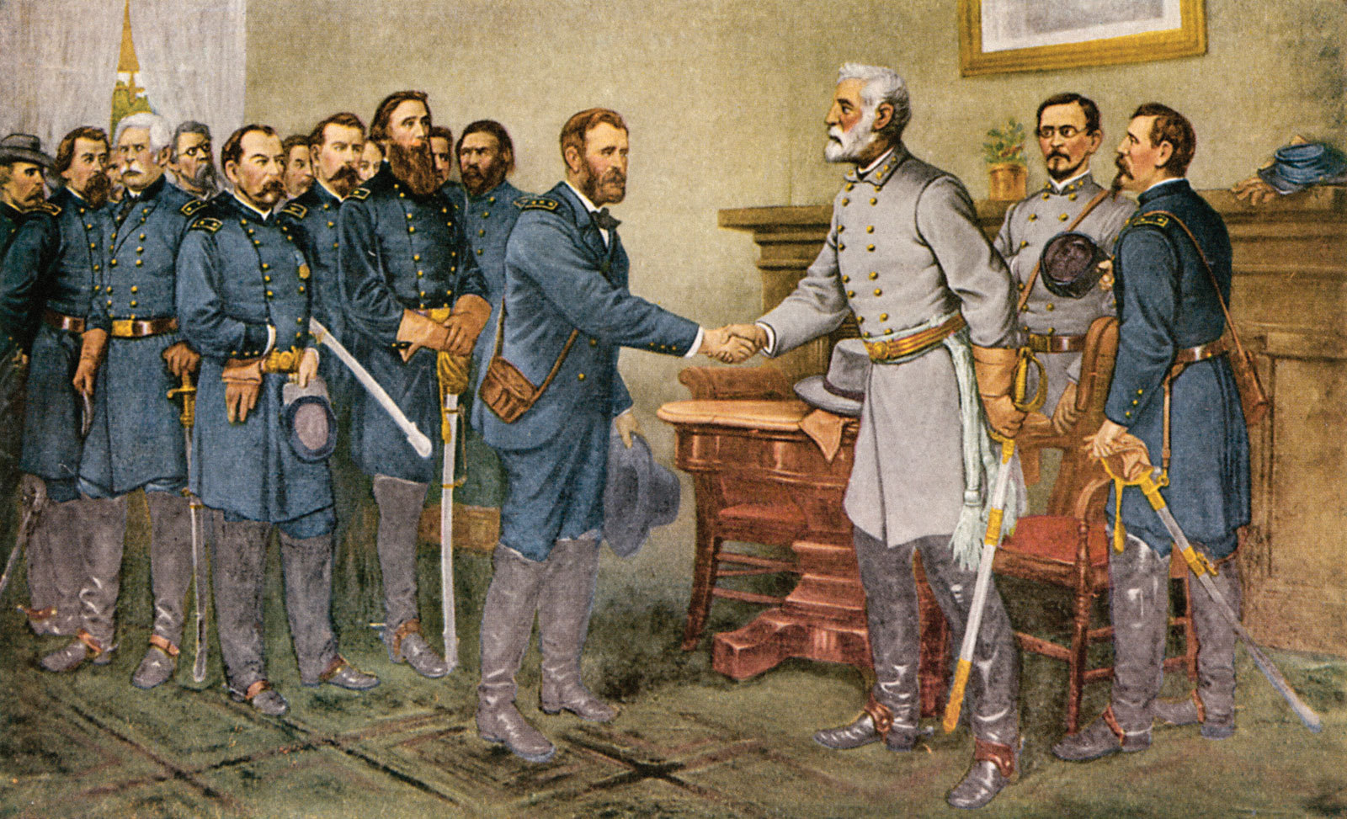
The War Ends – 1865
Southern foreign aid fails to show!
Final surrender, Appomattox Court House, VA
The country is reunited!
YAY!
What does this image say to you about the surrender of General Lee to General Grant?
SURRENDER

Slide 12
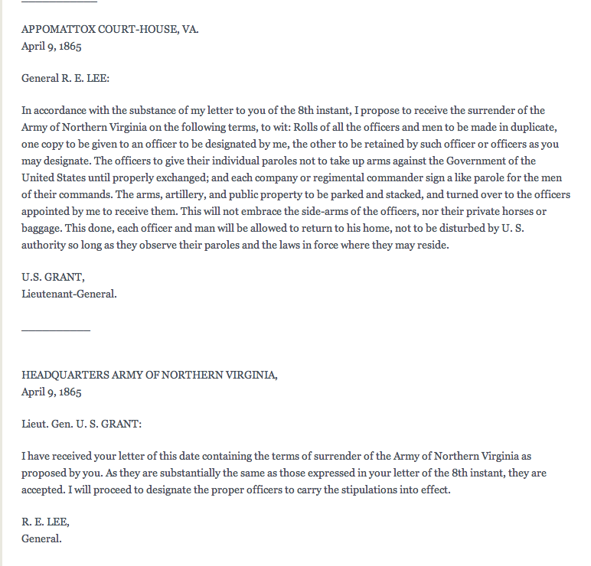
Document
Analysis
What is Grant requesting from General Lee? Does this seem fair or unfair? Explain.
What was General Lee’s response?
Why do you think he responded this way?

Slide 13
REGENTS Review
A major purpose of the
Emancipation Proclamation was to
give land to freedmen.
end Jim Crow laws in the South.
help the North win the Civil War.
provide for new state governments.

