Slide 1
AIM: How did Reconstruction positively and negatively affect the lives of African Americans?
Notes:
Lesson Plan for Thursday, November 13, 2008: Warm-Up Question, Finish Reconstruction notes

Slide 2
What’s the message?
Hayes’
“Let em alone policy”

Slide 3
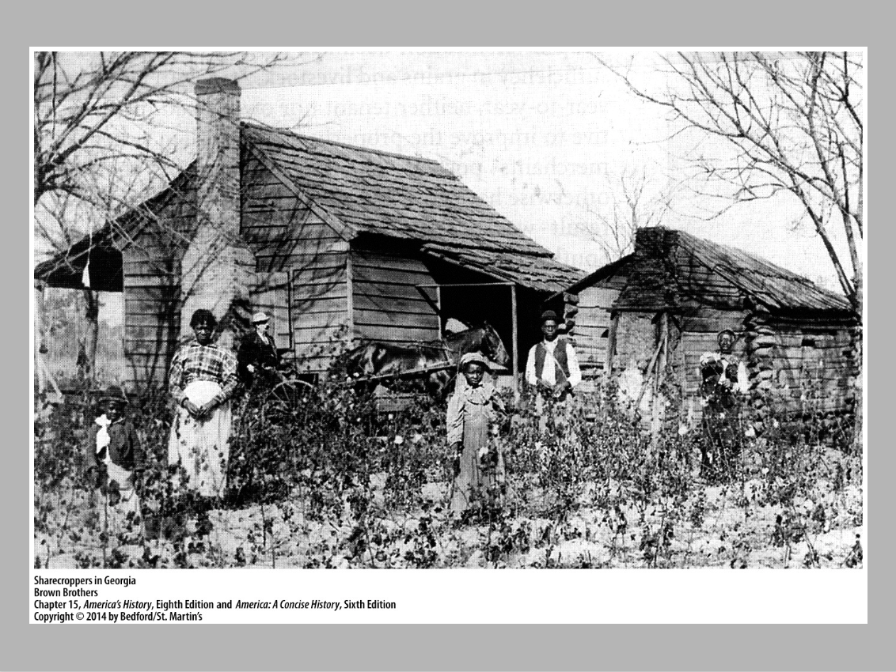
Sharecropping: A New Slavery?
Federal government settled nearly 10000 black families on abandoned plantation land often times receiving a single mule for their property

Slide 5
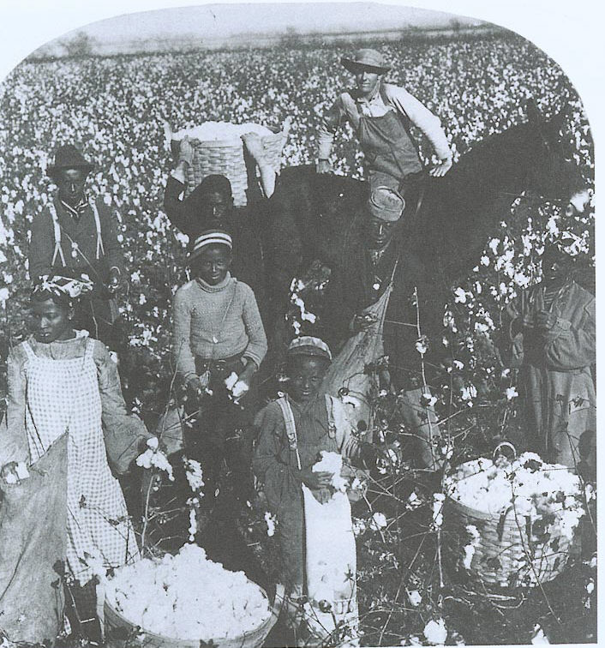
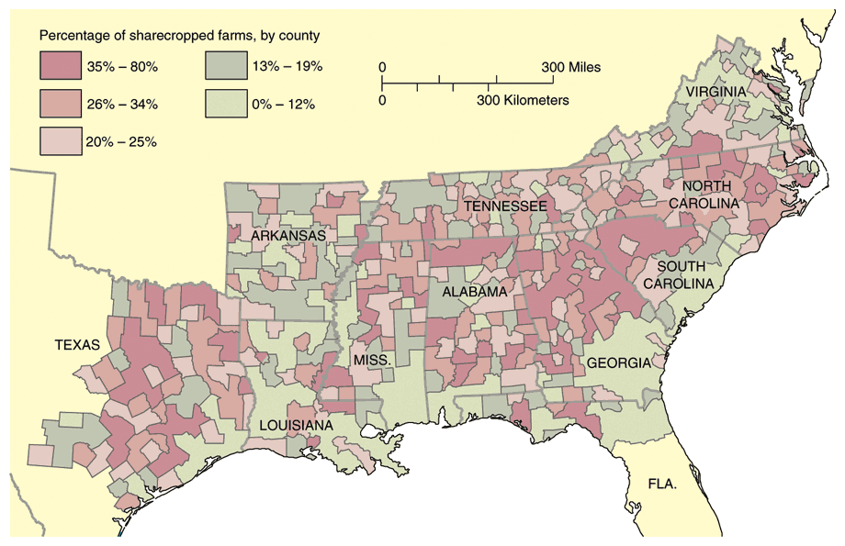
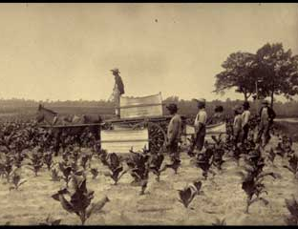
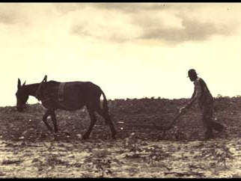
Sharecropping
Problem: families accumulated debt to the landowner before their crop was sold
By the end of 1865, most freedmen had returned to work on the same plantations on which they were previously enslaved!

Slide 6
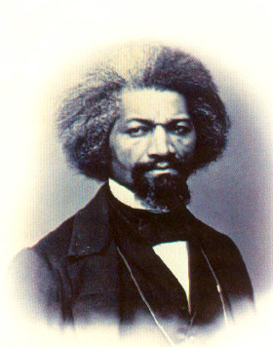
Don’t Copy this slide!
The End is near for Reconstruction
In 1876 Americans flocked to the centennial celebration of the United States in Philadelphia. The telephone and steam engine were introduced at this fair.
Frederick Douglass also spoke at this celebration.
President Grant was reelected for a second term but many Americans began to forget the war and loose faith in the government.
President Grant made poor appointments for public jobs. Many of the appointments were his friends. This led to many PROBLEMS!
Frederick Douglass

Slide 7
Grant then gets re-elected, and this happens…
PANIC of 1873
Caused by too many railroads and factories being formed than existing markets could bear
The over-loaning by banks to those railroad and factory projects
In a nutshell: over-speculation and too much credit!

Slide 8
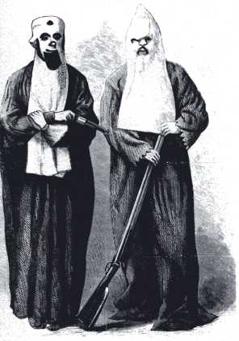
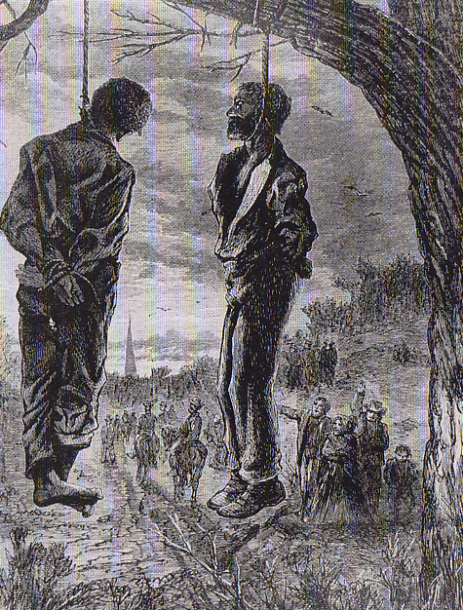
The “Invisible Empire of the South”
Many white Southerners who held power before the Civil War, known as conservatives, wanted the South to change as little as possible.
They were willing to let Africans vote and hold a few offices.
Other Southerners took a harsher view. They spread TERROR to African Americans and anybody who supported them.

Slide 9
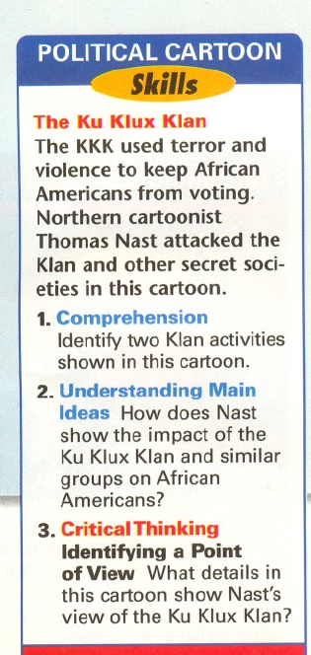
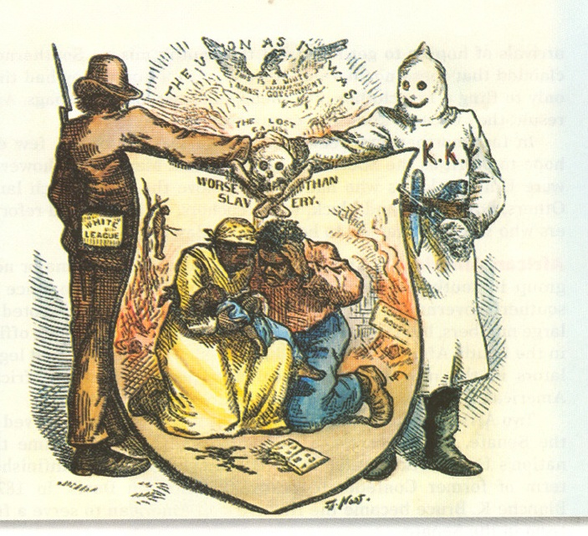
"The Union as it was / The Lost Cause, worse than slavery."

Slide 10
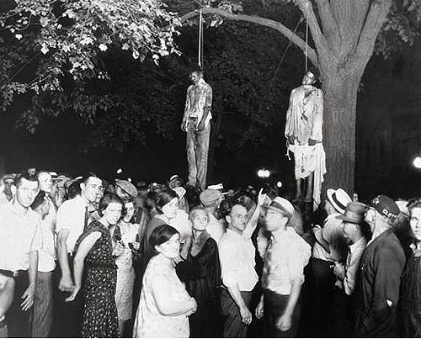

Slide 11
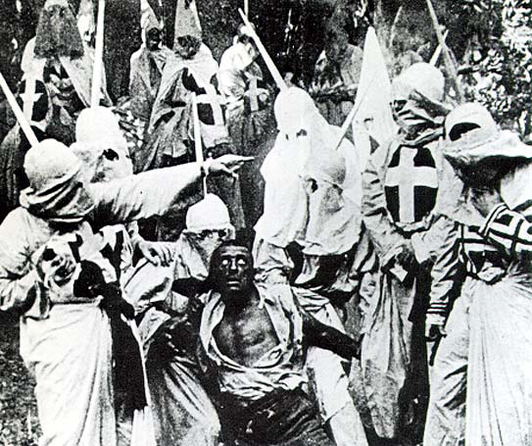
D.W. Griffith’s
The Birth of a Nation
(1915)
VIDEO CLIP

Slide 12
Primary Source Analysis
“Our legislature was composed of a majority of negroes, most of whom could neither read nor write. They were the easy dupes and tools of as dirty a band of vampires and robbers as ever preyed upon a prostrate people.
Life ceased to be worth having on terms under which we were living, and in desperation we determined to take the government away from the negroes...
Clashes came, it was then that we shot them; it was then that we killed them; it was then that we stuffed the ballot boxes.”
Source: Benjamin R. Tillman of South Carolina
(January 21, 1907)
What are Tillman’s reasons for the use of terror?
2. Are Tillman’s reasons acceptable?

Slide 13
ENFORCEMENT ACTS (1870-71)
Banned the use of terror, force or bribery to prevent someone from voting because of their race.
Other laws banned the KKK entirely and brought forth military help to enforce these laws.

Slide 14
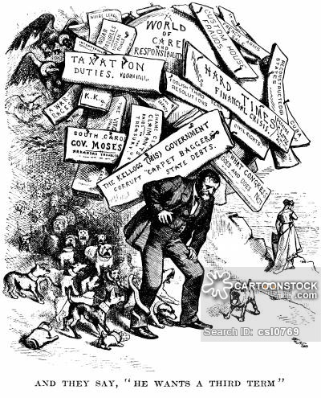
Don’t Copy this slide!
Radical Republicans
in DECLINE
By the 1870’s, Radical Republicans were losing power in Congress.
It was time to forget the Civil War and let southerners run their OWN governments.
By 1876, only THREE southern states – Louisiana, South Carolina, and Florida – were still controlled by Republicans.

Slide 15
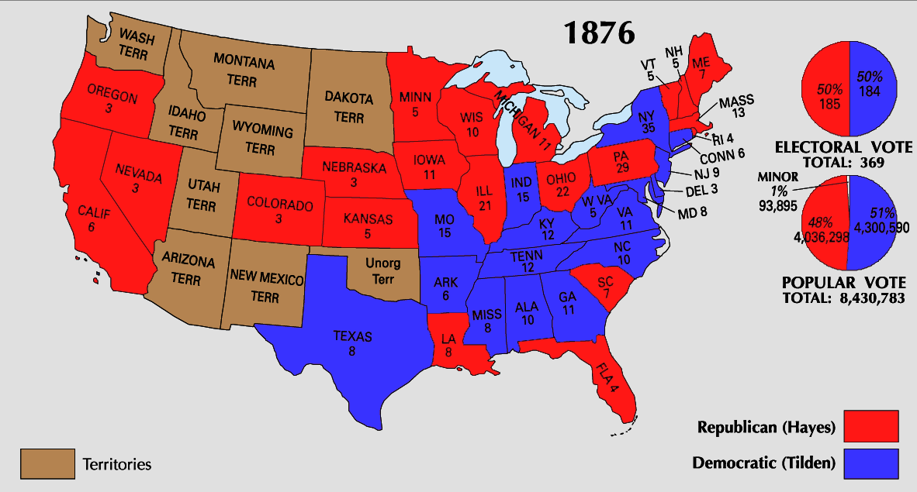
After Hayes wins in the House - Compromise of 1877 = It withdrew federal soldiers from their remaining position in the South, enacted federal legislation that would spur industrialization in the South

Slide 16
The SUCCESSES and FAILURES of Reconstruction
Read through your notes/reading guide and create a two column chart where you record the successes and failures of Reconstruction…
Which column can you fill with MORE information?
Was Reconstruction more of a SUCCESS or FAILURE?
Successes of Reconstruction Failures of Reconstruction

Slide 17
Plessy v. Ferguson Worksheet
HOMEWORK due MONDAY!
(1896) – One of the most important cases of the post – Reconstruction period
1. Read the historical circumstances (background of the case) and write a summary in your notebook.
2. What Constitutional Amendments were used in the argument? Why?
3. Answer questions 1, 2, and 4 from the worksheet.
4. What did the court decide? Why was it significant?

