Slide 1
AIM: How did Lincoln’s election (1860) directly lead to the beginning of the Civil War?

Slide 2
1860 Election: A Nation Coming Apart?!

Slide 3
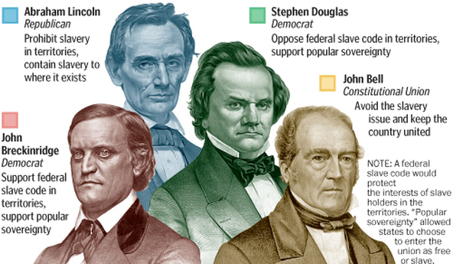
The Election of 1860
Four Candidates!
Abraham Lincoln – Republican
Stephen Douglas – Northern Democrat
John C. Breckinridge – Southern Democrat
John Bell – Constitutional Union Party

Slide 4
Which states in the South voted for Lincoln?
Which states in the North voted against Lincoln
Who did the people in the South vote for?
Why do you think the Democrats were unable to defeat Lincoln?

Slide 5
The South was MAD at the election results,
and how do you think they reacted?
“The excitement was very great. Everybody was talking at the same time...The stake is life or death – No doubt of it.”
– a South Carolina woman after Abraham Lincoln won the Election of 1860
To people in the south, Lincoln’s election mean that the South NO LONGER had a VOICE in the United States government!
Believed Lincoln and Congress were set against SLAVERY!

Slide 6
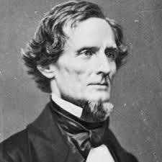
Southern Secession!
In response to Lincoln’s election, the southern states began to secede (leave the US)
South Carolina first!
They form the Confederate States of America – a separate country!
President = Jefferson Davis
Lincoln’s response?
Southern states did not have a right to secede so he must protect the union (USA).

Slide 7
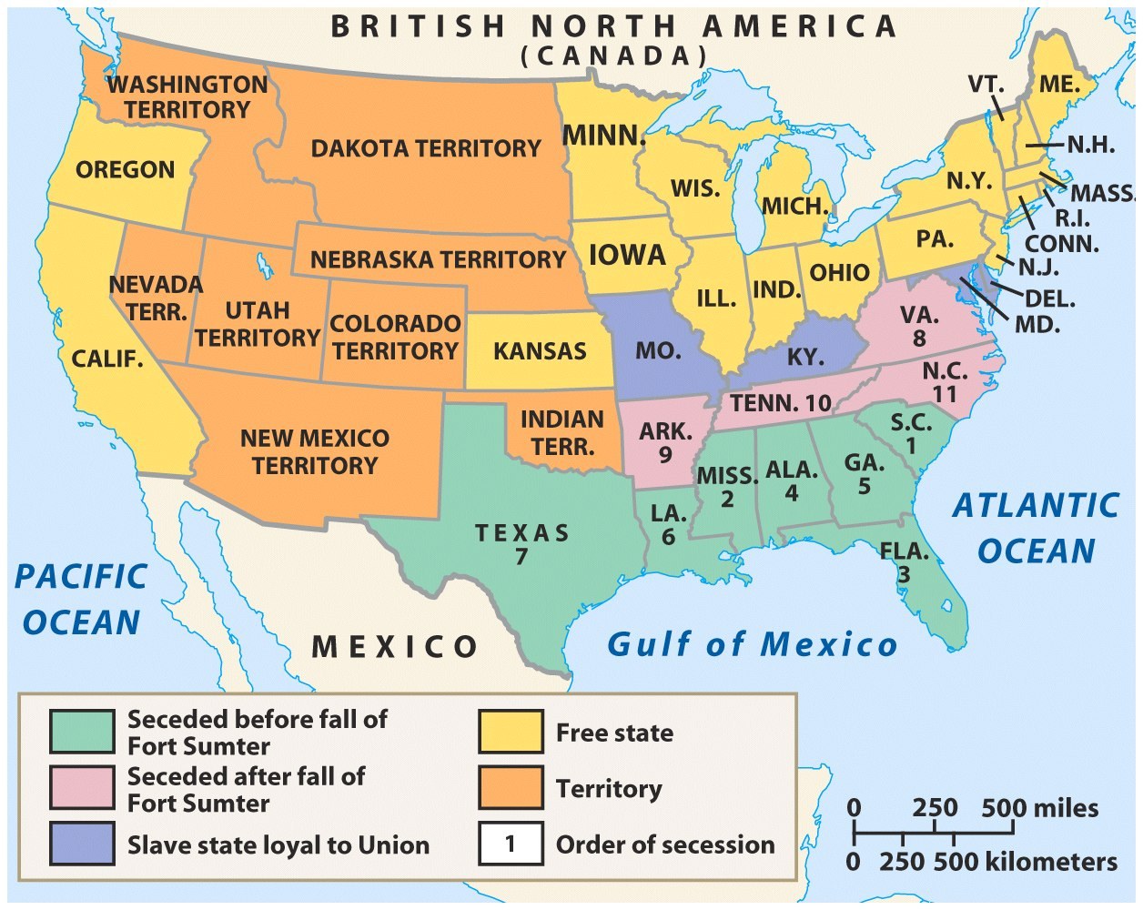
The Upper South did not view Lincoln’s election as a death sentence & did not secede immediately
Some Northerners thought the U.S. would be better off if the South was allowed to peacefully secede
SC seceded on Dec 20,1860
The entire Deep South seceded by Feb 1861
“Lame duck” Buchanan took no action to stop the South from seceding

Slide 8
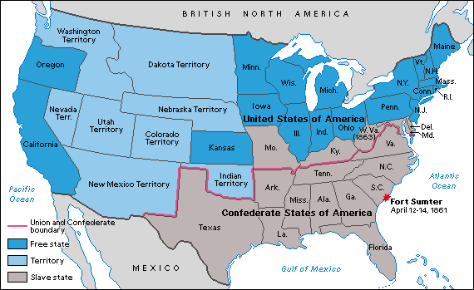
Secession!: SC Dec. 20, 1860
TAKE A PIC!
COPY LATER!
Reasons for secession
1. Emotional- the North wants to establish black rule in the South. Their goal is not equality, but the reversal of roles for the races. 2. Economic- the policies of a Republican president--protective tariffs, free homesteads in the west, etc.--will prevent the South from prospering.
Notes:
– How does the secession play out?
December 1860 – South Carolina legislature unanimously votes to secede after Lincoln’s election
Within next 6 weeks – 6 other states from the lower South follow
Eventually a total of 11 states seceded from the Union and created the Confederate State of America
Buchanan is blamed for not trying to force the states remain in the Union
Southern Secession Documents: Decide depending on length of discussion
What reasons does South Carolina give for Secession?

Slide 9
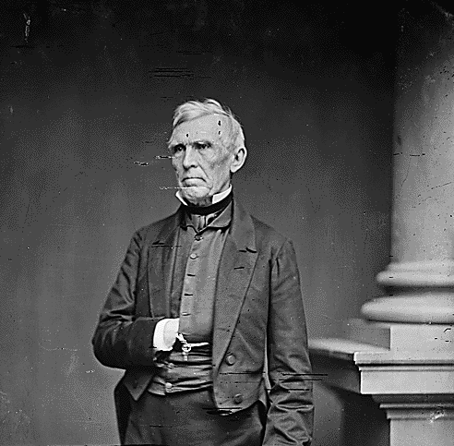
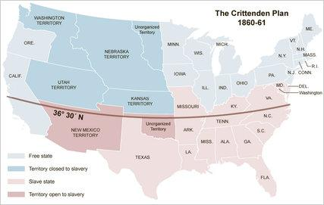
Crittenden Compromise: A Last Ditch Appeal to Sanity and AVOID WAR!
Senator John J. Crittenden (Know-Nothing-KY)
Crittenden Compromise
Bring back the Missouri Compromise line (36 30’N) BUT extend it to the WEST
How do the northerners feel about it?

Slide 10
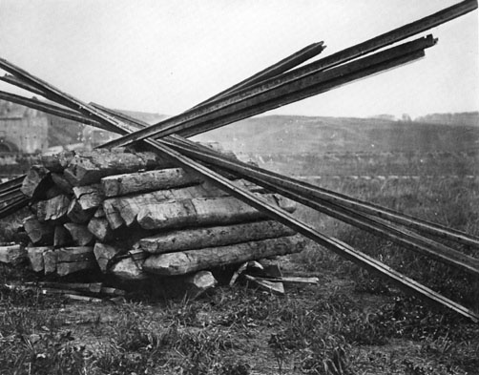
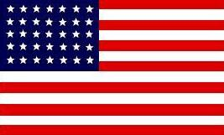
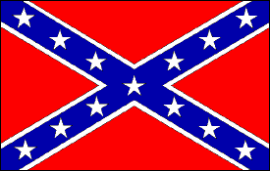
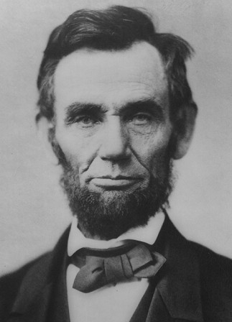
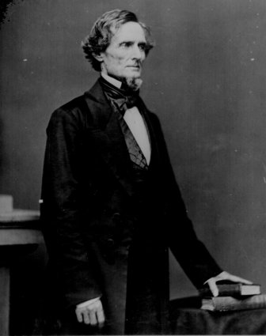
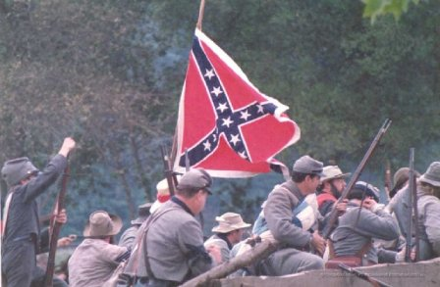
THE CIVIL WAR
1861–1865

Slide 11
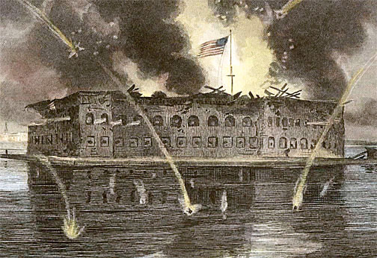
WHERE did the Civil War
BEGIN?

Slide 12
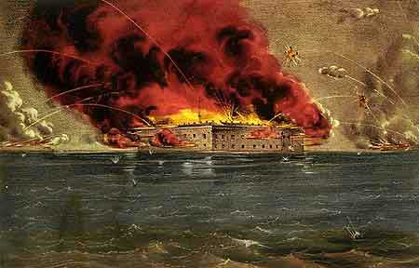
Fort Sumter, South Carolina
In April 1861, a skirmish at Fort Sumter, SC led to the 1st shots fired of the Civil War

Slide 13
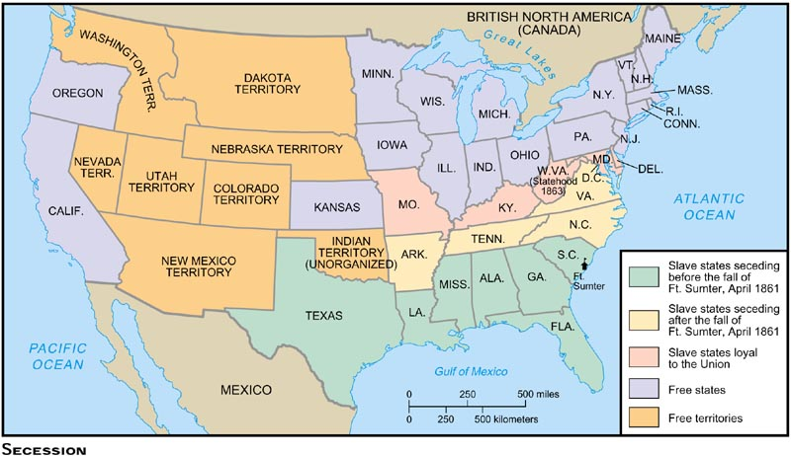
Effects of Fort Sumter
The attack rallied & unified the North for war!
Civil War was not technically between slave states & free states (the “border states” of MO, KY, DE, MD did not secede)
Many pro-slavery border states (Arkansas, TN, NC, & VA) viewed Fort Sumter as an act of aggression by the North & joined the CSA

Slide 14
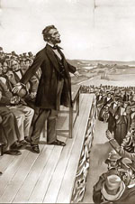
The South is in REBELLION. . .
I need 75,000 militiamen to report for duty NOW!
What was Lincoln’s reaction to the attack on Fort Sumter?

Slide 15
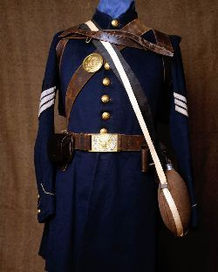
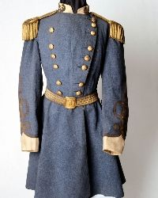
What uniforms did they wear?
At the beginning of the Civil War, states provided uniforms to soldiers; and the uniforms were in a variety of colors. This led to massive confusion on the battlefield, and often soldiers fired on their own men.
Union/USA
Confederates

Slide 16
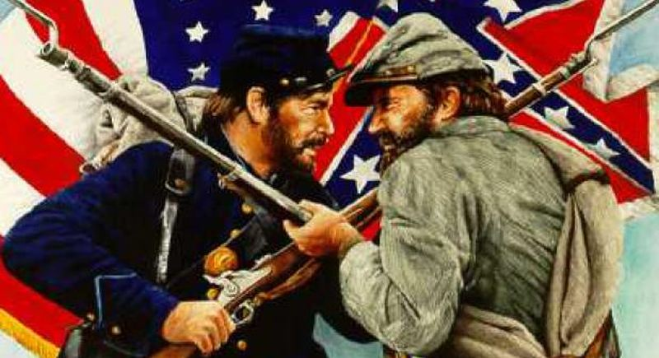
AIM: What factors helped the North turn the tide of the Civil War in 1863 that inevitably led to a Union victory in 1865?

Slide 17
How did both sides adjust to this Total War?

Slide 18
Union
ADVANTAGES
Confederate
ADVANTAGES
Almost 4 times as many free citizens to fight
Many people to grow food and to work in factories making supplies
Had more than 70% of the nation's rail lines
Had a strong navy
Defending their homeland.
Skilled soldiers and leaders
England and France appeared more willing to help the South

Slide 19
Union
DISADVANTAGES
Confederate
DISADVANTAGES
Northern soldiers had to conquer a huge area to bring the South back into the Union
Invading unfamiliar land
Few factories to produce weapons, railroad tracts, and other supplies
Few railroads to move troops and vital supplies
Smaller population
More than 1/3rd were slaves

Slide 20
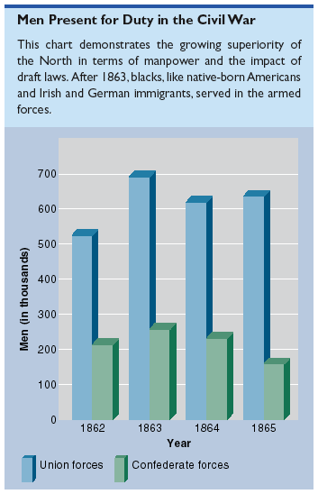
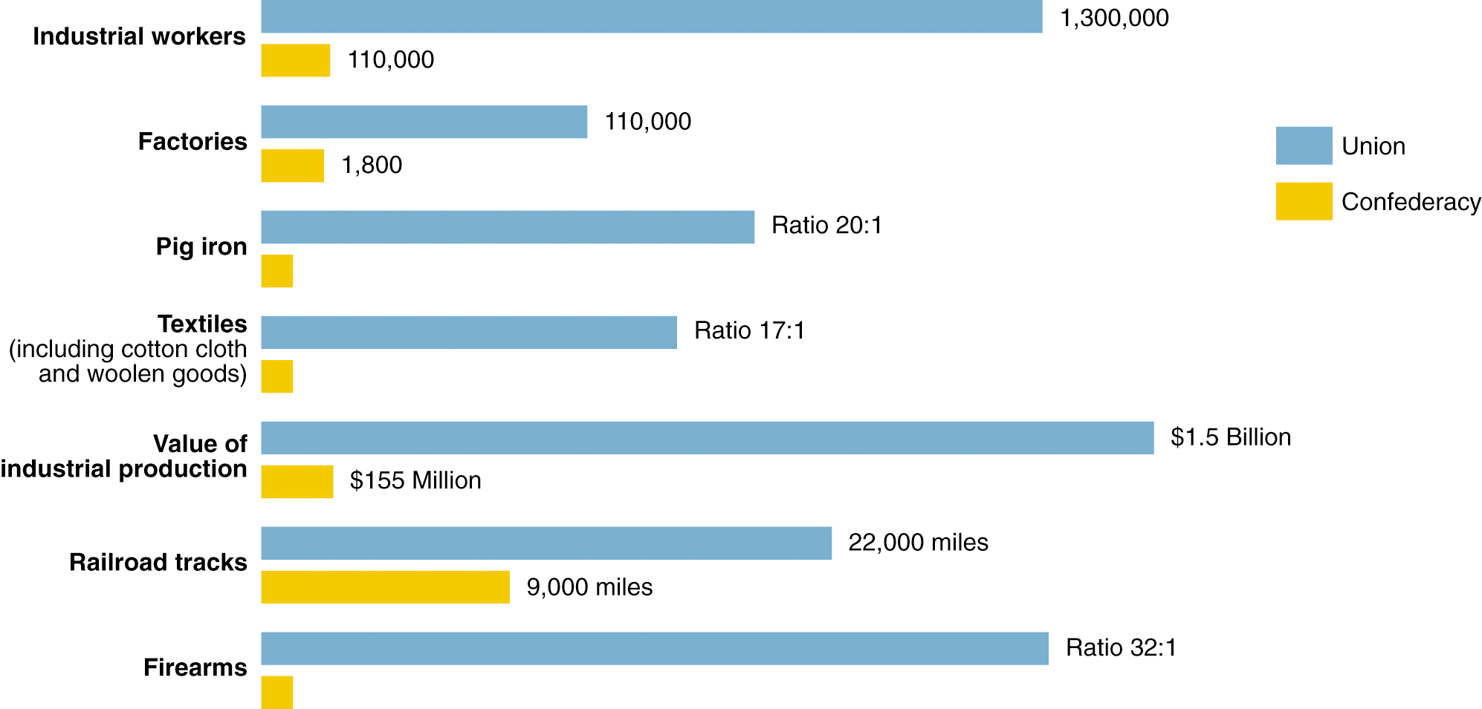
Resources of the Union and the Confederacy, 1861

Slide 21
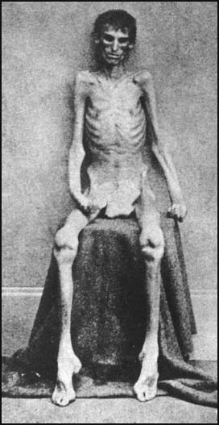
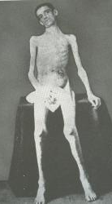
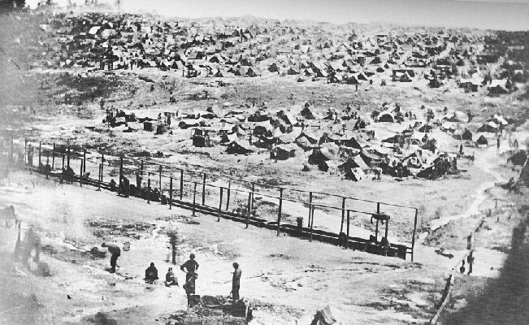
Confederate Prison Camp in Andersonville, GA
Union Prison Camp at Andersonville, GA
Built to hold 10,000 prisoners;
but held more than 32,000 Union POWs

Slide 22
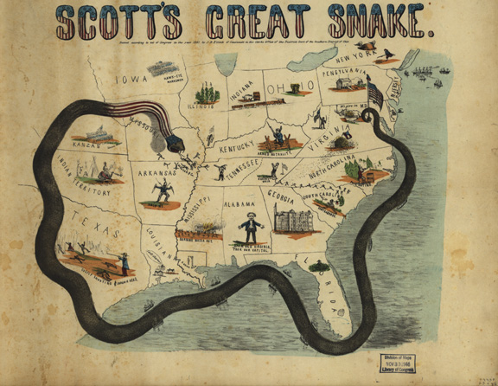
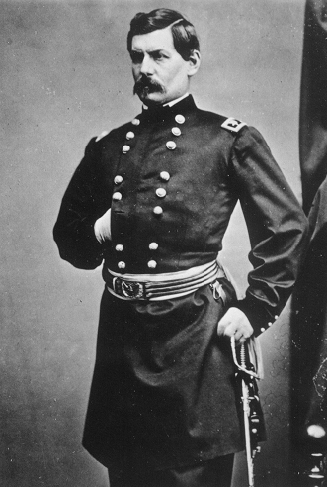
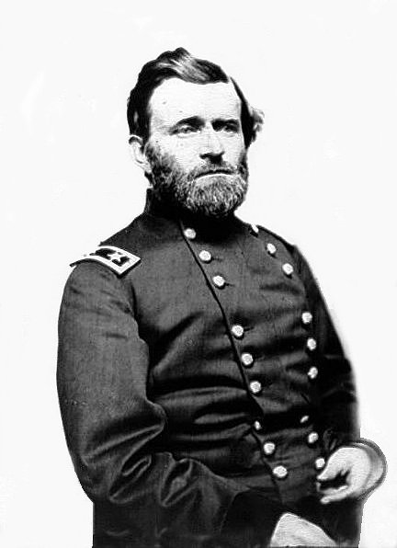
Southern strategy was an “offensive defense”: drag out the war & strategically attack the North to destroy Northern morale
Winfield Scott’s Anaconda Plan
Take the CSA capital at Richmond
Take control of the Mississippi River
George McClellan was in charge of Army of the Potomac
Ulysses Grant in the West
Divide the West from South
Blockade the Southern coast
Notes:
This plan maximized the North’s industrial advantages but required better leadership than North had

Slide 23
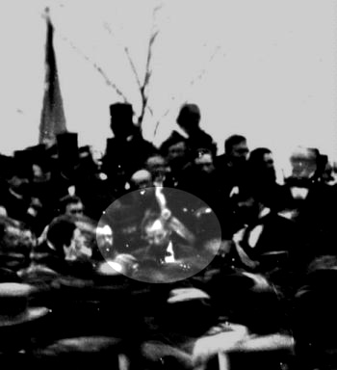
The Turning Point – 1863
The Battle of Gettysburg – tide turns, but at a tremendous loss of life.
The Gettysburg Address
Abraham Lincoln delivered this famous speech on November 19, 1863, to a crowd gathered at the dedication of Soldier’s National Cemetery in Gettysburg, Pennsylvania. The speech contains only two hundred seventy-two words, but it is considered one of the greatest speeches in American history.

Slide 24
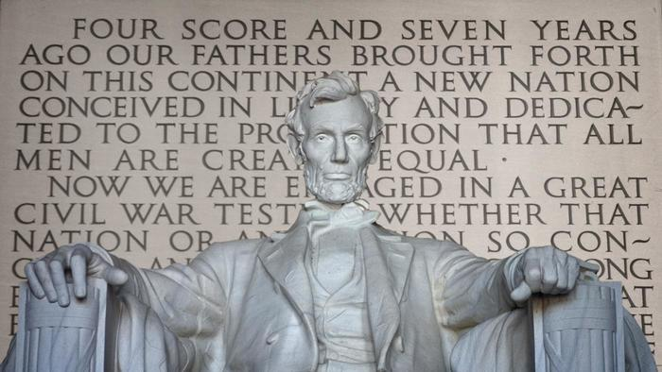
Document Analysis
Gettysburg Address VIDEO
What does Lincoln want Americans to do?
What is Lincoln’s main message?

Slide 25
Abraham Lincoln, The Gettysburg Address (1863)
Main Points:
It is time we talk about the promise of equality.
“…a new nation, conceived in liberty, and dedicated to the proposition that all men are created equal”
We honor the soldiers sacrifice.
“The world will little note, nor long remember what we say here, but it can never forget what they did here.”
“It is rather for us to be here dedicated to the great task remaining before us”
The Union is worth fighting for.
“—that this nation, under God, shall have a new birth of freedom and that government of the people, by the people, for the people shall not parish from the earth.”

