Slide 1
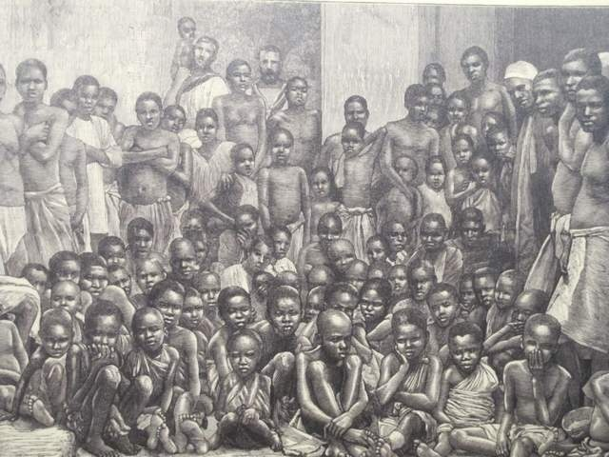
Slavery in American History (1619-1865)

Slide 2
Slavery in American History
In 1619, the 1st African slaves were introduced in the colonies
By 1660, slave labor replaced indentured servitude as the main colonial labor system:
Slaves worked on tobacco & rice plantations in Southern colonies
Slaves worked as domestic servants in Northern colonies

Slide 3
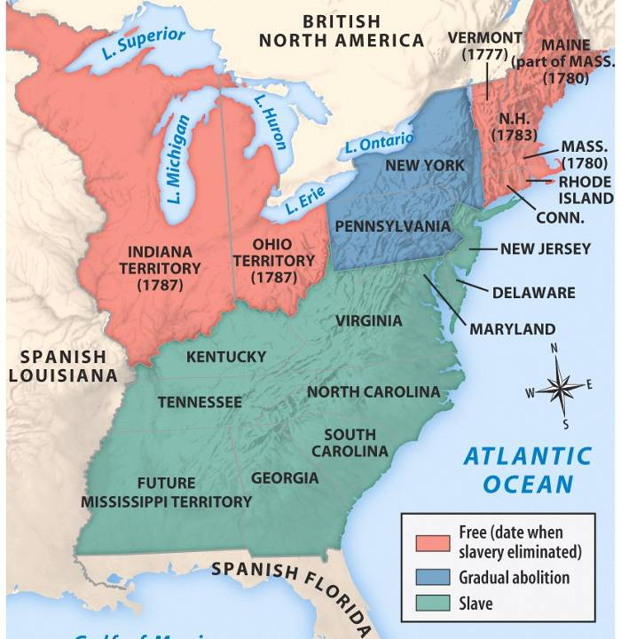
Before the American Revolution, slaves were present in each of the 13 colonies
But, the Founding Fathers did not abolish slavery
The Revolutionary War (1776-1783) changed attitudes towards slavery
By 1804, 9 outlawed slavery
In 1808, the USA outlawed the African slave trade
The Northwest Ordinance (1787), outlawed slavery

Slide 4
Slavery in American History
From 1800 to 1860, sectional tension increased in America as slavery expanded into the West
“King Cotton” became dominant & increased slavery in the South
During Manifest Destiny, slavery tensions increased as Texas & the Mexican Cession were added
The Compromises of 1820 & 1850 only temporarily settled the issue

Slide 5
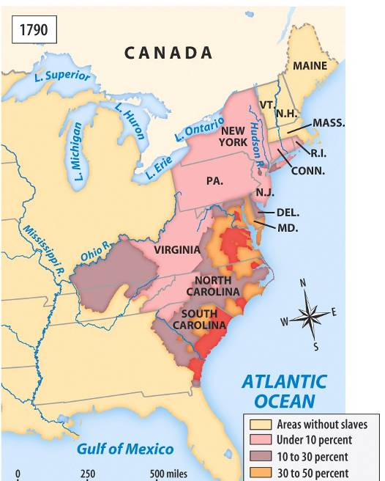
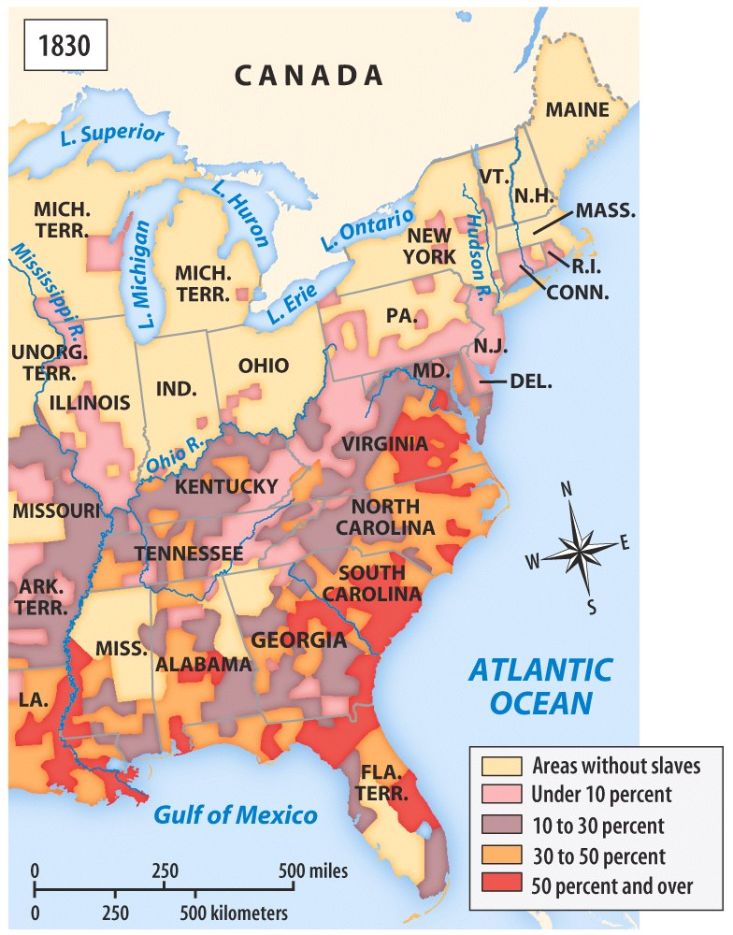
From 1800 to 1860, sectional tension increased as slavery expanded into the West
“King Cotton” became dominant & increased slavery in the South
1790
1830

Slide 6
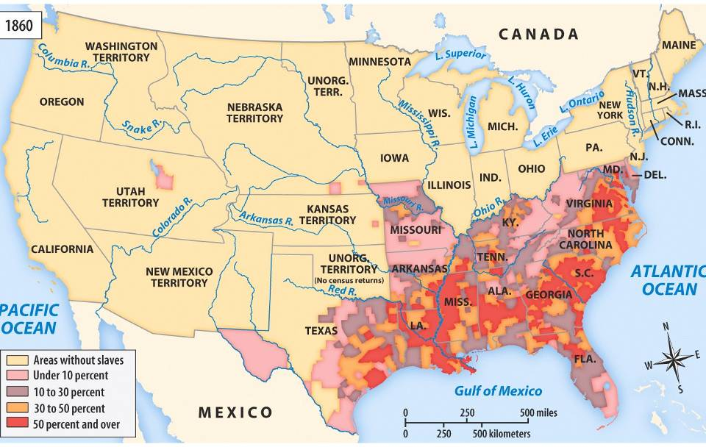
Slavery in America, 1860
From 1800 to 1860, sectional tension increased as slavery expanded into the West
Abolitionists like William Lloyd Garrison, Frederick Douglass, & Harriet Beecher Stowe attacked slavery
The Compromises of 1820 & 1850 only temporarily settled the issue
During Manifest Destiny, tensions over slavery increased as Texas & the Mexican Cession were added
Sectional events led to Civil War: Bleeding Kansas, Dred Scott case, John Brown’s Raid, Election of Lincoln in 1860
1860

Slide 7
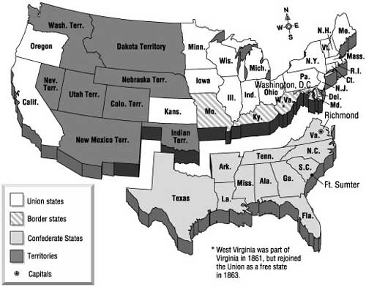
Lincoln issued the Emancipation Proclamation in 1863 which made the Civil War about slavery

Slide 8
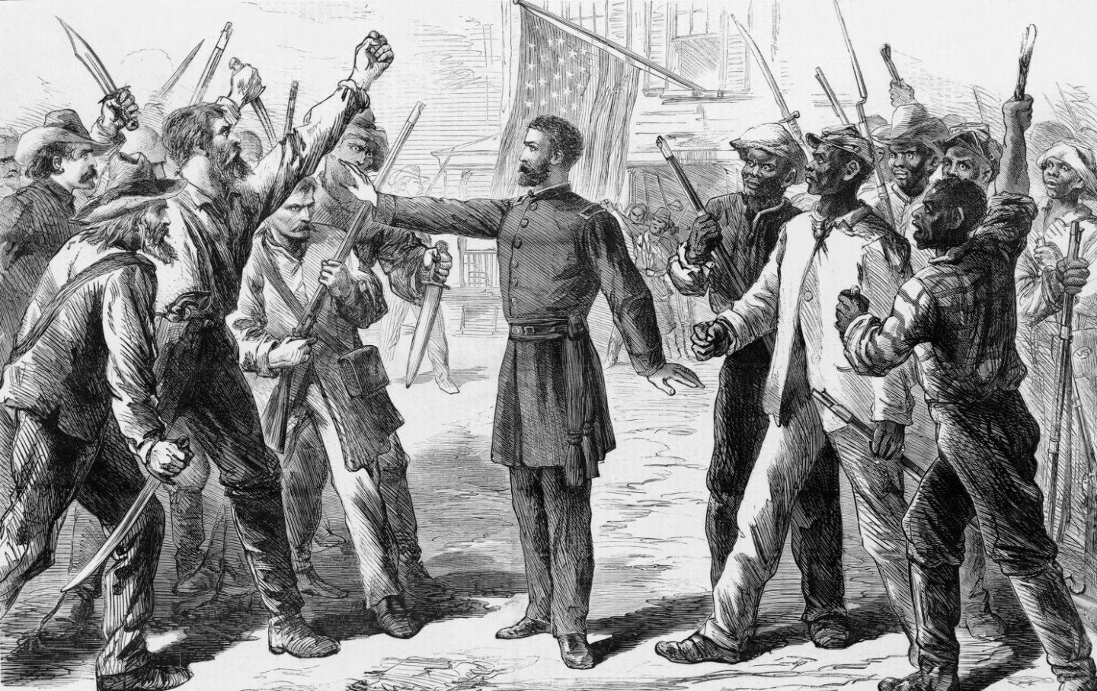
Reconstruction & the Jim Crow Era (1865-1954)

Slide 9
The Union victory in the Civil War led to the:
13th Amendment (ended slavery)
14th Amendment (citizenship for freedmen)
15th Amendment (voting rights for freedmen)
Freedman’s Bureau & Reconstruction Act
The South responded with the KKK & black codes; Reconstruction ended in 1877

Slide 10
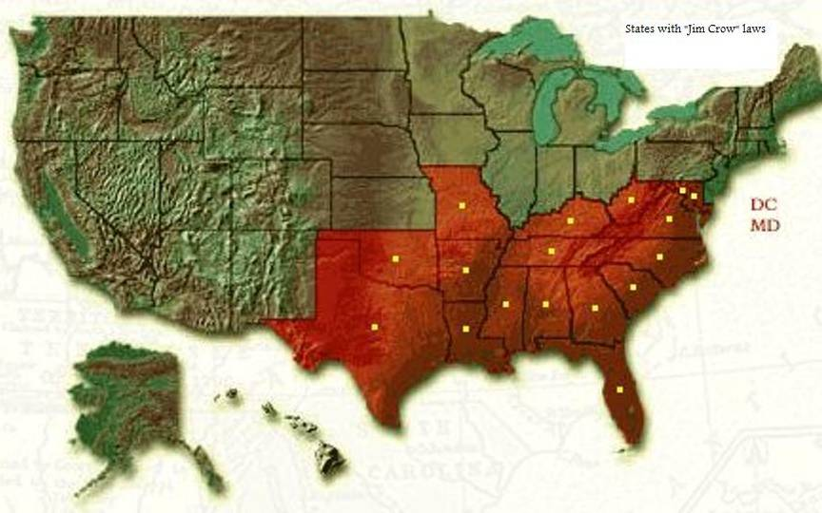
States with Jim Crow Laws
Jim Crow laws created segregation
Poll taxes, literacy tests, & grandfather clauses
Most blacks were sharecroppers
Civil rights leaders WEB DuBois & Booker T Washington fought against segregation laws; the NAACP was formed to help African Americans
In 1896, the Supreme Court declared “separate but equal” in the Plessy v Ferguson case

Slide 11
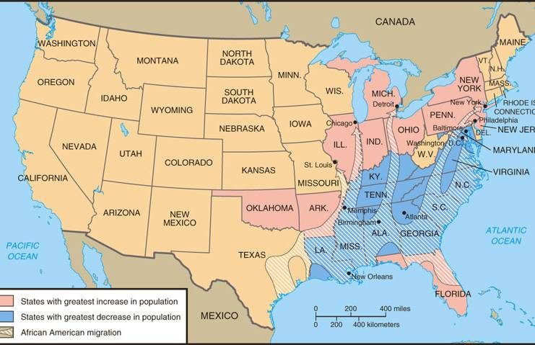
World War I & the 1920s
During WWI, the Great Migration led African American workers into the North; Black soldiers fought in segregated units
In the 1920s, African Americans experienced the Harlem Renaissance
In the 1930s, FDR’s New Deal discriminated against black workers

Slide 12
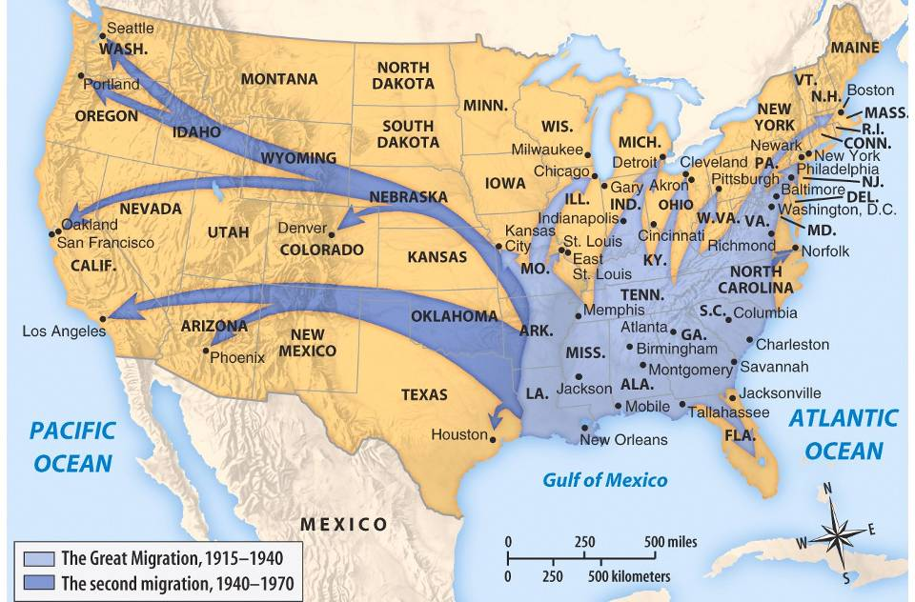
World War II
FDR pressured to create the Fair Employment Practices Commission
prohibiting employment-related discrimination practices by federal agencies, unions, and companies involved in war-related work
In WWII, the Great Migration helped break sharecropping in the South

Slide 13
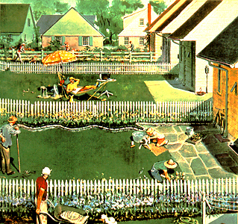
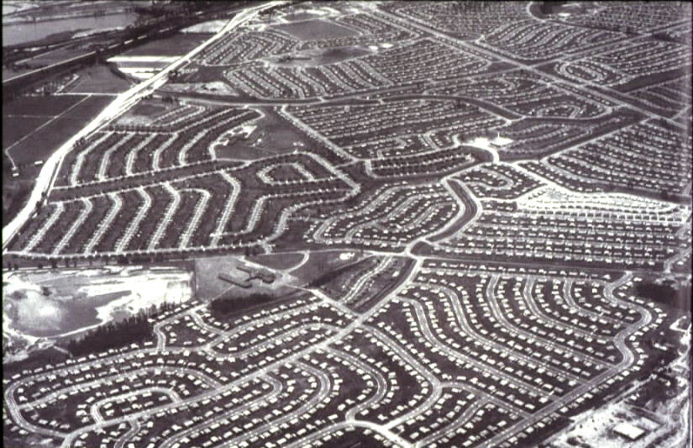
In the 1950s, white flight to the suburbs & Jim Crow laws left the U.S. segregated

Slide 14
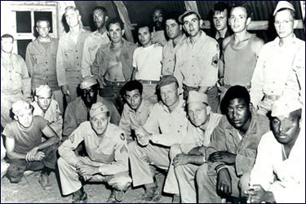
EARLY Successes in modern Civil Rights
In 1948, Truman became the 1st president to attack segregation:
Truman issued an executive order to integrate the military
He outlawed discrimination in the hiring of government employees
In 1947, Jackie Robinson was the 1st black major league baseball player

