Slide 1
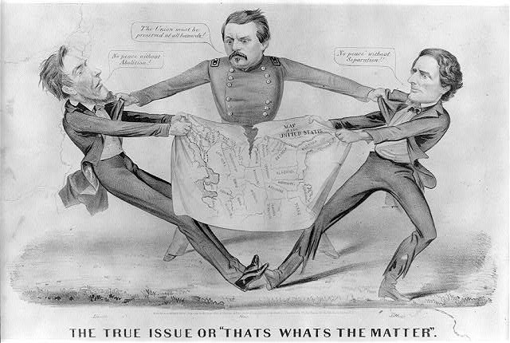
Aim: What was the most significant event leading up to the Civil War?

Slide 2
The result?

Slide 3
1856 Presidential Election
James Buchanan John C. Frémont Millard Fillmore Democrat Republican Know-Nothing
Who do you think is going to win?
Notes:
Pojer

Slide 4
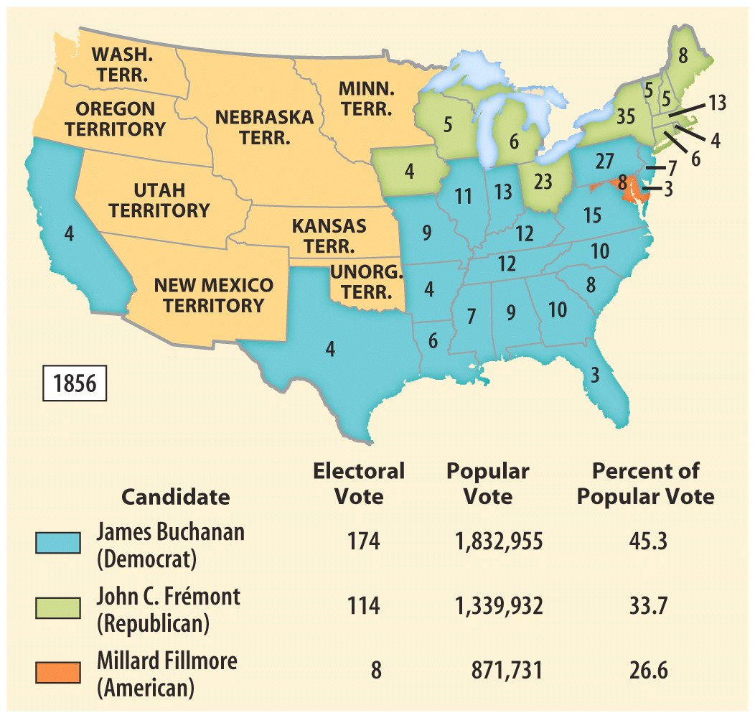
1856 Presidential
Election Results
But what do you notice about Fremont and the Republicans?
What does this tell you?
Notes:
Pojer

Slide 5
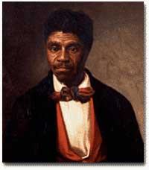
Dred Scott Decision 1857
Dred Scott v. Sandford heard by Supreme Court
Court ruled Scott was NOT a citizen and therefore, could NOT sue for his freedom
Increases abolitionist causes to end slavery
VIDEO
Why do you think this case been called “the Court's greatest self-inflicted wound”?

Slide 6
Outcomes of Dred Scott decision?
Angered millions of abolitionists against slavery and even those who didn’t care much about it!
Northerners complained; Southerners were ecstatic about the decision but ANGERED by northern defiance!
North
South
Had only Congress (which was now banned from outlawing slavery).
Had (1) the Supreme Court, (2) the president, and (3) the Constitution on its side

Slide 7
Panic of 1857
TAKE A PIC!
COPY LATER!
CAUSES:
California gold causing inflation
over-growth of grain,
over-speculation, as always, this time in land and railroads.
The North was especially hard hit, but the South rode it out with flying colors, seemingly proving that cotton was indeed king and raising Southern egos.
Also, in 1860, Congress passed a Homestead Act that would provide 160 acres of land at a cheap price for those who were less-fortunate, but it was vetoed by Buchanan.
This plan, though, was opposed by the northeast, which had long been unfriendly to extension of land and had feared that it would drain its population even more, and the south, which knew that it would provide an easy way for more free-soilers to fill the territories.
The panic also brought calls for a higher tariff rate, which had been lowered to about 20% only months before.

Slide 8
Lincoln – Douglas Debates 1858
The race for the Illinois senate!
Stephen Douglas – incumbent Senator
Abraham Lincoln – Congressman
Lincoln challenges Douglas to debates about slavery
Slavery was a “MORAL, SOCIAL, AND POLITICAL WRONG”
Gradually eliminate it
Slavery and freedom solved with POPULAR SOVEREIGNTY

Slide 9
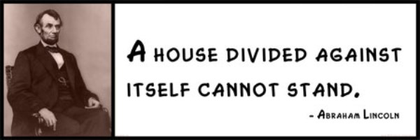
What are Lincoln’s views regarding the slavery in the US?
Going back to the DO NOW…
Why do you think Lincoln’s ideas scared Southerners?
Notes:
Excerpt Source:
The American Pageantry: Ninth Edition, p. 419
Lincoln expressed his view on the relation of the black and white races in 1858, in a debate with Stephen Douglas: “I, as well as Judge Douglas, am in favor of the race to which I belong, having the superior position. I have never said anything to the contrary, but I hold that notwithstanding all this, there is no reason in the world why the negro is not entitled to all the national rights enumerated [listed] in the Declaration of Independence, the right to life, liberty and the pursuit of happiness. I hold that he is as much entitled to those rights as the white man. I agree with judge Douglas he is not my equal in many respects- certainly not in color, perhaps not in moral or intellectual endowment. But in the right to eat the bread, without leave of anybody else, which his own hand earns, he is my equal and the equal of Judge Douglas, and the equal of every living man” (First Lincoln-Douglas Debate, Ottawa, Illinois, August 21 1858)

Slide 10
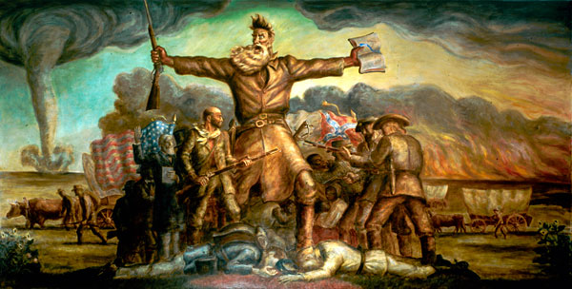
“A Tragic Prelude (Introduction)” – Painting of abolitionist John Brown

