Slide 1
Results of the F & I War
British:
acquired more land
became a world-wide “super power”
grew resentful of colonial “blundering” and the cost of defending the colonies

Slide 2
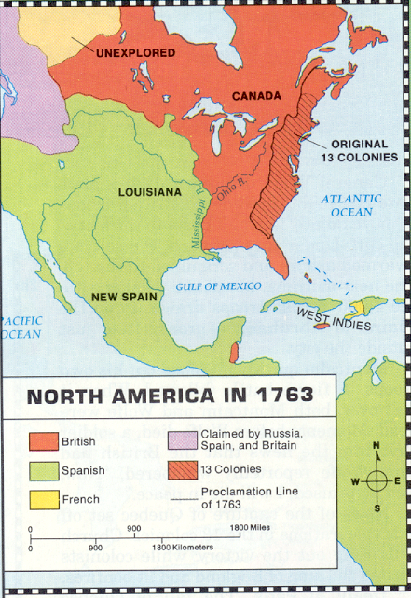
Results of the F & I War
French:
lost almost all land in North America
no longer important in American development
Native Americans:
continued to lose control over land in North America

Slide 3
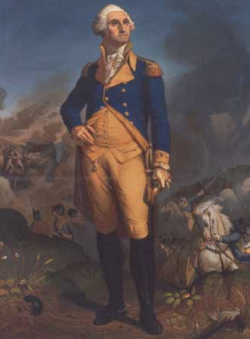
Results of the F & I War
Colonists:
acquired land to expand
gained valuable military experience
found their first “American” hero…Washington
learned how to cooperate
began to think of themselves as “Americans”

Slide 4
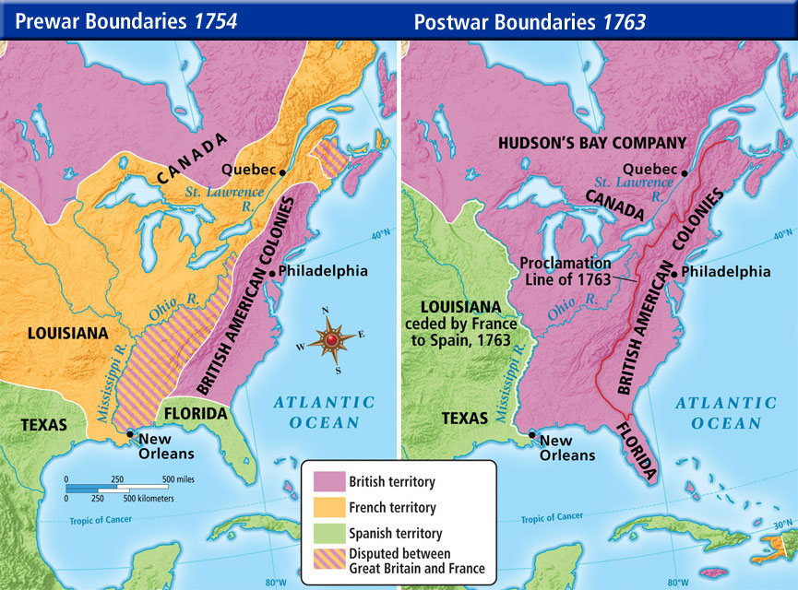
Following the French and Indian War…
The end of the French and Indian War in 1763 was a cause for great celebration in the colonies!
  Expand to the great western frontier
  It had opened to them when the French ceded the contested Ohio River territory to the British.

Slide 5

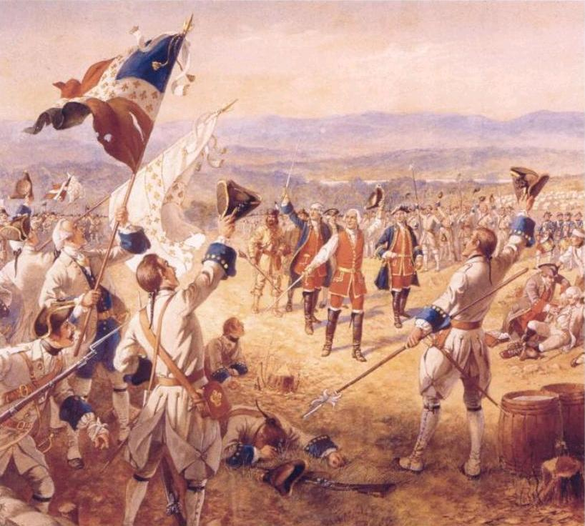
Britain's Financial Problems
BUT by 1763, the British were in trouble!
war debts – the British had fought 4 wars between 1689 and 1763, and they expected the colonists to help pay!
defense costs – lands expanding, and they needed to be protected
conflict over lands west of the Appalachian Mountains – this will lead to the passage of a number of “acts” by the British

Slide 6
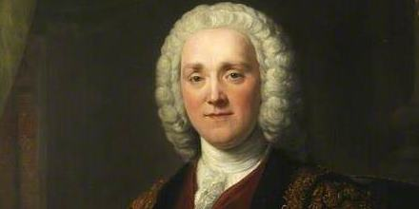

A man named George Grenville became the Prime Minister, but ignored the interests of the colonists…
He asked Parliament to tax the colonists to get money back!
“Why shouldn’t these
colonists begin to pay some of the
costs of their own government
and defense?”

Slide 7
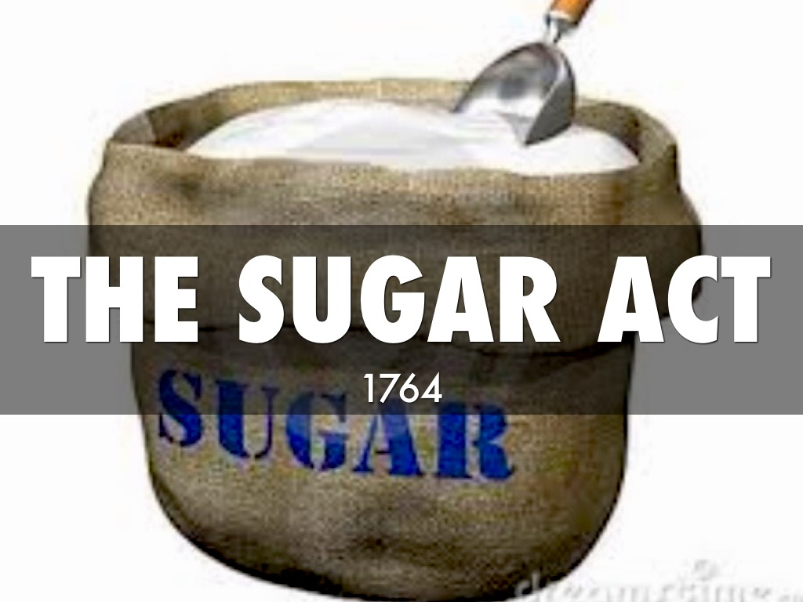


The First Wave of Taxes
In 1764, Parliament passed the Sugar Act, which taxed molasses and sugar that was imported by the colonists.
  Because of corruption, they mostly evaded the taxes and undercut the intention of the tax (smuggling)
  The act also listed more foreign goods to be taxed including sugar, certain wines, coffee, pimiento, and further, regulated the export of lumber and iron.

Slide 8
The Currency Act
1764
The colonies suffered a constant shortage of currency with which to conduct trade.
  There were no gold or silver mines and currency could only be obtained through trade as regulated by Great Britain.
The Currency Act of 1764 prohibited all American colonies from issuing paper currency, thereby creating severe monetary problems.

Slide 9
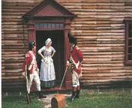
The Quartering Act
1765
The Quartering Act of 1765 was intended to help the British defray the cost of maintaining troops in America.
The Act required that the colonists had to supply British troops with food, munitions and barracks
The Act was bitterly resented by the Americans
  WHY? Because the troops were used to enforce Parliament’s new tax policies in the colonies;
  the negative effect this had on American emotions.

Slide 10
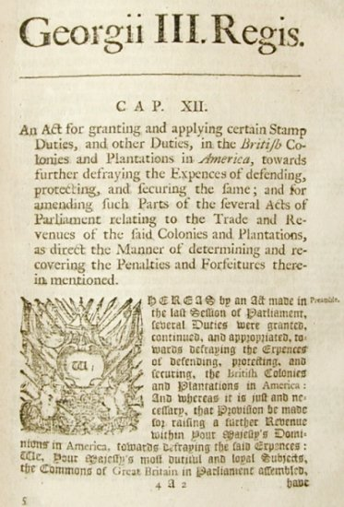
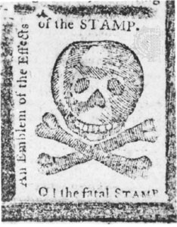
King George III and the British Parliament then decided to issue the Stamp Act in 1765, which placed a tax on legal documents such as newspapers, contracts, birth certificates, diplomas, and cards.
This tax helped the British tax the colonists DIRECTLY on everyday items
In reaction to the Stamp Act, the colonists demanded “no taxation without representation” and called the act unconstitutional.
illegal

Slide 11
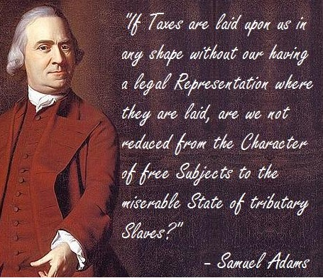
At a Boston town meeting in 1764, a local leader named Samuel Adams believed that Parliament could NOT tax the colonists without their permission.
He coined the phrase “no taxation without representation”
He helped found the Committees of Correspondence
each committee got in touch with other towns and colonies
shared ideas and challenge British laws!
What is Adams
saying here?

Slide 12
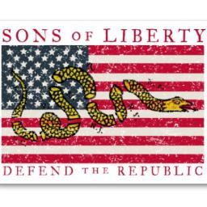
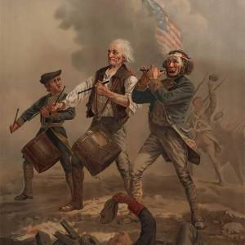
The Sons of Liberty are Formed
Protests against the Stamp Act began almost immediately!
Colonists formed a secret society known as the Sons of Liberty (organized by Samuel Adams)
  They sometimes used violence to frighten tax collectors
  Many colonial courts shut down because colonists refused to buy the stamps required for legal documents

Slide 13
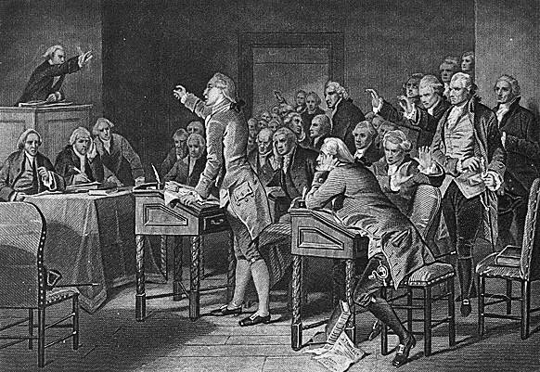
The Stamp Act Congress
The Stamp Act Congress was a meeting held between October 7 and 25, 1765 in New York City.
It consisted of representatives from 9 of the British Colonies in North America.
The objective of the representatives was to devise a unified protest against new British taxation - specifically the Stamp Act of 1765.

Slide 14
What was accomplished at the
Stamp Act Congress?
The delegates of the Stamp Act Congress drew up a "Declaration of the Rights and Grievances of the Colonists”.
In this document they declared that:
As subjects of the British king, they had the same rights as British subjects living in Britain
Only the colonial assemblies had a right to tax the colonies (no taxation without representation!!!)
They were free from taxes except those to which they had given their consent
They had the right of trial by jury

Slide 15
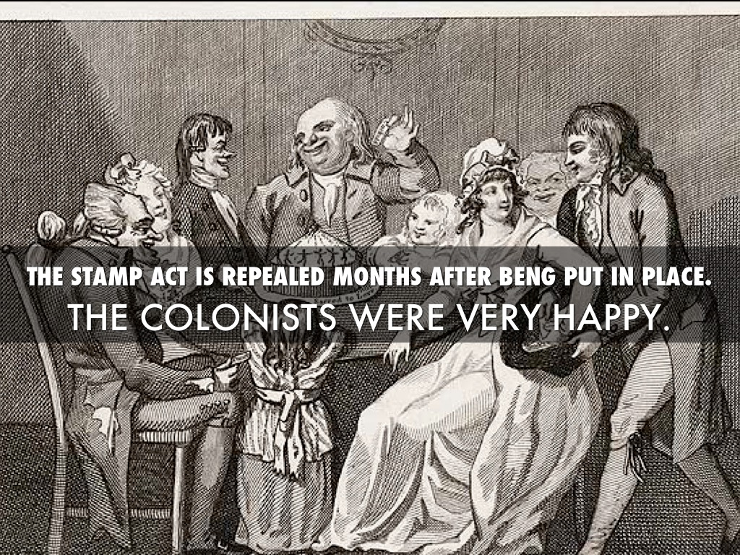
The Stamp Act is
REPEALED!

Slide 16
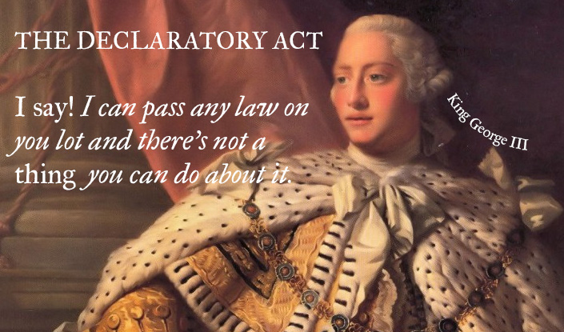
BUT on the same day in 1766, the Declaratory Act was issued by the British Parliament…
This act stated that the British Parliament had the power to make laws for the colonies.
Parliament “had, hath, and of right ought to have, full power and authority to make laws and statutes of sufficient force and validity to bind the colonies and people of America, subjects of the Crown of Great Britain, in all cases whatsoever.”

Slide 17
The Townshend Acts
BRING BACK ANGER!
Taxes on everyday items such as glass, paint, oil, lead, paper, and tea…
  Designed to raise £40,000 a year
  For the administration of the colonies
The result was the resurrection of colonial hostilities created by the Stamp Act.
“The Townsend Duties Crisis was never resolved. It culminated in the Boston Tea Party, that triggered off the final sequence of events leading to the War of American Independence.”
    Peter D.G. Thomas, The Townsend Duties Crisis

Slide 18
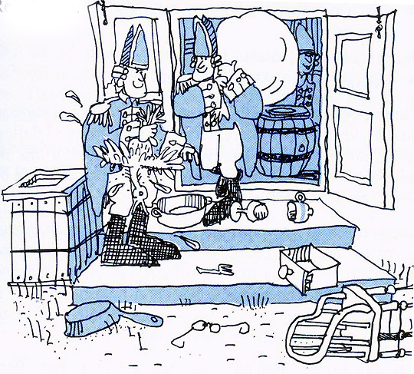
The writs of assistance were also created in order to enable British officials to search for smuggled goods that belonged to colonial merchants.

