Slide 1
Setting the Scene…
Times had taken a sharp turn for the worse. Lexington and Concord had changed everything. When the Redcoats fired into the Boston crowd in 1775 causing a “massacre”, the benefit of the doubt was granted.
Now the professional British army was attempting to arrest patriot leaders, and minutemen had been killed in their defense.
In May 1775, with Redcoats once again storming Boston, the Second Continental Congress convened in Philadelphia.

Slide 2
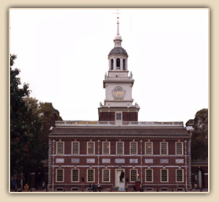
The early war effort
In May 1775, Second Continental Congress met to direct the war…
All 13 colonies present
Level out grievances (complaints)
NOT demanding independence
DEFENSE = first priority
Insisted on rights of colonists
Philadelphia State House (Independence Hall)
Advisory body governing body of America

Slide 3
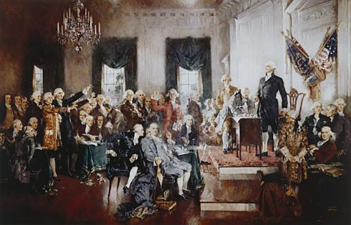
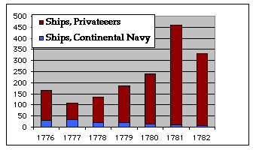
Second Continental Congress (1775) What did they accomplish?
Continental Army - George Washington
Declaration of the Causes and Necessity of Taking Up Arms
Olive Branch Petition = attempt at PEACE
Ambassadors to France, Spain, Netherlands = military/economic support in case of war
Created a navy
Privateers (ships) = attack British ships

Slide 4
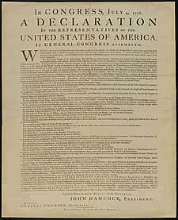
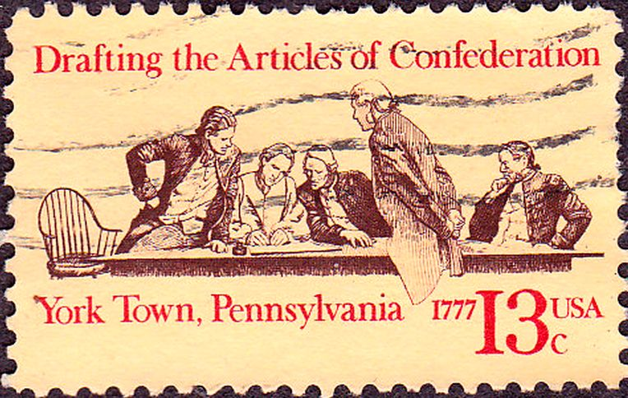
In the near future, what else is the Second Continental Congress going to do?
Authorize and sign the Declaration of Independence
Adopt the Articles of Confederation

Slide 5
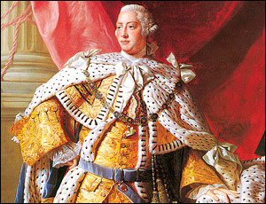
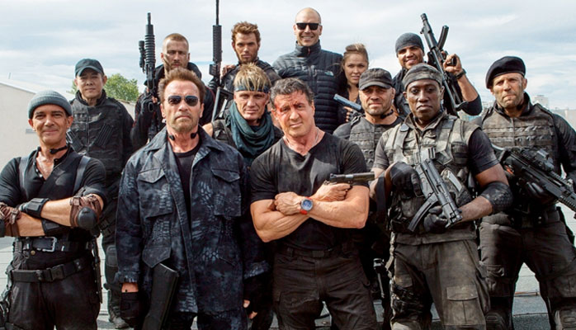
The King refuses the plan of the Second Continental Congress (especially the Olive Branch Petition)
Proclamation of Rebellion – asked loyal subjects to oppose the rebellion
Naval blockade
10,000 German (Hessian) mercenaries to control/fight in colonies
Americans now felt less and less like their English brethren. How could their fellow citizens order a band of ruthless, foreign goons, to fight them?
That will
never work!
I REFUSE!!!
VIDEO

Slide 6
Talking Point
To prevent the American Revolution from growing even larger, King George might have considered the colonists' Olive Branch Petition.
Why did you think he refused to listen to it? Should he have listened to it?

Slide 7
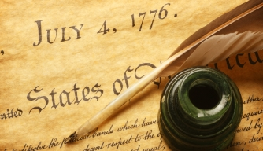
Where do the colonists go from here?
As the seasons changed and hostilities continued, cries for independence grew stronger. The men in Philadelphia were now wanted for treason. They continued to govern and hope against hope that all would end well. For them, the summer of 1776 brought the point of no return — a formal declaration of independence.

Slide 8
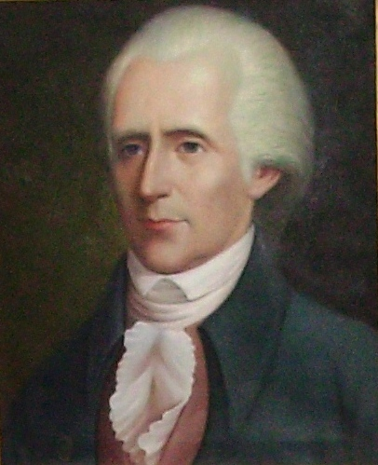
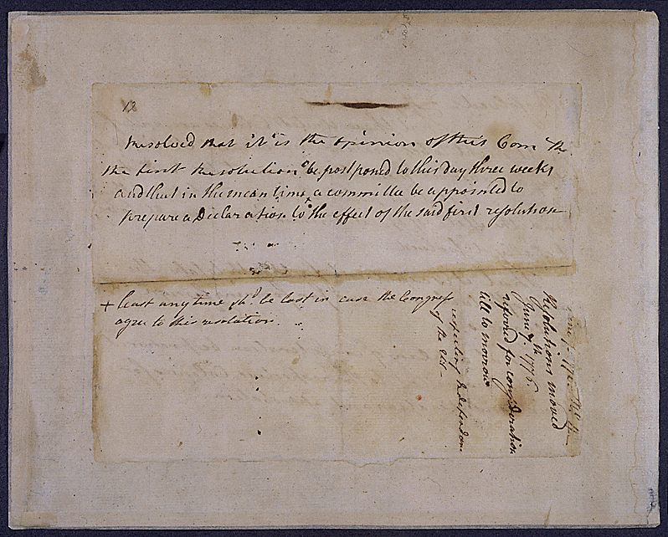
April 1776
North Carolina wants INDEPENDENCE!
Virginia followed, continued the debate
Richard Henry Lee (VA) – “these United Colonies are, and of right, ought to be, free and independent states!” (Lee’s Resolution)

Slide 9
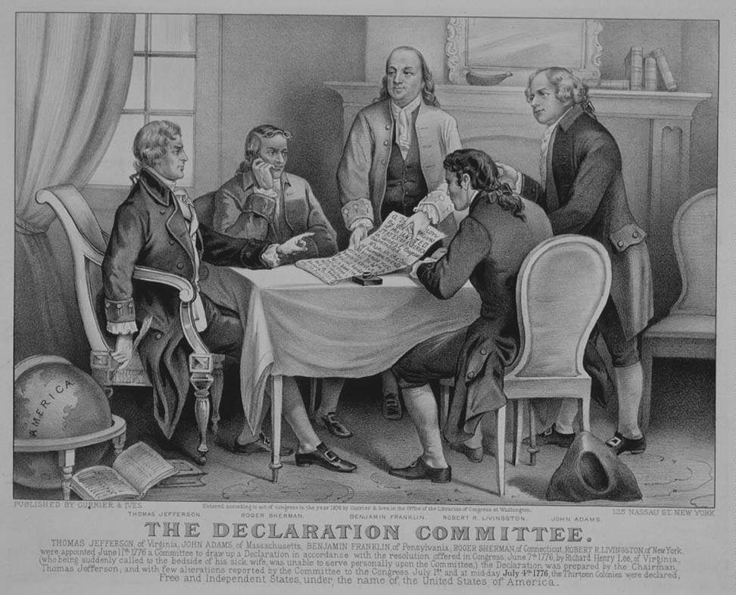
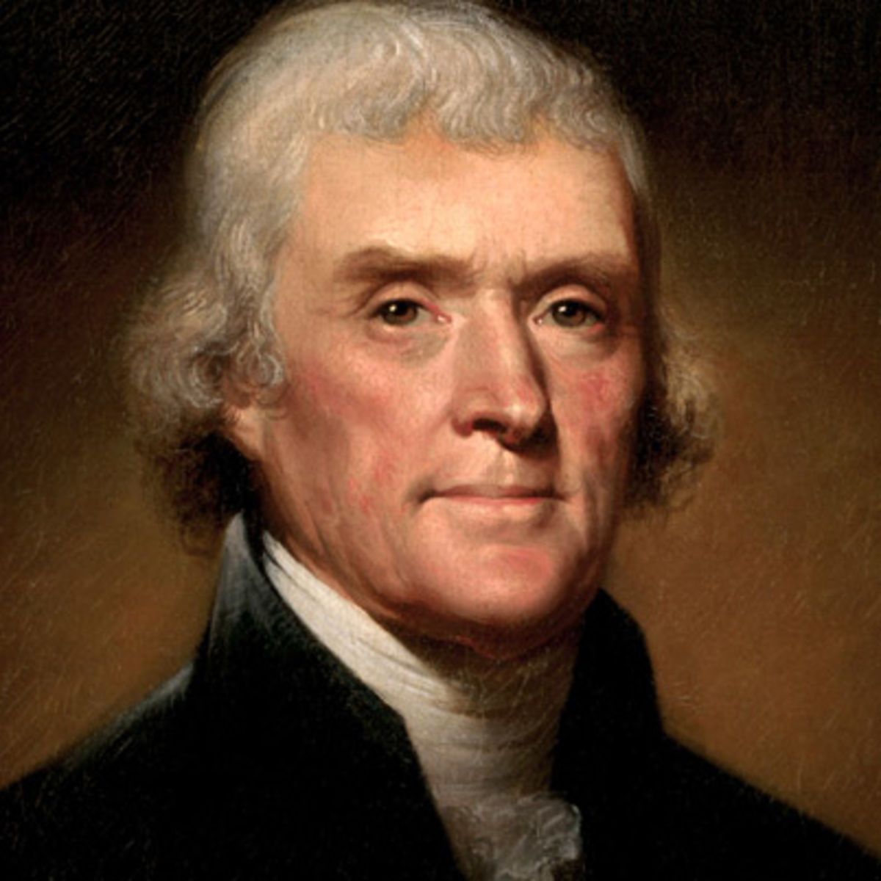
Who worked on creating the
Declaration of Independence?
Members of the declaration committee were:
1. Thomas Jefferson (Virginia)
2. John Adams (Massachusetts)
3. Roger Sherman (Connecticut)
4. Robert Livingston (New York)
5. Benjamin Franklin (Pennsylvania)
Who do you think drafted the first draft of the declaration??
Thomas Jefferson

