Slide 1
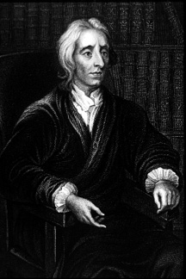
The ideas of John Locke
New ideas about the rights of people and their relationship to their ruler
Self-government
Challenged Church’s authority
Social Contract between the ruled and their ruler
If a ruler abuses the contract = OVERTHROW HIM/HER!

Slide 2
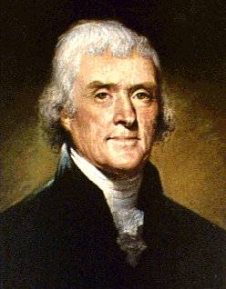
When drafting the declaration...
Thomas Jefferson was influenced by the ideas of the Enlightenment
He took ideas from John Locke
Self-evident truths (equality)
Natural order (natural laws for all)
“Governments are dissolved...when such a single person or prince sets up his own arbitrary will in place of the laws...without the consent, and contrary to the common interest of the people.”
– John Locke’s Second Treatise of Government (1690)
Where in this quote do you see “Enlightened” ideas?

Slide 3
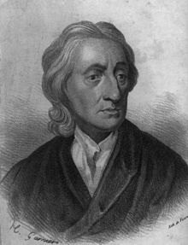
John Locke's views...
I wrote the following…
“All people are free, equal, and have ‘natural rights’ of life, liberty, and property, that rulers cannot take away!”
“All original power resides in the people, and they consent to enter into a ‘social contract’ among themselves to form a government to protect their rights!”
“Government’s powers are limited to those the people have consented to give it!”
“Whenever government becomes a threat to the people’s natural rights, it breaks the social contract, and the people have the right to overthrow it!”

Slide 4
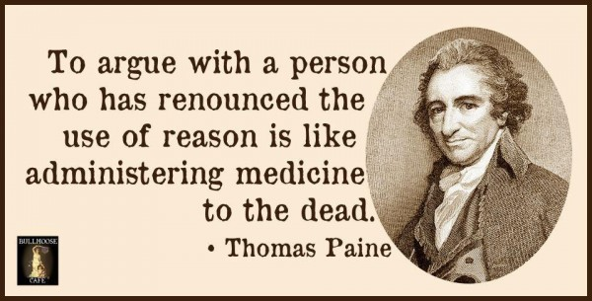
Thomas Paine and "Common Sense"
Pamphlet called Common Sense (Jan. 1776)
Challenged the King’s rule in the colonies
Independence from Great Britain!

Slide 5
What was the purpose?
The Declaration was seen as a way to
UNITE the colonists!
Colonists who remained loyal to Britain would be considered TRAITORS!

Slide 6
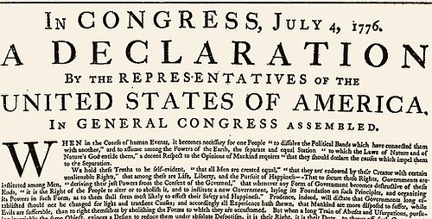
The Declaration of Independence
has FOUR major parts:
The Preamble – describes WHY the colonists are seeking their independence.
The Declaration of Rights
The List of Grievances
The Formal Declaration of Independence

Slide 7
PREAMBLE: “When in the Course of human events, it becomes necessary for one people to dissolve the political bands which have connected them with another, and to assume among the powers of the earth, the separate and equal station to which the Laws of Nature and of Nature's God entitle them, a decent respect to the opinions of mankind requires that they should declare the causes which impel them to the separation.”
– Thomas Jefferson Declaration of Independence
What KEY ideas/words
do you see that show
this idea of “independence”?

Slide 8
“We hold these truths to be self-evident, that all men are created equal, that they are endowed by their Creator with certain unalienable Rights, that among these are Life, Liberty and the pursuit of Happiness.”
What is MORE IMPORTANT...
Locke’s “Life, Liberty, and Property”
OR Jefferson’s “Life, Liberty, and
the Pursuit of Happiness”?

Slide 9
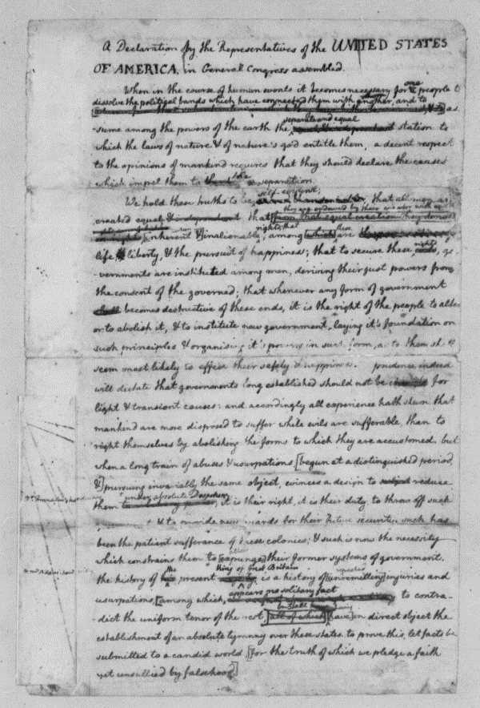
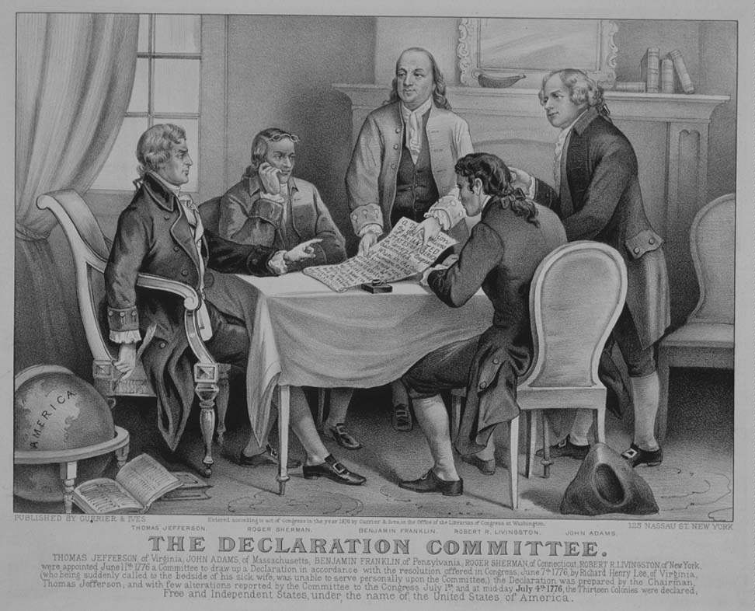
Drafting the Declaration
What does this
picture show us?

Slide 10
Do you think the Declaration supported
EVERYONE?
Abigail Adams (wife of John Adams) wrote that letter to John before the Declaration of Independence was finished...
“I long to hear that you have declared an independency. And, by the way, in the new code of laws which I suppose it will be necessary for you to make, I desire you would remember the ladies and be more generous and favorable to them than your ancestors. Do not put such unlimited power into the hands of the husbands. Remember, all men would be tyrants if they could.” – Abigail Adams
“REMEMBER
THE LADIES!” = EQUAL RIGHTS or
WE’LL REBEL!
What is she saying?

Slide 11
Top 5 Grievances in the Declaration:
Quartering large bodies of armed troops among us (the King has us provide food and shelter for his many soldiers)
Cutting off our trade with all parts of the world: (the King has cut off our trade with other parts of the world)
For imposing taxes on us without our consent: (the King is making us pay taxes that we didn't agree on paying)
For depriving us in many cases, of the benefits of Trial by Jury: (the King is not letting us have a trial by a jury)
He has plundered our seas, ravaged our Coasts, burnt our towns, and destroyed the lives of our people (the King has robbed us, destroyed us and our property, and is ruining our lives)

