Slide 1
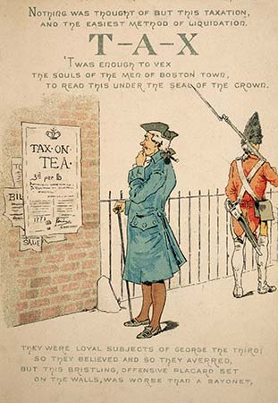
Colonial reaction to the Townshend Act was NEGATIVE!
Colonies angrily interpreted the act as an inappropriate tax to raise revenue and pay royal salaries
Colonists especially hated the tax on tea!
Notes:
Wikipedia Commons

Slide 2
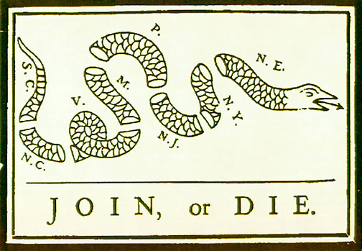
REMEMBER: This cartoon was created by Benjamin Franklin during the beginning stages of the French and Indian War
Do you think the idea of this cartoon changed since we last saw it? HOW?
In reaction to the various acts created by the British, the American colonists knew that only by joining together would they be able to survive…

Slide 3
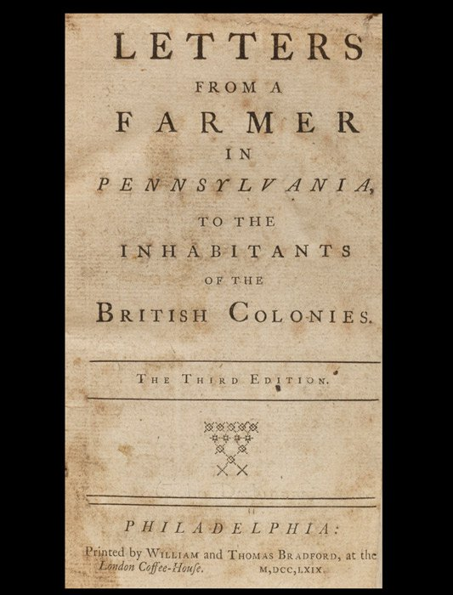
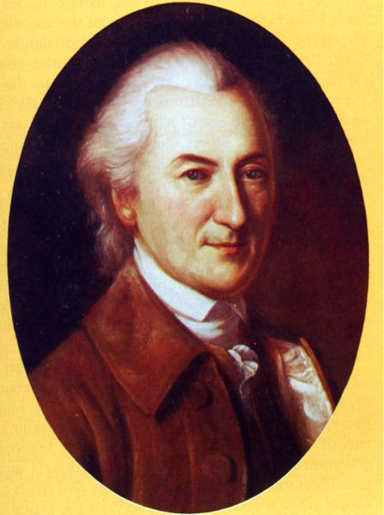
John Dickinson, Letters from a Farmer in Pennsylvania
• Essays challenged "internal" VS. "external“ taxes
internal = colonial affairs (ex. property tax)
external = mercantile system (ex. trade regulations)
Denied Britain’s right to collect taxes for purpose of revenue.
UNITED the colonists against the Townshend Acts!
Notes:
Wikipedia Commons

Slide 4
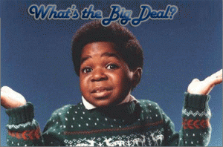
Massachusetts Circular Letter, 1768
Massachusetts legislature asked other colonies to pass petitions calling for Parliament to repeal the Townshend Acts.
Media was used to fuel the rebellion!
Notes:
Wikipedia Commons

Slide 5
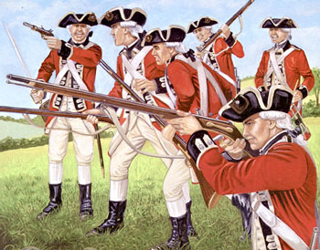
In response, the British sent troops to Boston and threatened to dissolve (CLOSE DOWN) Massachusetts' legislature if the letter was not retracted.
Other colonies that voted for the circular would likewise be dissolved.
Some colonies reenacted previous nonimportation agreements (So…British exports to America fell 40% over the next few months)
Notes:
Wikipedia Commons

Slide 6
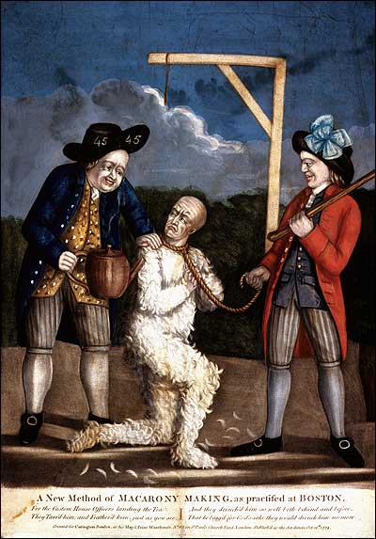
Several colonial legislatures were dissolved (closed down) as they supported Massachusetts: MA, MD, VA, DE, SC
Tax collectors were once again intimidated by Sons of Liberty members who opposed the Townshend Acts.
Notes:
Wikipedia Commons

Slide 7
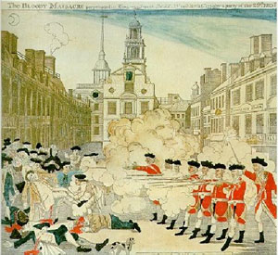
The Boston "Massacre"
(March 5, 1770)
Peaceful arrival of troops in Boston aroused American resistance
Colonials were fearful of standing armies; believed Britain sought to suppress colonial liberties.
There were a lot of tensions in the American colonies that had been growing since the British Parliament enforced the Townshend Acts in 1767.
Notes:
Wikipedia Commons

Slide 8
The Boston Massacre
England’s failure to remove the army from Boston heightened English-American tensions:
This “Boston Massacre” revealed the deterioration of English- American relations
Notes:
11

Slide 9
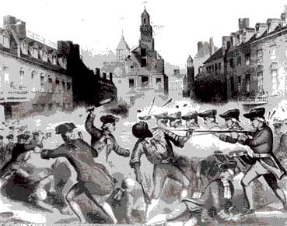
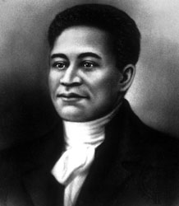
• 5 anti-British demonstrators KILLED! (11 wounded)
Crispus Attuks, a man of Wampanoag and African descent, was the first to be shot and killed during the “Boston Massacre.”
Notes:
Source: Wikipedia Commons

Slide 10
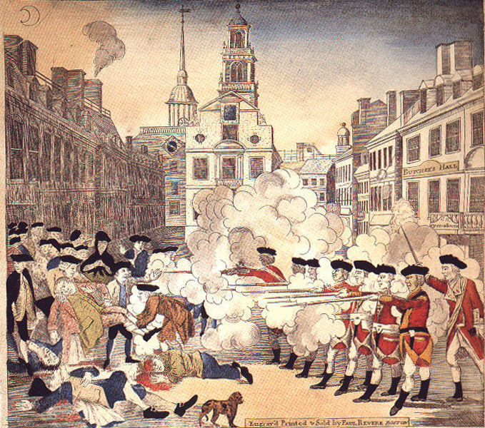
Paul Revere’s etching of the Boston Massacre became an American best-seller
Colonists injured British soldiers by throwing snowballs & oyster shells
With only 5 dead, this was hardly a “massacre” but it reveals the power of colonial propaganda
Notes:
11

Slide 11
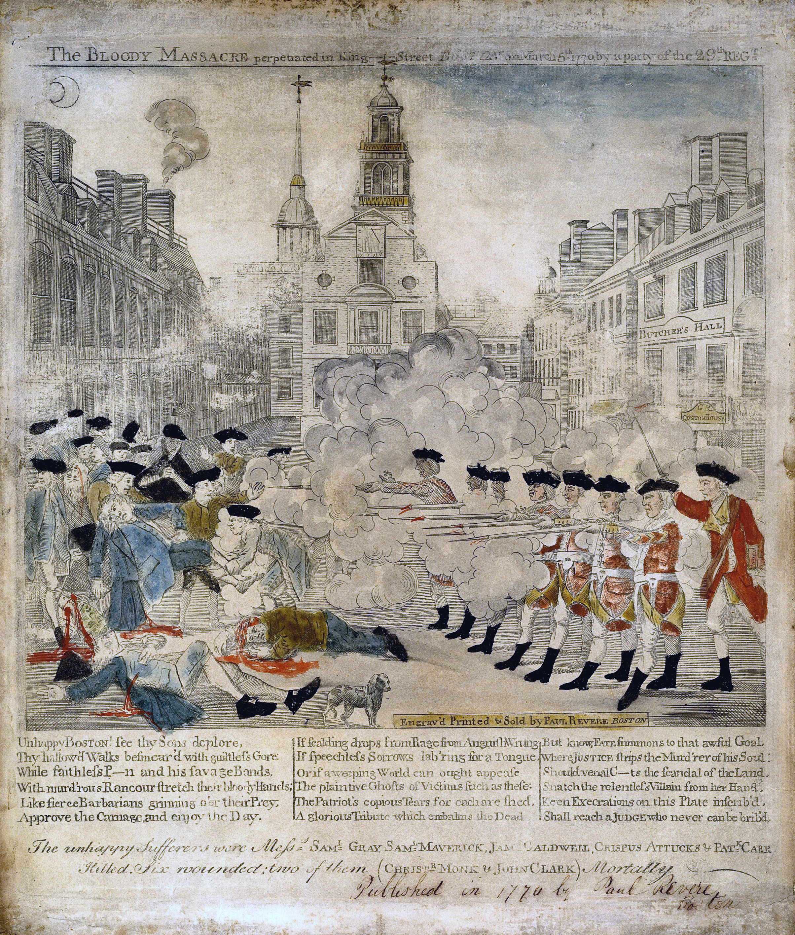
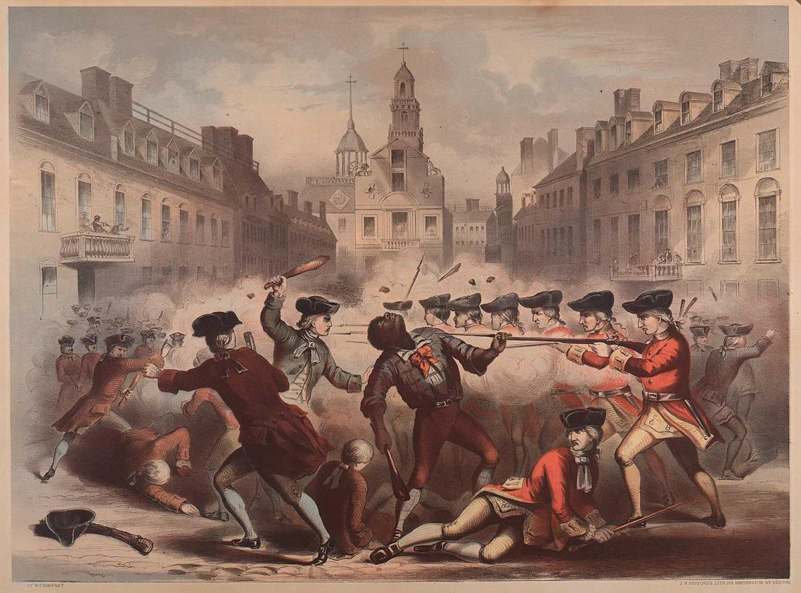
Paul Revere’s “Bloody Massacre”, 1770
Henry Pelham’s “The Fruits of Arbitrary Power”, 1770

Slide 12
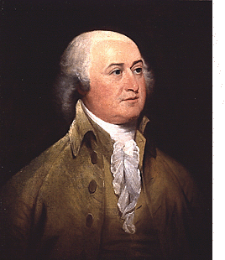
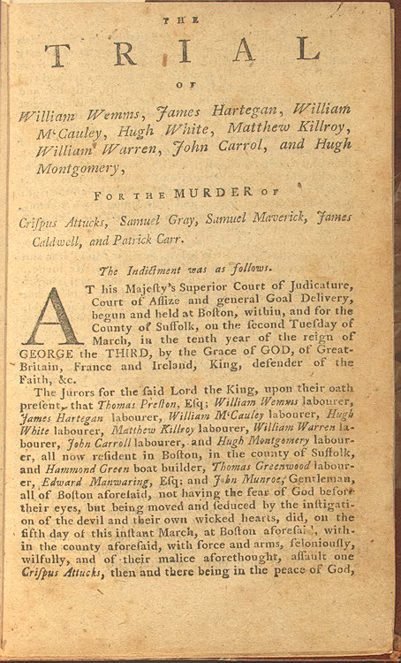
The trial of the British soldiers
In October 1770, a trial was held in colonial court accusing several of the British soldiers involved in the shootings with murder.
Six of the soldiers were found innocent of any charges.
Two were convicted on manslaughter charges and were punished by having their thumbs branded.
Their captain, Preston, was acquitted because the jury couldn’t be sure that he ordered his troops to fire into the crowd.
John Adams, defense attorney for the British soldiers. Later was elected the second president of the United States.
Notes:
After the Massacre, people in Boston clamored for justice against the British soldiers involved in the shooting. A colonial jury heard the case, and John Adams, a Boston lawyer, was hired to represent the soldiers. Six of the soldiers were acquitted of all charges. Two others were convicted on charges of manslaughter, and were punished by having their thumbs branded. Captain Preston, who had led the British troops the night of the Massacre, was acquitted because the jury could not determine whether he had ordered his troops to fire into the crowd.
The term “Boston Massacre” was first used by Samuel Adams, more for propaganda rather than the number of colonists killed.

Slide 13
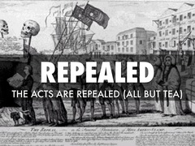
Response to the Boston Massacre
Soon after the massacre, Parliament canceled the Townshend Acts
They kept only the tax on tea as a remind of their power and authority (three-pence tax)
HALF of the troops in Boston were REMOVED
Relations
IMPROVED!
☺

Slide 14
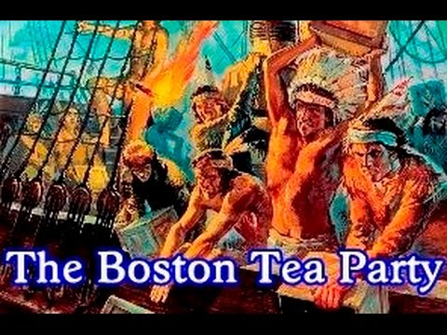
Causes of the Boston Tea Party
In 1773, the British Government passed the Tea Act, which gave the British East India Company a monopoly on tea sales by allowing them to sell tea at a lower price than their competitors
The theory was that the colonists would accept the tax more readily if they were able to get tea from the East India Company at a lower price
However colonial leaders in Boston protested, and cargoes of tea on ships were held in Boston Harbor…

Slide 15
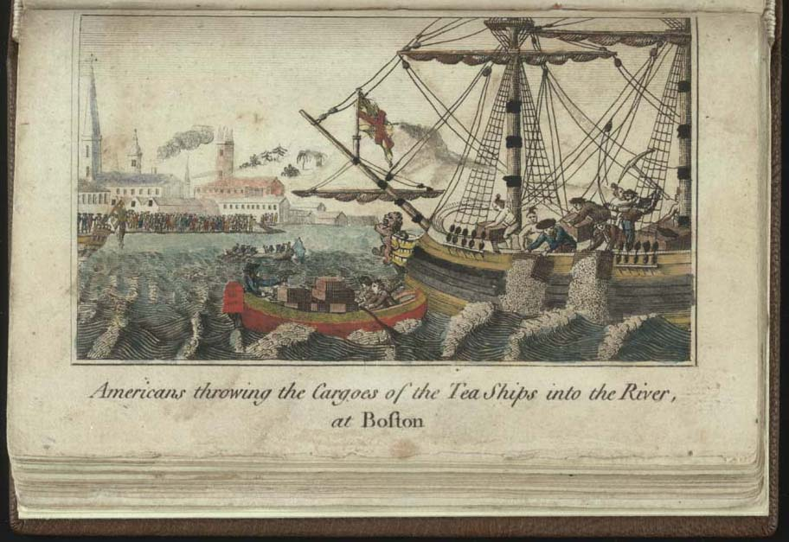
The Boston Tea Party
After the tea would not be removed from Boston Harbor, 50 members of the Sons of Liberty, led by Samuel Adams, dressed up like Mohawk Indians and boarded the ships.
Throwing 342 chests of tea overboard into the Harbor; worth more than 10,000 pounds sterling.
1 pound sterling = Roughly $1.50

Slide 16
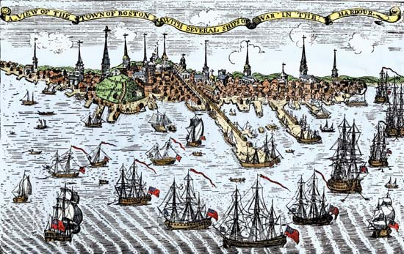
The Intolerable Acts were then passed in 1774, they were a punishment for the Boston Tea Party.
Officially called the “Coercive Acts”, but they were nicknamed the “Intolerable Acts” in the colonies
What does the word “coercive” mean?
Relating to or using force or threats.

Slide 17
The major laws considered “intolerable”…
Boston Port Act: Closed the Port at Boston Harbor until the tea was paid for.
Quartering Act: Forced the citizens of Massachusetts to house and feed British soldiers in their homes (it was brought back!)
Massachusetts Government Act: Suspended the Massachusetts Colonial Legislature until the tea was paid for.
Administration of Justice Act: Guaranteed that British officials would not be tried in colonial courts for capital crimes.

Slide 18
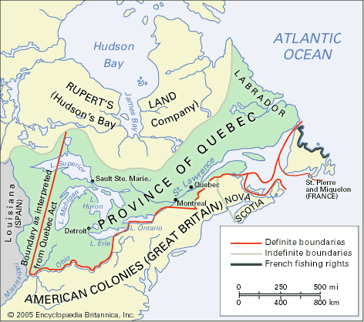
Quebec Act
The Quebec Act:
Extended the boundaries of Quebec to include most of the Ohio Country.
Guaranteed colonists of Quebec free practice of Catholicism.
British Rational: Appease French Canadians so as to keep them from joining the rebellious ranks of the American colonists
Was not a part of the laws passed in reaction to the Boston Tea Party (Coercive Acts)
Colonial Impact: Limited the opportunity for expansion to the West
Colonists viewed this act as one of The Intolerable Acts due in part to its stipulations and its timing

Slide 19
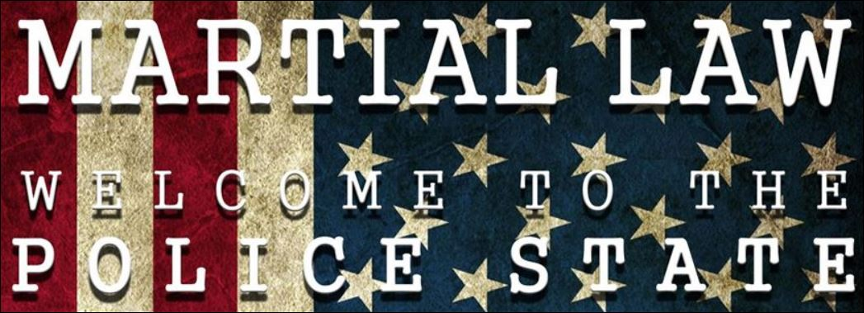
The British government attempted to restore order in Boston through martial law
Another result of the Boston Tea Party was that the Massachusetts colony was placed under martial law
In martial law, military authority usually takes the place of civilian justice
Notes:
In order to assure order in Massachusetts, British authorities suspended civil law and instituted martial law. In a system of martial law, civilian judiciary authority is suspended, and instead military authority controls civilian order.
One of the usual effects of martial law is the establishment of a curfew, in which civilian movement outside the home is restricted during certain hours. Another effect is the suspension of habeas corpus. In a situation where habeas corpus is suspended, civilians accused of a crime may be held in jail indefinitely without formal charges being filed against them. While a declaration of martial law in US History is rare, it has been declared during the Civil War as well as World War II. In the Civil War, President Abraham Lincoln used martial law to counteract actions of “Copperheads”, or northerners who sympathized with the Confederates during the war. While Lincoln’s move to suspend habeas corpus was later declared unconstitutional in the Supreme Court, he saw the suspension as a legitimate use of executive power and continued to do so. In 1941, after the Japanese attack on Pearl Harbor, President Franklin D. Roosevelt ordered the relocation of thousands of Japanese Americans living on the west coast of the United States. While later Supreme Court cases upheld FDR’s order as a legitimate use of his power as commander in chief, in the mid 1980s, the US Government formally apologized for the interment and offered surviving Japanese Americans a cash payment to compensate for their loss during the war.

