Slide 1
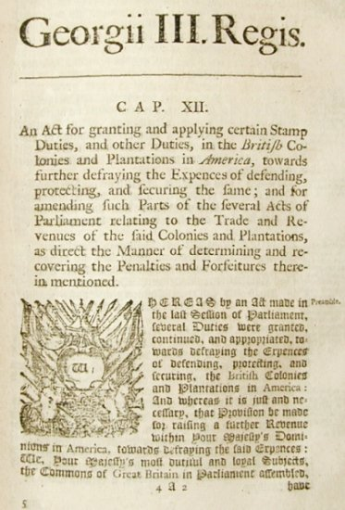
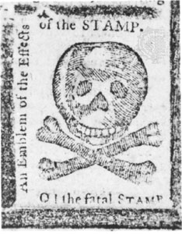
The Stamp Act in 1765, which placed a tax on legal documents such as contracts, birth certificates, diplomas, and then other items like playing cards and newspapers.
This tax helped the British tax the colonists DIRECTLY on everyday items
In reaction to the Stamp Act, the colonists demanded “no taxation without representation” and called the act unconstitutional.

Slide 2
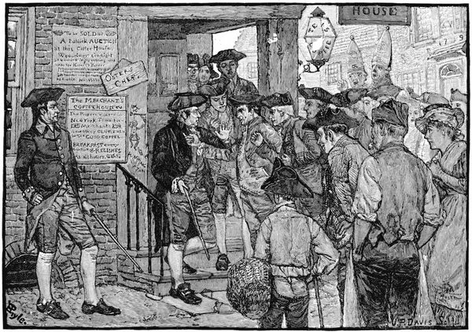
Many colonies refused to quarter troops and didn’t comply with the new laws.
Violators of the Sugar Act and the Stamp Act were tried in British admiralty courts, not by juries, the burden of proof was on the defendant, not the prosecution (so no “innocent until proven guilty”)

Slide 3
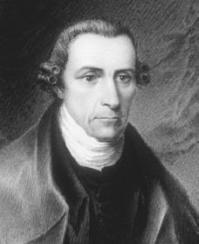
Virginia Stamp Act Resolutions (1765)
(led by Patrick Henry)
Created by the Virginia General Assembly.
One of the first acts of open revolution to a British law.
ALL men of Britain in the colony should be treated as representatives of Britain.
ALL the people in the colony should be treated as if they were born within England.
NO unbearable tax should be imposed to anybody in the colony.
Virginians shouldn’t be imposed with a tax that was not passed by a body that had not gained their consent.
Virginia General Assembly is the only one to have the right to lay taxes on people in the colony.

Slide 4
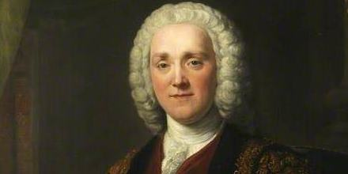
A man named George Grenville became the Prime Minister, but ignored the interests of the colonists…
He asked Parliament to tax the colonists to get money back!
A Stamp Act in Britain had been much heavier and in effect for about 50 years
“Why shouldn’t these
colonists begin to pay some of the
costs of their own government
and defense?”

Slide 5
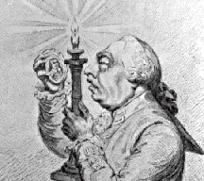
“This is totally unfair!” - colonists
Americans believed that only their colonial legislatures had any legal right to impose taxes on their people.
Grenville dismissed the Americans’ complaints and stated virtual representation
A Member of Parliament virtually represented every person in the empire;
Parliament represented the well being of ALL British subjects in ALL colonies when deliberating on legislation.

Slide 6
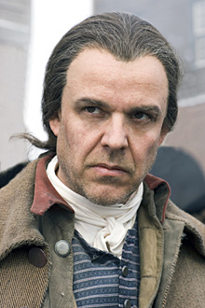
Virtual Representation is the WORST
Colonists dismissed "virtual representation"
Impractical - sending representatives across the Atlantic was too far away (too much time needed to issue instructions to colonial representatives)
Uneven numbers - American representation would be badly outnumbered as to make it totally ineffectual
NO TAXATION WITHOUT REPRESENTATION!

Slide 7
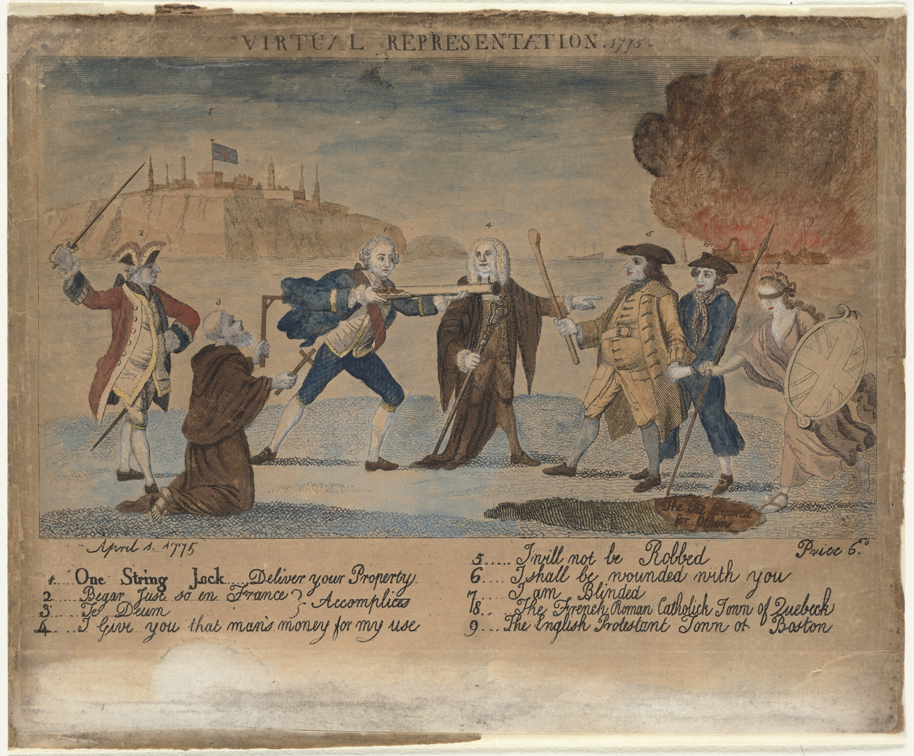
VIRTUAL REPRESENTATION 1775
Print shows Lord Bute aiming a blunderbuss at a man representing colonial America
A member of Parliament, pointing at the American, tells Bute "I give you that man's money for my use", to which the American responds by saying, "I will not be robbed".
On the right, blindfolded, Britannia is about to stumble into "The pit prepared for others" while behind her, in the background, "The English Protestant town of Boston" is in flames.
On the left kneels a monk holding a gibbet and a cross, behind him stands a Frenchman with sword raised; perched on a cliff and forming the backdrop to Bute, the monk, and the Frenchman, is the city of Quebec.

Slide 8
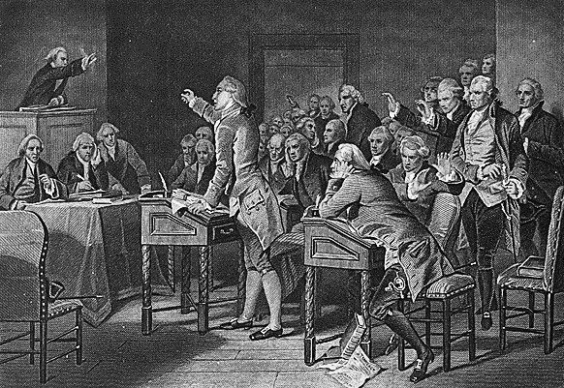
The Stamp Act Congress
The Stamp Act Congress was a meeting held between October 7 and 25, 1765 in New York City.
It consisted of 27 representatives from 9 of the British Colonies in North America.
The objective of the representatives was to devise a unified protest against new British taxation - specifically the Stamp Act of 1765.

Slide 9
What was accomplished at the
Stamp Act Congress?
The delegates of the Stamp Act Congress drew up a "Declaration of the Rights and Grievances of the Colonists”.
In this document they declared that:
They had the same rights as British subjects living in Britain
Only colonial assemblies had a right to tax the colonies (no taxation without representation!!!)
They were free from taxes except those to which they had given their consent
They had the right of trial by jury

Slide 10
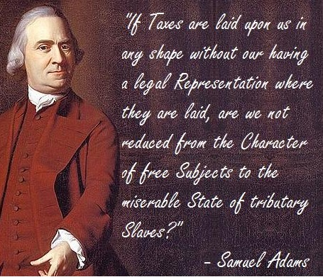
At a Boston town meeting in 1764, a local leader named Samuel Adams believed that Parliament could NOT tax the colonists without their permission.
He helped found the Committees of Correspondence
each committee got in touch with other towns and colonies
shared ideas and challenge British laws!
What is Adams
saying here?

Slide 11
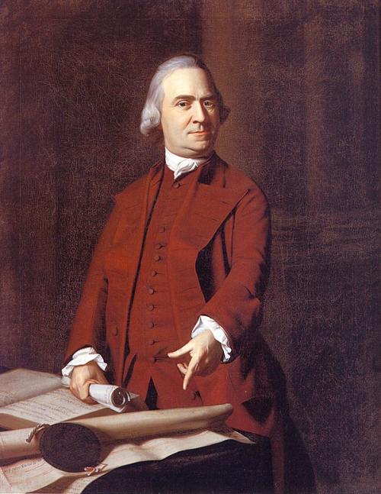
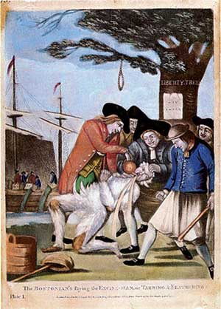
Sons of Liberty led by Samuel Adams violently enforced nonimportation agreements against violators (tarring and feathering was one brutal tactic)
Notes:
Courtesy of the Boston Museum of Fine Arts John Singleton Copely, 1772 Right: Library of Congress The Bostonians Paying the Excise-man, or Tarring and Feathering Attributed to Richard Dawe

Slide 12
Houses of pro-British officials were vandalized, burglarized, and the warehouse where stamps were stored was destroyed.
All stamp act agents were forced to resign; no one risked selling stamps.
“O! the fatal STAMP,” 1765
Colonial newspapers warned the Stamp tax would damage the free press.
Notes:
Pennsylvania Journal - Rare Books and Manuscripts Division, The New York Public Library, Astor, Lenox and Tilden Foundations

Slide 13
Sons of Liberty led by Samuel Adams violently enforced nonimportation agreements against violators (tarring and feathering was one brutal tactic)
Notes:
Courtesy of the Boston Museum of Fine Arts John Singleton Copely, 1772 Right: Library of Congress The Bostonians Paying the Excise-man, or Tarring and Feathering Attributed to Richard Dawe

Slide 14
Houses of pro-British officials were vandalized, burglarized, and the warehouse where stamps were stored was destroyed.
All stamp act agents were forced to resign; no one risked selling stamps.
“O! the fatal STAMP,” 1765
Colonial newspapers warned the Stamp tax would damage the free press.
Notes:
Pennsylvania Journal - Rare Books and Manuscripts Division, The New York Public Library, Astor, Lenox and Tilden Foundations

Slide 15
“No Taxation without Representation”
Virtual Representation - concept that members of Parliament represented all of the subjects in the Empire.
Actual Representation - idea that representatives come from the electorate

Slide 16
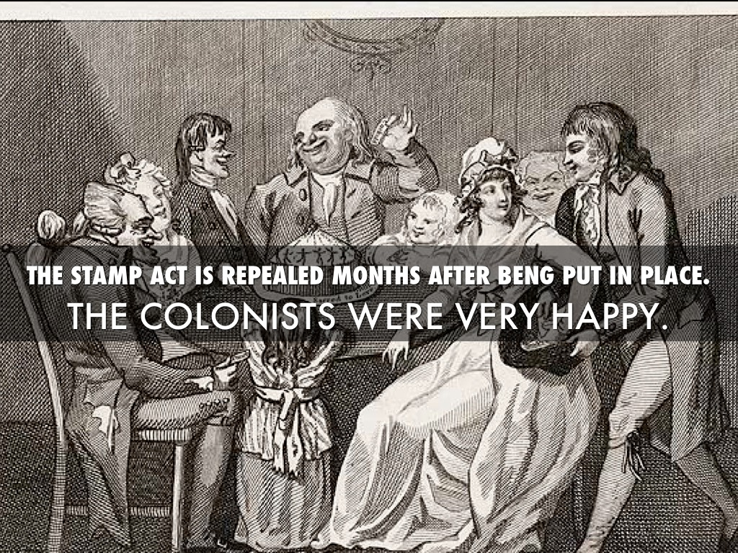
Stamp Act was REPEALED in 1766
Lord Rockingham (Grenville’s replacement) saw the Stamp Act as a possible cause of civil crisis
He encouraged British merchants to write Parliament to rescind the tax.
British bow to pressure from English merchants who are losing money from lack of trade.

Slide 17
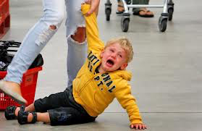
The Sugar Act tax was also lowered significantly.
The Stamp Act rebellion proved Parliament could be persuaded to yield to American boycotts and mob action.

Slide 18
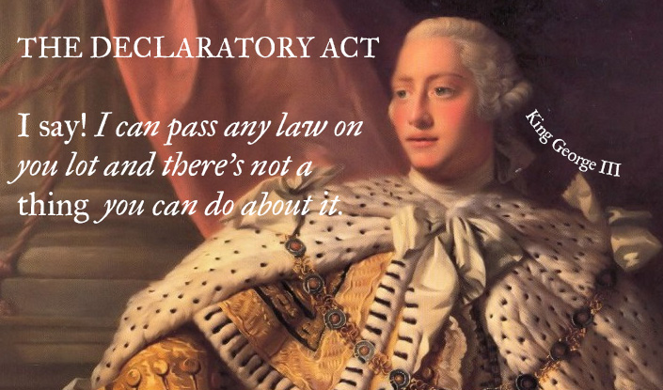
BUT on the same day in 1766, the Declaratory Act was issued by the British Parliament…
This act stated that the British Parliament had the power to make laws for the colonies.
Parliament “had, hath, and of right ought to have, full power and authority to make laws and statutes of sufficient force and validity to bind the colonies and people of America, subjects of the Crown of Great Britain, in all cases whatsoever.”
What message do you think this sent to the Colonists?

Slide 19
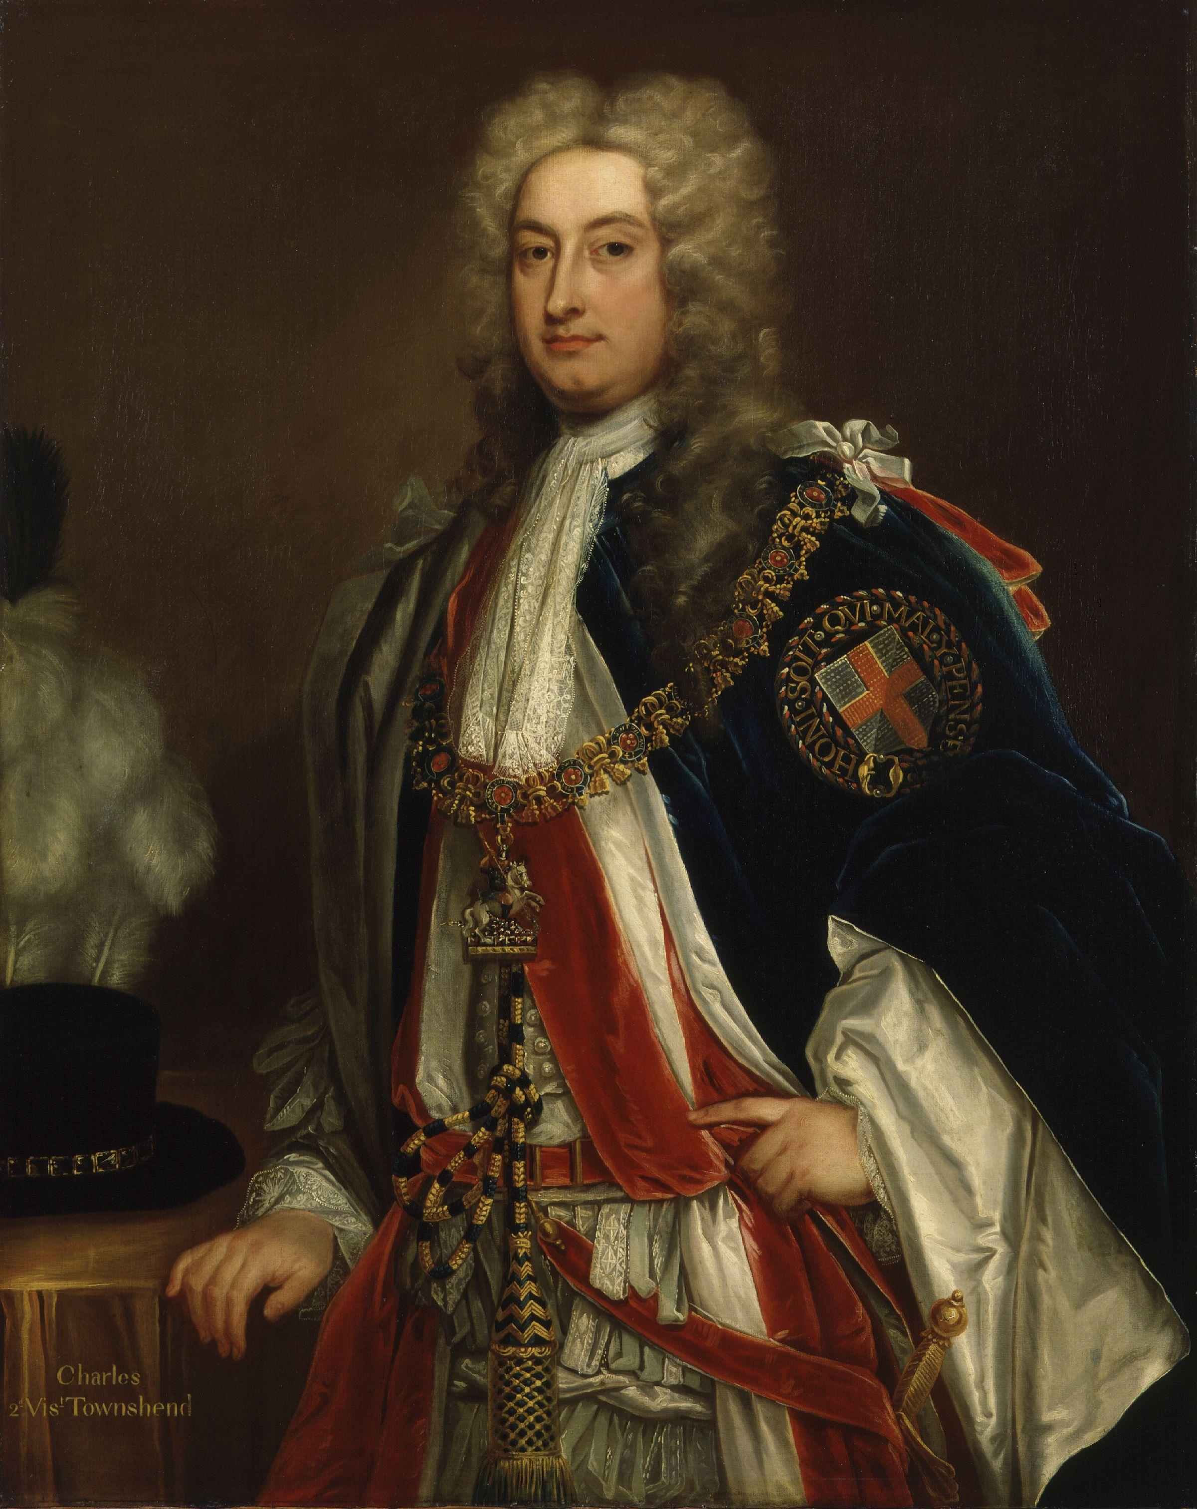
Charles Townshend British Leader, Chancellor of Royal British Treasury
British government NEEDS TO increases restrictions with NEW TAXES
All taxes pay for Royal officials in colonies

Slide 20
The Townshend Acts
BRING BACK ANGER!
Taxes on everyday items such as glass, paint, oil, lead, paper, and tea…
Designed to raise £40,000 a year
For the administration of the colonies
The result was the resurrection of colonial hostilities created by the Stamp Act.
“The Townsend Duties Crisis was never resolved. It culminated in the Boston Tea Party, that triggered off the final sequence of events leading to the War of American Independence.”
Peter D.G. Thomas, The Townsend Duties Crisis

Slide 21
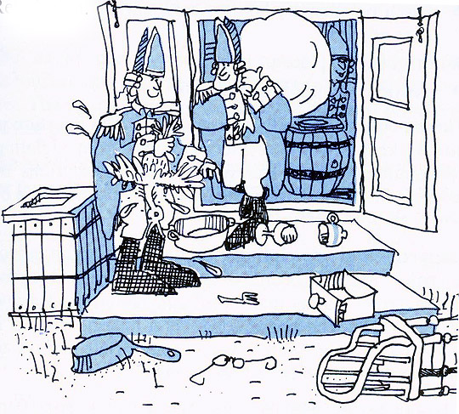
The writs of assistance were also created in order to enable British officials to search for smuggled goods that belonged to colonial merchants.

