Slide 1
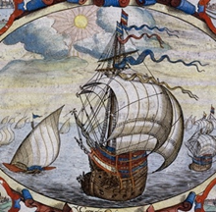
DO NOW:
Answer the following questions in your notebook…
Why do families decide to move to a new home?
What are the positive and negative effects of moving to a new home?
Why do you think the Europeans wanted to discover and move to new lands around the world?

Slide 2
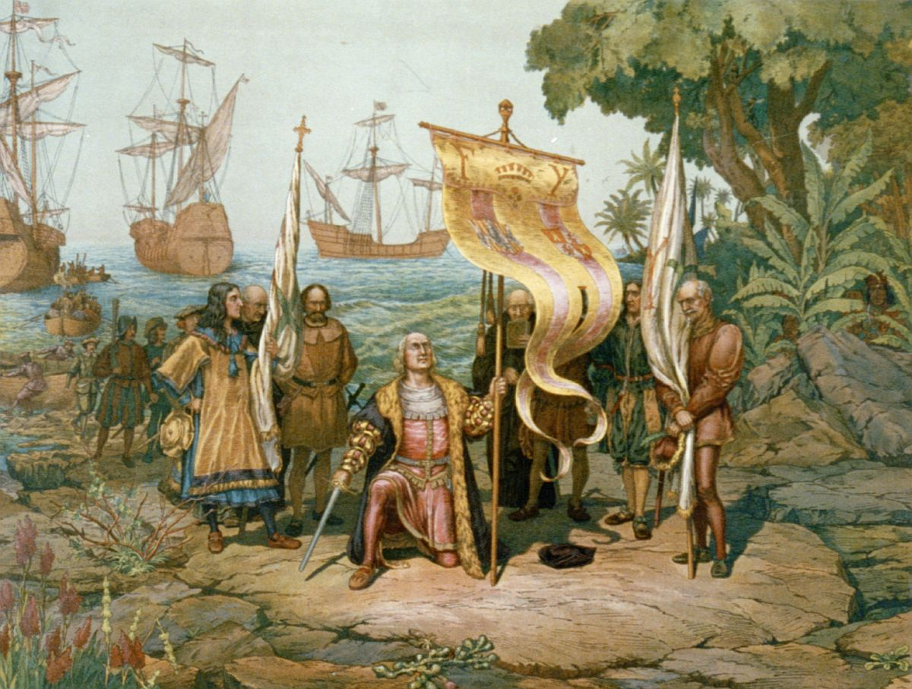
CHAPTER 1
Vocabulary QUIZ
on FRIDAY 9/16

Slide 3
New World Beginnings 33,000 BC – AD 1769
UNIT 1 – PART 1

Slide 4
Today’s AIM: What motivated European exploration and migration to the Americas?

Slide 5
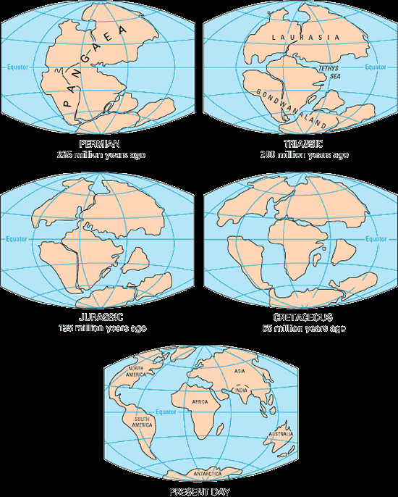
How did it all begin??
The continents split apart from a single, giant land mass about 225 million years ago.
The basic geological shape of North America was born about 10 million years ago.

Slide 6
Shaping of North America
Glaciers shaped geography – creating rivers, Great Lakes, Plains (beginning 2 million years ago)
Earliest Americans arrived between 11,000 and 35,000 years ago from Asia
Genetic markers on Y chromosome is shared between Native Americans and Asians
Early Migration
First Migration (9,000 years ago)
Walked across Berengia land bridge
Created during Ice Age because glaciers dropped oceanic levels
Second Migration (8,000 years ago)
Traveled by water
Brought Navajos and Apaches
Third Migration (5,000 years ago)
Traveled by water
Brought Eskimos (Aleuts and Inuits)

Slide 7
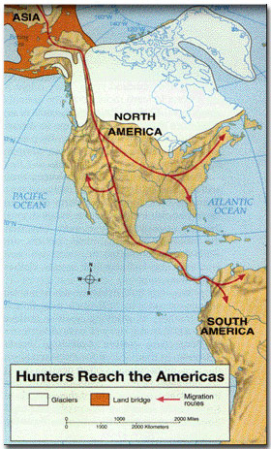
Pre-Columbian America
Bering Straight/Land Bridge
Hunters and Gathering people follow herds from Asia over the ice and into the Western Hemisphere.
Evidence of 50,000 year old bones found in South America

Slide 8
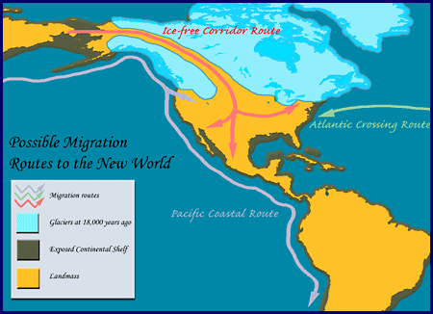

Slide 9
By 1492 – 54 million people live in Americas
Diverse cultures developed and over 2,000 languages created
Each tribe adapted to local environment

Slide 10
Image Gallery

Slide 11
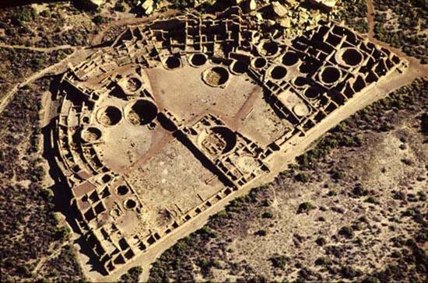
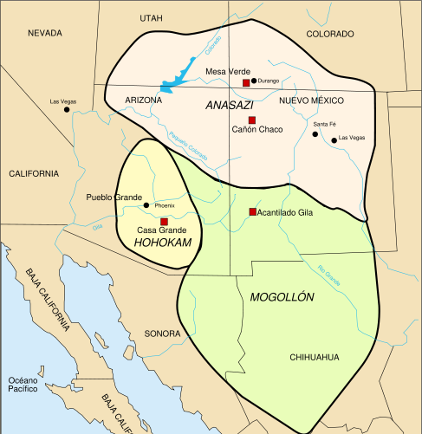
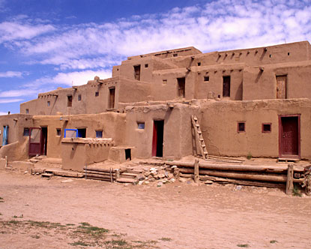
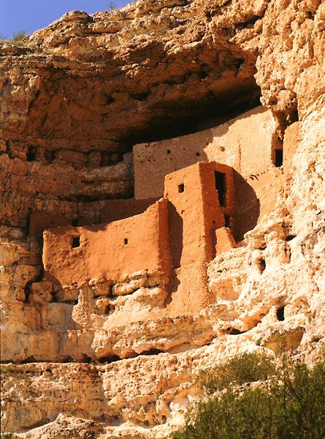
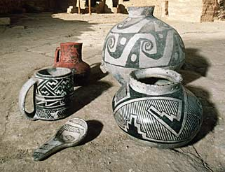
Earliest Americans
Corn (maize) cultivation
6,000 BC domesticated crops and animals
Led to civilization
Ended nomadic lifestyles
Anasazi, Hohokam, Mogollon (Pueblo) Indians
Built apartment style buildings of adobe and cliff dwellings
Known for pottery, textiles, baskets, kokopelli
Engaged in trade with tribes as far away as Mexico
Chaco Canyon
Taos Pueblo
Montezuma’s Castle

Slide 12
Earliest Americans
Mound Builders and Mississippian Culture
Built towns in flood plains for fertile soil
Had connections to Mexico
Cahokia – 40,000 residents – was in western Illinois
Built temples and houses on top of mounds
Began serious decline in 1350
Three Sister Farming
American Southeast
Creek, Choctaw, Cherokee
Beans, Squash, Corn grown together
Improves diet, led to large populations
Cahokia

Slide 13
Earliest Americans
Eastern Woodlands
Iroquois League
Created by Hiawatha
Mohawk, Seneca, Oneida, Onondaga and Cayuga
council’s leaders chosen by women
planned for defense, supported cooperation between member tribes
built longhouses
Had communal property
Native Americans believed people should live with environment, not control it
Lineage and custom based societies
When massive death from disease and war, it destroyed culture

Slide 14
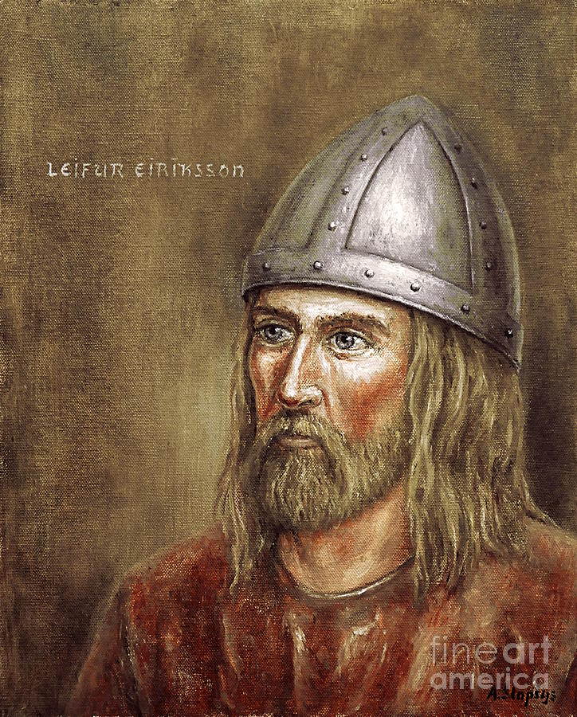
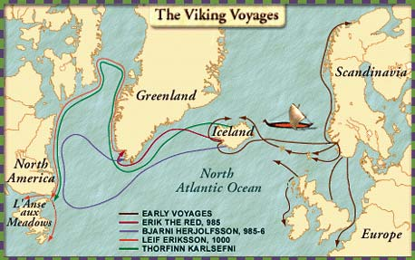
Viking Discoveries
First Europeans to come to America were Vikings
Leif Eriksson (1001)
Made temporary settlement in L’Anse aux Meadows, Newfoundland Canada
Called it Vinland
Did not spread word about new territory

Slide 15
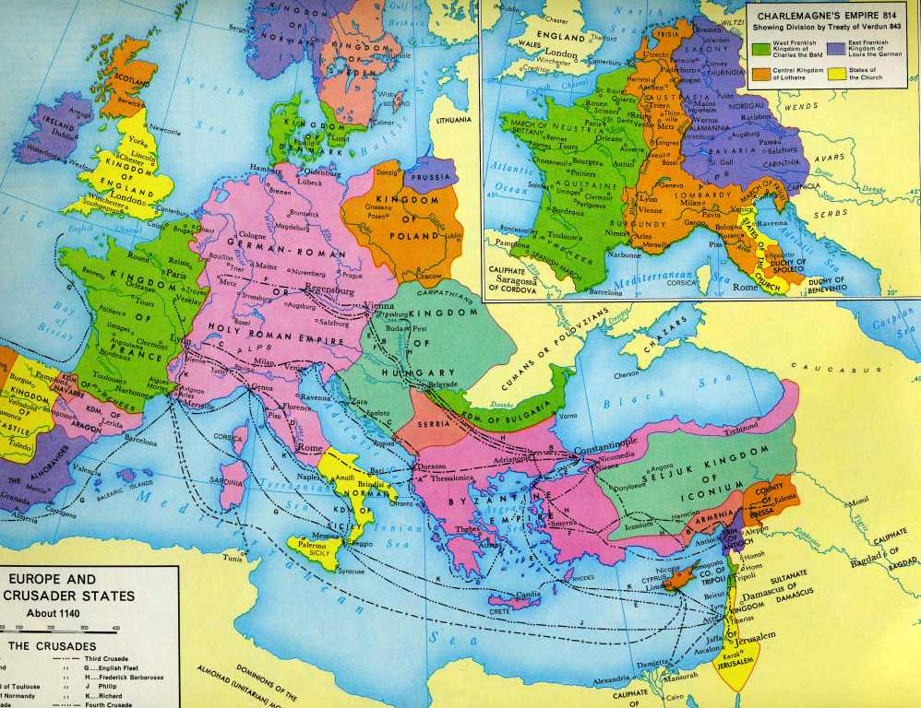
Causes of Exploration: THE CRUSADES
Christians from Europe went to Middle East to take Holy Land from Muslims
Europeans lost wars, but created a demand for trade with east
Silk, perfume, spices, etc.

Slide 16
Causes of Exploration: Marco Polo and Trade
Marco Polo travelled to China, lived there 17 years and wrote book
Described wealth and products of China
Trade over Silk Road and through Arabia was slow and expensive
Contributed to development of Italian trading states of Genoa, Florence, Pisa and Venice
Wealth created by trade made capital available for investment and encouraged people to seek more efficient trade routes

Slide 17
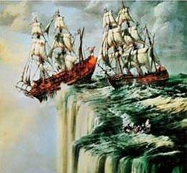
Causes of Exploration: Technology
Europeans did not fear world was flat, but could not sail against wind and sea currents
Portuguese develop idea to sail west to return from Africa
Astrolabe
told latitude (North South)
No way to determine Longitude (East West)
Caravel
allowed sailors to sail with or against wind
Europeans now sail south toward Africa
Compass
told direction

Slide 18
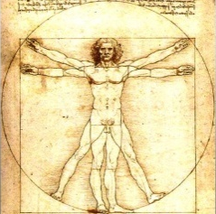
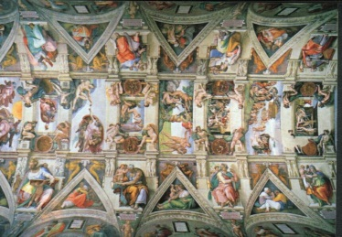
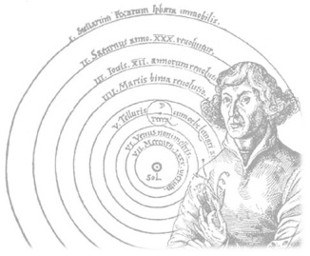
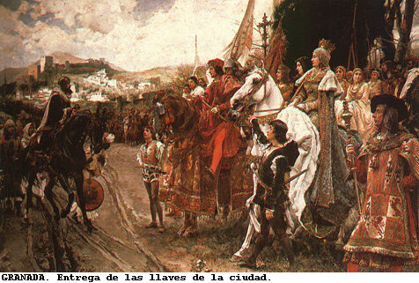
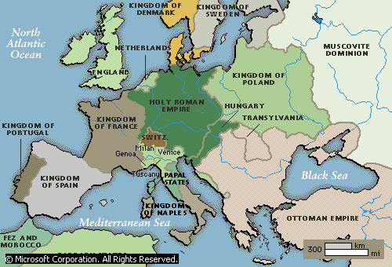
Causes of Exploration: Intellectual and Political development
(mid 1400s) Gutenberg press makes books, maps, scientific and technological ideas widely available
Renaissance
Created sense of optimism, adventure and intellectual curiosity
Reconquista -1492
Spanish unification and expulsion of Moors
Inspired Spain to grow and challenge Portugal
Nation States
Kings in Europe consolidate power and sought ways to increase wealth and allegiance to Crown

Slide 19
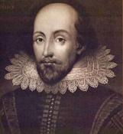
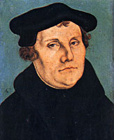
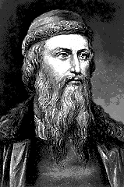
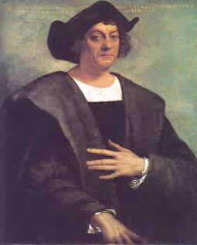
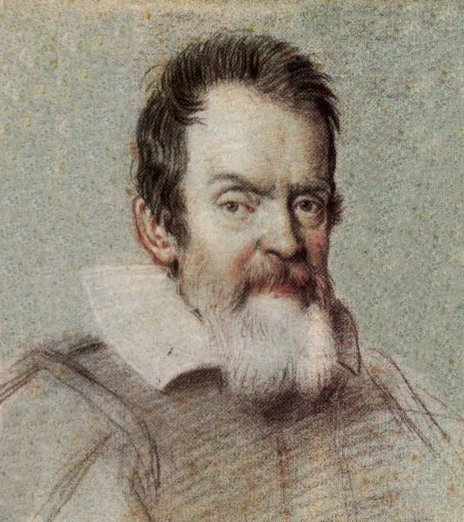
A time of rebirth in Western Civilization “intellectual enlightenment”

Slide 20
The Rebirth of Europe
Economy
Culture
Politics
Nations competed for Asian trade.
Ancient Greek, Roman,and Muslim art and learning were rediscovered.
Reformation: revolt against the Roman Catholic Church
Improved sea- faring technology aided exploration and trade.
Philosophy of humanism: use of reason and experimentation in learning
Government by nobles and the Church declined.
Spain & Portugal competed to explore trade routes.
Michelangelo, Leonardo da Vinci Shakespeare
The rise of nations

Slide 21
Causes of Exploration: Conditions in Europe
1450 most Europeans were peasants
Had no rights, few possessions, worked hard and died young
Hereditary nobility and men dominated society
Christianity
Taught people had to be constantly on defense against temptations
Limits on Economic Opportunity
Manorial obligations to nobility
Guilds controlled trades
Primogeniture limited inheritance rights of land

Slide 22
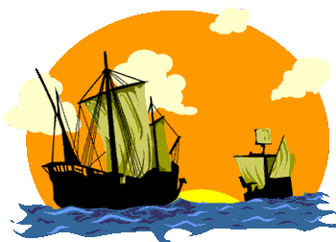
Direct Causes = 3 G’s
Political: Become a world power through gaining wealth and land. (GLORY)
Economic: Search for new trade routes with direct access to Asian/African luxury goods would enrich individuals and their nations (GOLD)
Religious: spread Christianity and weaken Middle Eastern Muslims. (GOD)
The 3 motives reinforce each other

Slide 23
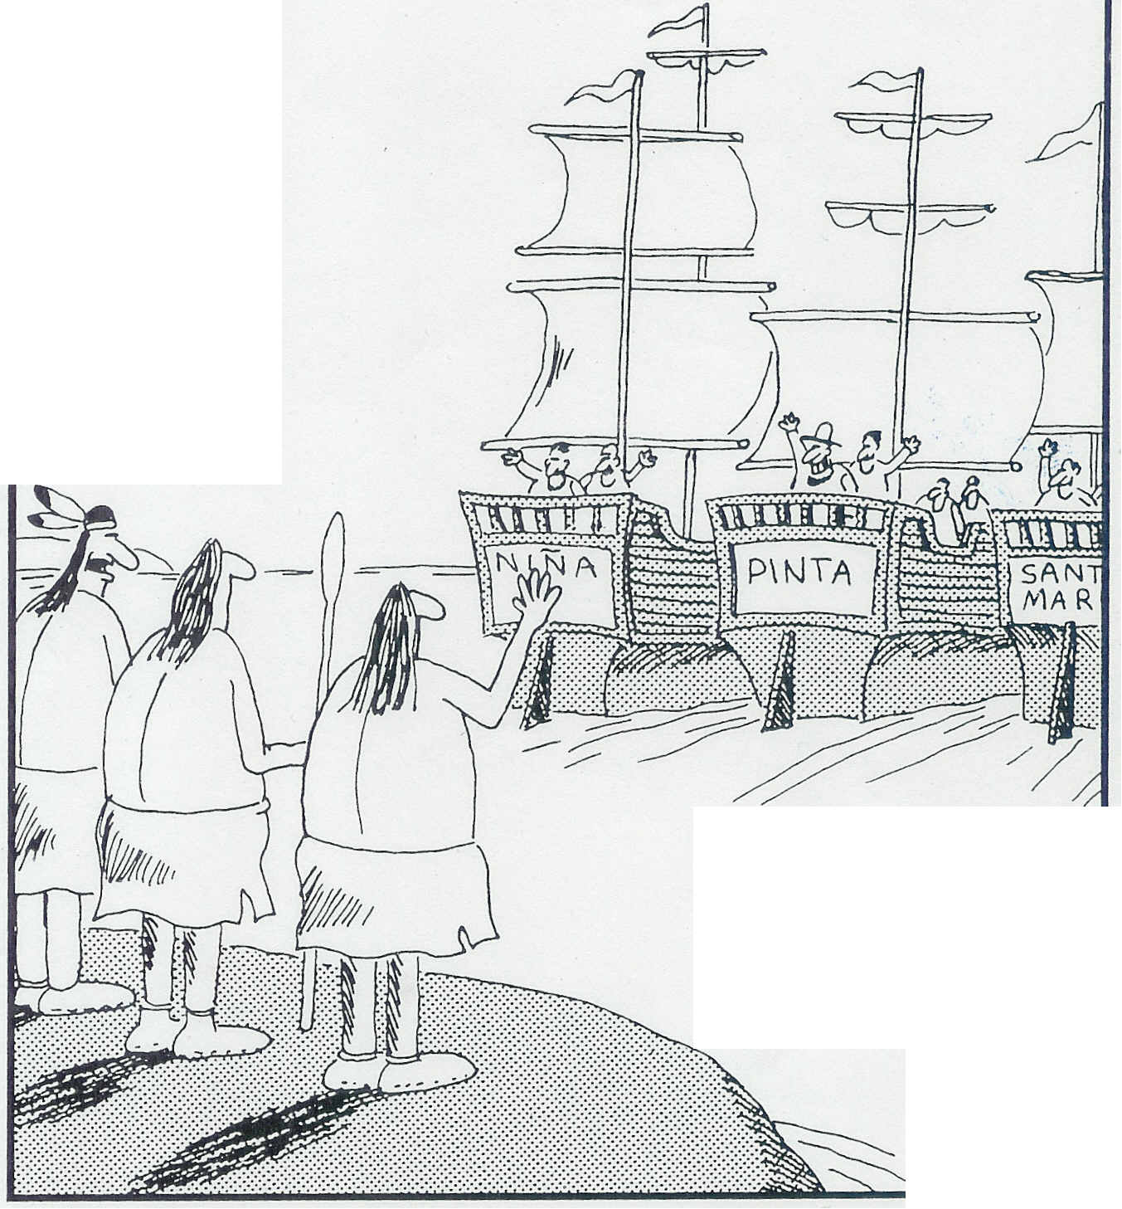
"Did you detect something a little ominous in the way they said, 'See you later'?"

Slide 24
Individual Writing Activity
Writing Prompt: Pretend that you are a European living in your home country during the mid-1400s. You want to move and explore a new land with your friends, but your family doesn’t want you to leave. In a letter (1 page long), explain to your family…
The cause of you leaving them (make sure to use at least TWO of the causes we learned today)
What your goals are in this new land
**BE CREATIVE! Use as much information from today’s lesson as you can**
DUE DATE: TOMORROW, THURSDAY 9/15

Slide 25
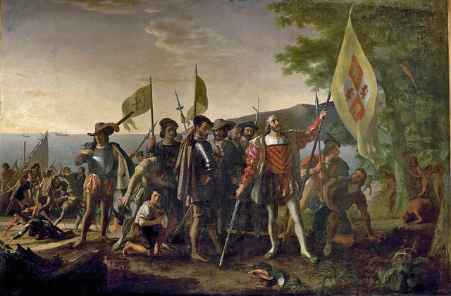
EXIT Assessment
In 3-5 sentences…
what do YOU think was the most significant reason/cause of European exploration to the Americas? Explain.

