Slide 1
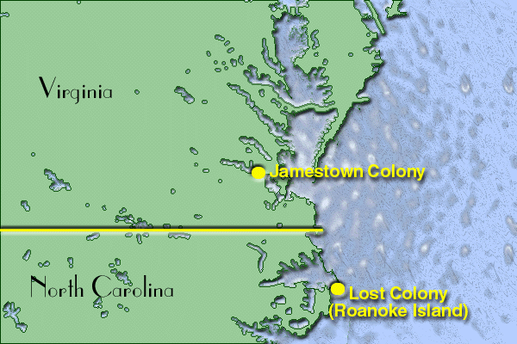

Slide 2
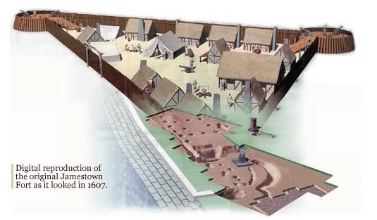
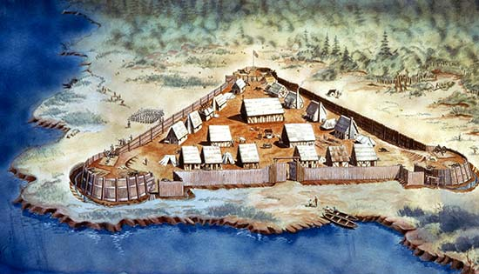
Notes:
Why is it set up the way it is?
Courtesy of Historic Jamestown

Slide 3
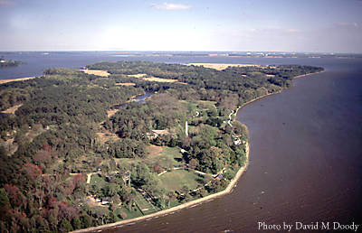
Location of Jamestown
When the settlers first arrived, Jamestown was located on a narrow peninsula bordered on three sides by the James River. Today Jamestown is located on an island in the James River.
Jamestown

Slide 4
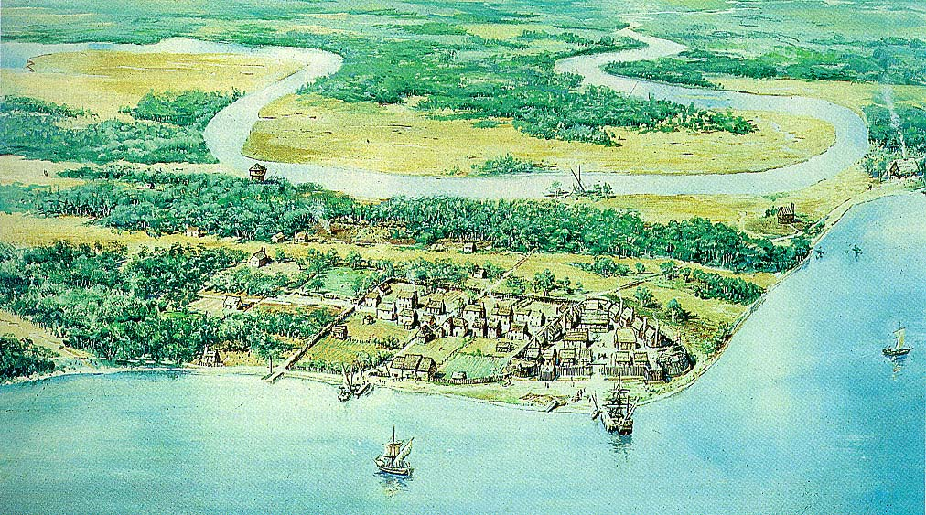
BRAINSTORM: Positives vs. Negatives
of starting a colony HERE?

Slide 5
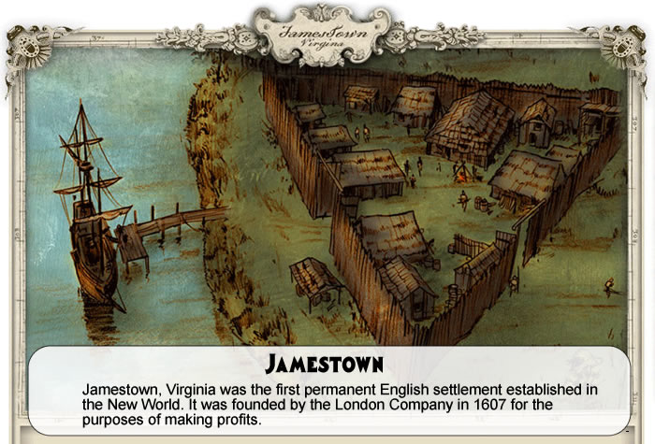
Jamestown - The Story of US

Slide 6
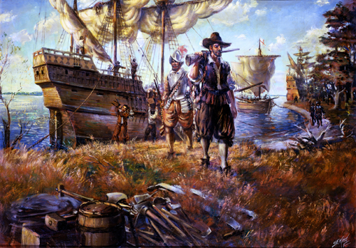
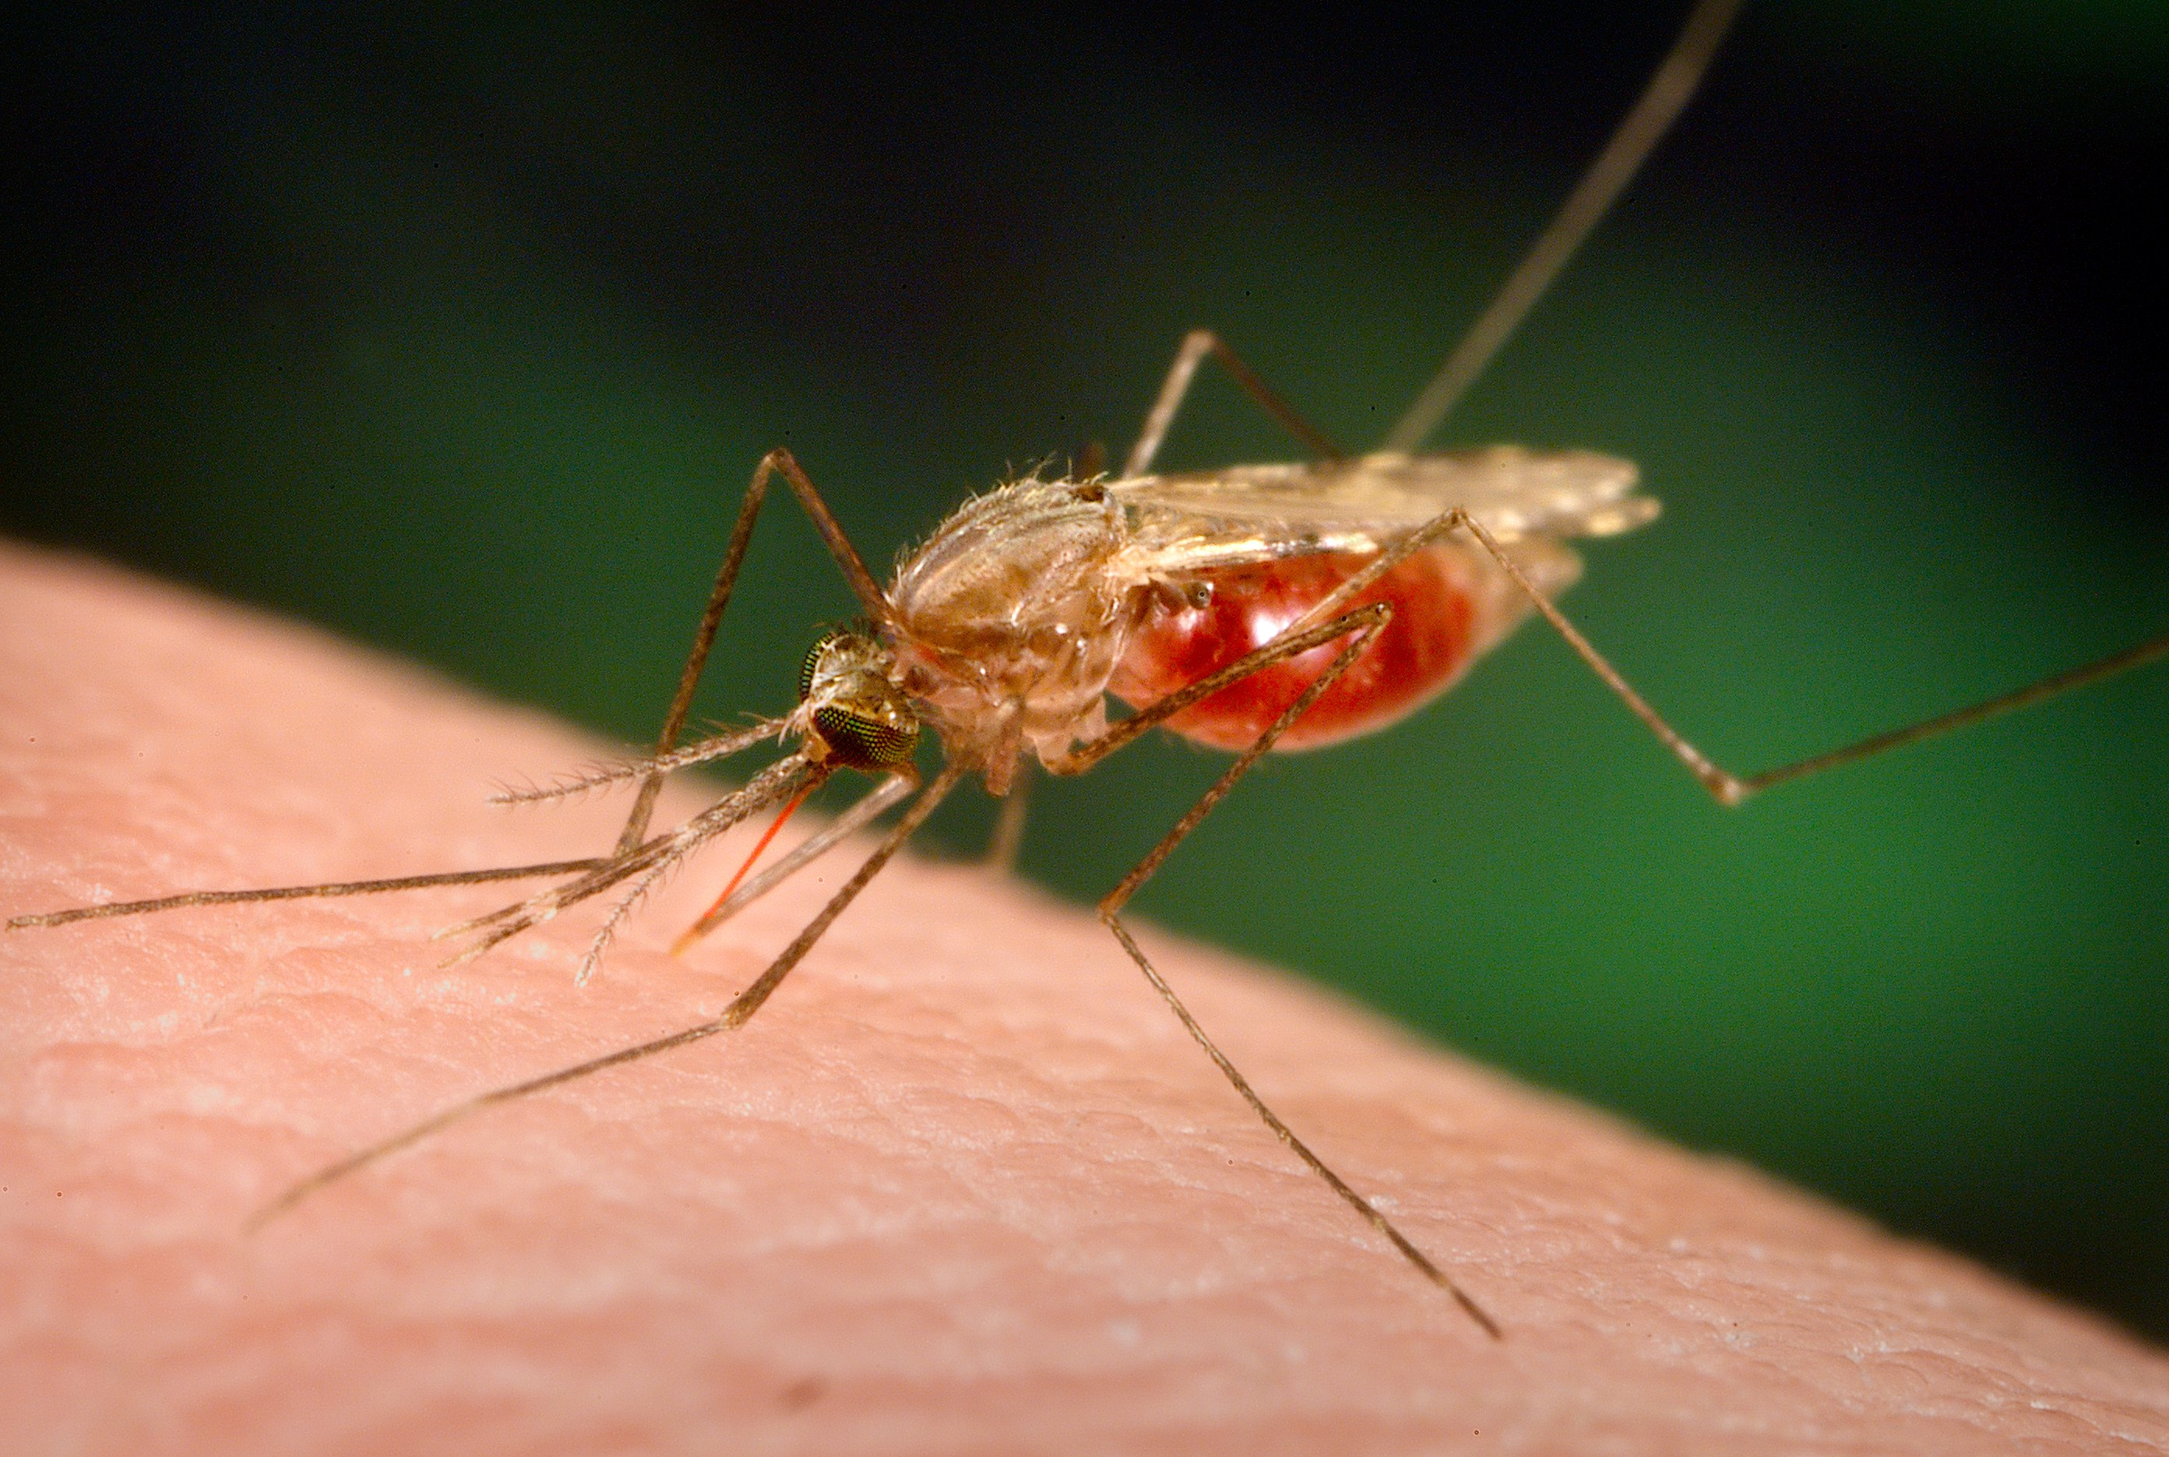
The colonists were NOT well prepared
Most of the colonists who came to Jamestown were adventurers with no farming experience or useful skills
Jamestown was wracked by tragedy during its early years: famine, disease, and war with Amerindians
By 1625, only 1200 of the nearly 8,000 colonists survived.
Only 60 out of 400 settlers survived the "starving time" of 1610-1611.

Slide 7
Account of Life in Jamestown
Gold fever swept the colony. One settler wrote in disgust of how the sailors "made all men their slaves. There was no talk, no hope, no work, but dig gold, wash gold, refine gold, load gold."
Carl Bridenbough in Jamestown 1544-1699 wrote: "... the Englishmen who first went to the colony were an unskilled, improvident, and lazy lot who, 'no more sensible than beasts, would rather starve in idleness ... than feast in labor.' Like the grasshoppers in Aesop's fable, they took little if any thought for the future, and as a result, many of them perished, not only during the 'starving time' but also for years to come because of their failure to plant crops."

Slide 8
Primary Source Analysis
“Nay, so great was our famine, that a Salvage we slew, and buried, the poorer sort tooke him up againe and eat him, and so did divers one another boyled and stewed with roots and herbs: And one amongst the rest did kill his wife, powdered [i.e. salted] her, and had eaten part of her before it was knowne, for which hee was executed, as hee well deserved; now whether shee was better roasted, boyled or carbonado’d, I know not, but of such a dish as powdered wife I never heard of.”
Source: John Smith’s Account of the Starving Time, 1609-10
How did settlers attempt to stave off starvation? (CITE evidence)
How did starvation affect the way that settlers treated one another? (CITE evidence)

Slide 9
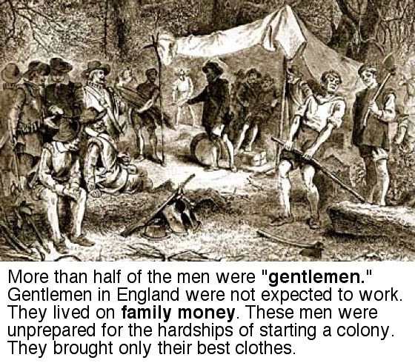

Slide 10
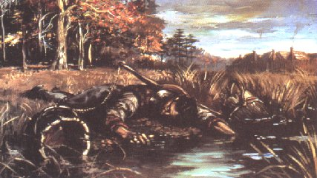
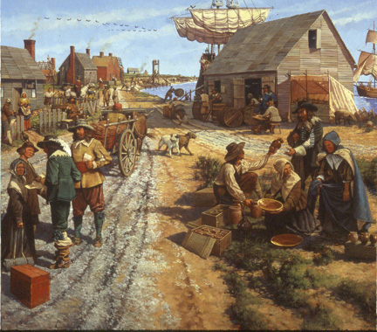
How did they go from
this…to this…
Jamestown 1650's

Slide 11
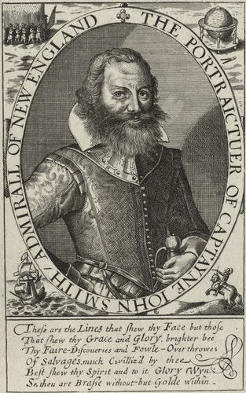
Captain John Smith reorganized the colony beginning in 1608:
He forced settlers to work harder and to build houses
Rewarded good workers with food
“He who does not work, shall not eat!”
Notes:
Source: National Portrait Gallery, London Source: National Park Service

Slide 12
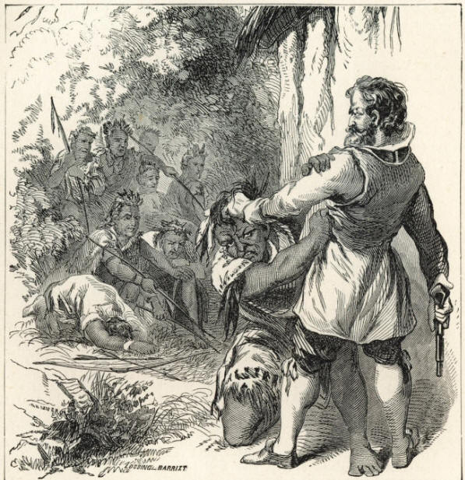
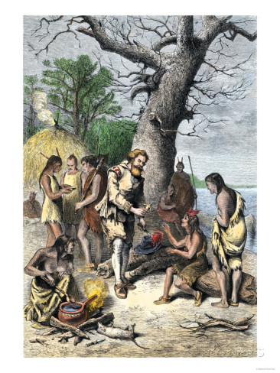
Which view of John Smith would lead to more success?

Slide 13
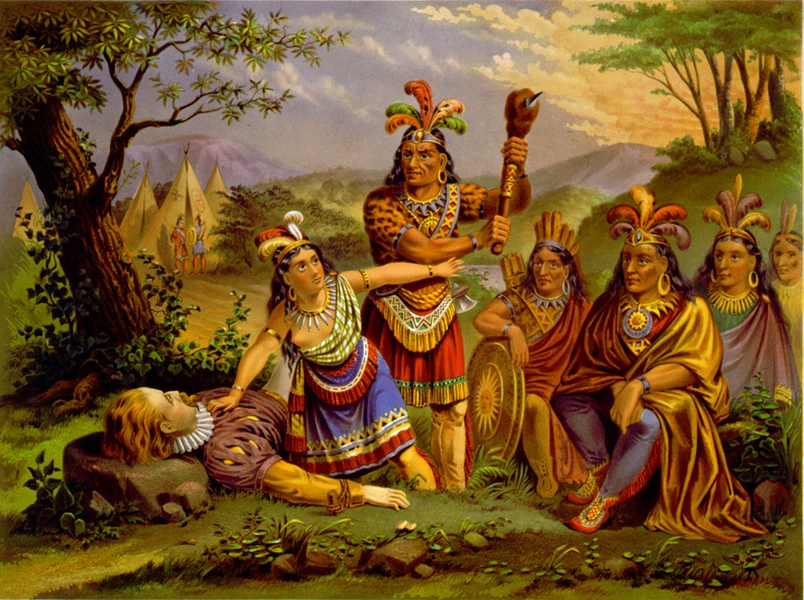
Smith’s leadership helped Jamestown survive the “starving time.”
Smith was kidnapped in Dec. 1607 by Powhatans led by Chief Powhatan who subjected Smith to a what may have been a mock execution.
Smith was perhaps "saved" by Pocahontas, Powhatan's daughter, when she was only 12-years old.
Notes:
Courtesy of National Park Service

Slide 14
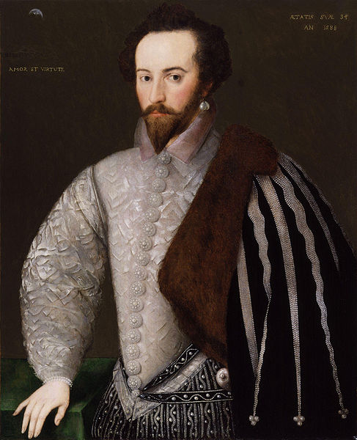
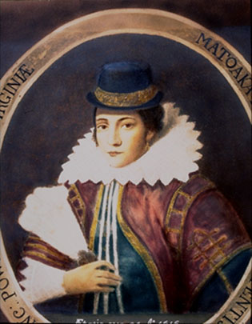
Pocahontas and John Rolfe
Notes:
Images are in the public domain

Slide 15
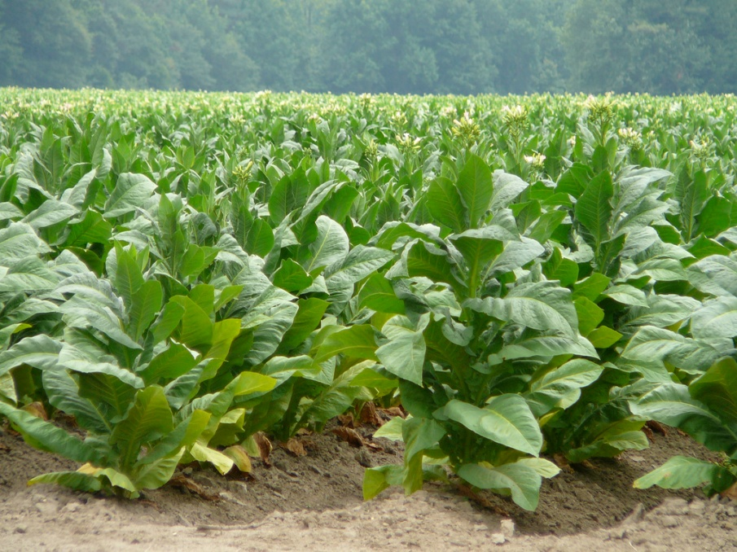
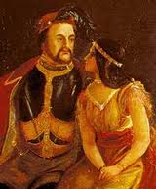
John Rolfe and the tobacco crop economy
a. Rolfe introduced a new tough strain of tobacco and it became perhaps the most important reason for Virginia’s survival.
The Wedding of Pocahantas and John Rolfe, April 1, 1614
Notes:
Source: Wikipedia Commons

Slide 16
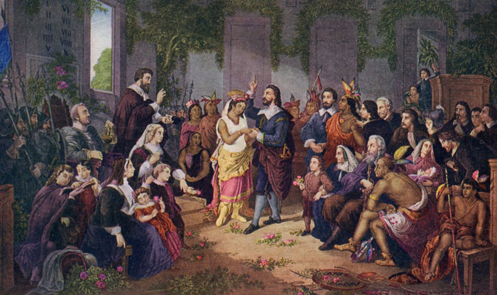
John Rolfe married Pocahontas, who was the daughter of the Powhatan leader
He began experimenting with growing tobacco, eventually using seeds grown in the West Indies to develop Virginia’s first profitable export.
Their marriage helped the colonists form more peaceful relations with the Powhatan natives
The couple sailed to England with their infant son in 1616; seven months later, Pocahontas died as they prepared to travel home.
The Wedding of Pocahantas and John Rolfe, April 1, 1614

Slide 17
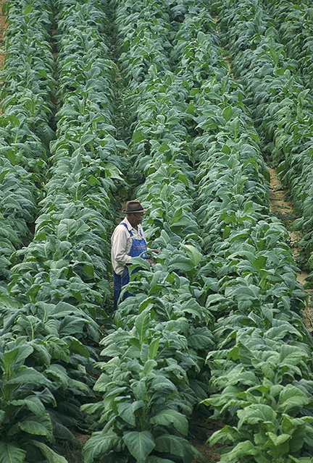
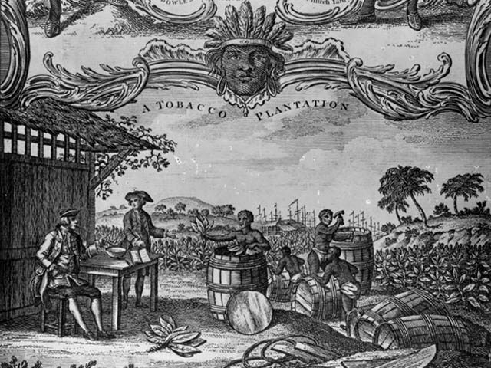
The tobacco industry became the cornerstone of Virginia's economy.
A plantation system emerged.
A modern-day tobacco field.
Notes:
Wikipedia Commons

Slide 18
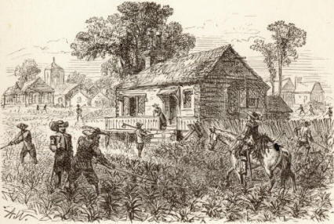
Synthesis: How do you think the introduction of tobacco to the Chesapeake region affect the colony of Virginia?

