Slide 1
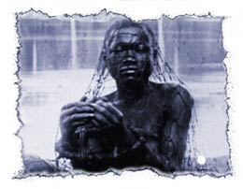
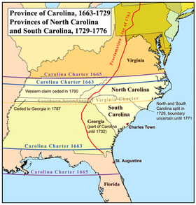
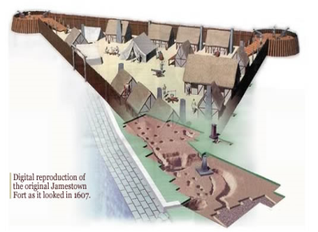
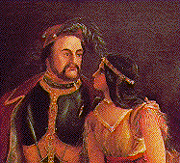
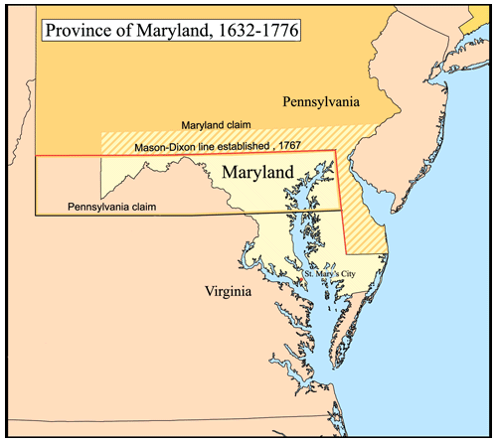
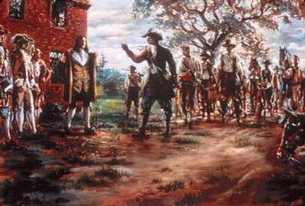
The Southern Colonies in the 17th and 18th Centuries
Period 2: 1607-1754
Jamestown Founded
First Africans Arrive in Jamestown
Carolina Founded
1607
1612
1619
1634
1670
1676
John Rolfe Plants Tobacco in Virginia
Maryland Founded
Bacon’s Rebellion

Slide 2
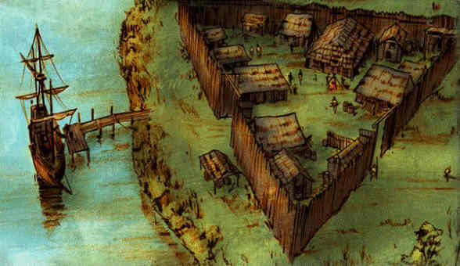
AIM: How and why did the colony of Jamestown develop in Virginia?

Slide 3
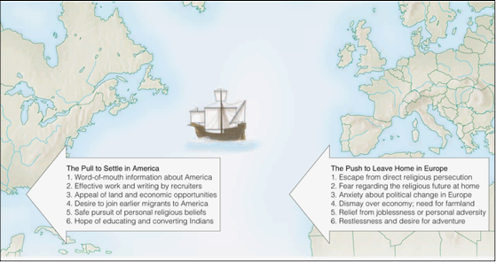
Reasons for Migration in the 17th Century

Slide 4
England’s Search for an
Overseas Empire
Major CAUSES leading to British colonial impulse…
Eventual peace with Spain provided opportunities overseas without harassment (post Anglo-Spanish War);
2. Population growth created a surplus of workers, many of whom became potential colonists; high unemployment;
3. New World had economic opportunity, farm land, adventure, markets, political freedom, religious freedom, social change;
4. Joint-stock companies provided financial means: investors pooled resources for risky sea expeditions…
Notes:
Unit 1 Notes Page 9

Slide 5
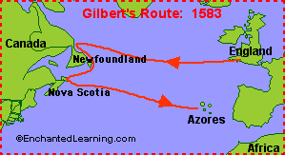
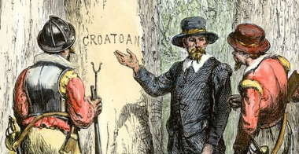
English attempts to colonize in the late-16th century
1. 1583, Sir Humphrey Gilbert attempted to colonize Newfoundland but died while at sea.
2. Roanoke: The Lost Colony

Slide 6
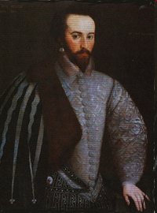
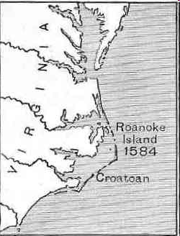
It all Started with the Lost Colony…
Sir Walter Raleigh given rights to claim land for Queen Elizabeth in August 1587
1st sends Philip Amadas and Arthur Bartlowe to check out sites
Find Roanoke Island off coast of NC
They depend too much on NA’s, strain relations, 1st attempt fails

Slide 7
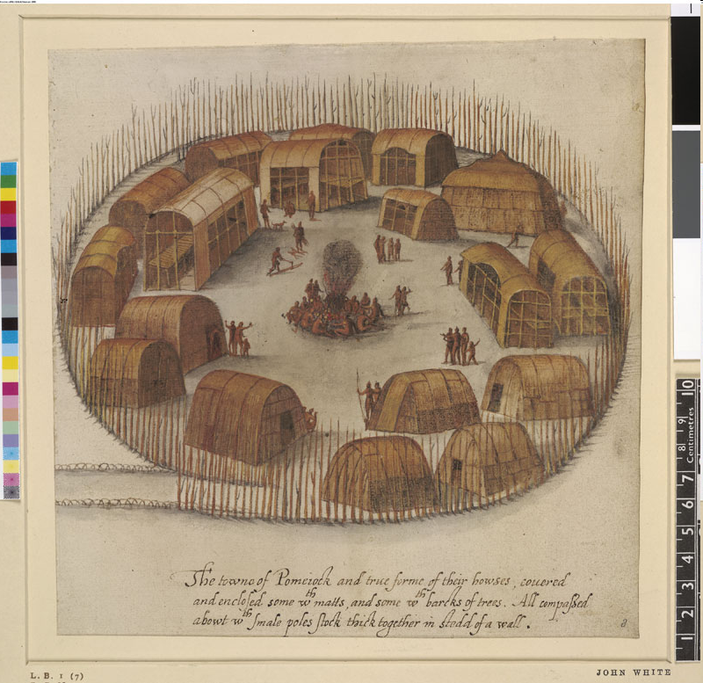
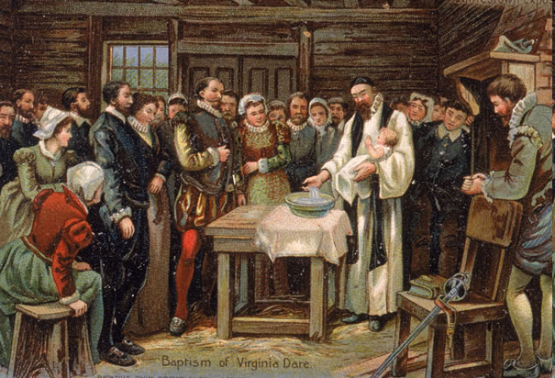
2yrs later Raleigh sends John White and more men
White has to return to England for supplies and gets stuck there for 3yrs due to war with Spain
White left his daughter there and his grand daughter is born– Virginia Dare– 1st English child born in the new world

Slide 8
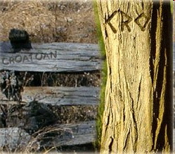
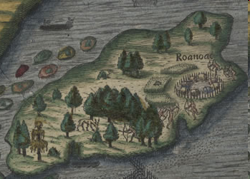
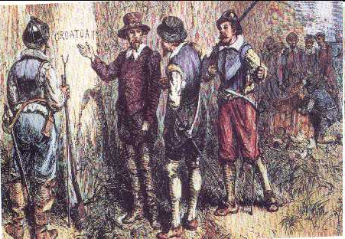
When White returns, the settlement is abandoned, supplies left, no bodies
Only clue is word “Croatoan” carved several places nearby
White can’t search because of a hurricane, returns to England
No one knows what happened to settlers, Croatan Indians kill them? Live with them? Went and settled in mainland NC?

Slide 9
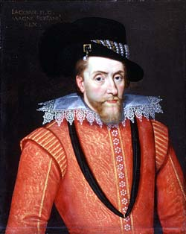
A. Virginia (founded in 1607 by the Virginia Company)
1. Jamestown (1607): first permanent British colony in the New World
a. Virginia Company: joint-stock company that received a charter from King James I in 1606 to establish settlements in North America.
Main goals: Promise of gold, conversion of Amerindians to Christianity, and new passage through North America to the East Indies.
Consisted largely of well-to-do adventurers.
Yes, you may
settle in Virginia.
Notes:
Courtesy of National Park Service

Slide 10
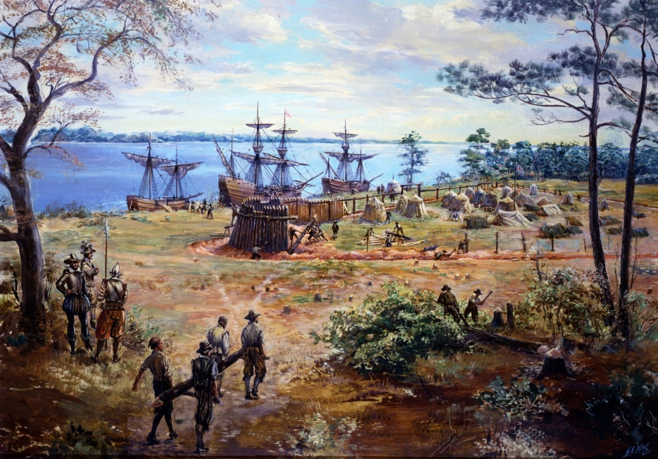
b. Virginia Charter
Overseas settlers were given same rights of Englishmen in England.
Became a foundation for American liberties; similar rights would be extended to other North American colonies.
Notes:
Courtesy of National Park Service

Slide 11
