Slide 1
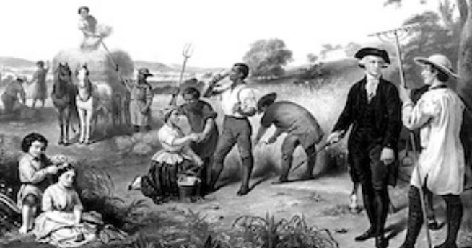
AIM: What were the impacts of indentured servitude in Jamestown?

Slide 2
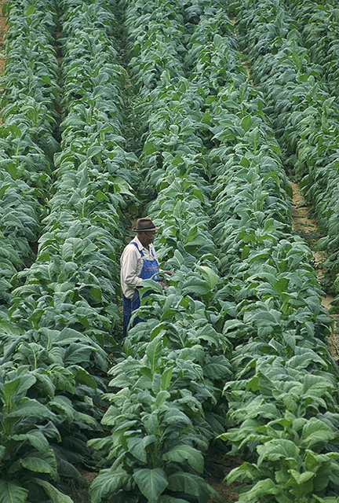
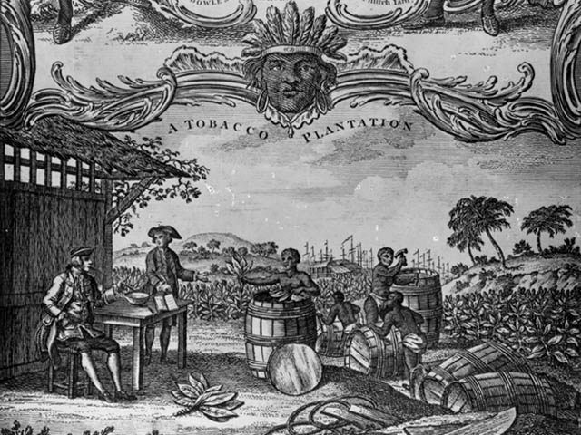
Remember from yesterday…
The tobacco industry became the cornerstone of Virginia's economy.
A plantation system emerged.
A modern-day tobacco field.
Notes:
Wikipedia Commons

Slide 3
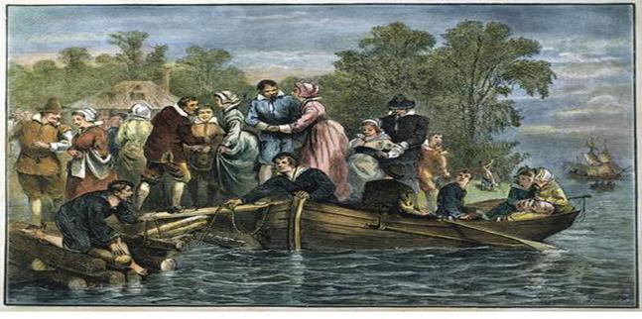
One solution for the labor shortage…
Indentured Servitude
Indentured servants usually received passage to the New World in exchange for four or five years of service (later extended to SEVEN years!)
The system was also extended to include the Irish, a group viewed as less civilized than the English and more like the "savage" American Indians.

Slide 4
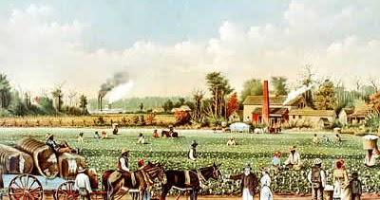
)
Indentured Servitude Institution
(1607 - 1700)
Freedom Dues: Once servant completed his contract, he/she was freed….They were given land, tools, seed and animals.
However, they did not receive voting rights**

Slide 5
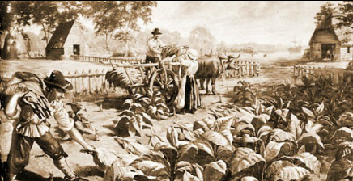
Indentured Servants
More men than women came to the New World as indentured servants.
Women were outnumbered 4:1 and made up only 20 percent of the servant population.
Women were not allowed to marry while a servant, so many became pregnant out of wedlock.
Some pregnant women escaped servitude while others had to add two years to their term of service.

Slide 6
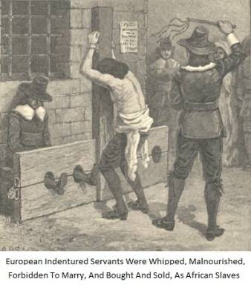
Indentured Servants
There was almost no incentive to keep indentured servants well fed or healthy, so many servants were mistreated.
Some owners bought and sold indentured servants even though this was illegal, and some servants complained of being treated as slaves.

Slide 7
Quick thought…
What were the advantages of indentured servitude to the “owners”?
Cheap source of labor
Little cost, no incentive to keep servants well fed or healthy
Headrights

Slide 8
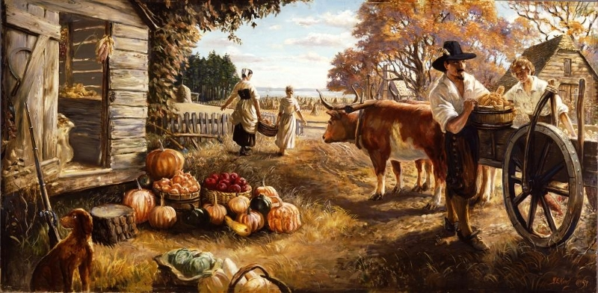
The Headright System
Originally created in 1618 in Jamestown, Virginia.
It was used as a way to attract new settlers to the region and address the labor shortage.
With the emergence of tobacco farming, a large supply of workers was needed.
HEADRIGHT = a grant of land, usually 50 acres

Slide 9
The Headright System
Colonists already residing in Virginia were granted two headrights, meaning two tracts of 50 acres each, or a total of 100 acres of land.
New settlers who paid their own passage to Virginia were granted one headright.
Since every person who entered the colony received a headright, families were encouraged to migrate together.
Wealthy individuals could accumulate headrights by paying for the passage of poor individuals (indentured servants)
Plantation owners were further enriched by receiving headrights for newly imported slaves.
As a result…
More people = MORE WORKERS!

Slide 10
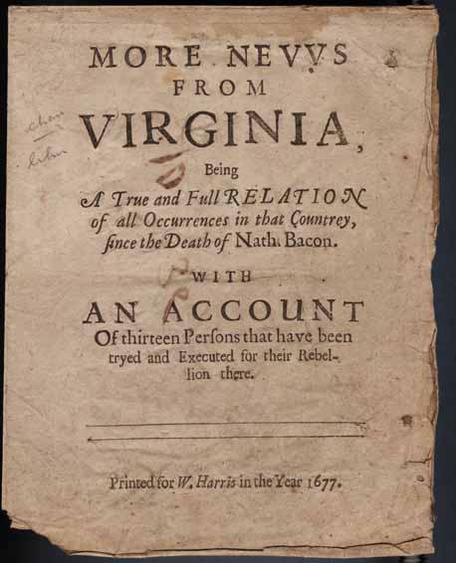
BACON'S REBELLION
Involved former indentured servants (too poor to own land)
Not accepted in Jamestown
Deprived and unable to receive their land
They got FRUSTRATED!
Gov. Berkeley would not defend settlements from Indian attacks

Slide 11
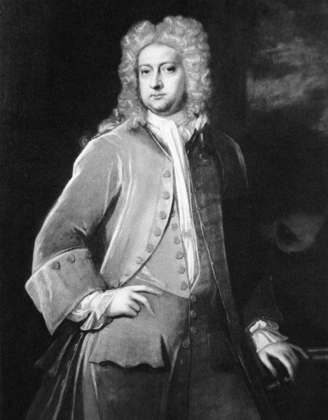
CAUSES of BACON’S REBELLION…
High taxes
Low prices for tobacco
Resentment against special privileges given those close to the governor
Gov. Berkeley's failure to defend the frontier against attacks by Native Americans.
All is good with
the natives…

Slide 12
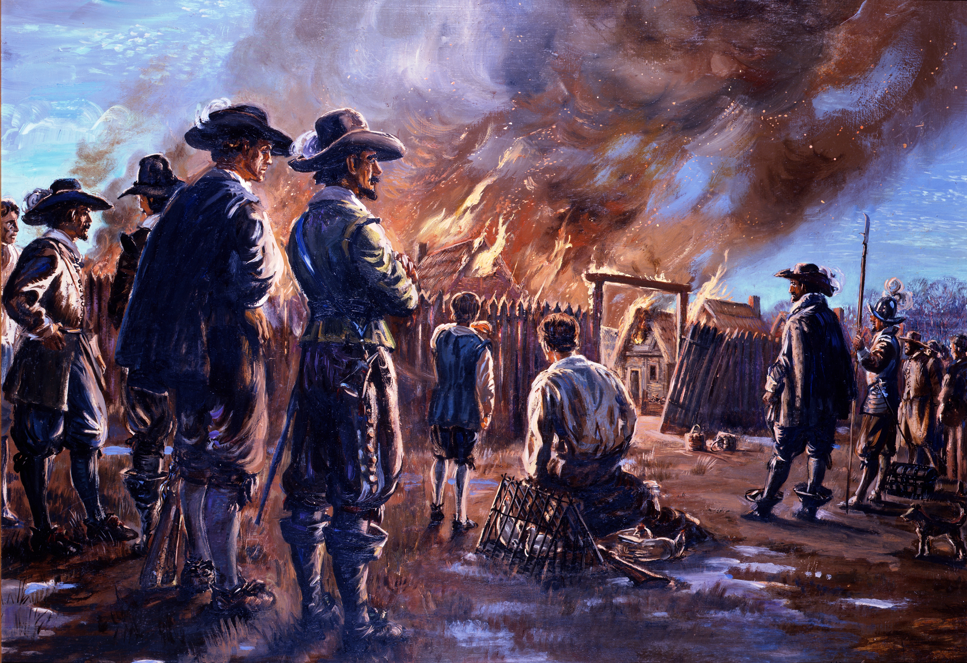
Nathaniel Bacon, an aristocrat in western Virginia and member of House of Burgesses, began mobilizing a militia to protect whites from natives.
In 1676, Bacon's militia massacred natives and set fire to Jamestown, forcing Governor Berkeley out of the city.
Bacon’s rebels were opposed to aristocrats and the natives.

Slide 13
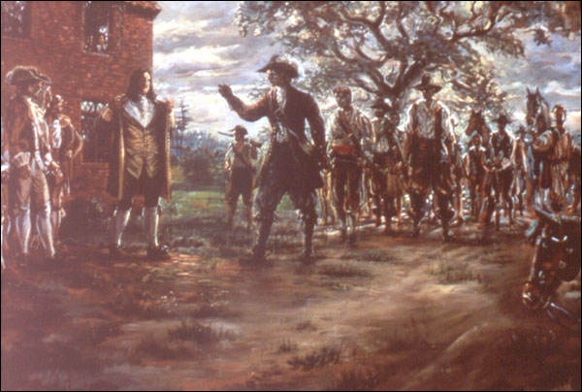
BACON'S REBELLION
Nathaniel Bacon was acting as the representative for the poor rebels
Gov. Berkeley refused to meet their conditions and erupts into a civil war.
Bacon dies, Gov. Berkeley puts down rebellion and several rebels are hung
Consequence of Bacon’s Rebellion Plantation owners gradually replaced indentured servants with African slaves because it was seen as a better investment in the long term than indentured servitude.

Slide 14
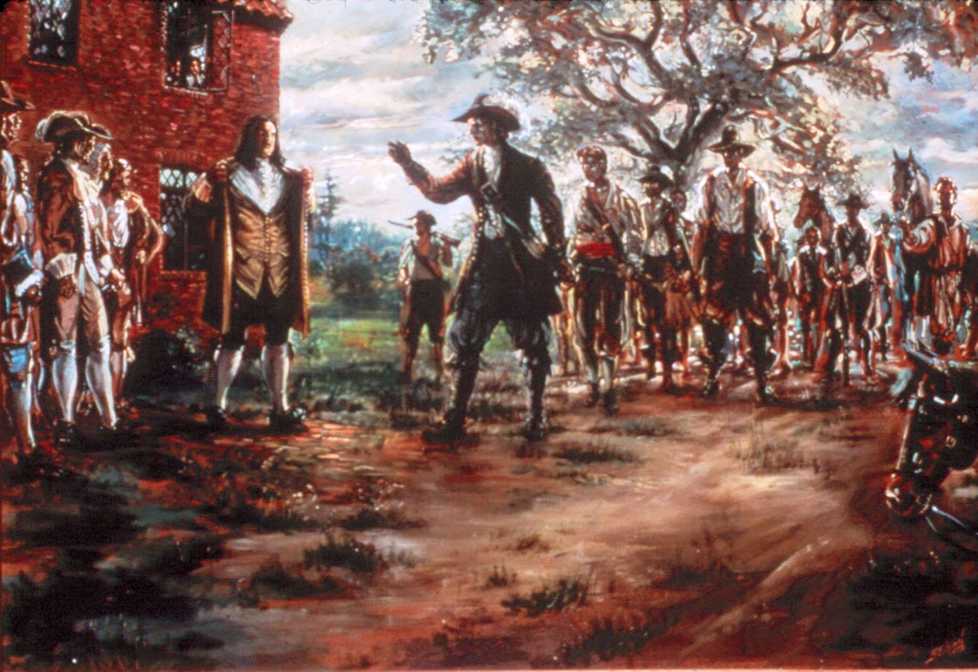
Nathaniel Bacon (center) confronts Governor Berkeley (left)
Notes:
Courtesy of National Park Service Painter: Sidney King

Slide 15
Impact of Bacon’s Rebellion
Planters saw white indentured servants as too difficult to control and significantly increased importation of black slaves while reducing the number of white indentured servants.
Planter elite increasingly played the "race card": encouraged poor whites to discriminate against blacks.
Planters feared another alliance again in the future = REBELLION PART 2
Planters effectively controlled poor whites psychologically by emphasizing that poor whites, despite poverty, would always be "superior" to blacks.

Slide 16
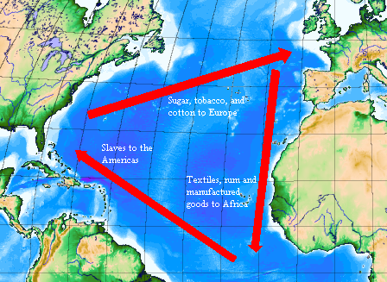
MAJOR
INCREASE

Slide 17
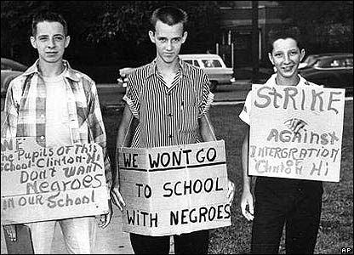
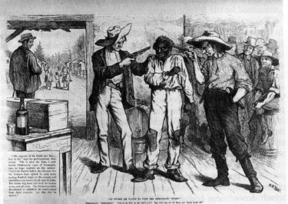
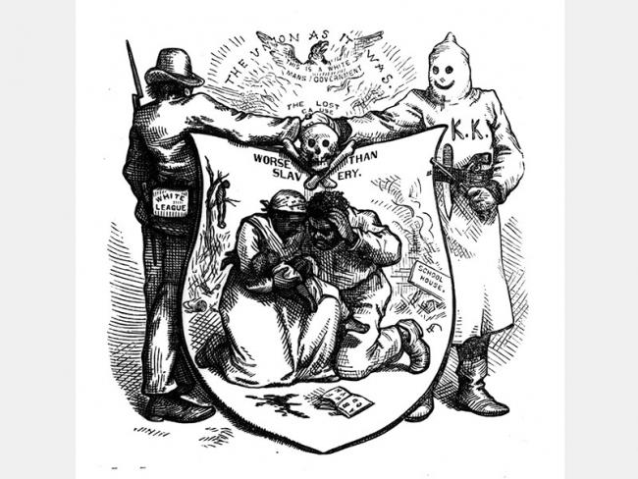
Synthesis Alert!
Slavery became more and more race based and the legacy of pitting whites against blacks continued to what time periods in history??

Slide 19
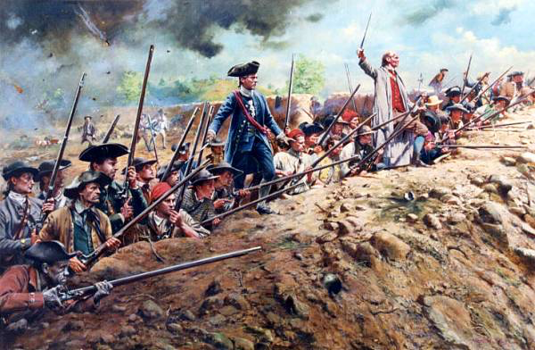
Think about this…
What connection can you make from Bacon’s Rebellion to the American Revolution?
Rebelling against control from distant government (Britain)…over taxes and Native American threat on the frontier!!!
Notes:
Rebelling against control from distant government…over taxes and Native American threat on the frontier!!!

