Slide 1
Europeans Enter Africa
Europe was aware of sub-Saharan civilizations but no contact
Portuguese establish trading posts on coast beginning in 1450s
Gold and slaves
Slaves were used on sugar plantations in Atlantic islands
Foundation for American plantation system
Bartholomeu Dias rounded Africa in 1488
Vasco da Gama made it to India by going south of Africa in 1498

Slide 2
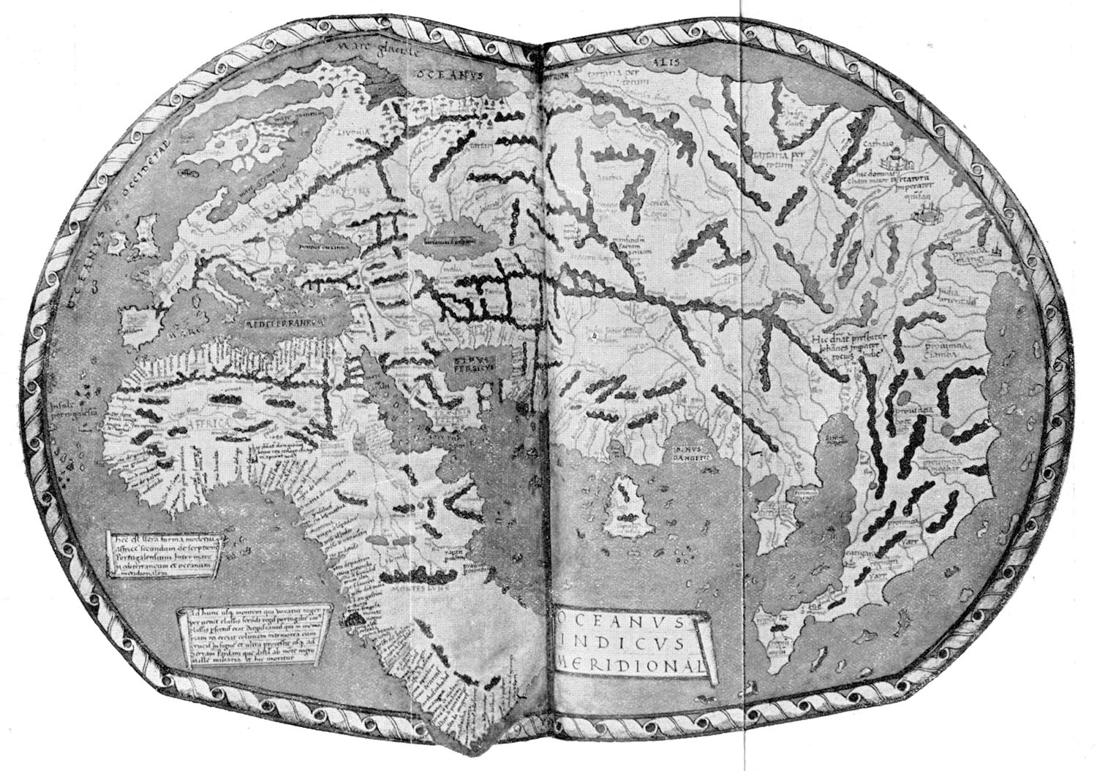
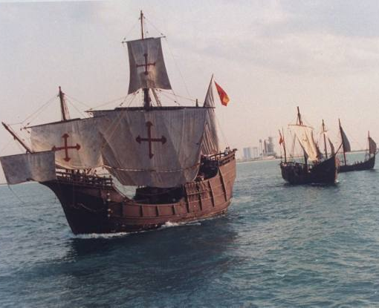
Columbus Comes Upon a New World
Columbus’ plan was rejected by Portugal
King Ferdinand and Queen Isabella of Spain funded the voyage
given ships Nina, Pinta and Santa Maria
Columbus left Spain August 3, 1492, arrived October 12
First land sighted was in Bahamas
By 1494 Columbus decided to “subjugate by force of arms” the Taino, Arawak and Carib people
World Map 1492
Replicas of Nina Pinta Santa Maria on 500th Anniversary

Slide 3
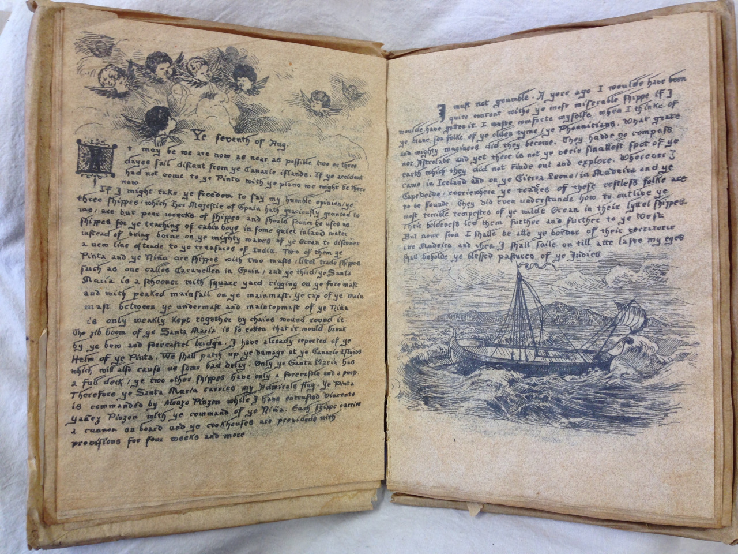
The Diary of Christopher Columbus
Primary Source Analysis

Slide 4
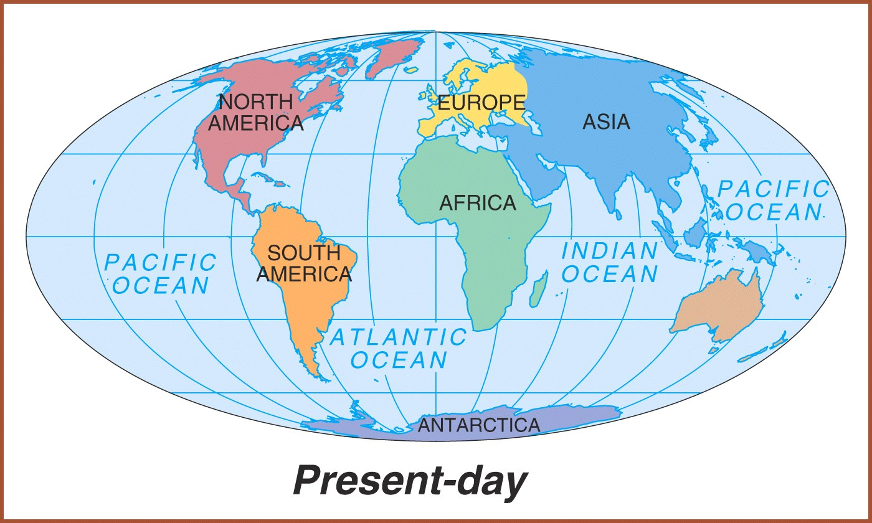
NEW WORLD
OLD WORLD

Slide 5
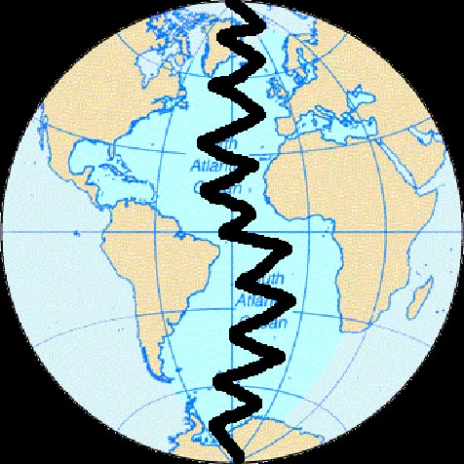
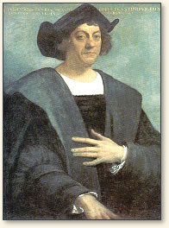
Before Columbus sets sail in 1492
Two sets of culturally diverse peoples
Two very different environments
Notes:
Before Columbus crossed the Atlantic, the Eastern Hemisphere (that is Europe, Africa and Asia) and the Western Hemisphere (that is the Americas) were two very different ecosystems. These ecosystems had been developing in biological isolation for thousand and thousand of years. This meant that there were two different disease pools and two sets of flora and fauna, as well as two sets of culturally diverse peoples.

Slide 6
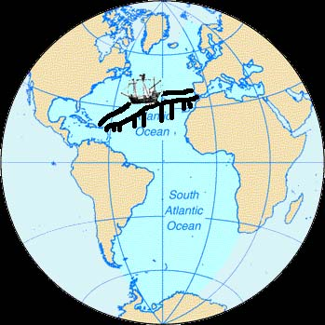
The two cultures COLLIDED, and created
brand new interactions and exchanges.
NEW World
OLD World
Notes:
Two Biological Ecosystems Merge To Create A New World Ecology
When Christopher Columbus brought these two hemispheres (these two very different worlds) in contact with one another by crossing the Atlantic in 1492, he effectively brought together two biological ecosystems which then interchanged over the years to create a new world ecology. The development of this intermixed world ecology had profound consequences for humans.

Slide 7
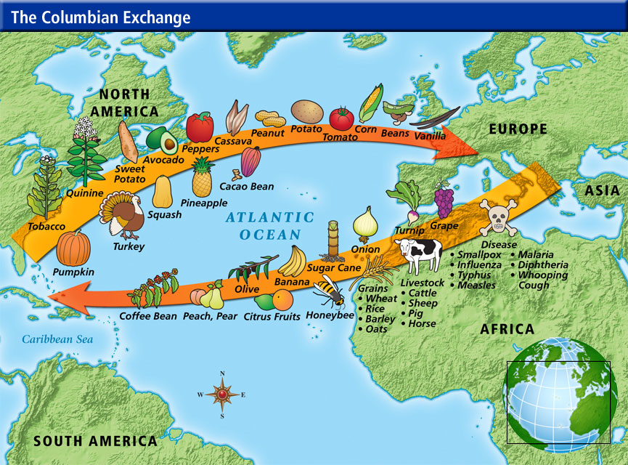
This interaction was known as the: Columbian Exchange

Slide 8
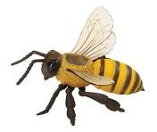
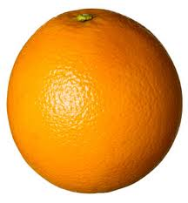
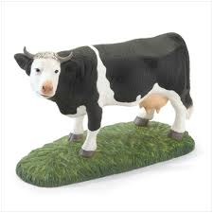
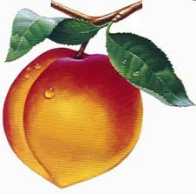
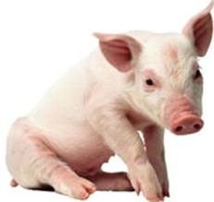
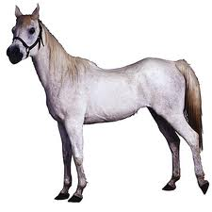
Imagine a life without…
Honeybees
Peaches
Coffee
Onions
Bananas
Citrus Fruits
Wheat
Rice
Cows
Sheep
Pigs
Horses

Slide 9
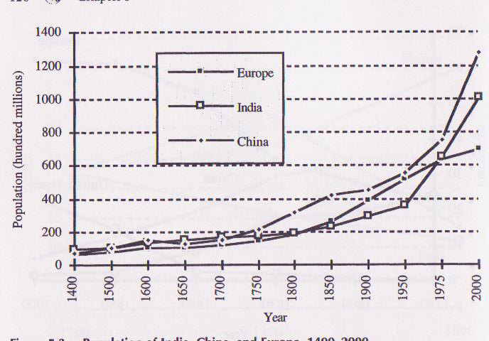
POSITIVE Impact of the Columbian Exchange
Introduction of new crops from the Americas to Europe, Africa, and Asia led to population growth.
People across the world had better nutrition.

Slide 10
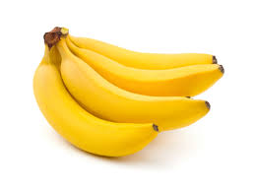
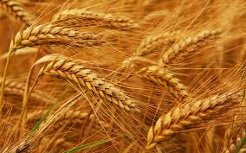
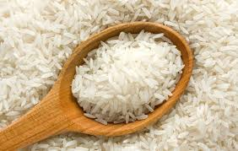
Columbian Exchange
Old World (Europe) ➔ New World (Americas)
Plants:
rice melons
wheat olives
barley dandelions
oats daisies
coffee ragweed
sugarcane
bananas

Slide 11
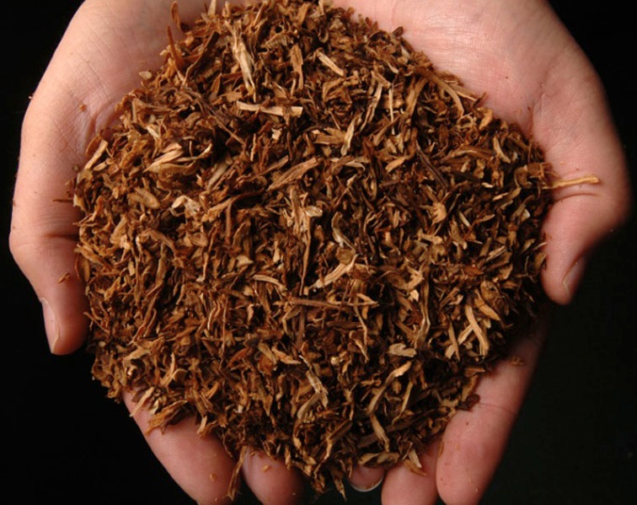
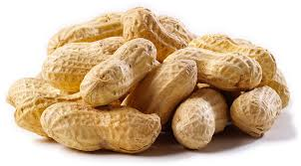
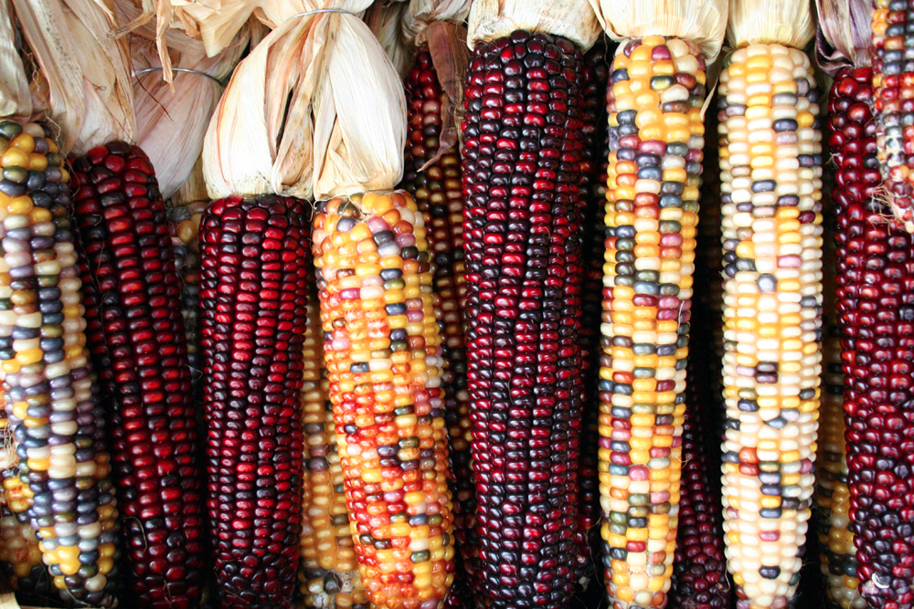
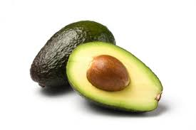
Columbian Exchange
New World (Americas) ➔Old World (Europe)
Plants:
avocados pumpkins
peanuts pineapple squash
corn (maize) tobacco
potatoes (white / sweet)
beans (snap / kidney, lima)
cacao (source of chocolate)
chicle (source of gum)

Slide 12
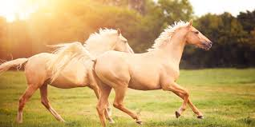
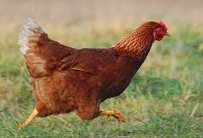
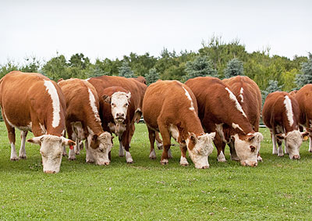
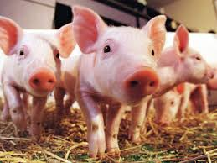
Columbian Exchange
Old World (Europe) ➔New World (Americas)
Animals:
horses
cattle
pigs
sheep
goats
chickens

Slide 13
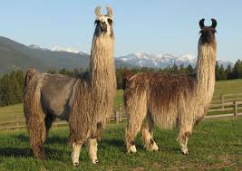
Columbian Exchange
New World (Americas) ➔Old World (Europe)
Animals:
llamas
alpacas
guinea pigs

Slide 14
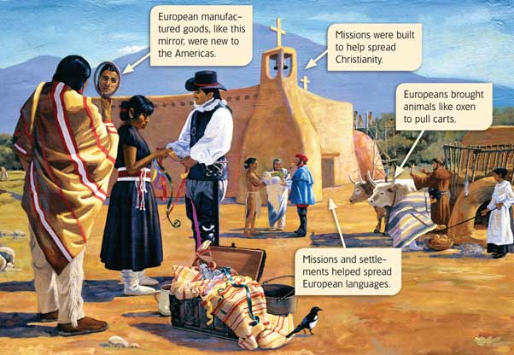
POSITIVE Impact of the Columbian Exchange
Increased cultural diffusion (the spread of one culture to another)
Europeans were influenced by Native American foods as well as African farming methods, cooking styles, and music
Spread of European languages
Spread of Christianity

Slide 15
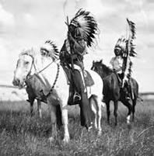
POSITIVE Impacts of the Columbian Exchange
The combination of new products and ideas promoted economic growth in Europe
Gold and wealth change power and social structure in Europe
Horses and guns changed methods of fighting and hunting in the Americas.

Slide 16
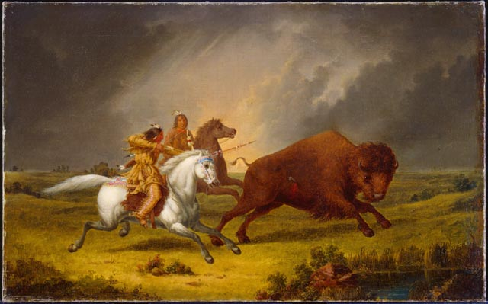

Slide 17
Lets see what you recall…
What was an economic result of the Columbian exchange?
Establishment of a feudal land system in Europe.
Development of a European-dominated global trade network.
Introduction of slash-and-burn farming techniques in the Americas.
Creation of the English Bill of Rights.

Slide 18
Think about this…
Why would the
'Columbian Exchange'
be considered the
tsunami of
unintentional
"bio-terrorism"??

Slide 19
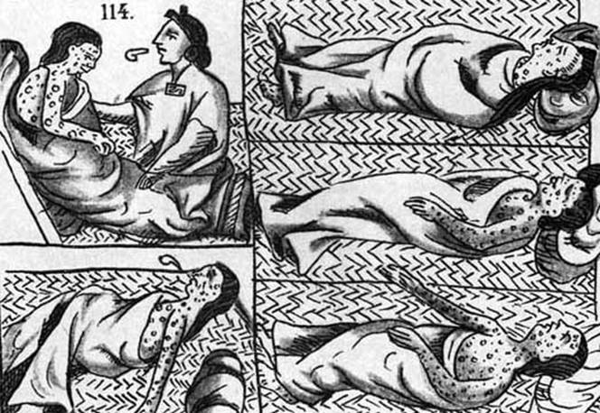
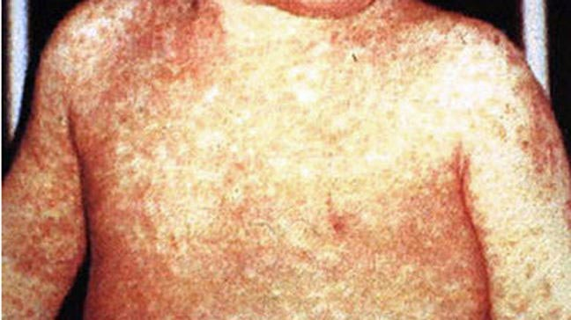
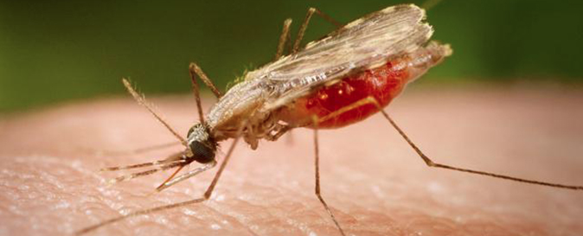
Now, imagine life without…
Whooping Cough
Smallpox
Measles
Malaria
Influenza (the flu)

Slide 20
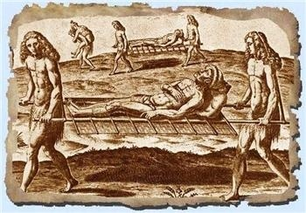
Columbian Exchange
Old World (Europe) ➔New World (Americas)
Disease:
measles
chicken pox
smallpox
yellow fever
Malaria
influenza (flu)
common cold

Slide 21
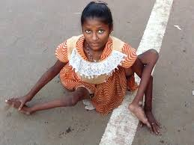
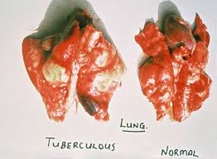
Columbian Exchange
New World (Americas) ➔Old World (Europe)
Disease
Syphilis
Hepatitis
Polio
Tuberculosis

Slide 22
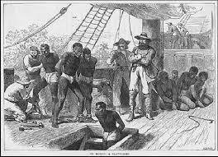
NEGATIVE Impacts of the Columbian Exchange
Diseases spread and killed a lot of people AND animals in the New World.
Slaves were traded across the Columbian Exchange
Europeans treated slaves BADLY because they felt that they were the better race!

Slide 23
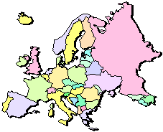
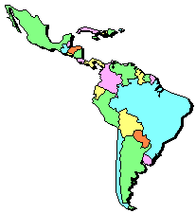
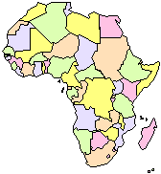
Columbian Exchange or the transfer of goods involved 3 continents, Americas, Europe and Africa
* Squash * Avocado * Peppers * Sweet Potatoes * Turkey * Pumpkin * Tobacco * Quinine * Cocoa * Pineapple * Cassava * POTATO * Peanut * Tomato * Vanilla * MAIZE * Syphillis
* Olive * Coffee Beans * Banana * Rice * Onion * Turnip * Honeybee * Barley * Grape * Peach * Sugar Cane * Oats * Citrus Fruits * Pear * Wheat * HORSE * Cattle * Sheep * Pig * Smallpox * Flu * Typhus * Measles * Malaria * Diptheria * Whooping Cough
https://www.youtube.com/watch?v=fw0olvF-0ic

