Slide 1
AIM: How did the American Revolution impact the victorious Patriots, as well as other groups of people living in America?

Slide 2
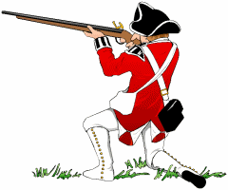
The BRITISH (20-30%)
The British STRENGTHS
Well-equipped
Trained army
BEST navy
50,000 Loyalist supporters
African Americans = promised their freedom for fighting
Mercenaries
The British WEAKNESSES
NOT POPULAR in Britain = English citizens pay taxes for war!
NOT on their own soil
RESISTANT to Native American fighting styles

Slide 3
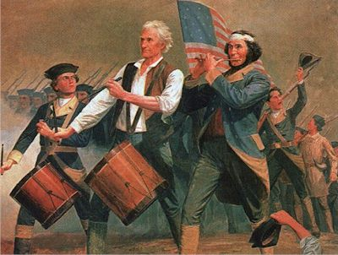
The PATRIOTS (40%)
Most from VA and NE
STRENGTHS:
Their own soil
GUERILLA WARFARE
G. Washington = LEADER
MAJORITY of the population
Emotionally invested
WEAKNESSES:
New recruits always arriving
Reluctant to travel outside own region – WHY?
Couldn’t raise enough funds
Rarely paid

Slide 4
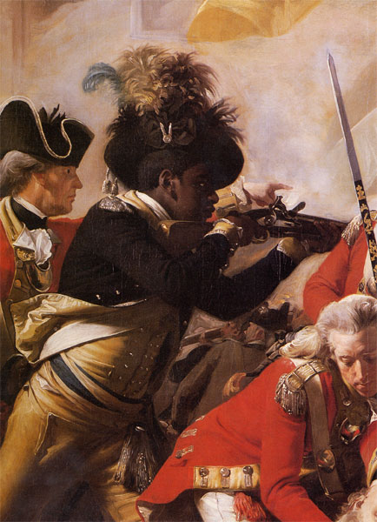
African Americans and the Revolution
SLAVERY = contradicted “all men created equal”
Some states freedom, most no change
Continued tension between liberty and slavery
AFTER the revolution = slave labor essential to economy

Slide 5
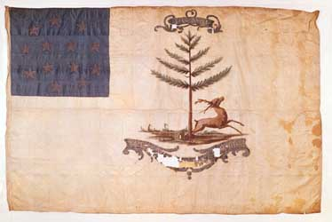
African Americans and the Revolution
GW initially rejected the idea of them as Patriots – WHY?
5,000 fought for Patriots (mostly free citizens from North)
Most mixed racial forces
Some all black units (Bucks of America)

Slide 6
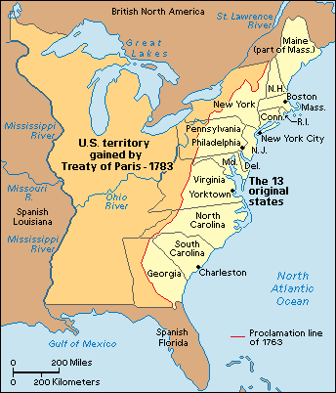
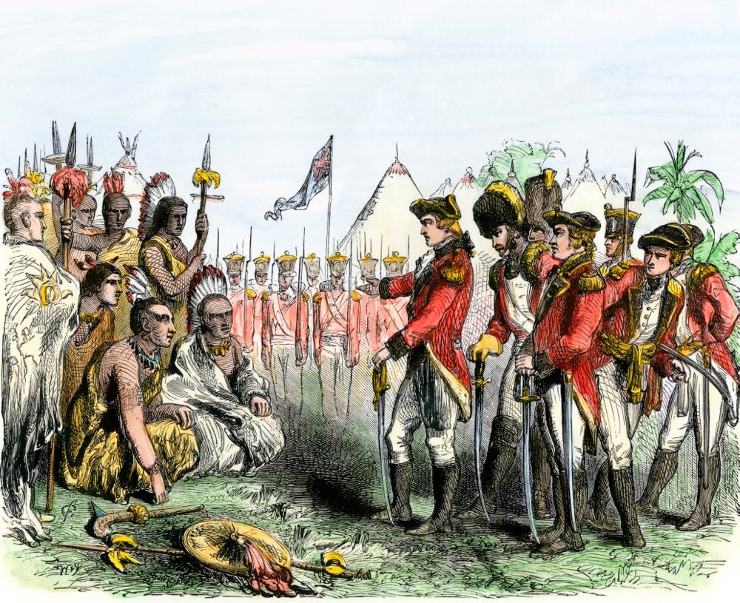
Native Americans
STAY OUT of the war!
Didn’t want to support the Patriots…WHY?
Victory over the British meant a victory over Natives too
Iroquois Confederacy falls apart
Treaty of Paris 1783 = Americans get Natives land west

Slide 7
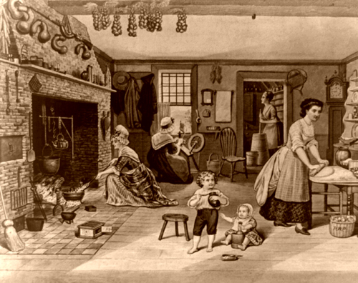
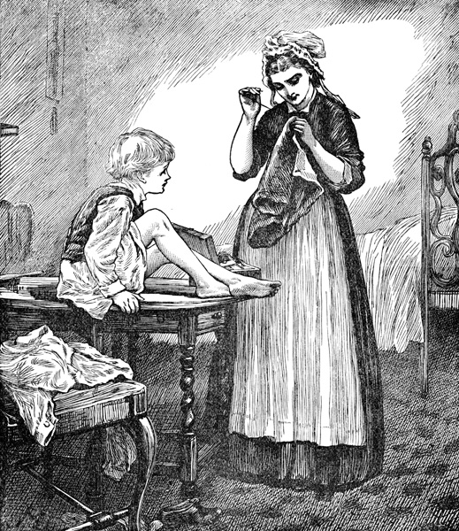
Women of the Revolution
Nurses
Cooks
Maids

Slide 8
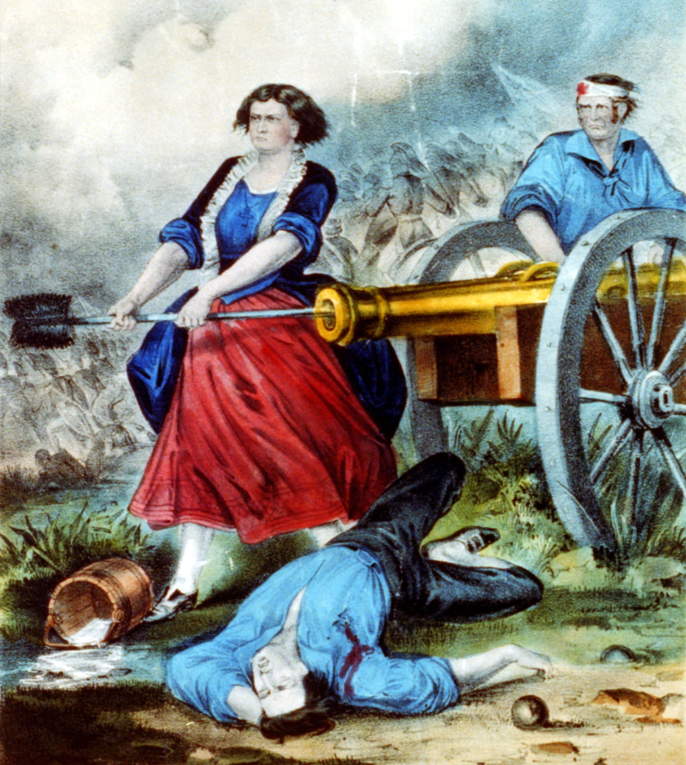
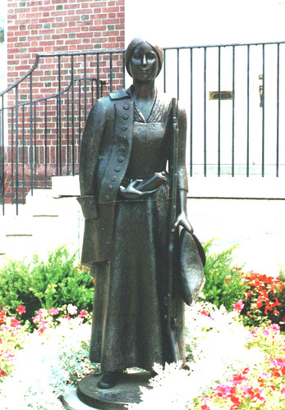
Women of the Revolution
Molly Hayes (AKA Molly Pitcher) is one example of a woman who traveled with her husband and got her nickname by carrying pitchers of water to the soldiers. It is said that her husband got wounded and she took over.
Deborah Sampson enlisted in the Army disguised as a man. She was discovered when she got wounded and had to be examined by a doctor. She was unfortunately discharged and later gave lectures about her experience, all while proudly wearing her uniform.

Slide 9
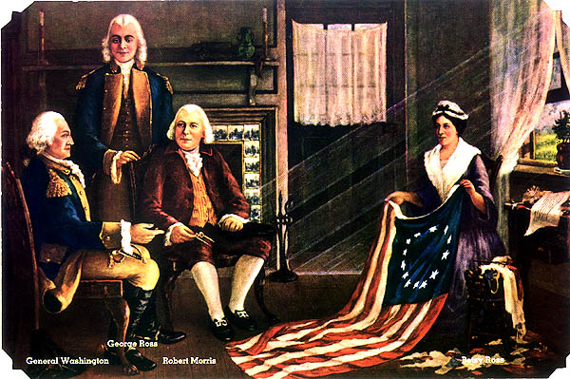
Betsy Ross
Believed to have designed the first American Flag in June 1776
George Washington, George Ross, and Robert Morris (members of the Continental Congress) asked for her help.
The flag had 13 stripes, and thirteen stars on a blue background.

Slide 10
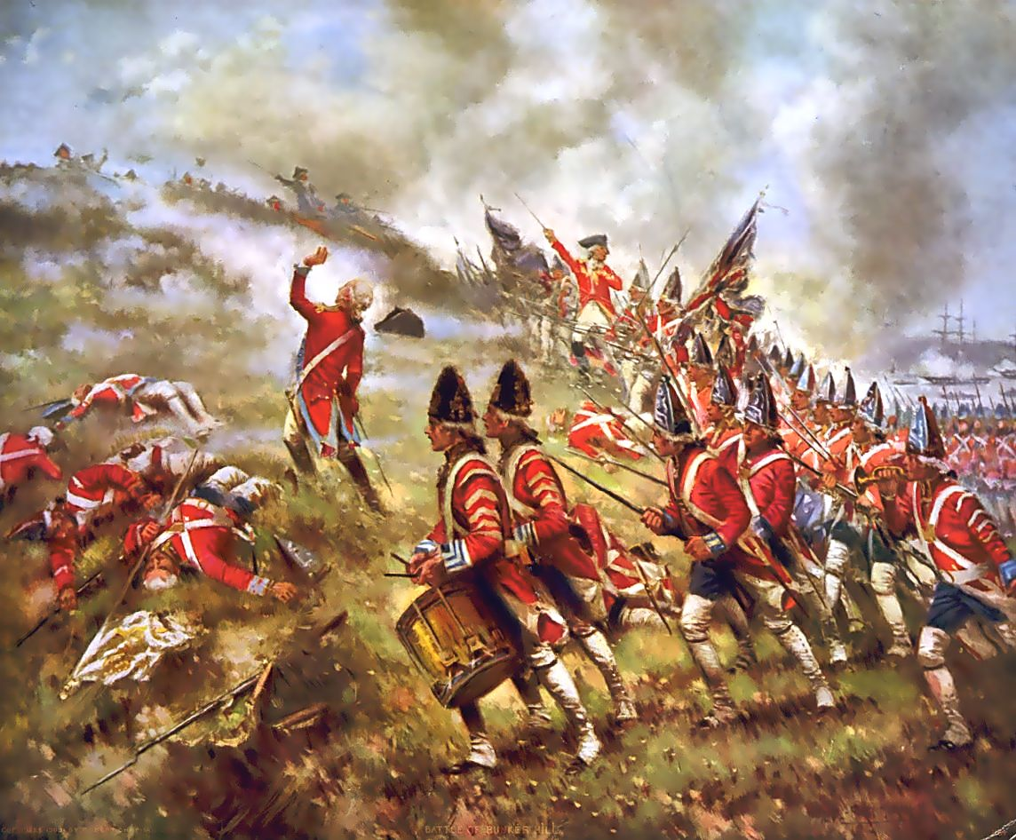
The American Revolution
The Battle of Bunker Hill (June 1775)
Casualties:
Colonials British
311 1000
Deadliest battle of American Revolution.

Slide 11
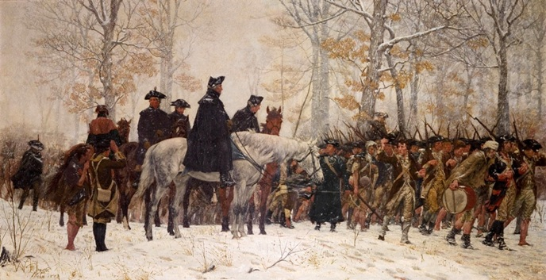
Initial American Losses
After losing in Philadelphia, Washington’s troops suffered through a severe winter at Valley Forge, PA (1777-78)
1775-1777 – VERY BAD for Washington’s army
Battle for NYC = British lopsided victory
British occupied NYC and Philadelphia
British occupied American ports
95% decline in trade for Patriots
Inflation increased
Continental Army:
19,000 untrained
recruits/poor equipment – FORCED TO RETREAT INTO PA

Slide 12
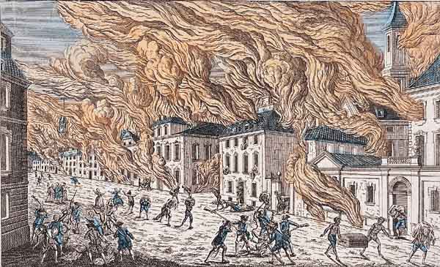
Battle for New York City
Summer 1776
New York City in Flames (1776)

Slide 13
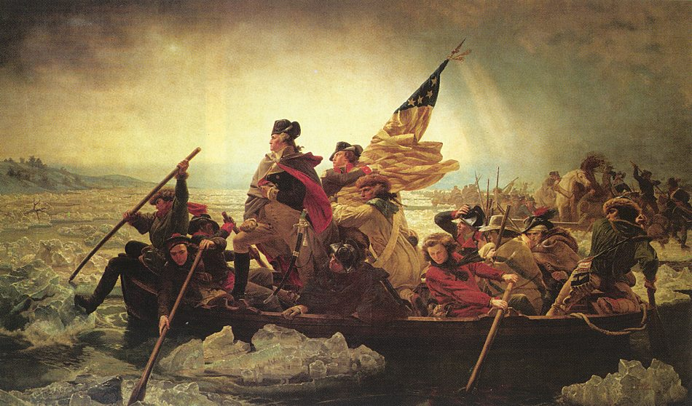
BATTLE OF TRENTON --surprise attack, defeated Hessians with minimal ammunition.
Christmas night (1776) Washington leads the Continental Army across the Delaware River into New Jersey.

Slide 14
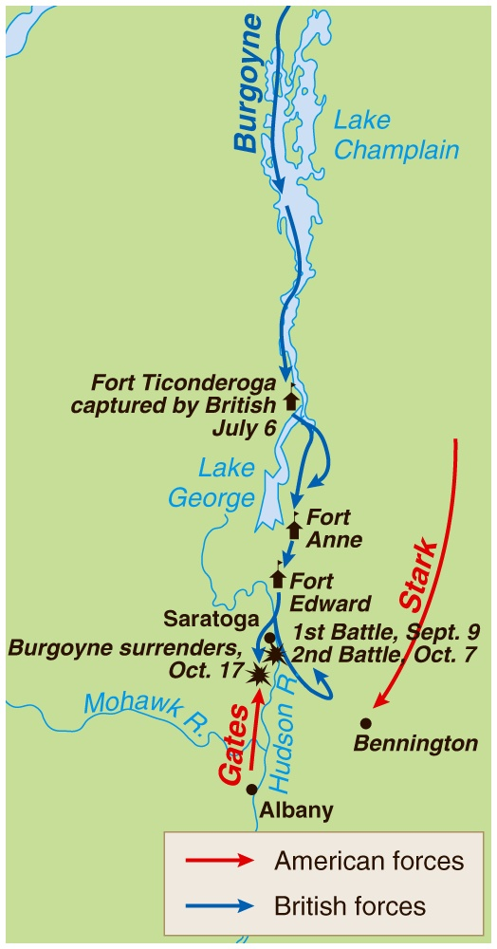
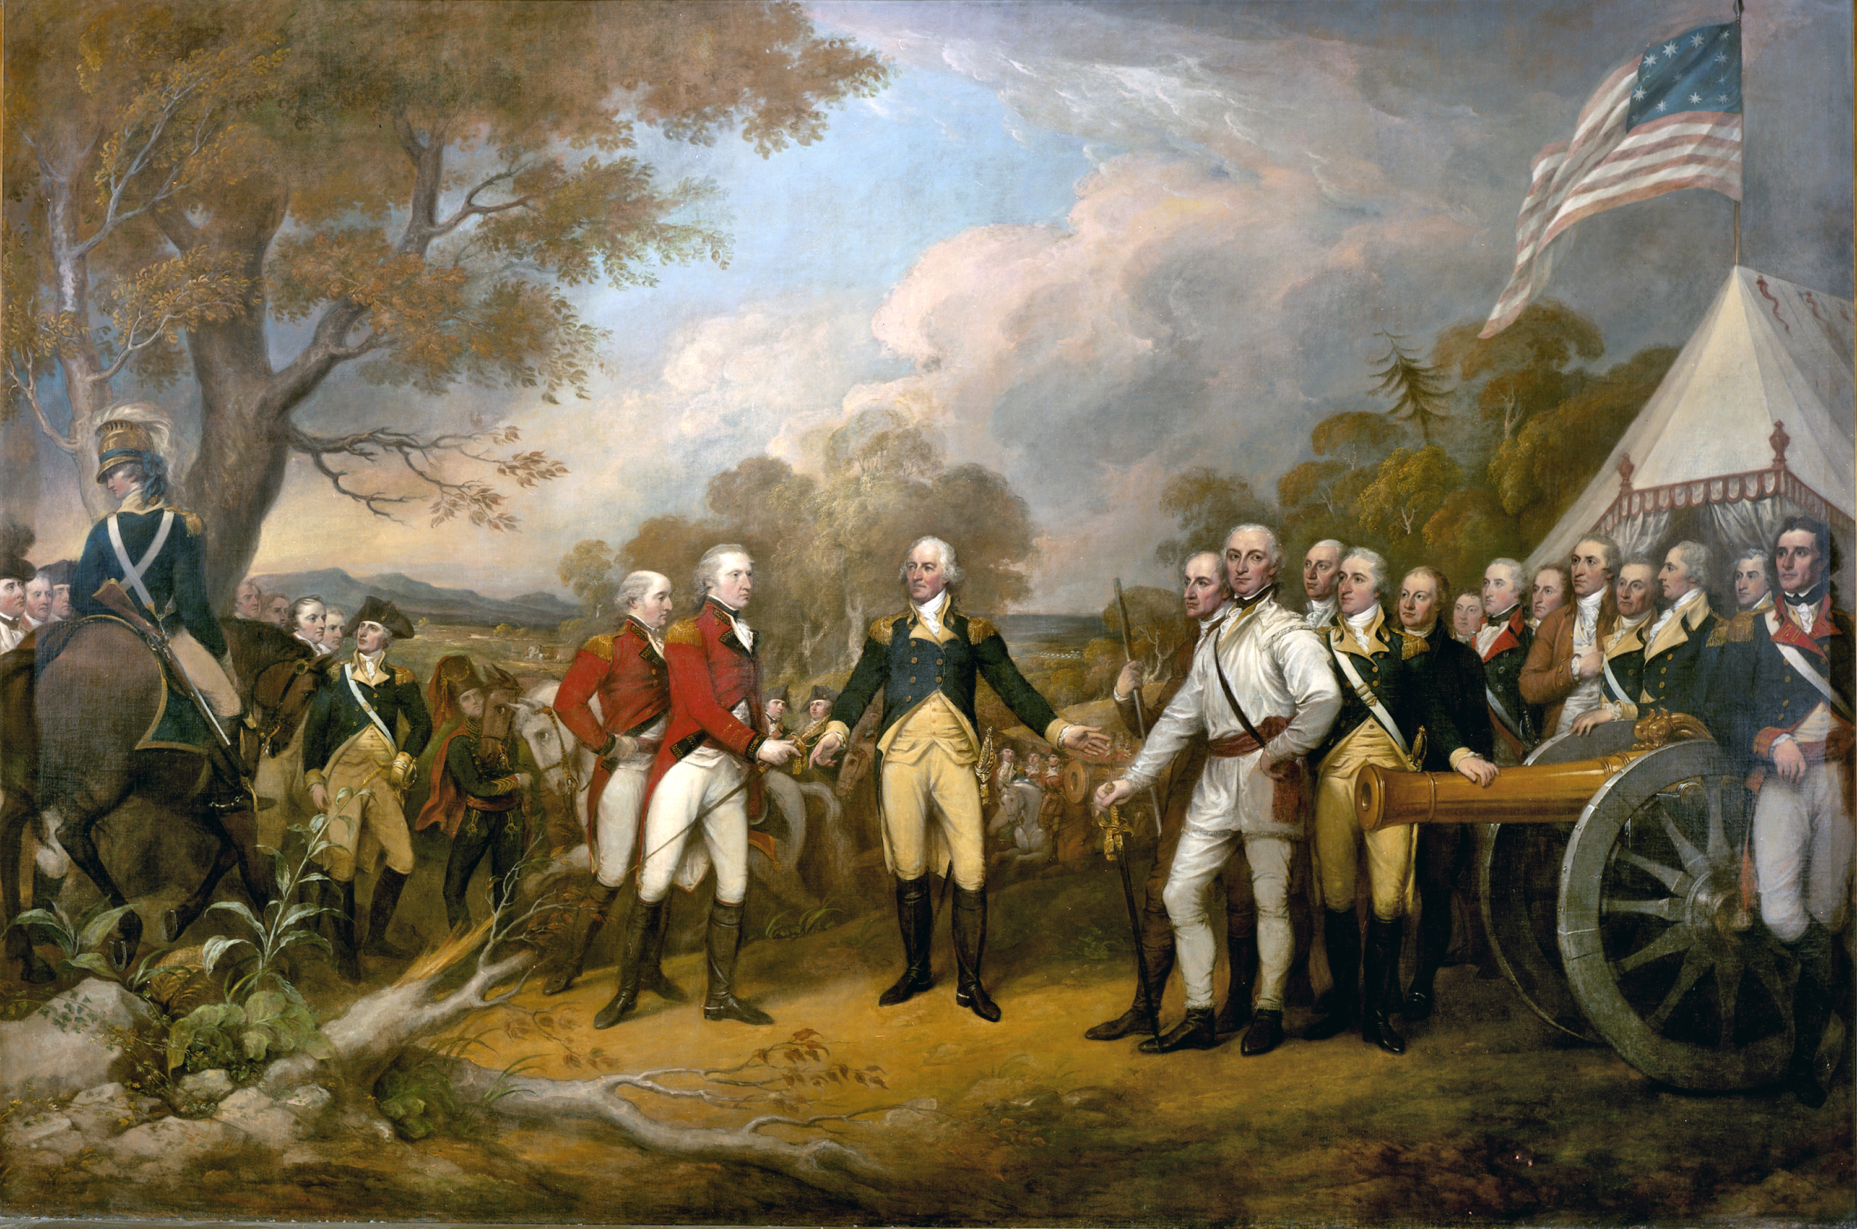
Battle of Saratoga
British General Burgoyne was forced to surrender! = TURNING POINT
Persuaded France to join! – HUGE ADVANTAGE
Louis XVI – weaken his enemy GB
Spain/Holland join later too!

Slide 15
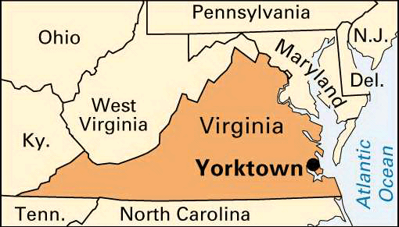
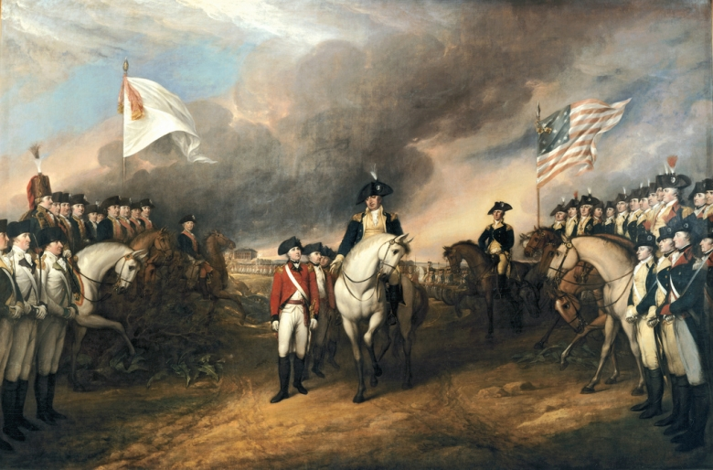
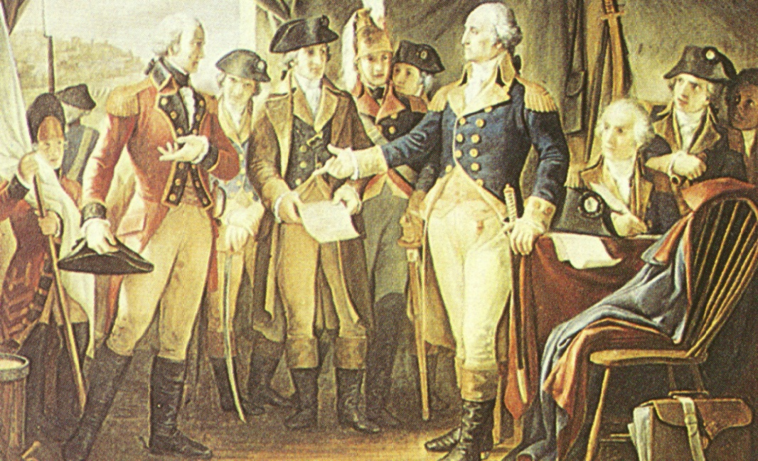
Victory at Yorktown
1781 – FINAL battle of the American Revolution
Yorktown, Virginia
General Cornwallis of Britain VS. army 2x’s the size of his own (2 French navy fleets)
Cornwallis surrendered to Washington (October 19, 1781)

Slide 16
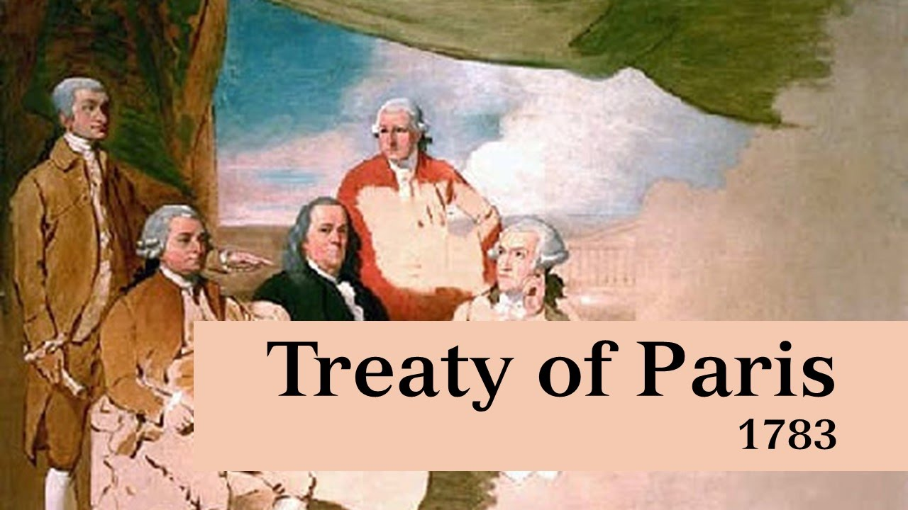
How did it all end?
What were the final arrangements agreed upon by the Treaty of Paris 1783?
U.S. negotiators: John Adams,
Benjamin Franklin & John Jay

Slide 18
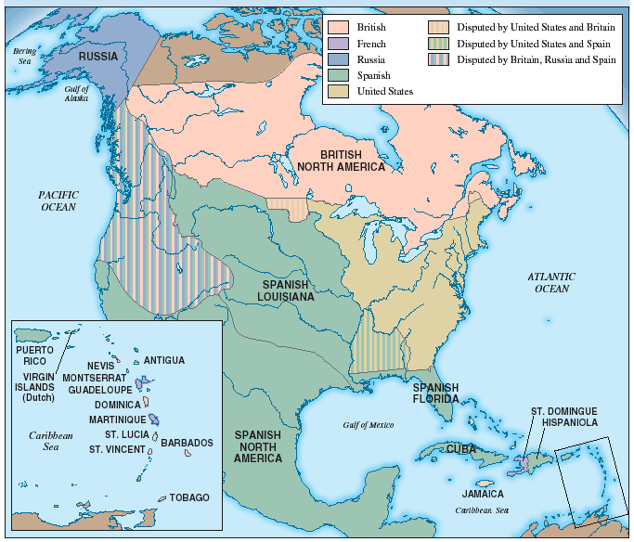
North America After the Treaty of Paris, 1783

Slide 19
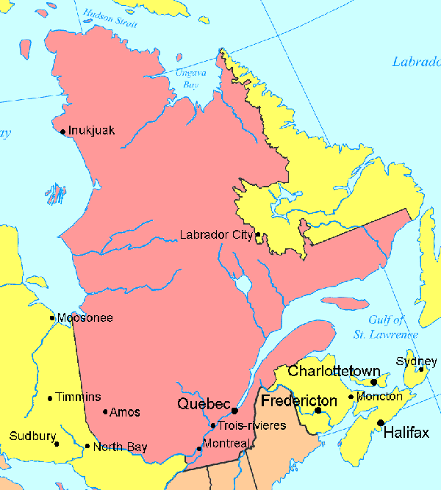
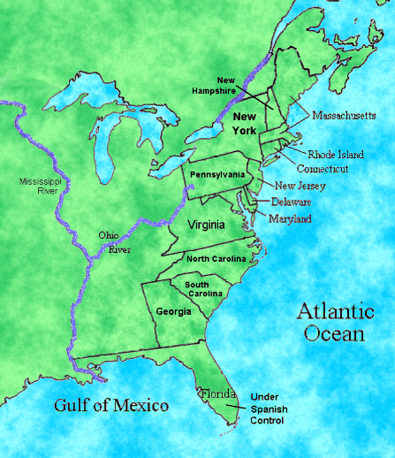
What happened to the surviving Loyalists?
Hounded by Patriots
Harassed by judicial & legislative actions
100,000 fled to England and to Canada
Created the first English speaking community in Quebec

