Slide 1
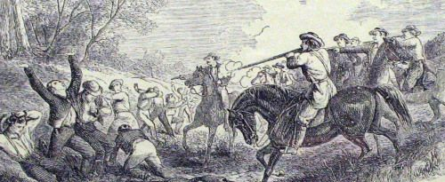
Today’s Aim: How did the debate over slavery escalate after 1850?

Slide 2
REMEMBER: How did northern abolitionists react to the Fugitive Slave Act?
“My house is my castle...If any man approaches that house in search of a slave – I care not who he may be, whether constable or sheriff...
“…if he crosses the threshold of my door, and I do not lay him in a lifeless corpse at my feet, I hope the grave may refuse my body...”

Slide 3
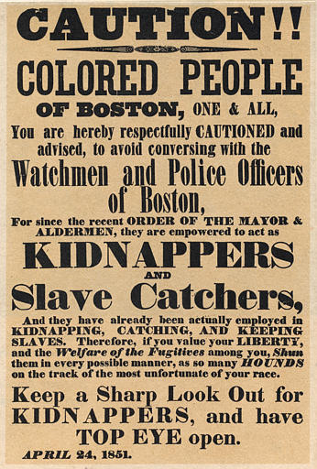
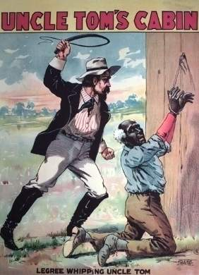
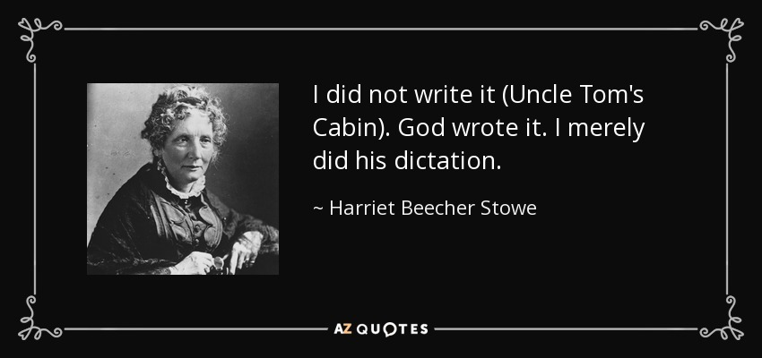
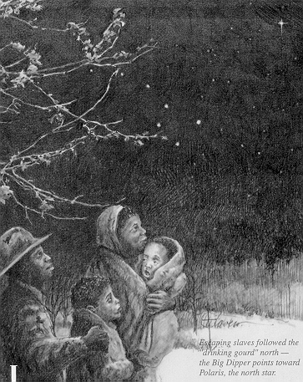
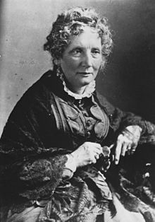
Abolitionist Voices Grow Louder
Many attempts to protect free blacks in the north in response to the Fugitive Slave Act:
Harriet Beecher Stowe writes
“Uncle Tom’s Cabin” (1852)
Exposes horrors of slavery
300,000 copies in 1st year!
South bans the book!

Slide 4
The Powerful Story
Stowe told the story of Uncle Tom, a slave noted for his kindness and devotion to his religion.
Tom is bought by a man named Simon Legree, a cruel planter who treats his slaves brutally!
In the end, Tom refuses to obey Legree’s order to whip another slave. So, Legree whips Tom to death.

Slide 5
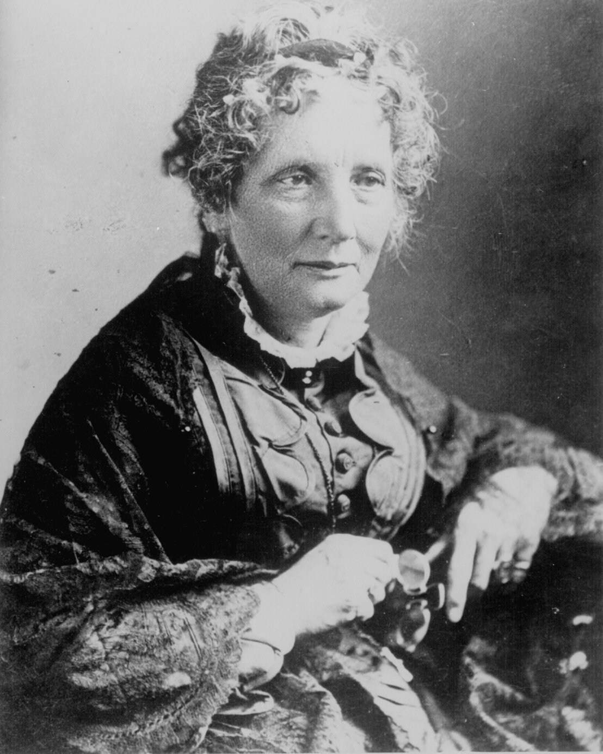
Harriet Beecher Stowe (1811 – 1896)
“So this is the lady who started the Civil War.” -- Abraham Lincoln
Notes:
the character of Uncle Tom, a long-suffering black slave around whom the stories of other characters—both fellow slaves and slave owners—revolve. The sentimental novel depicts the reality of slavery while also asserting that Christian love can overcome something as destructive as enslavement of fellow human beings.[2][3][4]

Slide 6
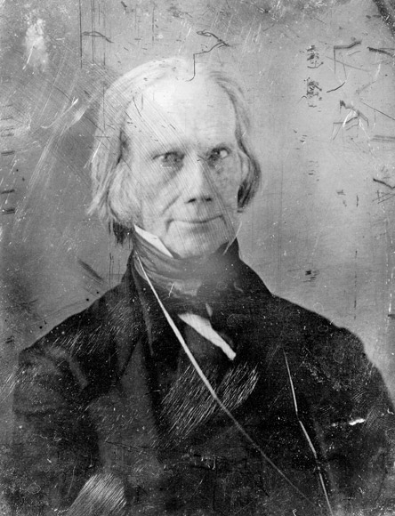
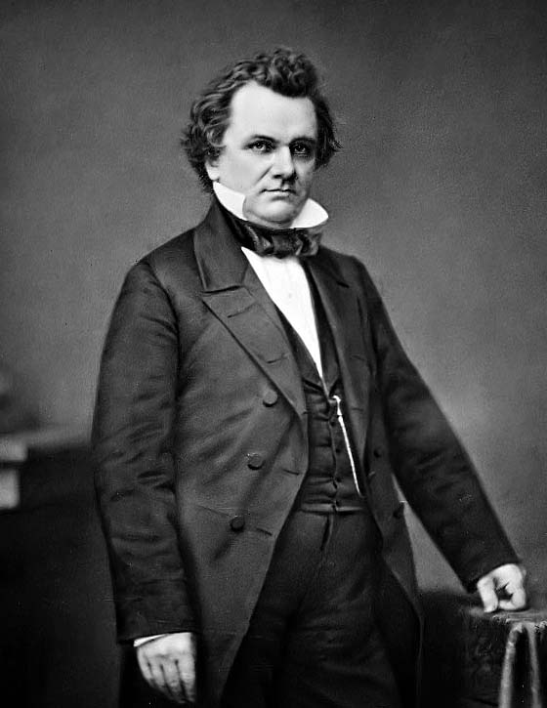
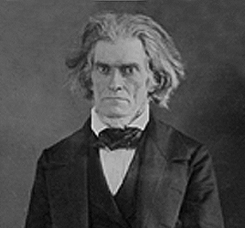
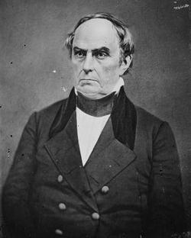
Our
Senatorial
Hotties
Notes:
Henry Clay, Stephen Douglas, John Calhoun, Daniel Webster
The Great Debate of 1850.—The temper of the country was white hot when Congress convened in December, 1849. It was a memorable session, memorable for the great men who took part in the debates and memorable for the grand Compromise of 1850 which it produced. In the Senate sat for the last time three heroic figures: Webster from the North, Calhoun from the South, and Clay from a border state. For nearly forty years these three had been leaders of men. All had grown old and gray in service. Calhoun was already broken in health and in a few months was to be borne from the political arena forever. Clay and Webster had but two more years in their allotted span.
Experience, learning, statecraft—all these things they now marshaled in a mighty effort to solve the slavery problem. On January 29, 1850, Clay offered to the Senate a compromise granting concessions to both sides; and a few days later, in a powerful oration, he made a passionate appeal for a union of hearts through mutual sacrifices. Calhoun relentlessly demanded the full measure of justice for the South: equal rights in the territories bought by common blood; the return of runaway slaves as required by the Constitution; the suppression of the abolitionists; and the restoration of the balance of power between the North and the South. Webster, in his notable “Seventh of March speech,” condemned the Wilmot Proviso, advocated a strict enforcement of the fugitive slave law, denounced the abolitionists, and made a final plea for the Constitution, union, and liberty. This was the address which called forth from Whittier the poem, “Ichabod,” deploring the fall of the mighty one whom he thought lost to all sense of faith and honor.

Slide 7
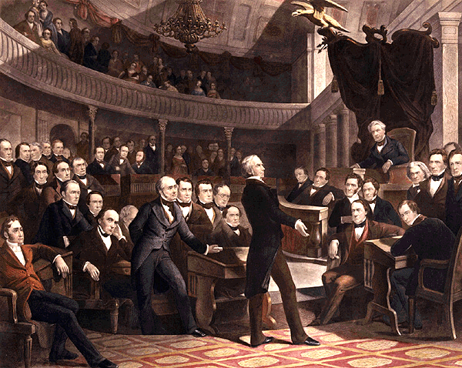
Comp of 1850
Compromise of 1850
Most intense debate in U.S. History
John C. Calhoun
North should honor the Constitution and enforce the Fugitive Slave Law
South wanted California
threatened to secede from U.S.
U.S. should have two Presidents---one from the North and one for the South
Daniel Webster
Secession is impractical & impossible
How would we split the land?
The military?
Compromise at all cost
Preserve the Union
Henry Clay
The Great Compromiser, with John C. Calhoun, Daniel Webster and Stephen Douglas, propose this compromise.

Slide 8
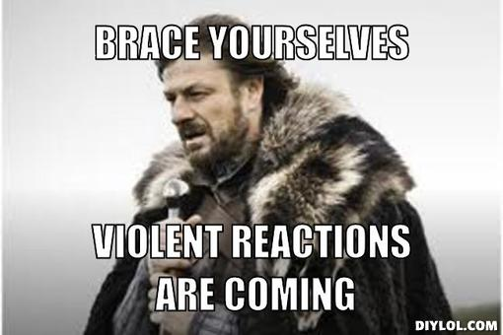
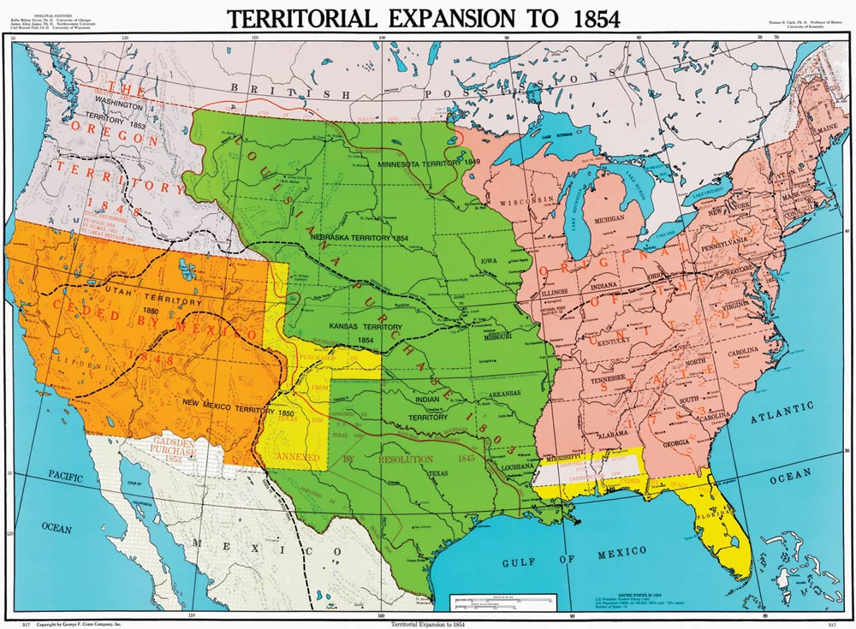

Slide 9
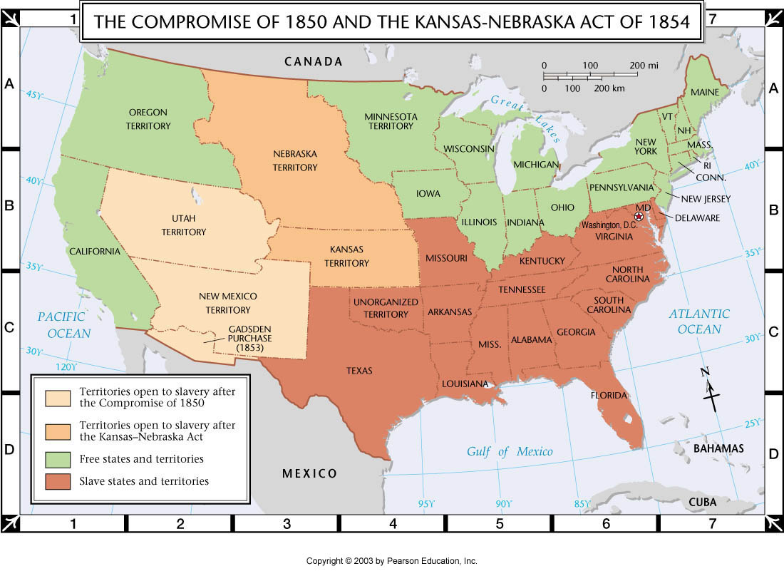
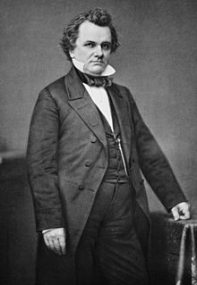
KANSAS AND NEBRASKA ACT
Stephen Douglas (Illinois) wanted the railroad built in the North but had to convince the South that it would benefit ALL…
PLAN = Kansas and Nebraska territories be opened up to SLAVERY in return for building the RAILROAD in the NORTH
But how is that going to work?
Stephen Douglas

Slide 10
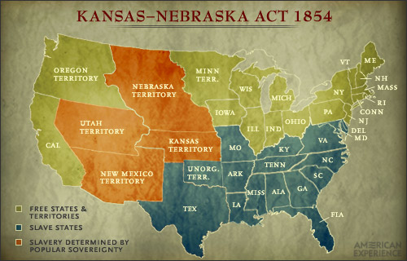
The Kansas-Nebraska Act of 1854
It will:
REPEAL the Missouri Compromise
Have popular sovereignty decide issue of slavery in these 2 territories

Slide 11
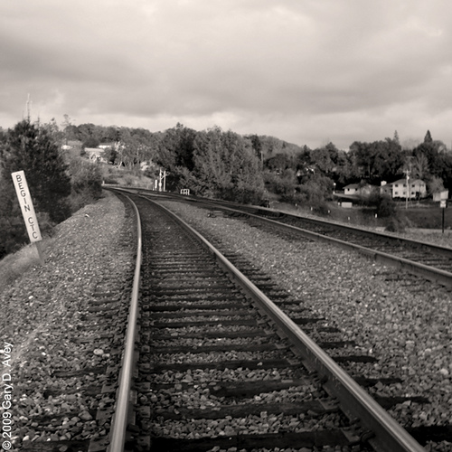
Stephen Douglas’ Motives?
Populate Kansas to spur the building of the transcontinental railroad through Illinois
Gain Southern support for his Presidential ambitions
Believed slavery unlikely to take hold in the climate

Slide 12
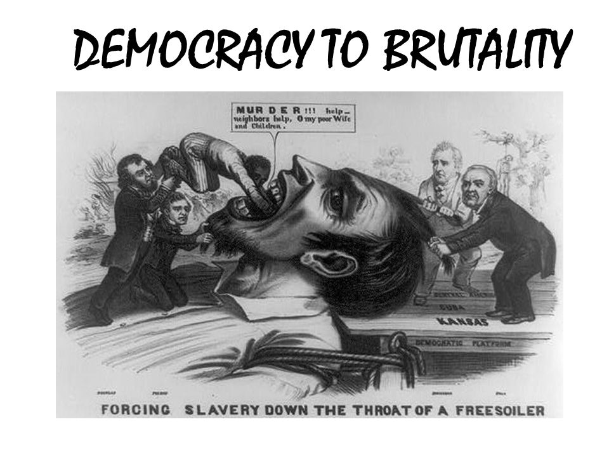

Slide 13
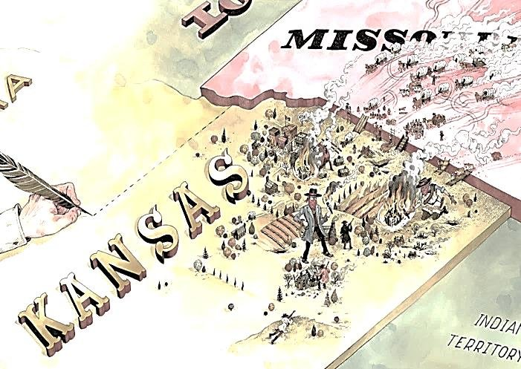
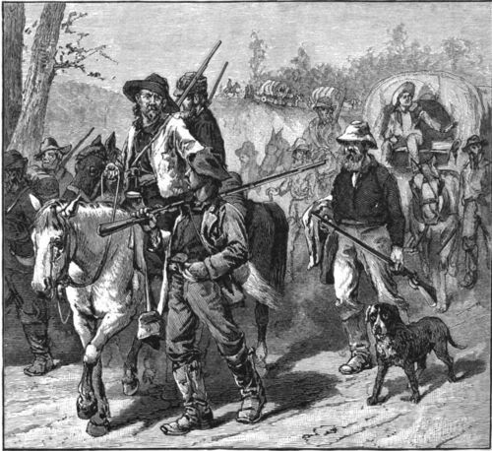
> Free State settlers – part of Free Soil Movement which demanded “Free territory for Free White People” (most were not abolitionists, but anti-plantation and just anti-black)
Kansas - the capital was in Topeka…..the pro-slavery settlers set up an alternate capital in Lecompton, Kansas which was recognized by the federal govt. as the legitimate govt, despite the fact that most settlers were Free Staters
> Missourians – poured over borders to sway the ballots in favor of pro-slavery legislation and officials (Border Ruffians)
First elections in Kansas

Slide 14
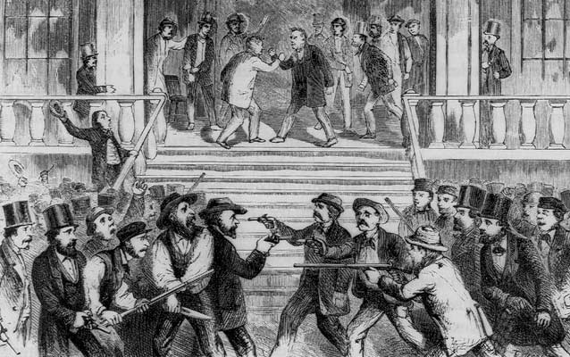
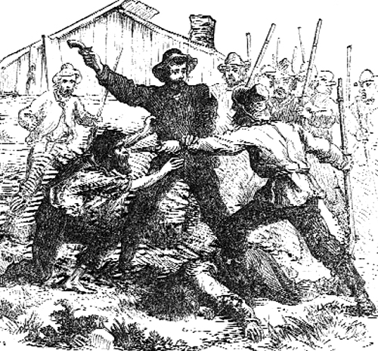
While you watch:
What were the immediate results of the Kansas-Nebraska Act?
What was “Bleeding Kansas”?
VIDEO
Several attacks during this time, primarily of proslavery against Free State men. People were tarred and feathered, kidnapped, killed. But now the violence escalated.
Leads to “Bleeding Kansas”
Pro-Slavery and Anti-Slavery forces rush to Kansas for the vote = “Mini Civil War”

Slide 15
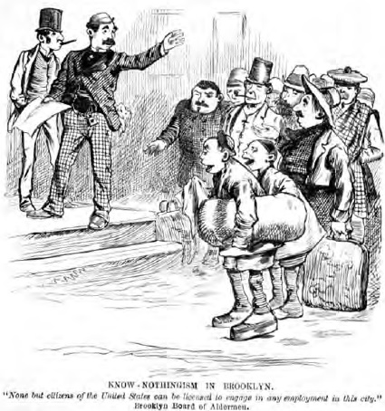
TWO NEW PARTIES EMERGE!
The TEMPORARY one:
Know-Nothing Party (“I know nothing” to political questions)
NATIVIST opposition to immigrant Catholics entering cities

Slide 16
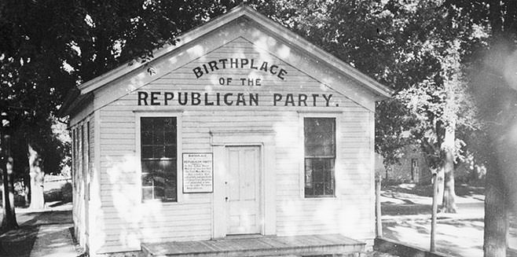
TWO NEW PARTIES EMERGE!
The PERMANENT one:
Republican Party
Freesoilers/antislavery
OPPOSE the spread of slavery in the territories
Did NOT want to end slavery itself
“Let’s REPEAL
BOTH the Kansas-Nebraska Act and the Fugitive Slave Law!”
Wisconsin, 1854

