Slide 1
AIM: How were the 1950s both a time of prosperity and fear?

Slide 2
Title your page: THE COLD WAR AT HOME
Then, draw a chart in your notebook with columns labeled:
Consumerism
Popular Culture
The Baby Boom
Conformity
Social Groups
Suburbs
Automania
2nd Red Scare

Slide 3
The Cold War at Home
The AFFLUENT SOCIETY
The end of WWII led to an era of wealth & spending in the 1950s:
  The war stimulated the economy & ended the Great Depression
  High wages, service pay for soldiers, & war bond investments gave Americans money to spend
  The economic boom allowed Americans to enjoy the highest standard of living in the world
The rationing that characterized wartime society was soon replaced by seemingly unlimited supplies of food in the postwar era.

Slide 4
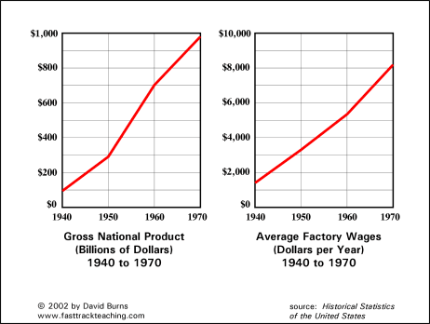
Notes:
http://www.fasttrackteaching.com/Charts8_Affluent_Society.html

Slide 5
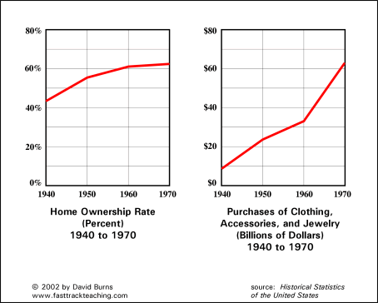
Notes:
http://www.fasttrackteaching.com/Charts8_Affluent_Society.html

Slide 6
The 1950s: Consumerism
Consumerism returned in the 1950s
  People rushed to buy new goods like TVs & hi-fi record players
  Credit became available (The 1st credit card was created in 1950)
  Advertisers used newspaper ads, radio, & new TV commercials to market goods to Americans
  Franchises offered people across the country the same products
For the 1st time since the 1920s, Americans had access to cheap electrical appliances & cars
1950s TV commercials
Notes:
Expansion of business in the 1950s:
Corporations, Franchises (848)
Consumerism (854-855)

Slide 7
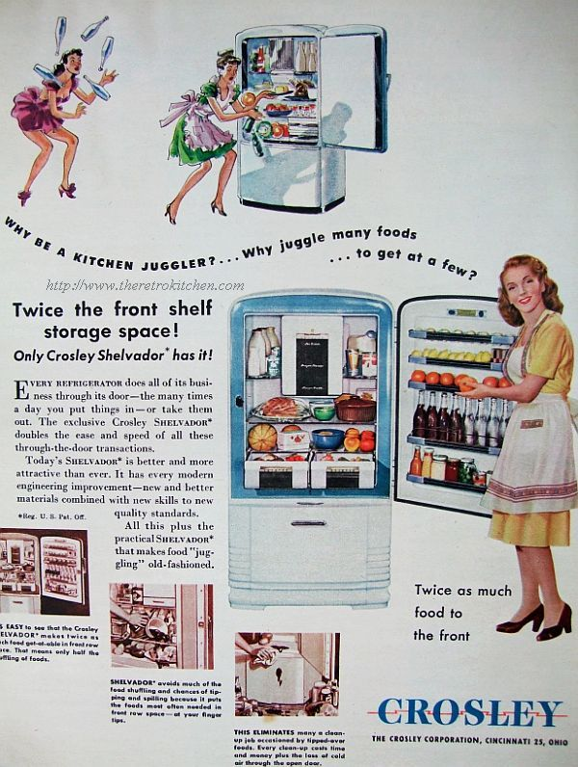
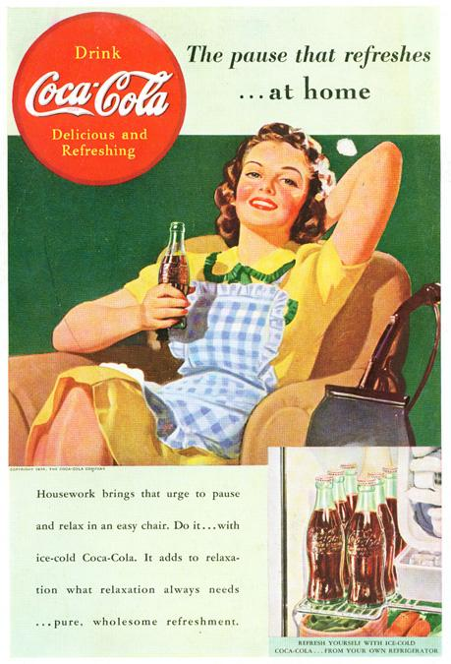
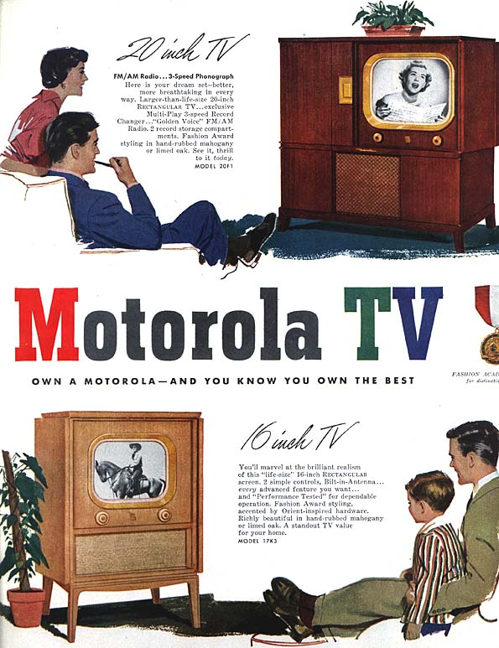
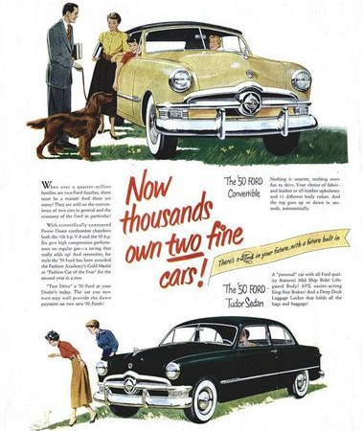
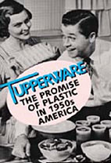
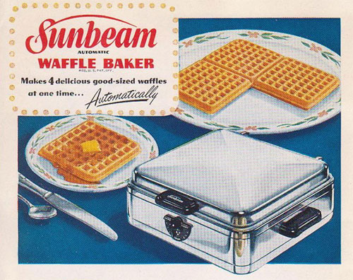
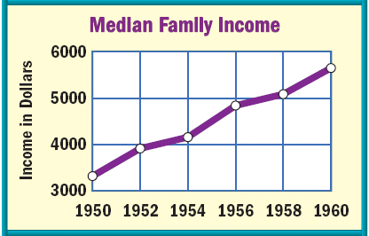
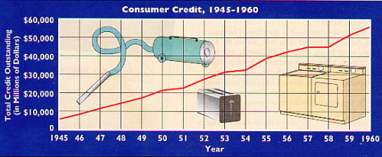
The “Affluent Society”

Slide 8
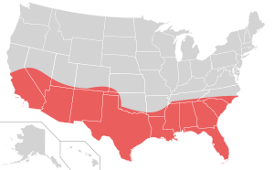
The Sunbelt
A 15-state area stretching from Virginia through Florida and Texas to Arizona and California (includes all former Confederate states)
Warmer climates, lower taxes, and economic opportunities prompted families uprooted by the war to move to these areas.

Slide 9
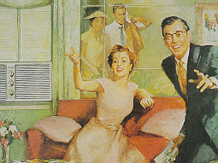
The advent of air-conditioning spurred enormous growth.
a. Population increase was twice that of the old industrial zones of the Northeast.
b. California which became most populous state by 1963.
A 1960s Advertisement for Air Conditioning

Slide 10
War industries and high-tech industries attracted millions to the west coast.
The aerospace industry and huge military installations attracted millions to Texas and Florida.

Slide 11
The 1950s: The Baby Boom
Americans produced a “baby boom” in the 1950s, leading to the largest generation in U.S. history
  The return of soldiers from war led to an increase in marriages
  & a rise in the birthrate
  The baby boom led to a demand for new baby products, schools, & homes for growing families
Notes:
Returning soldiers, housing shortage, baby boom
Levittville
Suburban shopping centers
GI Bill of Rights (?)

Slide 12
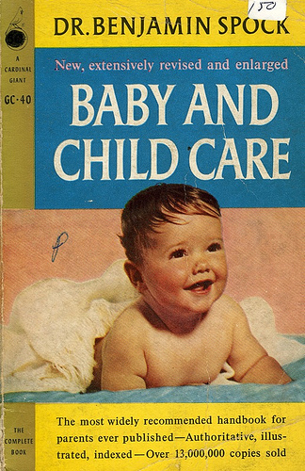
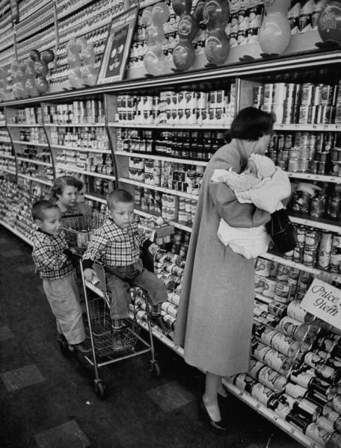
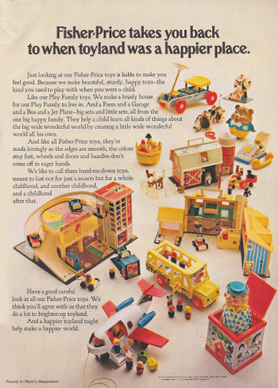
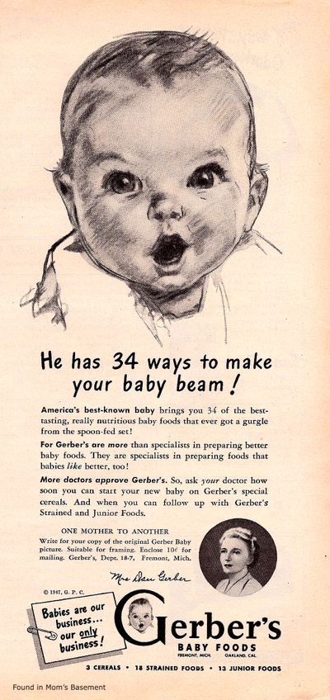
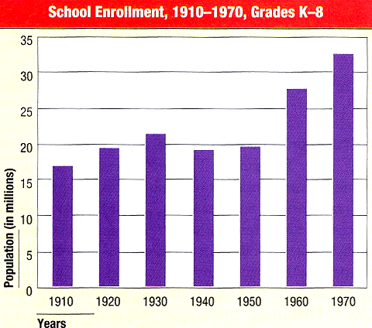
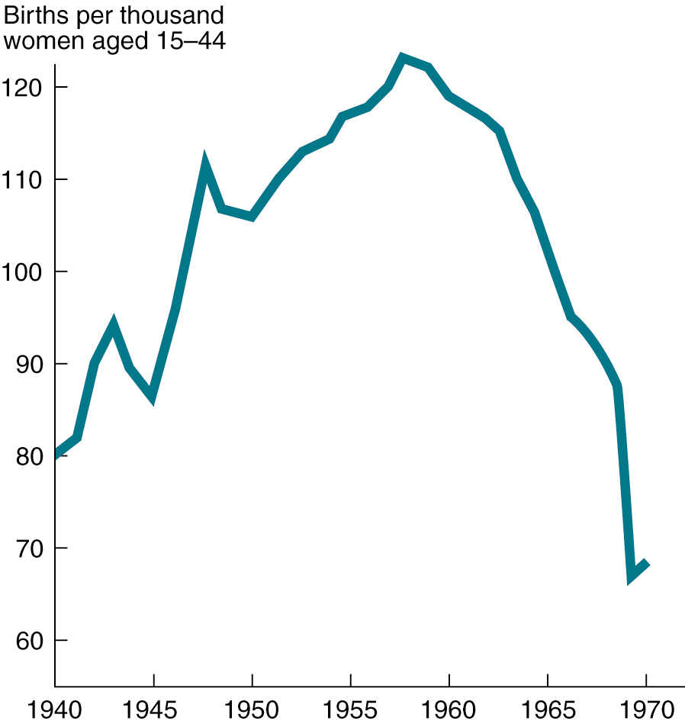
U.S. Birthrate, 1940-1970
The late 1940s & 1950s experienced the “baby boom”
In 1957, a baby was born every 7 seconds

Slide 13
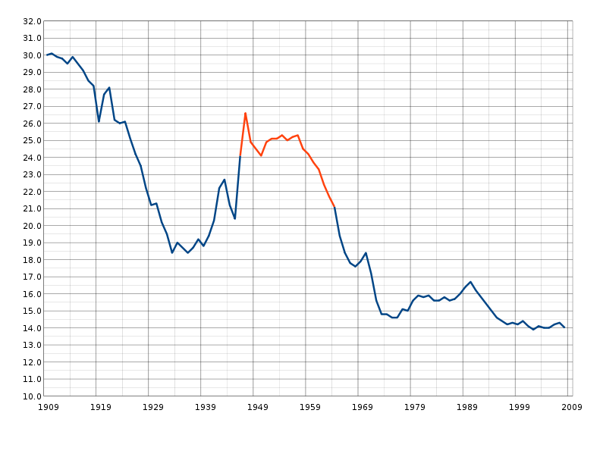
The baby boomers became major targets of businesses who sought to cash in on their sheer numbers and relative affluence.
Notes:
Wikipedia Commons

Slide 14
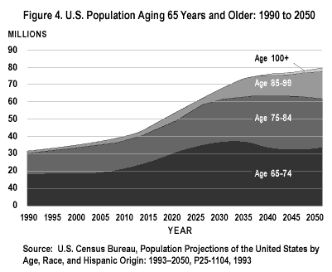
Notes:
http://www.nia.nih.gov/health/nianci/intro.asp

Slide 15
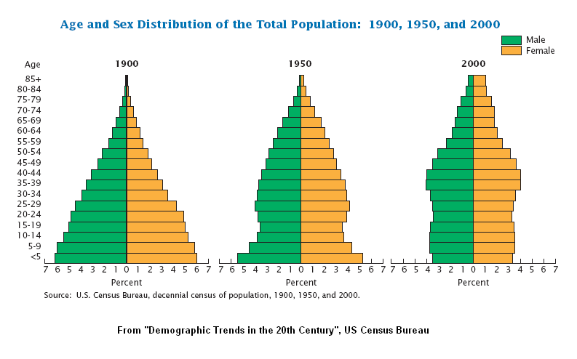
3. By around 2020, they will place enormous strains on the Social Security system.

Slide 16
The 1950s: Suburbs
Suburbs boomed in the 1950s:
  The majority of Americans worked in cities but wanted the security of suburbs for their families
  Suburbs offered peace of mind, affordable homes, & good schools
  The GI Bill of Rights offered returning soldiers cheap loans for new homes & tuition for college (created by FDR, but effects really felt post-WWII under Truman)
Notes:
Returning soldiers, housing shortage, baby boom
Levittville
Suburban shopping centers
GI Bill of Rights (?)

Slide 17
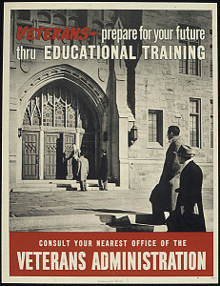

U.S. Government Posters Encouraging Veterans to take advantage of the GI Bill
Notes:
U.S. Veterans Administration

Slide 18
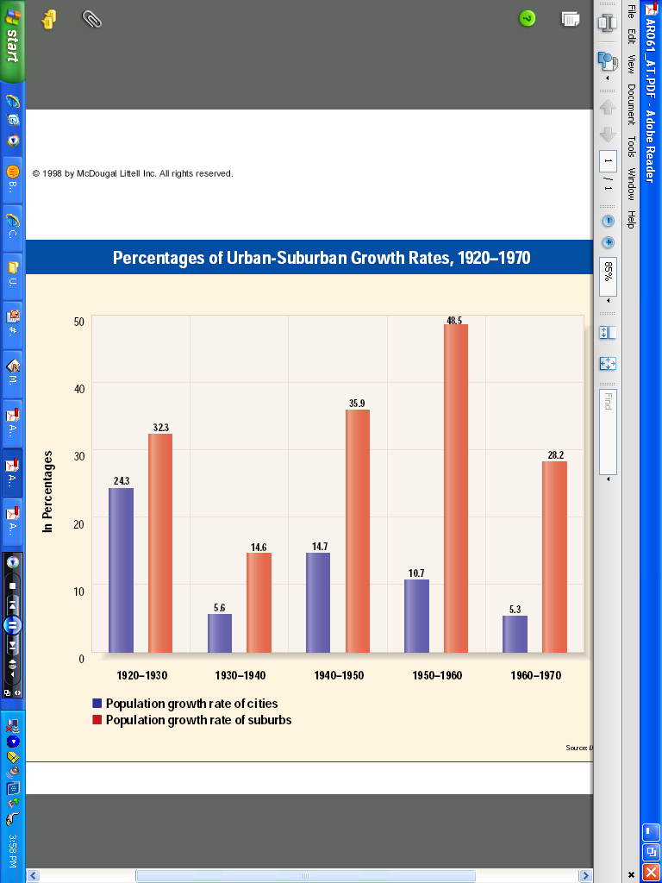
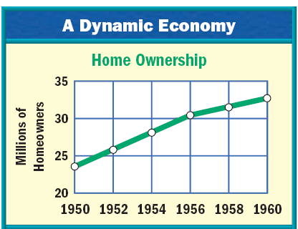

Slide 19
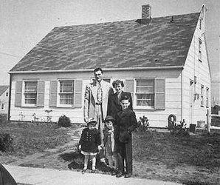
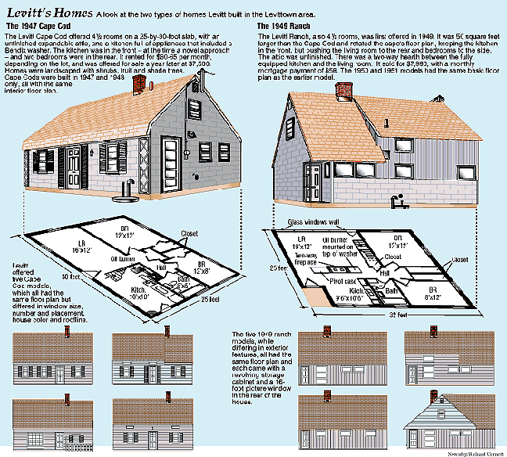
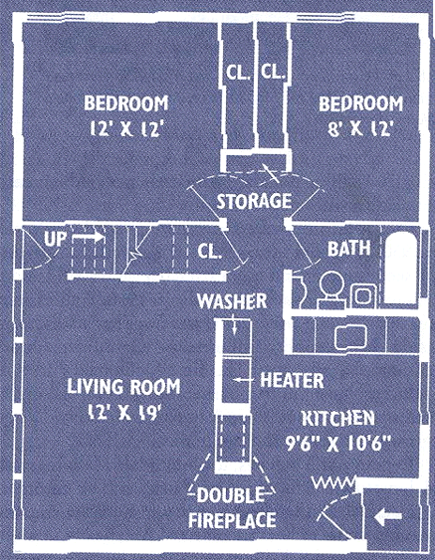
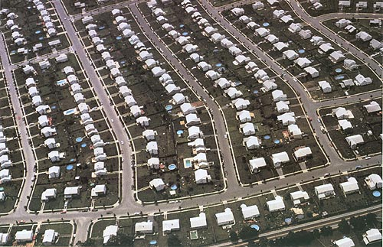
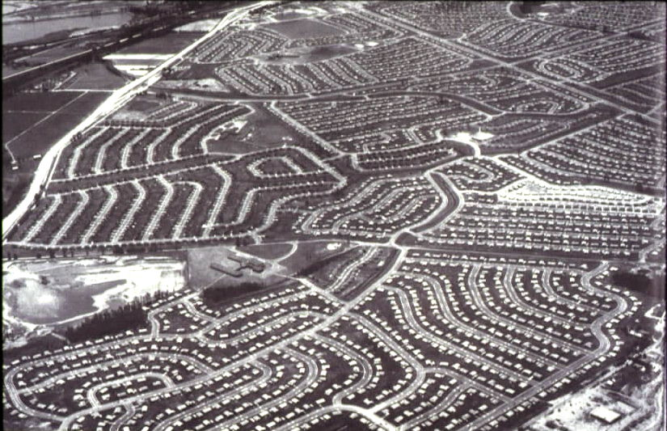
The desire for homes in the suburbs led to massive communities like Levittown in NY
1 story high
12’x19’ living room
2 bedrooms
tiled bathroom
garage
small backyard
front lawn
SHIFTS IN POPULATION
DISTRIBUTION,
1940-1970
1940 1950 1960 Cities 31.6% 32.3% 32.6% Suburbs 19.5% 23.8% 30.7% Rural Areas 48.9% 43.9% 36.7%

Slide 20

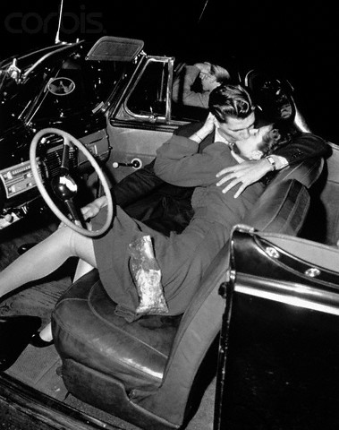

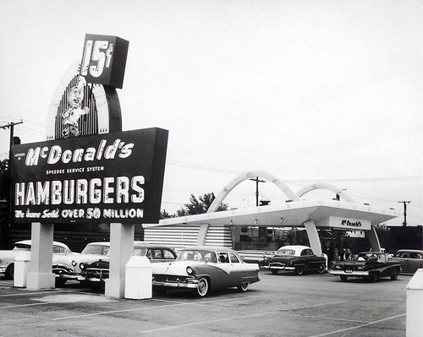
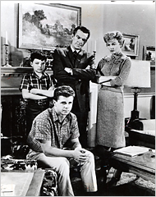
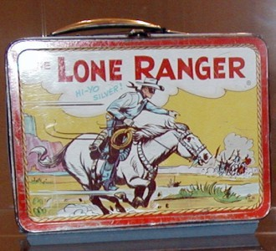
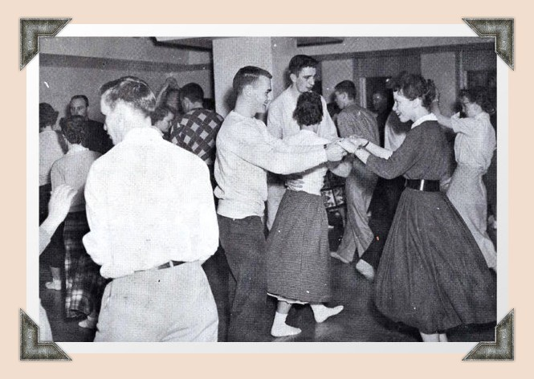
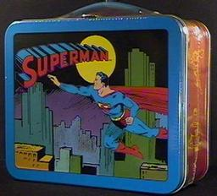
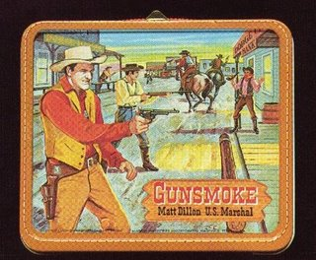
Little boxes on the hillside,
Little boxes made of ticky-tacky,
Little boxes on the hillside,
Little boxes, all the same.
There's a green one and a pink one
And a blue one and a yellow one
And they're all made out of ticky-tacky
And they all look just the same.
And the people in the houses
All went to the university,
Where they were put in boxes,
And they came out all the same.
And there's doctors and lawyers
And business executives,
And they're all made out of ticky-tacky
And they all look just the same.
And they all play on the golf-course,
And drink their Martinis dry,
And they all have pretty children,
And the children go to school.
And the children go to summer camp
And then to the university,
Where they are put in boxes
And they come out the same.
And the boys go into business,
And marry, and raise a family,
In boxes made of ticky-tacky
And they all look just the same.
There's a pink one and a green one
And a blue one and a yellow one
And they're all made out of ticky-tacky
And they all look just the same.

Slide 21
The 1950s: Suburbs
Suburbs changed American life:
  Suburbs increased America’s need for cars & highways
  Churches, schools, grocery stores, & shopping centers were build to service the suburbs
  But, the migration to the suburbs was mostly by white families; “White flight” to the suburbs left African Americans in urban areas
Notes:
Returning soldiers, housing shortage, baby boom
Levittville
Suburban shopping centers
GI Bill of Rights (?)

Slide 22
The Economy, Suburbs, & Baby Boom
VIDEO

Slide 23
The 1950s: “Automania”
VIDEO
In the 1950s, Americans bought cars in record numbers:
  The growth of suburbs, creative advertising, easy credit, & cheap gasoline led to a car boom
  Congress added 41,000 miles of expressway when the Interstate Highway Act was passed in 1956
  Automobile companies made big, powerful, flashy cars

Slide 24
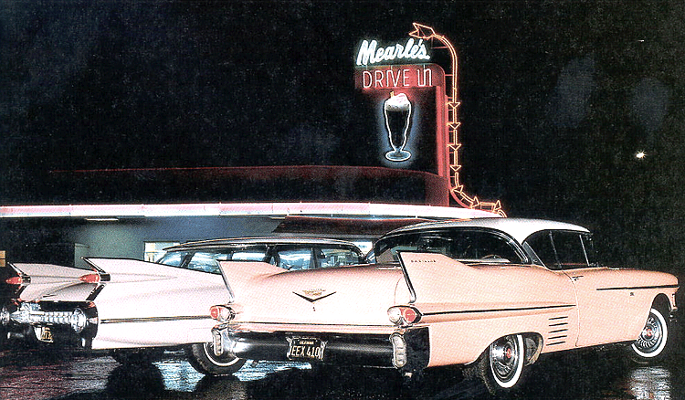
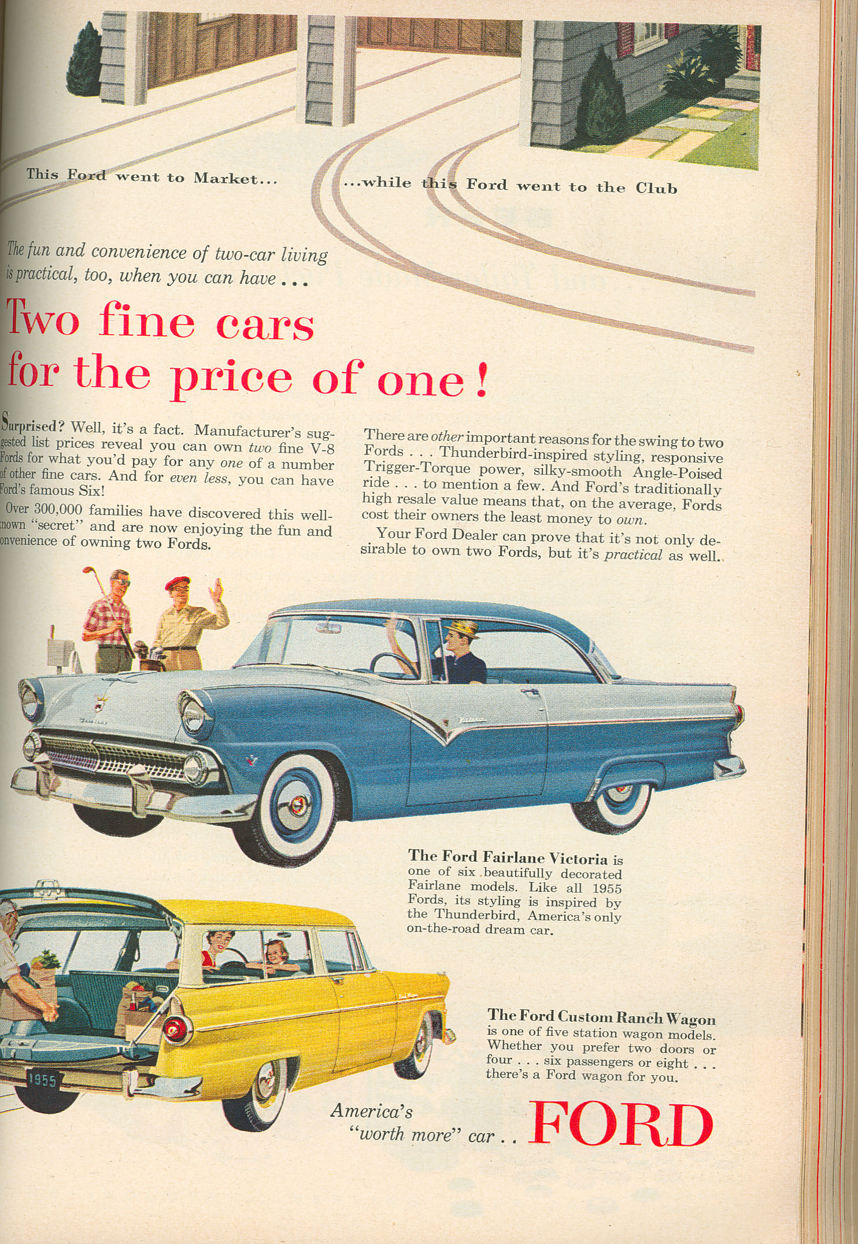
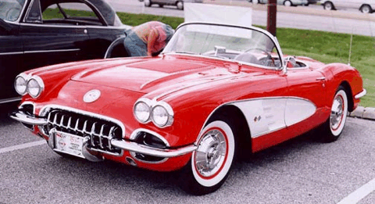
Notes:
Ford 1955

Slide 25
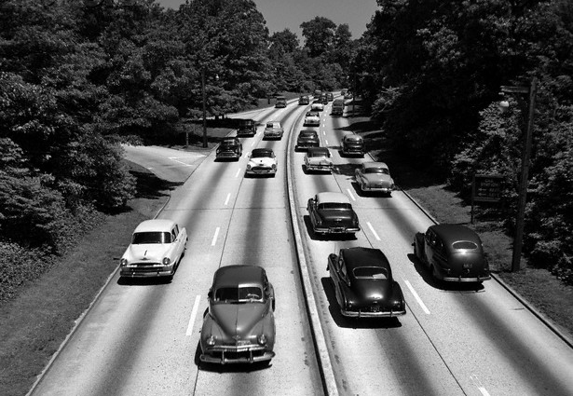
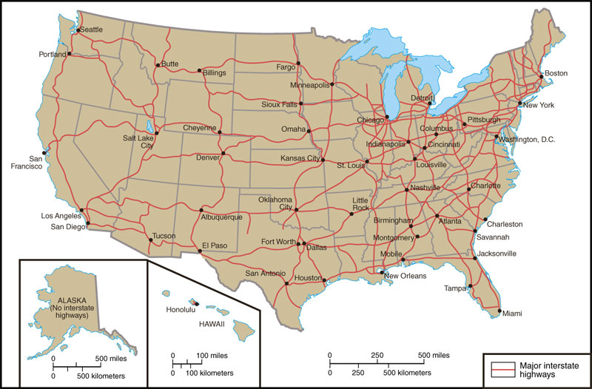
Interstate Highway Act 1956
  These highways helped promote national defense, interstate trade, & vacation travel
  All funds were raised exclusively through gas, tire, & car taxes

Slide 26
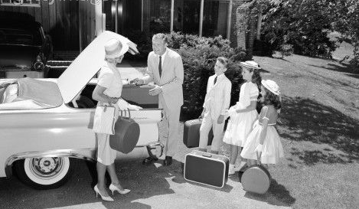
“Automania” transformed America
Americans were more mobile, took long-distance vacations, & lived further from their jobs

Slide 27
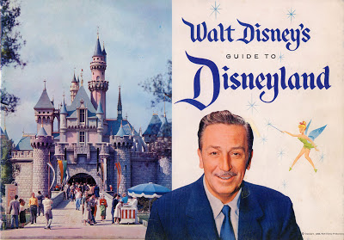
Does anyone know what famous family vacation destination opened on July 17, 1955?

Slide 28
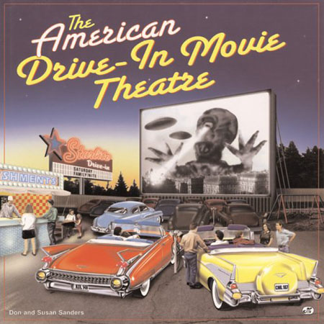
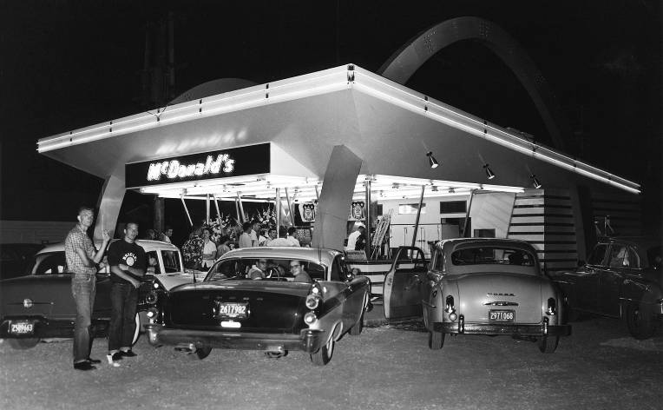
“Automania” transformed America
First EVER McDonalds commercial
April 15, 1955
Dairy Queen commercial
Cars led to drive-thru restaurants &
drive-in movies

Slide 29
The 1950s: Popular Culture
Americans in the 1950s enjoyed new forms of entertainment:
  Television boomed as Americans watched comedies, news reports, westerns, & variety shows
  TV ownership jumped from 9% in 1950 to 90% by 1960 (45 million)
  Businesses took advantage of TV to advertise goods to buyers

Slide 30
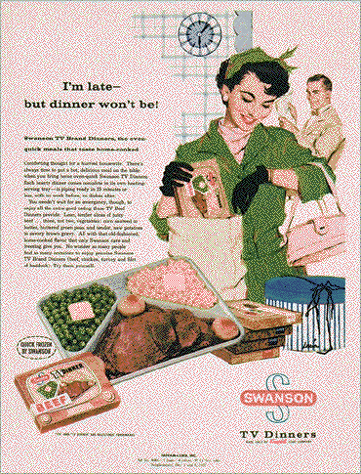

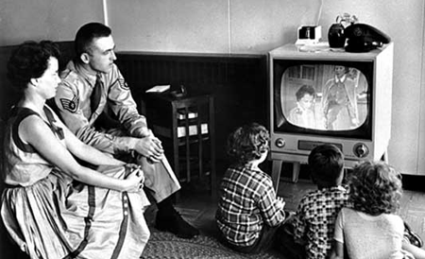
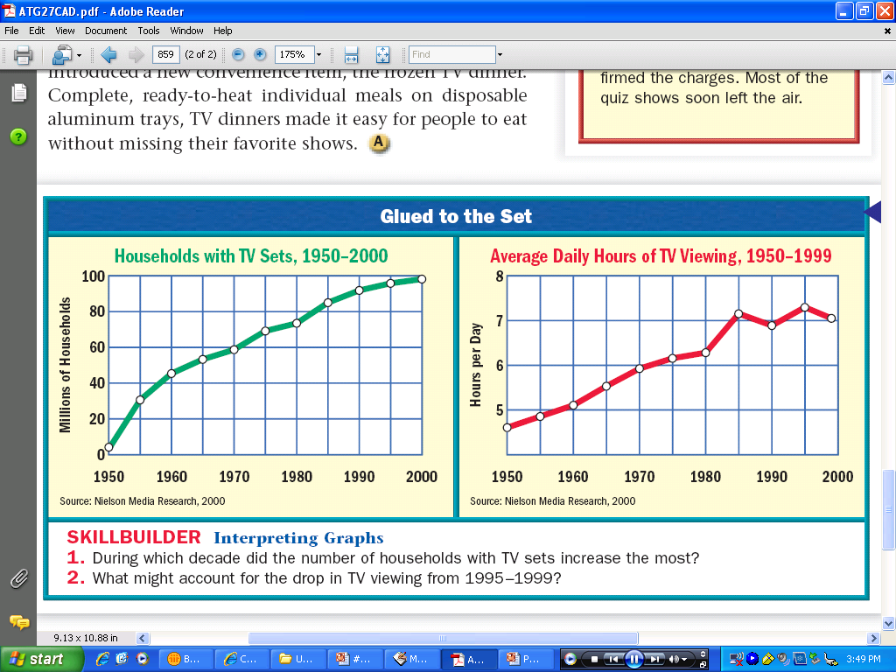

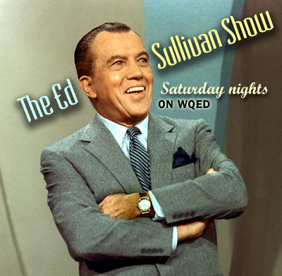
Television in the 1950s
“I Love Lucy” TV Show
TV Dinners

Slide 31
The 1950s: Popular Culture
Music changed in the 1950s:
  “Doo-wop” music dominated the early 1950s, but, was challenged in popularity by rock n’ roll
    Rock ‘n’ roll music was inspired by black artists, but Elvis Presley made it popular among the youth
    Originally referred to as “race music”, and would not be played on mainstream radio stations
    Rock scared parents who thought the fast beats were immoral

Slide 32
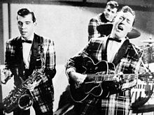
Bill Haley and the Comets
VIDEO
In 1954, Rock Around the Clock became the first rock n’ roll title to top the charts.
Notes:
Wikipedia Commons

Slide 33
VIDEO

Slide 34




VIDEO
This rock ‘n’ roll music is a SIN!

Slide 35


Teenagers were an important force in the 1950s
Suburban teens had leisure time &
money to spend
Notes:
Businesses targeted teenagers, selling billions of dollars of “cool” consumer goods
Music & movies were made specifically for teens

Slide 36


Teenagers were an important force in the 1950s
Businesses targeted teenagers, selling billions of dollars of “cool” consumer goods

Slide 37



Hollywood movies targeted teens & made films about “juvenile delinquency”

Slide 38
According to the video clip from Leave it to Beaver, what were the social expectations in the American household?
VIDEO
Notes:
Father Knows Best: TV shows; Social expectations for men, women, children; Conformity; Suburbs;

Slide 39





The 1950s: Conformity
TV, movies, & advertising in the 1950s promoted conformity & stereotypes
The “ideal woman” was a housewife & mother
Notes:
Ideal man? Ideal woman? Family expectations? Social expectations? Keeping up with the Joneses? White America?

Slide 40

Perhaps a more realistic portrait of a homemaker during the 1950s.
Notes:
PUBLIC DOMAIN

Slide 41

As for the text itself, nobody has turned up the infamous textbook that supposedly included these ten steps. The list is often attributed to Helen B. Andelin's book Fascinating Womanhood, first published in 1963 to provide instruction in "The Art of Winning a Man's Complete Love," but no such list appears in that work.

Slide 42


The 1950s: Conformity
TV, movies, & advertising in the 1950s promoted conformity & stereotypes
The “ideal man” was provider & boss of the house
Notes:
Ideal man? Ideal woman? Family expectations? Social expectations? Keeping up with the Joneses? White America?

Slide 43


The 1950s: Conformity
The “beat movement” rejected conformity:
  “Beatniks” were artists & writers who lived non-conformist lives
  Originated in Greenwich Village, NY
  Played off of the Lost Generation after WWI
  Rebelled against conformity (suburbs, consumer goods,
  & “regular jobs”)
  Emphasized alcohol, drugs, sex, jazz, and a vagabond lifestyle
  Led by Jack Kerouac, the beats inspired the “hippies” of the 1960s
Notes:
Ideal man? Ideal woman? Family expectations? Social expectations? Keeping up with the Joneses? White America?

Slide 44
The 1950s: Social Groups
The 1950s had an important impact on women:
  The media promoted women as mothers & homemakers, but almost 40% of mothers had jobs
  20% of suburban women reported being dissatisfied, isolated, bored
  Working women were limited to nursing, teaching, clerical jobs

Slide 45


1951 Ad
1953 Ad

Slide 46
The 1950s: Social Groups
African American civil rights leaders began to challenge segregation laws
  In 1947, Jackie Robinson integrated professional baseball
  In 1954, in Brown v Board of Education, the Supreme Court integrated public schools
  In 1955, Martin Luther King, Jr. emerged as the leader of the civil rights movement

Slide 47



The Beginning of Civil Rights in the 1950s

Slide 48

How does American society in the Affluent 1950s compare to American society in the Roaring 1920s after WWI?
Which society would YOU have rather lived in?

Slide 49

American Fear of Communism
Why do you think America feared communism so much? (Take 1 minute and discuss with a partner)
  Communism opposed many American values and ideals
    Capitalism
    Private ownership of land and business
    First Amendment rights
    Leads to a SECOND RED SCARE

Slide 50


American Fear of Communism

Slide 51



Atomic War Preparations

Slide 52



Atomic War Preparations

Slide 53

The Anti-Communist Campaign
House Un-American Activities Committee (HUAC)
  An investigative unit that looked into communist activities in the U.S. between 1938 & 1975
  During the 1940s & 1950s many people in the movie industry were publicly investigated
    Charlie Chaplin was blacklisted and couldn’t work in American
  Loyalty Review Board: fired gov’t workers for “reasonable doubt”
What is the cartoonist’s message about HUAC?

Slide 54


The Anti-Communist Campaign
The Rosenberg Trial
  A working class Jewish couple (Julius and Ethel) from New York City were convicted of conspiracy to pass secrets pertaining to the atomic bomb to Soviet agents during World War II
  The evidence was classified government documents and chief accuser was Ethel Rosenberg's brother
  They were executed despite murky evidence against them both
  Reinforced the belief that Soviet spies were lurking in the U.S.

Slide 55

McCarthyism in Action
In 1950 Joseph McCarthy (R-WI) accused 205 State Dept workers of being Communists; Began a 4½ year attack on “Communists”
McCarthyism was popular because it offered an easy solution to the Cold War: defeat the enemy at home & avoid costly, entangling policies abroad
McCarthy failed to find a single confirmed Communist in the U.S. gov’t & never had more than 50% approval rating among voters

