Slide 1
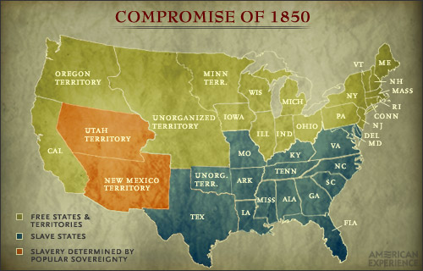
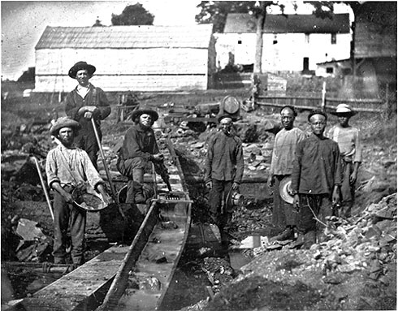
Today’s Aim: Did westward expansion ultimately have more of a positive or negative effect on the United States in the 1800s?

Slide 2
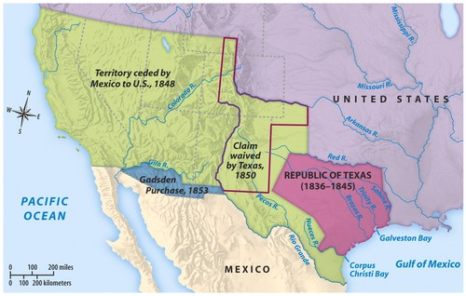
ESSENTIAL QUESTIONS Controversies After Mexican War
Would slavery expand into newly acquired land?
What about Texas and California?

Slide 3
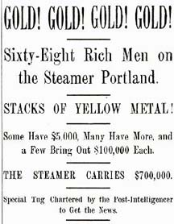
What did this make Americans want to do in the 1800s?

Slide 4
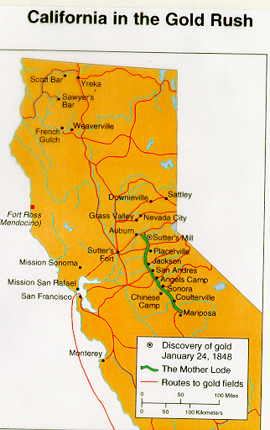
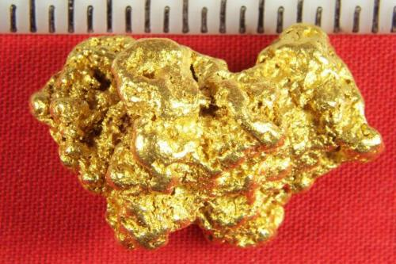
While you watch:
Were the effects of the gold rush more positive or negative?
What impact will it have on the nation?
GOLD
was
EVERYWHERE!

Slide 5
Where the 49ers Came From

Slide 6
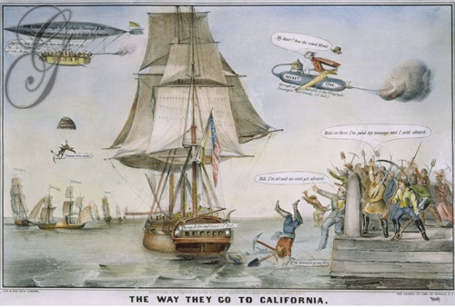
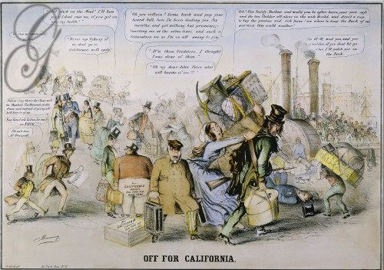
Immigration to California was national
…and global
San Francisco before the gold rush
San Francisco after the gold rush

Slide 7
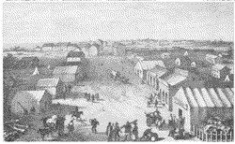
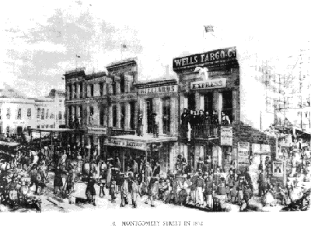
San Francisco before the gold rush
San Francisco after the gold rush

Slide 8
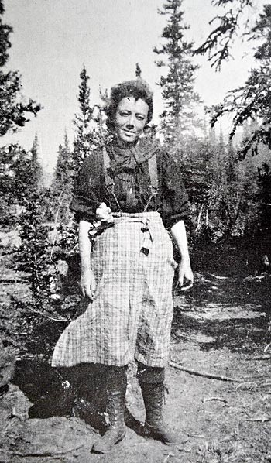
Primary quote analysis
“I tell you, women are in great demand in this country whether they are married or not. You need not think strange if you see me coming home with some good looking man some of these times with a pocket full of rocks...it is all the go here for ladies to leave their husbands, two out of three do it.”
- A married woman who wrote from California to her sister in New England (1853)

Slide 9
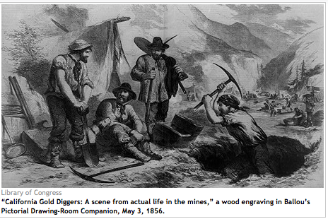
The real money made in CA was in supplying miners with food, saloons, & provisions
The gold rush led to a population boom, increase in agriculture, & multicultural Californian society

Slide 10
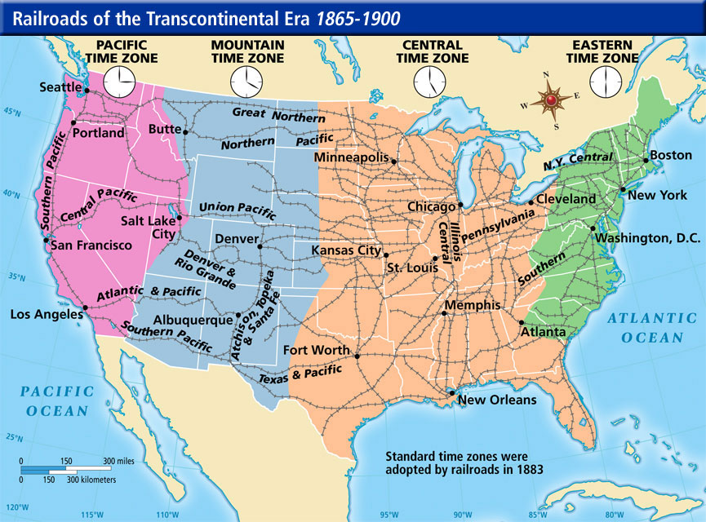
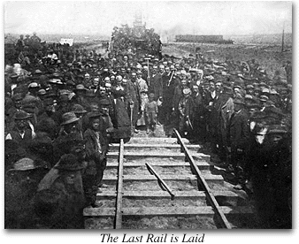
1862 - the Pacific Railroad Act chartered the Central Pacific and the Union Pacific Railroad Companies, and tasked them with building a TRANSCONTINENTAL RAILROAD that would link the United States from east to west.

Slide 11
3 Different Solutions
Free Soil:
All new territory should be FREE (prohibit slavery)
Popular Sovereignty:
Allow people who live in new territories to vote and decide for themselves
Extend the Missouri Compromise Line

Slide 12
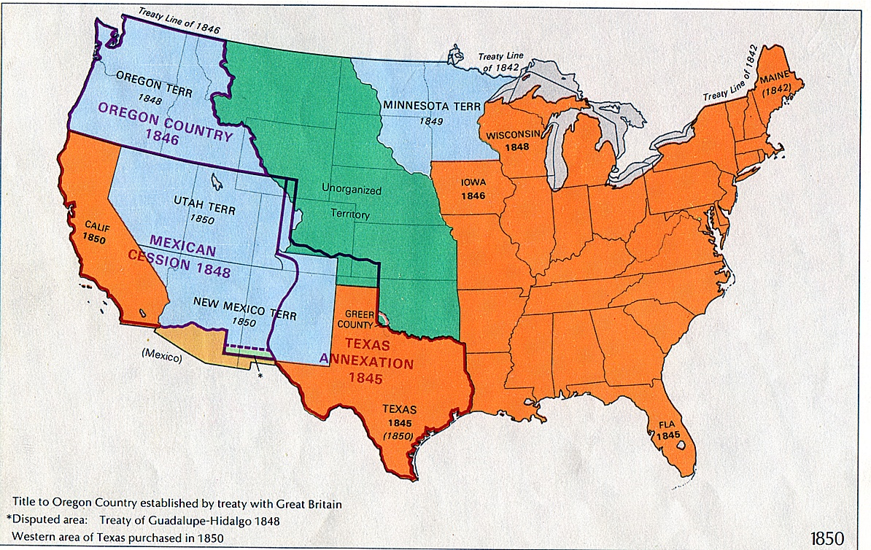
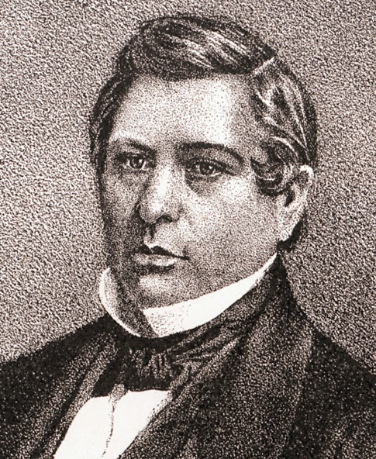
What do we do about the land we got from Mexico?
The first attempt
The WILMOT PROVISO
NO slavery in areas gained from Mexico (not Texas)
Passed by the House, and defeated in pro-slave Senate
INTENSIFIED SECTIONALISM
Slavery
prohibited

Slide 13
Why didn’t Wilmot work?
The USA is full of people with different views/opinions on the issue
The Wilmot Proviso just showed a growth in SECTIONALISM
The NORTH
Abolitionists wanted to get rid of slavery!
Slavery was MORALLY WRONG!
The SOUTH
Slaveholders said slavery should be allowed ANYWHERE!
Slaves who escaped should be returned!

Slide 14
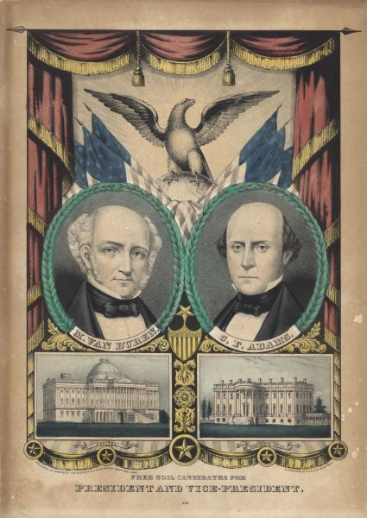
Free-Soil Movement supports Wilmot
“Keep the West a land of opportunity for whites ONLY so that the white majority would not have to compete with the labor of slaves or free blacks.”
Preventing the extension of slavery
Weren’t necessary abolitionists
Supported that ALL BLACKS – slave or free– should be EXCLUDED from the Mexican Cession territory
“Free soil, free labor, free men!”

Slide 15
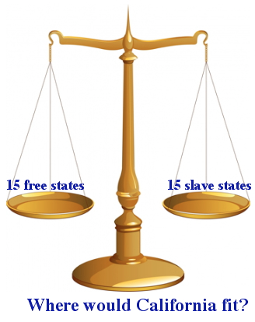
We need to figure this out
ASAP!
Do California and the other NEW territories become
FREE states or
SLAVE states?

Slide 16
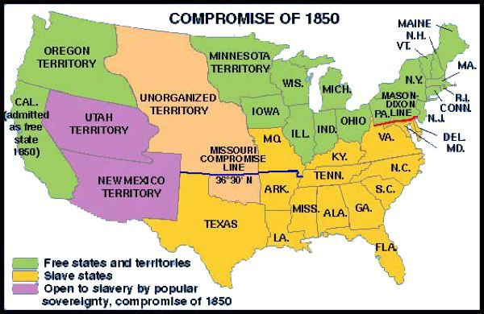
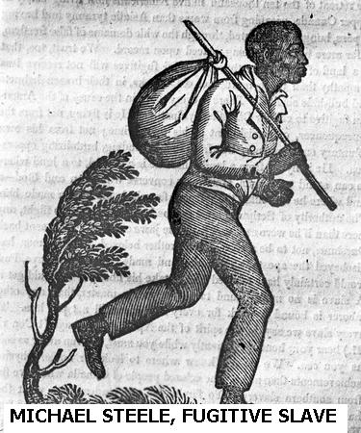
The Compromise of 1850
1. California = FREE STATE
2. Rest of Mexican Cession = popular sovereignty SLAVE or FREE
3. BAN slave TRADE in D.C.
4. New Fugitive Slave Law

Slide 17
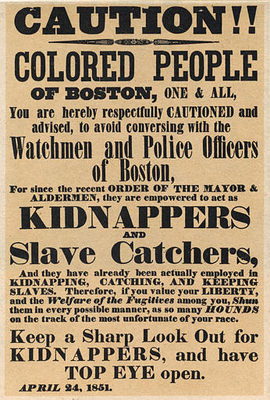
The NEW Fugitive Slave Act
A CRIME to HELP runaway slaves
Arrest those slaves in FREE areas!
Anti-slavery northerners were ANGRY because they felt like they were part of the slave system now!

Slide 18
Northern states - Personal Liberty Laws that prevented the kidnapping of alleged runaway slaves
Personal liberty laws were ruled unconstitutional - capturing of fugitive slaves was a federal matter in which states did not have the power to interfere

Slide 19
QUOTE Analysis – abolitionists react to the slave law
“My house is my castle...If any man approaches that house in search of a slave – I care not who he may be, whether constable or sheriff...
“…if he crosses the threshold of my door, and I do not lay him in a lifeless corpse at my feet, I hope the grave may refuse my body...”
How did northern abolitionists react to the newly created Fugitive Slave Act?

Slide 20
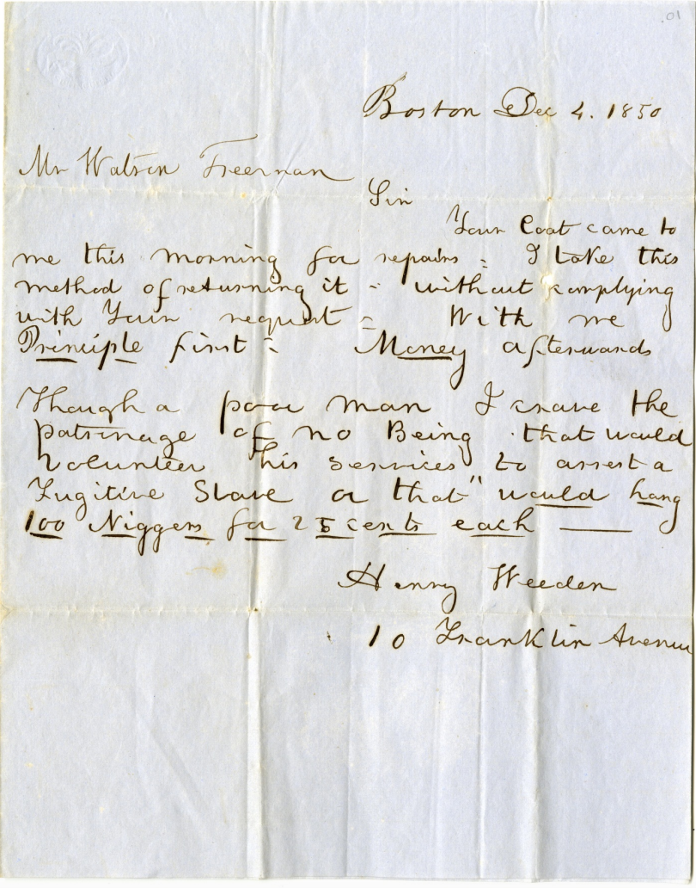
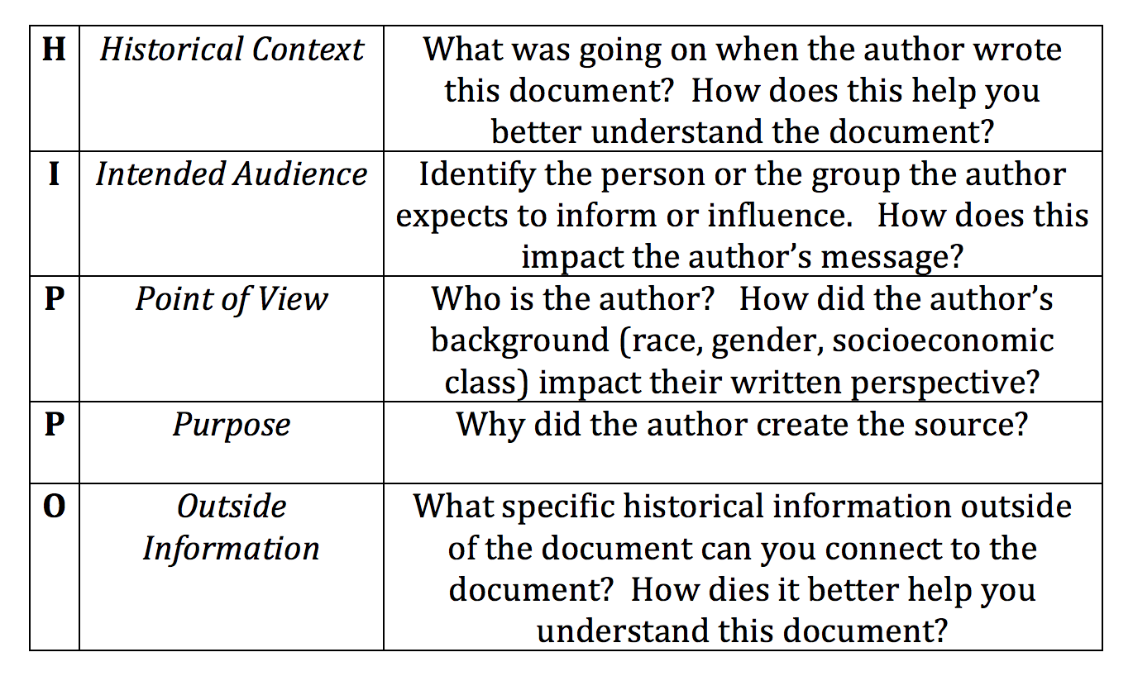
Document HIPPO Analysis Activity
An African American protests the Fugitive Slave Law, 1850

