Slide 1
AIM: What factors led the United States to shift from isolation in the 1920s & 1930s to an active war participant by 1941?
EQ: How did the US try and remain neutral/in isolation during the beginning stages of WWII?
May 22, 1941
December 8, 1941
Notes:
Lesson Plan for Thursday, February 19, 2009: Warm-Up Q, WW2 Notes

Slide 2
US isolationism? Really?
DON’T COPY
After WWI, the U.S. assumed a selective isolationist foreign policy
Americans wanted to maintain the economic boom of the 1920s & were desperate for an answer to the depression in the 1930s
But, the U.S. did play an active role in attempts at international disarmament & economic stability:
The Washington Naval Conference (1921) –disarmament, free trade, collective security among world leaders
Kellogg-Briand Pact (1928) – international “no war to resolve disputes or conflicts” agreement
Dawes Plan (1924) – help stabilize German economy; gave loans to help Germany pay war debts to England & France
Hawley-Smoot Tariff (1930) – limited European attempts to sell their goods in the US; US unable to provide loans leaving Germany unable to pay reparations and war debts
Notes:
Add content from Out of Many, pg 826
Not really isolationist foreign policy (active but selective)

Slide 3
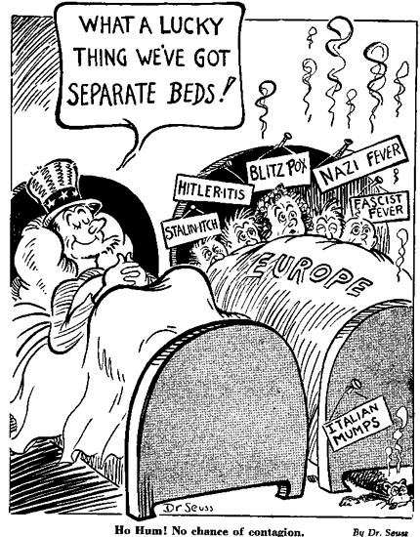
Do you recognize the cartoonist?
Dr. Seuss
Why did Americans believe they could remain neutral?
The separate beds meant they were separated by an ocean. Europe’s “diseases” wouldn’t spread to America.

Slide 4
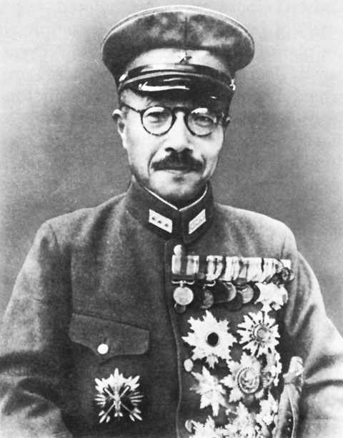
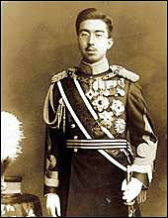
Did Japan stay isolated and neutral? Open your document packet to PAGE 1
International agreements did not last:
Japan needed raw materials to continue industrial expansion
Japan began to create an Asian empire by attacking Manchuria (1931) & China (1937)
In both occasions, the League of Nations reprimanded Japan but chose no punishment
Totalitarian Regimes: Hideki Tojo & Emperor Hirohito

Slide 5
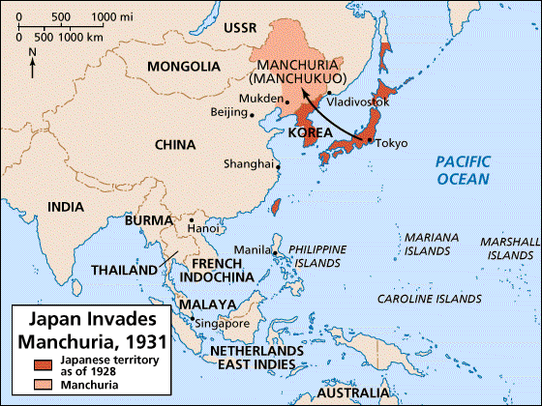
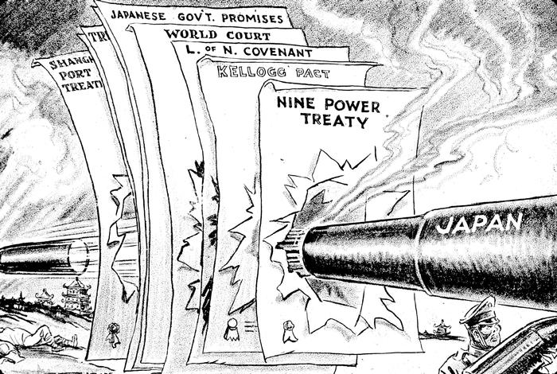
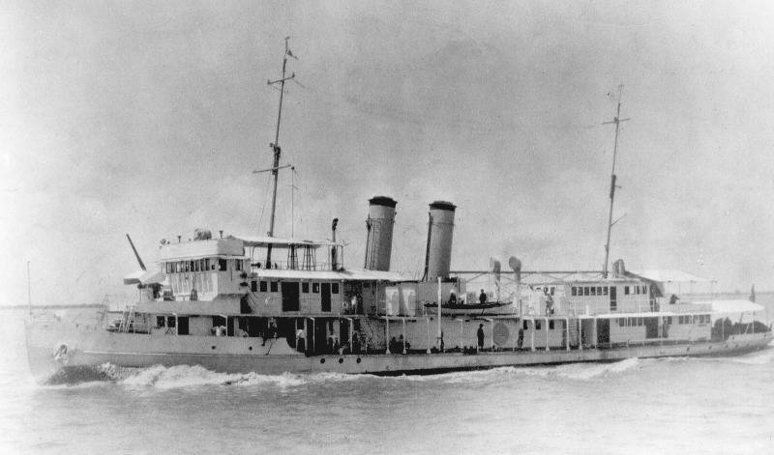
Japan Invades Manchuria
In 1937, Japanese pilots bombed the USS Panay, a U.S. gunboat stationed in China, killing 3 Americans. The U.S. accepted Japan's apology & promise against future attacks
Unlike the USS Maine or Lusitania, few Americans called for war against Japan
Notes:
In December 1937, Japanese aircraft bombed the Panay, a U.S. gunboat stationed on the Yangtze River near Nanking, killing three Americans. While the attack angered the public, few calls for war rang out, a similar response to those following the sinking of the Maine or the Lusitania. The United States quickly accepted Japan's apology, indemnities for the injured and relatives of the dead, promises against future attacks, and punishment of the pilots responsible for the bloodshed.

Slide 6
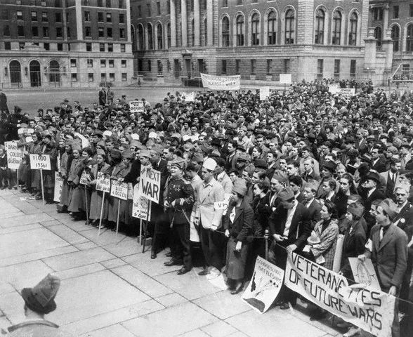
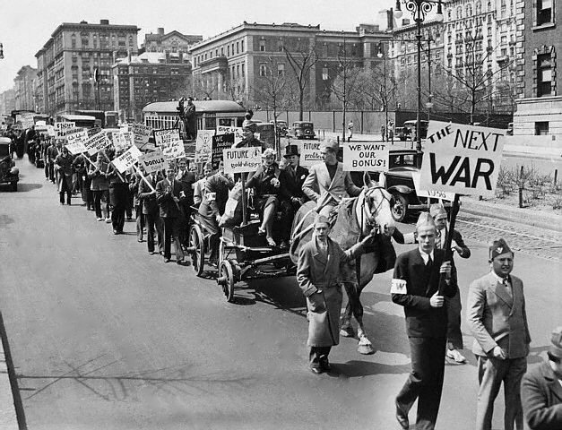
US Foreign Policy with Europe and Asia
FDR & Congress were too preoccupied with the Great Depression to adequately plan for new world conflicts
The rising threat of war in Europe & Asia strengthened Americans’ desire to avoid involvement in another “meaningless” world war (LIKE WWI)

Slide 7
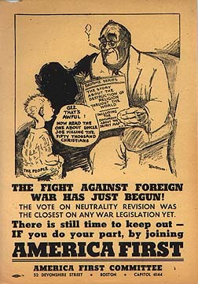
So, what is our decision? Read the “Neutrality Act” in your packet
1. Neutrality Act of 1935 = The President of the United States was banned from
Selling arms
Providing loans
Giving an form of assistance to nations involved in war
All U.S. citizens traveling on warring ships, did so at their own risk
2. Neutrality Act of 1936 = banned loans to any warring nation around the world
3. Neutrality Act of 1937 = Response to Spanish-American War; U.S. could sell materials to belligerents if
They paid cash
Arranged for the transportation of those materials

Slide 8
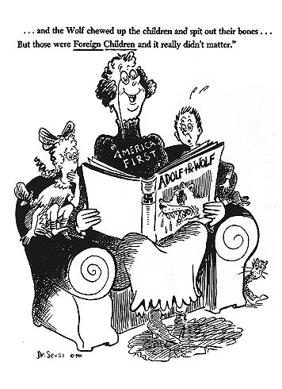
POINT OF VIEW: According to the Dr. Seuss cartoon, do you think he was more critical or supportive of US neutrality?

Slide 9
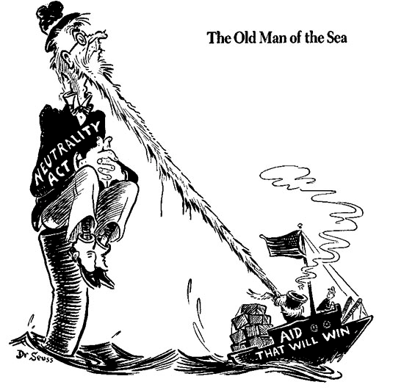

Slide 10
The Road Towards American Intervention in World War II

Slide 11
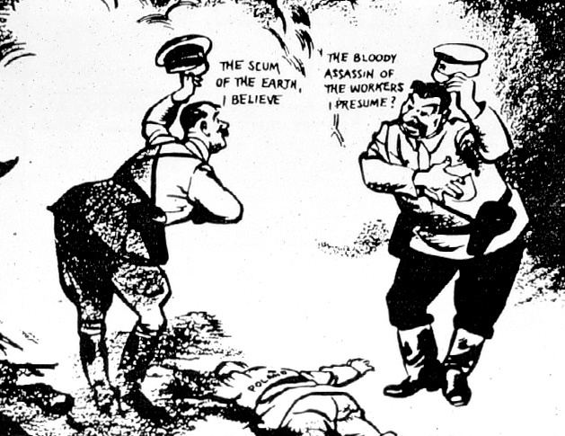
War breaks out in Europe!
DON’T COPY
Everything changed in 1939 with the Nazi-Soviet Pact & the German invasion of Poland

Slide 12
DON’T COPY

Slide 13
Pushing NEUTRALITY BACK
FDR openly expressed his favor for intervention & gradually give aid to the Allies (ESPECIALLY BRITAIN)…it was the BEST WAY FOR US TO STAY OUT OF WAR!
“Cash and Carry” (1939) = ALLIES could buy US arms for war ONLY if it used its own ships and paid cash
Selective Service Act (1940) = peacetime draft, men ages 21-35
Destroyers for Bases Deal (1940) = sell OLDER US naval destroyers to Britain to help vs. Germany
US gets naval bases in Atlantic
73% of US supports aid to Britain

Slide 14
TWO OPPOSING SIDES
TAKE A PIC!
“The future of western civilization is being decided upon the battlefield of Europe”
—CDAAA chair, William Allen White
Isolationists
Were appalled by this departure from neutrality & FDR’s involvement of the U.S. in foreign war
Their “fortress of America” idea argued that Germany was not a threat to the U.S.
Interventionists
Groups like the Committee to Defend America by Aiding the Allies called for unlimited aid to England
They argued that the events in Europe did impact the security of U.S.
St. Louis Dispatch headline: “Dictator Roosevelt Commits Act of War”

Slide 15
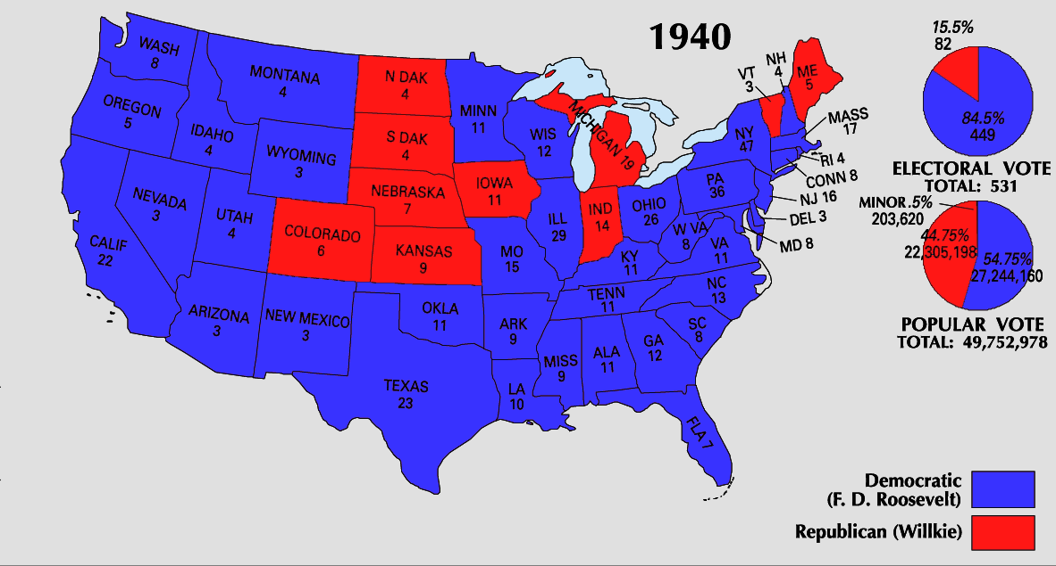
First president to break 2 term tradition and seek a 3rd term? FDR – ITS CRITICAL! “Your boys are not going to be sent into any foreign wars”
Smaller margin, but Americans TRUST HIM.

Slide 16
DON’T COPY

Slide 18
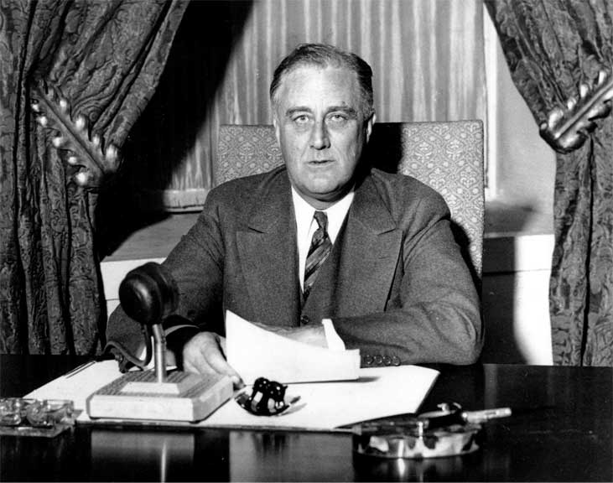
“If your neighbor’s house is on fire, you don’t sell him a hose. You lend it to him and take it back after the fire is out.”
Cash and Carry left the Allies short on cash
Lend-Lease Act (1941)
“lease, lend, or otherwise dispose of” any items not vital to the nation’s defense
Isolationists HATED it, but its too late now…

Slide 19
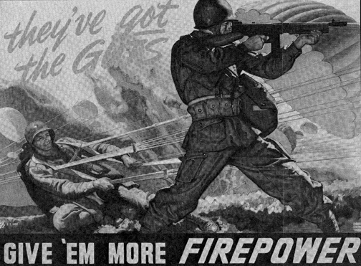
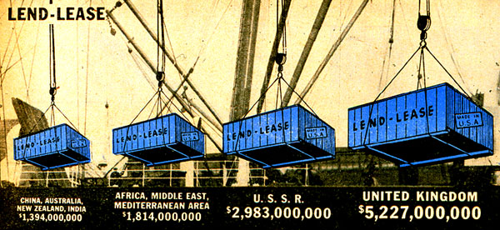
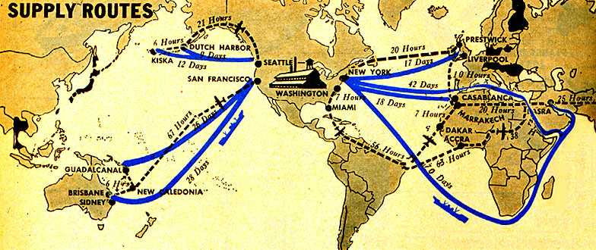
Lend-Lease Supply Routes

Slide 20
Close to war, time for a secret meeting…
Atlantic Charter (August, 1941)
FDR and Churchill meet:
Allies goals for the post-war world
“a permanent system of general security”…which becomes WHAT?
United Nations (1945)
SIGNIFICANCE?
FDR’s commitment to end isolation
US committed to British victory

Slide 21
AIM: Why did the Japanese attack the US at Pearl Harbor, and how did the American home front react?
EQ: What role did the US play in winning the wars in Europe and the Pacific?
May 22, 1941
December 8, 1941
Notes:
Lesson Plan for Thursday, February 19, 2009: Warm-Up Q, WW2 Notes

Slide 22
Calm before the storm…
FDR brought U.S. to the brink of war & opened himself to criticism:
In Sept 1941, polls showed 80% of Americans supported remaining neutral in WWII
FDR had to wait for the Axis to make a decisive move…which Japan delivered on Dec 7, 1941

Slide 23
Showdown in the Pacific
In 1941, the U.S. & Japan were unable to diplomatically resolve their differences, so the USA:
The U.S. supported China through the Lend-Lease Act
Embargoes and Sanctions
US froze Japan’s assets in America
US refused to trade oil, steel and rubber to Japan
Japan needed these resources to continue its imperial march in the Pacific
U.S. wanted the Japanese removed from China
Japan wanted an end to sanctions & a free hand to China
Why did the Japanese feel as though they were provoked by the United States? (read documents 3&4 in your packet)

Slide 24
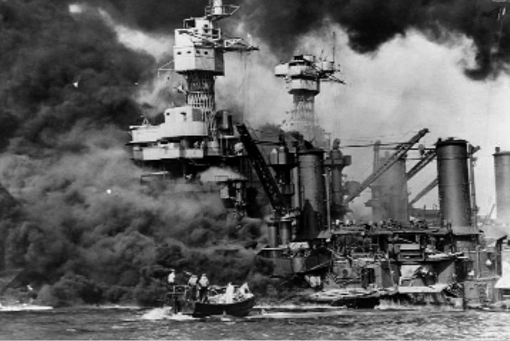
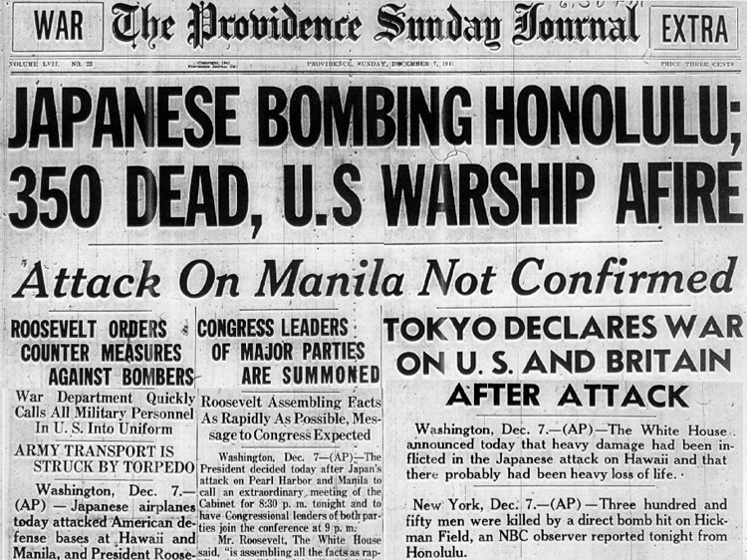
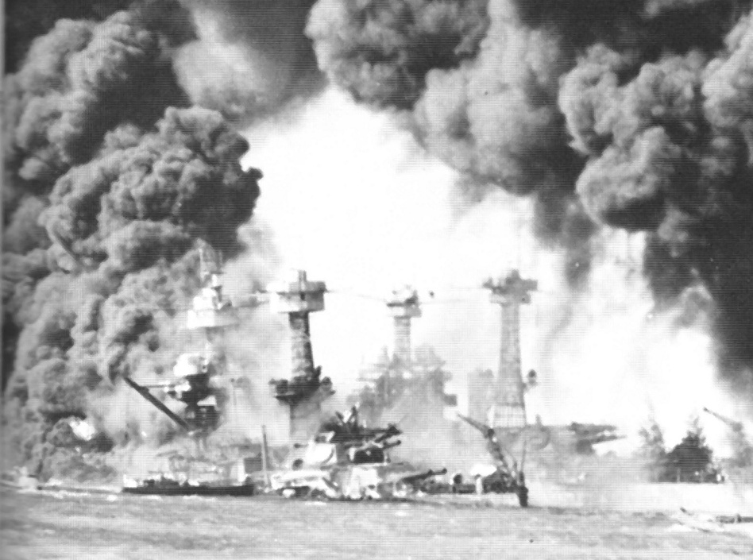
On Dec 7, 1941, the U.S. naval fleet in the Pacific was crippled by the attack; 8 battleships were sunk & 2,400 Americans were killed
Japan believed attacking Pearl Harbor would cripple the US Pacific Fleet for 18 months, thus allowing them to continue their plans for a Greater East Asia Co-Prosperity Sphere.
Notes:
On Dec 7, 1941, the U.S. naval fleet in the Pacific was crippled by the surprise attack; 8 battleships were sunk & 2,400 Americans were killed

Slide 25
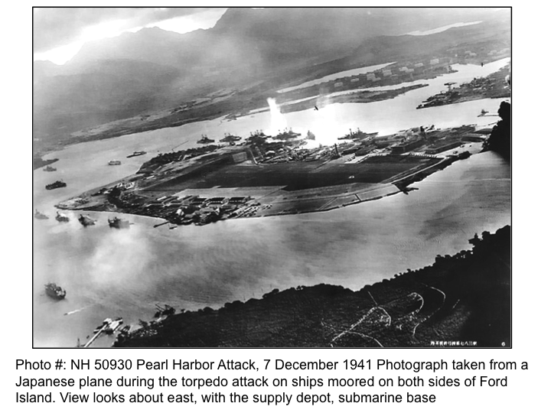

Slide 26
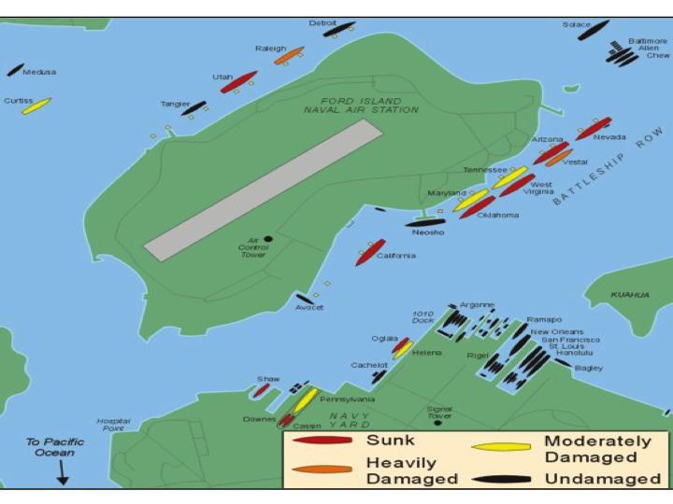

Slide 27
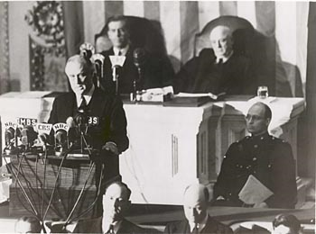
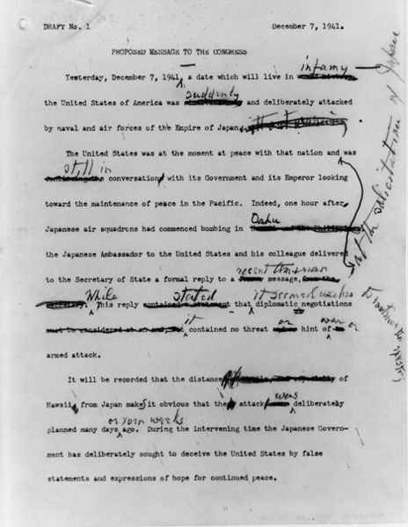
December 7, 1941: A date which will live in infamy
The attack on Pearl Harbor prompted FDR to ask Congress for a declaration of war
Congress votes 477 – 1 in favor of war
Japan, Germany, and Italy made an agreement that if a country not involved in WWII attacked one of the three, the others would come to that countries aid.
Germany & Italy declare war on the U.S. on December 11, 1941

Slide 28
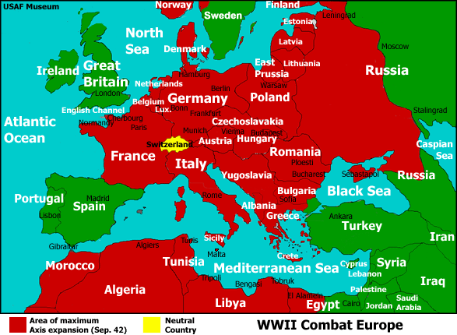
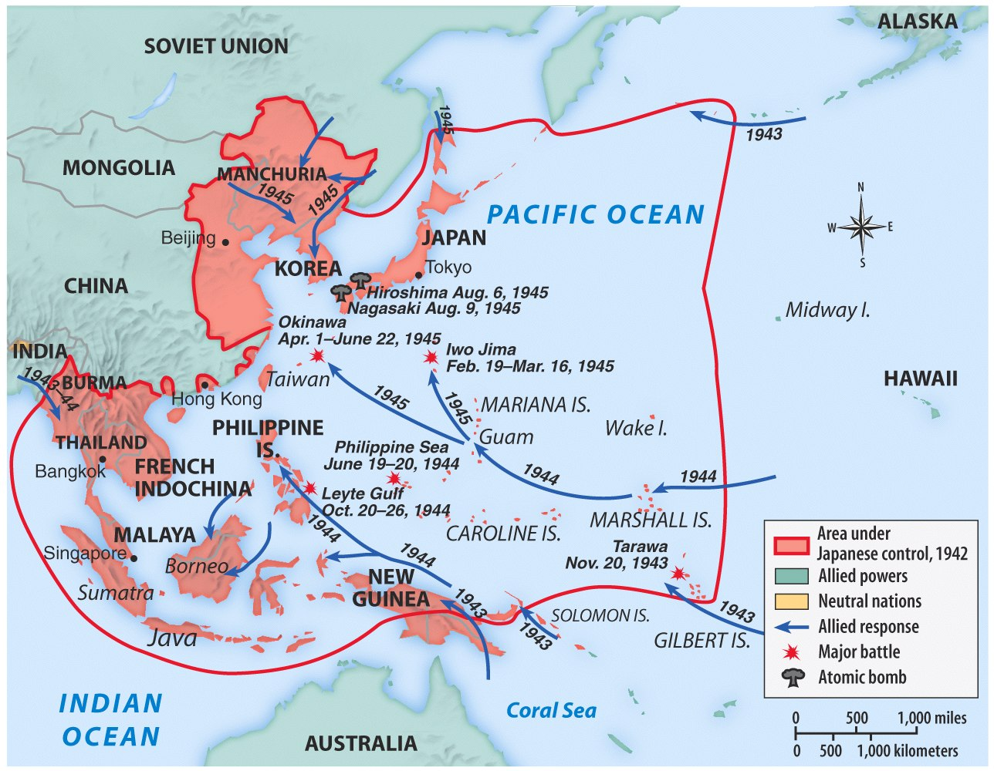
When the U.S. entered WW2 in late 1941, victory seemed remote
Japan dominated the western half of the Pacific Ocean
Germany controlled almost all of Europe
Germany pressed into Russia
Axis armies controlled Northern Africa & threatened the Suez Canal
VIDEO: But…over the next 2 years, the U.S. & the Allies began to win the wars in Europe & the Pacific

Slide 29
DON’T COPY
By agreeing to “Operation Overlord” (D-Day), the Allies would divide the Axis military across two fronts
In 1943, FDR, Churchill, Stalin met in Tehran, Iran for the first of three wartime conferences:
The USA, Britain, USSR coordinated their war strategy
FDR & Churchill finally committed to Stalin’s demands to open a western front (D-Day)
Discussed plans to create a “general internat’l organization” to promote “peace & security” (UN)
FDR proposed a future United Nations dominated by “4 policemen” (USA, Britain, China, & USSR) with power to “deal immediately with any sudden emergency which requires action”
Notes:
Stalin agreed to declare war on Japan after the defeat of Germany
Broader international cooperation also became a central theme of the negotiations at Tehran. Roosevelt and Stalin privately discussed the composition of the United Nations. During the Moscow Conference of the Foreign Ministers in October and November of 1943, the United States, Britain, China, and the Soviet Union had signed a four-power declaration whose fourth point called for the creation of a "general international organization" designed to promote "international peace and security." At Tehran, Roosevelt outlined for Stalin his vision of the proposed organization in which the future United Nations would be dominated by "four policemen" (the United States, Britain, China, and Soviet Union) who "would have the power to deal immediately with any threat to the peace and any sudden emergency which requires action."

Slide 30
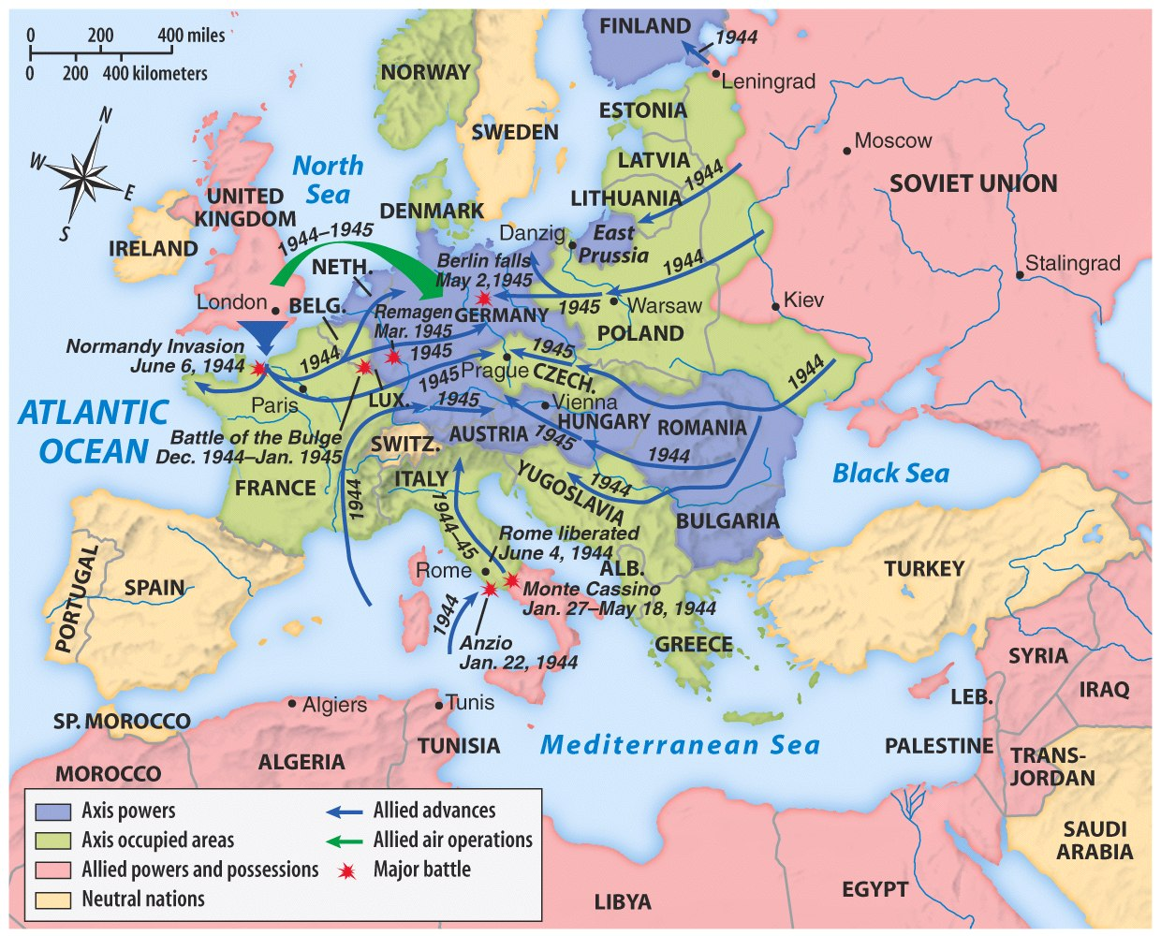
Europe 1944-1945
U.S. & British troops landed at 5 strategic points, pushed through France drove towards Germany
The long-awaited 2nd front came on June 6, 1944 with D-Day

Slide 31
Yalta Conference in February 1945
To recognize the independence & sovereignty of nations in Eastern Europe
The “Big 3” met at Yalta to discuss post-war Europe given the eminent defeat of Germany:
Stalin refused to give up Eastern Europe but he did agree to “self-determination”
Stalin agreed to send Soviet troops to the Pacific after the German surrender if the USSR could keep Manchuria

Slide 32
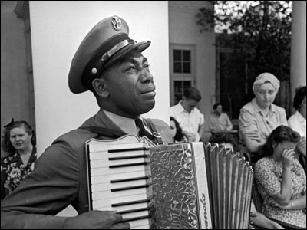
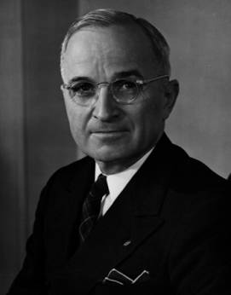
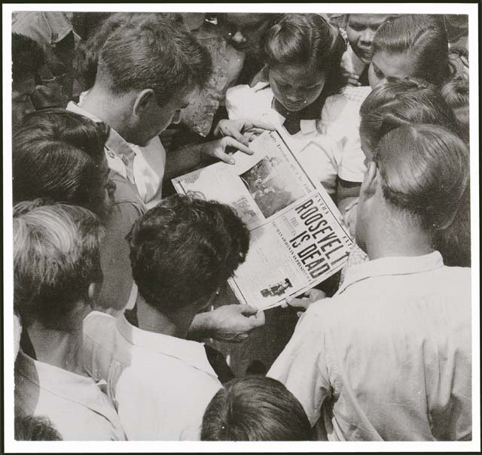
Soon after the Yalta Conference in Feb 1945, FDR died…and Harry Truman became president

Slide 33
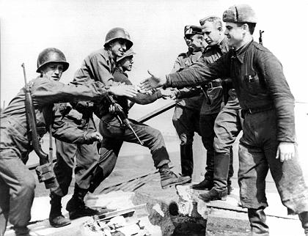
In late April 1945, the Allies broke through the Eastern & Western Fronts forcing both Italy & Germany to surrender

Slide 34
Next, “Island-hopping” allowed the Allies to win strategic islands without investing precious time, resources, & American lives
In the Pacific, U.S. victory at Midway (1942) gave the Allies naval supremacy

Slide 35
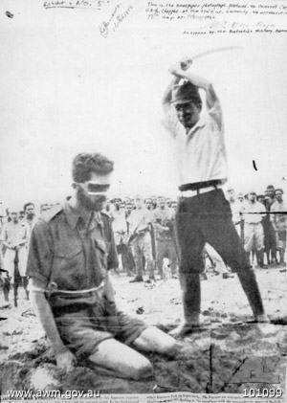
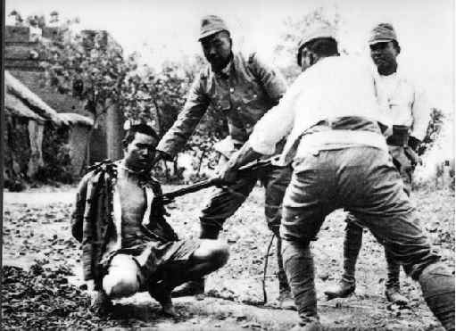
The Japanese refused to play according to the Geneva Convention “rules” of war

Slide 36
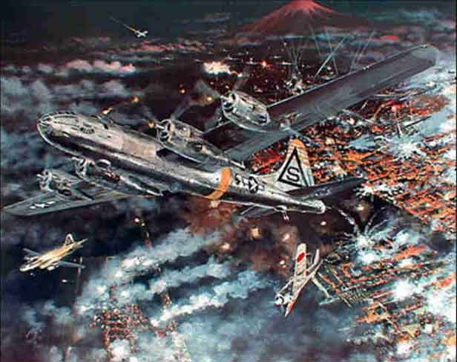
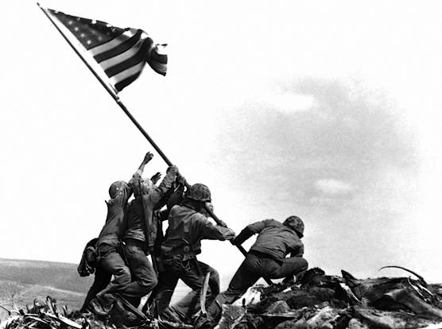
The German surrender in May 1945, allowed the U.S. to turn its full attention towards Japan
Victories at Saipan in 1944 & Iwo Jima & Okinawa in 1945 allowed for bombings on Japan

Slide 37
The Decision to Drop the A-Bomb
With no definitive end it sight, how would the Allies defeat Japan?
The U.S. military favored a full-scale invasion of Tokyo by 1946
The Japanese refused to surrender & were arming civilians for an Allied invasion
At the Potsdam Conference in July 1945, Truman gave the order to use the atomic bomb

Slide 38
Triumph & Tragedy in the Pacific
In August 1945, the USA forced Japan to surrender by dropping 2 atomic bombs
Effect of the atomic bomb:
Saved hundreds of thousands of American (& Japanese) lives
Revenge for Pearl Harbor
Showed the USSR that the USA had the ultimate weapon (began the Cold War nuclear arms race)

Slide 39
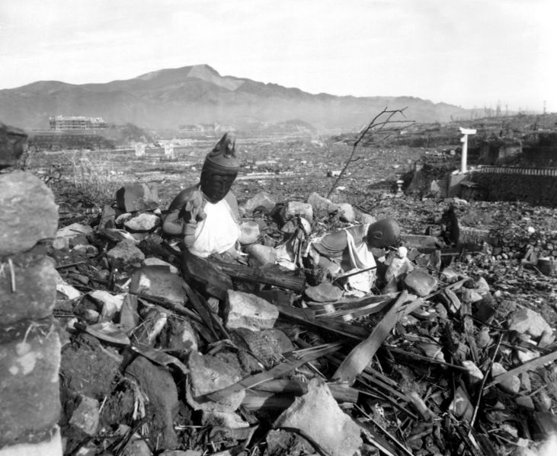
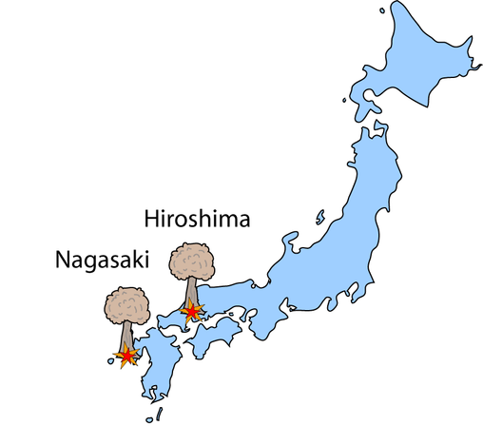
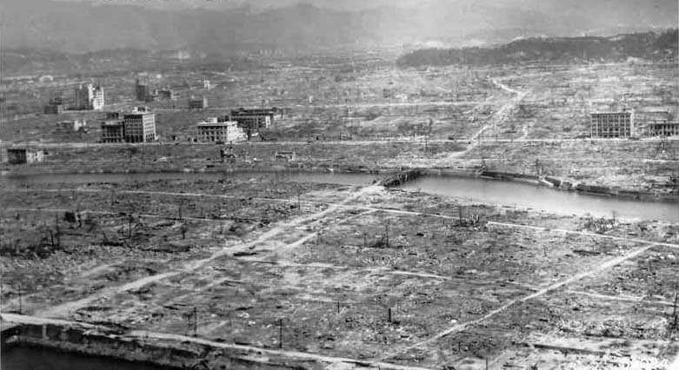
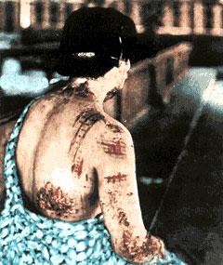
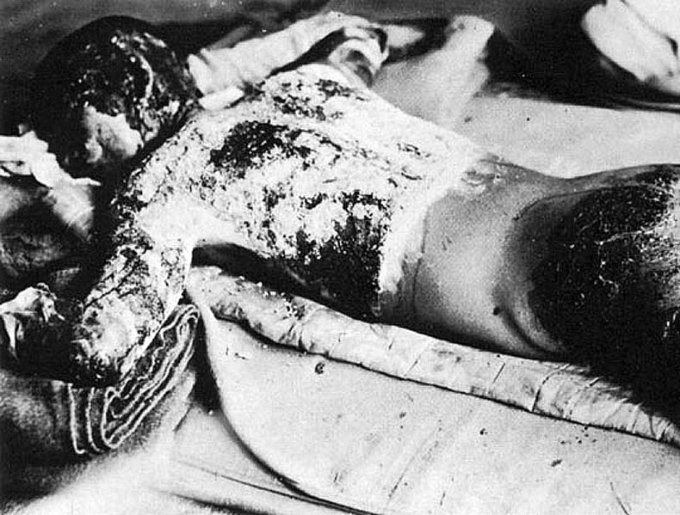
Nagasaki
Hiroshima

Slide 41
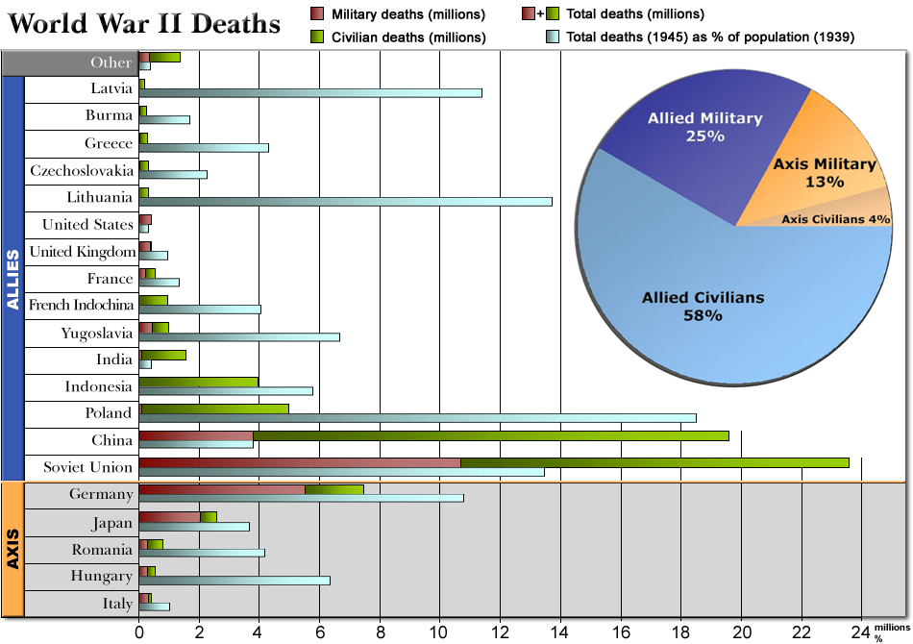
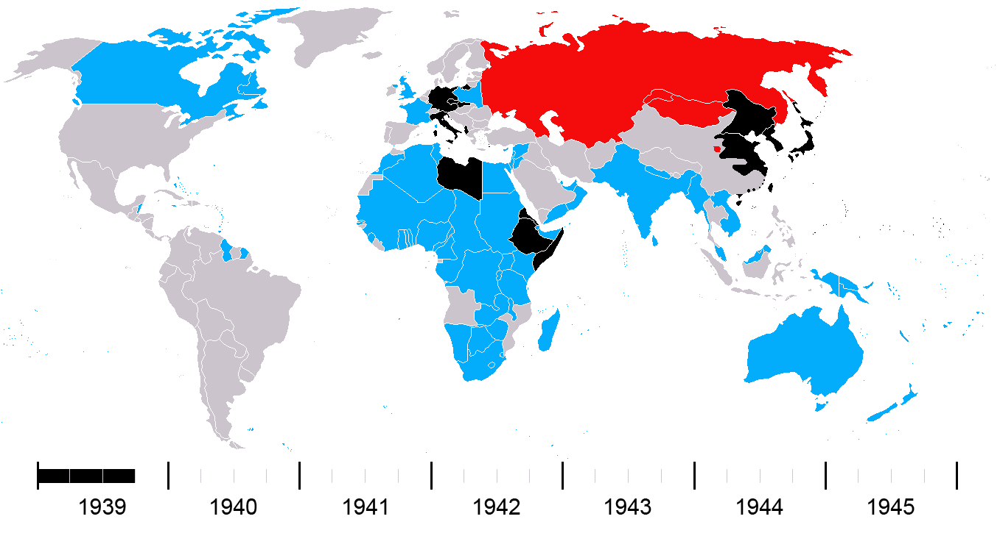
WW2 Timeline (Allies, Axis, USSR)

Slide 42
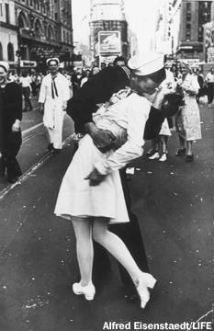
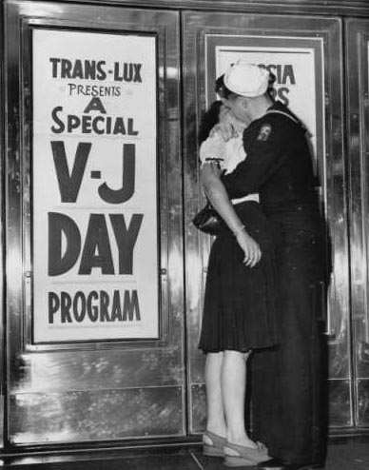
Its Finally Over!

