Slide 1
AIM: What were the causes & consequences of America’s involvement in the Vietnam War?

Slide 2
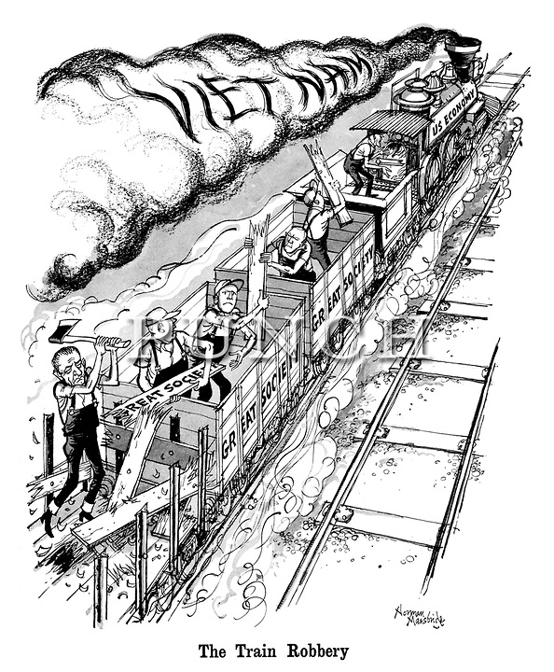
According to the cartoon, why did the Great Society programs fail?
Vietnam limited the impact of some Great Society programs.

Slide 3
The Vietnam War (November 1, 1955 – April 30, 1975)
During the Cold War, the U.S. was committed to containing communism
So far, the U.S. was effective in limiting communist influence in Europe
But, the spread of communism in Asia led the U.S. to become involved in a civil war in Vietnam
Involvement in Vietnam from 1950 to 1973 proved to be America’s longest & most controversial war…

Slide 4
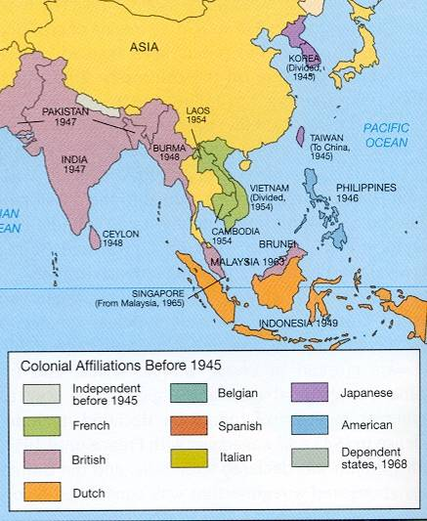
America’s Commitment to Vietnam
Since 1887, France controlled the colony of Vietnam in SE Asia
By 1945, Communist leader Ho Chi Minh led a war of independence for Vietnam
Truman & Eisenhower feared the spread of communism in Asia (“domino theory”) & sent aid to France

Slide 5
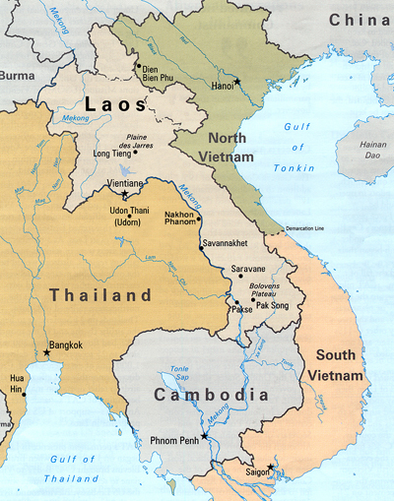
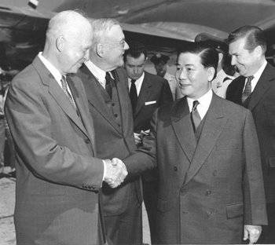
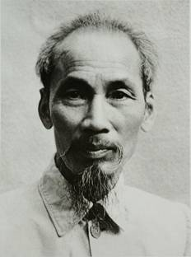
America’s Commitment to Vietnam
Ho Chi Minh gained control of communist North Vietnam
Vietnam won independence in 1954 but was divided along the 17th parallel
Ngo Dinh Diem became democratic president of South Vietnam

Slide 6
America’s Commitment to Vietnam
Ho Chi Minh’s communist supporters in the North were called the Vietminh
In South Vietnam, a group of communists (Vietcong) were formed to oppose Diem & unify Vietnam

Slide 7
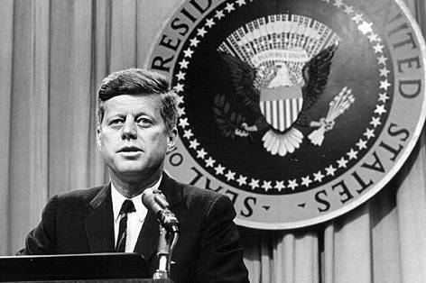
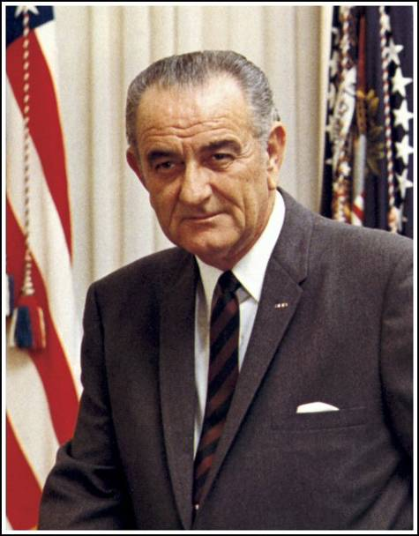
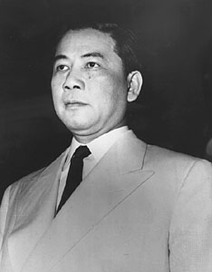
America’s Commitment to Vietnam
In 1963, Buddhist monk Quang Duc immolated himself to protest Diem’s regime
South Vietnamese President Diem led a corrupt government, offered little assistance to the poor, & oppressed Buddhists
Presidents Eisenhower & Kennedy supported Diem despite his growing unpopularity
“Strongly in our mind is what happened in China at the end of World War II, where China was lost. We don’t want that.”
—JFK
In 1963 President Kennedy recognized that Diem had lost control of Vietnam & gave approval for the assassination of Diem
After JFK’s death in 1963, the responsibility for Vietnam fell to Lyndon Johnson
Diem’s assassination led to chaos in South Vietnam

Slide 8
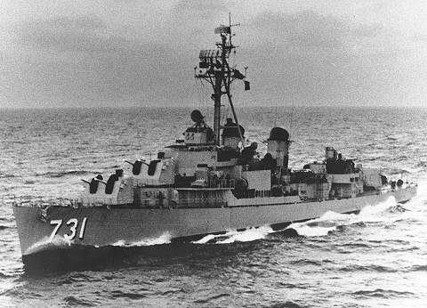
The Gulf of Tonkin Resolution, 1964
In 1964, a North Vietnamese gunboat attacked the USS Maddox in the Gulf of Tonkin
Congress responded with the Gulf of Tonkin Resolution which gave Lyndon Johnson broad powers to “defend Vietnam at any cost”
Notes:
Under LBJ, America escalated its role in Vietnam & began
Defend Vietnam at any cost
Unlimited military intervention to be used at LBJ’s discretion

Slide 9
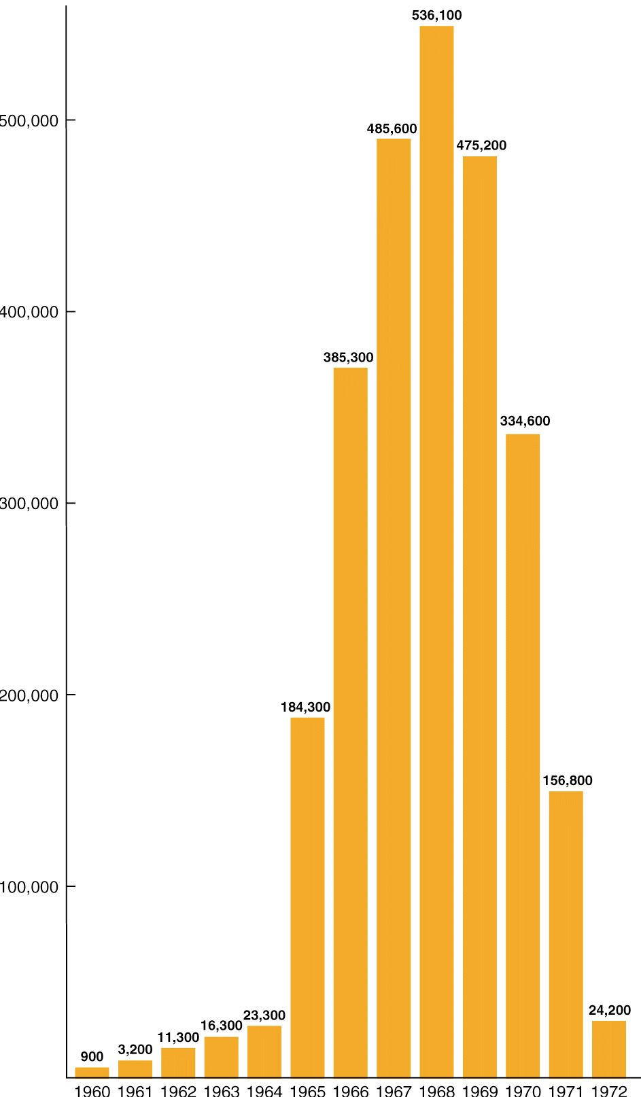
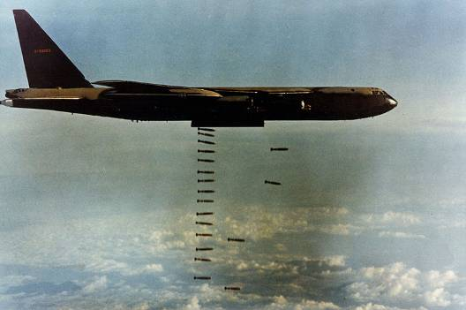
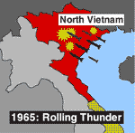
The Escalation of the Vietnam War
In an effort to contain the spread of communism into South Vietnam, LBJ began sending U.S. troops in 1965
By 1968, over 500,000 U.S. soldiers were fighting in Vietnam
In “Operation Rolling Thunder,” the U.S. military began bombing North Vietnam
U.S. Troops in Vietnam

Slide 10
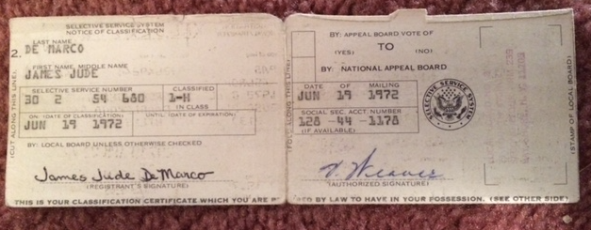
The U.S. had a draft to bring
more soldiers to Vietnam

Slide 11
Fighting the War in Vietnam: what do you think our GOAL was?
The goal of U.S. military was to defeat the Vietcong & support democracy in South Vietnam:
But, the Vietcong lived among the civilians in Vietnamese in cities & villages (who is the enemy?)
(We Were Soldiers) WHILE YOU WATCH: What made fighting in Vietnam SO DIFFICULT for the United States troops?
VIDEO

Slide 12
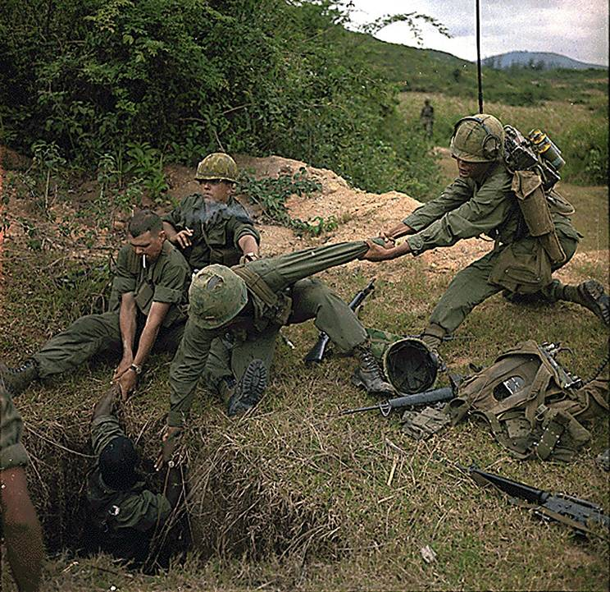
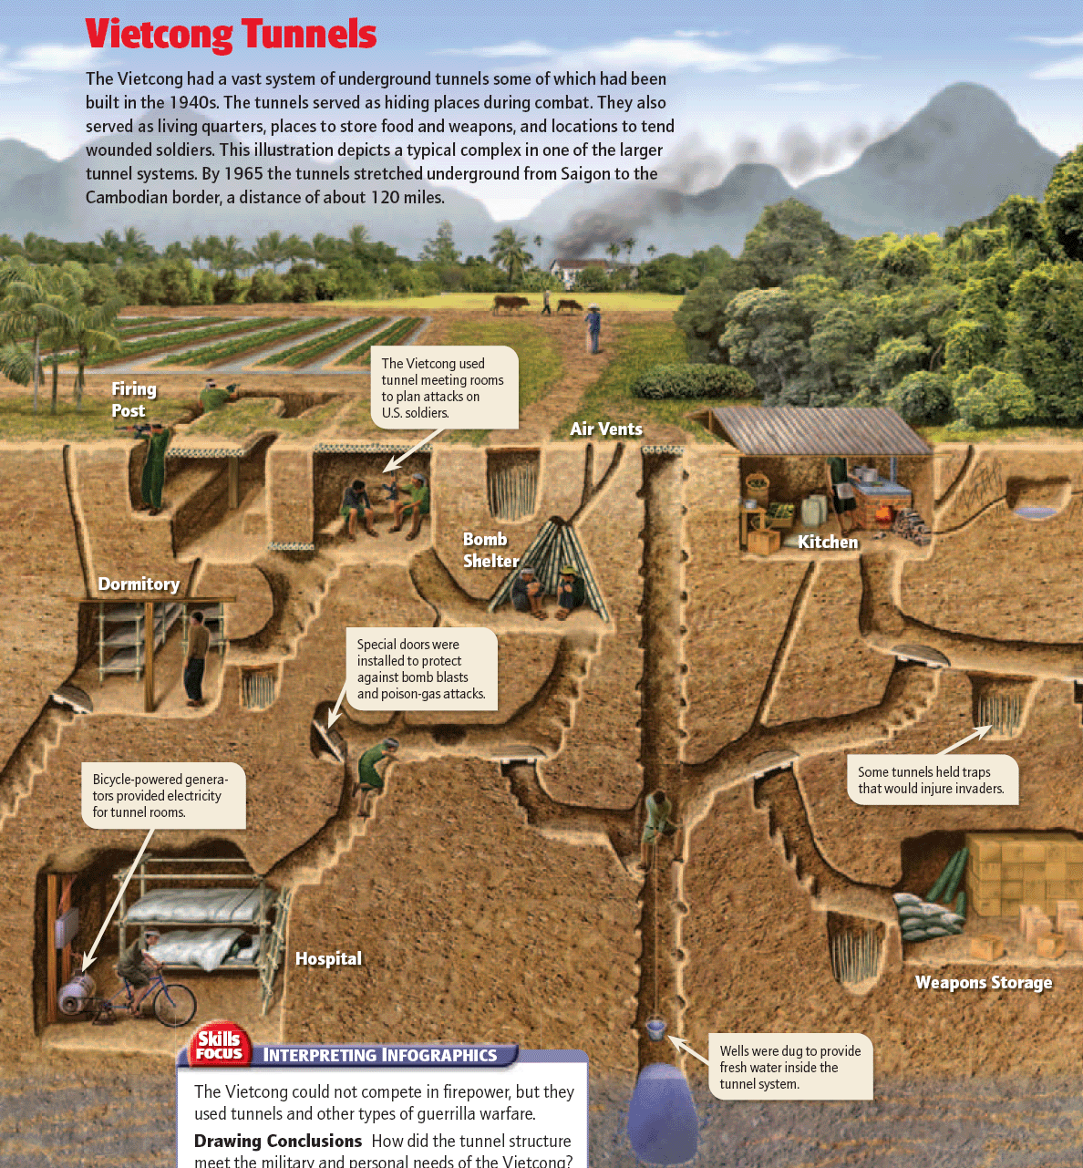

Slide 13
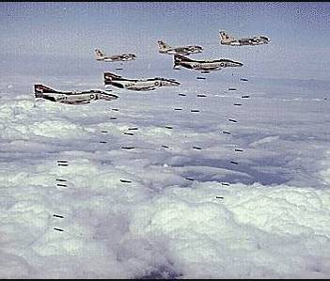
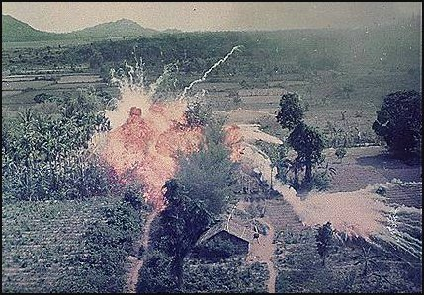
The U.S. military used a variety of tactics to fight the war in Vietnam
The air force bombed villages & supply lines (Ho Chi Minh Trail)

Slide 14
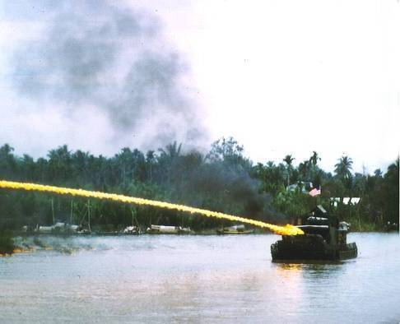
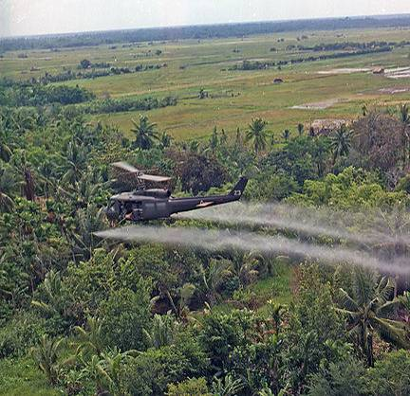
The U.S. military used a variety of tactics to fight the war in Vietnam
The military used napalm to destroy villages & pesticides (Agent Orange) to destroy crops

Slide 15
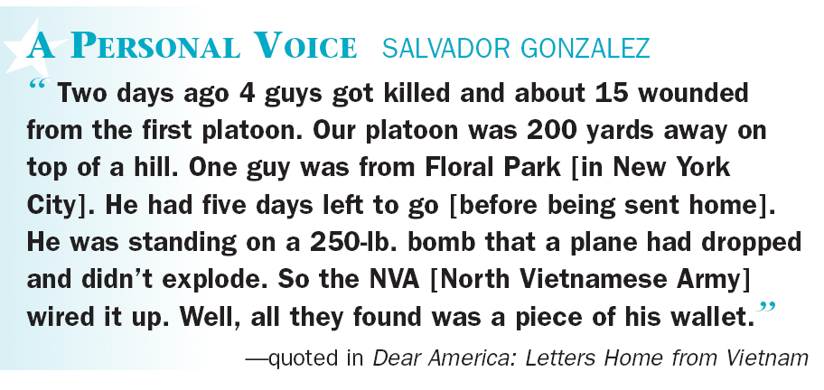
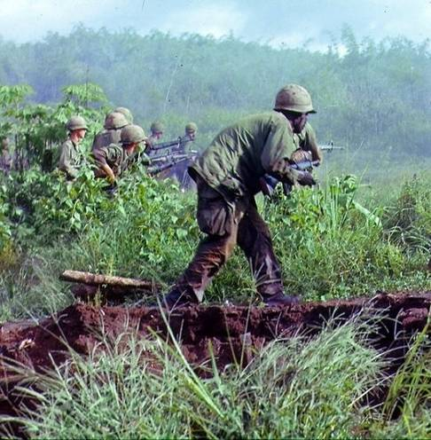
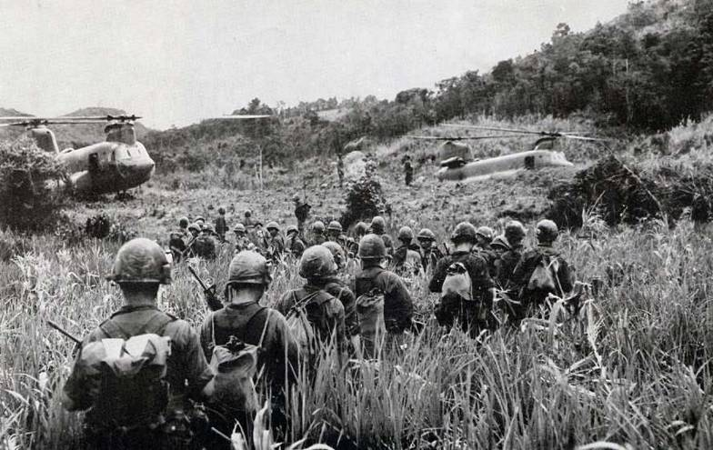
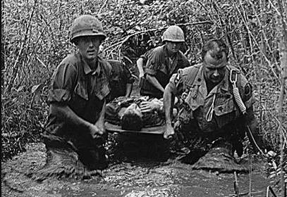
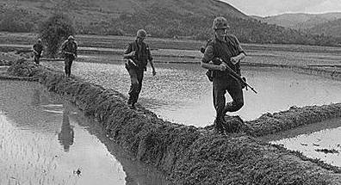
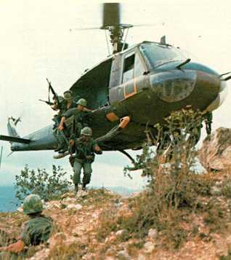
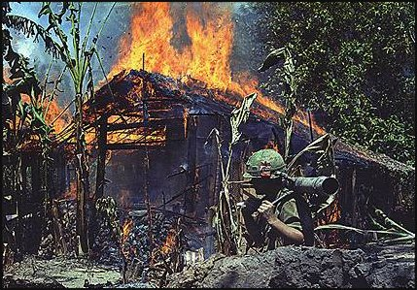
The U.S. military used a variety of tactics to fight the war in Vietnam
Soldiers were sent on deadly “search & destroy” missions into the jungles to find the Vietcong

Slide 16
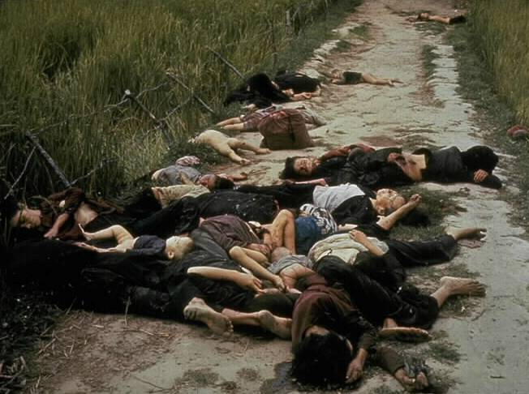
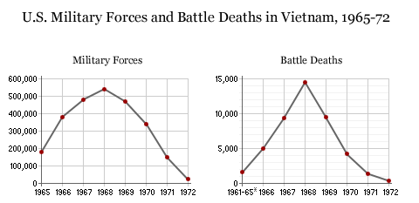
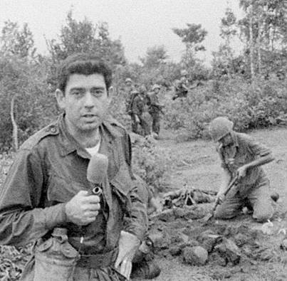
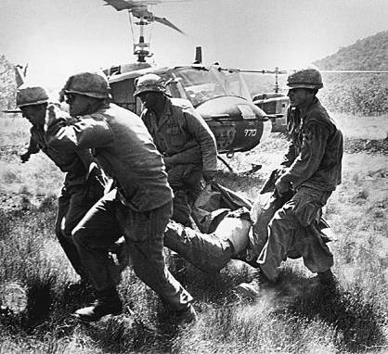
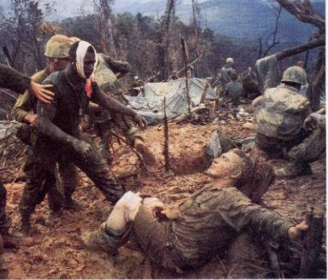
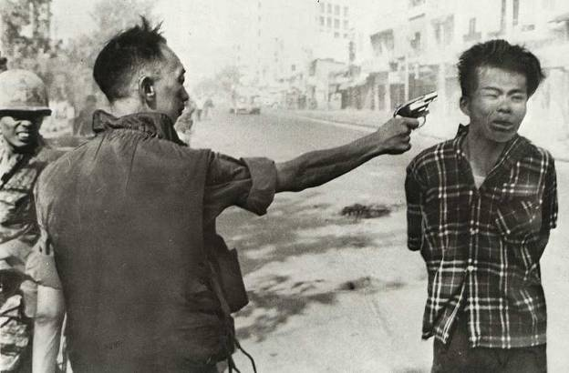
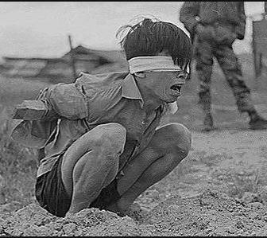
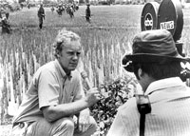
Despite overwhelming military superiority, the U.S. could not win in Vietnam & the war became unpopular at home
“My Lai Massacre” 1968
TV broadcasts reported body counts, atrocities, declining troop morale, & lack of gains in the war
Television made Vietnam a “living room war”
Notes:
Dan Rather for CBS

Slide 17
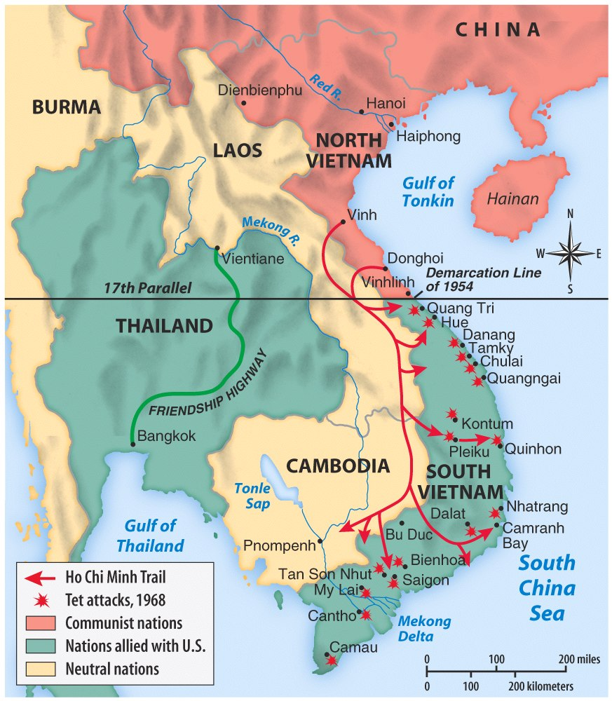
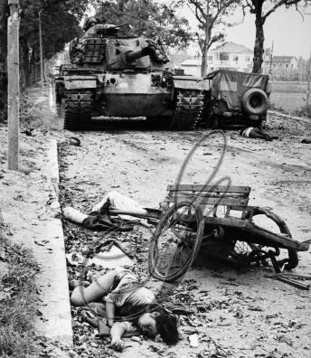
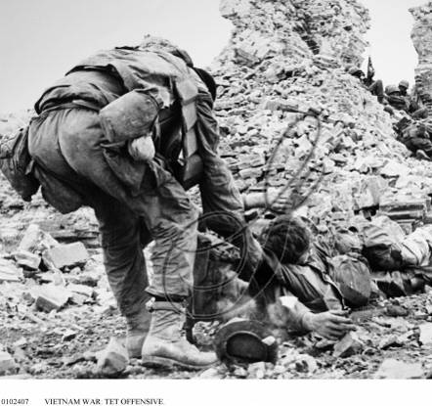
Why was the The Tet Offensive (1968) considered a turning point in the war?
In 1968, the Vietcong launched the Tet Offensive against U.S. forces in South Vietnam
The attack was contrary to media reports that the U.S. was winning the Vietnam War

Slide 18
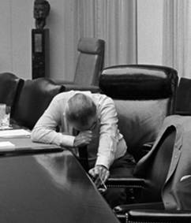
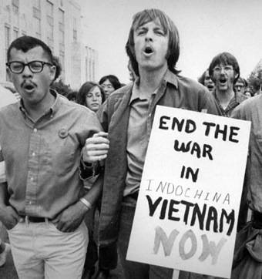
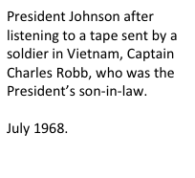
The Tet Offensive, 1968
The Tet Offensive was a turning point in the Vietnam War
American attitudes towards the war changed & anti-war movement grew
President Johnson began to question whether the war could be won…
…& LBJ announced that he would not seek re-election
“Johnson’s War”

Slide 19
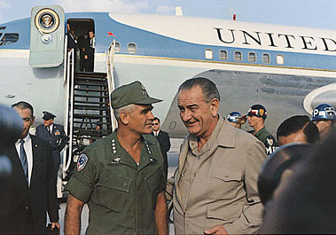
General Westmoreland & the Credibility Gap
“Vietcong surrender is imminent”
“The U.S. has never lost a battle in Vietnam”
But, the military continued to draft more young men to fight in Vietnam
“There is a light at the end of the tunnel”
The American public believed their was a “credibility gap” between what the government was saying & the reality of the Vietnam War

Slide 20
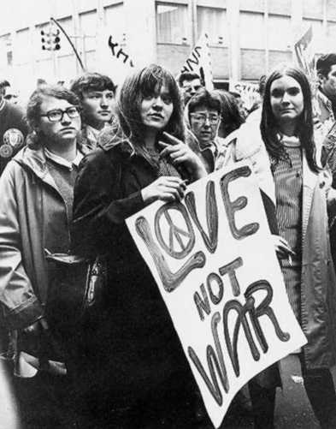
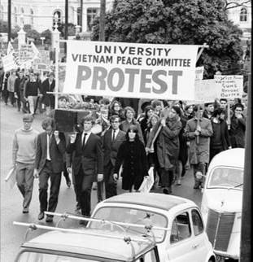
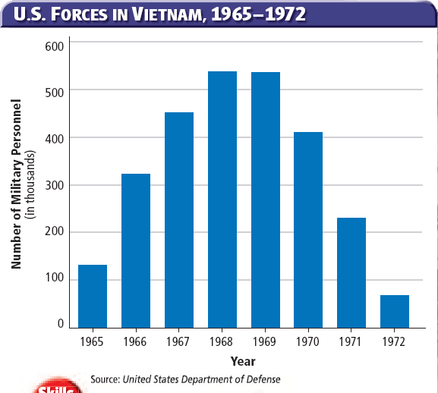
Protesting the Vietnam War
Since 1965, U.S. troops had been in Vietnam… but 1968 was the height of the Vietnam War & the year of the disastrous Tet Offensive
As more men were drafted into the war, the larger the anti-Vietnam protests became

Slide 21
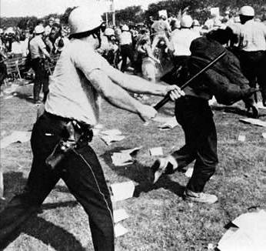
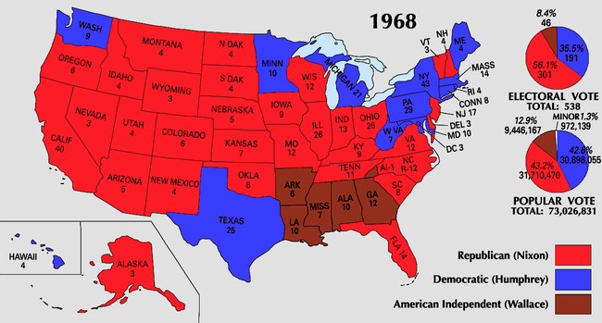
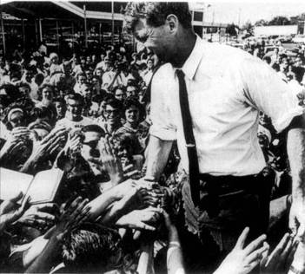
Richard Nixon & the Election of 1968
LBJ’s decision not to run for re-election & the assassination of Robert Kennedy left the Democrats divided for the election of 1968
Republican Richard Nixon took advantage of the divided Democrats & won the 1968 election

Slide 22
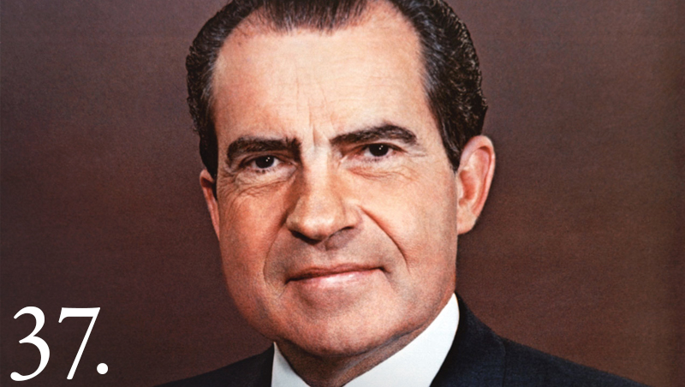
Richard Nixon
Presidential term: January 20, 1969 – August 9, 1974

Slide 23
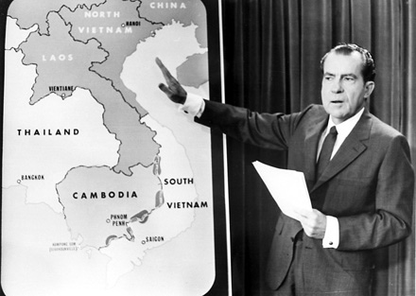
Nixon wanted “peace with honor” in Vietnam

Slide 24
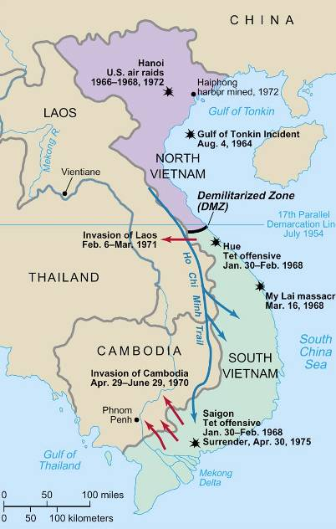
Vietnamization
Nixon & National Security Advisor Henry Kissinger developed a plan called Vietnamization: gradually withdraw U.S. troops & replace them with South Vietnamese soldiers
But, Nixon really wanted a “knockout blow” in Vietnam & secretly sent U.S. troops Cambodia & ordered bombings of Laos

Slide 25
When Americans found out about Nixon’s attacks on Cambodia & Laos, it set off the largest protest in U.S. history
250,000 people, mostly students on college campuses, protested the war & some protests turned violent…

Slide 26
MUSIC reacts to the Vietnam war…

Slide 27
“Ohio” by Crosby, Stills,
Nash & Young
Tin soldiers and Nixon coming, We're finally on our own. This summer I hear the drumming, Four dead in Ohio. Gotta get down to it Soldiers are cutting us down Should have been done long ago. What if you knew her And found her dead on the ground How can you run when you know?
Gotta get down to it Soldiers are cutting us down Should have been done long ago. What if you knew her And found her dead on the ground How can you run when you know? Tin soldiers and Nixon coming, We're finally on our own. This summer I hear the drumming, Four dead in Ohio.

Slide 28
Kent State Massacre (May 4, 1970)
At Kent State University in Ohio, four students were killed by National Guardsmen who were called out to preserve order on campus after days of anti-Nixon protest.

Slide 29
Ending the Vietnam War
In 1973, the U.S. & North Vietnam agreed to a cease fire & the U.S. withdrew troops from Vietnam
In 1975, North Vietnam violated the cease fire, invaded South Vietnam, & unified the nation under a communist government
Notes:
By 1975, the South Vietnamese capital of Saigon fell & Vietnam became unified under the Communist government
Vietnam proved Containment could not be sustained

Slide 30
The Impact of the Vietnam War
The conflict in Vietnam was the longest & most divisive war in U.S. history
Of the 3.3 million U.S. soldiers who served:
58,000 were killed
303,000 were wounded
15% were diagnosed with post-traumatic stress disorder after the war
Many vets faced hostility from other U.S. citizens when they returned home

Slide 31
The Impact of the Vietnam War
The war changed foreign policy:
Containment ended as Americans became cautious of the U.S. role in the world
Congress limited a president's ability to send troops without a declaration of war by passing the War Powers Act in 1973

Slide 32
The Impact of the Vietnam War
The war changed America domestically:
People began to lose faith in the honesty of government leaders during the Johnson & Nixon years
The $176 billion cost of the war led to high inflation in the 1970 & weakened LBJ’s Great Society
The 26th Amendment lowered the voting age to 18 years old

Slide 33
The Impact of the Vietnam War
In 1971, the New York Times published the Pentagon Papers (classified documents)
The U.S. was involved in Vietnam going back to World War II
Revealed how Presidents Truman, Eisenhower, Kennedy, Johnson, and Nixon misled the American people about involvement in Vietnam

