Slide 1
AIM: Why and how did the United States expand its policy of imperialism across the world in the late 19th century?
Notes:
Lesson Plan for Friday, January 16, 2009: Warm-Up Question, Foreign policy notes, Compare foreign policy cartoons

Slide 2
Lesson Vocabulary
1. What is imperialism?
Policy in which a strong nation seeks to dominate other countries politically, economically, and/or socially.
2. What is expansionism?
Policy in which a nation attempts to expand its borders or land holdings into new territories.

Slide 3
Is it better to be
imperialistic and take over foreign lands
OR
is it better to stay isolated and not get involved in anyone’s business?

Slide 4
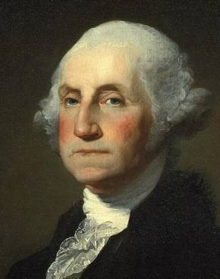
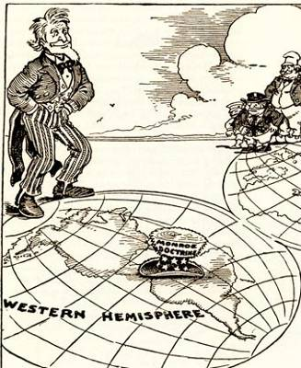
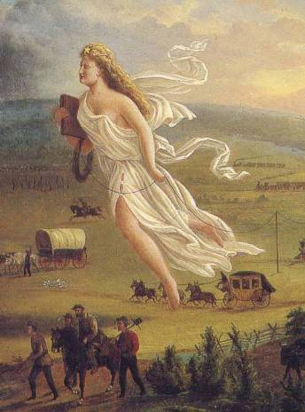
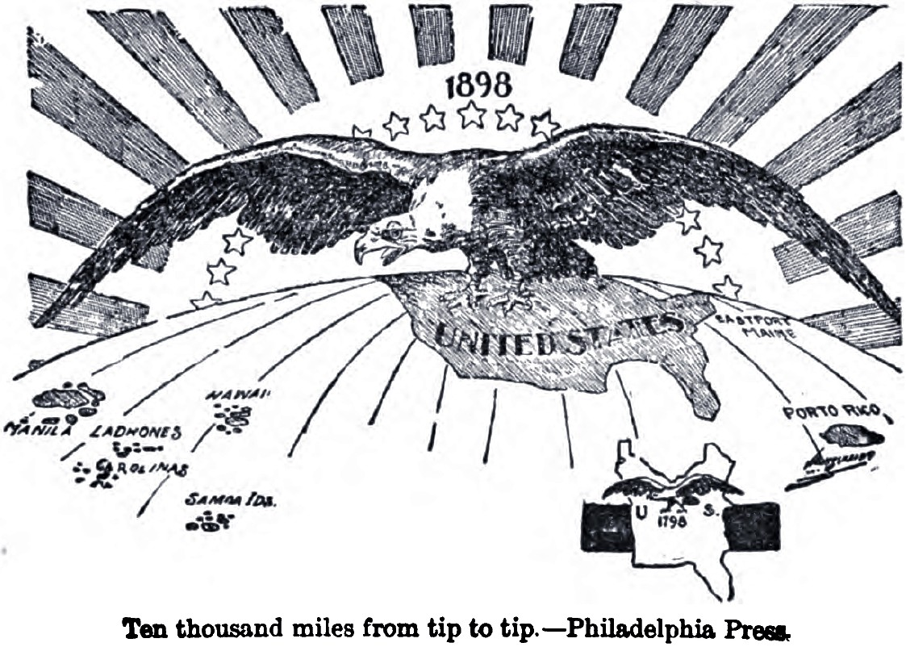
U.S. Foreign Policy Over Time…

Slide 5
U.S. Foreign Policy (1789-1850)
Washington’s Farewell Address
Avoid permanent alliances, but defend American interests
Jefferson’s Empire of Liberty
Model of republicanism and democracy
Louisiana Purchase (1803)
Monroe Doctrine
Prevention of European intervention in Western Hemisphere
Manifest Destiny
Adams-Onis Treaty
Webster-Ashburton Treaty
Oregon Territory
Texas
Mexican-American War – Mexican Cession
Limited Involvement
Domestic economic expansion
Protective tariffs
Economic dependency on European powers
Immigration
Mass wave during 1830s-1840s
TAKE A PIC!

Slide 6
U.S. Foreign Policy During Sectionalism (1850-1860)
TAKE A PIC!
Zachary Taylor (W)
Clayton-Bulwer Treaty (1850)
Neutrality of possible Nicaragua canal
Millard Fillmore (W)
Pursued Asian markets
Franklin Pierce (D)
Gadsden Purchase (1853)
Commodore Matthew Perry Expedition (1853-1854)
Encourage trade and diplomatic relations with Japan
Convention of Kanagawa (1854)
James Buchanan (D)
Limited foreign affairs due to onset of Civil War

Slide 7
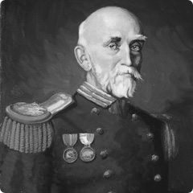
ALL considered arguments for
“new imperialism”…
Alfred Thayer Mahan: The Influence of Sea Power Upon History (1890) = NAVY IS VITAL TO IMPERIALISM

Slide 8
…The time is coming when the pressure of population on the means of subsistence will be felt there as it is now felt in Europe and Asia. Then will the world enter upon a new stage of its history-the final competition of races, for which the Anglo-Saxon is being schooled…
Missionary Josiah Strong’s Our Country: Its Possible Future and Present Crisis (1885)
And can anyone doubt that the result of this competition of races will be the "survival of the fittest"?...
Protestant Americans had a “religious duty” to colonize and spread Christianity and the benefits of our “SUPERIOR” civilization (medicine, science, tech.)
In my own mind, there is no doubt that the Anglo-Saxon is to exercise the commanding influence in the world's future…

Slide 9
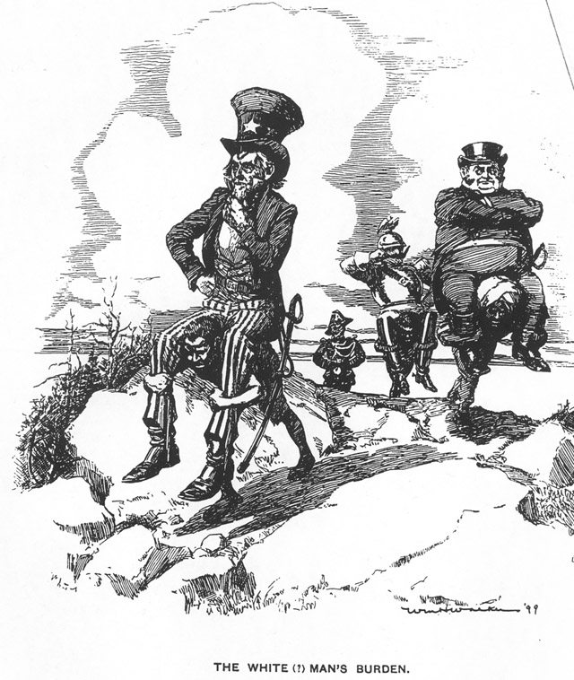
“We are Anglo-Saxons, and must obey our blood and occupy new markets, and, if necessary, new lands.” – Senator Albert Beveridge, April 1898
RACIAL
SUPERIORITY!
Also known as…

Slide 10
How do the we see the justifications for imperialism rising up again during the Progressive Movement?
…the Industrial Revolution?
#1 Social Darwinism was a prominent belief
People believed that “survival of the fittest” applied to people AND nations
#2 Imperialism was the product of strains in US society due to industrialization
Increase in productivity = need for new markets to expand into
US needs more natural resources

Slide 11
DON’T COPY!

Slide 12
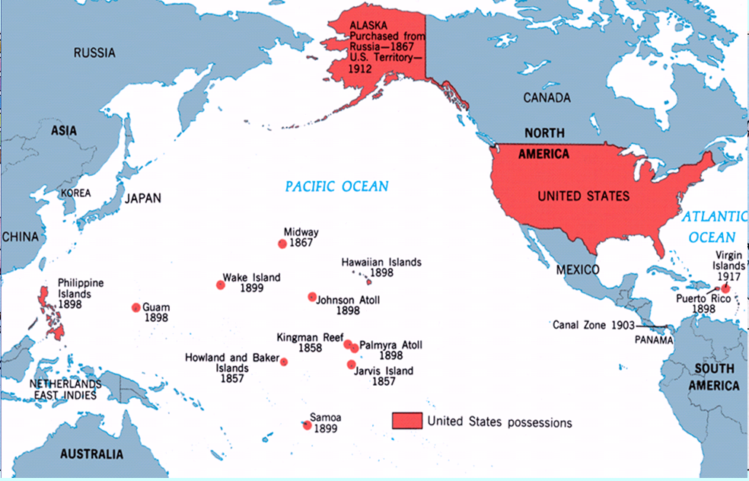
American Imperialism

Slide 13
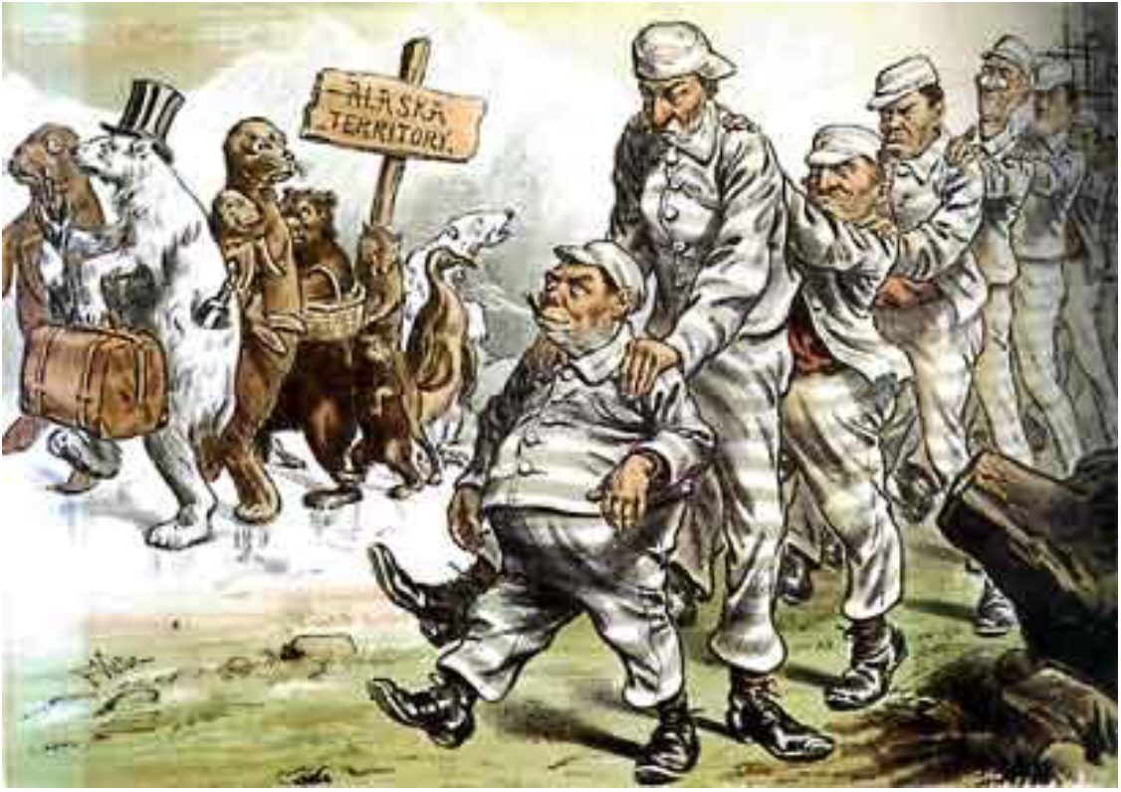
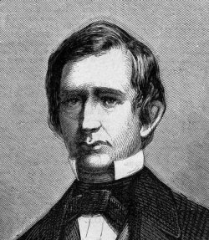
In the 1890s a number of economic and political forces sparked a spectacular burst of imperialistic expansionism for the United States that culminated in the Spanish-American War—a war that began over freeing Cuba and ended with the highly controversial acquisition of the Philippines and other territories.
So, when did American expansion begin?
William H. Seward = Sec. of State under Lincoln and Andrew Johnson
#1 The French in Mexico
Napoleon III sent French troops to occupy Mexico during the Civil War
What’s the American response?
1865 – MONROE DOCTRINE BROPOLEON!
Napoleon backed down, troops left
BUT, we got some RESOURCES and cut off Russia from the Americas
Paid off! GOLD was found!
49th state to join the US in 1959!
I give American expansion a THUMBS UP!
#2 The Purchase of Alaska (1867)
Russia controlled Alaska
Nervous of a GB takeover!
He’ll buy it!
We bought Alaska for $7.2 million
SEWARD’S FOLLY = we saw no value in it!

Slide 14
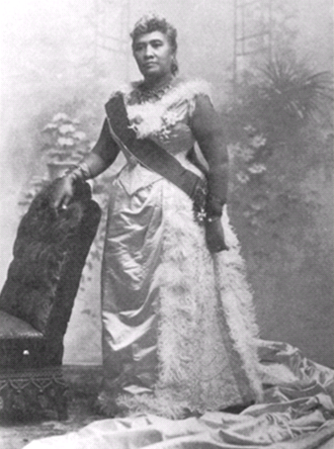
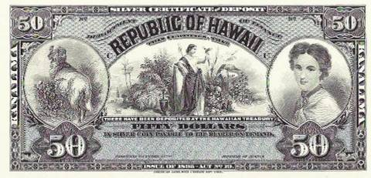
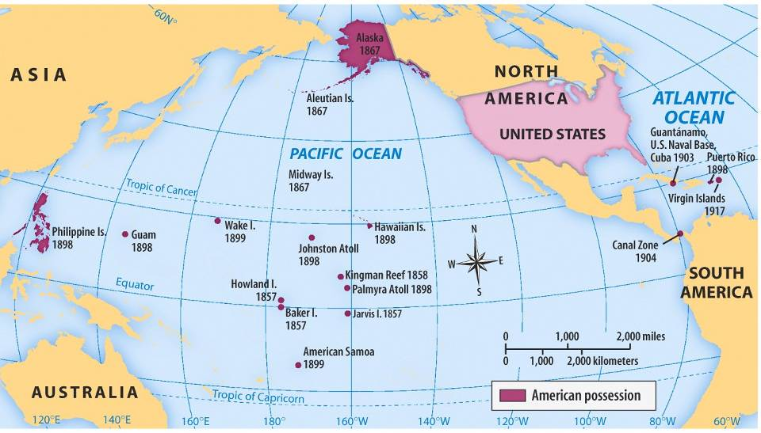
U.S. Imperialism: HAWAII
From 1820 to 1890, Americans moved to Hawaii as missionaries & fruit plantation owners
In 1891, Queen Liliuokalani came to power & tried to reduce the power of Americans living in Hawaii
President Cleveland opposed imperialism and Hawaii was annexed under McKinley
Became 50th state in August 1959
Americans overthrew Queen Liliuokalani in 1893 & Hawaii was annexed by the USA in 1898

Slide 15
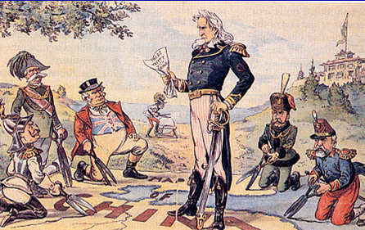
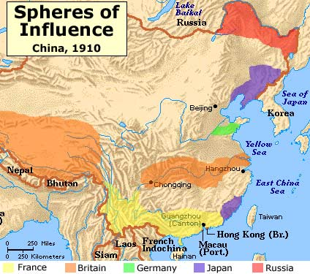
U.S. Imperialism: CHINA
By the 1890s, European powers were carving China into spheres of influence = exclusive trade rights in Chinese ports
Russia, Japan, Great Britain, France, AND Germany all had influence to shut out competitors
In 1899, the USA Sec. of State John Hay declared an Open Door Policy in China to allow free trade by any nation in any Chinese port
No one responded! So…I’ll take that as a yes?
DIPLOMATIC SUCCESS!

Slide 16
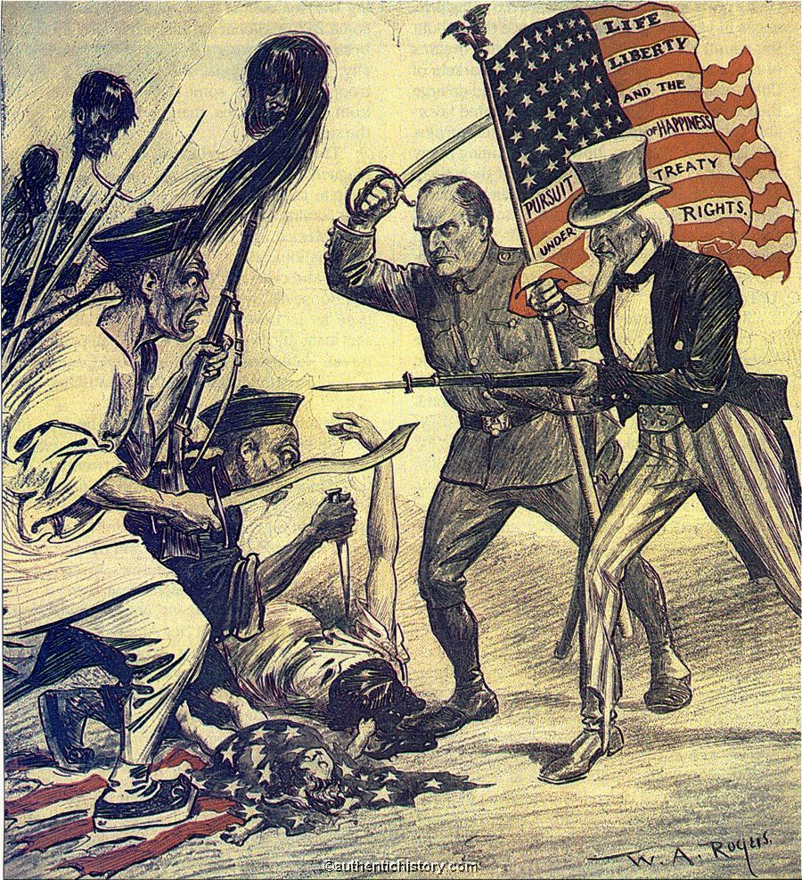
THE BOXER REBELLION
How did we react?

