Slide 1
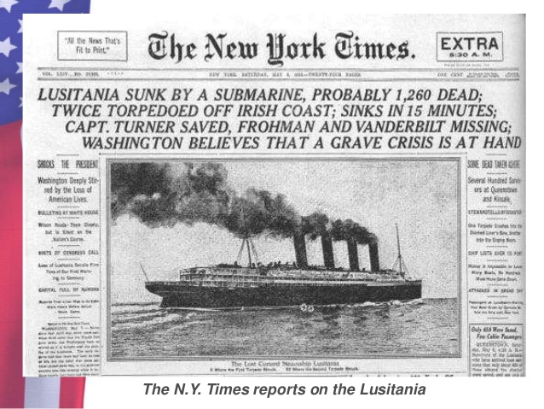
AIM: How did the U.S. get involved in WWI and could it have been avoided?

Slide 2
Do you think it was wise for the USA to stray away from its policies of neutrality and isolationism in the late 1800’s early 1900’s?

Slide 3
Quick Class Discussion: What Caused the World War I (“Great War”)?

Slide 4
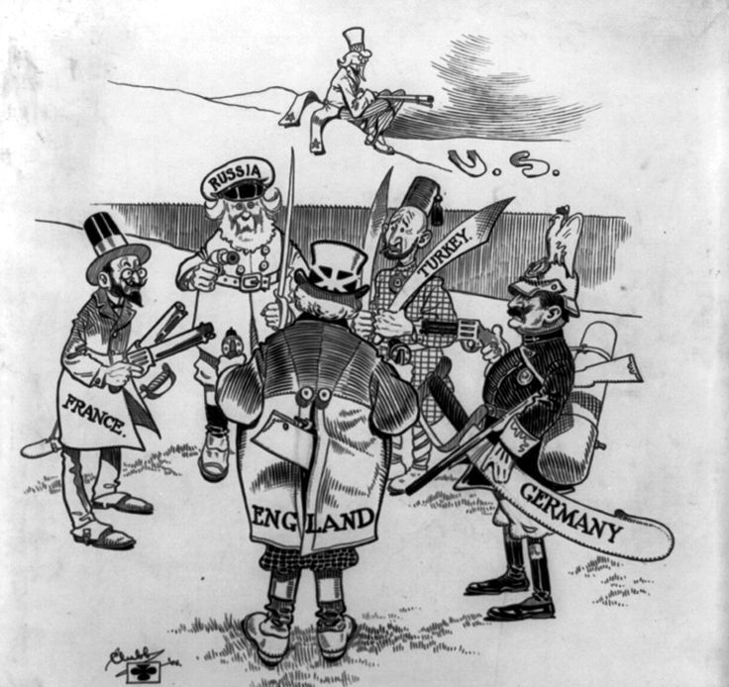
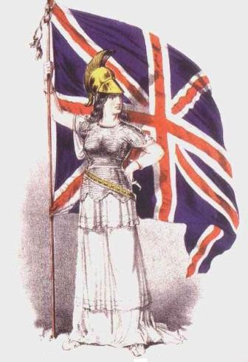
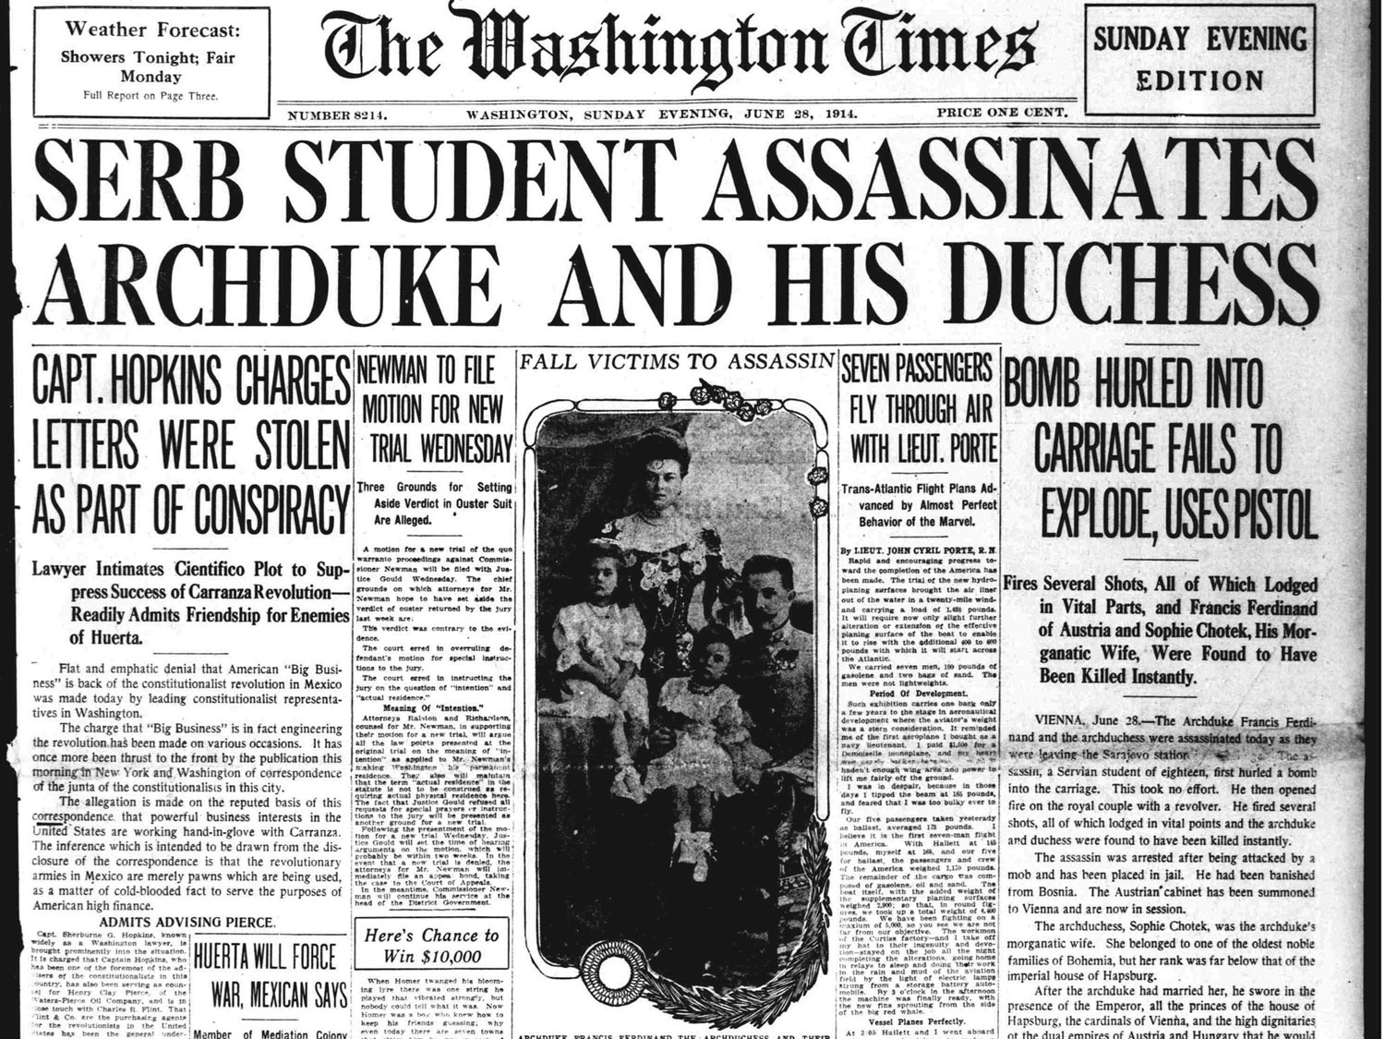
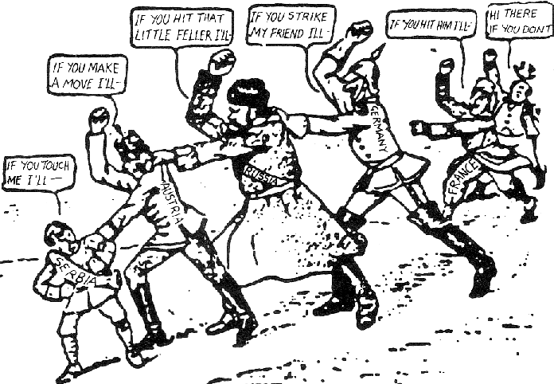
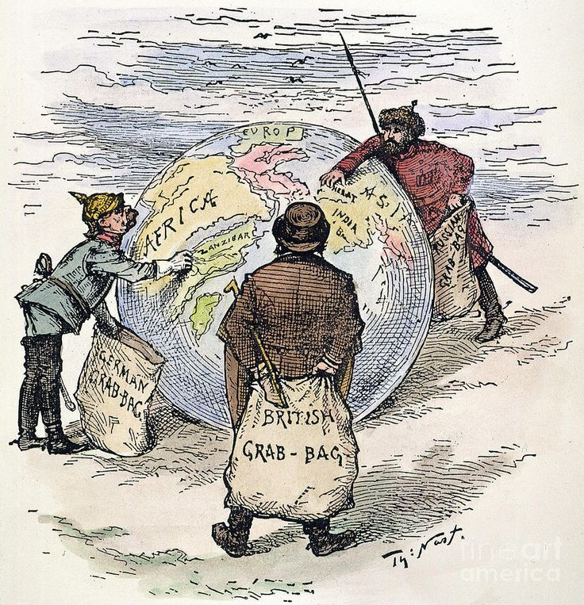
What were the MAIN causes of World War I?
MA
N
I
A
Militarism – growing a nation’s military in preparation for war or defense
Alliances – creation of friendships between nations that requires response in times of trouble
Nationalism – growing pride for one’s country
Industrialization & Imperialism – need for growth to get resources and markets (and power!)
Assassination – of Archduke Franz Ferdinand of Austria-Hungary by a Serbian assassin

Slide 5
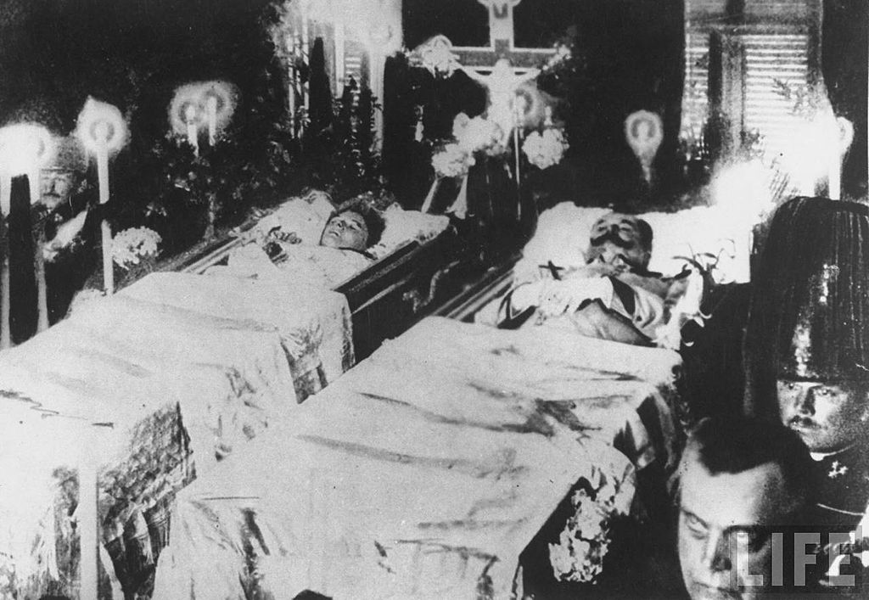
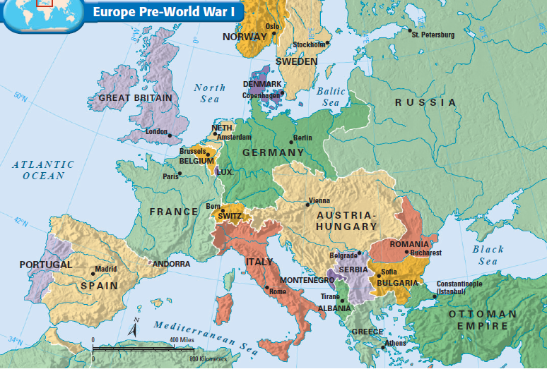
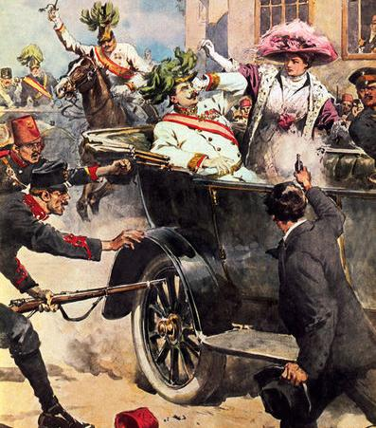
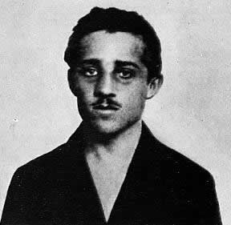
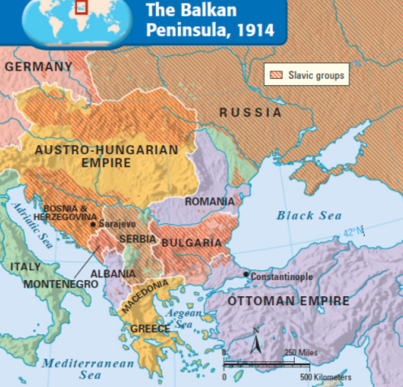
The Outbreak of World War I
On June 28, 1914, the Austro-Hungarian Archduke Franz Ferdinand & his wife were assassinated by a Serbian terrorist
The Balkans became a “powder keg” waiting for a spark to blow up
The assassin Gavrilo Princip

Slide 6
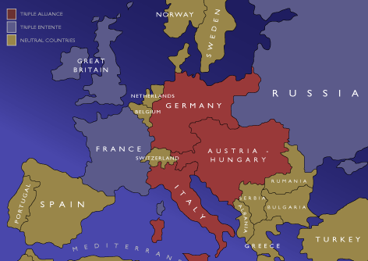
World War 1 Begins
Austria-Hungary declared war on Serbia & its ally Russia
On August 4, 1914, England declared war on Germany & Austria-Hungary
On August 1, 1914, Germany declared war on Russia
On August 3, 1914, Germany declared war on France
Russia mobilized for war to protect Serbia
Italy backed out of its agreement with Germany & Austria-Hungary…
…and joined the Allies
On July 28,1914, Serbia declined the ultimatum
World War I had begun

Slide 7
Germany, Austria-Hungary, & Italy made up the Triple Alliance
England, France, & Russia made up the Triple Entente

Slide 8
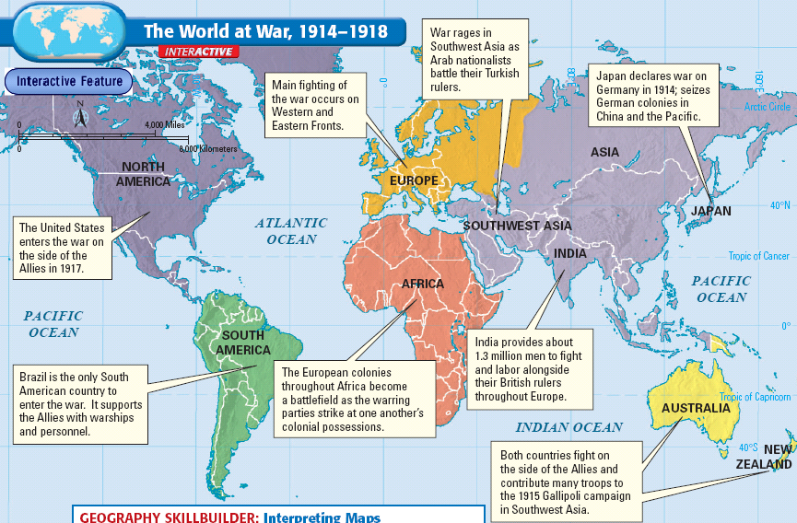
How was WW1 a “world war”?

Slide 9
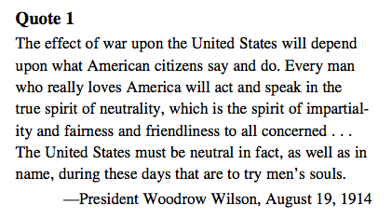
QUOTE ANALYSIS:
What did WOODROW want to do?

Slide 10
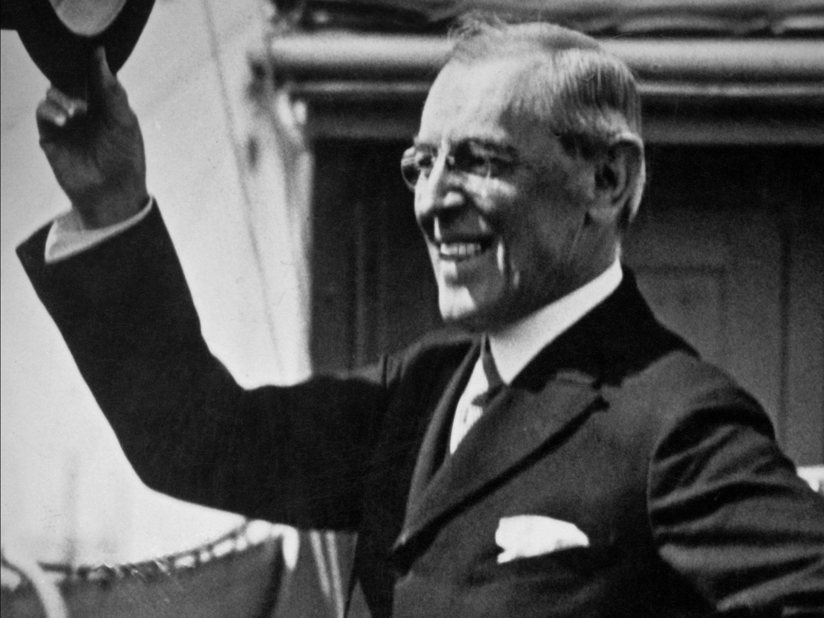
American Neutrality
War has been declared in Europe, and we will be NEUTRAL!
But WHY Mr. Wilson?
Tradition of non-involvement
Progressives & women organized against war
America as a land of immigrants should not take sides in Europe
The majority of the U.S. supported the Allies but wanted to avoid war
Notes:
10

Slide 11
From your HW: What were FOUR major reasons for the US entering WWI?
United States trade alliances with the Allied Powers
The Lusitania tragedy
The Zimmerman Telegram
Woodrow Wilson’s war message

Slide 12
SOURCE C: United States Trade?
England creates a naval blockade around Germany to cut off war supplies…
Woodrow Wilson: that gets in the way of our neutral trade!
But it ended up not hurting the US that bad…WHY?

Slide 13
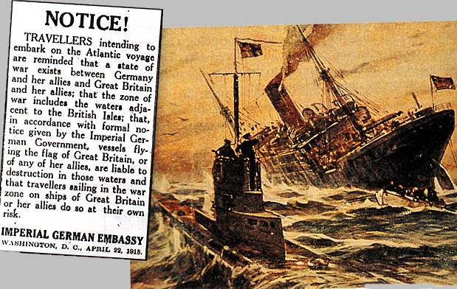
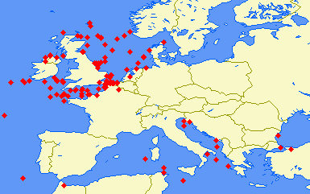
Germany used u-boats to create a naval blockade of England

Slide 14
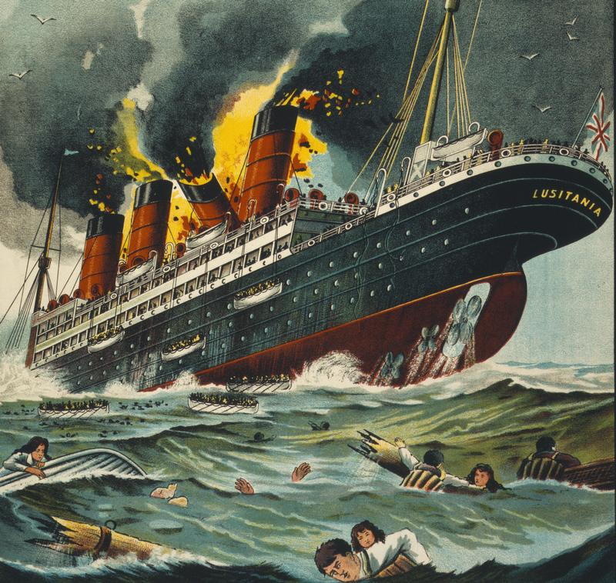
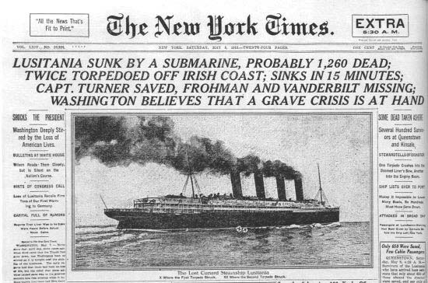
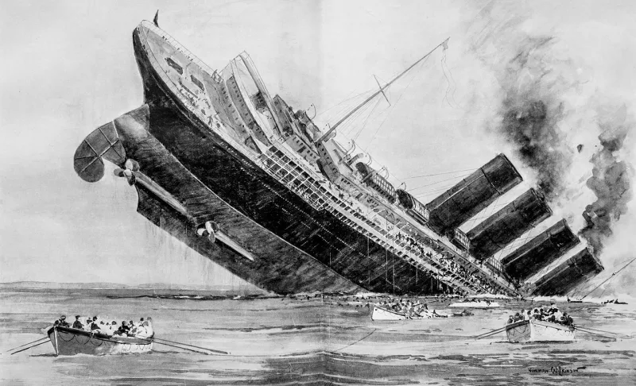
SOURCE A: What happened to the Lusitania?
May 7,1915: a German U-boat sank the British liner Lusitania
Killed 1,198 people (including 128 Americans)
Even though the ship was mostly carrying weapons, many denounced Germany’s actions as MURDER!
> American public was outraged! (just like with the U.S.S. Maine)

Slide 15
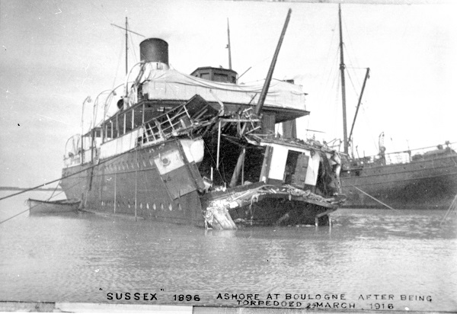
RESULT of the Sinking of the Lusitania
Germany (despite promises to stop) sunk another ship – The Sussex (killing 2 Americans)
President Wilson protested & Germany issued the Sussex Pledge – not “to sink merchant or passenger ships without warning and without saving human lives”
Did Germany listen?
The Sussex Pledge broken: February 1, 1917 Germany CONTINUED unrestricted submarine warfare

Slide 16
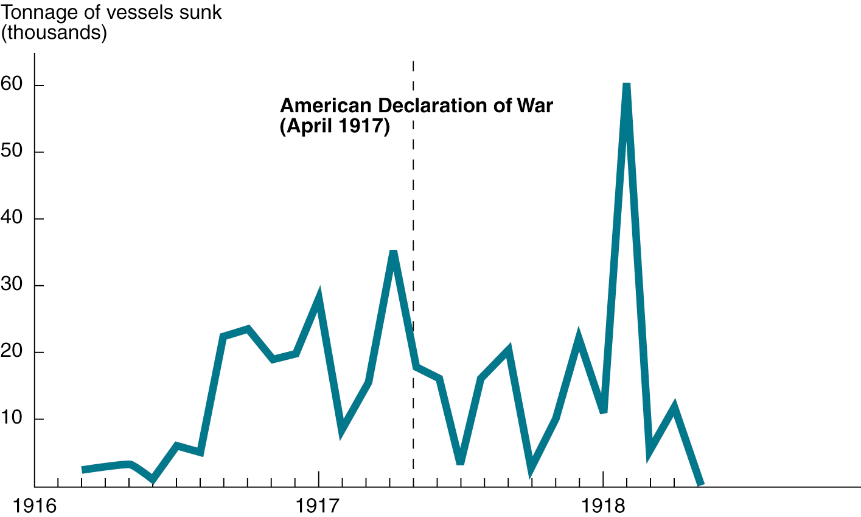
U.S. Losses to German Submarines, 1916-1918
Notes:
14

Slide 17
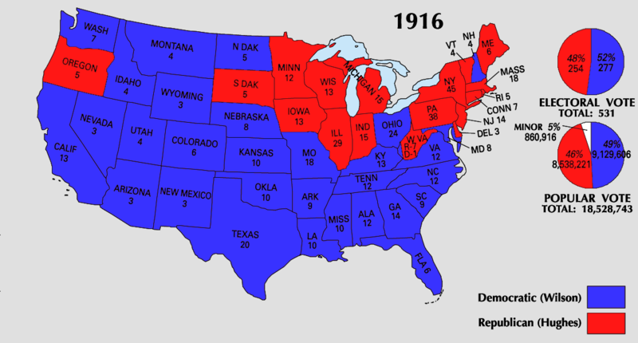
Election of 1916
Wilson:
Appealed to progressives & anti-war voters with the slogan “He kept us out of war”
Argued for “preparedness” in case the U.S. joins the war
Wilson won by campaigning 2 goals: freedom of the seas & neutrality
Notes:
13

Slide 18
SOURCE D: What did the Zimmerman Telegram say?
”On the first of February we intend to begin unrestricted submarine warfare. In spite of this, it is our intention to keep the United States of America neutral.
If this attempt is not successful, we propose an alliance on the following basis with Mexico: That we shall make war together and together make peace. We shall give general financial support, and it is understood that Mexico is to reconquer the lost territory in New Mexico, Texas, and Arizona…
What is being said here?
If the US doesn’t remain neutral, what does Germany propose to Mexico?

Slide 19
Analyzing the Zimmerman Telegram
“You are instructed to inform the President of the above in the greatest confidence as soon as it is certain there will be an outbreak of war with the United States. Please call to the attention of the President of Mexico, that submarine warfare now promises to force England to make peace in a few months.”
Signed, ZIMMERMANN.
Rationale behind the Zimmerman Note: The U.S. & Mexico almost went to war in June 1916 over events related to the Mexican Revolution (Huerta, Carranza, Pancho Villa)
What was the rationale behind this telegram? (think “Moral Diplomacy”)
Why do you think this document cause anti-German feelings in the US?

Slide 20
SOURCE B: What does Wilson say is the real reason the US should declare war?
“It is a distressing and oppressive duty, Gentlemen of the Congress, which I have performed in thus addressing you. There are, it may be, many months of fiery trial and sacrifice ahead of us. It is a fearful thing to lead this great peaceful people into war, into the most terrible and disastrous of all wars, civilization itself seeming to be in the balance.
But the right is more precious than peace, and we shall fight for the things which we have always carried nearest our hearts - for democracy, for the right of those who submit to authority to have a voice in their own Governments, for the rights and liberties of small nations, for a universal dominion of right by such a concert of free peoples as shall bring peace and safety to all nations and make the world itself at last free.
To such a task we can dedicate our lives and our fortunes, everything that we are and everything that we have, with the pride of those who know that the day has come when America is privileged to spend her blood and her might for the principles that gave her birth and happiness and the peace which she has treasured. God helping her, she can do no other.”
- President Woodrow Wilson, War Message to Congress, April 2, 1917

Slide 21
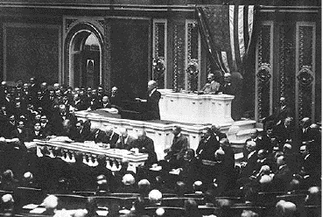
April 2, 1917, Wilson asked Congress for a declaration of war to “make the world safe for democracy”

