Slide 1
Aim: How did the frontier change during and after the Civil War & Reconstruction?

Slide 2
PERIOD 6: 1865-1898
The transformation of the United States from an agricultural to an increasingly industrialized and urbanized society brought about significant economic, political, diplomatic, social, environmental and cultural changes.
Source: College Board, AP United States History Course and Exam Description (Including the Curriculum Framework)

Slide 3
Settlement of the Frontier (the Plains in the WEST)
Homestead Act (1862) – gov’t program to settle the west – Provided 160 acres of land, 5 yrs. to make it work
Thousands of families rushed west, including African Americans fleeing the south (exodusters)
WHY??
Had to START OVER after the Civil War
How would this act benefit the country?

Slide 4
Why else did the EXODUSTERS move west?
It was the GREAT EQUALIZER!
How could the difficulties of life on the frontier make it a “great equalizer”?

Slide 5
After the war…Buffalo Soldiers
Don’t Copy!
1866 Congressional legislation was adopted to create six all African American army units.
Units - the 9th and 10th cavalry and the 38th, 39th, 40th and 41st infantry regiments.
4 infantry units were reorganized in 1868 as the 24th and the 25th infantry.
5 years and received $13.00 a month, far more than they could have earned in civilian life.

Slide 6
Bob Marley’s - Buffalo Soldier
Buffalo soldier, dreadlock rasta: There was a buffalo soldier in the heart of America, Stolen from Africa, brought to America, Fighting on arrival, fighting for survival.
Said he was a buffalo soldier win the war for America; Buffalo soldier, dreadlock rasta, Fighting on arrival, fighting for survival; Driven from the mainland to the heart of the Caribbean.

Slide 7
Challenges of farming on the Plains
Wood was SCARCE
Many farmers built houses made of SOD (soil held together by grass)
Rain was a major problem – sod roofs “leaked two days before a rain and for three days after...”
DON’T COPY!
Farmers who lived in these homes became known as SODBUSTERS

Slide 8
Cattle Frontier
The original COWBOY…
hired man
tends cattle
performs many of his duties on horseback
used cattle ranching was the way to make money

Slide 9
Mining Frontier
Western mining camps were some of the most violent places in the US during the late 1800s.
The absence of law enforcement sometimes led people in mining camps to form vigilante committees to combat theft and violence.
Stability came to mining camps as they grew into towns and families arrived.

Slide 10
Morrill Land Grants
July 1862 - gave proceeds from the sale of public lands to states for the establishment of agricultural colleges
30,000 acres of federal land
Colleges created:
University of Florida
Florida A&M
MIT
Cornell

Slide 11
How else did the Civil War
impact economic expansion?
TAKE A PICTURE!
1. National Banking Act (1863) created a modern system that facilitated economic growth
The Morrill Tariff (1862) protected American companies from foreign competition

Slide 12
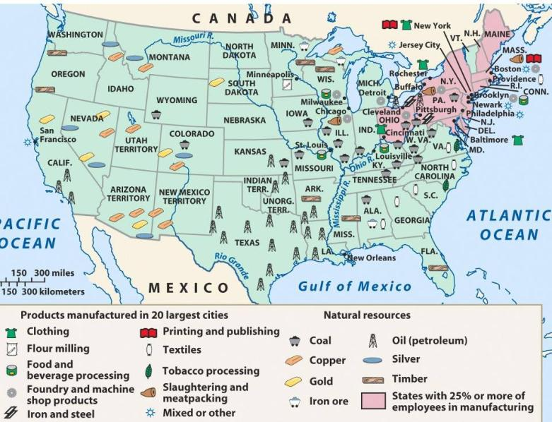
During what would become known as the Gilded Age, the United States experienced an industrial revolution

Slide 13
America’s industrial revolution was fueled by 4 major industries (R.O.S.E.) Railroads, Oil, Steel, Electricity

Slide 14
* Key to Remembering the 1st Industrial Revolution:
T extiles
R ailroads
I ron
C oal
* Key to Remembering the 2nd Industrial Revolution (after the Civil War):
R ailroads (transcontinental)
O il
S teel
E lectricity

Slide 15
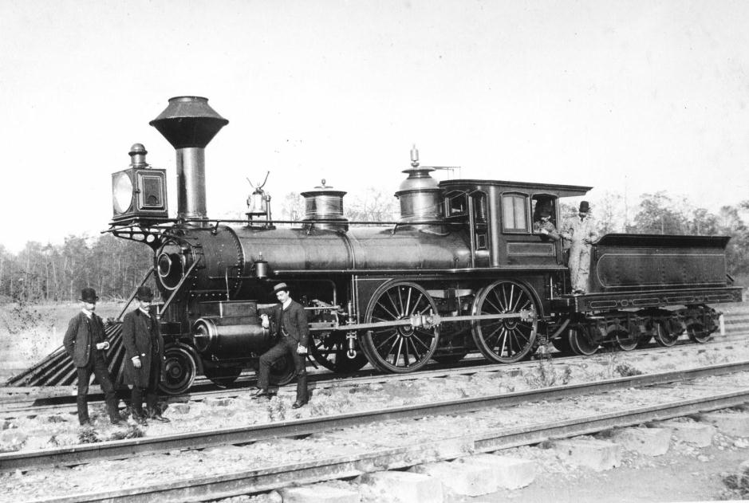
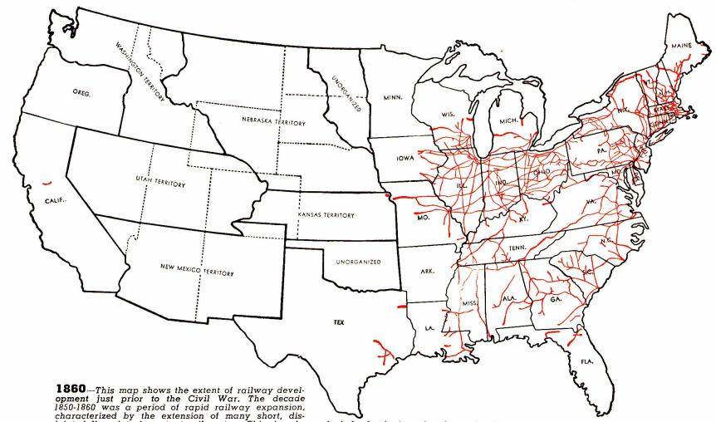
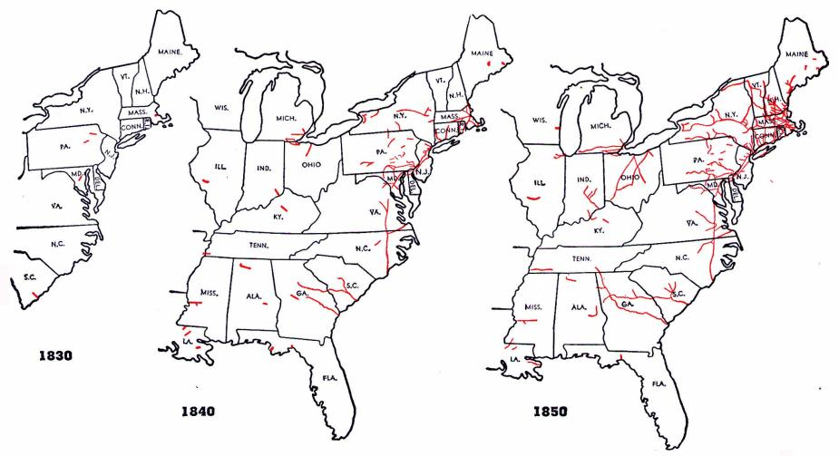
The RAILROAD was about to become America’s first “big business”
Railroad construction grew in the years before the Civil War…

Slide 16
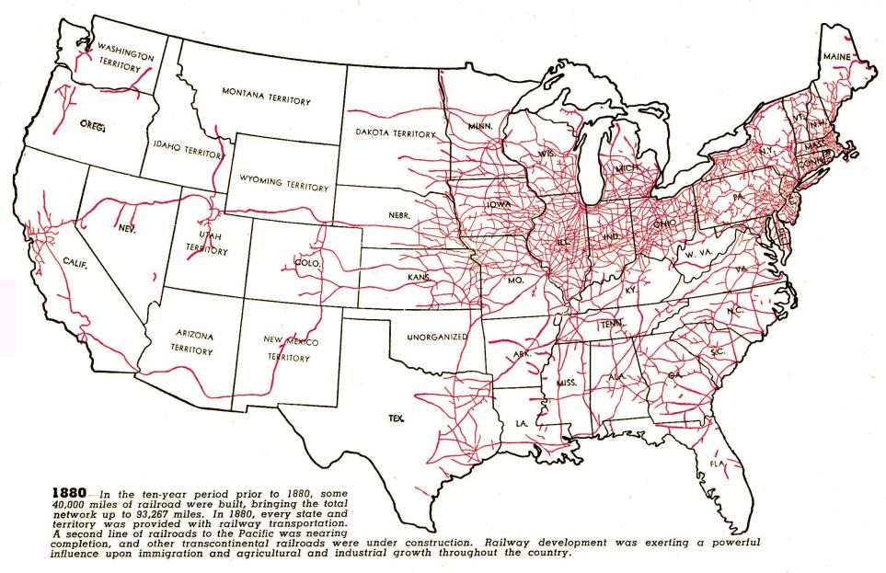
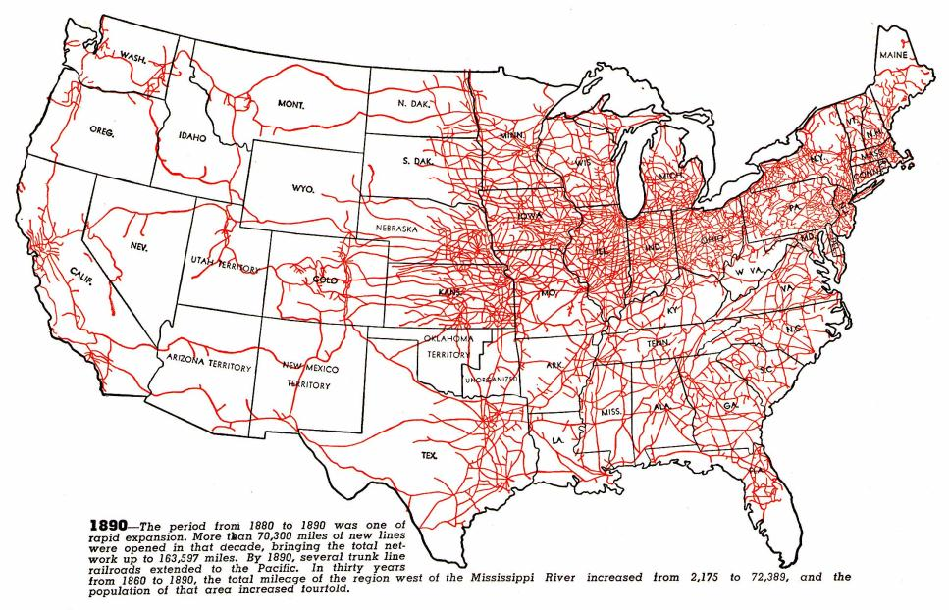
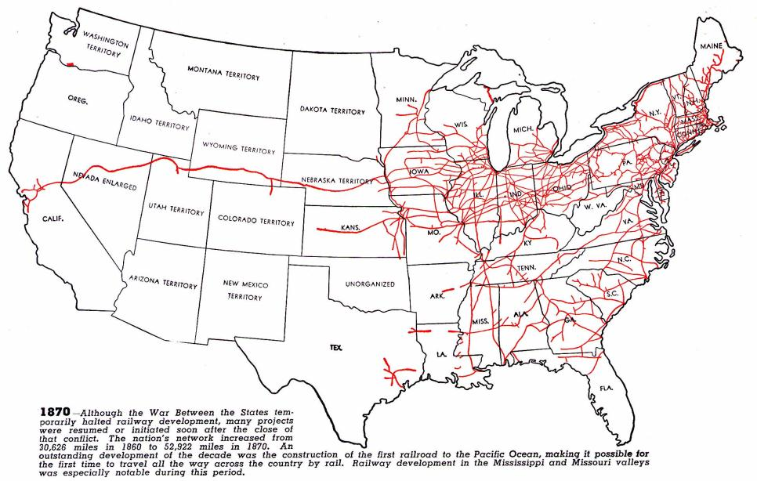
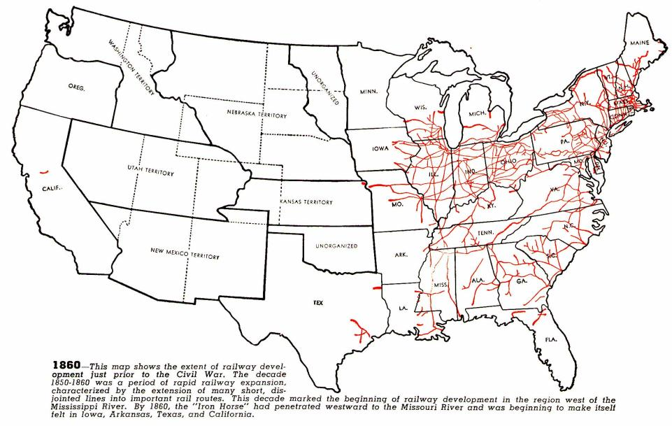
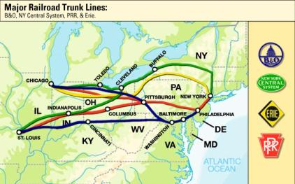
Railroad expansion led to a BOOM in the economy
Railroads connected the East, South, and West and allowed for national trade and regional specialization
The 1st transcontinental railroad was finished in 1869
Eastern railroads were connected to the West by 4 great trunk lines
Railroads stimulated demand for coal, oil, iron, and steel

Slide 17
"This is the story of the first transcontinental railroad; the greatest, most daring engineering effort the country had yet seen. The time was the 1860s. Imagine the task.
The idea was to span the West with iron rails from Omaha to Sacramento, to build a railroad across two-thirds of the continent and some of the most difficult terrain on earth. 'Ruinous space,' a Boston paper called it. Not in all that distance, not in 1,700 miles, was there a single settlement of any appreciable size except at Salt Lake. The railroad would join what essentially were two different countries: California and back East. Construction crews would cross hundreds of miles of desert – push into the mountains at elevations as high as 8,000 feet. And all this without benefit of bulldozers or rock drills, modern explosives or modern medical facilities.
They called it a work of giants. But like all great stories, it's about people: construction bosses, politicians, thousands of workers and the people who got the whole thing started in the first place."
– David McCulloch,
"The Iron Road" for The American Experience, PBS
VIDEO
Notes:
Ask for a student to volunteer to read in a dramatic voice over

Slide 18
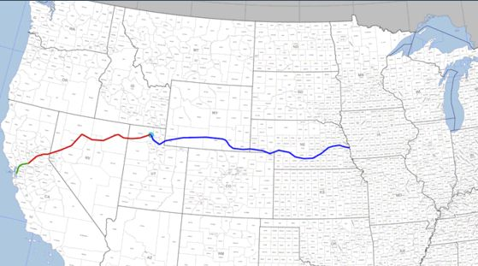
The First Continental Railroad
Central Pacific Railway
Union Pacific Railway
Notes:
From Wikipedia Commons

Slide 19
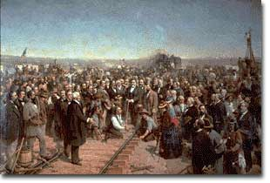
Two companies were hired -- the Central Pacific would build from the west and the Union Pacific from the east.
In 1869, a golden spike linked the Central Pacific Railroad and the Union Pacific Railroad at Promontory, Utah.

Slide 20
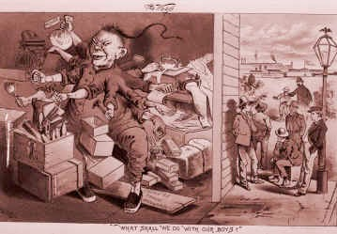
Who built the RRs?
Octopus Chinese Man Cartoon "What Shall We Do With Our Boys?" As the Chinese expanded into a range of industries, other immigrants feared and blamed economic hardship on them. Anti-Chinese cartoons such as this one, were prevalant during the years leading up to the Exclusion Act of 1882.

Slide 21
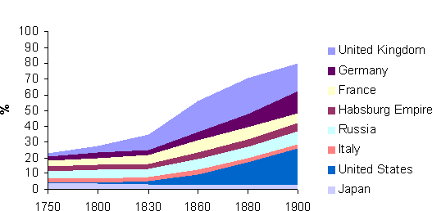
Relative Shares of World Manufacturing Output, 1750-1900
When does U.S. manufacturing take off? Why?
Notes:
Encyclopedia Commons

Slide 22
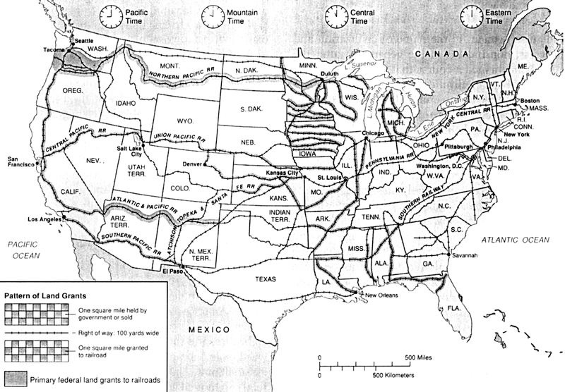
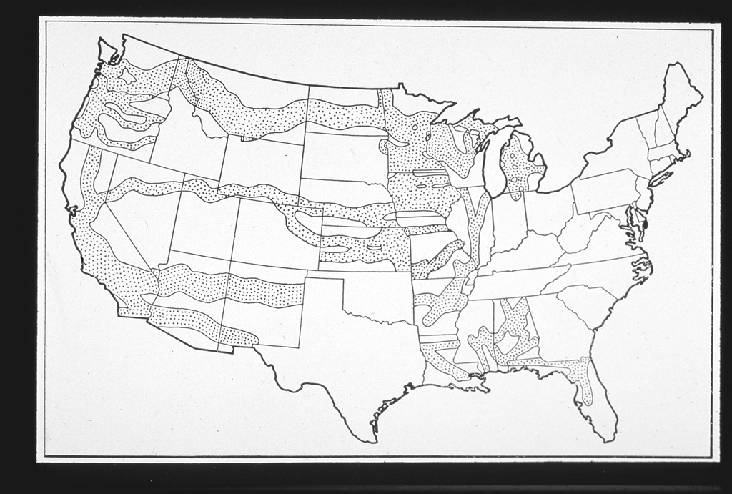
1850-1871
Over 180 million acres are granted to railroads, encouraging construction and development, particularly in western states
map of land Congress turned over to the railroads in the form of land grants
Notes:
Four of the five transcontinental railroads were built with assistance from the federal government through land grants. Receiving millions of acres of public lands from Congress, the railroads were assured land on which to lay the tracks and land to sell, the proceeds of which helped companies finance the construction of their railroads.

Slide 23
Connecting Lines
DON’T COPY!
Early railroads were short lines that served local communities.
Many lines ran for no more than 50 miles.
When passengers and goods reached the end of one line, they had to move to a train on a different line to continue their journey.
ALSO, different lines used rails of different gauges, or widths…
Northern and southern tracks were DIFFERENT
Now, trains of one line couldnt run on the tracks of another line...

Slide 24
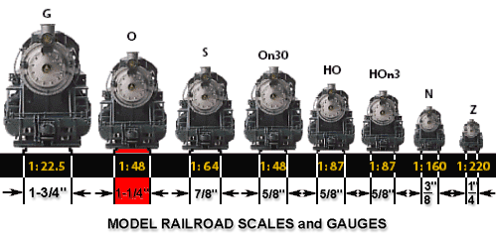
Why was it so important
to make the gauge sizes
the SAME?

Slide 25
Connecting Lines
1886 - railroads in the South decided to adopt the northern gauge (they became standardized with the North)
Goods could now be traded all across the country, and shippers had to pay only one fare for the whole distance

Slide 26
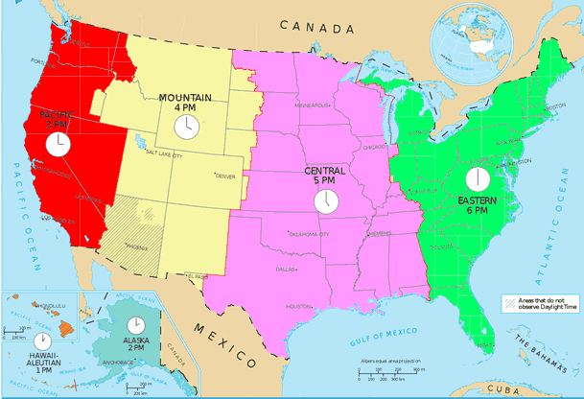
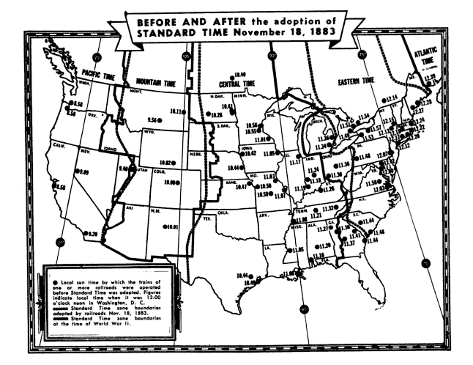
Other improvements
Railroad companies created a system of standard time zones
Before that, each town kept their own time based on the position of the sun
Towns in Illinois had 27 different local times!

Slide 28
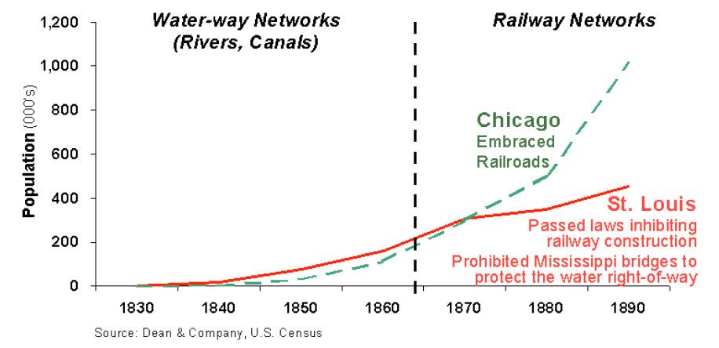
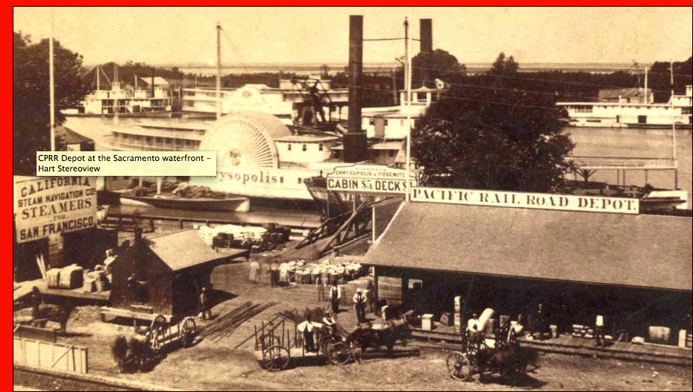
Population Growth
Railroads gave land their value; towns where railroads ran became sprawling cities while those skipped by railroads sank into ghost towns, towns wanted railroads in them.

Slide 30
Railroads bring the following:
Unity between the states
Industrialization and huge demand for steel (both domestic and global)
Boom in mining and agriculture
Urbanization
Increased immigration from Europe and Asia
Increased population in West
----------------------------------------------------------
But also bring destruction to land and Indian way of life and the end of the “open range”
Also bring stock speculation, “robber barons”, and land speculators

