Slide 1
AIM: Why were the 1920s considered such a monumental and prosperous decade?

Slide 2
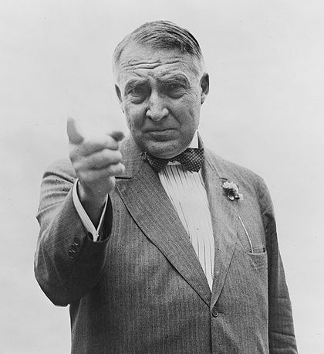
The 1920s were supposed to be normal...
...but they were anything but normal.
The 1920s

Slide 4
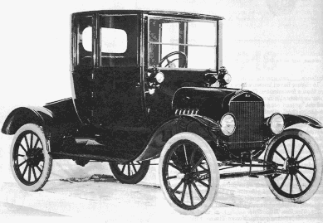
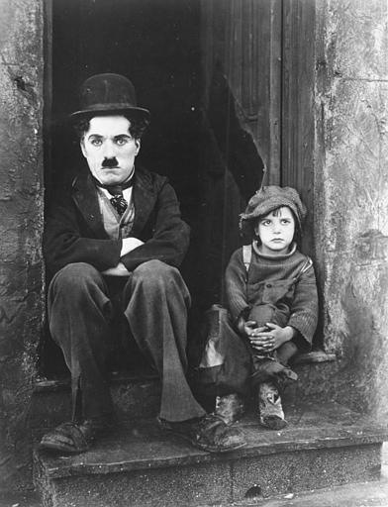
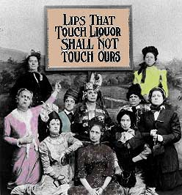
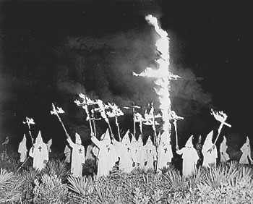
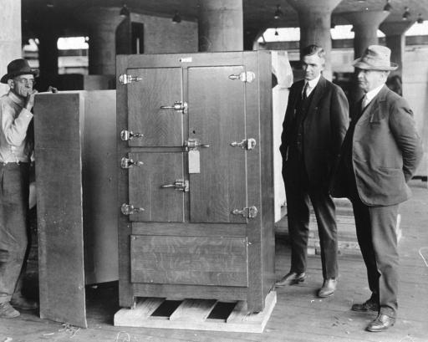
“The Roaring 20’s”
Named for the booming economy and changing lifestyles in America
Coolidge and Hoover = laissez-faire
Government influence to a minimum…allow businesses to GROW!
The USA was the richest & most developed country in the world!
Wages rose, hours declined, & Americans had access to new, innovative consumer goods...

Slide 5
The Second Industrial Revolution (1922-29)
BOOM in consumer goods (appliances, cars, radios, furniture, & clothing)
Electricity industry boomed
To stop the growth of labor unions companies used welfare capitalism
Provide benefits to encourage worker loyalty
For the first time people had the ability to buy on credit

Slide 6
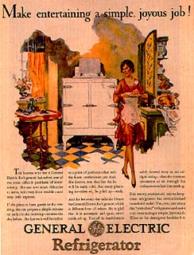
Glenwood Stove Ad
1920s consumerism led to luxury living:
New appliances like refrigerators, washing machines, & vacuums

Slide 7
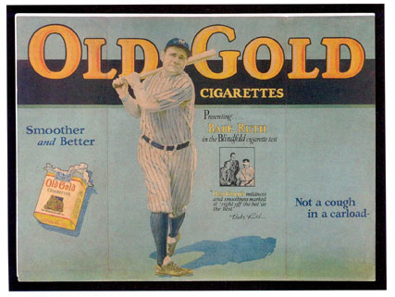
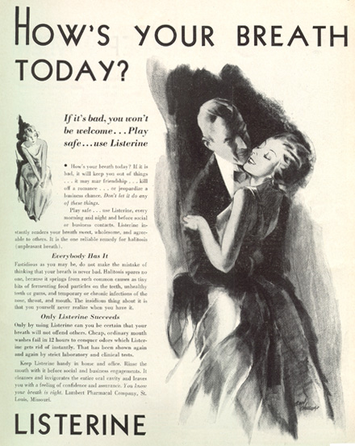
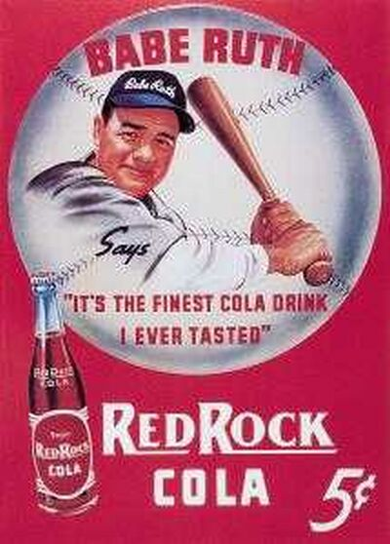
1920s advertising

Slide 8
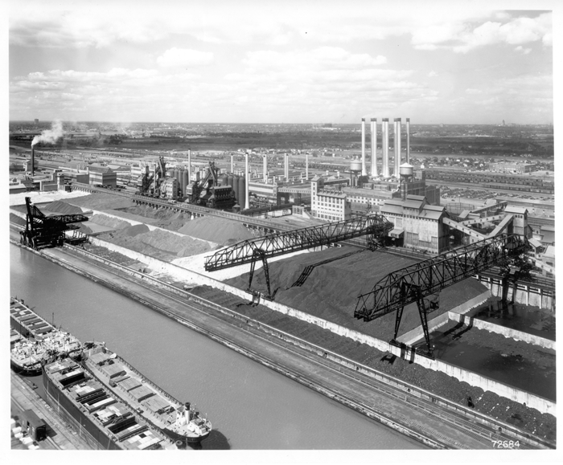
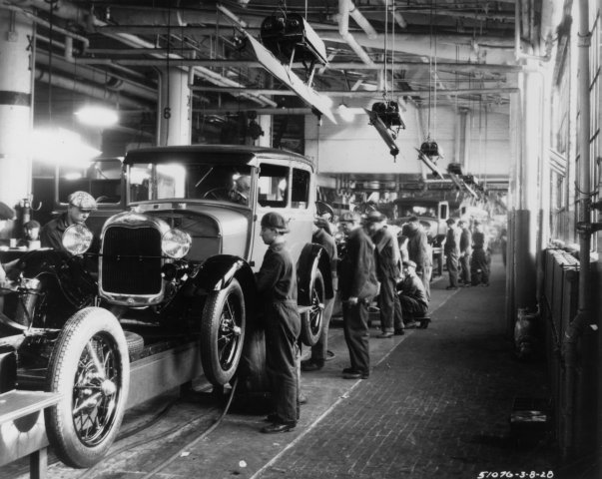
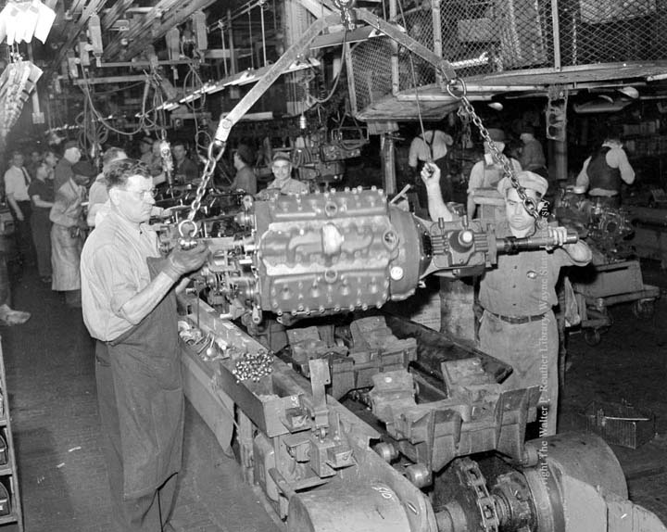
Henry Ford revolutionized the assembly line, the “$5-day,” new marketing & advertising techniques, & annual model changes
The consumer goods revolution was best seen in the auto industry
“The work moves and the men stand still”
The auto industry stimulated the steel, sheet metal, rubber, glass, petroleum industries
Henry Ford’s River Rouge plant emphasized uniformity, speed, precision, & coordination

Slide 9
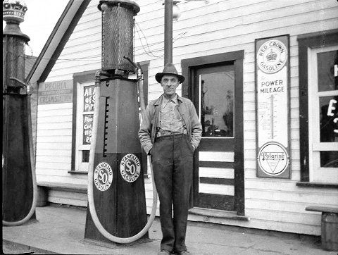
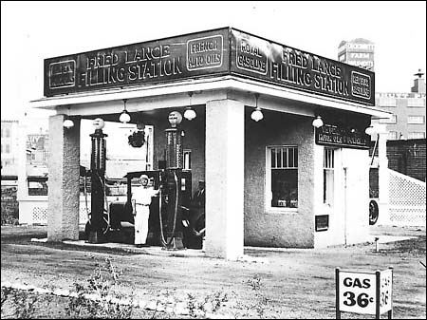
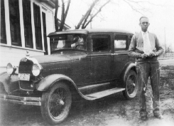
The auto industry led to the construction of roads & new filling stations…
Notes:
Filling station 36 cent gas is from 1925

Slide 10
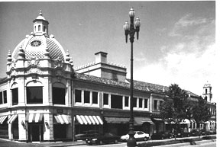
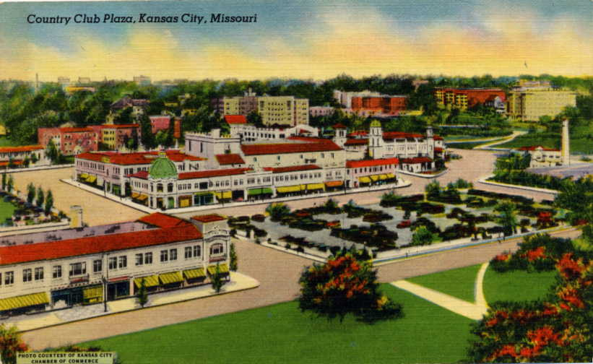
…and new suburban shopping centers: Kansas City’s Country Club Plaza was the 1st U.S. shopping mall (built in 1924)

Slide 11
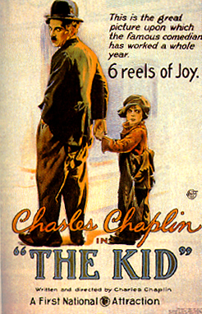
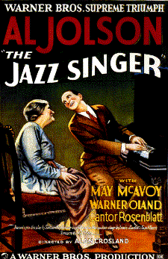
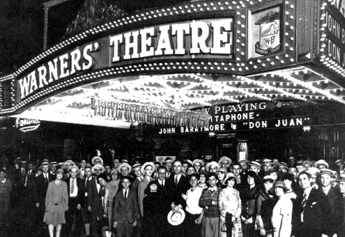
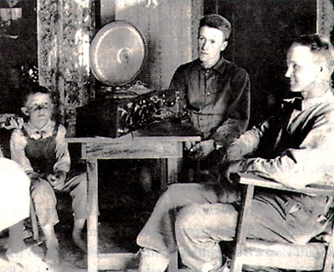
1920s consumerism led to luxury living:
Radios & movies boomed
The Lion’s Cage
100 million Americans went to the movies in 1929 per week
The first “talkie”
NBC was the 1st successful radio network

Slide 12
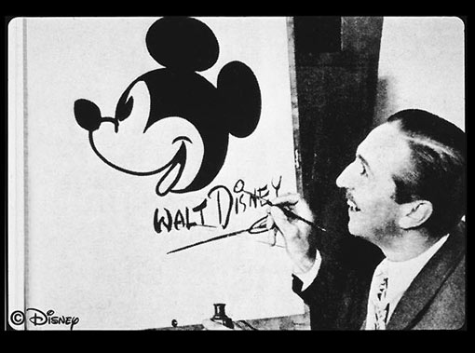
Walt Disney & Mickey Mouse
Other key films:
The Four Horsemen Of The Apocalypse (1920), Robin Hood (1922), The Thief Of Baghdad (1924), The Hunchback Of Notre Dame (1923), The Phantom Of The Opera (1925), Ben-Hur (1925), Wings (1927), Steamboat Willie (1928).

Slide 13
It wasn’t roaring for everyone…
RR, cotton textile, coal industries suffered due to new competition;
Farming boomed during WWI but a decline in demand after the war deflated farm prices
Union membership dropped
Northern migration of blacks grew but workers gained menial jobs & faced racism
Farm per capita income was $273 per year vs. the U.S. average of $681 per year
TAKE A PIC!

Slide 14
Women of the 20’s
And what were these "own lives" of theirs to be like? Well, for one thing, they could take jobs. Up to this time girls of the middle classes who had wanted to "do something" had been largely restricted to school teaching, social-service work, nursing, stenography, and clerical work in business houses. But now they poured out of the schools and colleges into all manner of new occupations. They besieged the offices of publishers and advertisers; they went into tea-room management until there threatened to be more purveyors than consumers of chicken patties and cinnamon toast; they sold antiques, sold real estate, opened smart little shops, and finally invaded the department stores.
According to Allen, what is ONE way middle-class women’s lives changed in the 1920’s?

Slide 15
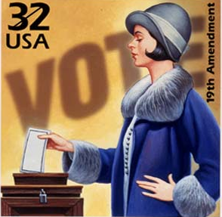
Women and the Family
Change (& continuity) for women:
Female workers after WWI were limited to teachers, nurses, & other low-paying jobs
The 19th
Amendment gave
women the right
to vote but few
women voted…
WHY?

Slide 16
Traditionalists & Fundamentalists vs. Modernists A CULTURAL WAR!
TAKE A PIC!
Traditionalists/ Fundamentalists
Modernists
Fear that the “new” culture of the 1920s are corrupting Americas youth & society as a whole
Believe that young people should turn back to the Bible, God, and traditional family values
Mostly RURAL areas
Education = BIBLE
Excited by the new music, mobility (cars are CHEAP), movies, dancing, and style
Women/Girls are especially fond of the 1920s as make-up, clothing, style are radically different from before.
Education = SCIENCE/SECULAR VALUES

Slide 17
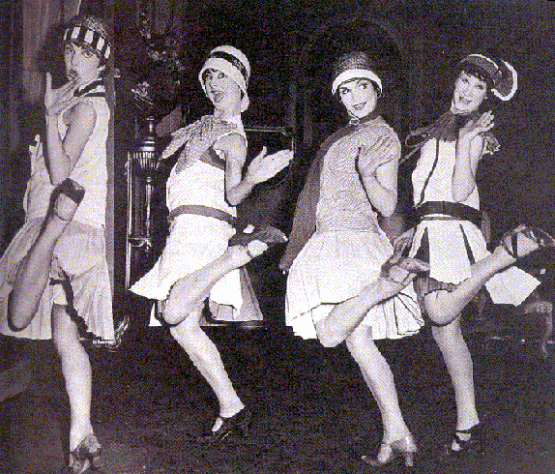
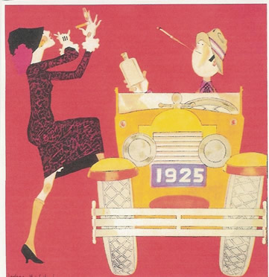
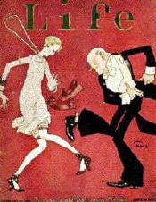
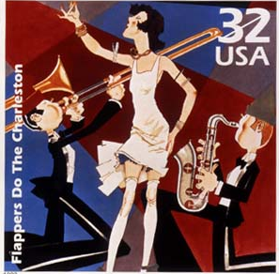
Women’s changing identity…
“Flappers” rebelled against traditional customs
Divorce rates doubled
But…most women looked forward to lives as a mother and a wife
“The creation and fulfillment of a successful home…compares favorably with building a beautiful cathedral.”
—Ladies Home Journal
“I have been kissed by dozens of men. I suppose I’ll kiss dozens more.”
— character in F. Scott Fitzgerald novel

Slide 18
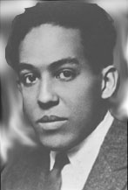
African American social changes in the 1920s
What was the Harlem Renaissance?
Harlem Renaissance -- A rebirth in African American culture and pride that began in Harlem, NY.
Jazz & blues expressed the social realities of blacks (Louis Armstrong)
Poetry, novels, & plays promoted equality, condemned racism, & celebrated black culture (Langston Hughes)
Langston Hughes

Slide 19
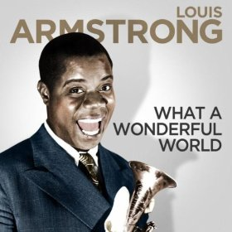
“What a Wonderful World,
by Louis Armstrong”
I see trees of green, red roses too. I see them bloom, for me and you. And I think to myself, what a wonderful world. I see skies of blue, And clouds of white. The bright blessed day, The dark sacred night. And I think to myself, What a wonderful world.
The colors of the rainbow, So pretty in the sky. Are also on the faces, Of people going by, I see friends shaking hands. Saying, "How do you do?" They're really saying, "I love you".

Slide 20
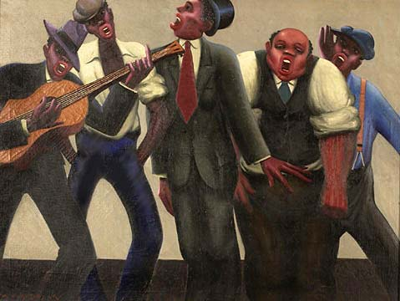
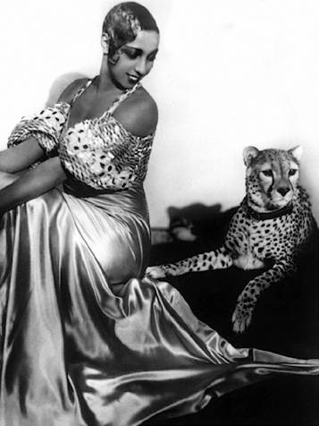
Josephine Baker, internationally renowned singer/dancer
“You could be black & proud, politically assertive & economically independent, creative & disciplined—or so it seemed”
Notes:
Josephine Baker-international singer/dancer

Slide 21
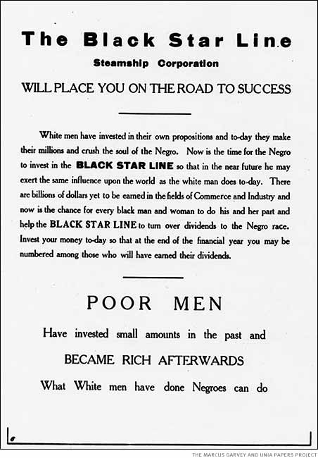
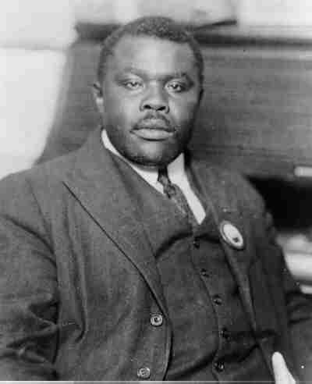
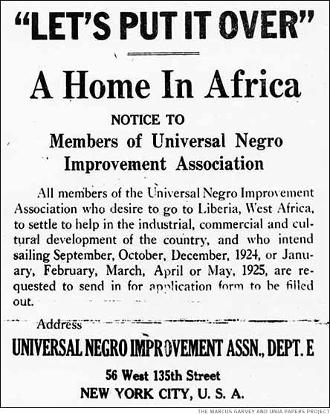
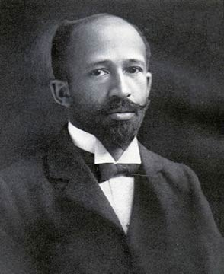
Marcus Garvey
Civil rights activist of the 1920s
United Negro Improvement Association & advocated a return to Africa
“The most dangerous enemy of the Negro race”
—W.E.B. DuBois

Slide 22
“The Lost Generation” after WWI
The 1920s gave rise to a new class of intellectuals who condemned the new American industrial society & materialism:
Pessimistic Literature: TS Eliot, Ezra Pound, Sinclair Lewis, F Scott Fitzgerald, Hemingway
Playwrights: Eugene O’Neill
Music: Gershwin & Copeland

Slide 23
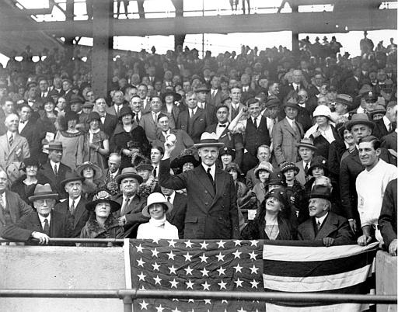
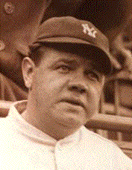
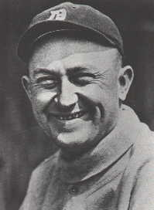
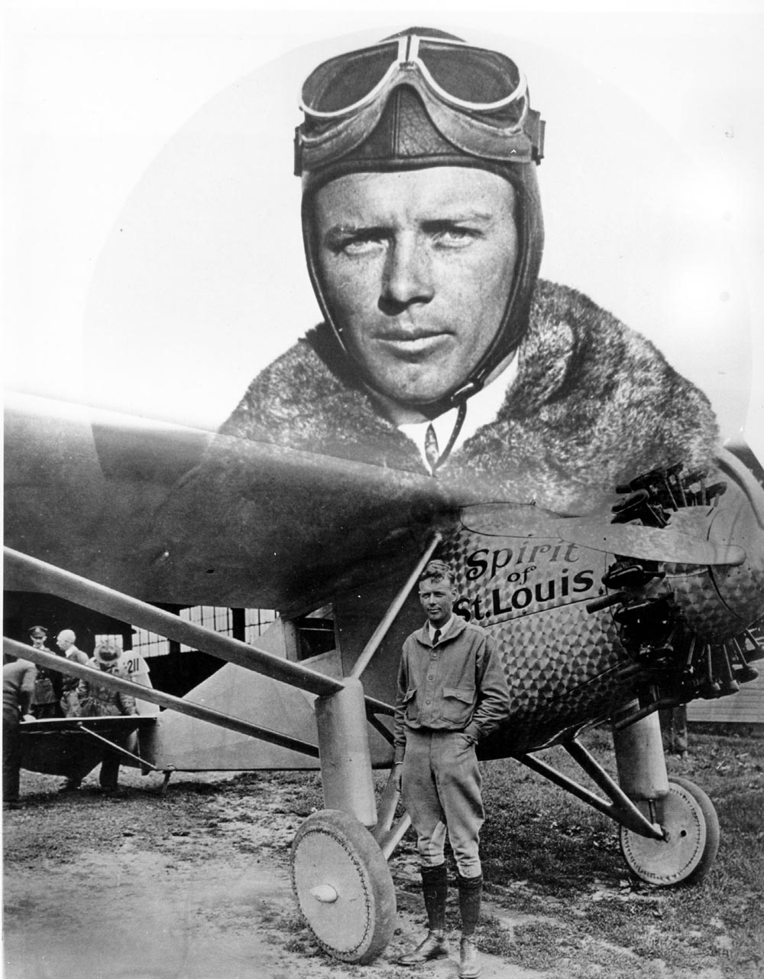
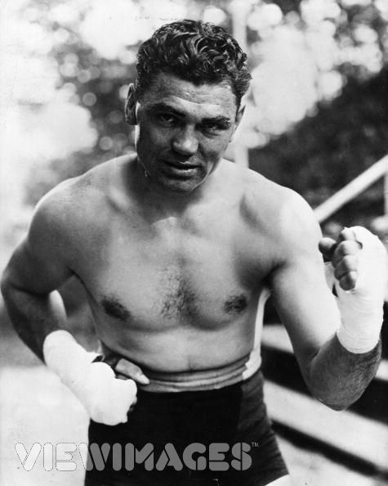
Celebrities
Babe Ruth &Ty Cobb
Charles Lindbergh
The Spirit of St. Louis
Jack Dempsey

Slide 24
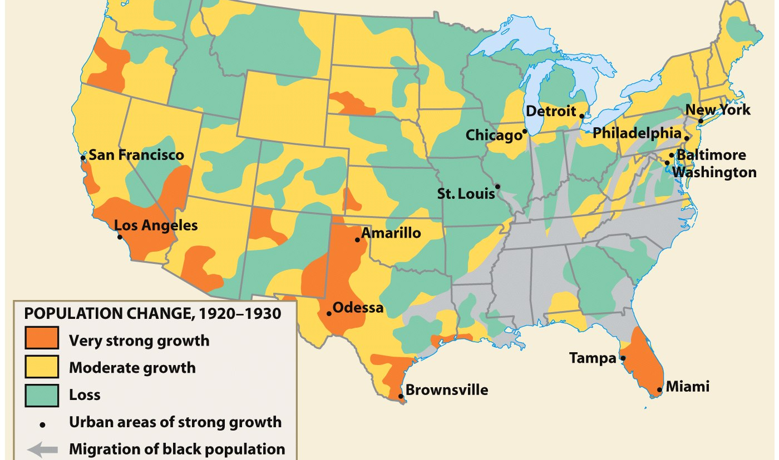
City Life in the 20’s
The shift in focus from the rural countryside revealed that urban life was very different, and the traditional ways of home, church, schools were absent…
The 1920 census revealed for the 1st time that more Americans lived in cities than the countryside
The New York City skyline in 1930: Skyscrapers gave cities a unique architectural style

Slide 25
What was the rural reaction to the urban changes?
Fundamentalists/Traditionalists identified cities with saloons, communist cells, & sin;
Wanted to restore a “Protestant” culture in America

Slide 26
Other major cultural events of the 1920s
January 1920: Volstead Act - carry out the 18th Amendment (1917)
"no person shall manufacture, sell, barter, transport, import, export, deliver, furnish or possess any intoxicating liquor except as authorized by this act."

Slide 27
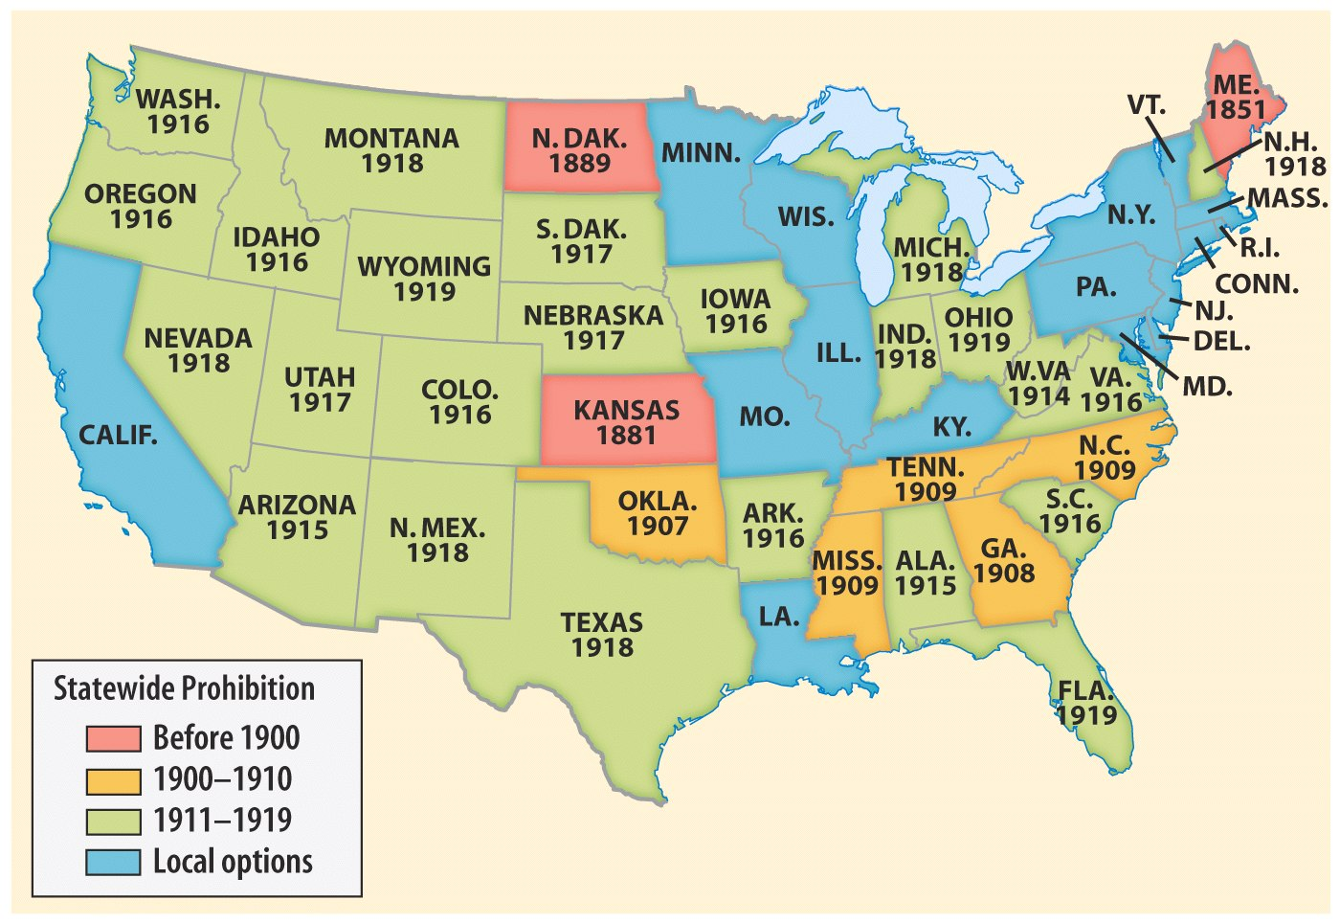

Slide 28
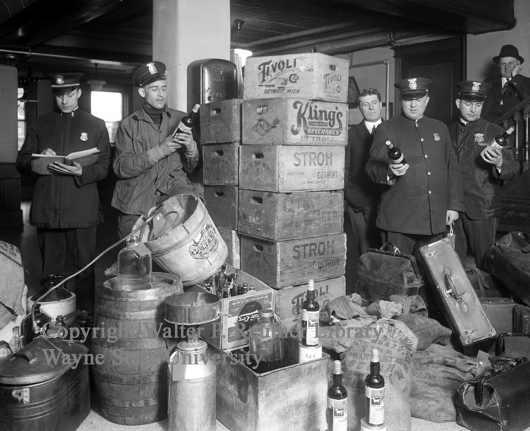
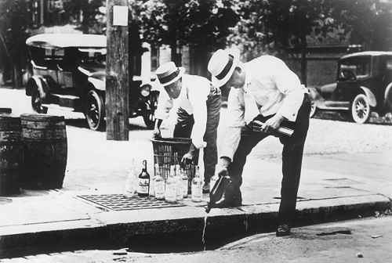
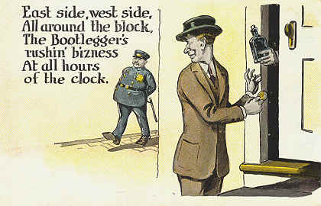
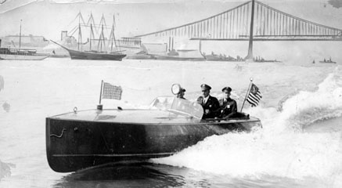
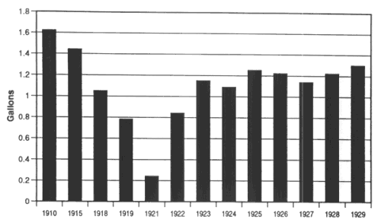
Per capita consumption of alcohol (1910-1929)
Was prohibition really working??

Slide 29
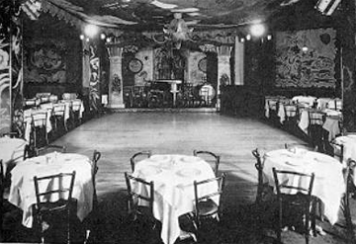
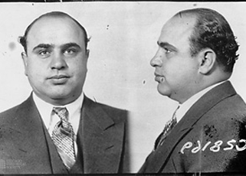

Slide 32
The Butler Law – State of Tennessee
March 13, 1925
AN ACT prohibiting the teaching of the Evolution Theory in all the Universities and all other public schools of Tennessee, which are supported in whole or in part by the public school funds of the State, and to provide penalties for the violations thereof.
Section 1. Be it enacted…That it shall be unlawful for any teacher in any of the Universities and all other public schools of the State which are supported in whole or in part by the public school funds of the State, to teach any theory that denies the story of the Divine Creation of man as taught in the Bible, and to teach instead that man has descended from a lower order of animals.
Section 2. Be it further enacted…any teacher found guilty of the violation of this Act, Shall be guilty of a misdemeanor and upon conviction, shall be fined not less than One Hundred $ (100.00) Dollars nor more than Five Hundred ($ 500.00) Dollars for each offense.
What is the PURPOSE/POV of the document above?

Slide 33
Scopes “Monkey” Trial
VIDEO
John Scopes (TN school science teacher) taught the theory of evolution to his students
Science vs. the Bible
William Jennings Bryan (Fundamentalist) - prosecuted Scopes
Scopes was found guilty, but conviction was overturned by a higher court…

Slide 34
American Civil Liberties Union
The ACLU provided Scopes with free legal representation.
Clarence Darrow
ACLU Lawyer

Slide 35
What is the purpose of this cartoon?

Slide 36
Foreign Policy- Dawes Plan
1923: Germany had stopped payment on their reparations from WWI.
US: loaned money to the Germans (with a low interest rate), who paid the British and French, who repaid their loans to the US.
The circular flow of money was known as the Dawes Plan, and would work until 1929…

Slide 37
Conclusions
Urban America came to define all of the United States in the 1920s:
Radio, movies, advertising reflected urban culture
Consumer goods were made in American cities
Small-town whites, blacks, & immigrants moved to cities
But, conservative rural Americans (religious fundamentalists & KKK) attacked these new, urban ideas

Slide 38
Closure Activity
EXIT ASSESSMENT: Answer ONE of the following…
Briefly explain ONE example of how religion and science were a source of conflict in American society during the 1920s.
Briefly explain ONE important difference in the immigration legislation of the 1920s in comparison to other periods.

