Slide 1
Frederick Jackson Turner’s Frontier Thesis (1893)
According to Frederick Jackson Turner, why has the frontier been an important part of American development?
Settlement of the frontier was an evolutionary process
Began as a wilderness
Started with a hunting frontier
Followed by mining and cattle frontiers
Finished with towns/cities
Frontier was “the meeting point between savagery and civilization.”
EXPANSION was the most important factor in American history
“the existence of an area of free land, its continuous recession, and the advance of American settlement westward explain American development.”

Slide 2
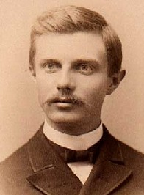
There’s no where left to go!
U.S. Census of 1890 claims American frontier is closed!
"And now, four centuries from the discovery of America, at the end of a hundred years of life under the Constitution, the frontier has gone, and with its going has closed the first period of American history.”
“How will American culture and history develop from this point on?
…will Americans be able to retain that coarseness and strength combined with acuteness and acquisitiveness . . . that dominant ‘rugged individualism’ bred by expansion now that the frontier is closed?!”

Slide 3
Aim: How did new inventions and technologies aid in the Industrial Revolution and the development of BIG BUSINESS?

Slide 4
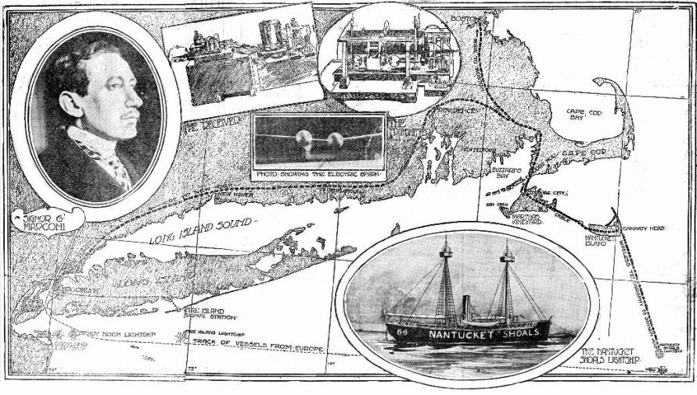
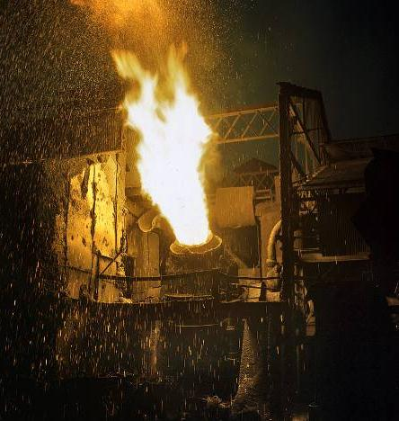
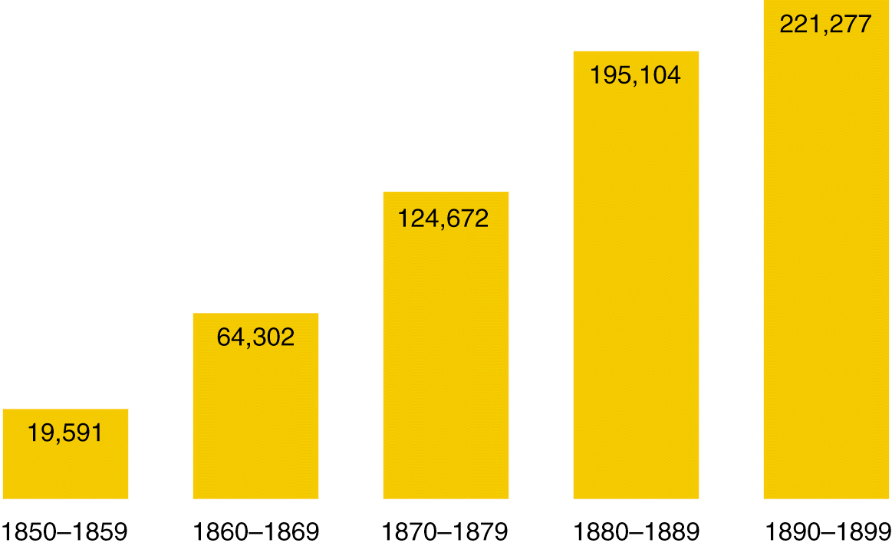
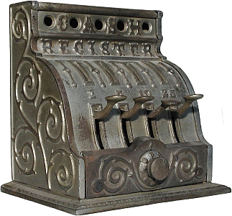
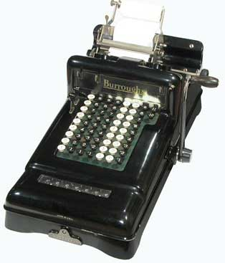
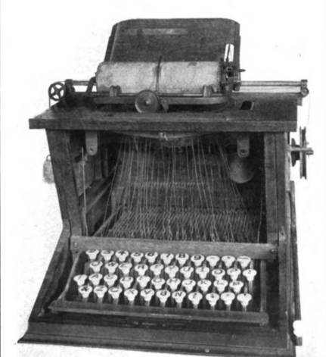
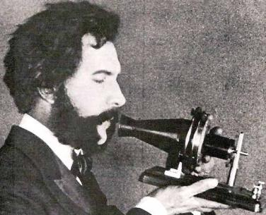
America’s industrial revolution began as a wave of inventions
Cash registers, typewriters adding machines, made businesses more efficient
Guess the Gilded Age invention
Marconi’s wireless transmitter and Bell’s telephone revolutionized communication
U.S. Patents Issued (1850-1899)
The Bessemer process created a cheap way to transform iron into stronger, lighter steel
New inventions allowed for improved industrialization

Slide 5
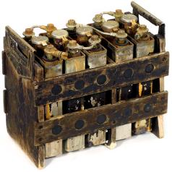
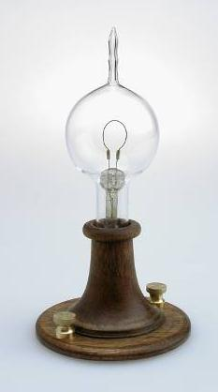
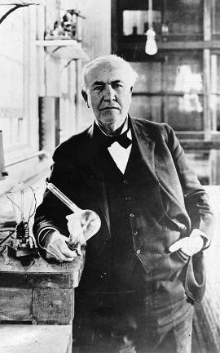
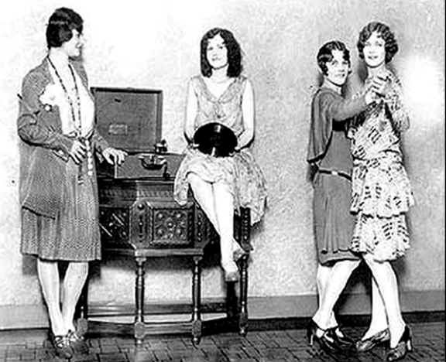
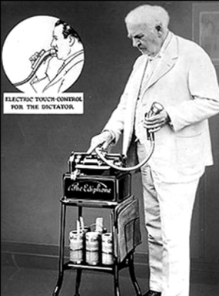
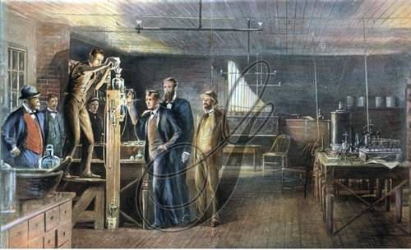
Thomas Edison (the “Wizard of Menlo Park”) was the greatest inventor of the 1800s
In his New York research lab, he invented the 1st phonograph, audio recorder, and battery
Thomas Edison
?
?
?
His most influential invention was the 1st electric light bulb

Slide 6
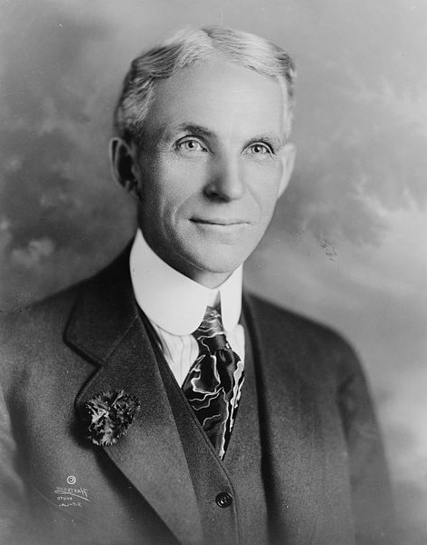
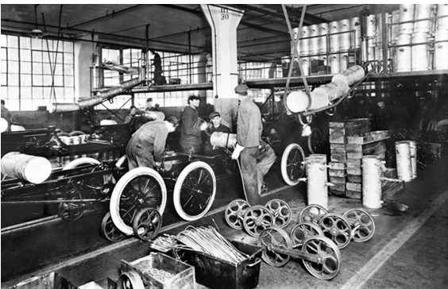
The Assembly Line Changes Factories
Optimized by Henry Ford
Used for creating automobiles (Model T)
WHILE YOU WATCH: EFFECTS of the assembly line on factory work?
Benefits to factory work?
Speeds up production
Lowers cost of production and the final product!

Slide 7
The Assembly Line Changes Factories
Optimized by Henry Ford
Used for creating automobiles (Model T)
WHILE YOU WATCH: EFFECTS of the assembly line on factory work?
Benefits to factory work?
Speeds up production
Lowers cost of production and the final product!

Slide 8
“Model T” Prices & Sales

Slide 9
U. S. Patents Granted
1790s → 276 patents issued

Slide 10
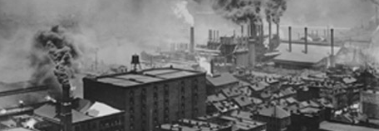
Causes of Rapid Industrialization
Take a pic!
Unskilled & semi-skilled labor in abundance.
Abundant capital.
New, talented group of businessmen [entrepreneurs] and advisors.
Market growing as US population increased.
Government willing to help at all levels to stimulate economic growth.
Abundant natural resources.

Slide 11
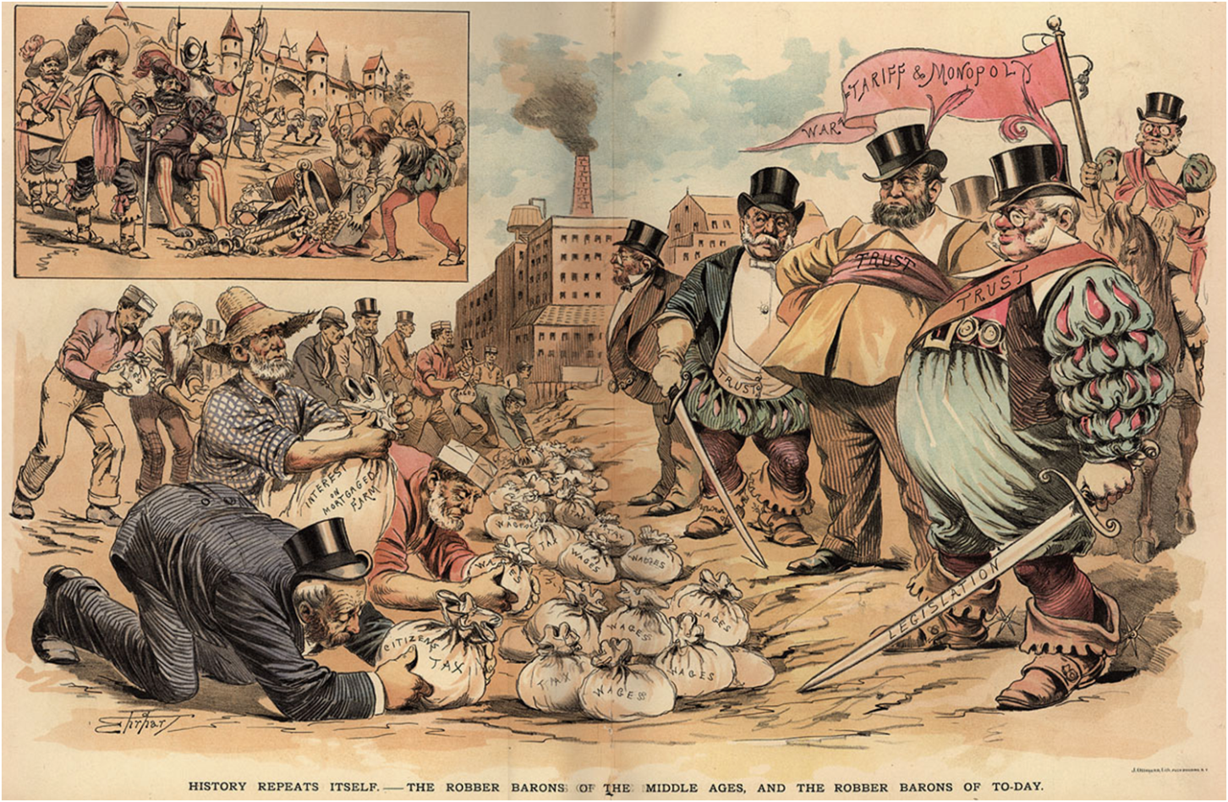
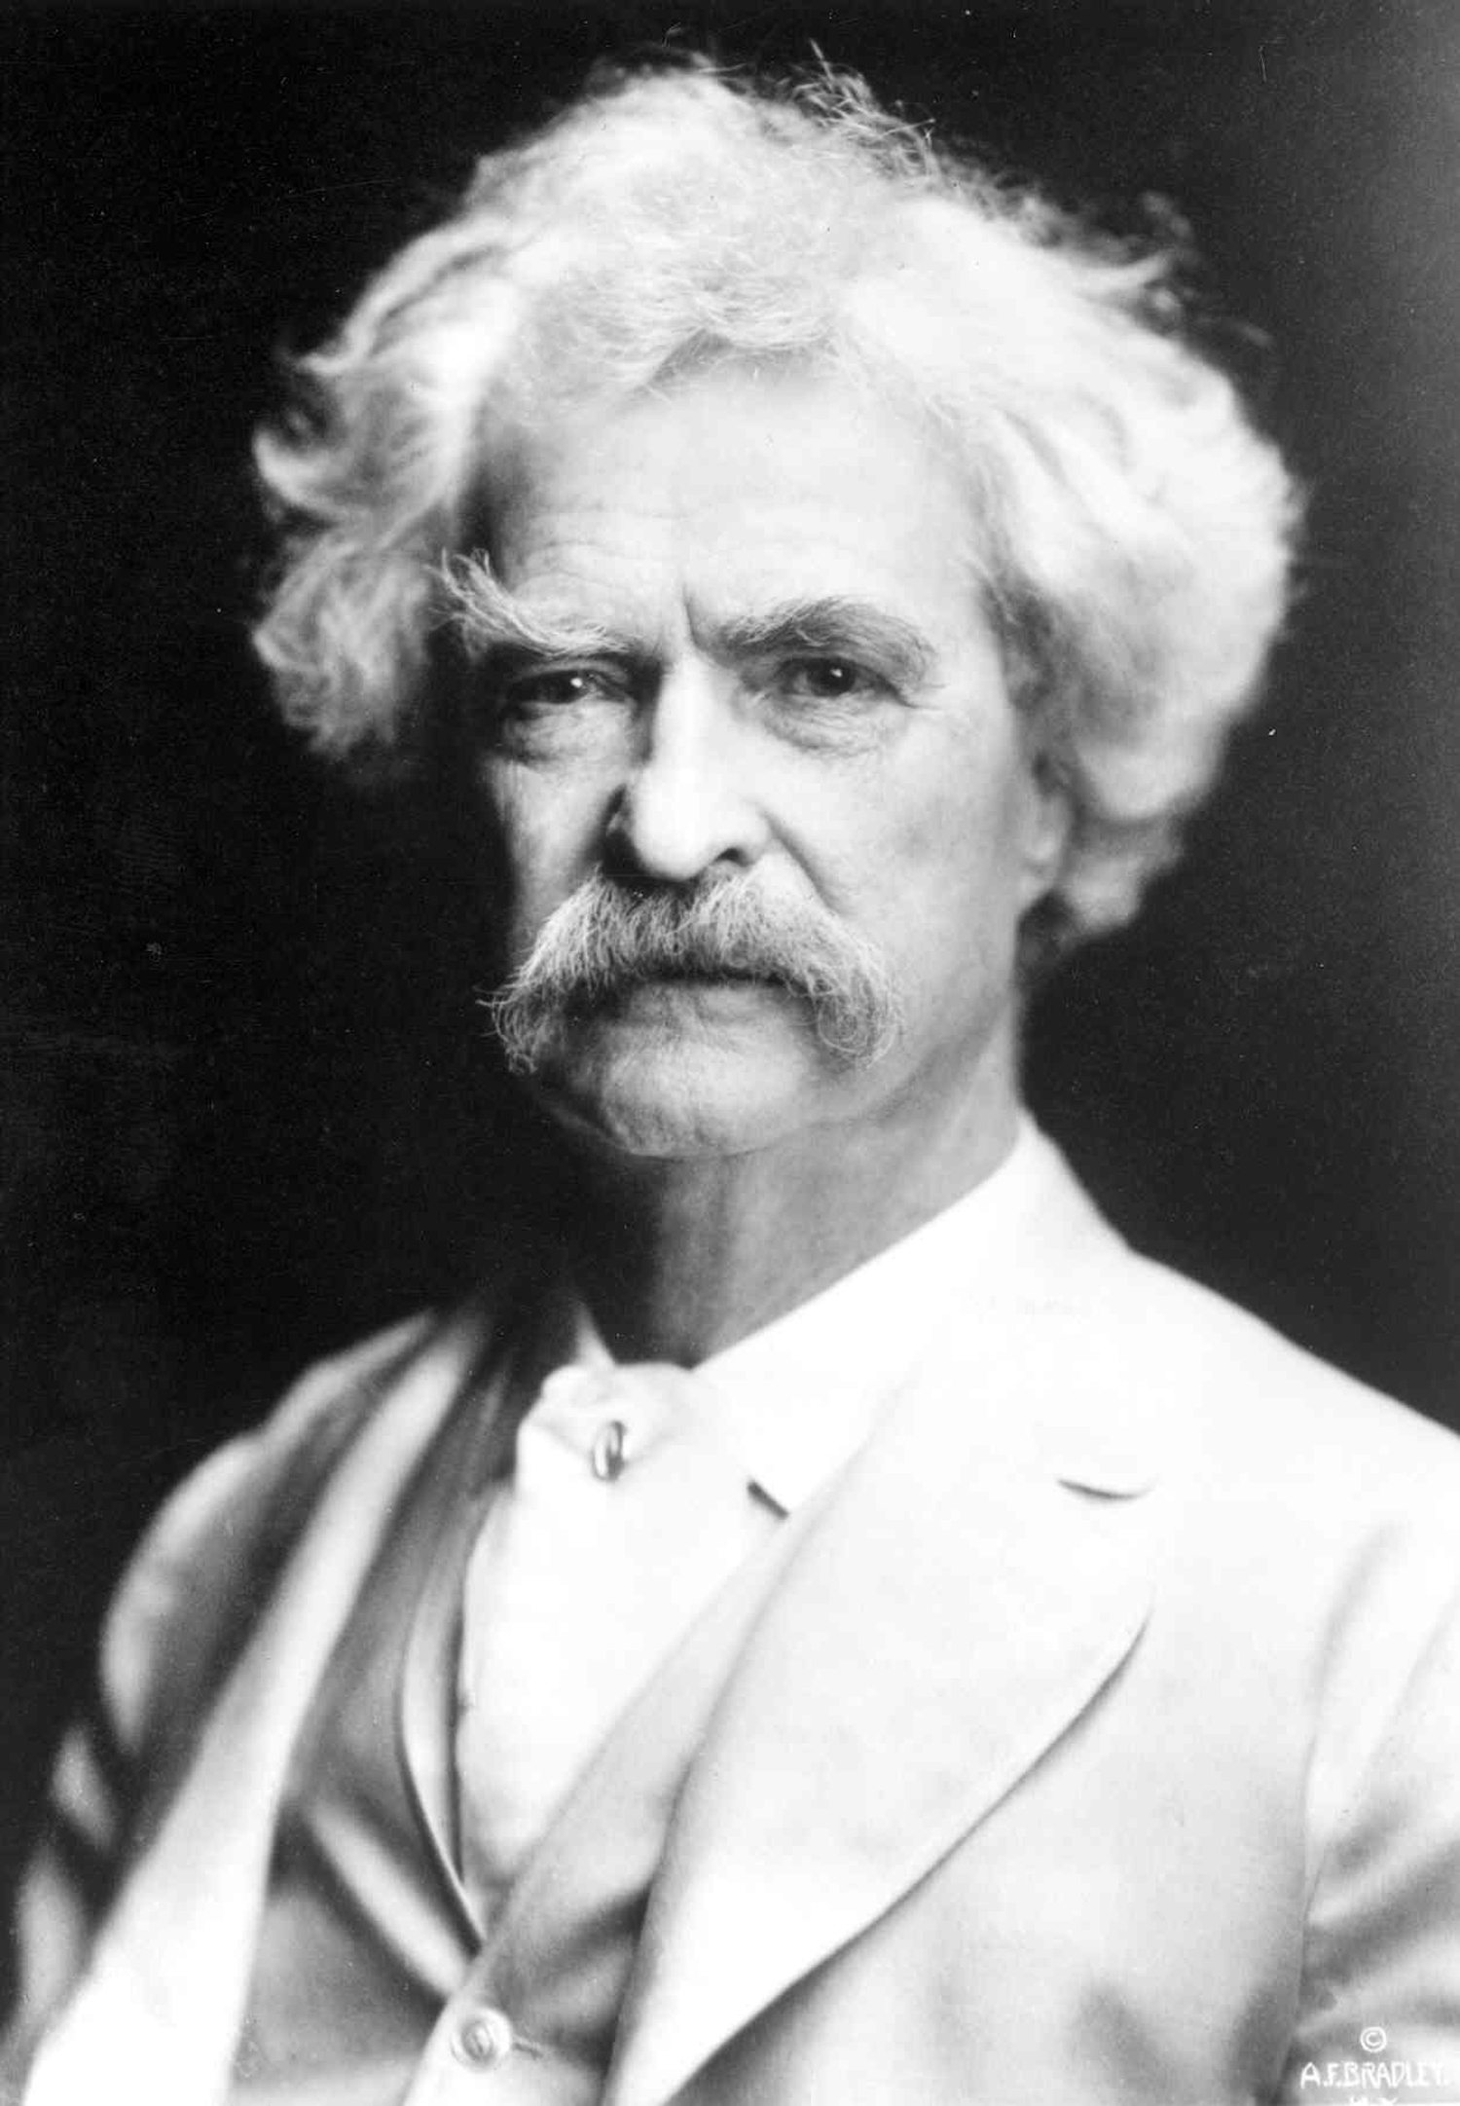
The Gilded Age “All that glitters is not gold…”
Gilded Age – term coined by Mark Twain
Growing gap between the rich and the poor
Wealthy industrialists vs. the poor working classes

Slide 12
Capitalism in America
What are the characteristics of CAPITALISM?
What are some economic systems that are different from capitalism?
Why would capitalism be a beneficial economic system to use during this period of industrial growth in America?

Slide 13
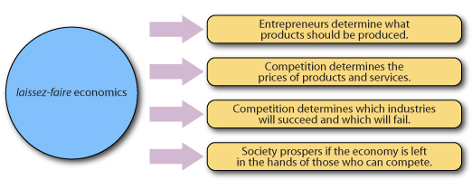
New Economic Theories
Laissez Faire Capitalism
Adam Smith – Wealth of Nations (1776)
Business regulated by the “invisible hand” of supply and demand.
Individuals should compete freely in the marketplace.
No room for government in the market!

Slide 14
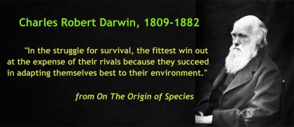
2. Social Darwinism in Europe
Darwin’s ideas of “Survival of the Fittest” and “natural selection”
Concentrate wealth in the hands of the “FIT”
Promoter of laissez-faire.
Herbert Spencer:
British economist

Slide 15
2. Social Darwinism in America
NO government aid for the poor!
Reforms to help the weak will weaken society!
Now imagine you are Bill Gates ($85 billion) – What would you do with your money?
Would Andrew Carnegie approve of your decisions?
William
Graham Sumner
What were Carnegie’s views of philanthropy in his Gospel of Wealth?

Slide 16
Andrew
Carnegie
Inequality is inevitable and good.
Wealthy should act as “trustees” for their “poorer brethren” – GOD-GIVEN responsibility
Why did Carnegie feel that “the man who thus dies rich dies disgraced”?

Slide 17
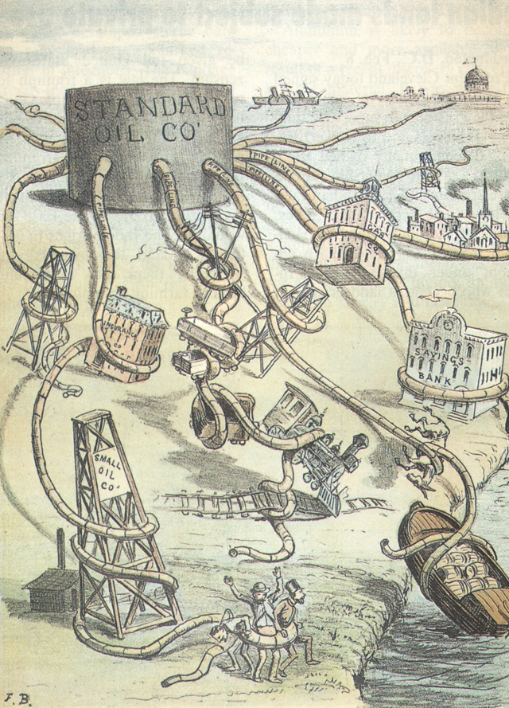
The Growth of Big Business
MONOPOLY = exclusive control of a commodity in a market, or a control that makes possible the manipulation of prices.
TRUST = control over property is transferred to a person or organization (the trustee) for the benefit of someone else (the beneficiary).
Positives?
Big profits for the business!
Negatives?
Destroys competition and small businesses

Slide 18
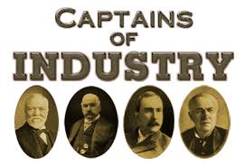
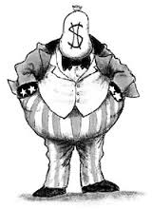
“Robber Barons” or “Captains of Industry”
Captain of Industry
Successful business leader,
helps the economy and
country to grow
Robber Baron
Business leader who uses
ruthless tactics (practices) to destroy competition
Are there Robber Barons today? Captains of Industry, today? Who?

