Slide 1
Temperance Movement
Excessive drinking of alcohol by male factory workers was causing poverty and problems for immigrant and working class families!
Women’s Christian Temperance Union (1874)– TOTAL abstinence from alcohol!
Antisaloon League (1893) – persuaded 21 states to close down ALL saloons and bars.
Carry A. Nation = raided saloons and smashed barrels of beer with a hatchet.

Slide 2
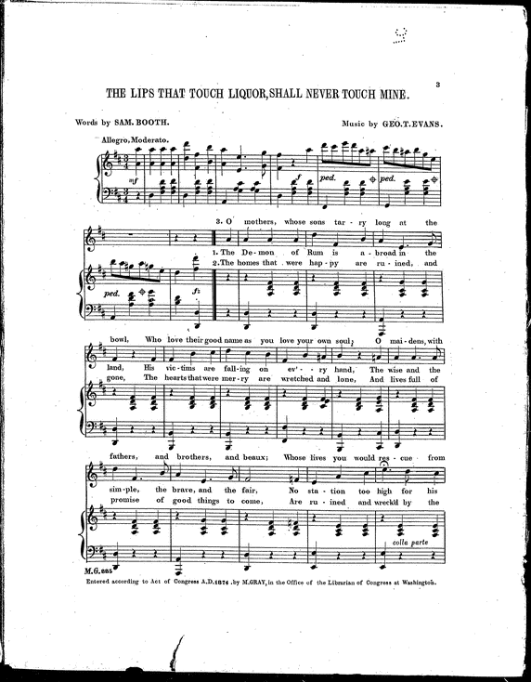
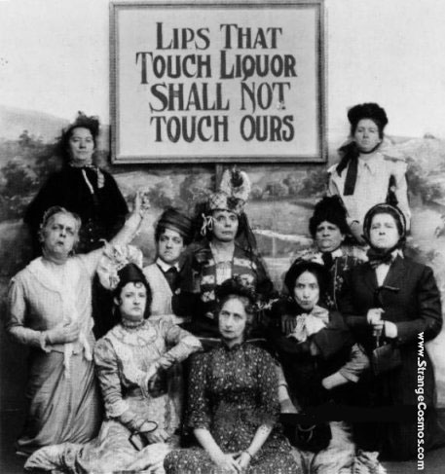
The Lips that Touch Liquor Shall Never Touch Mine
O mothers, whose sons tarry long at the bowl,
Who love their good name as you love your own soul,
O maidens with fathers, and brothers and beaux; Whose lives you would rescue from infinite woes,
Let war be your watchword, from shore unto shore,
Till Rum and his legions shall ruin no more,
And write on your banners, in letters that shine, The lips that touch liquor shall never touch mine.
With this for your motto, and succor divine,
The lips that touch liquor shall never touch mine…
The Demon of Rum is about in the land,
His victims are falling on every hand…
O women, the sorrow and pain is with you,
And so be the joy and the victory, too;

Slide 3
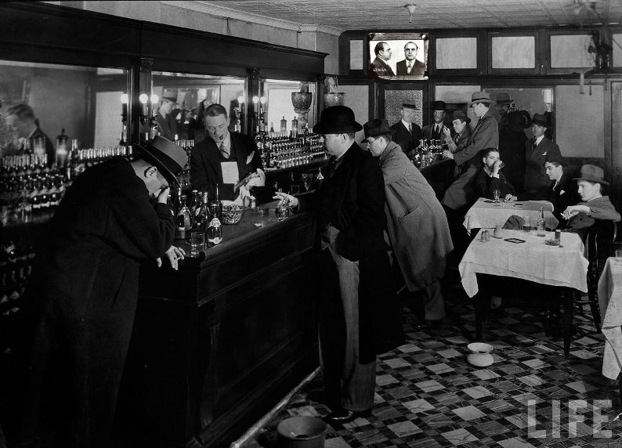
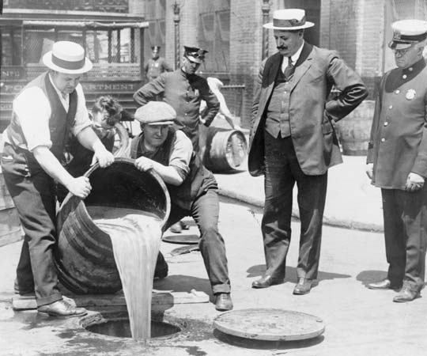
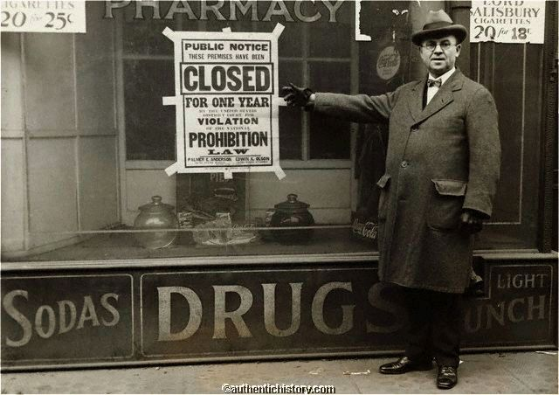
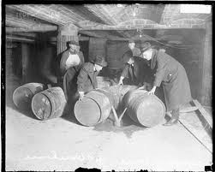
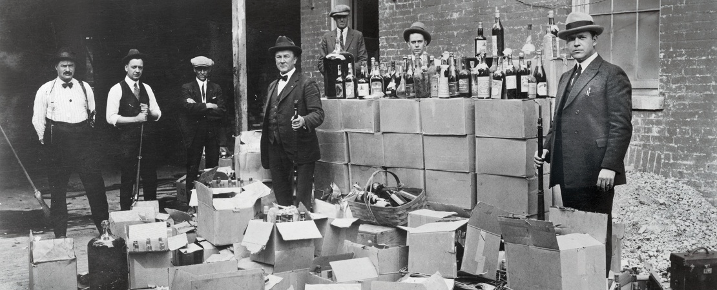
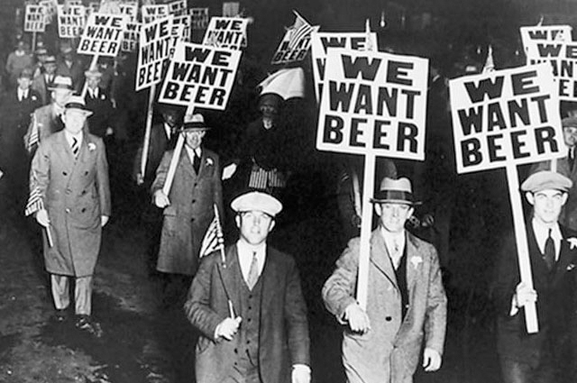
Prohibition
Starts in 1919 with the ratification of the 18th Amendment – prohibits alcohol in the USA = a Progressive success!
Did NOT ban the consumption of alcohol, but made it difficult to obtain alcoholic beverages legally, as it prohibited the sale and distribution of them in U.S. territory.
Later repealed in 1933 (21st Amendment) …WHY?

Slide 4
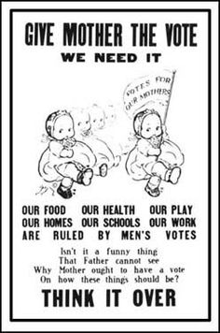
What do the babies want?
What arguments do the babies make to support their position?
How might opponents of the women’s suffrage argue against the message of the cartoon?

Slide 5
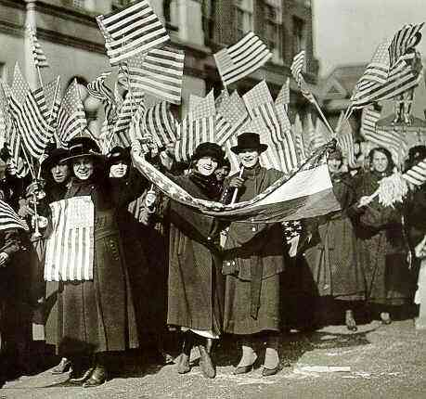
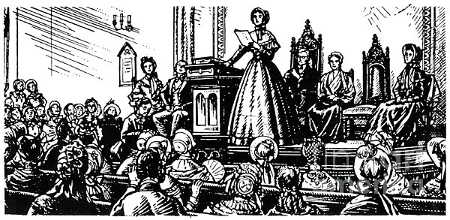
Women’s Suffrage Movement
Ultimately, the work of women on the home front during WWI led to Congress ratifying the 19th amendment (1920)
Guaranteed women the right to vote in ALL elections at the local, state, and national levels
Began with the Seneca Falls Convention of 1848
Movement was led by Susan B. Anthony, Elizabeth Cady Stanton, Lucretia Mott, Carrie Chapman Catt, and Alice Paul and MORE!

Slide 6
Aim: How were African-Americans involved in the Progressive Movement?

Slide 7
13th, 14th, and 15th Amendments to the
United States Constitution
“With the passage of these amendments to the Constitution, African Americans expected all of the rights of citizenship. African American males specifically expected the right to vote because the 15th Amendment stated, “The right of the citizens of the United States to vote shall not be denied or abridged by the United States or by any State on account of race, color, or previous condition of servitude.”
How did African Americans
benefit from these amendments?

Slide 8
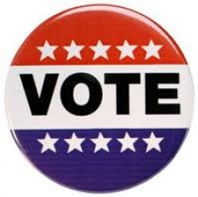
Evolution of the
Jim Crow South
How were African Americans DISCRIMINATED AGAINST throughout history so far? (HINT: When they got the right to vote…)
Poll taxes
Literacy Tests
Grandfather Clauses
Intimidation and Fear (Ku Klux Klan, Black Codes)
Don’t Copy!

Slide 9
Don’t Copy!
Jim Crow Laws
Systematic State-Level Legal Codes of Segregation
WHERE in society were African Americans discriminated against?
Transportation (buses, trains, etc.)
Schools
Libraries
Drinking fountains

Slide 10
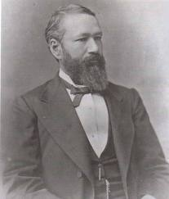
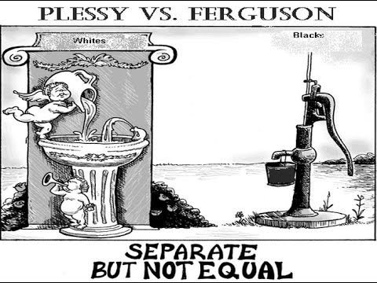
Plessy vs. Ferguson: what did it decide?
The Case: Homer Plessy, 1/8th black, was arrested for sitting in the “white car” of a Louisiana train in violation of that state’s “Separate Car Act.”
The Ruling: SEPARATE facilities were lawful as long as they were EQUAL.
Don’t Copy!

Slide 11
African-American Progressives: What motivated them??
Racial discrimination
Poor conditions of many African-American facilities around society
Most leaders only progressed in terms of the WHITE RACE - lowering tariffs was more important than antilynching laws because they benefitted EVERYONE
Individuals wanted to help blacks “progress” – but had different ideas of how to do it…

Slide 12
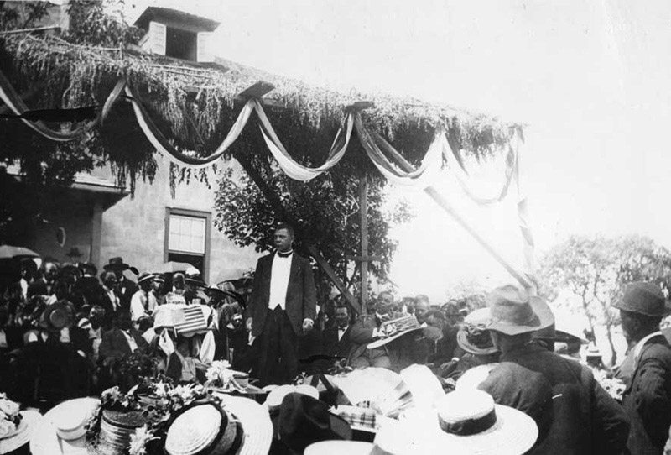
PHILOSOPHIES OF BLACK LEADERS
Booker T. Washington
Southern Perspective – STRESS on ECONOMICS!
Former slave (Up From Slavery)
Head of the Tuskegee Institute (industrial and agricultural school for African Americans – vocational skills) - 1881
Stressed HARD WORK!
Engineering, architecture, etc.
Must be economically SELF-SUFFICIENT before EQUAL in society!
Don’t confront segregation head on – it has to be GRADUAL!
”No race can prosper till it learns that there is as much dignity in tilling a field as in writing a poem. It is at the bottom of life we must begin and not at the top."

Slide 13
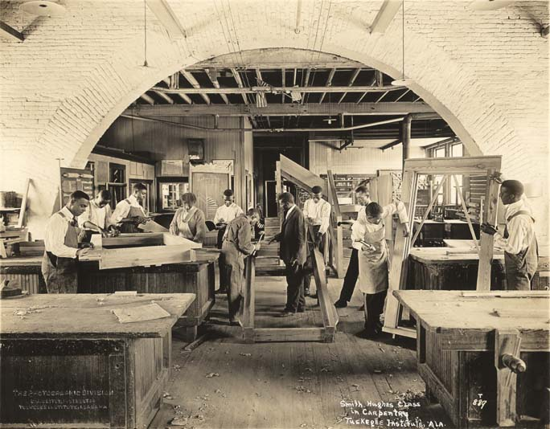
Carpentry class at
Tuskegee Institute
Notes:
Carpentry class at Tuskegee Institute (currently Tuskegee University)
From the collections of the Alabama Department of Archives and History
http://216.226.178.196/cdm4/item_viewer.php?CISOROOT=/photo&CISOPTR=4419&CISOBOX=1&REC=3

Slide 14
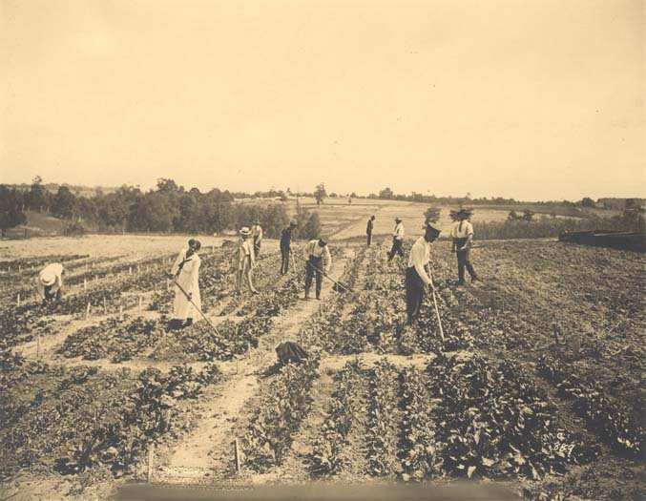
Senior agriculture class
at Tuskegee Institute
Notes:
Senior class in Agricultural Education at Tuskegee Institute
From the collections of the Alabama Department of Archives and History
http://216.226.178.196/cdm4/item_viewer.php?CISOROOT=/photo&CISOPTR=3386&CISOBOX=1&REC=5

Slide 15
What are the real challenges that African Americans face?
“Our greatest danger is that in the great leap from slavery to freedom we may overlook the fact that the masses of us are to live by the productions of our hands, and fail to keep in mind that we shall prosper in proportion as we learn to dignify and glorify common labor, and put brains and skill into the common occupations of life; shall prosper in proportion as we learn to draw the line between the superficial and the substantial, the ornamental gewgaws of life and the useful. No race can prosper till it learns that there is as much dignity in tilling a field as in writing a poem. It is at the bottom of life we must begin, and not at the top. Nor should we permit our grievances to overshadow our opportunities.”
Source: Booker T. Washington, at the Atlanta Exposition, speech, 1895

Slide 16
ATLANTA COMPROMISE SPEECH
Speech given by Booker T. Washington in Atlanta, Sept. 18, 1895, at the Atlanta World Exposition.
Argued that blacks’ needs for education and economic progress were MOST IMPORTANT!

Slide 17
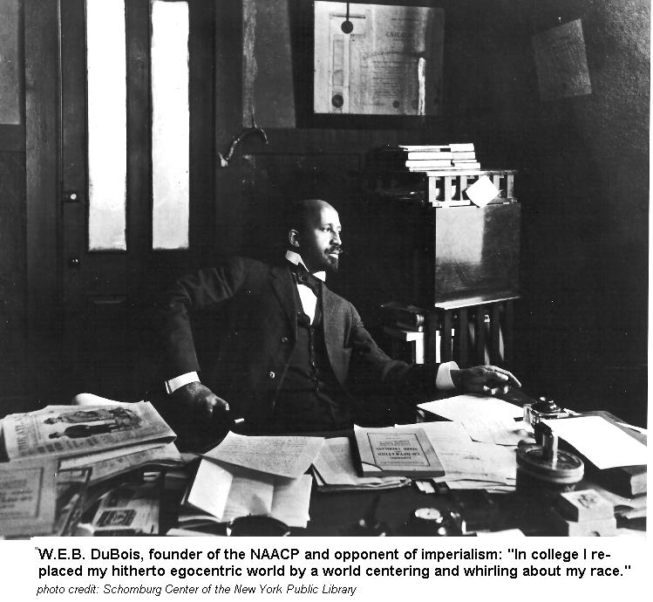
PHILOSOPHIES OF BLACK LEADERS
W.E.B. Dubois
Northern Perspective – STRESS ON EQUALITY!
Northerner/college education (Harvard)
The Souls of Black Folk (1903) = DEMANDED immediate equal rights for African Americans!
WRONG to expect CITIZENS to EARN their rights!
Political and social rights FIRST….THEN you get economic independence!

Slide 18
NIAGARA MOVEMENT
Begins in 1906 in a meeting at Niagara Falls, Canada in opposition to Booker T. Washington’s philosophy of accepting segregation.
Encourage black pride!
No acceptance of segregation----opposed Booker T. Washington’s “gradualism”.
Gain acceptance of white reformers.
ALSO helped form the NAACP (1906)
ABOLISH all forms of segregation
Increase educational opportunities for African American children
ALSO got help from the National Urban League (1911)
Help migration to northern cities

Slide 19
The NAACP had some victories:
Guinn v U.S. (1915) ended Oklahoma’s grandfather clause
Buchanan v Worley (1917) ended KY housing segregation
Notes:
CFL Lesson #33

Slide 20
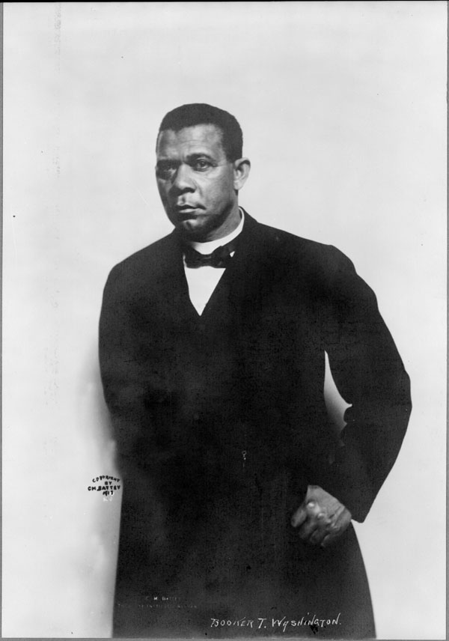
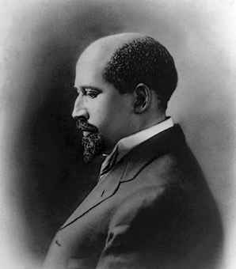
Why do they matter?
How do the views of
Booker T. Washington
DIFFER from the views of
W.E.B. DuBois? (VIDEO)
Booker T. Washington
W.E.B. Dubois

Slide 21
Which leader, Washington or DuBois, had the better plan for African-Americans by 1900? Why?

