Slide 1
AIM: How did Theodore
Roosevelt’s Progressive agenda attempt to
protect small businesses, labor,
consumers, and the environment?

Slide 2
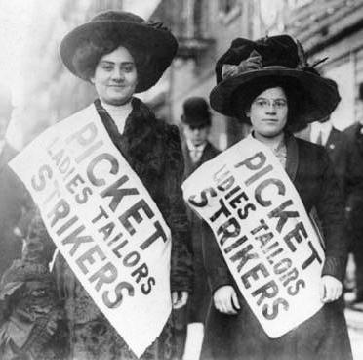
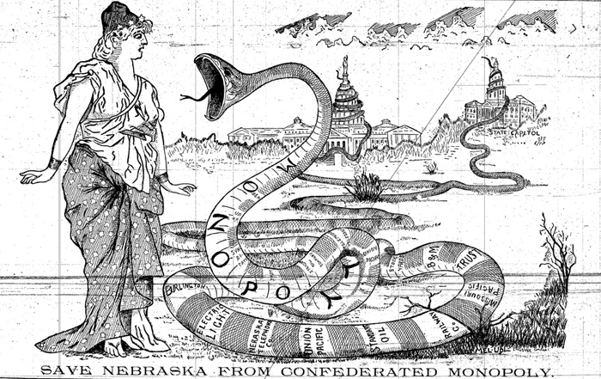
Progressive reformers impacted state governments too!
States began regulating railroads and big businesses to help workers and promote competition
States governments passed laws limiting the work hours for children and women
Most state created commissions (agencies) to oversee gov’t spending (CIA and FTC agencies today)
Galveston, Texas = 1st city to use a city commission rather than a mayor & city council (power in hands of 5 people after BAD hurricane)
Some of these urban reforms were less democratic but much more efficient & less corrupt

Slide 3
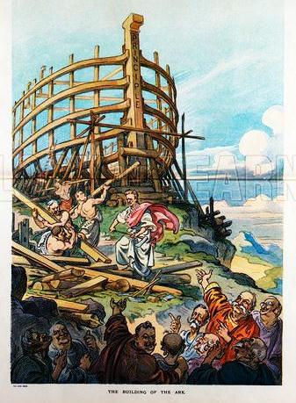
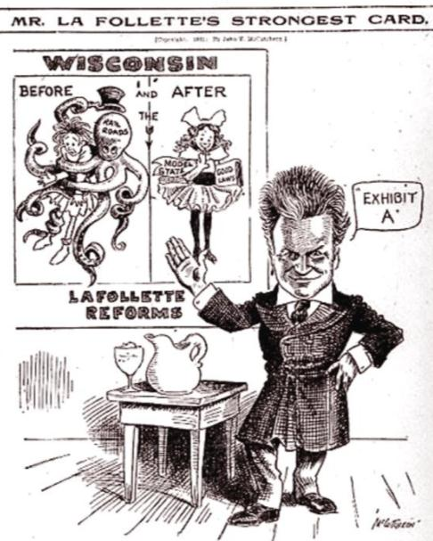
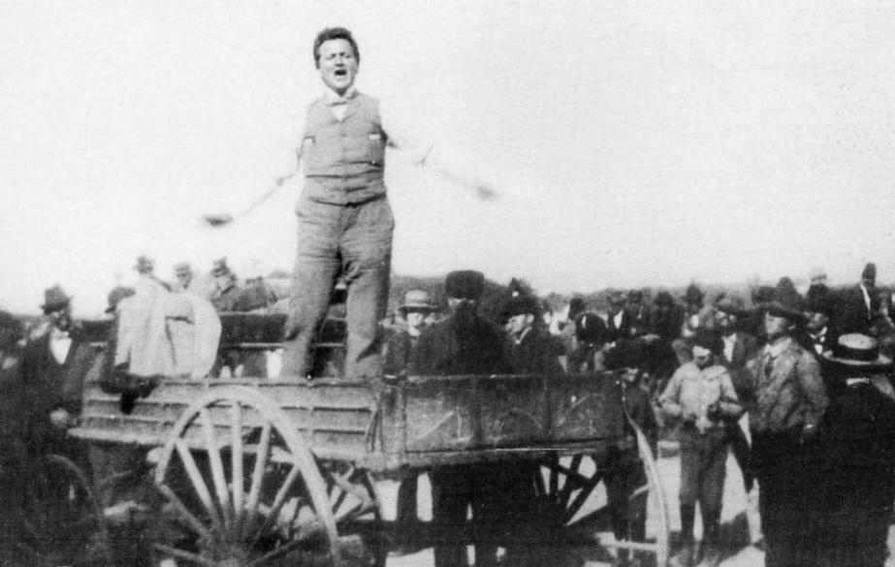
The most significant state reformer was governor Robert La Follette’s “Wisconsin Idea”
Wisconsin was the first state to
create an income tax
form industrial commissions
adopt regulations on big businesses
Wisconsin politicians teamed with academic “experts” from the University of Wisconsin to create state laws
La Follette
Wisconsin became a model for other progressive state reforms

Slide 4
Progressive State Reforms
1) Referendum allows citizens vote to increase taxes for new programs
2) Initiatives allow citizens to bypass the state legislature by putting an issue on a state ballot and voting to make it a law
3) Recalls allow citizens to vote to remove an elected official
**ALL PUT IN PLACE FOR PEOPLE TO GAIN GREATER CONTROL OF GOVERNMENT***
4) Direct primary elections allow voters to choose party candidates

Slide 5
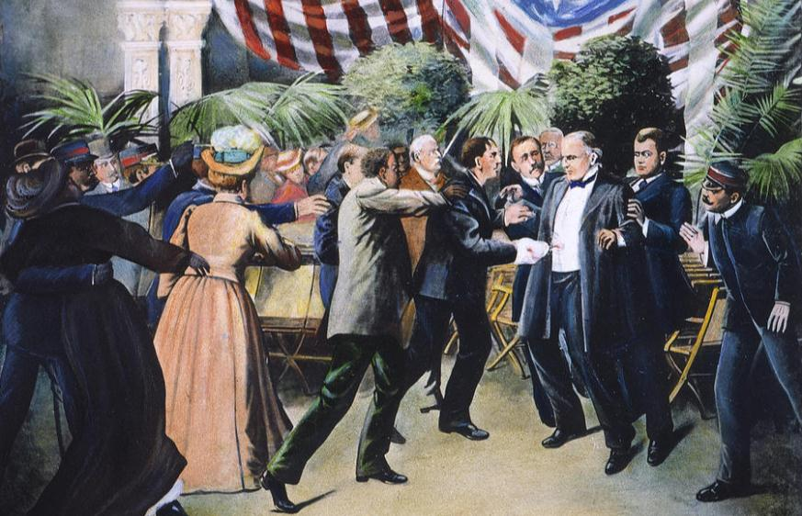
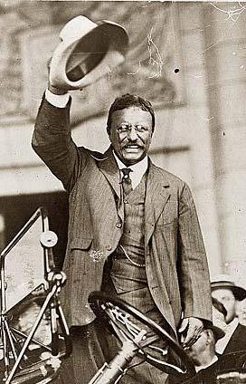
In 1901, Republican President William McKinley was assassinated...
…Vice President Theodore Roosevelt became president

Slide 6
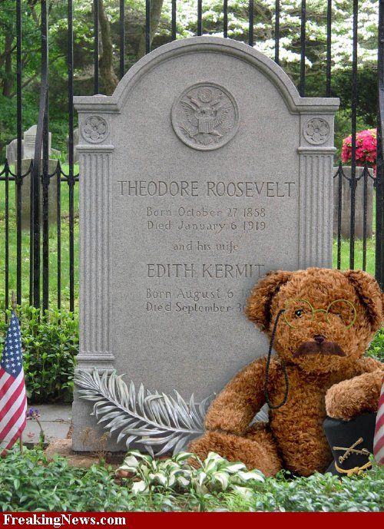
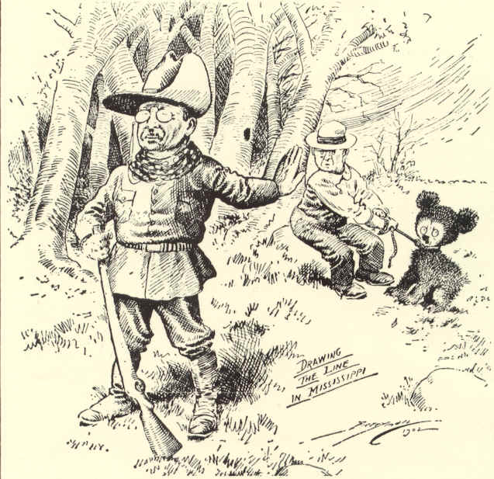
DON’T COPY
Origin of the nickname “Teddy”
Teddy was a BIG OUTDOORSMAN…
He went on a hunt and spared the life of a captured baby bear…
Why was he so important to the nation at this time?

Slide 7
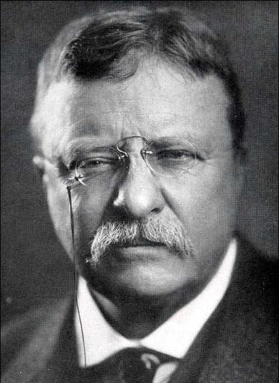
Theodore Roosevelt was a different kind of president because he thought the government ought to take responsibility for the welfare of the people
“It is the duty of the president to act upon the theory that he is the steward of the people, and…to assume that he has the legal right to do whatever the needs of the people demand, unless the Constitution or the laws explicitly forbid him to do it”
“Bully Pulpit”: Teddy’s platform to publicize important issues and seek support for policies.

Slide 8
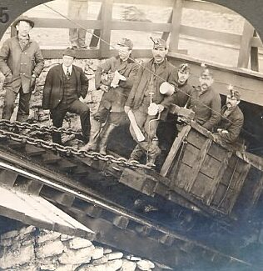
The Anthracite Coal Strike, 1902
1902: United Mine Workers went on strike to demand higher pay & an eight-hour work day
The anthracite coal strike lasted 11 months & threatened the nation as winter approached

Slide 9
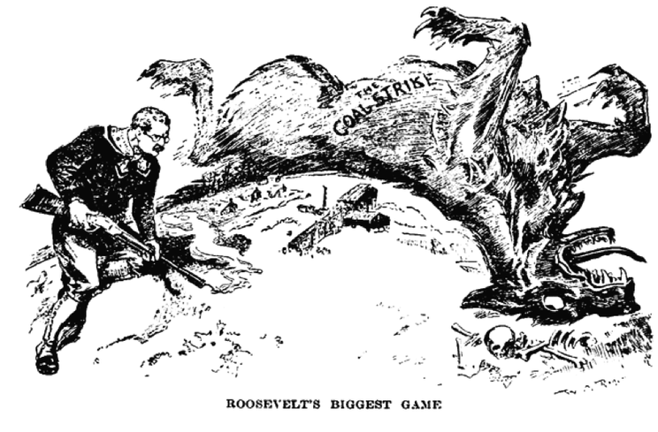
In recent history, had presidents tended to side with the owners or laborers?
Hayes – RR strike of 1877
Cleveland – Pullman strike 1894

Slide 10
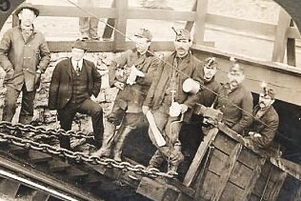
Theodore Roosevelt did NOT side with the owners and break up the strike! > Roosevelt forced both sides to COMPROMISE or force to be CLOSED!
THE RESULT: Roosevelt negotiated a “Square Deal” between striking anthracite coal miners and management
Strikers got HIGHER WAGES
OWNERS got no formal recognition of the union
Teddy promised to “see that each person is given a square deal, because he is entitled to no more and receive no less.”
Notes:
In 1902, the United Mine Workers went on strike to demand higher pay & an eight-hour work day
(a) The anthracite coal strike lasted 11 months & threatened the nation as winter approached
(b) Unlike the Gilded Age presidents, TR did not side with the owners & break up the strike
(c) TR forced both sides to arbitrate or face gov’t seizure of the coal mine
(d) The result was a “square deal” for labor (higher wages) & owners (no formal recognition of the union)

Slide 11
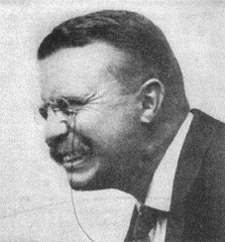
Teddy’s 3 C’s of the Square Deal
WHAT ARE SOME PROBLEMS
IN SOCIETY THAT YOU THINK
TEDDY WANTED TO FIX??
CONTROL of CORPORATIONS = limiting Power of Trusts
Square Deal
CONSERVATION of natural resources
CONSUMER PROTECTION = promoting Public Health and Safety

Slide 12
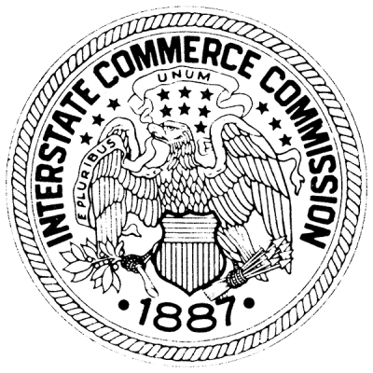
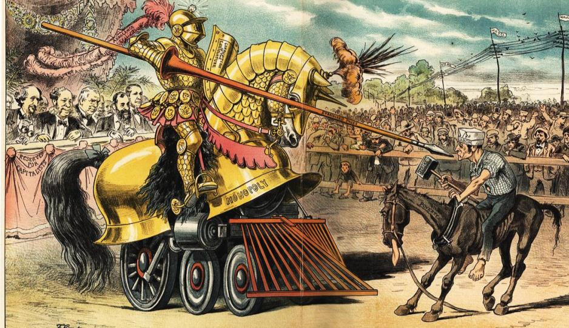
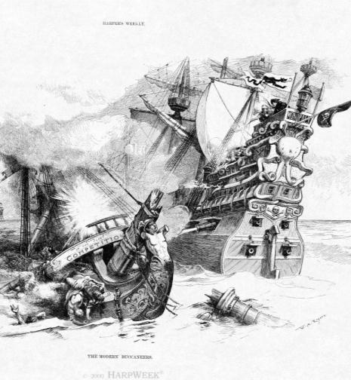
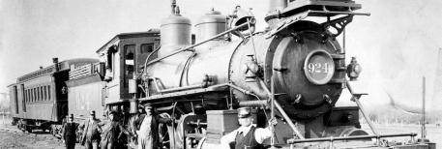
Throughout the Gilded Age, laissez-faire policies by the national government led to powerful monopolies and unfair working conditions for laborers
Congress created the Interstate Commerce Commission (ICC) in 1886 to regulate railroads…
…and passed the Sherman Anti-Trust Act in 1890 to regulate companies that restrict trade
But neither was used to control monopolies during the Gilded Age
REGULATION

Slide 13
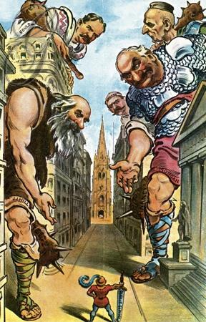
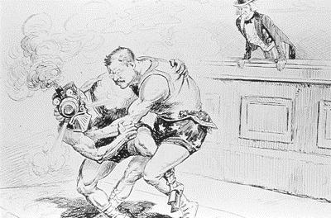
Roosevelt was the first president to regulate big business and break up corporate monopolies
He became known as a “trustbuster” - used the Sherman Anti-Trust Act to break up the Northern Securities Company in 1902

Slide 14
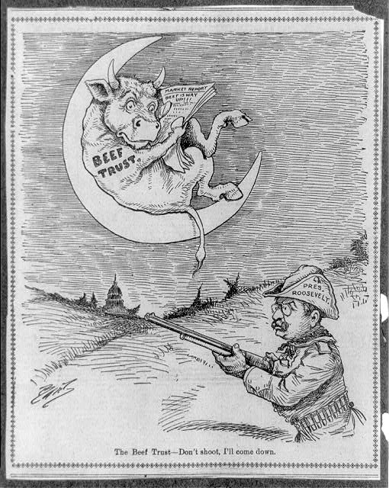
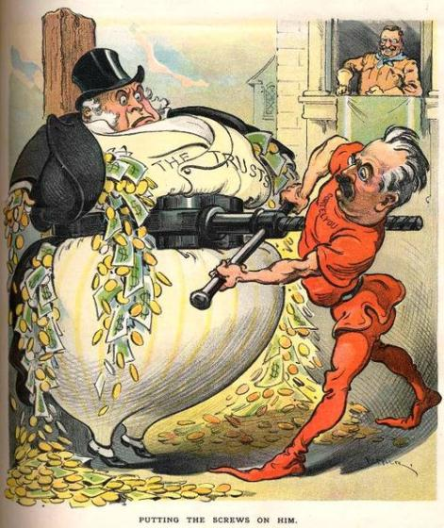
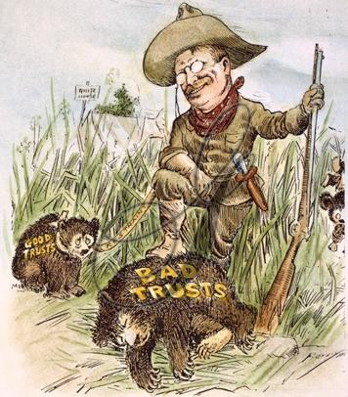
He “busted” 25 other corporate monopolies during his presidency
BUT, he saw the benefit of efficient monopolies, and wanted to control “good” trusts
RESTRAINT

Slide 15
BUT, Teddy the Trustbuster?
Teddy was not always consistent:
He relied on business to gain re-election in 1904; sought the advice of JP Morgan; allowed some monopolistic mergers
The Roosevelt administration only “busted” 25 trusts in 7 years
Taft busted 43 monopolies in 4 years

Slide 16
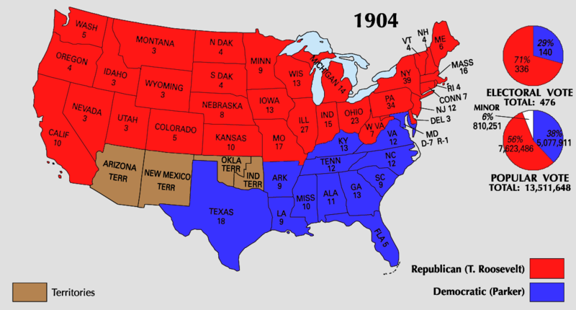
Teddy was a popular president & won a landslide victory in 1904
Roosevelt strived to continue to greatly expand the power of the presidency and the role of government beyond that of helping control big business…

Slide 17
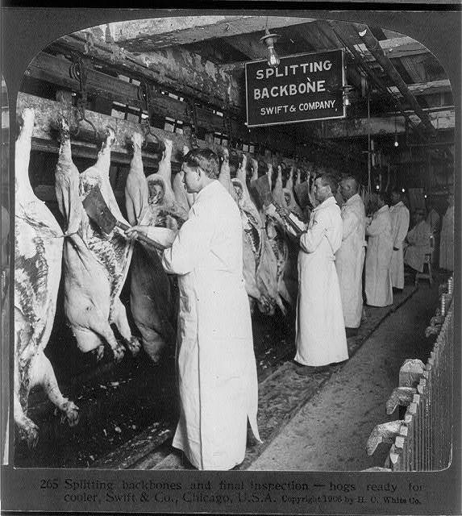
Regulating Society
Teddy’s re-election agenda focused on business regulation:
Hepburn Act (1906) increased the ICC’s power to set maximum railroad rates & investigate railroad company financial records
The Food & Drug Act (1906) & Meat Inspection Act (1906) protected consumers
Notes:
The ICC gained the power to set maximum RR rates & the ICC could investigate RR company financial records

Slide 18
Teddy conserving the nation…
“conservation” = federal government’s wise use of natural resources
Newlands Reclamation Act (1902)
National Conservation Commission (1908)
Forest Reserve Act – set aside 150 million acres as national reserves that couldn’t be sold
Worked with Congress to create:
Crater Lake National Park (OR)
Wind Cave National Park (SD)
Mesa Verde National Park (CO)
Declared the Grand Canyon a historical landmark

Slide 19
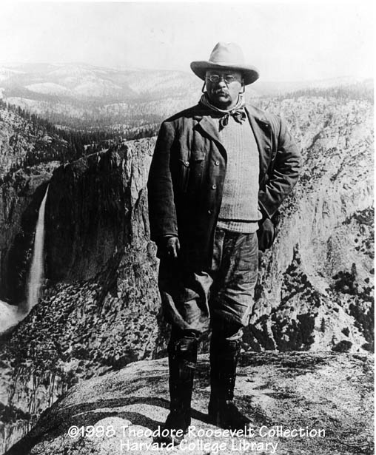
"We have fallen heirs to the most glorious heritage a people ever received, and each one must do his part if we wish to show that the nation is worthy of its good fortune." - Theodore Roosevelt

Slide 20
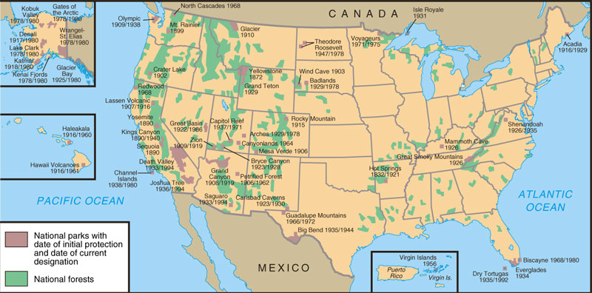
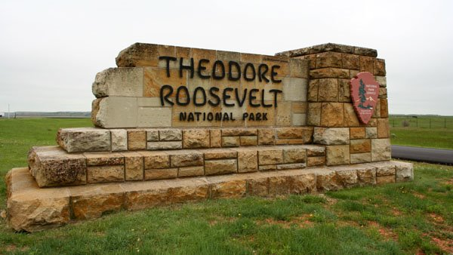
National Parks and Forests

Slide 21
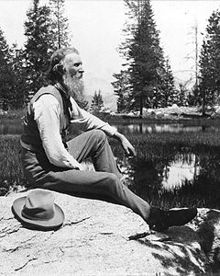
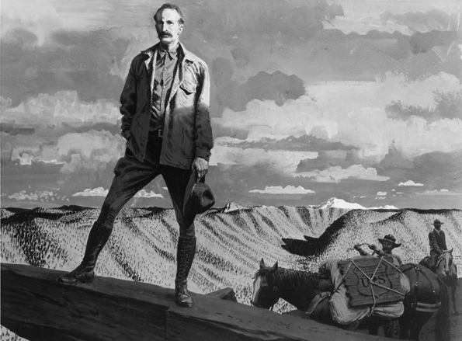
How do you manage America’s wild lands?
Conservation vs. Preservation
Teddy & Gifford Pinchot
“conservationists”
Lands owned by the federal government used for:
Recreation and industry for logging, mining
MANAGE land’s resources for social and economic value
“intelligent use”
John Muir
“preservationist”
Lands owned by the federal government are preserved FROM human interference
The Sierra Club (1892)
Social value > economic value

Slide 22
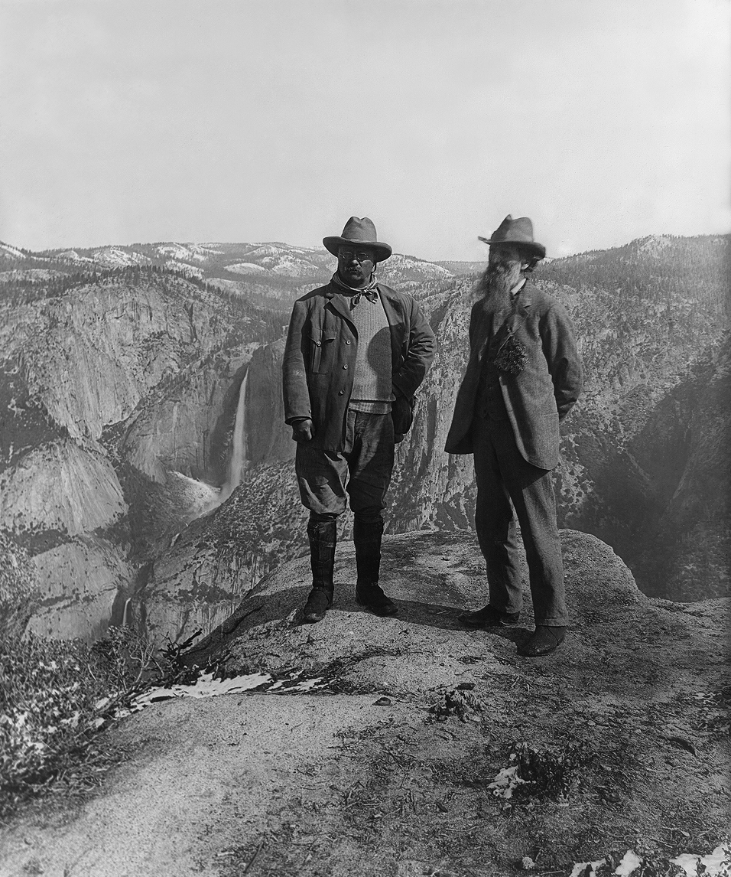
Muir establishes the National Park System
Yosemite National Park
SAQ PRACTICE: Briefly explain ONE way in which an implication for public policy of Teddy Roosevelt’s view contrasts with the implication of public policy of Muir’s view.

Slide 23
AIM: How did Presidents Taft and Wilson help to promote progressive reforms after Roosevelt?

Slide 24
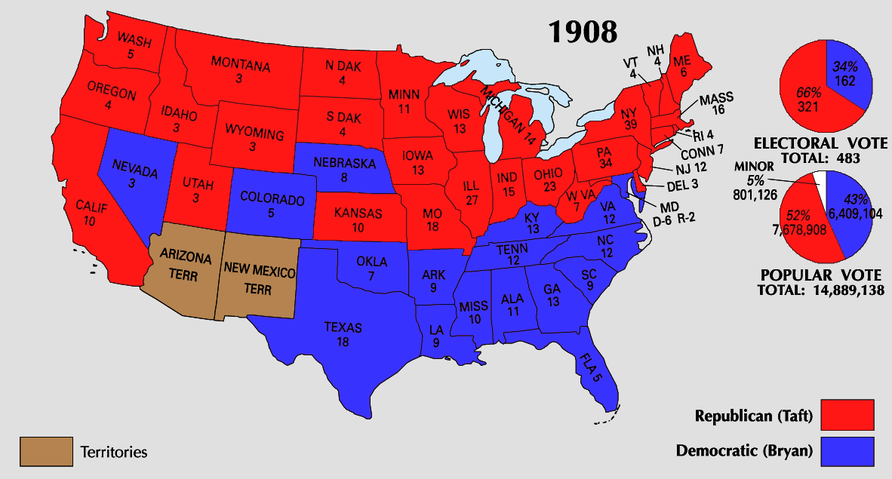
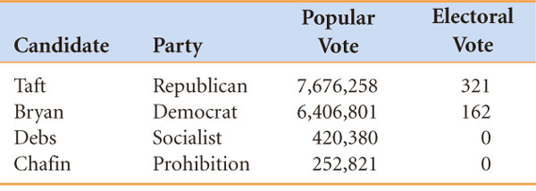
The Taft Presidency
Teddy did not run for a 3rd term (which weakened him politically)
Helped pick William Howard Taft as the Republican nominee for president
Taft seemed ready to carry out TR’s political agenda
“I feel a bit like a fish out of water…I hate the limelight.”

Slide 25
The Taft Presidency
Payne-Aldrich Tariff (1909) = raised tariff on imports (angered progressive Republicans who wanted more foreign competition to force monopolies to reduce their prices)
But, Taft was poorly equipped to continue Roosevelt’s agenda:
did not trust the gov’t to regulate business behavior
was “too honest & sincere”
tended to side with conservative Republicans rather than progressive Republicans
Taft fired Chief of the Forest Service (Gifford Pinchot) after the Ballinger-Pinchot Affair
He also removed 1 million acres of forest and mining lands from the reserved list and returned it to the public.
Notes:
In 1909, Sec of Interior Ballinger offered for sale 1 million acres of land Pinchot refused to sell; After investigation, Taft backed Ballinger; Pinchot covertly leaked ties to JP Morgan & issue became a scandal; Taft fired Pinchot & muckrakers assailed Taft in newspapers
Progressive break with Taft began talk of a TR return to the White House

Slide 26
Taft still had some positives…
All the work to create the 16th & 17th amendments was done under Taft, but neither was ratified while Taft was president!
1.) What was the 16th Amendment (1913)?
How did it help the gov’t? What Populist idea was included?
2.) What was the 17th Amendment (1913)?
How was this beneficial to American democracy?
Congress created a federal income tax
The rich now pay their “fair share”
Business leaders rush to donate!
Direct election of U.S. senators by the people of the states
Originally chosen by state legislatures - “corrupt bargains”

Slide 27
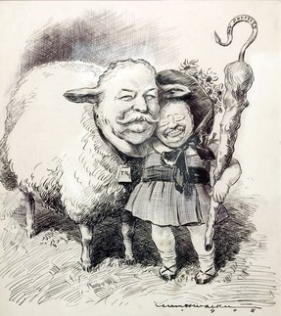
“My policies”
What is the message and significance of this political cartoon in relation to the similarities and differences between Roosevelt and Taft?

Slide 28
The Election of 1912
“I’m feeling like a Bull Moose!”
TEDDY IS BACK! Decides to run against Taft for the Republican nomination in 1912 but conservative Republicans refused to nominate him over Taft
Teddy = new Progressive/Bull Moose Party
Democrats nominated former Princeton president & NJ governor Woodrow Wilson (a progressive reformer)
This further divided the already fragmented Republican Party
“I have a message to deliver and I will deliver it as long as there is life in my body.”
Notes:
After being shot by anti-third term fanatic: “I have a message to deliver and I will deliver it as long as there is life in my body.”

Slide 29
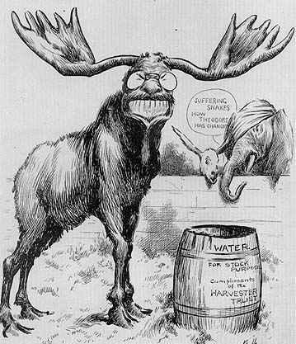
What is
the message
of this cartoon?

Slide 30
Primary Source Analysis
“The Progressive Party, believing that no people can justly claim to be a true democracy which denies equal political rights on account of sex, pledges itself to the task of securing equal suffrage to men and women alike.
We pledge ourselves to work…for: Effective legislation looking to the prevention of industrial accidents, occupational diseases, overwork, involuntary unemployment, and other injurious effects incident to modern industry; The fixing of minumum safety and health standards...The prohibition of child labor; Minimum wage standards for working women, to provide a “living wage” in all industrial occupations.”
Source: Progressive Party Platform, 1912
What were the goals of the new Progressive Party?

Slide 31
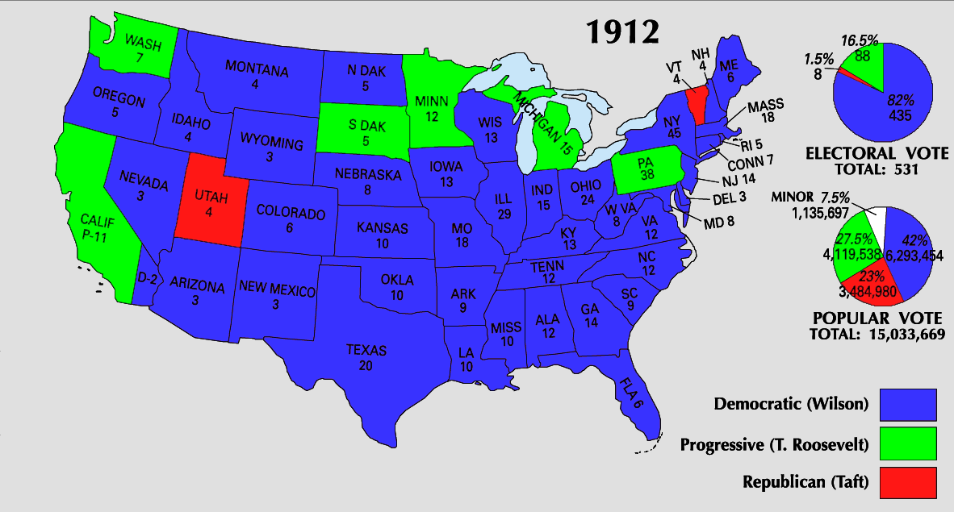
The Election of 1912
The 1912 election was the most significant 4-way election since 1860: Lincoln (Republican), Stephen Douglas (Northern Democrat), John Breckenridge (Southern Democrat), John Bell (Constitutional-Union)
TR’s New Nationalism
U.S. needs a nat’l approach to reform & a strong president
Social-justice reforms: protection of women, children, workers; “good” trusts to help growth
1st to enlist women
WW’s New Freedom
U.S. needs small gov’t, free trade & competition
Both plans saw the economy as the central issue, but Wilson distrusted federal power & nat’l planning
Eugene Debs (Socialist) came in a distant 4th
Democrats not only won the presidency, but also outright control of both House & Senate

Slide 32
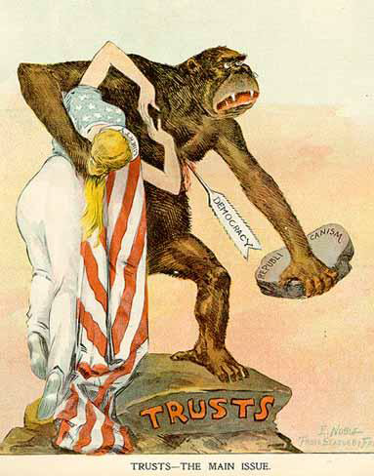
What is
the message
of this cartoon
created during
the Wilson
presidency?

Slide 33
Woodrow Wilson's New Freedom
Wilson believed in strong, activist leadership & helped push through many “New Freedom” ideas:
Underwood Tariff Act (1913) = reduced tariffs & created the 1st graduated income tax
Federal Reserve Act (1913) = the Federal Reserve regulates the economy by adjusting the money supply & interest rates
1% tax for all, but 2% for the rich
The 1st efficient national banking system since Jackson destroyed the BUS in 1832
Notes:
(1913) was;

Slide 34
Woodrow Wilson's New Freedom
Clayton Anti-Trust Act (1914) made Sherman Anti-Trust Act STRONGER- legalized STRIKES!
MANY benefits to workers!
As the 1916 elections neared, Wilson pushed for more social reforms…but U.S. involvement in WWI in 1917 distracted Americans from progressive reform…
Endorsed an 8-hour day for all workers
Federal Farm Loan Act
Supported women’s suffrage
Defended unions’ right to collectively bargain

Slide 35
The End of Progressive Reform
When World War I ended in 1919, the last of the progressive reforms were enacted:
In 1919, the temperance movement gained a victory when the 18th amendment & Volstead Act prohibited alcohol
In 1920, women were rewarded for their WW1 contribution with the right to vote (19th amendment)

Slide 36
How successful was the Progressive Era?
Progressive reforms led to:
Urban & labor improvements
Direct primaries & female voting
More government responsibility for social welfare
Regulatory commissions
Increased importance of interest groups & public opinion polls
An “expert” bureaucracy
A more powerful presidency

