Slide 1
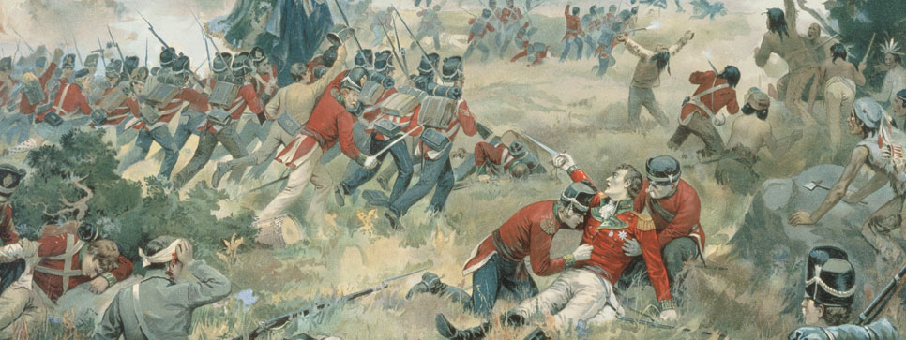
**ADAMS to MONROE – MC EXAM on WEDNEDDAY 12/14**
DO NOW:
How did the rulings of the Supreme Court (under Marshall) increase the power of the federal government? Explain and give CONTEXT.
Why do countries go to war? Make a list of reasons.
VIDEO

Slide 2
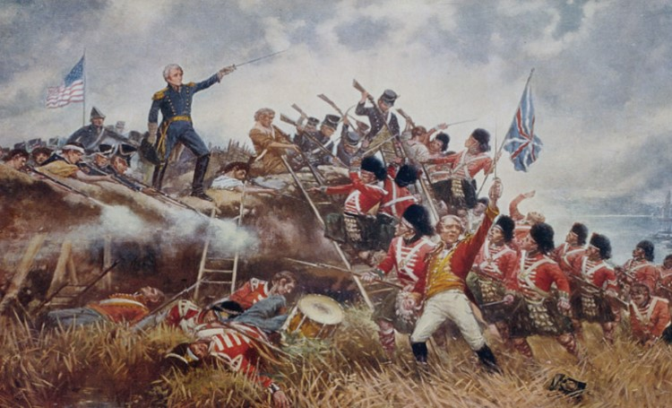
AIM: Was the War of 1812 inevitable, and what effects did it have on the nation?
Essential Questions:
1. In what ways did Britain anger the United States during the early 1800’s?
2. How did the policy of impressment violate the Americans’ policy of neutrality?
3. Why did James Madison make the choice to declare war on Britain?
4. How was the War of 1812 going to be revolutionary throughout the United States?

Slide 3
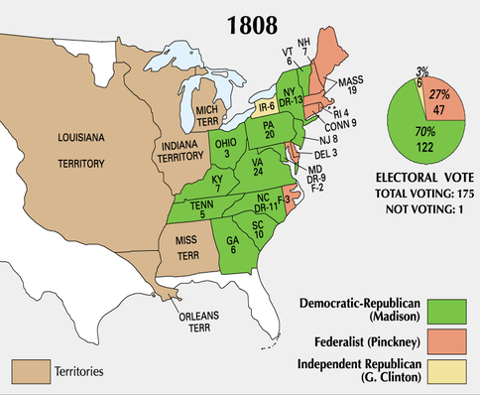
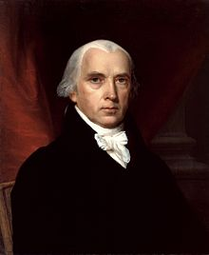
James Madison (#4)
FIRST: Diplomacy with the European nations
THEN: Brings the US to war
Macon’s Bill No. 2 (1810): RESTORED US trade with Britain and France
If one respected the US neutral rights at sea, we’d prohibit trade with their foe

Slide 4
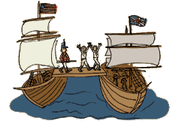
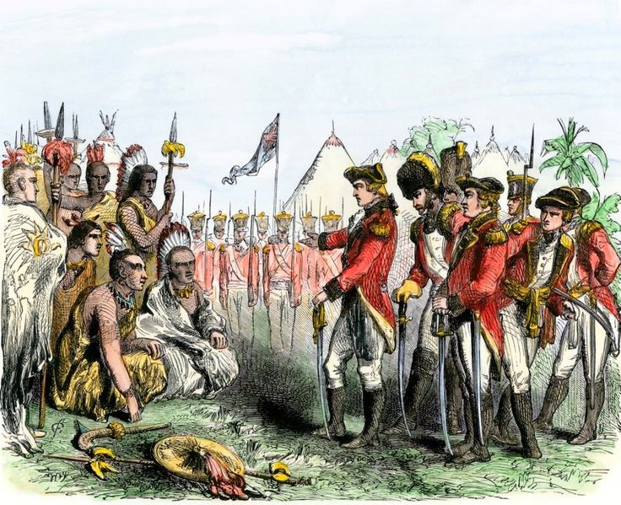
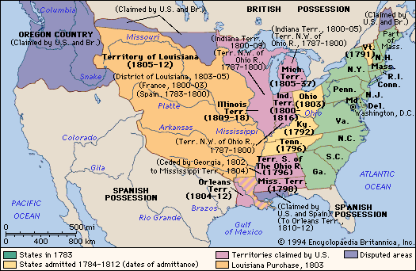
What caused the War of 1812?
#1 Freedom of the seas
Blatant BRITISH actions (RESENTMENT)
DR’s still kind of liked the French and their cause
#2 American belief that the Brits in Canada were arming and encouraging the Indians
#3 Americans want to annex Canada and Florida
DILEMMA: Territorial expansion v. maritime rights?

Slide 5
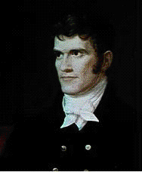
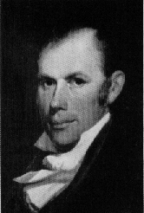
The Drift to War
“War Hawks”
Young Congressmen from the South and the West
WAR!!!
Demanded war against Britain to acquire Canada and against Spain, to acquire Florida
John C. Calhoun of South Carolina.
Henry Clay of Kentucky.
How do these war hawks display a
new American identity?

Slide 6
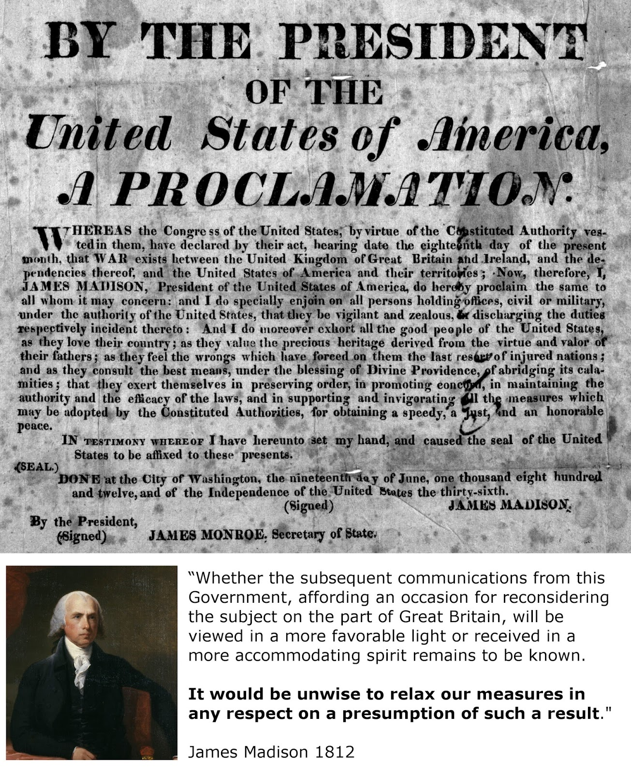
“The practice, hence, is so far from affecting British subjects alone that…thousands of American citizens…have been torn from their country and from everything dear to them; have been dragged on board ships of war of a foreign nation and exposed, under the severities of their discipline, to be exiled to the most distant and deadly climes, to risk their lives in the battles of their oppressors…”
Who would oppose Mr. Madison’s War?
NE merchants – less profits/Protestant - British
Federalist politicians – Republican scheme to increase strength in gov’t
“Quids”/ “Old” Republicans – violated Republican values of limited government
“…the conduct of her government presents a series of acts hostile to the United States as an independent and neutral nation.”

Slide 7
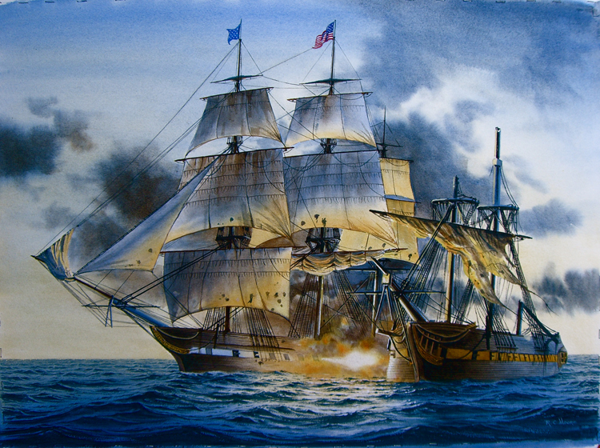
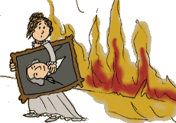
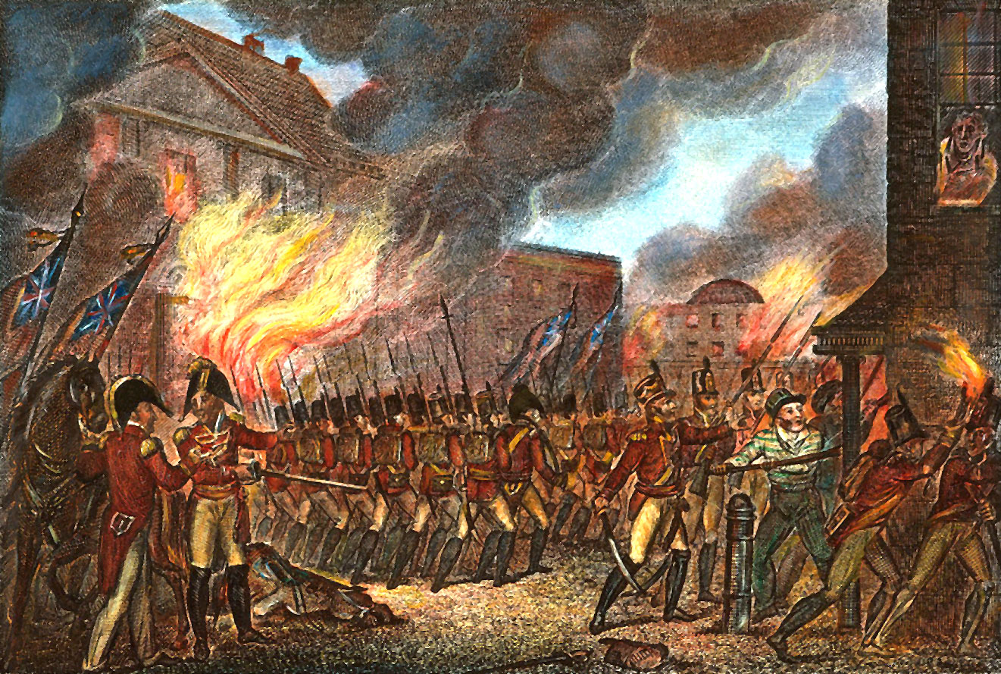
The British invaded WASHINGTON, D.C. in 1814
British soldiers BURNED the Capitol, the White House, and other public buildings
Dolley Madison saved a famous painting of George Washington
The Constitution
“Old Ironsides”
Won decisive battles, raised American morale by sinking British ships!

Slide 8
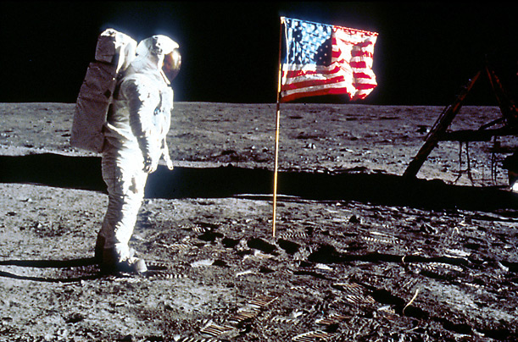
QUICK Discussion
Why does the American flag symbolize pride for the United States?
What does the national anthem mean to you?

Slide 9
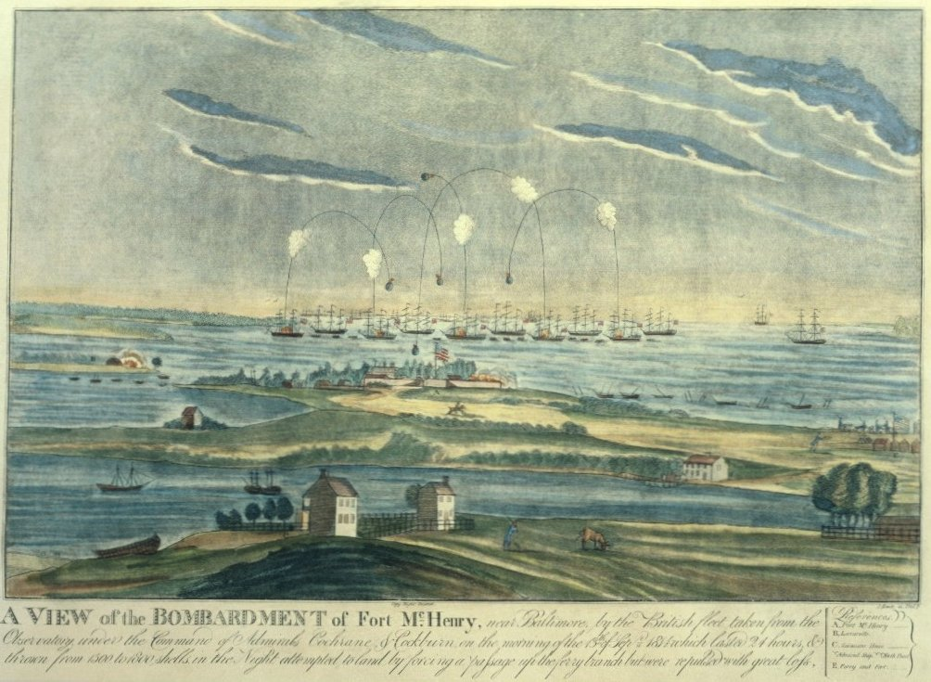
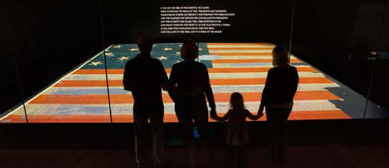
“O say can you see, by the dawns early light”
Battle at Fort McHenry
Francis Scott Key
The flag inspired “The STAR-SPANGLED BANNER”

Slide 10
DO NOW: On the worksheet given to you, answer the 5 REVIEW questions based off of the past few lessons…
**ADAMS to MONROE – MC EXAM on WEDNESDAY 12/14**

Slide 11
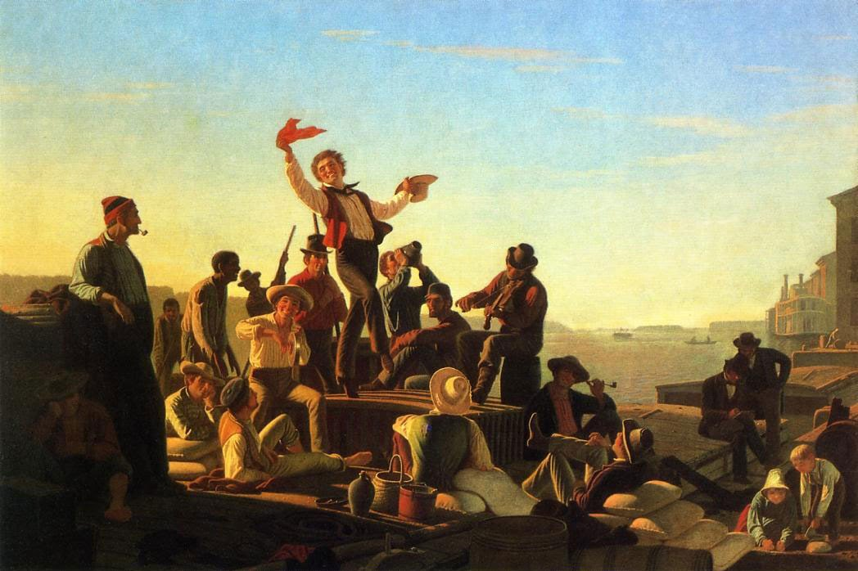
AIM: How did the War of 1812 lead to an “Era of Good Feelings”, and was it all necessarily “good”?
Essential Questions:
How was the War of 1812 going to be revolutionary throughout the United States?
Was the War of 1812 inevitable?
Why did the Federalist Party “die off” during the Era of Good Feelings?
Is too much nationalism ever a bad thing?

Slide 12
The Battle of New Orleans (1814-1815)
MOST IMPORTANT battle!
Lead to victory by General Andrew Jackson
US TOOK CONTROL of the Mississippi River
2500 British soldiers killed or captured VS. American army only 8 men were killed
The battle continued even after the war ended with a peace treaty, word did not reach the Americans for several weeks!

Slide 13
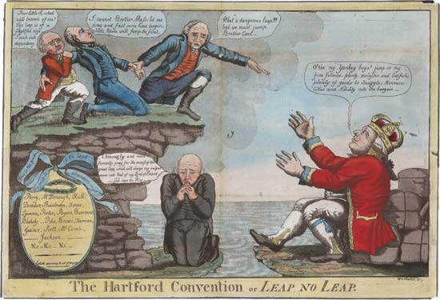
The Hartford Convention (1814)
Radical NE Federalists almost SECEDED – OPPOSED WAR of 1812!
Growing sectionalism
LIMIT the growth of the DR’s
Proposal: 2/3 vote of both houses to declare war
Approaching END of the Federalist Party
R.I.
Conn.
Mass.
This is the produce of the land they wish to abandon.

Slide 14
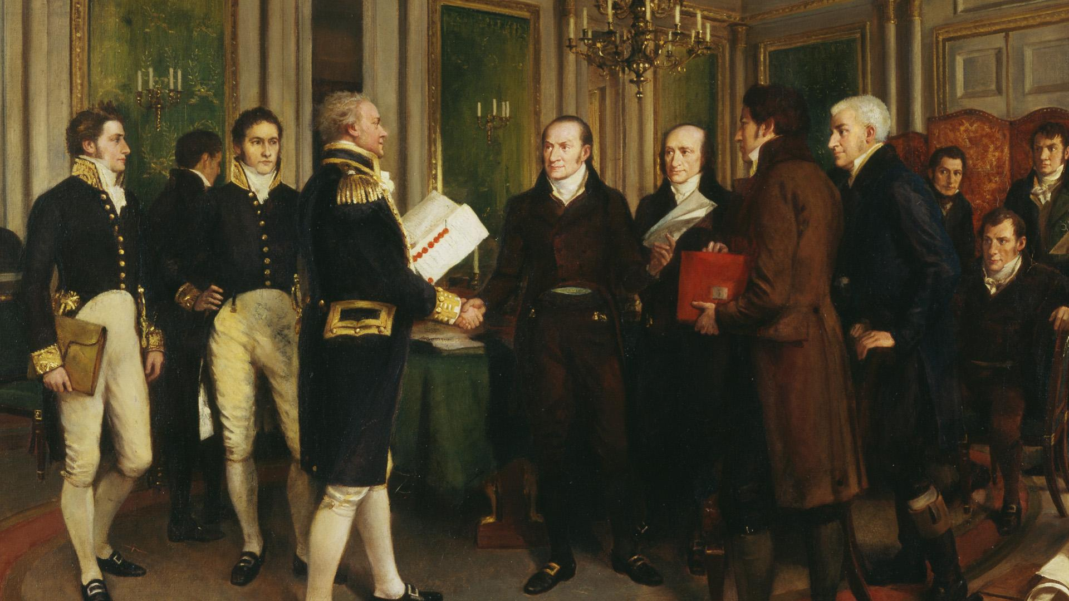
Treaty of Ghent - 1814
Ghent, Belgium – PEACE TREATY
HALT to fighting
Return of territories
Prewar boundary between Canada and the US
***NOTHING about impressment
In his 1914 painting A Hundred Years Peace, artist Amedee Forestier illustrates the signing of the Treaty of Ghent between Great Britain and the US, 24 December 1814
STALEMATE
Any significance of this being painted in 1914?

Slide 15
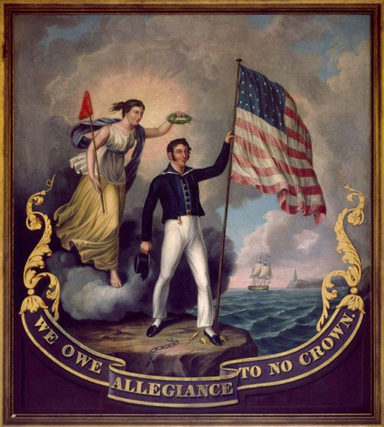
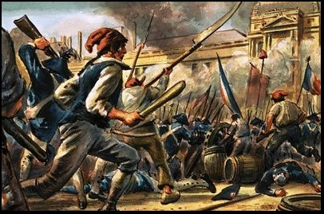
We Owe Allegiance to No Crown, by John Archibald Woodside. c. 1814. Photograph copyright Nicholas S. West. Photography by Erik Arnesen.
Interpret this painting
1. What do you see?
2. What was its message to Americans?
“The war has renewed and reinstated the national feelings and character which the Revolution had given, and which were daily lessened,” wrote Albert Gallatin. “The people now have more general objects of attachment with which their pride and political opinions are connected. They are more Americans; they feel and act more as a nation.”
This ”Second War for Independence” will lead to an Era of Good Feelings throughout the nation…

Slide 16
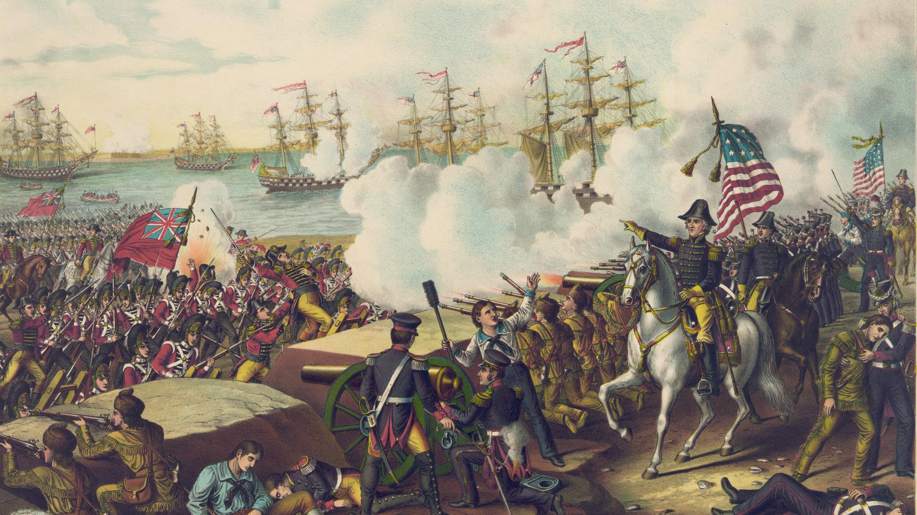
Was the War of 1812 inevitable, and what effects did it have on the nation?

Slide 17
OUTCOMES OF WAR OF 1812
The War of 1812 won new respect for America among many British. Michael Scott, a young lieutenant in the British navy wrote,
“I don’t like Americans; I never did, and never shall like them…..I have no wish to eat with them, drink with them, deal with, or consort with them in any way; but let me tell the whole truth, nor fight with them, were it not for the laurels to be acquired, by overcoming an enemy so brave, determined and alert, and in every way so worthy on one’s steel, as they have always proved.

Slide 18
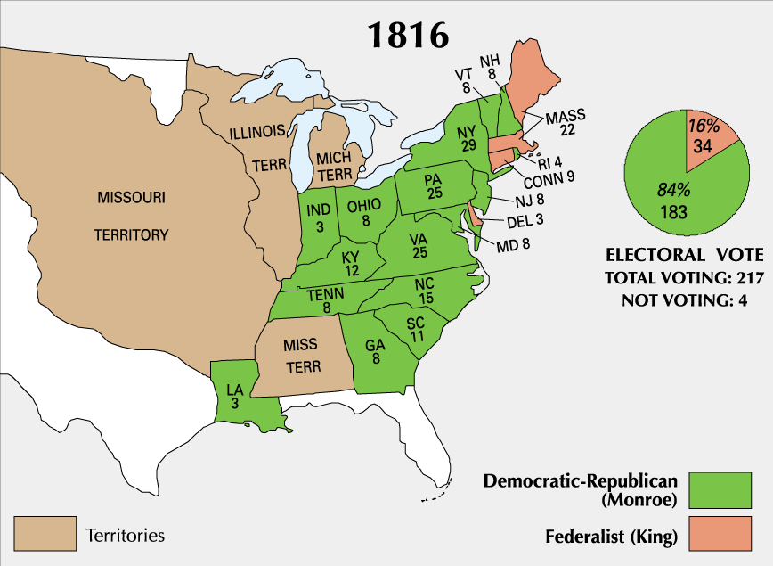
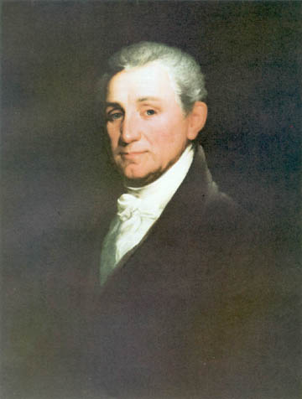
The Election of 1816 [The Demise of the Federalist Party!]
5th POTUS
James Monroe

Slide 19
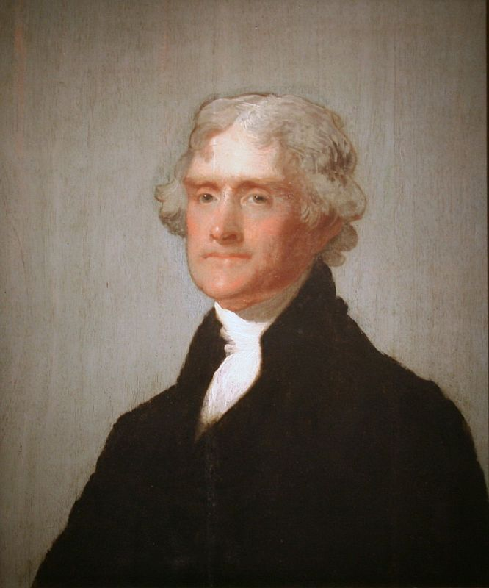
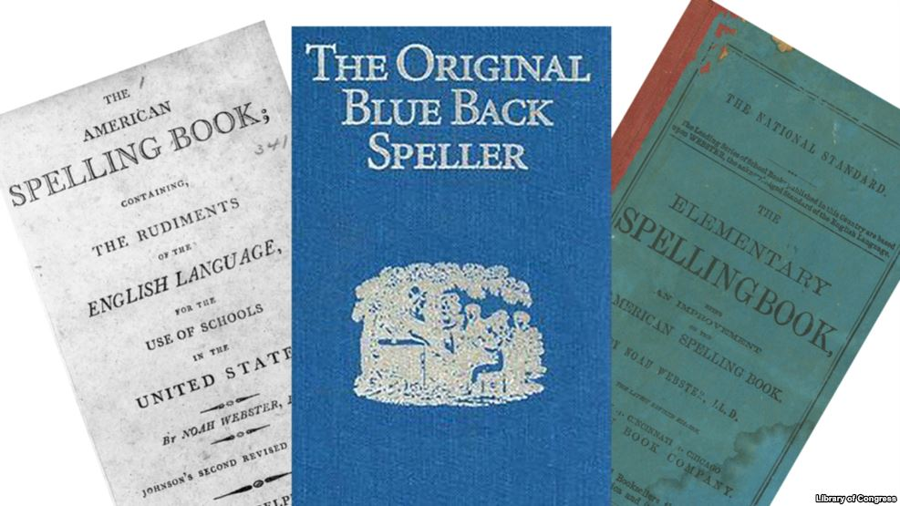
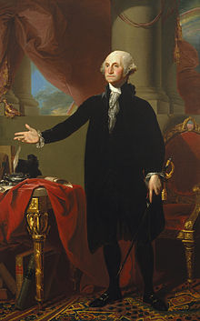
ERA OF GOOD FEELINGS
1. Cultural Nationalism
Books and paintings of Revolutionary heroes
Noah Webster’s blue-backed speller that promoted public education
taught five generations of American children how to spell and read!

Slide 20
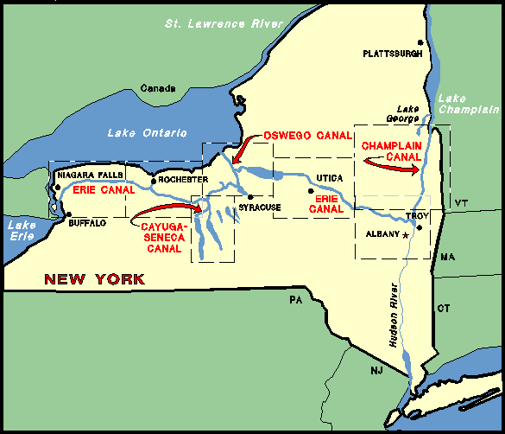
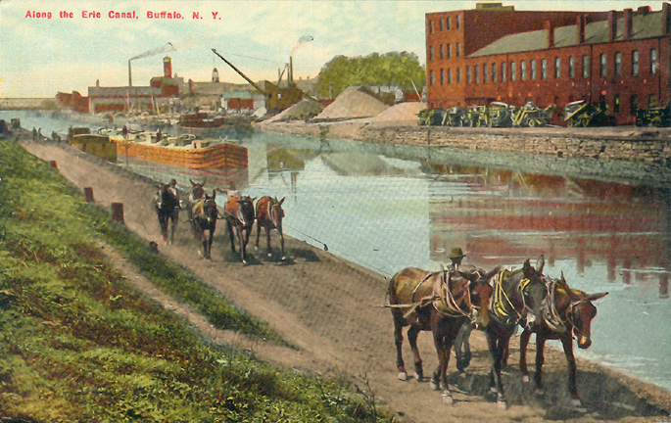
2. Economic Nationalism
ERIE CANAL (NY)
Connects the Great Lakes with the Atlantic Ocean
Cut transport costs by about 90%
Massive population surge in western New York

Slide 21
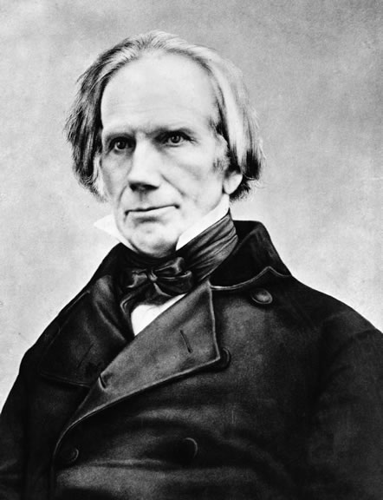
2. Economic Nationalism
b) TARIFF of 1816
Raised tariffs to protect US manufacturers
FIRST protective tariff in US history
NE opposed – little manufacturing
c) Henry Clay’s American System – UNITE the US and INDUSTRIALIZE!
Protective tariffs - $$ to build roads and canals
2nd National bank of the US (1816) = national currency
Internal improvements – build up the WEST and SOUTH
Madison and Monroe said its UNCONSTITUTIONAL
Monroe – VETO, VETO, VETO
States did it on their own…

Slide 22
ERA OF GOOD FEELINGS
1817 TO 1825
Spirit of Nationalism in US
patriotism or national oneness
Country is united, confident, and growing
1791-1819, 9 states joined the original 13.
One political party---Republican party
Respect from Europe
Monroe first president to visit all states.
Boston newspaper declared an “Era of Good Feelings” had began.
But, time period was not free of problems.

Slide 23
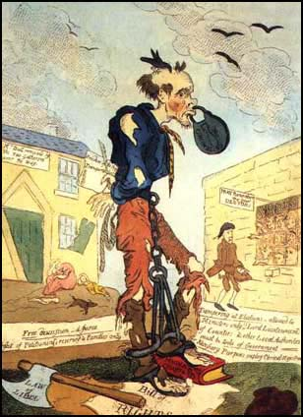
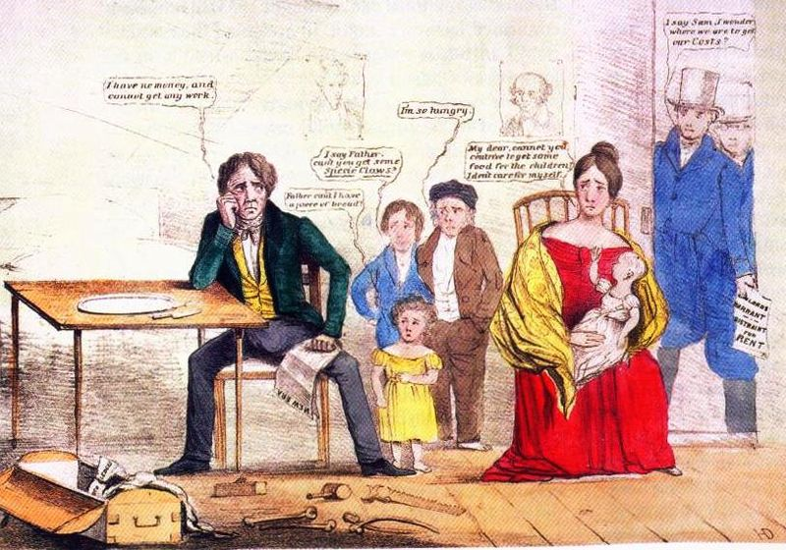
The Panic of 1819
Look at these pictures…
What do you think happened to the strength of nationalism as a result of the Panic of 1819?
Fault of the 2nd Bank
Why? Tightened credit while trying to control inflation.
State banks CLOSED
Value of money FELL
Unemployment, bankruptcies, and imprisonment for debt
Who suffered the most?
People in the WEST – land speculation (buying and reselling land)

Slide 24
EXIT assessment:
Using details from today’s lesson, assess the validity of the following quotation… “The Era of Good Feelings was not necessarily good.”

Slide 25
DO NOW

Slide 26
AIM
Western Settlement and the Missouri Compromise

Slide 27
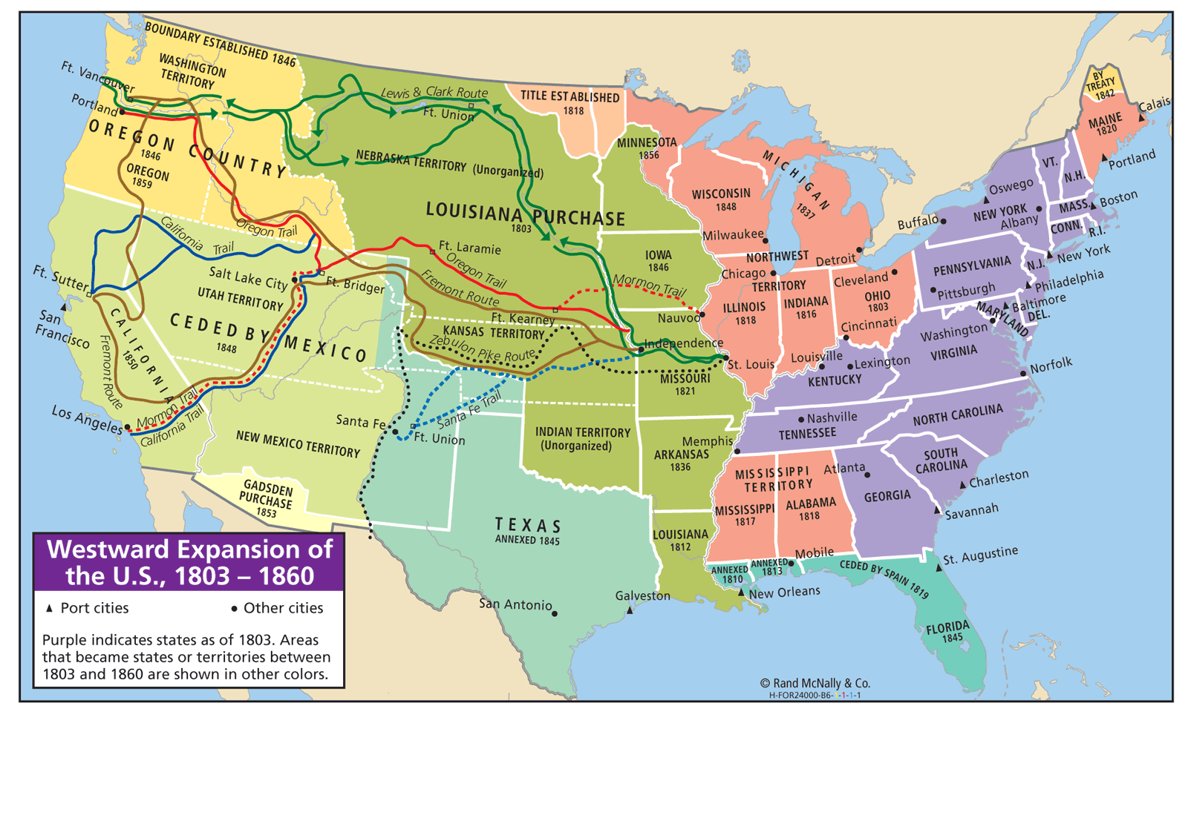
War of 1812 over…

Slide 28
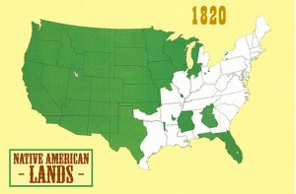
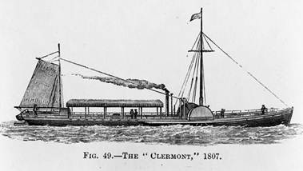
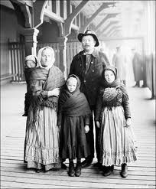
Why are people moving west?
Acquisition of Native Americans’ lands
Economic pressures
NE – embargo
South – new land to replace poorly farmed soil
3. Improved Transportation
Roads
Canals
Steamboats
Railroads
4. Immigrants
Speculators offering cheap land in the Great Lakes and Mississippi River valleys

Slide 29
Western state issues – how do they enhance their political influence in Congress?
What was most important to the westerners?
“Cheap money” — easy money from state banks vs. Bank of US
Cheap land from the government
Improved transportation
Slavery
Southern settlers wanted the spread of slavery…WHY?
Northern settlers had no use for slavery

Slide 30
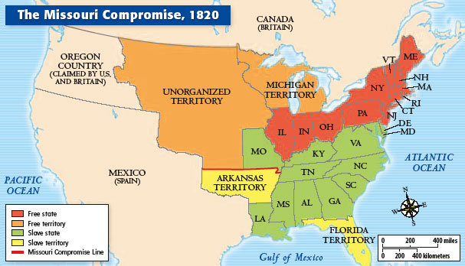
Sectional Crisis and Expansion: Missouri Compromise
1819 - Missouri wants to enter the Union as a slave state
ALARMED THE NORTH! WHY?
1819- 11 free and 11 slaves states…
North and South don’t want to lose power ie., votes in Congress (states had entered in pairs slave/free especially the Senate)

Slide 31
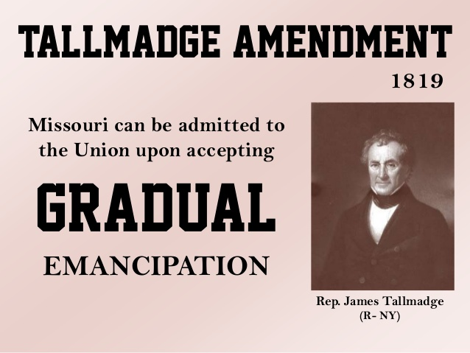
Tallmadge amendment tries to help the argument…
James Tallmadge – NY
Prohibit further introduction of slaves into Missouri
Children of Missouri slaves me emancipated at the age of 25
What would this have done in the US?
Gradual elimination of slavery in Missouri…
BUT it was defeated in the Senate
North trying to abolish slavery all together??

Slide 32
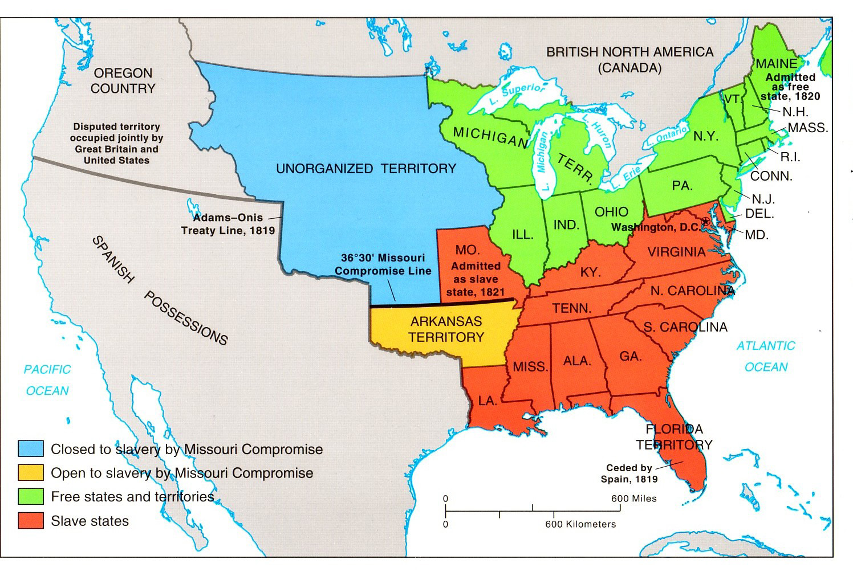
Missouri Compromise
Henry Clay creates a deal
Missouri enters = slave state
Maine enters = free state
Territory of the Louisiana purchase above 36°30’ could not have slavery

Slide 33
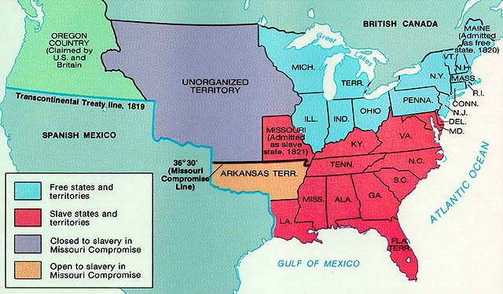

Slide 34
ABC BRAINSTORM REVIEW
PERIOD 4: 1800-1848
The Early Republic/New Presidencies

