Slide 1
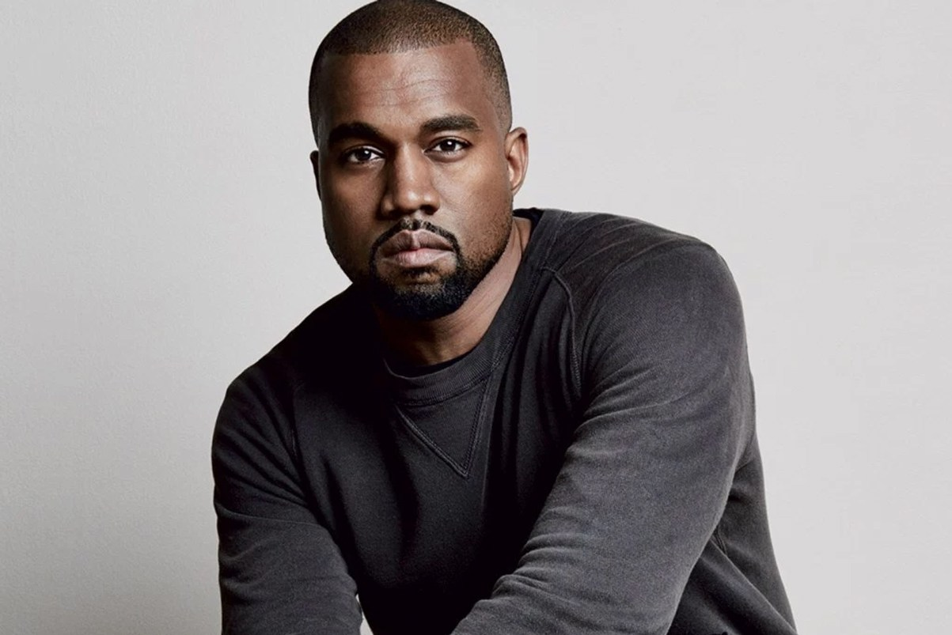
BEGINNING of PERIOD 4: 1800-1848
The Early Republic/New Presidencies
DO NOW:
TIME TO VOTE…
Out of this group, who is the BEST option to be PRESIDENT of the US? WHY?

Slide 2
BEGINNING of PERIOD 4: 1800-1848
The Early Republic/New Presidencies
AIM: Why was the election
of 1800 known as a “peaceful revolution”
in United States history?

Slide 3
KEY CONCEPT 4.1 (I)
A) In the early 1800s, national political parties continued to debate issues such as the tariff, powers of the federal government, and relations with European powers.
Essential Questions:
What factors made the presidential campaign of 1800 so contentious?
What major controversy resulted from the election results? How was this issue addressed?
How does this campaign compare with more recent presidential campaigns, such as those of 2000 and 2012?

Slide 4
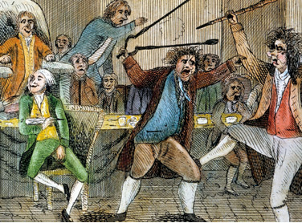
The Sedition Act
18 total people charged!
Representative Roger Griswold of Connecticut VS. Representative Matthew Lyon of Vermont…
Revealed political sectionalism in the House
Griswold supported John Adams’ diplomacy toward France and military preparations in the event of hostilities.
Lyon believed that preparations for war would eventually LEAD TO war.
THINGS GET HEATED! (1798)

Slide 5
Kentucky and Virginia Resolutions
REPUBLICANS = Alien & Sedition Acts VIOLATED the 1st Amendment and invaded states' rights!
Set a precedent for sectionalism and the states' rights debate later on regarding WHAT MAJOR ISSUE?...
Drafted by Jefferson (Kentucky) and Madison (Virginia).
Stated the following.
1. The Constitution was a “compact”
between sovereign states
2. IMPORTANT: IF COMPACT WAS BROKEN… states can NULLIFY the law!

Slide 6
Lesson Review Question
The Virginia and Kentucky Resolutions argued that the right to determine the constitutionality of a law passed by Congress rested in
A. Congress.
B. the states.
C. the President.
D. the Supreme Court.
E. the vote of the common people.

Slide 7
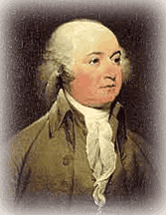
Adams’ mistake…
I’m in trouble…where’s all my peeps at?!
Adams remains coooool
Sends ministers to France and Spain to negotiate treaties
MANY FEDERALISTS WANT WAR NOT PEACE!
Infuriates these Federalists, who withdraw some support in the next election

Slide 8
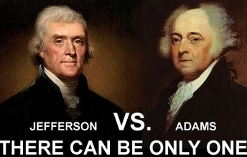
The Campaign (DON’T COPY)
In 1800, there were NO campaign speeches or statements from the candidates
Campaigns were conducted through newspapers, pamphlets, etc...
Jeffersonian newspapers called Adams a MONARCHIST
Jefferson appealed to the COMMON MAN and said Adams was an ENEMY of the people!
Federalists said that Jefferson was a “godless man” who would lead the nation into a state of CHAOS!
TPS: who would
YOU vote for?

Slide 9
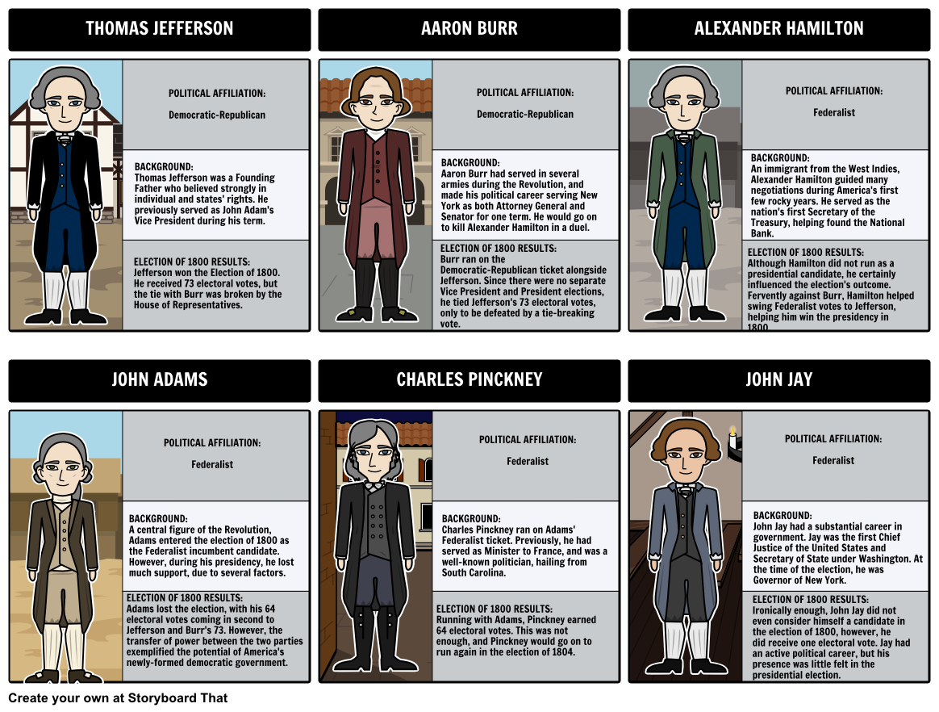
It’s time for another election…
Who is the public going to pick this time?
VIDEO

Slide 10
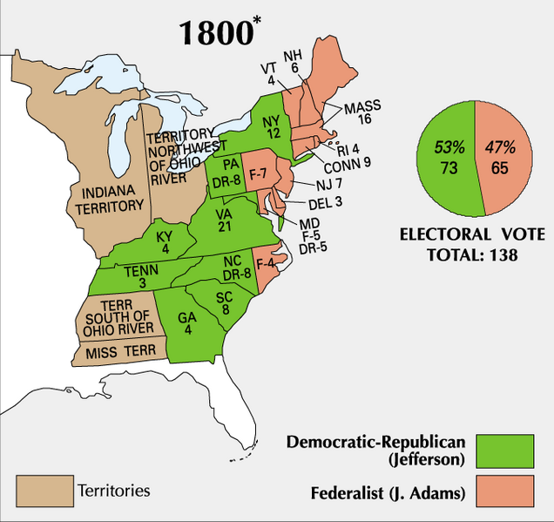
The Election of 1800
Jefferson and Burr TIE
On 36th ballot, Hamilton convinced other Federalists to change vote to Jefferson (Burr was personal enemy)
PEACEFUL passing of power from one political party to another
DEMOCRATIC-REPUBLICANS WIN!!!
Jefferson (D-R) 73
Burr (D-R) 73
J. Adams (F) 65
Pinckney (F) 64

Slide 11
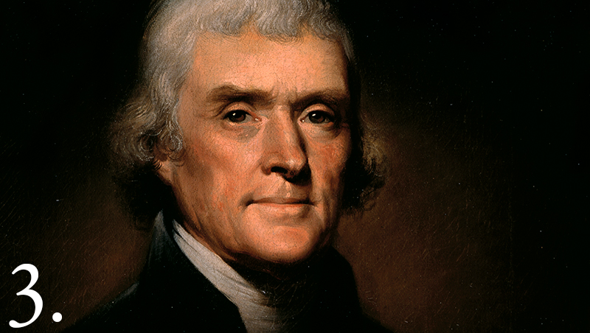
To what extent did the death of the Federalist Party teach a lesson to future political parties?

Slide 12
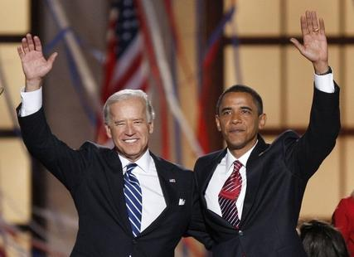
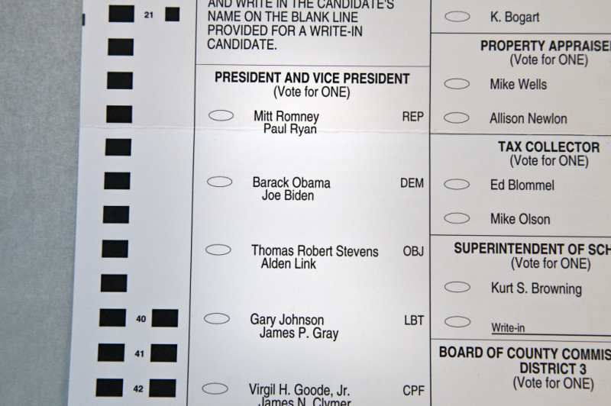
Election of 1800 RESULTS
12th Amendment (1804)
President, VP run as a ticket
Federalists lose control of legislature
How did the Election of 1800 show a problem with the electoral college and how did the 12th Amendment fix it?

Slide 13
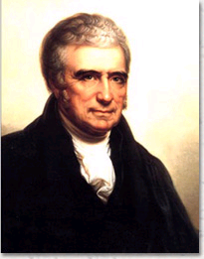
Election of 1800 RESULTS
Judiciary Act of 1801 = created new federal courts which Adams filled with loyal Federalists
“midnight appointments”
John Marshall = Chief Justice of Supreme Court
Notes:
12
Beware of the Baggett editorial: “John Marshall, the greatest Supreme Court chief justice ever!”

Slide 14
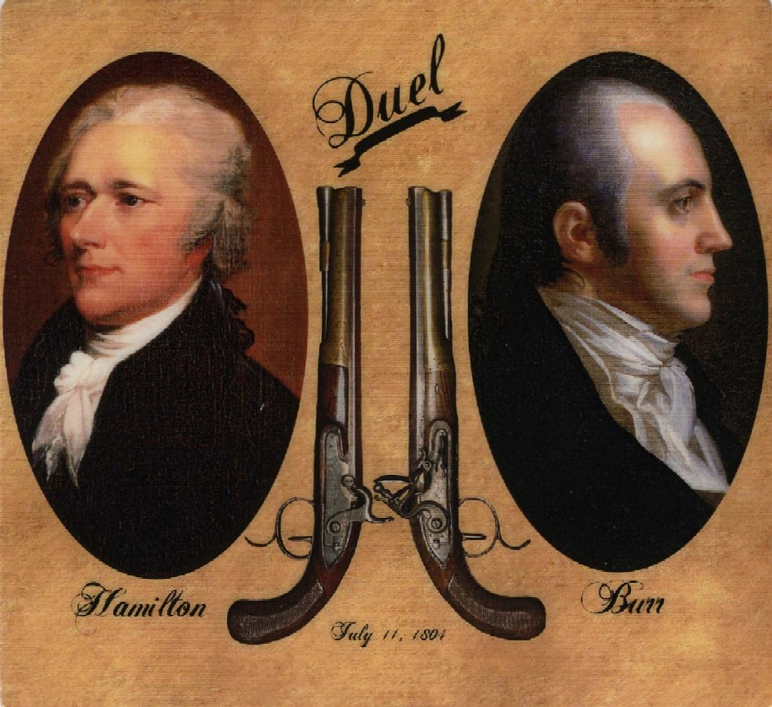
Another result…
VIDEO
“Mr. Jefferson, though too revolutionary in his notions, is yet a lover of liberty and will be desirous of something like orderly Government – Mr. Burr loves nothing but himself – thinks of nothing but his own aggrandizement – and will be content with nothing short of permanent power [struck: and] in his own hands…”

Slide 15
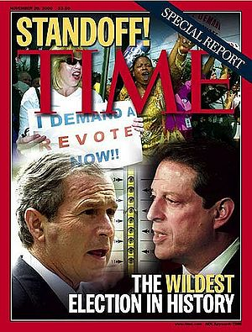
The Election of 1800
vs.
The Election of 2000
Both exposed flaws in the electoral college system.
In 1800, two candidates tied for president--Thomas Jefferson and Aaron Burr--so the election was decided by the House of Representatives.
In 2000, the election was won by Al Gore, but the Electoral College votes favored George W. Bush. The Supreme Court refused a recount of the Florida vote in a clearly partisan move, so Bush became president.

Slide 16
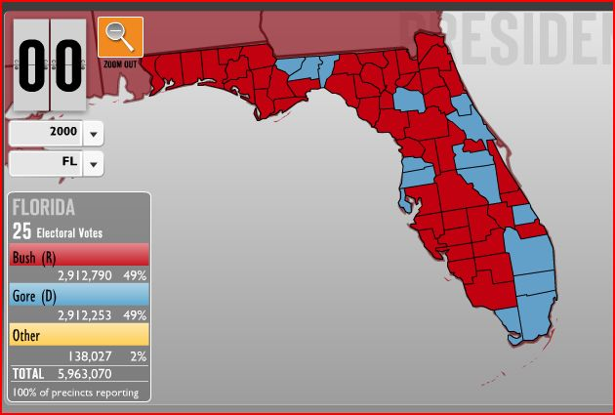
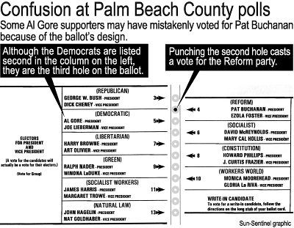
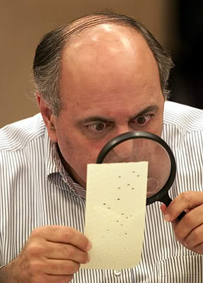

Slide 17
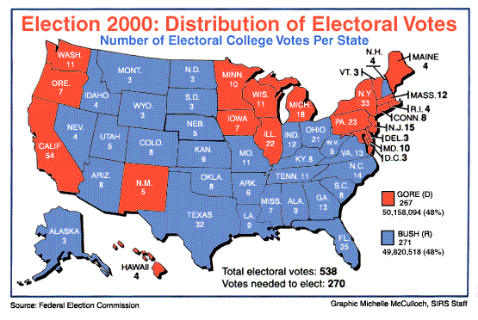

Slide 18
Using evidence from today’s lesson, develop a short paragraph…
Answering the AIM:
Why was the election of 1800 known as
a “peaceful revolution”
in United States history?

Slide 19
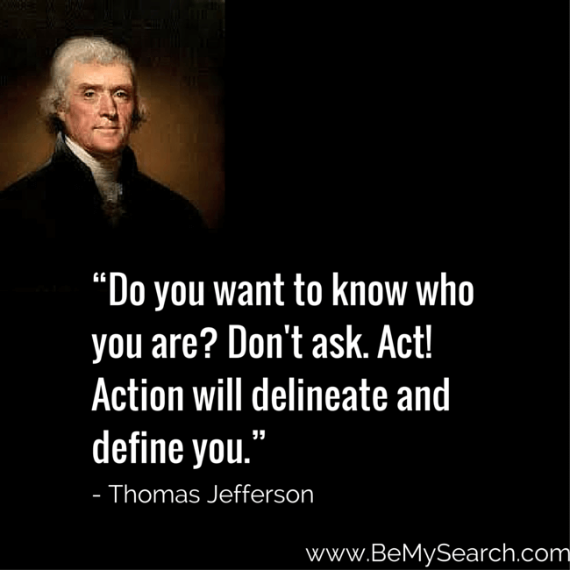
DO NOW: Quote Analysis
Copy the quote
2. What does the quote mean to you?
3. Does it relate to your life in any way?

Slide 20
PERIOD 4: 1800-1848
The Early Republic/New Presidencies
AIM: How did President Jefferson’s purchase of Louisiana transform the development of America?
Essential Questions:
Why was New Orleans so important to settlers in the western regions of the United States?
Why did Jefferson insist on purchasing the Louisiana Territory from the French?
How did the Louisiana Purchase affect Native Americans living in the new territory?
What are some possible results (both positive and negative) of expansion into the Louisiana Purchase?

Slide 21
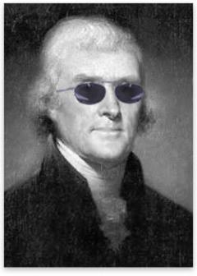
President Thomas Jefferson 1801-1809 Democratic-Republican

Slide 22
Thomas Jefferson…good man for the job?
Plantation and slave owner from Virginia
Statesman
Assemblyman
Declaration of Independence
Governor
Minister to France
Secretary of State
Vice-President
President
Democratic-Republican
Founded the party in opposition to Alexander Hamilton’s Federalists
Kentucky Resolution
Inaugural Address
“Every difference of opinion is not a difference of principle... We are all Republicans, we are all Federalists.”
“Renaissance Man”
Inventor, philosopher, architect, scientist

Slide 23
What’s the plan, Thomas?
All federal revenue was generated exclusively by shipping taxes…
Jefferson’s priority was to reduce the role of the national gov’t & return key decisions to the states
Jefferson worked with Congress to
Repeal excise taxes
Reduce the army by 50% & retire most naval ships
Eliminate all national debt
Did not renew the charter of the Bank (The bank will die in 1811)
EXPAND WEST!
But…Jefferson approved of the creation of the Army Corps of Engineers & the U.S. Military Academy at West Point
Notes:
6

Slide 24
North America in 1800
Spain controlled the most territory in North America with valuable cities like Mexico City, New Orleans, St Louis, & Los Angeles
In 1800, the USA was a new & weak nation sharing North America with other European powers
But, Spain’s hold on these territories was slipping
British Canada was sparsely populated, but its control over the fur trade & Great Lakes frustrated westward-bound Americans
Russia dominated the fur trade in Alaska
France ruled Haiti & gained Louisiana from Spain in 1801 during the Napoleonic Wars

Slide 25
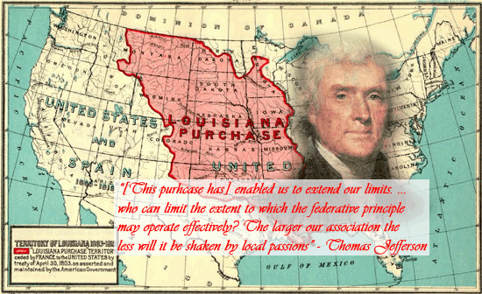
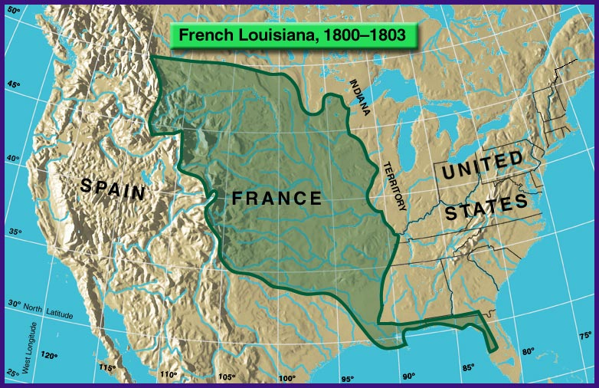
Jefferson needs to make a BIG choice…
VIDEO
France looking to create an EMPIRE!
Haitian Revolution & cost of European wars = Napoleon lost interest in America
1803 - Jefferson negotiated with France = $15 million for French Louisiana ($200 million TODAY)

Slide 26
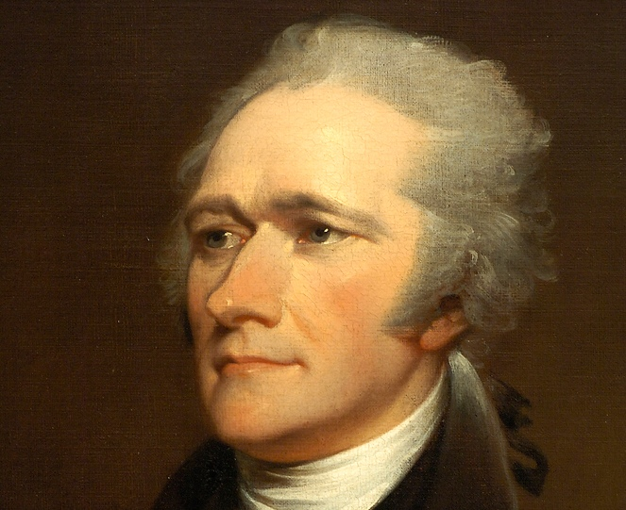
Hamilton and Jefferson were buddies now, right?
How do you think Federalists feel about the Louisiana Purchase?
“This purchase will probably make it seem like Mr. Jefferson is brilliant. Any man, however, who possesses any amount of intelligence, will easily see that the purchase is the result of lucky coincidences and unexpected circumstances and not the result of any wise or thoughtful actions on the part of Jefferson’s administration.
…the possibility that this new purchase will be a place of actual settlement seems unlikely. If our own citizens do eventually settle this new land, it would weaken our country and central government. On the whole, we can honestly say that this purchase is at best extremely problematic.”
“Purchase of Louisiana” for the
New York Evening Post, July 1803.

Slide 27
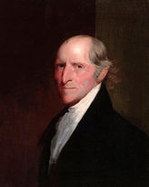
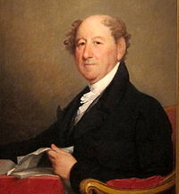
“I am disgusted with the men who now rule us. The coward at the head [Jefferson] is like a French revolutionary. While he talks about humanity, he enjoys the utter destruction of his opponents.”
“…the territory must be formed into states and admitted into the Union. Will Congress be allowed to set any rules for their admission? Since slavery is legal and exists in Louisiana, and the treaty states that we must protect the property of the inhabitants, won’t we be forced to admit the new states as slave states? Doing so will worsen the problem of unequal representation from slave and free states.”
More Federalists
RESPOND
Timothy Pickering, Federalist
Rufus King, Federalist

Slide 28
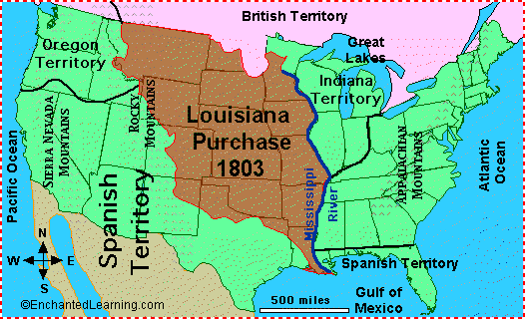
Was the Louisiana Purchase a GOOD DEAL?
Doubled the size of the USA
USA gained control of the port of New Orleans.
USA became one of the largest countries in the world.

Slide 29
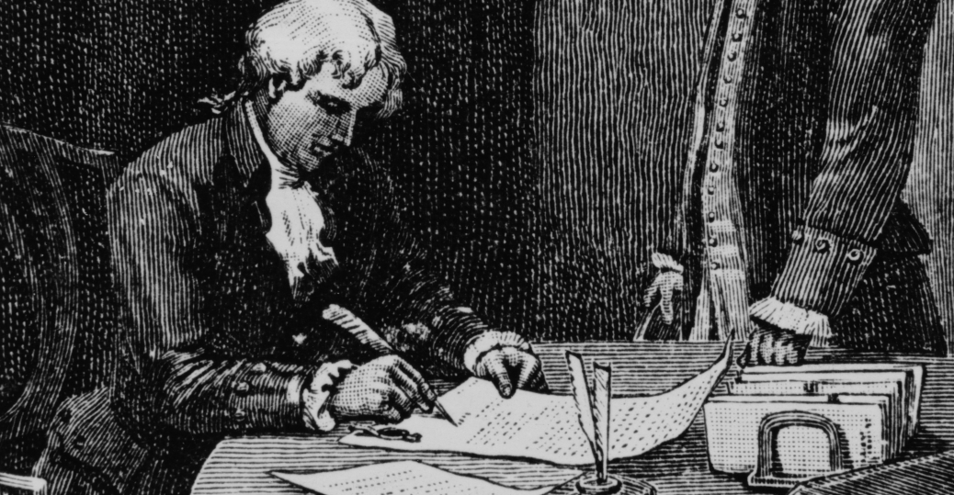
Document Analysis
With a partner, you will examine BOTH Thomas Jefferson’s “Letter to John Breckinridge” and “Message of the President of the United States, Transmitting a Treaty Lately Concluded Between the United States and the Kaskaskia Tribe of Indians”…
There are 3 questions for each document
Choose if you’d like to split them up or work on them separately, then share out
We will discuss both documents in 10 minutes, so get to work! ☺

Slide 30
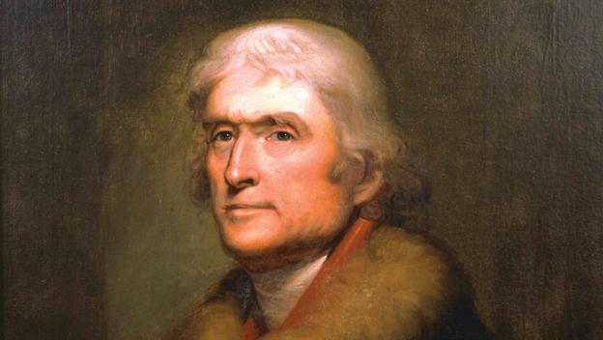
What is Jefferson saying?
Agree/Disagree with his rationalization?
"It is the case of a guardian, investing the money of his ward in purchasing an important adjacent territory; and saying to him when of age, I did this for your own good."

Slide 31
Was it CONSTITUTIONAL?
Jeffersonian contradictions:
The Constitution was vague on which branch had the authority to purchase new lands
Jefferson abandoned “strict construction” to buy Louisiana
Louisiana Gov’t Act = denied self-rule to Louisiana residents
Republicans feared giving the mostly French & Spanish residents of New Orleans authority in a territorial assembly
Notes:
7
James Monroe & Robert Livingstone were US diplomats to buy New Orleans

Slide 32
Take notes as you watch…
VIDEO

Slide 33
BENEFITS:
Increase geographical and scientific knowledge of unexplored country
Strengthened US claims in Oregon Territory
Improved relations with Natives

Slide 34
EXIT Assessment
Answering the AIM: How did President Jefferson’s purchase of Louisiana transform the development of America?

