Slide 1
The Growth of Cities and American Culture, 1865-1900
AIM: Why did immigration to America increase during the late 1800s, and how did immigration policies and nativist attitudes demonstrate discrimination against them?

Slide 2
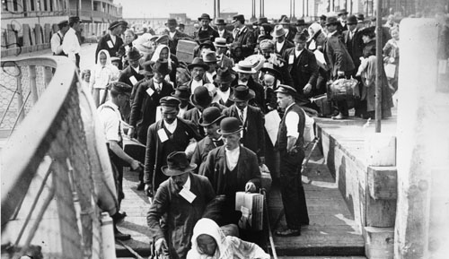
From 1880 to 1921, a record 23 million immigrants arrived in the U.S. looking for jobs and opportunities
The USA did not have quotas (limits) on how many immigrants from a particular country could enter the country
Notes:
From 1880 to 1921, a record setting 23 million immigrants arrived in the USA. At the time,.
From the colonial era to 1880, most immigrants to America came from England, Ireland, or Germany in Northern Europe. Between 1880 and 1921, approximately 70% of all immigrants entering the USA came from southern and eastern Europe (Italy, Austria-Hungary, Russia, Poland).
These “new immigrants” were typically young, male, and either Catholic or Jewish. Most spoke little or no English. The majority were unskilled agricultural laborers with little money or education.

Slide 3
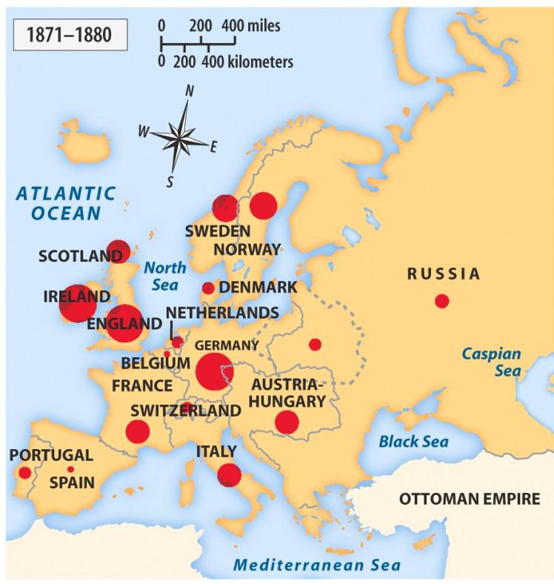
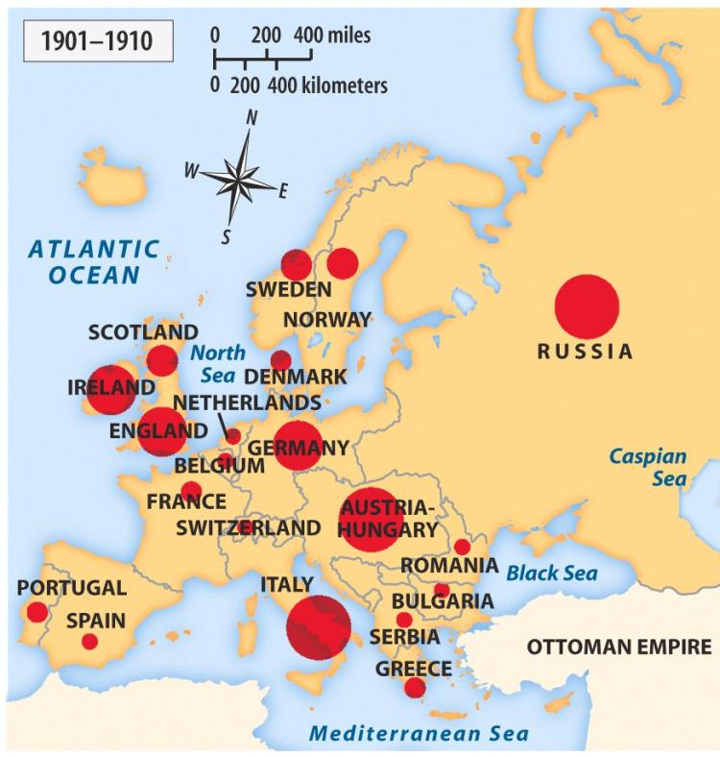
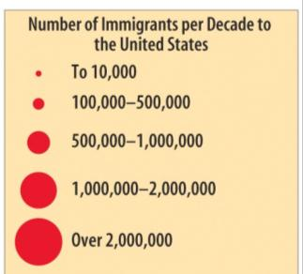
While you watch: 1) In the early 1800’s, from what countries did most immigrants to America come from? 2) How did that change as we got closer to 1900?
VIDEO

Slide 4
Between 1880 and 1921, 70% of all immigrants to the USA came from southern and eastern Europe (Italy, Poland, Austria-Hungary, Russia)
From the colonial era to 1880, most immigrants came from England, Ireland, or Germany in Northern Europe
The “new immigrants” were typically young, male, either Catholic or Jewish, and spoke little or no English
The majority were unskilled agricultural laborers with little money or education

Slide 5
TAKE A PIC!
Old Immigrants vs. New Immigrants
 | OLD Immigrants | NEW Immigrants
RELIGION | Protestant | Catholic and Jewish
BIRTHPLACE | Northern/Western Europe (Germany, France, Britain) | Southern/Eastern Europe (Italy, Poland, Russia)
REASONS for immigrating | Escaping poverty, religious and political persecution | Escaping poverty, religious and political persecution
DESTINATION (Where were they immigrating to?) | Moved to farms in the Midwestern U.S. | Moved to cities in the Northeastern U.S.
OCCUPATION (Jobs) | Farmers | Unskilled workers in factories
OLD Immigrants | NEW Immigrants

Slide 6
Push Factors = Factors that force/“push” people out of a place or land
For example…
Drought or famine
Political revolutions or wars
Religious persecution
Economic struggles
1880s - Farmers suffered in Poland and China.
1840s - Wars and political revolutions in China and Eastern Europe which caused economic troubles.
Russian and Eastern European Jews faced religious persecution.
TAKE A PIC!

Slide 7
Pull Factors = Factors that attract people to a place or land.
For example…
Plentiful land
Employment
Religious freedom
Political freedom
New life
1862 - Homestead Act and aid from railroad companies made western farmland inexpensive.
Workers were recruited from homelands to build railroads, dig mines, or work in factories.
Many wanted to find gold.
TAKE A PIC!

Slide 8
Before Ellis Island opened, immigrants were required to be processed by the State, not the federal government. Castle Garden was a fort built for the War of 1812, located in Battery Park, NY.
It served as the New York immigration processing station between 1855 and 1890.
DON’T COPY

Slide 9
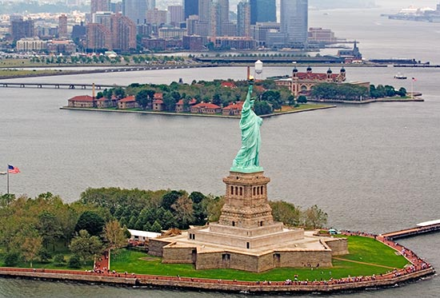
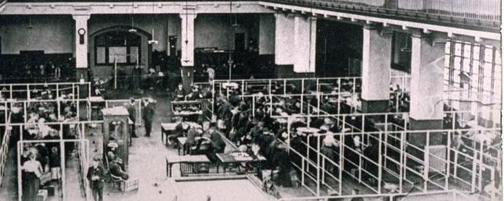
Beginning in 1892, 75% of all immigrants entered the USA through the immigration center at Ellis Island, in New York
Immigrants had to pass a health examination and anyone with a serious health problem or disease was not let in
Inspectors questioned immigrants to make sure that they were not criminals, could work, and had some money ($25)
There, they saw the Statue of Liberty in the harbor.
The Statue of Liberty was a gift from France to the United States.
The Statue of Liberty became a symbol of HOPE and FREEDOM.
Notes:
The processing of immigrants on Ellis Island was an ordeal that might take five hours or more. First, they.
Those who passed the medical exam then reported to a government inspector. The

Slide 10
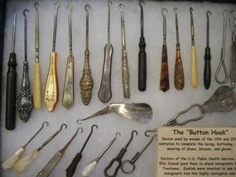
DON’T COPY
Buttonhook collection. U.S. Public Health Service used items like these to conduct immigrant eye exam at Ellis Island.
Doctors of the U.S. Public Health Service at Ellis Island often used these devices to check immigrants for trachoma, a highly contagious and difficult to cure eye disease. Eyelids were inverted or pulled outward to see if immigrants displayed symptoms of this dreaded disease.

Slide 11
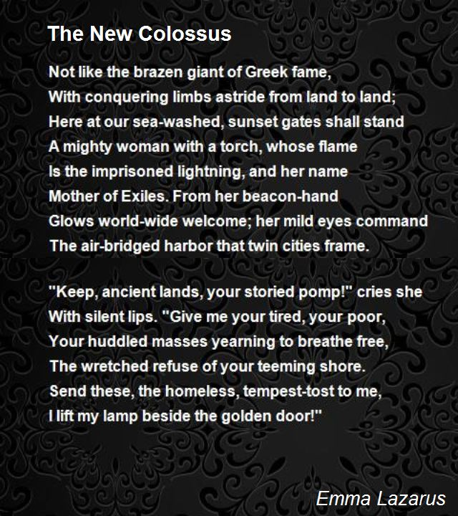
According to this poem,
how will immigrants be treated upon arriving in America?

Slide 12
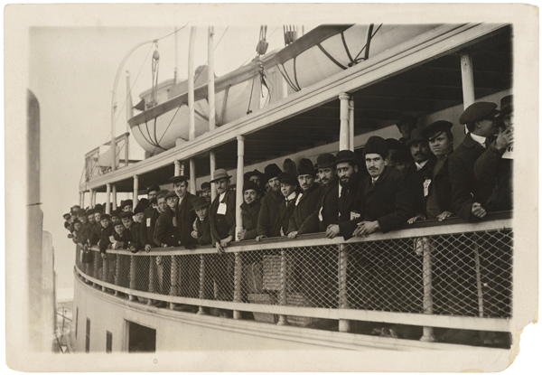
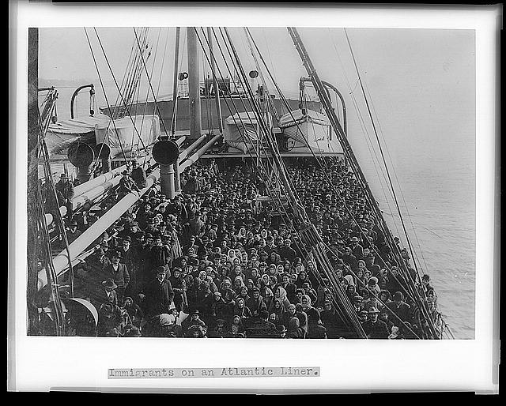
Ocean Liners
Traveling in Steerage
Into the Unknown

Slide 13
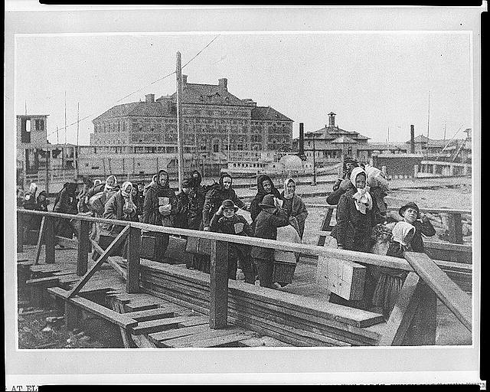
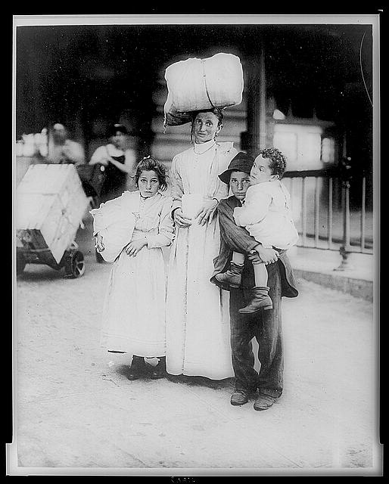

Slide 14
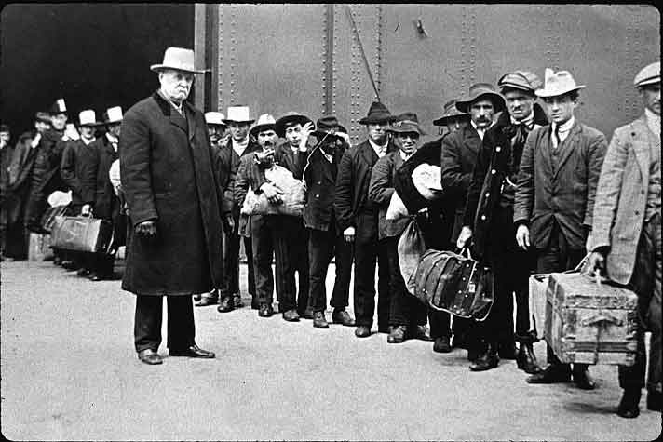

Slide 15
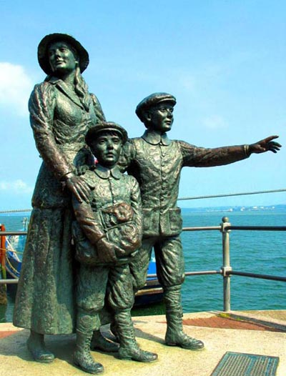
When Ellis Island officially opened on January 1, 1892, the first passenger processed through the now world-famous immigration station was an Irish girl named Annie Moore.
17-year-old girl was traveling with her two younger brothers.
from Queenstown (County Cork, Ireland)
spent 12 days at sea, including Christmas Day, arriving in New York on Thursday evening, December 31
reunited with their parents who were already living in New York City
DON’T COPY

Slide 16
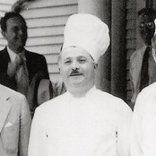
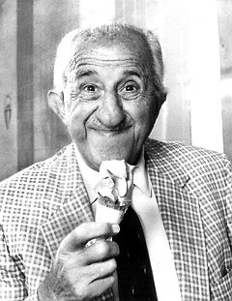
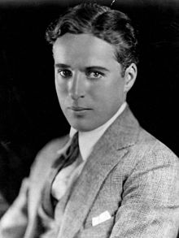
Other famous figures to pass through the port of New York and Ellis Island
Ettore Boiardi
Athanasios Karvella
Charles Chaplin
AKA
Chef Boyardee
AKA
Tom Carvel
AKA Charlie Chaplin

Slide 17
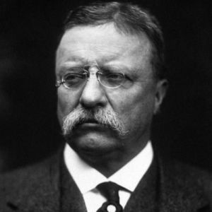
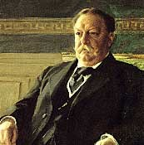
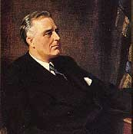
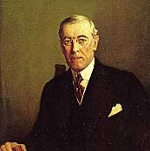
US Presidents too…

Slide 18
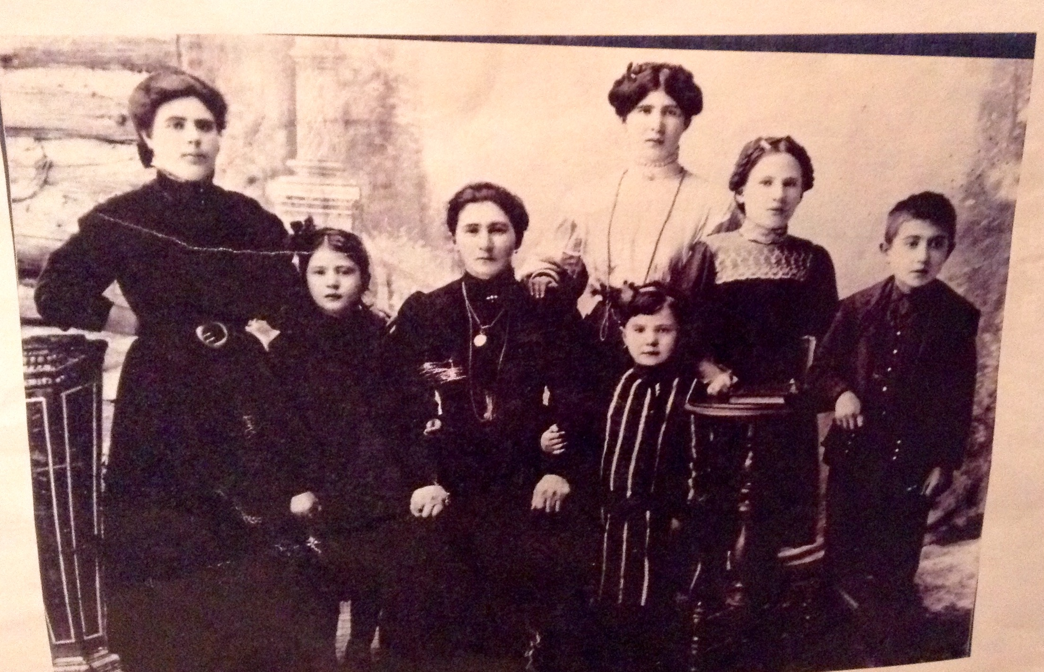
My family

Slide 19
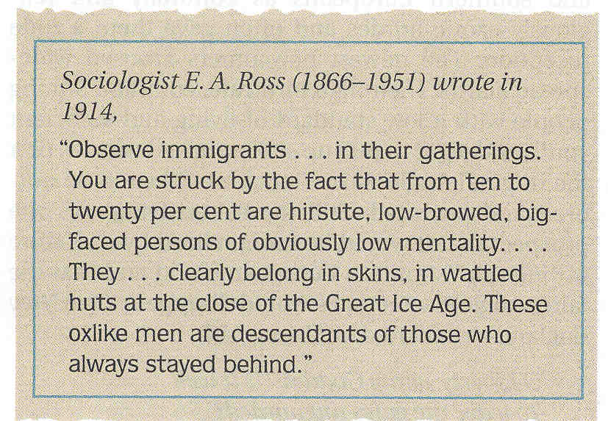

Slide 20
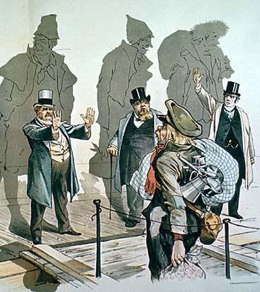
HOWEVER, many Americans expressed NATIVISM and viewed immigrants with a sense of fear, suspicion, and hostility
Nativists had intense prejudices about immigrants
Ethnicity
Religion
Political & social beliefs
Many Americans accused immigrants of taking jobs away from “real” Americans and called for QUOTASnthat would limit the number of immigrants

Slide 21
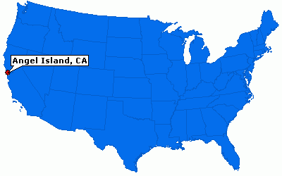
Where is ELLIS Island compared to
Angel Island?

Slide 22
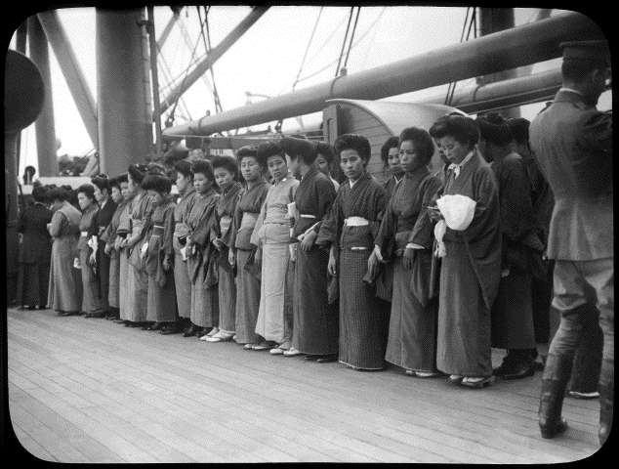
Japanese “picture brides”

Slide 23
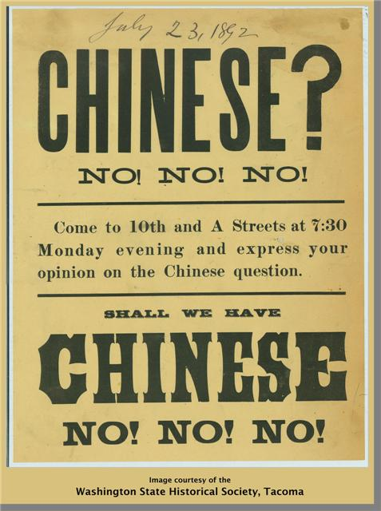
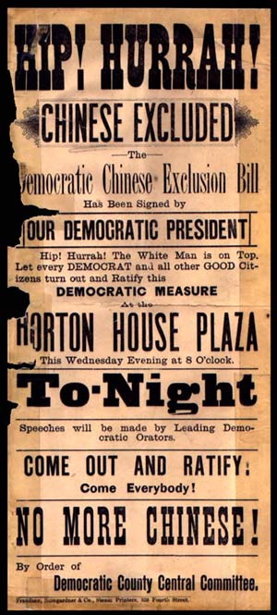
Audience and point of view of these ads?
Chinese Exclusion Act (1882)
Banned Chinese laborers from immigrating to America for 10 years
Prevented Chinese-Americans from becoming citizens
Fined Americans for bringing in or aiding Chinese-Americans

Slide 24
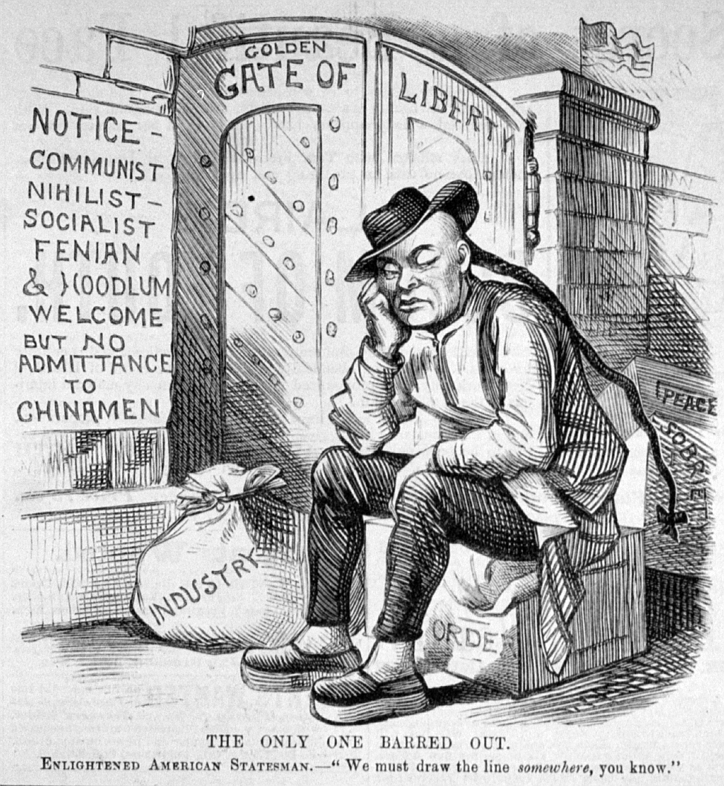

Slide 25
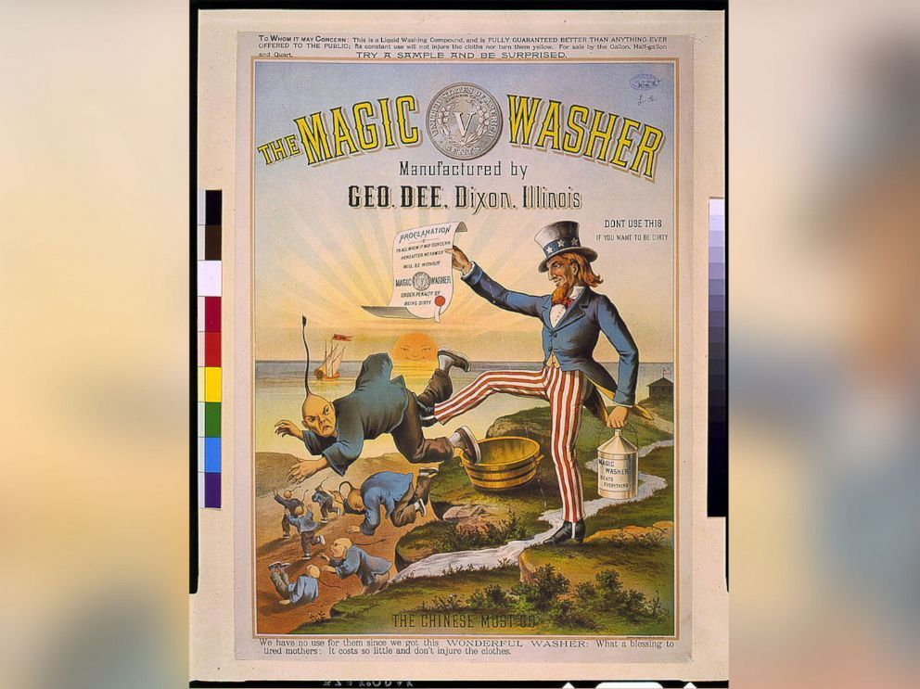
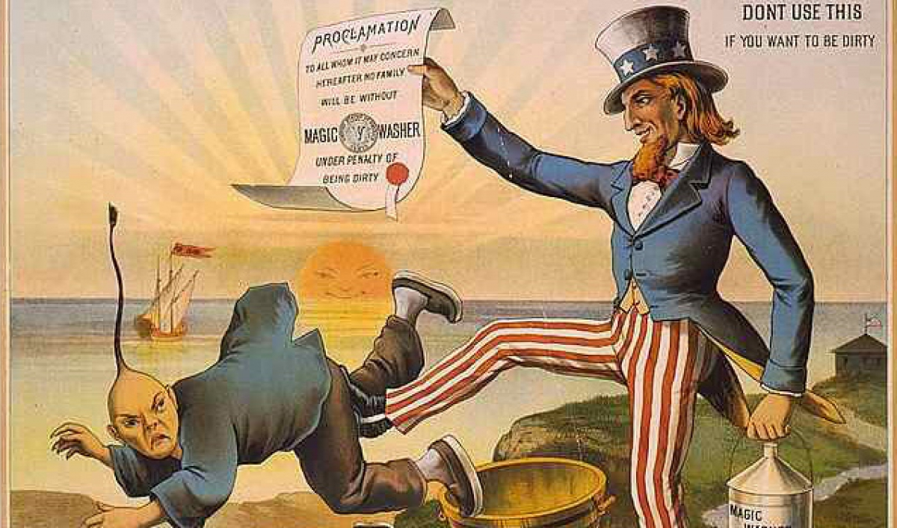

Slide 26
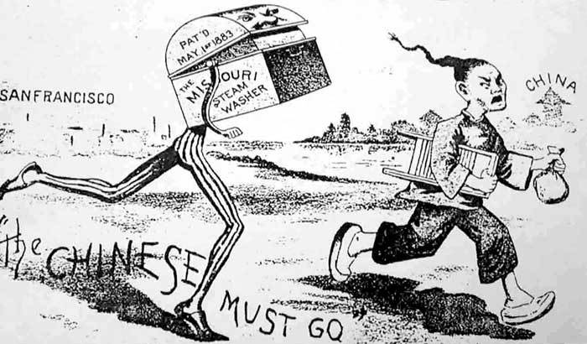

Slide 27
Federal Immigration Law (1882)
Forbade criminals and the insane
Required an immigrant to prove to officials that he/she would not become a 'public charge’
Immigrants who could not support themselves (children/the elderly) had to produce a statement by a friend or relative promising support
Contract Labor Law (1885)
Forbade American individuals or organizations from engaging in labor contracts with individuals prior to their immigration to the United States
TAKE A PIC!

Slide 28
Which groups would support laws to restrict immigration?
Labor Unions (feared employers would use immigrants to break up strikes and lower wages)
Social Darwinists (new immigrants were biologically inferior)

Slide 29
What types of CHALLENGES do immigrant still face
in America TODAY?

Slide 30
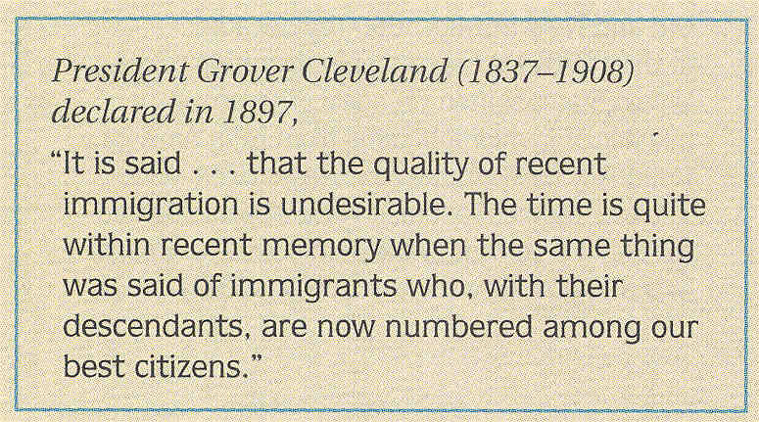
The Great American MELTING POT
TAKE A PIC!
Immigrants changed America in many ways.
Fueled industrial growth
Acquired citizenship
Elected politicians
Made their traditions a part of American culture
Mexican Americans developed ranching techniques.
Chinese, Irish, and Mexican workers built railroads.
Immigrants worked in coal mines, steel and textile mills, and factories.
Women immigrants worked in factories, seamstresses, laundresses, made piecework, and worked as servants.
Immigrants helped the U.S. become a world power.

