Slide 1
Today’s AIM: What did FDR hope to accomplish with his New Deals?
Essential Questions:
How effective were Roosevelt’s programs of relief, reform and recovery?
How do the programs of the New Deal continue to affect our society today?

Slide 2
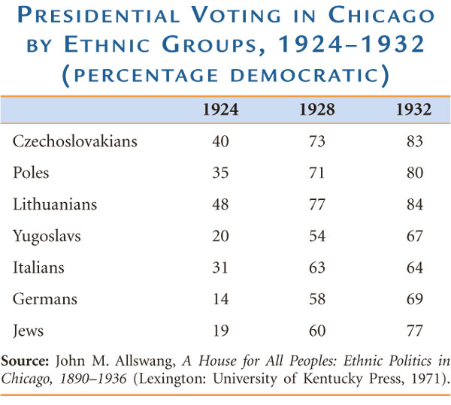
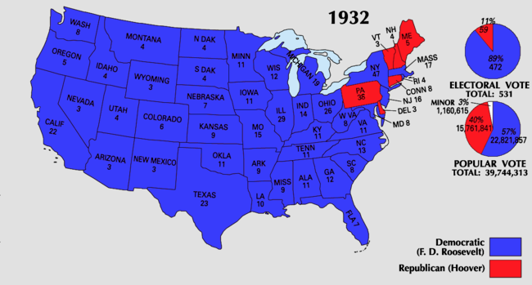
Where do we go next?
Great Depression made Hoover a “VICTIM” and made FDR a “SAVIOR”
FDR unites the rural and urban factions of the Democratic party
Appealed to Protestants & Catholics, farmers & workers, native-born Americans & immigrants
“I voted for Herbert Hoover in 1928,” she wrote. “God forgive me and keep me alive at least until the polls open!”
46 of 48 states!

Slide 3
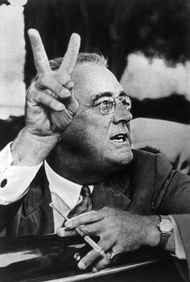
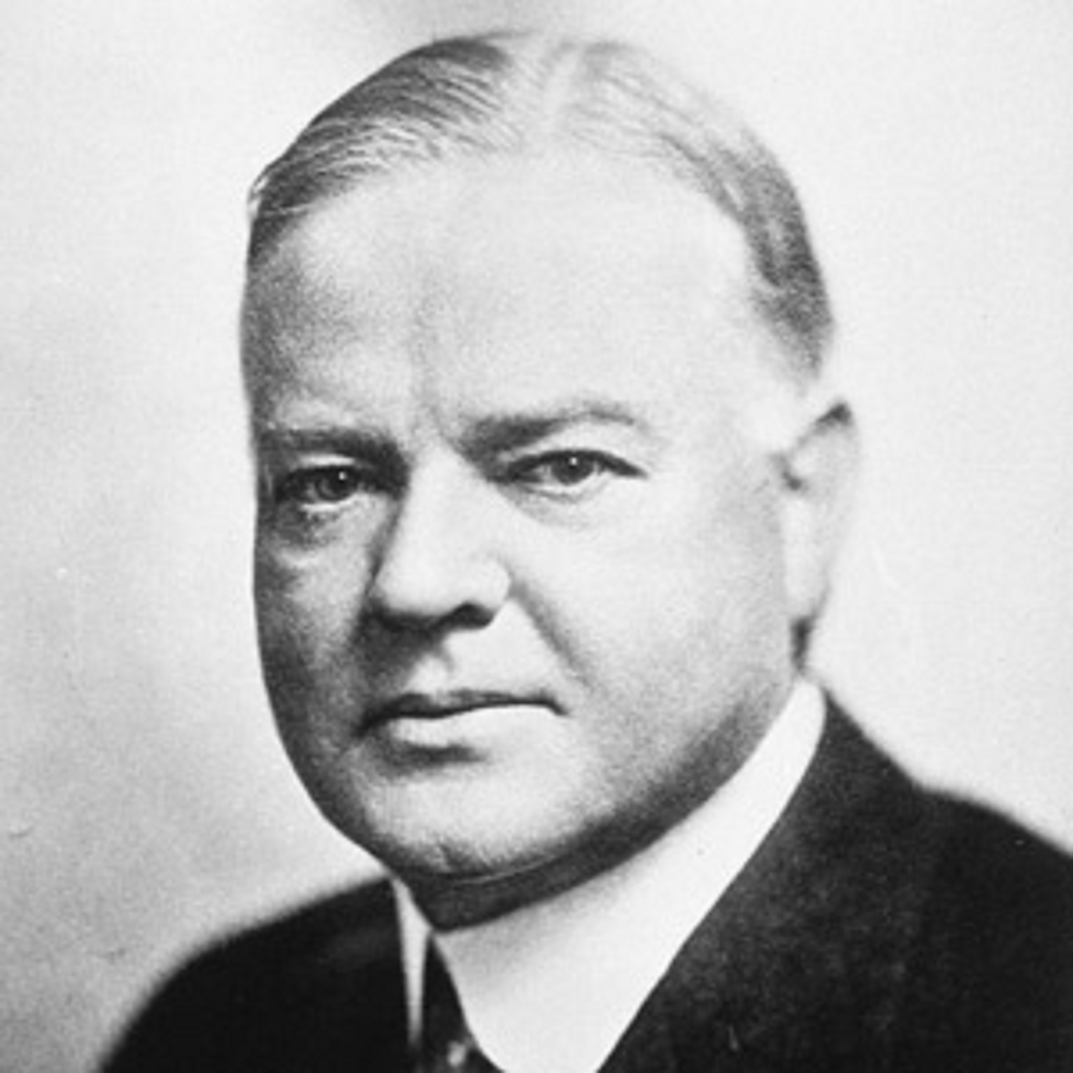
For the four months between FDR’s election and inauguration in March 1933, Hoover was still president (“lame-duck”)
He offered to help FDR with the depression, but FDR said NO.

Slide 4
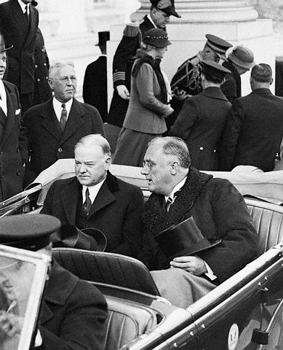
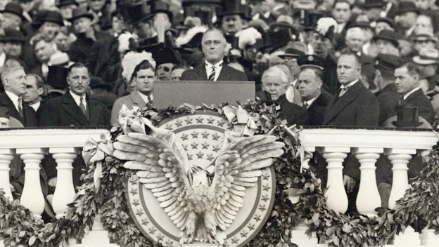
FDR’s 1st inaugural address
Washington, D.C.
March 4, 1933
“I’m the guy your girlfriend warned you about.”
“The only thing we have to fear is fear itself.”

Slide 5
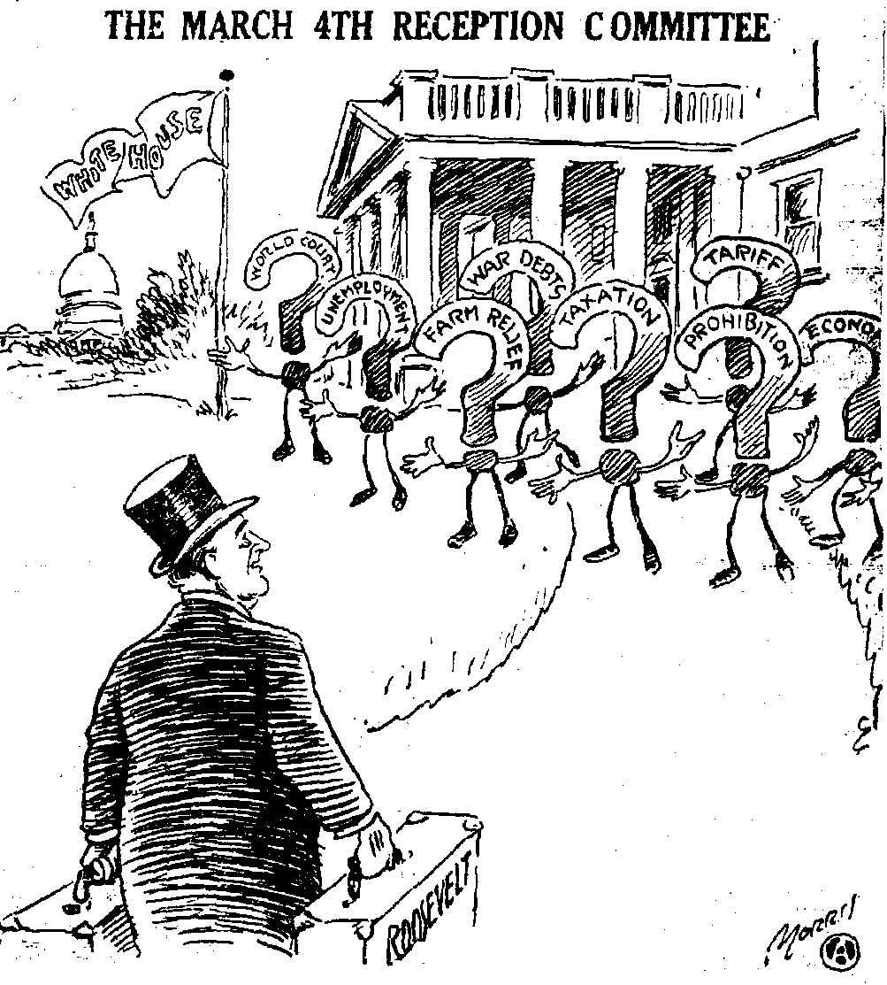
What is the message of the cartoon? How do you know?
What is important about the DATE?
What are some of the problems FDR will face upon becoming president?
1933: 20th amendment – lame duck amendment
(March 4th moved to January 20th)

Slide 6
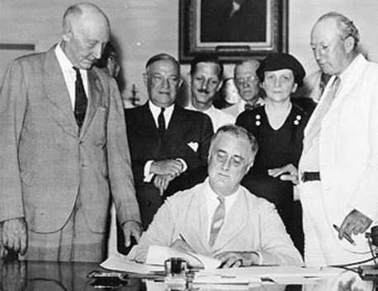
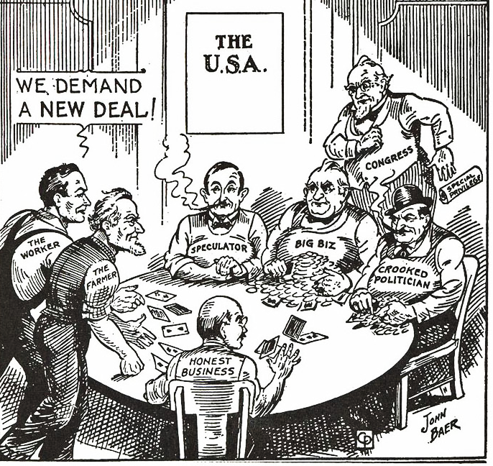
First “Hundred Days” begins… (March 9, 1933)
FDR and Congress passed a broad platform of legislation to attack the depression called the “New Deal”
“broad executive power that would be given to me if we were in fact invaded by a foreign foe.”
FDR requested from Congress broad executive power to begin his “New Deal”

Slide 7
The New Deal focused on the three “Rs”
New Deal Programs
Relief Relief checks and job programs to lower unemployment
Recovery Programs to stimulate agriculture, industry, and the economy to end the depression
Reform Programs to correct problems in the economy and prevent future depressions

Slide 8
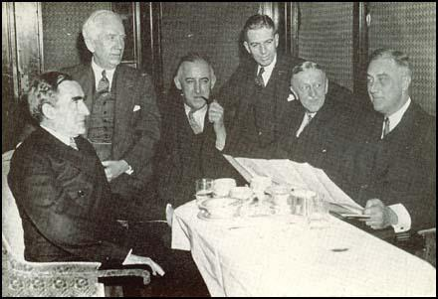
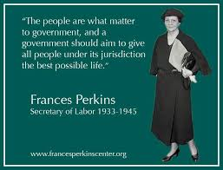
FDR’s “Brain Trust”
Group of closest advisers (helped him in NY before presidency)
Frances Perkins = secretary of labor (first woman to ever serve in a president’s cabinet)
THINK: Why is Congress going to support every idea FDR had in the First Hundred Days despite them being radical changes?

Slide 9
FDR’s SUCCESSES
Virtually all of the important bills he proposed were enacted by Congress.
FDR gets more laws passed than any other president during this time period.
FDR works with Congress to create many alphabet agencies
AAA
CCC
FDIC
SSA
SEC
TVA

Slide 10
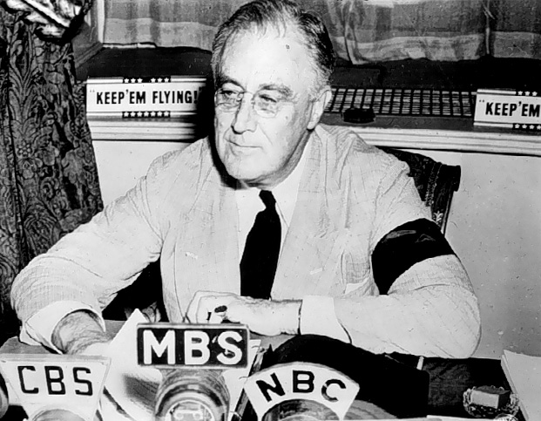
Public Relations Efforts: FDR’s Fireside Chats
FDR gave the nation regular updates on the status and health of the nation by giving these “fireside chats”
Notes:
Roosevelt’s Fireside Chats

Slide 11
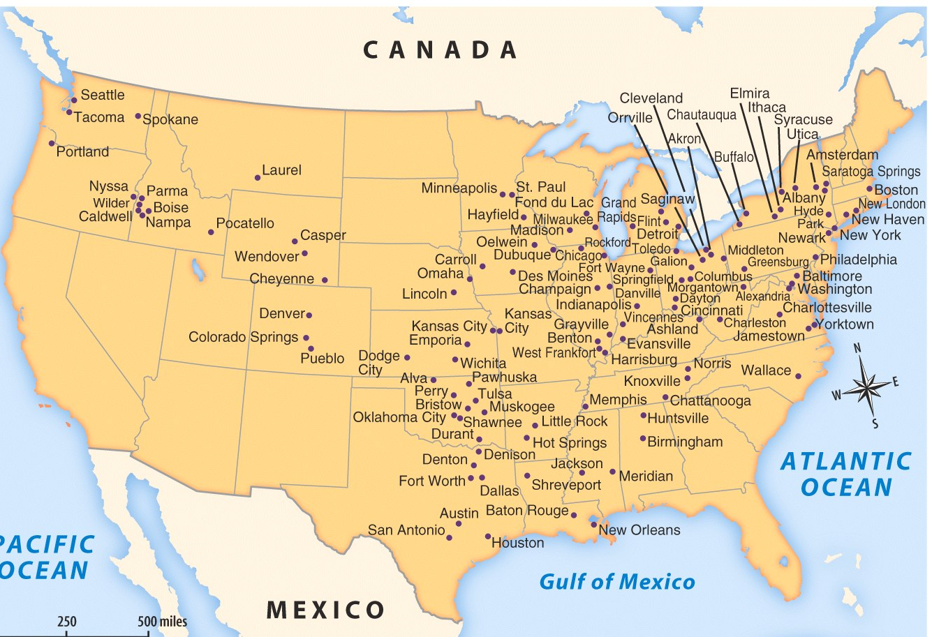
Public Relations: Eleanor Roosevelt’s travels
Notes:
Roosevelt’s Fireside Chats

Slide 12
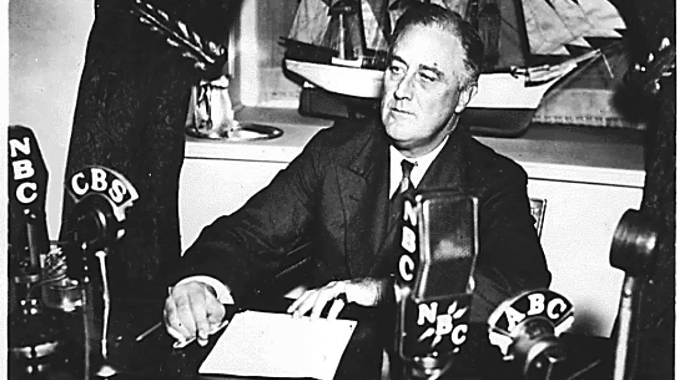
The Impact of Fireside Chats
Listen to the excerpt of the March 12 , 1933 fireside chat about the bank crisis.
While you listen: take notes on what you HEAR…
How does he make you feel?
What is the information he is providing?
What did you notice about the fireside chat and how FDR is speaking to the people? Did anything stick out to you?
Did his fireside chat help clarify anything for you?
How does FDR use these “chats” to get the people’s support? What makes them so special?
VIDEO

Slide 13
First on the list:
Financial REFORMS

Slide 14
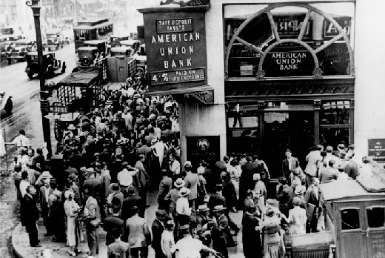
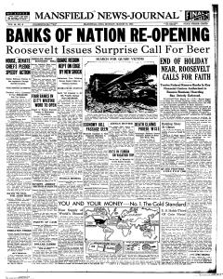
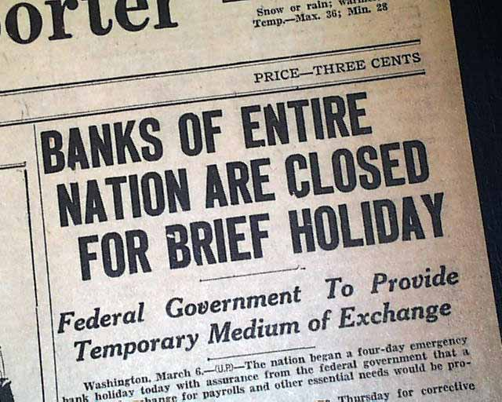
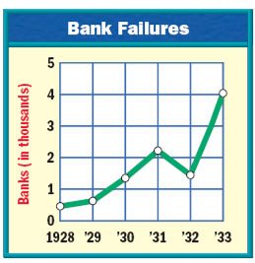
1st New Deal: (RECOVERY) FDR first addresses the BANK crisis…
1933: 25,000 banks had failed and the USA was in a complete financial collapse
EMERGENCY BANKING ACT = Four-day “bank holiday” = all banks closed and inspected by federal regulators to determine which banks were healthy…
…Only healthy banks could reopen after the bank holiday

Slide 15
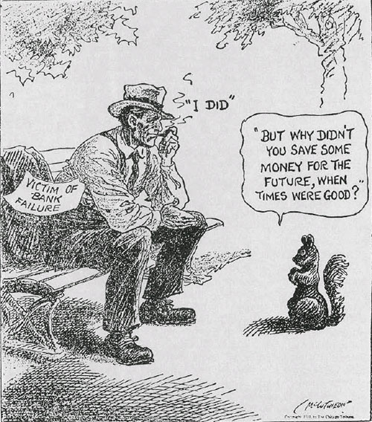
Glass-Steagall Act (1933)
Created the Federal Deposit Insurance Corporation (FDIC) which guaranteed the SAFETY of all bank deposits up to $5,000
Now, the FDIC insures deposits up to $250,000

Slide 16
“Capitalism was saved in eight days”

Slide 17
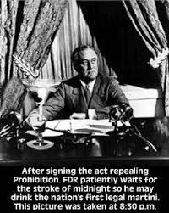
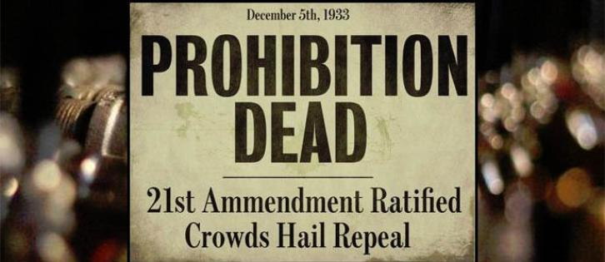
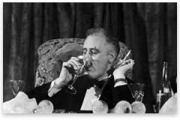
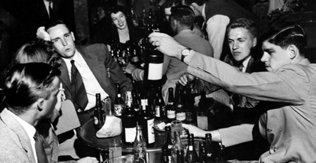

Slide 18
RELIEF for the unemployed

Slide 19
Hundred Days: RELIEF for the UNEMPLOYED
The greatest success of the First New Deal was its ability to offer relief to unemployed citizens
CREATE JOBS/WORK WITH GOVERNMENT DOLLARS
Federal Emergency Relief Act (FERA)
$500 million into state welfare programs
Harry Hopkins
Civilian Conservation Corps (CCC)
employed urban men for reforestation and conservation
RELIEF for unemployed
Public Works Admin (PWA)
build public roads, bridges, & buildings
Harold Ickes
Civilian Works Admin (CWA)
hired 4 million men & women
Notes:
The Federal Emergency Relief Administration
The “Hundred Days Congress” also created the Federal Emergency Relief Administration (FERA), in May 1933, to dole out roughly $500 million to the states. About half of this money was earmarked to bail out bankrupt state and local governments. States matched the other half (three state dollars for every one federal dollar) and distributed it directly to the people. FERA also created the Civil Works Administration (CWA), which helped generate temporary labor for those most in need.

Slide 20
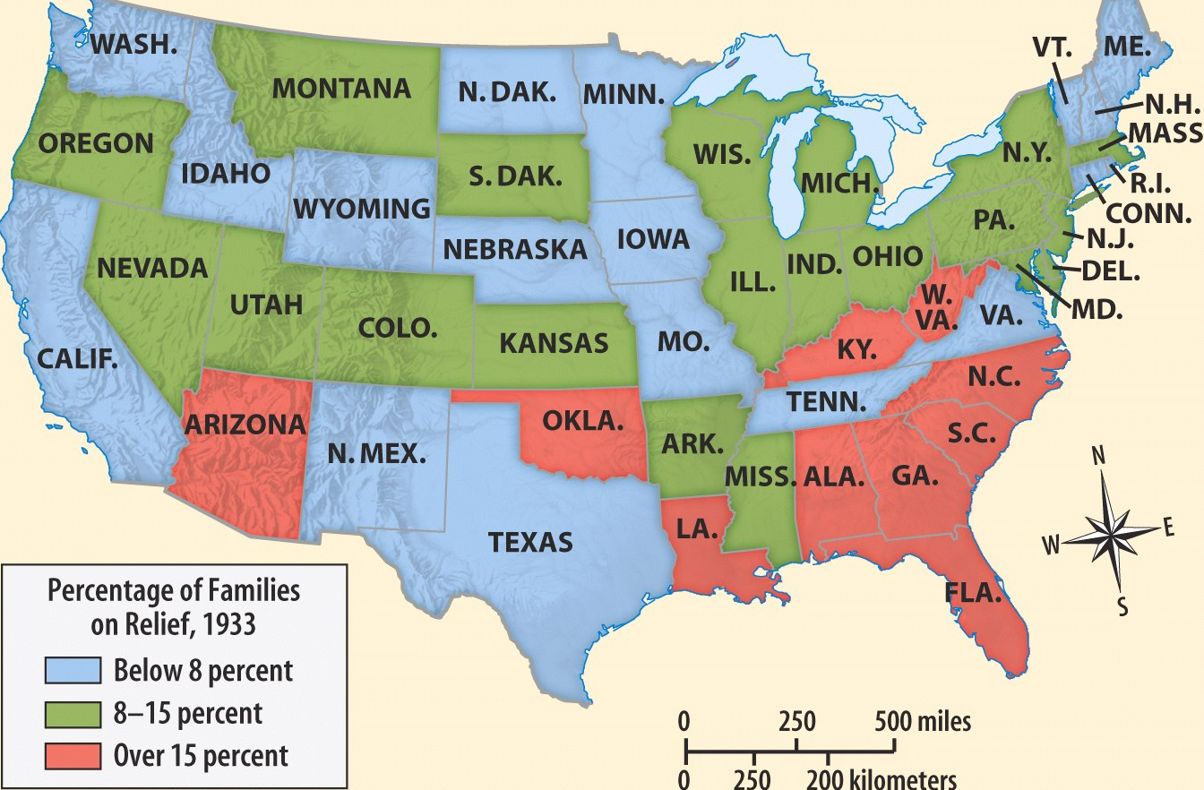
Percentage of American Families Accepting Government Relief in 1933

Slide 21
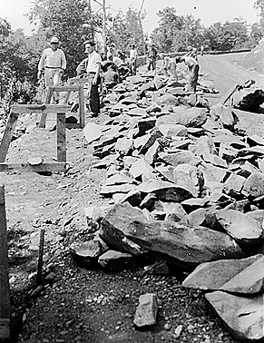
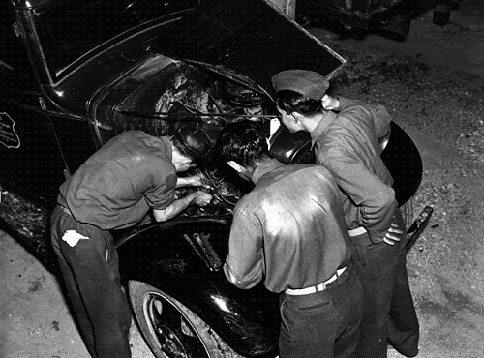
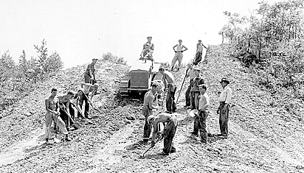
CCC workers paved roads, planted trees, built bridges

Slide 22
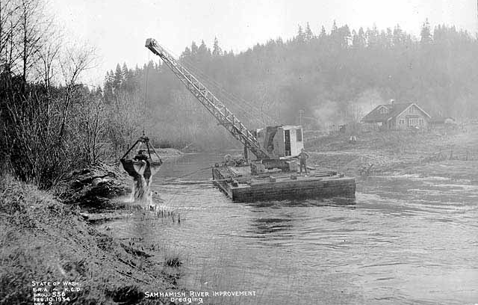
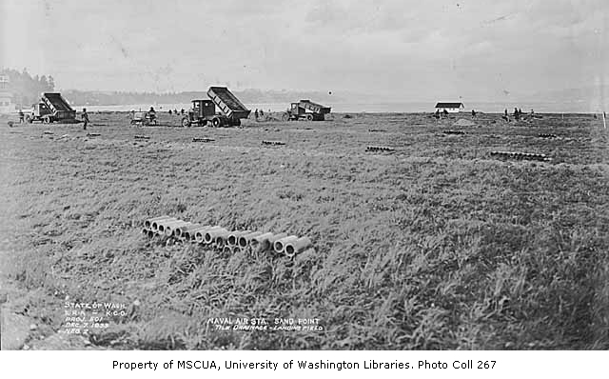
CWA
Creating drainage system for an airfield
Dredging (cleaning) a lake

Slide 23
RECOVERY for industry

Slide 24
Still the First Hundred Days…RECOVERY - AIMED AT HELPING THE ECONOMY
Agricultural Adjustment Admin (AAA)
Paid farmers to produce LESS and INCREASE DEMAND
UNCONSTITUTIONAL in 1935
National Recovery Admin (NRA)
Enforce fair competition
President dictates minimum wages
Collective bargaining of workers
UNCONSTITUTIONAL in 1935
INDUSTRIAL and FARM RECOVERY
Notes:
The National Industrial Recovery Act
The 1933 National Industrial Recovery Act was the federal government’s first attempt to revive the economy as a whole. The bill created the National Recovery Administration (NRA) to stimulate industrial production and improve competition by drafting corporate codes of conduct. The NRA also sought to limit production of consumer goods to drive up prices. Furthermore, the act helped set up the Public Works Administration (PWA) to construct public roads, bridges, and buildings. In accordance with Keynesian economic theories, Roosevelt believed that improving the public infrastructure would put more money into the economy.

Slide 25
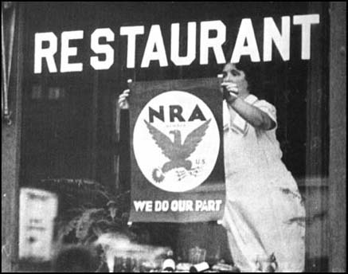
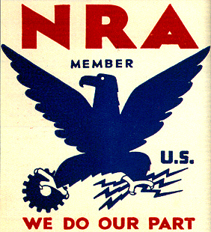
National Recovery Administration

Slide 26
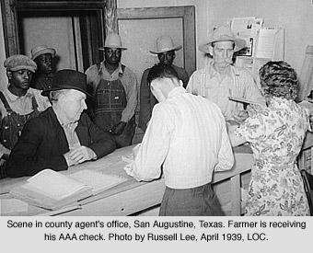
AAA

Slide 27
other REFORMS

Slide 28
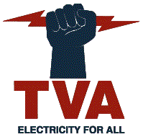
Still the First Hundred Days…REFORM - LONG-TERM REFORMS
TAKE A PIC!
Securities & Exchange Commission (SEC)
regulate the stock market
no buying on the margin
Tennessee Valley Authority (TVA)
created dams in 7 states to provide cheap hydroelectric power
created jobs
Notes:
The Tennessee Valley Authority
Congress also created the Tennessee Valley Authority (TVA), whose goal was to modernize and reduce unemployment in the Tennessee River valley, one of the poorest and hardest-hit regions in the country. The agency hired local workers to construct a series of dams and hydroelectric power plants, which brought cheap electricity to thousands of people. The public corporation also created affordable employee housing, manufactured cheap fertilizer, and drained thousands of acres for farming. The TVA, like the AAA, was highly controversial. Many conservatives claimed that government production of electricity was a mild form of socialism and that it disrupted market prices too much. Competing electric companies also attacked the TVA for selling cheaper electricity and lowering their profits. Still, the TVA had such a profound impact on the economy and quality of life in the Tennessee River valley region that the federal government initiated similar projects throughout the West and South. Within a decade, many major U.S. rivers were set up to produce hydroelectric power that provided both electricity and jobs.
Restructuring American Finance
Finally, Roosevelt also lobbied Congress to establish new regulations on the financial sector of the economy. After taking office, he took the country off the gold standard, which allowed citizens and foreign countries to exchange paper money for gold. To prevent people from hoarding the precious metal, the president also ordered all private gold stocks to be turned over to the U.S. Treasury in exchange for paper dollars. Congress also created the Securities and Exchange Commission (SEC) to regulate trading on Wall Street and curb the out-of-control speculation that had led to the Crash of 1929.

Slide 29
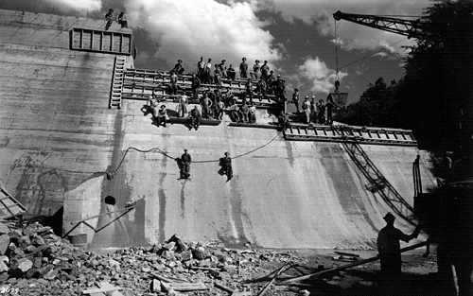
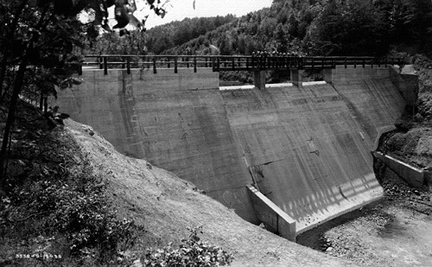
The Tennessee Valley Authority

Slide 30
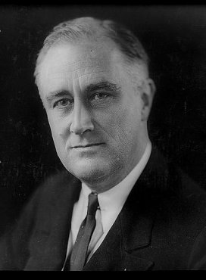
RECAP: The Hundred Days
The 1st hundred days of FDR’s administration were temporary solutions to solve problems, but…
…psychologically, Americans believed that FDR was actively responding to the Great Depression…

Slide 31
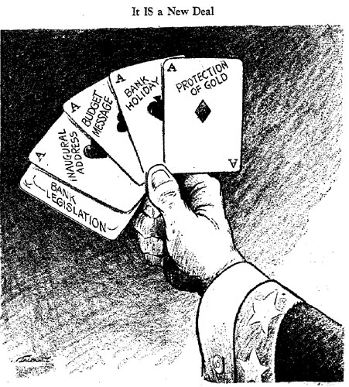
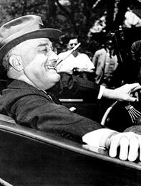
The Hundred Days
“The whole country is with him, just so he does something. If he burned down the capitol we would cheer and say ‘well, we at least got a fire started anyhow.’”
—Will Rogers
Notes:
Alf Landon ran against FDR as a Republican candidate in 1936

Slide 32
The Second New Deal (1935) (more focused on RELIEF and REFORM)
RELIEF!
1935: Works Progress Admin (WPA) – LARGEST program of the New Deal
10 million Americans hired
Building projects, funded the arts/theater/literature, & pumped $10 billion into the economy
Notes:
In January 1935, Congress created the Works Progress Administration (WPA). Roosevelt's program employed 3.5 million workers at a "security wage"--twice the level of welfare payments, but well below union scales. Roosevelt, again, turned to Harry Hopkins to head the new agency. Since the WPA's purpose was to employ men quickly, Hopkins opted for labor-intensive tasks, creating jobs that were often makeshift and inefficient. Jeering critics said the WPA stood for "We Piddle Along," but the agency built many worthwhile projects. In its first five years alone, the WPA constructed or improved 2,500 hospitals, 5,900 schools, 1,000 airport fields (including New York's LaGuardia Airport), and nearly 13,000 playgrounds. By 1941 it had pumped $11 billion into the economy.
The WPA's most unusual feature was its spending on cultural programs. Roughly five percent of the WPA's spending went to the arts. While folksingers like Woody Guthrie honored the nation in ballads, other artists were hired to catalog it, photograph it, paint it, record it, and write about it. In photojournalism, for example, the Farm Security Agency (FSA) employed scores of photographers to create a pictorial record of America and its people. Under the auspices of the WPA, the Federal Writers Project sponsored an impressive set of state guides and dispatched an army of folklorists into the backcountry in search of tall tales. Oral historians collected slave narratives, and musicologists compiled an amazing collection of folk music. Other WPA programs included the Theatre Project, which produced a live running commentary on everyday affairs; and the Art Project, which decorated the nation's libraries and post offices with murals of muscular workmen, bountiful wheat fields, and massive machinery.
Valuable in their own right, the WPA's cultural programs had the added benefit of providing work for thousands of writers, artists, actors, and other creative people. In addition, these programs established the precedent of federal support to the arts and humanities, laying the groundwork for future federal programs to promote the life of the mind in the United States.
In 1939, a Gallup Poll asked Americans what they liked best and what they liked worst about Franklin Delano Roosevelt's New Deal. The answer to both questions was: “the WPA, the Works Projects Administration.”
Work crews were criticized for spending days moving leaf piles from one side of the street to the other. Unions went on strike to protest the program's refusal to pay wages equal to those of the private sector. President Ronald Reagan, a staunch critic of large-scale government programs, was one of the WPA's defenders, however. "Some people," he said, "have called it boondoggle and everything else. But having lived through that era and seen it, no, it was probably one of the social programs that was most practical in those New Deal days."
Approximately five percent of its budget was devoted to the arts. WPA alumni include writers Saul Bellow, John Cheever, Ralph Ellison, and Richard Wright, the artist Jackson Pollack, and actor and director Orson Welles.
The WPA was not especially efficient. In Washington, D.C., construction costs typically ran three-to-four times the cost of private work. Although, this was intentional. The WPA avoided cost-saving machinery in order to hire more workers. At its peak, the WPA spent $2.2 billion a year, or approximately $30 billion annually in current dollars.
The Works Progress Administration
The first major legislation that Roosevelt and Congress passed in the Second New Deal—in response to the critics—was the Works Progress Administration (WPA). Created in 1935, the WPA was an effort to appease the “Longites” who clamored for more direct assistance from the federal government. The WPA was similar to the Public Works Administration of the First New Deal, this time hiring nearly 10 million Americans to construct new public buildings, roads, and bridges.

Slide 33
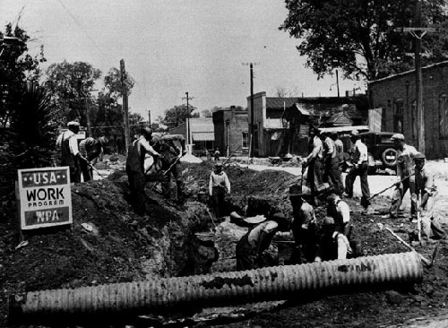
WPA Public Work Project
WPA cared less about what got done as long as work was done: built hospitals, schools, airport fields… but also moved leaf piles & dug ditches

Slide 34
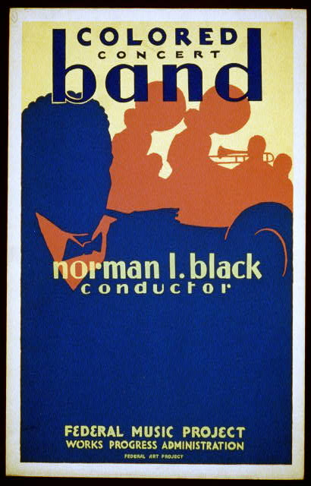
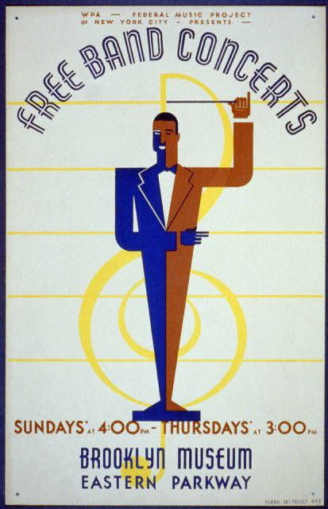
WPA Music Projects

Slide 35
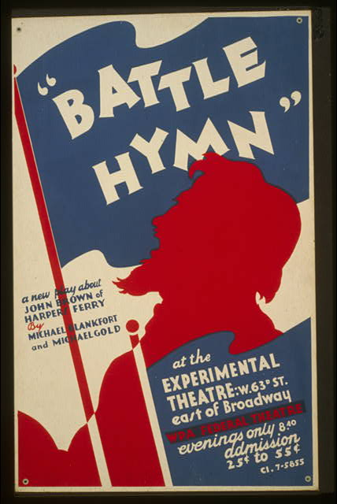
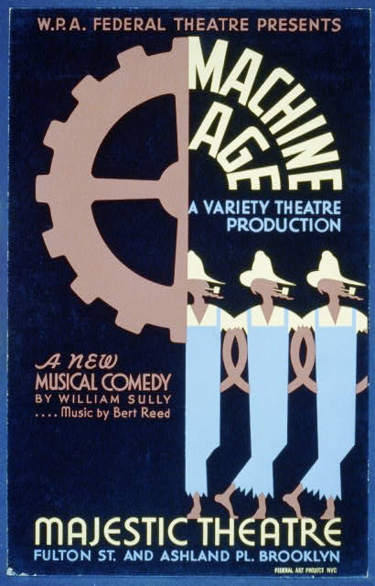
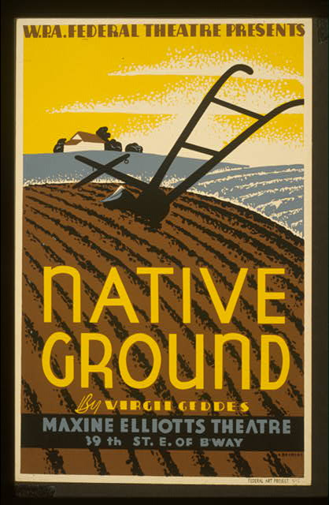
WPA Theater Projects

Slide 36
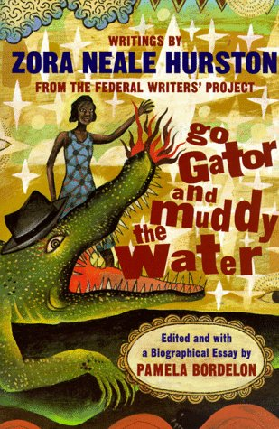
WPA Writers Projects

Slide 37
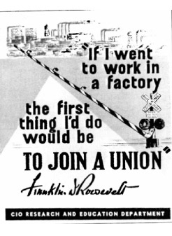
The Second New Deal (1935) (more focused on RELIEF and REFORM)
FDR’s sympathy with unions and laborers’ concerns grows!
Wagner Act (1935) - workers can join unions and outlawed union-busting
NLRB enforces this act
REFORM!
40 hours per week
40¢ per hour
2. Fair Labor Standards Act (1938) - 1st minimum wage & maximum hour laws (aimed at helping non-unionized workers)

Slide 38
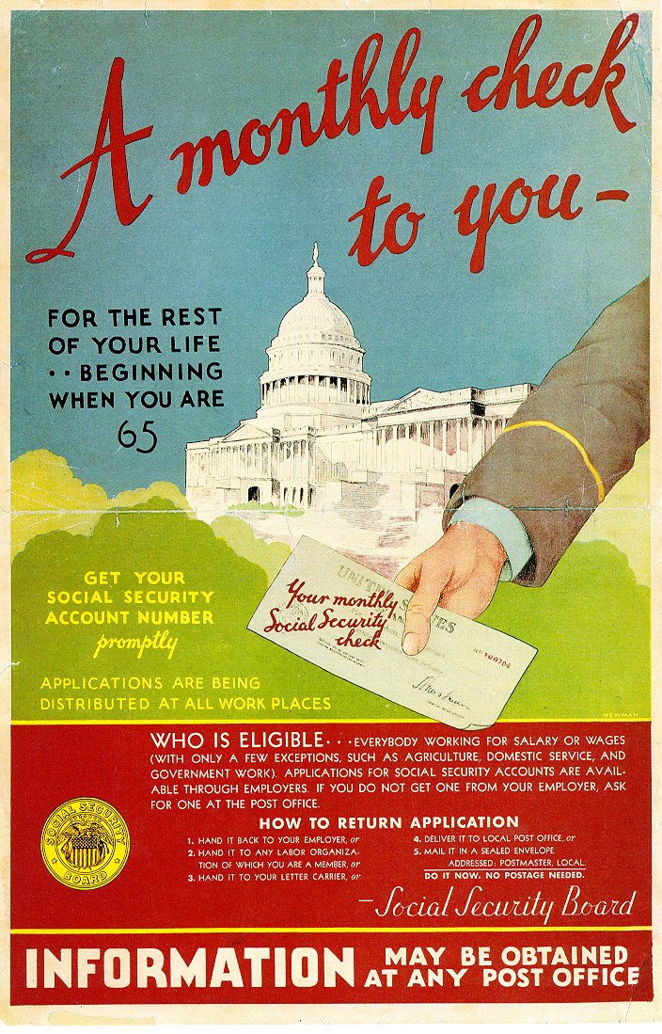
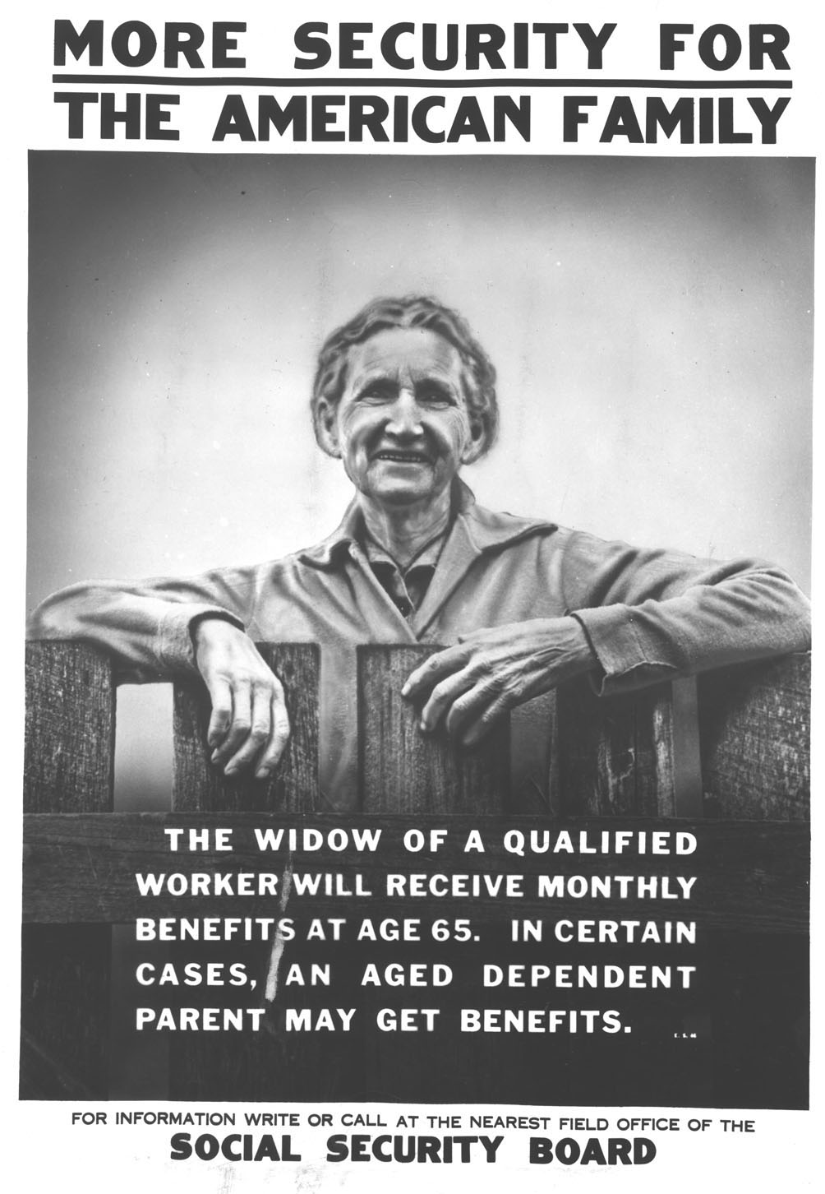
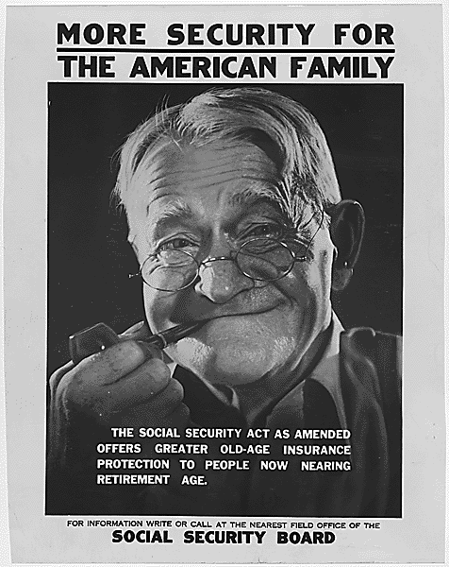
The Second New Deal (1935) (more focused on RELIEF and REFORM)
Social Security Act (1935)
Old-age pensions to be funded by employers & workers
13 weeks of unemployment insurance
Aid to blind, deaf, disabled, and dependent children

Slide 39
Liberal critics argued that Social Security did not do enough
Conservative critics argued that Social Security violated individualism & self-reliance
DON’T COPY

Slide 40
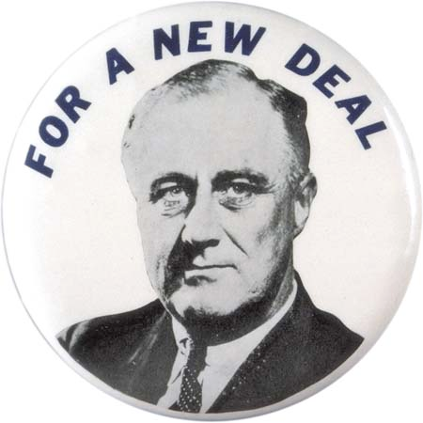
Was the Second New Deal better than the First New Deal?

