Slide 1
AIM: How successful was Franklin Roosevelt’s New Deal?

Slide 2
RECAP: The 1st Hundred Days
The 1st Hundred Days of FDR’s administration were temporary solutions to solve problems and work towards RECOVERY (bank holiday, Glass-Steagall, FDIC, AAA, CCC, PWA, etc.)
…psychologically, Americans believed that FDR was actively responding to the Great Depression…
“The whole country is with him, just so he does something. If he burned down the capitol we would cheer and say ‘well, we at least got a fire started anyhow.’”—Will Rogers (actor)

Slide 3
NEW DEAL: ALPHABET AGENCIES
Part of FDR’s New Deal……Agencies created by the US Govt. to bring about the 3 R’s……Relief, Recovery, and Reform.

Slide 4
The Second New Deal (1935) (more focused on RELIEF and REFORM)
RELIEF: Ease Suffering of the Needy
WPA / 1933 to 1943
Works Progress Administration
Employed 10 million workers in construction and other jobs, but more importantly provided work in arts, theater, and literary projects.

Slide 5
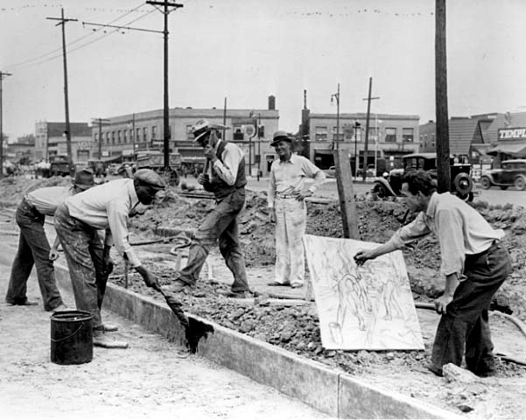
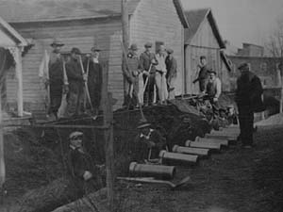
WPA
Works Progress Administration (WPA), the New Deals main relief agency.
People employed by the WPA at its peak was more than 3 million
2,500 hospitals
5,900 schools
13,000 playgrounds
125,000 public buildings

Slide 6
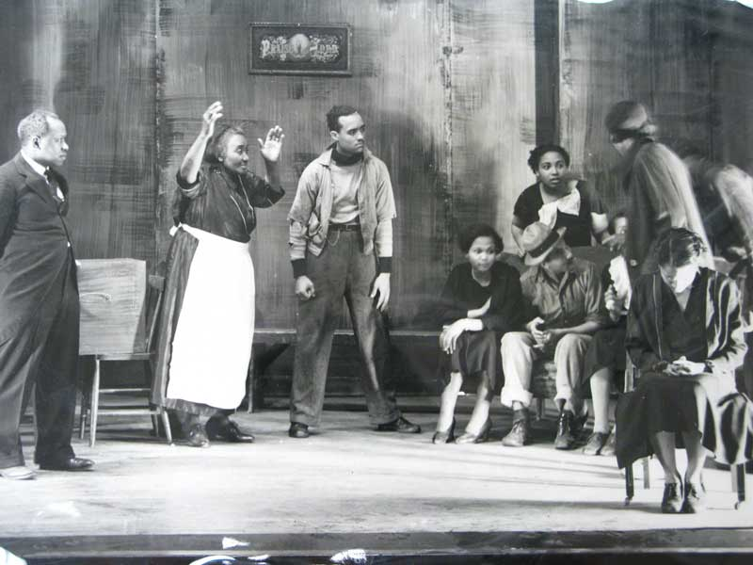
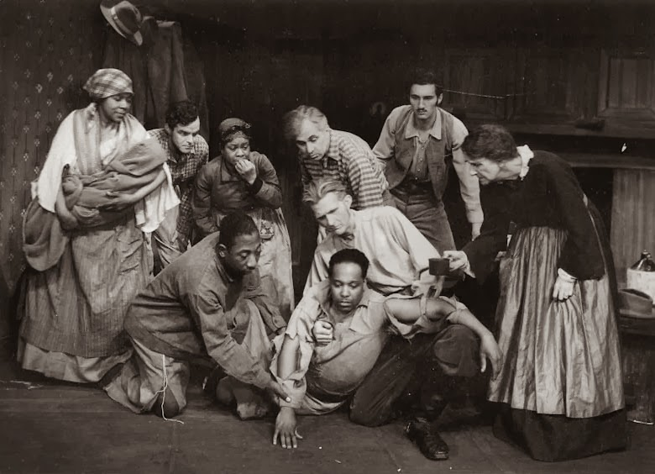
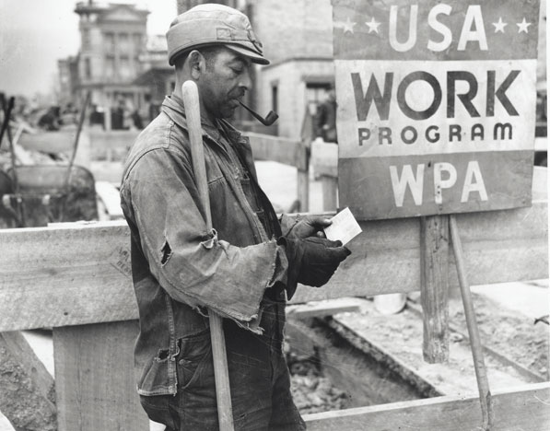
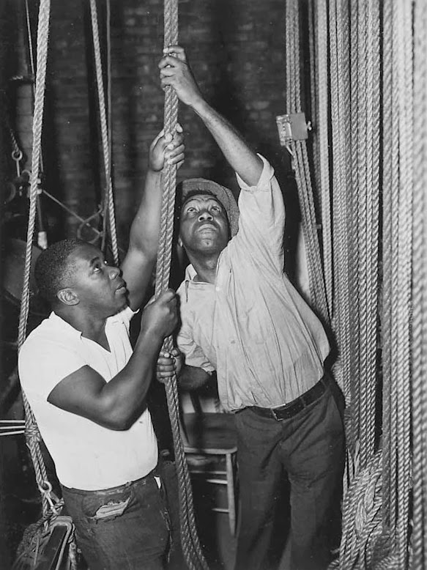
Positive Impact on African-Americans
40% of unemployed blacks helped through the WPA
Negro Repertory Company was one of the few all-African American theatre companies in the nation – New York

Slide 7
Negative Impact on African-Americans
The New Deal did little for blacks:
Racism & segregation remained strong during the Depression
The NRA allowed lower wage scales for black workers; The AAA allowed for the eviction of sharecroppers & tenant farmers
Minimum wage & SS did not apply to farmers & domestic servants (65% were black)
The NRA stands for “Negroes Robbed Again”
Social Security “looks like a sieve with the holes just large enough for the majority of Negroes to fall through”
—NAACP
Blacks were the last hired & first fired
Blacks experienced 50% unemployment rate

Slide 8
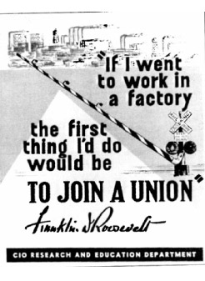
The Second New Deal (1935) (more focused on RELIEF and REFORM)
FDR’s sympathy with unions and laborers’ concerns grows!
Wagner Act (1935) - workers can join unions and outlawed union-busting
NLRB enforces this act
REFORM!
40 hours per week
40¢ per hour
2. Fair Labor Standards Act (1938) - 1st minimum wage & maximum hour laws (aimed at helping non-unionized workers)

Slide 9
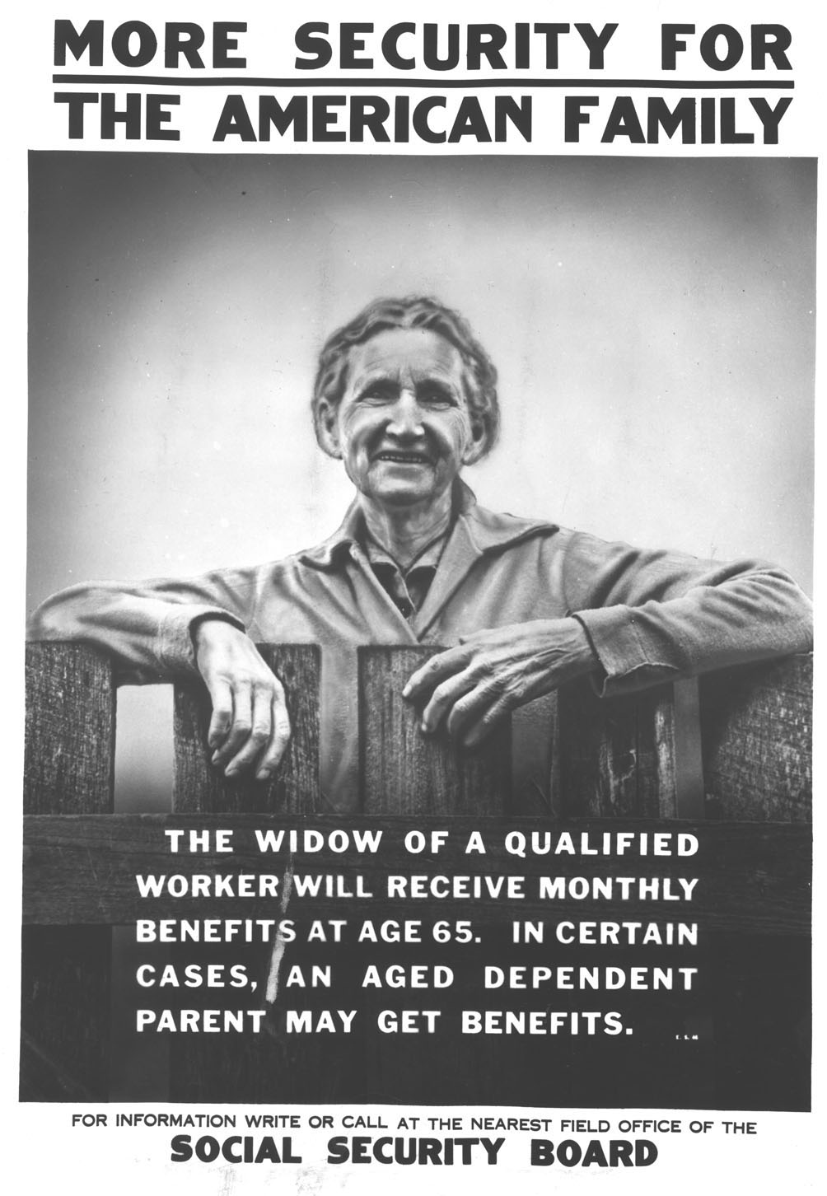
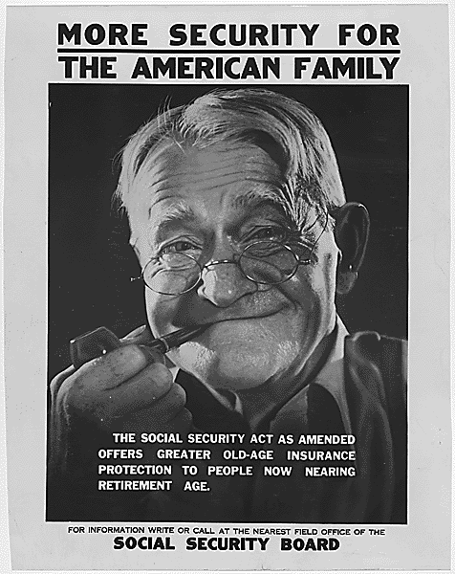
The Second New Deal (1935) (more focused on RELIEF and REFORM)
Social Security Act (1935)
Old-age pensions to be funded by employers & workers
13 weeks of unemployment insurance
Aid to blind, deaf, disabled, and dependent children

Slide 10
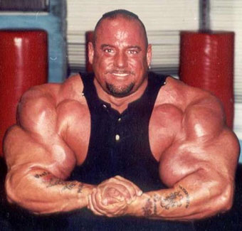
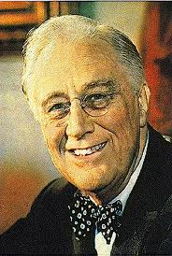
Opposition to New Deal
Major argument- FDR had too much power

Slide 11
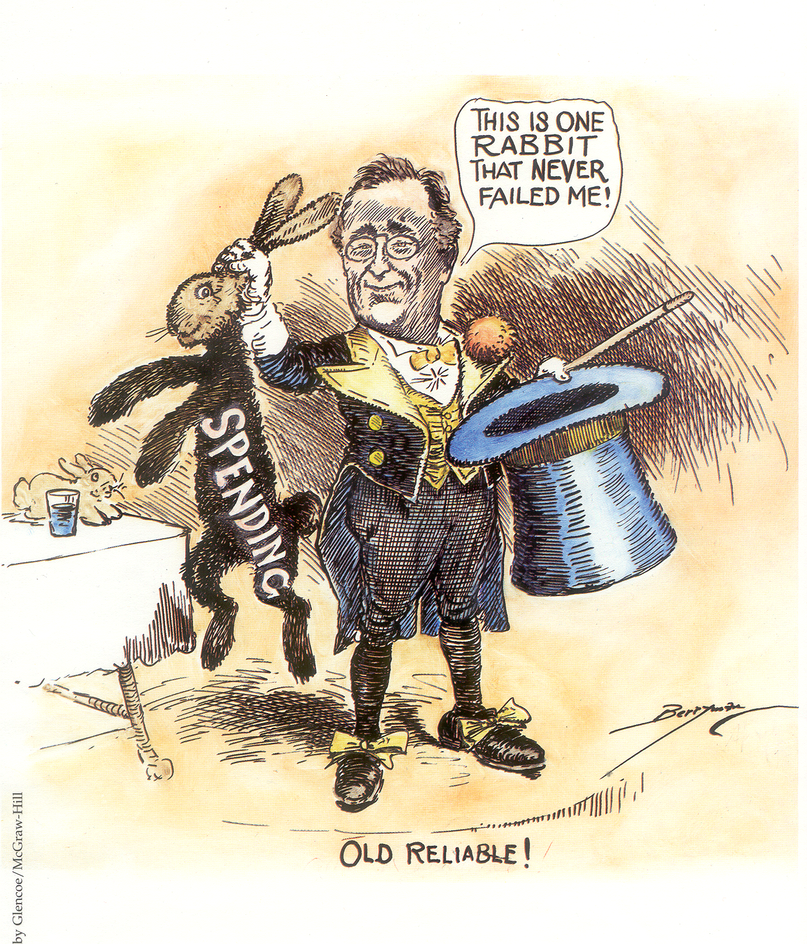
Critics of New Deal
US government and President too powerful (conservatives) > STILL SEE THIS TODAY!
Violated laissez faire
Supreme Court declared NIRA and AAA unconstitutional (too much for business and LITTLE for the unemployed!)
Critics:
Father Charles Coughlin
Dr. Francis Townsend
Al Smith (American Liberty League – anti New Deal!)
Huey Long
Deficit spending: Government spends $$$ to stimulate the economy and help people even if it means US Government goes into debt (conservatives HATED this!)
Welfare state: Created a population of Americans who relied on the US Government to live.

Slide 12
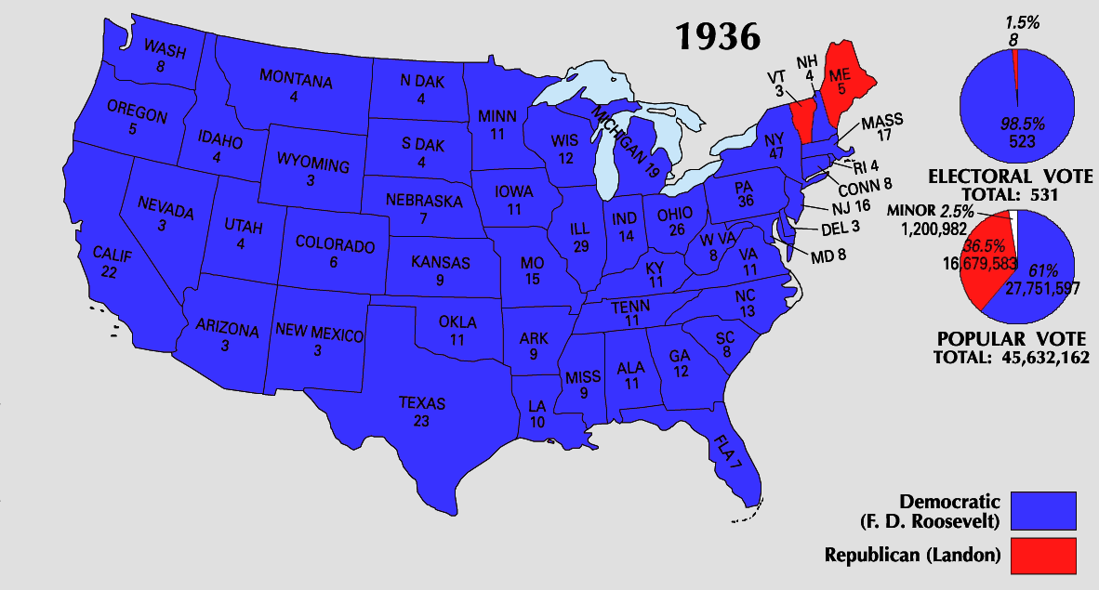
End of the New Deal
New Deal reached its high point when FDR was re-elected in 1936
FDR’s experienced more setbacks in his 2nd term than his 1st term but he still remained a popular leader

Slide 13
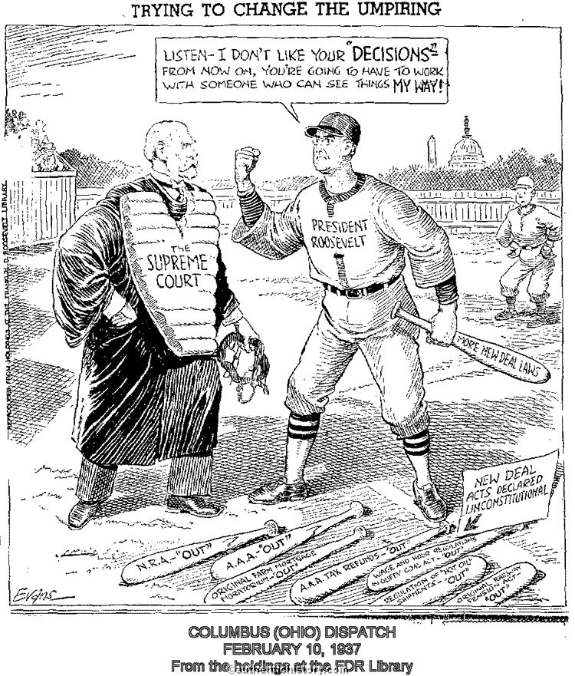
Based on this cartoon, why is FDR upset with the Supreme Court?

Slide 14
FDR and the Supreme Court
Schechter v. U.S.
(1935)
U.S. v. Butler
(1936)
The Supreme Court ruled some of the New Deal programs unconstitutional – Why?
Argued programs like the NRA and AAA were more state concerns – NOT federal concerns.
FDR proposed a “court-packing” plan to get 6 more justices on the court
Ask Congress to appoint 1 new justice for each justice over 70 years old
Why?
To get more justices that favored his New Deal programs
All 9 justices were old, white men; Only 3 were sympathetic to the New Deal; 2 were unpredictable; 4 wanted to block New Deal

Slide 15
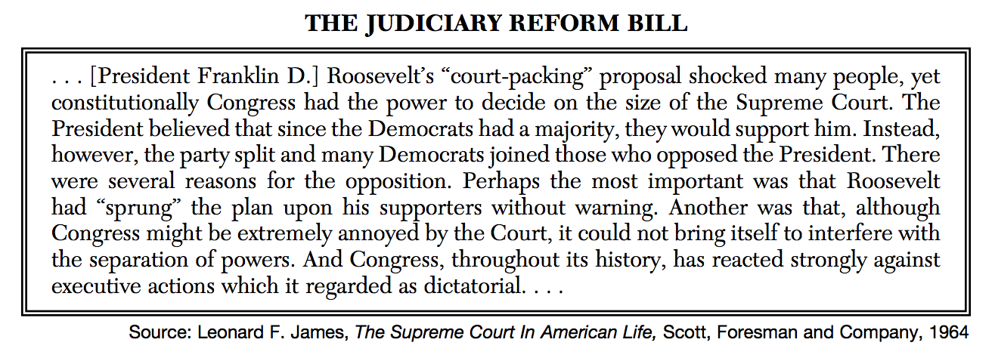
The court-packing bill was not passed by Congress…WHY?

Slide 16
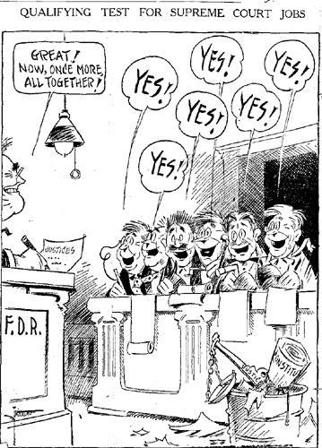
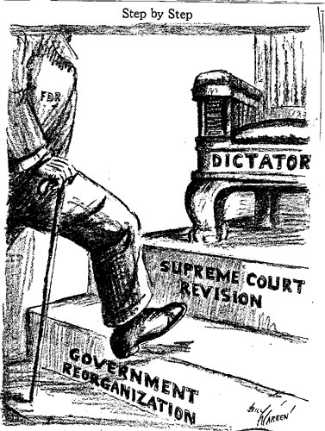
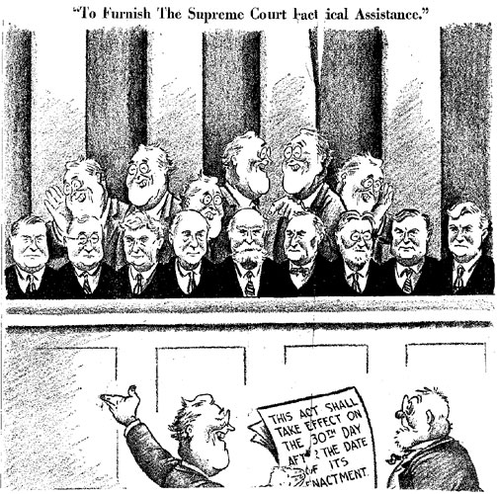

Slide 17
1938 = end of the New Deal
FDR’s court-packing plan hurt his relationship with Congress
“The 168-day contest also has bequeathed some salutary [beneficial] lessons. It instructs presidents to think twice before tampering with the Supreme Court. FDR’s scheme, said the Senate Judiciary Committee, was “a measure which should be so emphatically rejected that its parallel will never again be presented to the free representatives of the free people of America.” And it never has been.”
- William E. Leuchtenburg, “When Franklin Roosevelt Clashed with the Supreme Court—and Lost,” Smithsonian Magazine, May 2005
Notes:
FDR’s attempt to balance budget & reduce WPA spending led to 2 more years of Depression hardships

Slide 18
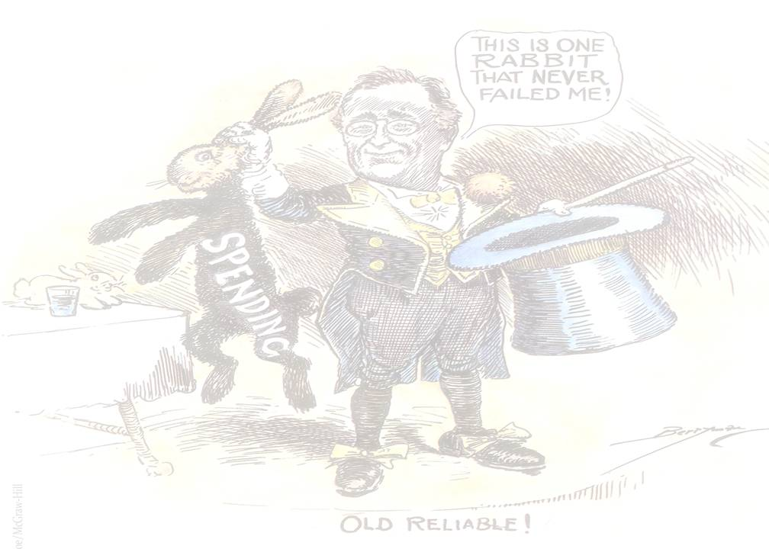
LEGACY OF NEW DEAL
Successes of New Deal
TAKE A PIC!
Stimulated the economy
Put people back to work
Restores HOPE and PRIDE
Government’s role changes and became directly involved in helping people
Social Security, CCC (parks system), WPA projects, and educational programs STILL EXIST!

Slide 19
Unemployment, 1929-1942

Slide 21
Even with all of her championing for women’s equality, many New Deal programs didn’t include women, or gave them lower wages than men.

Slide 22
Negatives of New Deal
Increased power in Government -threatened principles of democracy
Alarmed because of deficit spending.
Government was spending more than it took in creating an increase in national debt.
Did not end Great Depression
Economy not in full swing until producing war goods in WWII
TAKE A PIC!

Slide 23
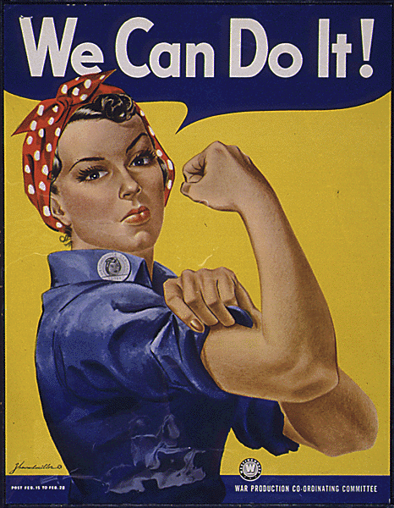
Coming Soon to a Classroom Near You…
World War II, 1939-1945

