Slide 1
Today’s AIM:
How did muckrakers shed light on and work to reform American society during the Progressive Era?

Slide 2
What is Progressivism?
From 1890s to 1920, progressives addressed the rapid economic & social changes of the Gilded Age
Progressive reform had wide appeal but was not a unified movement with a common agenda
Progressive reforms included prostitution, poverty, child labor, factory safety, women’s rights, temperance, & political corruption
Progressive reform began in the late Gilded Age, especially during the Panic of 1893 which exposed serious flaws in the American political, economic, & social fabric
Some histories mark the end of Progressivism in 1917 when the USA entered WWI; others mark the end at 1920 with the 19th amendment
Some reformers targeted local community problems, others aimed for state changes, & others wanted national reforms

Slide 3
What is Progressivism?
Optimism & belief in progress (“investigate, educate, & legislate”)
Social Gospel taught Christians that it was their duty to end poverty & inequality
But, Progressive reform had distinguishing characteristics:
Looked to the government to help achieve goals
Desire to “humanize” industry & urbanization
Their actions impacted the entire nation; not regions like the Populists
Progressive Themes
Led by educated middle-class “experts” who developed “rational” solutions
Change the environment in order to change people (no Social Darwinism)

Slide 4
You decide! Was life improving during the Industrial Age in America? For each image (#1-5) you see think about 1 or 2 PROBLEMS America was facing during the Industrial Age/Gilded Age

Slide 5
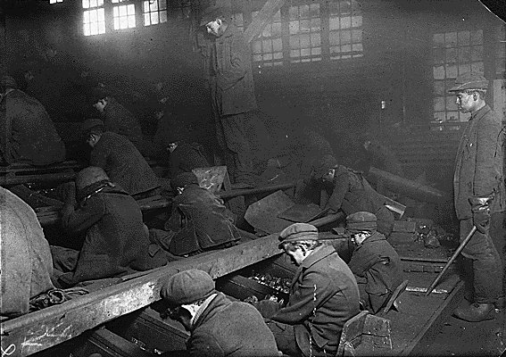
#1 - Child workers in mining industry

Slide 6
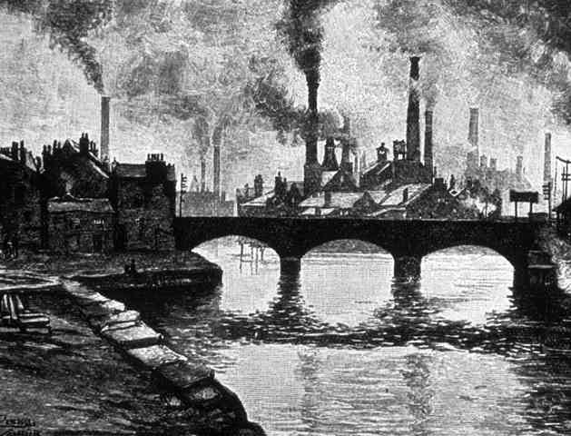
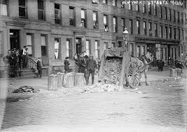
#2 - Industrial cities

Slide 7
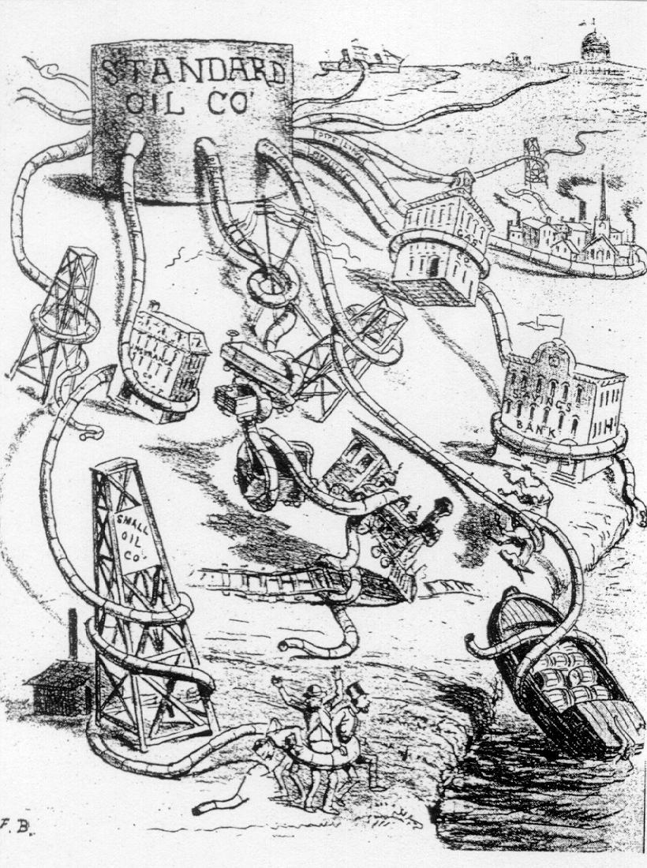
#3 – Growth of Monopolies

Slide 8
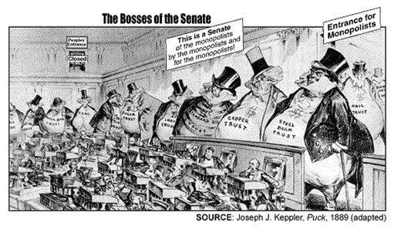
#4 – Political Corruption

Slide 9
Attacking Political Machines
Mugwumps = reformers who strove to end corruption among political machines in cities:
The Gilded Age saw the height of urban machines whose politicians controlled lawmaking, police departments, & courts
The “Good Government” Movement = shift power from bosses to mayors & city councils
“Boss Tweed”
Dominated the NYC and state Democratic Party
Associates appointed to key city and county posts, thus establishing a network of corruption that became known as the "Tweed ring.”

Slide 10
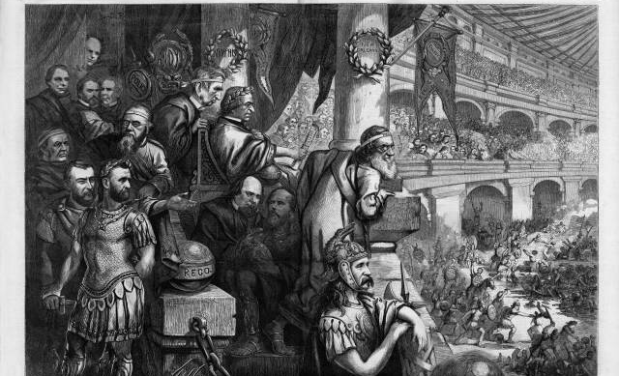
Thomas Nast was the Gilded Age’s most famous Mugwump cartoonist

Slide 11
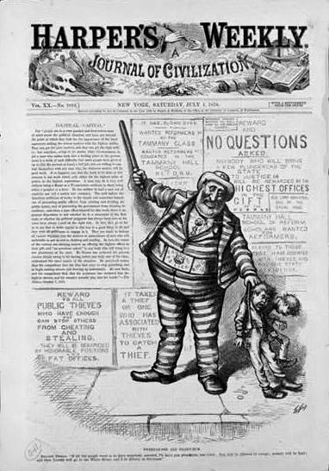
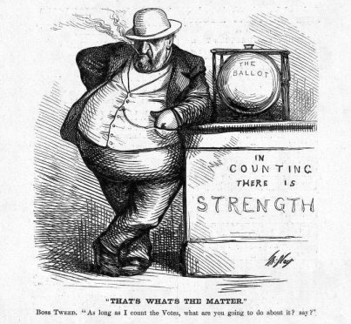
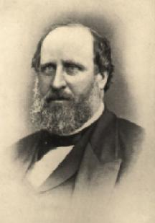
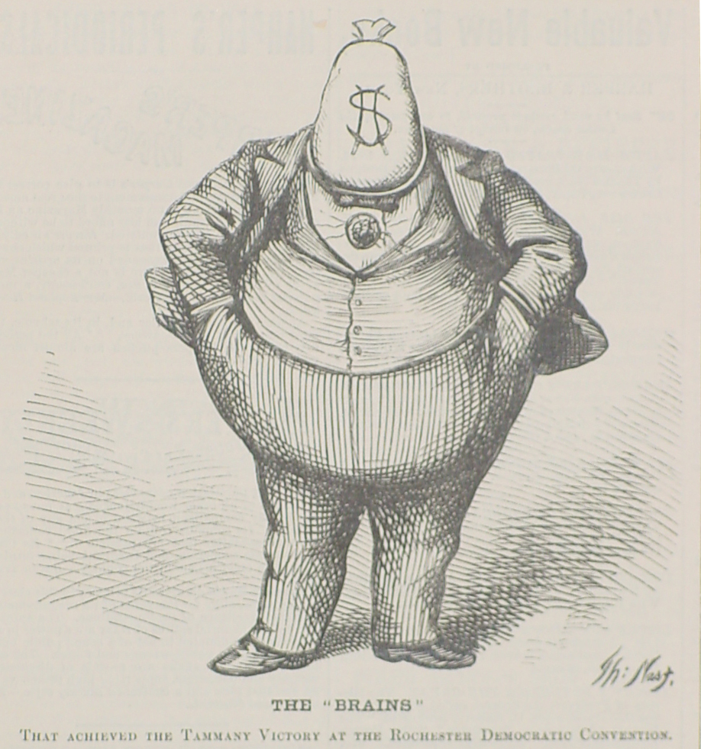
Nast’s Favorite Target: Boss Tweed
Tweed’s Downfall: “STOP them damn pictures!”

Slide 12
Political Corruption How does the clip from “Gangs of New York” depict problems and political corruption? (answer in writing as you watch) https://www.youtube.com/watch?v=OQ04YdyQPAc

Slide 13
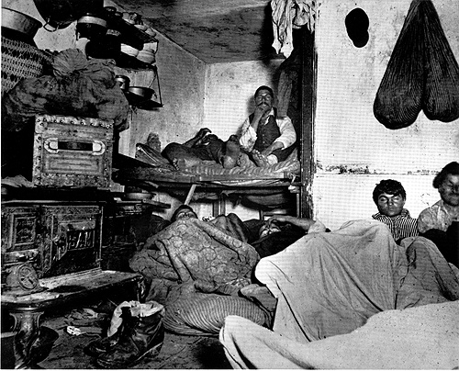
#5 - Life in the tenements

Slide 14
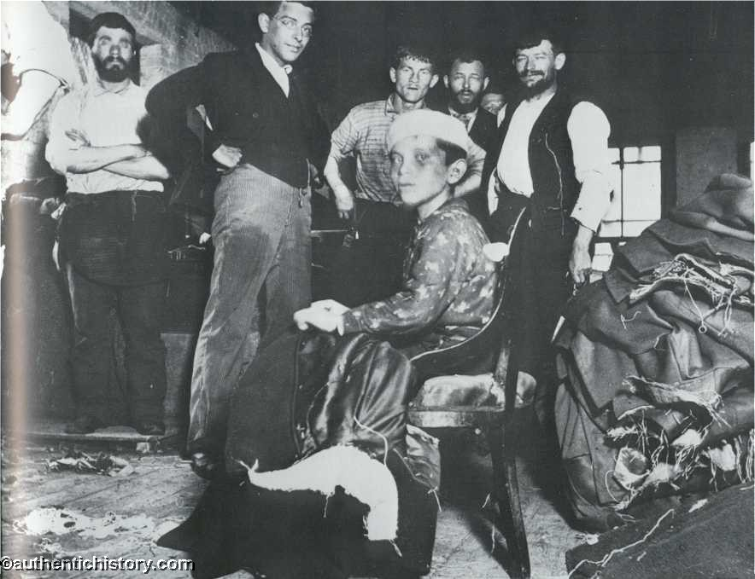
Urban Problems
Most American cities were not prepared for such rapid population growth
Housing: Overcrowded TENEMENTS were un-healthy places to live.
Sanitation: Often, garbage was not collected and polluted the air.
Famous photographer Jacob Riis captured the struggle of living in crowded tenements

Slide 15
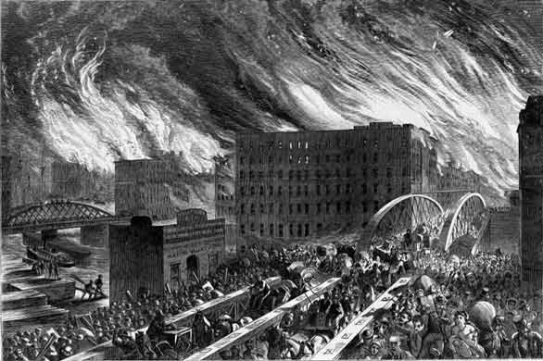
Few adequate transit systems.
Limited safe drinking water = CHOLERA
As populations increased thieves flourished.
Fires! Limited water, wooden structures, and the use of candles led to many major urban fires.
Harper’s Weekly image of Chicagoans fleeing the fire over the Randolph Street bridge in 1871
Chicago 1871 and San Francisco 1906 were two major fires.
TAKE A PIC!

Slide 16
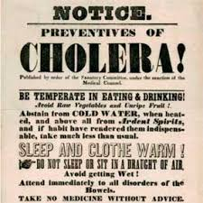
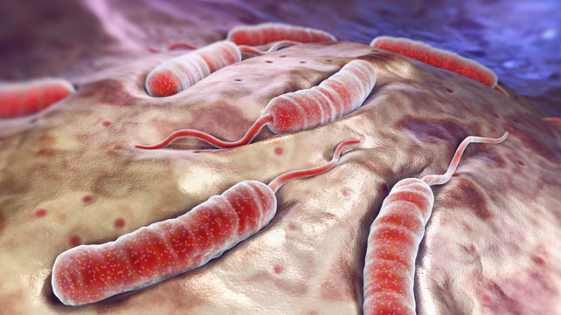
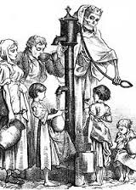

Slide 17
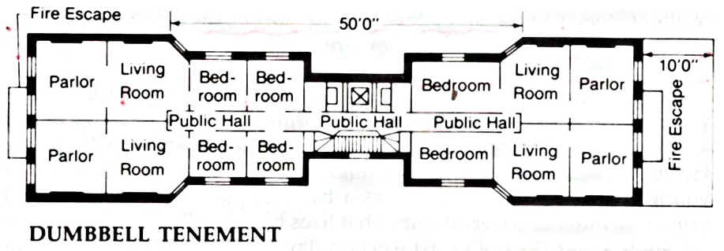
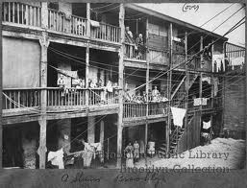
Dumbbell Tenement
More apartments for more families and shared restrooms.
These tenements were fire hazards, filled with waste and diseases.

Slide 18
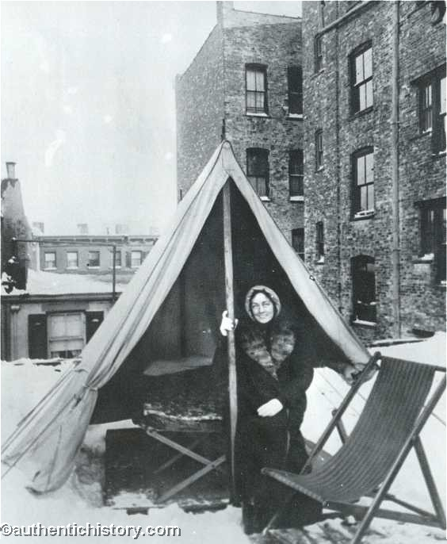
The Tenement Question--Inside and Out!
Many urban poor developed lung disease or tuberculosis; About 60% of immigrant babies died before their first birthday
“Tuberculosis windows” = cross-ventilation, help reduce the spread of diseases like tuberculosis

Slide 19
Reforming America’s Cities
Progressive reform 1st began in cities in the 1890s to address factory, tenement, labor problems:
Early reformers realized that private charity was not enough to cure all social ills!
The Social Gospel movement was a new religious philosophy that focused on improving society & saving individual souls

Slide 20
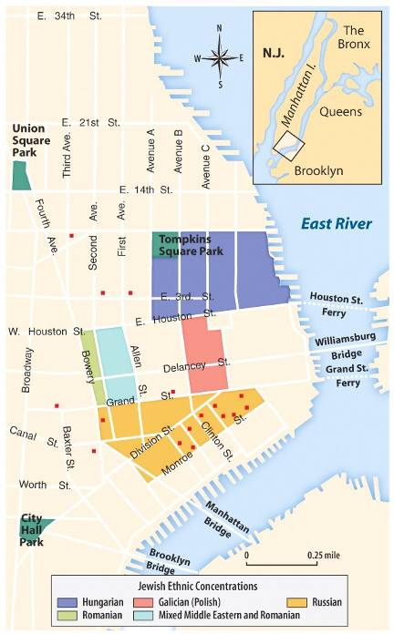
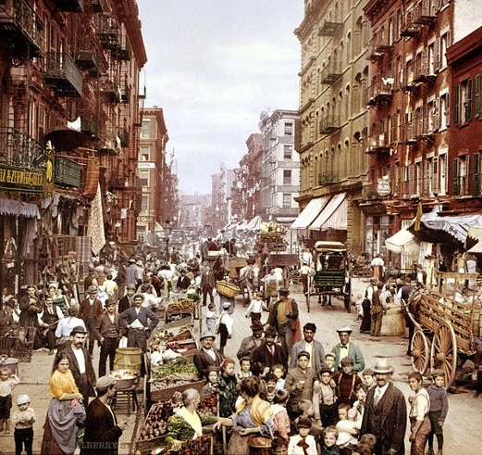
About 2/3 of immigrants settled in cities, such as New York, Chicago, Boston, or Philadelphia and lived in ethnic neighborhoods called ghettos
Why might new immigrants to America concentrate into ethnic communities (with people of the same ethnicity)?
Ghettos provided new immigrants with a sense of community and security, as the immigrants were surrounded by the familiar customs, food and language of their homeland

Slide 21
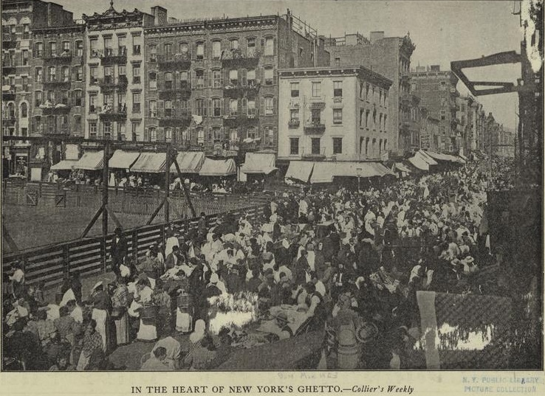
NYC Jewish ghetto

Slide 22
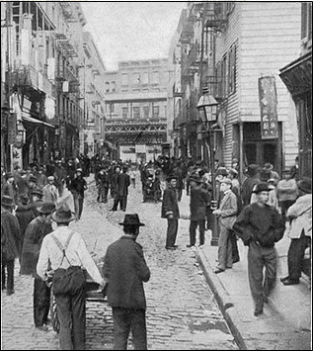
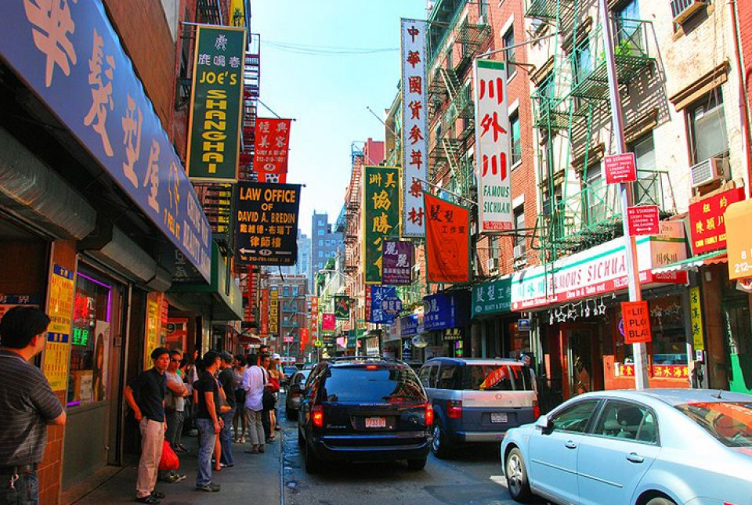
Chinatown
San Francisco
Los Angeles
New York City

Slide 23
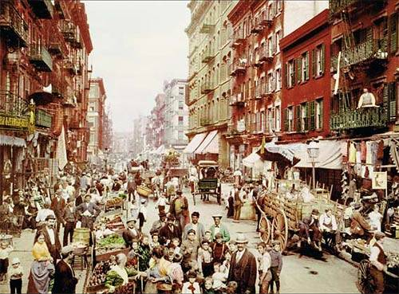
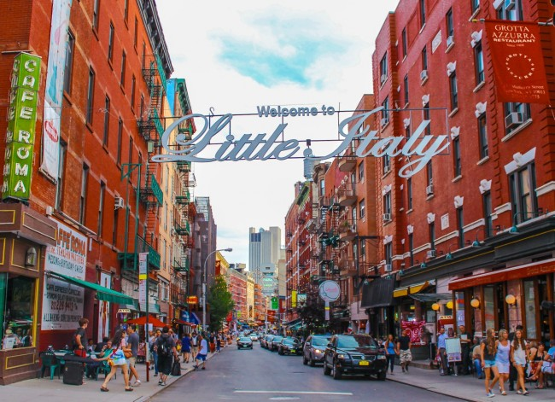
Mulberry Street/“Little Italy”

Slide 24
Who were the muckrakers?
Journalists who wrote about or photographed problems in society.
Wanted to “stir the muck” so people noticed it.
Used newspaper and magazine articles, books, music, poetry and photography to get people to pay attention.

Slide 25
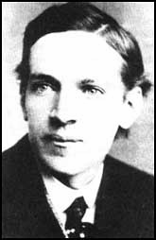
Upton Sinclair
The Jungle
Exposed conditions in meat packing industry
Shed light on terrible working conditions and lack of food regulations
Sinclair is quoted as saying, “I aimed at their brains and hit them in the stomach.”
While you watch:
What was Sinclair trying to expose?
VIDEO

