Slide 1
Continuing PERIOD 4: 1800-1848
DO NOW:
The Industrial Revolution blossomed in America during the 1800s.
List 5 objects you use daily that would not have been available to Americans in the 1800s.
List 4 objects that Americans may have used then but do not need now.

Slide 2
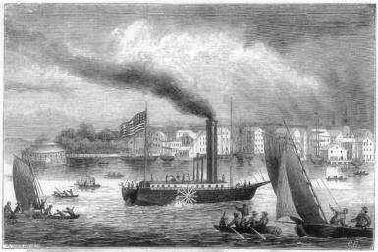
AIM: How did new inventions & improved transportation help facilitate a national market economy in the 1840s?
Notes:
Lesson Plan for Thursday, October 9, 2008: Warm-Up Question, Market Revolution Notes

Slide 3
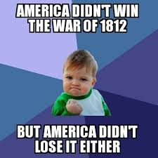
OUTCOMES OF WAR OF 1812
The War of 1812 won new respect for America among many British. Michael Scott, a young lieutenant in the British navy wrote,
“I don’t like Americans; I never did, and never shall like them…..I have no wish to eat with them, drink with them, deal with, or consort with them in any way; but let me tell the whole truth, nor fight with them, were it not for the laurels to be acquired, by overcoming an enemy so brave, determined and alert, and in every way so worthy on one’s steel, as they have always proved.”

Slide 4
ERA OF GOOD FEELINGS
1817 TO 1825
Spirit of Nationalism in US
Country is united, confident, and growing
1791-1819, 9 states joined the original 13.
One political party---Republican party
Respect from Europe
Monroe first president to visit all states
An “Era of Good Feelings” had began
INDUSTRY EXPANDS

Slide 5
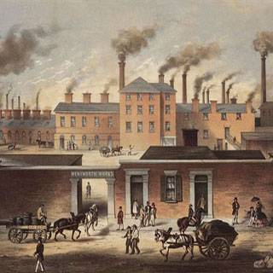
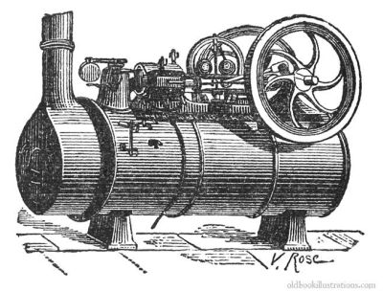
FIRST, the English Industrial Revolution…
The Industrial Revolution began in England in the 1700’s
Several English inventions encouraged America’s Industrial Revolution...
The spinning jenny
The water loom
The steam engine: invented by James Watt – it provided energy to pump water out of mines, and run machines
How would this influence not only the USA, but the world?

Slide 6
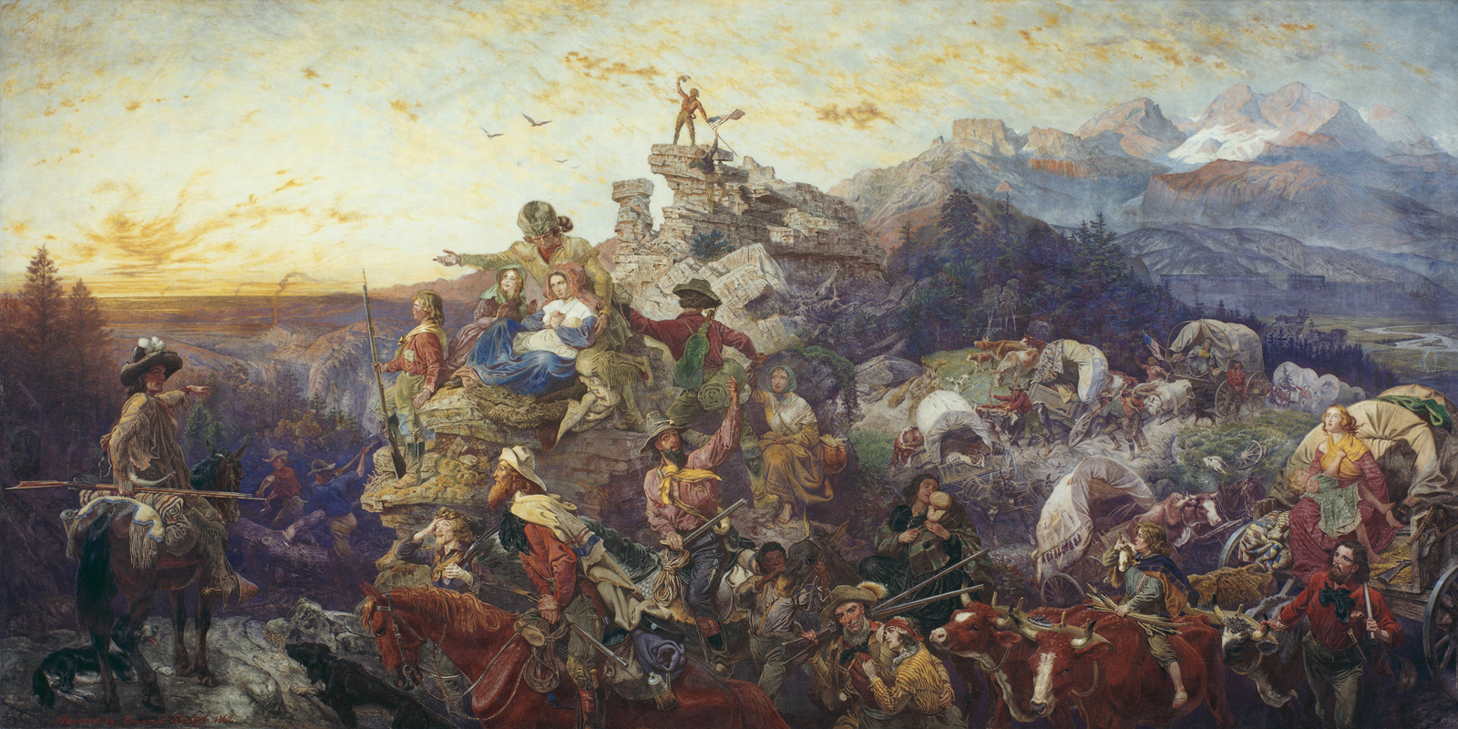
American Antebellum Changes
First off…what does the word “ANTEBELLUM” mean?
PRE-Civil War
In the 1830s & 1840s, territorial & technological growth led to important changes in America:
Improved transportation
Rapid technological innovation
A growing national economy
Mass European immigration
Desire for transcontinental expansion! (AKA “Manifest Destiny”)

Slide 7
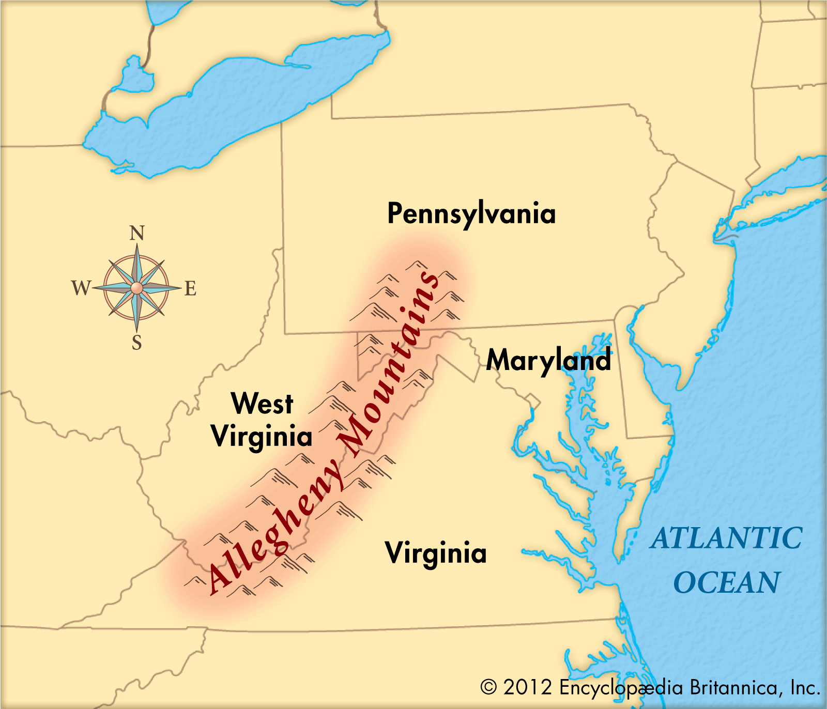
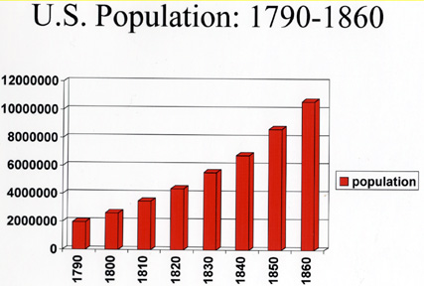
Population doubling
Birthrate, now immigration from Europe (GB and Germany)
Almost 1/3 lived west of the Alleghenies…
BUT how do we get goods and people out there QUICKLY and EFFICIENTLY?

Slide 8
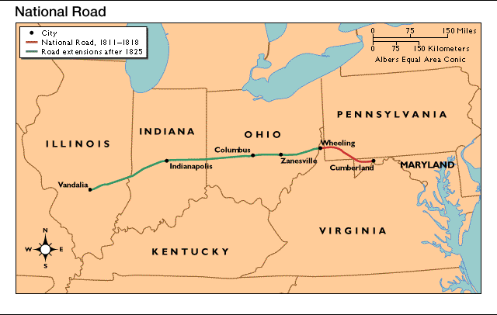
A Revolution in TRANSPORTATION!
Henry Clay’s American System…what did it want to work towards creating?
National Road (1811-1837) = 1st federal transportation project (AKA Cumberland Road)
Roads were useful but they did not meet the demand for low-cost, over-land transportation
Connect us
WEST

Slide 9
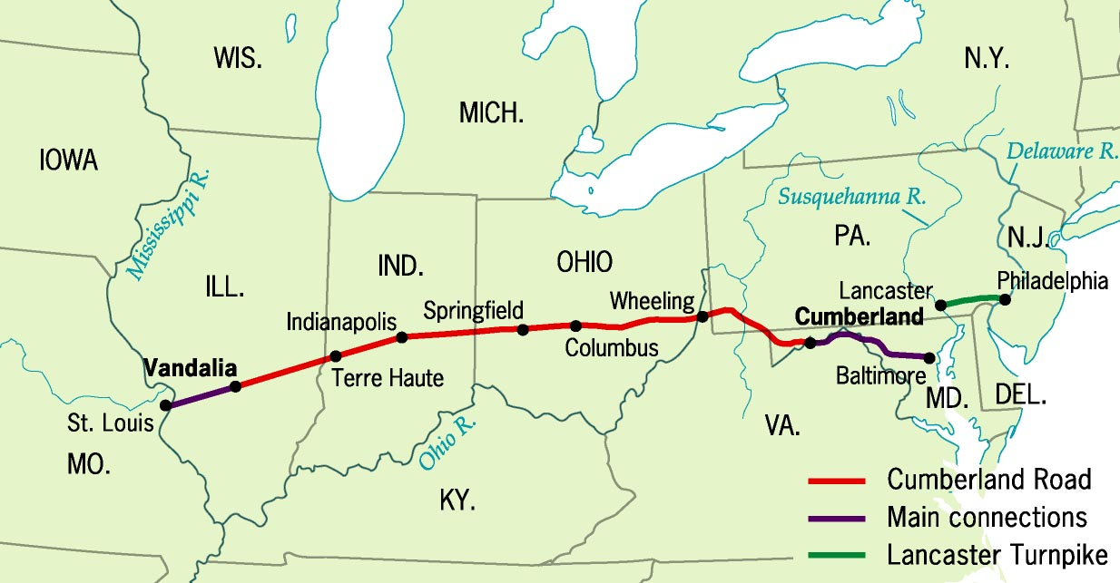
States’ righters (a person who opposes federal intervention in affairs of the separate states) BLOCKED spending of federal funds on internal improvements…
interstate-highway construction unusual
National/Cumberland road was an exception...

Slide 10
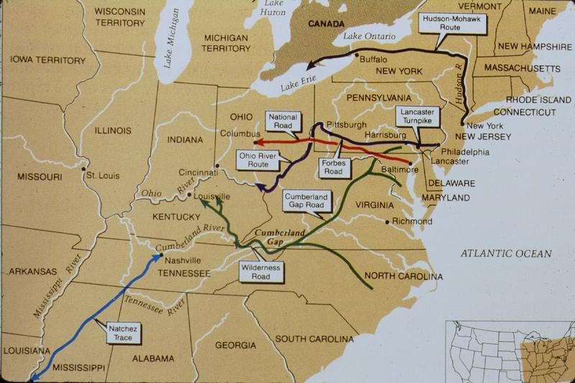
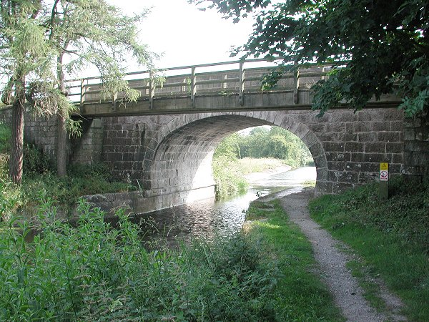
America's 1st Turnpike:
Pennsylvania’s Lancaster Turnpike, PA 1790
By 1832, nearly 2,400 miles of roads connected most major cities

Slide 11
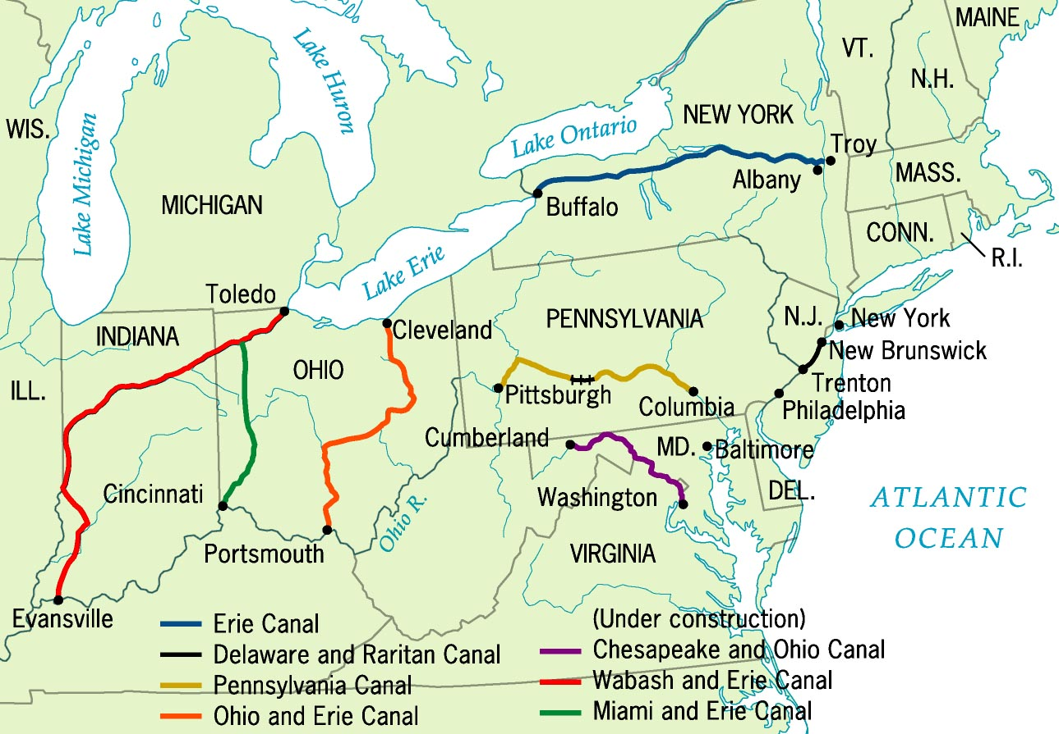
Principle Canals by 1840
Steamboats & canals stimulated commercial agriculture by providing for the free-flow of manufactured goods TO THE WEST

Slide 12
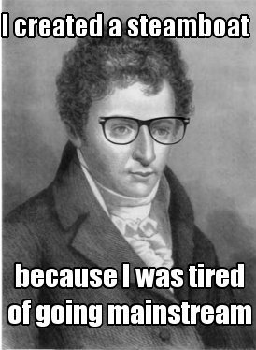
Steamboats & Canals
Mississippi & Ohio Rivers helped farmers get their goods to the East but there was no fast way to get manufactured goods to the West…
Robert Fulton – steamboat – connected the West with Northern manufacturing
State-directed canal projects cut shipping costs by 90% between the West & the North
Steamboats provided upstream shipping with reduce costs & increased speeds

Slide 13
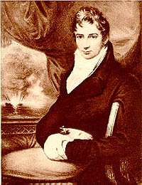
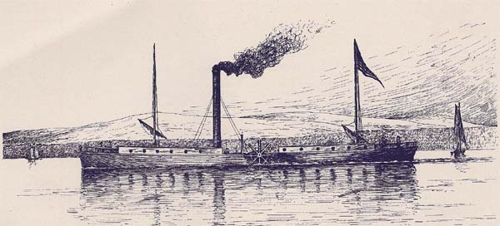
Robert Fulton’ s Steamboat
The Clermont

Slide 14
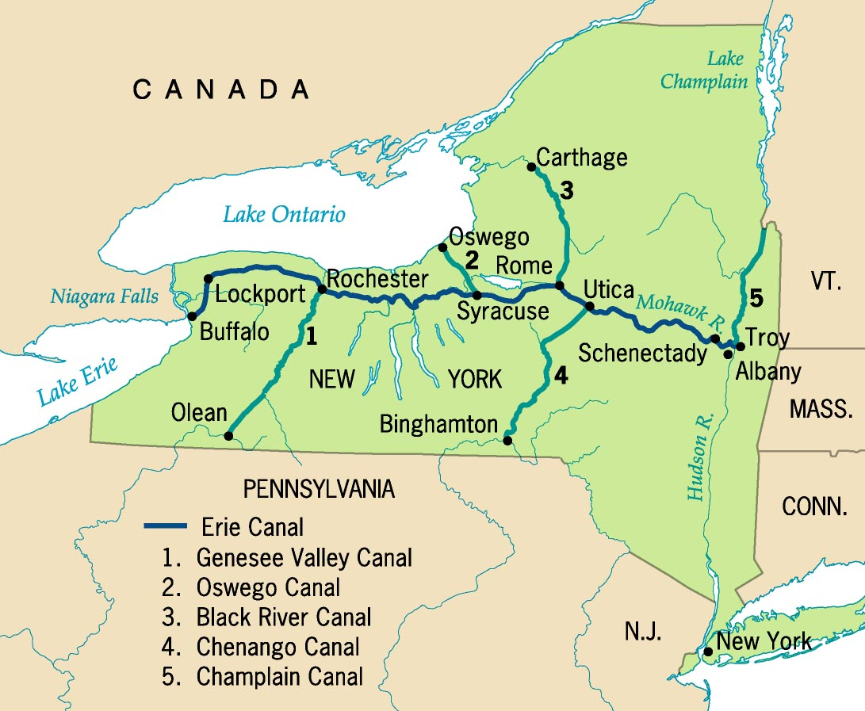
The Erie Canal (1825) provided the 1st link between East cities & West farms
VIDEO
What obstacles did the men face while constructing the Erie Canal?
The Erie Canal made New York City the commercial capital of the U.S.

Slide 15
The Railroad
From 1840 to 1860, the greatest new transportation advancement!
RAPID and RELIABLE!
Railroads began to challenge canals’ dominance
Stimulated industrial & commercial agricultural growth
Led to state & local gov’t subsidies (aids)
Turned small western towns into BOOMING COMMERCIAL CENTERS (Cleveland, Detroit, Chicago)

Slide 17
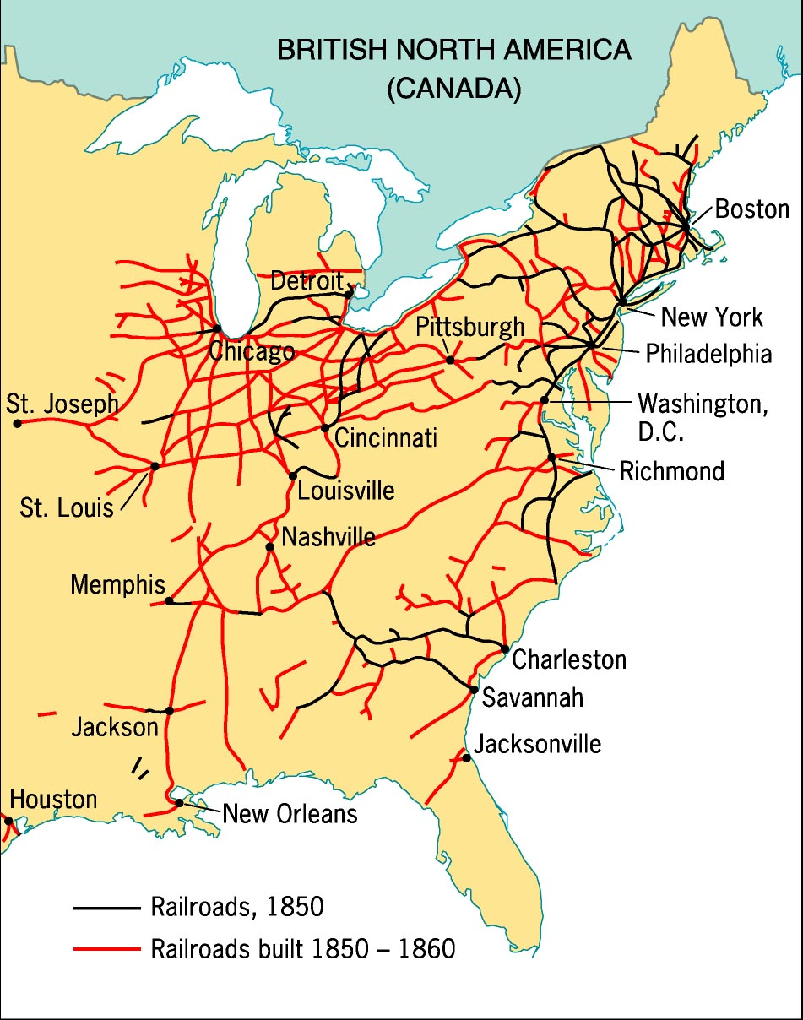
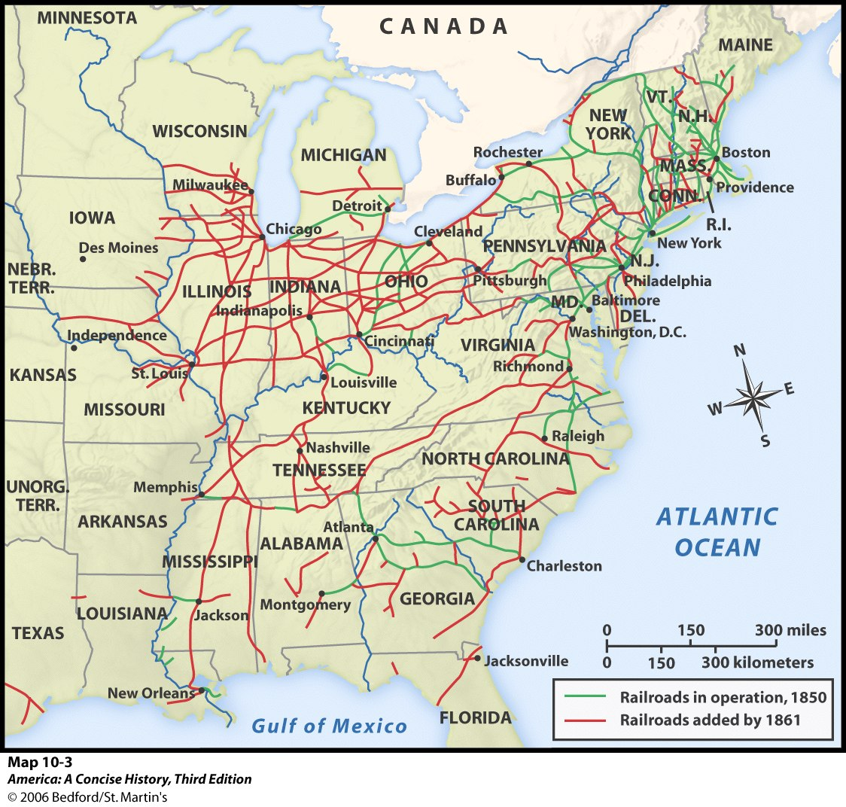
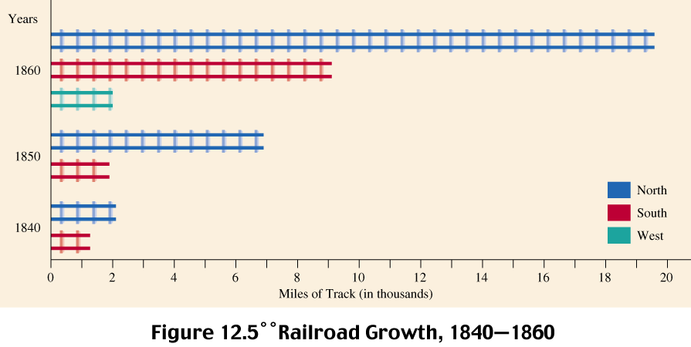
The Railroad Revolution, 1850s
Railroad Expansion by 1860
The Expansion of Railroads by Region
Immigrant labor built railroads in the North
Slave labor built railroads in the South

Slide 18
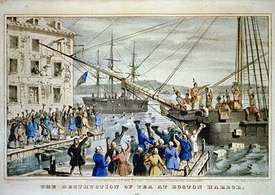
Today in history:
December 16, 1773 – The Boston Tea Party
DO NOW:
What inventions shaped the Industrial Revolution of the United States during the early-mid 1800s? HOW?
What is a “market revolution”, and how is it different from an “industrial revolution”?
Throughout the 19th century, what was the principle cash crop of the South?

Slide 19
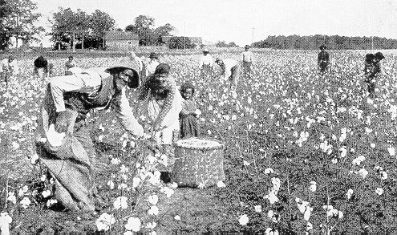
AIM: How did the growth of industry impact women and African Americans throughout the United States during the 19th century?
Notes:
Lesson Plan for Thursday, October 9, 2008: Warm-Up Question, Market Revolution Notes

Slide 20
A Market Revolution!
1840: improved transportation & innovations = a national market economy:
based on commercial farming & manufactured goods
But, the U.S. economy was driven by regional specialization
Western commercial farming
Northern industry
Southern cotton production

Slide 21
Rise of commercial agriculture
Farming becoming more COMMERCIAL and less about SUBSISTENCE
WHY?
Cheap land out west and easy credit from state banks
Markets expanding because of canals and railroads

Slide 22
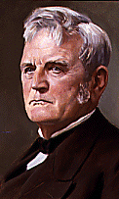
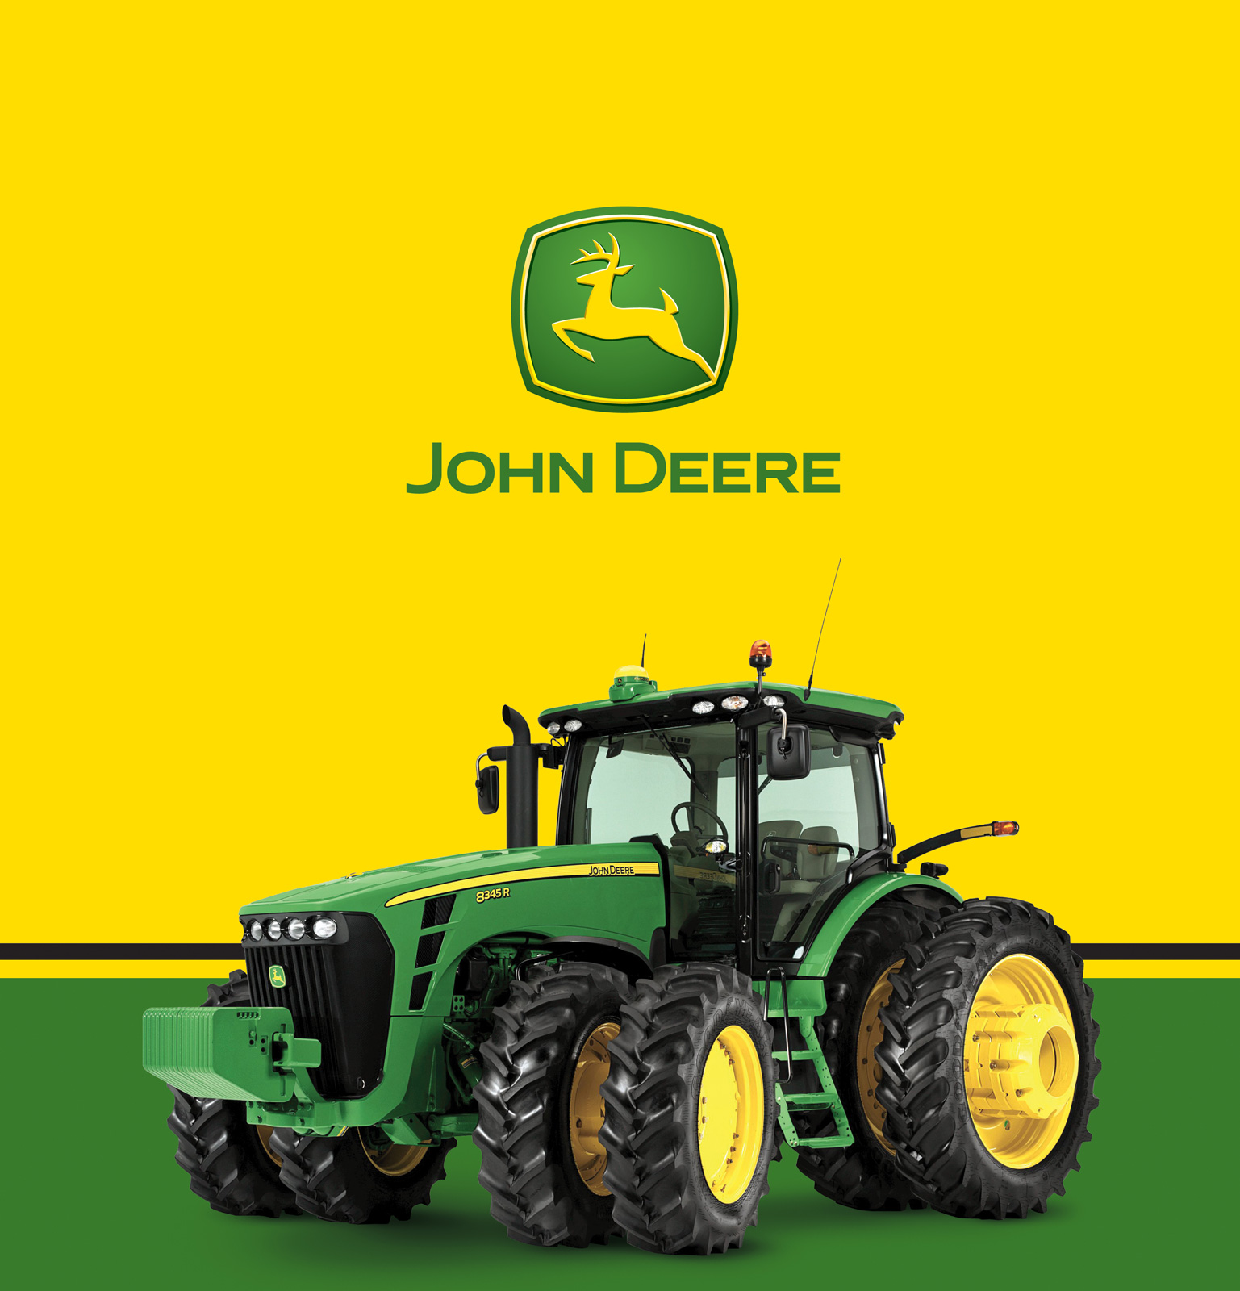
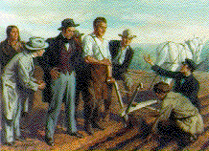
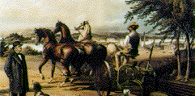
#1 John Deere & the Steel Plow (1837)

Slide 23
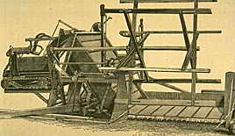
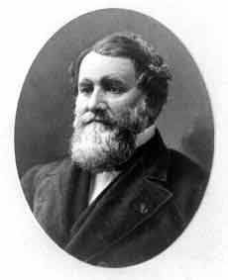
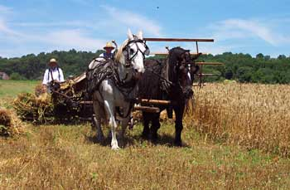
#2 Cyrus McCormick & the Mechanical Reaper (1837)
cuts grain

Slide 24
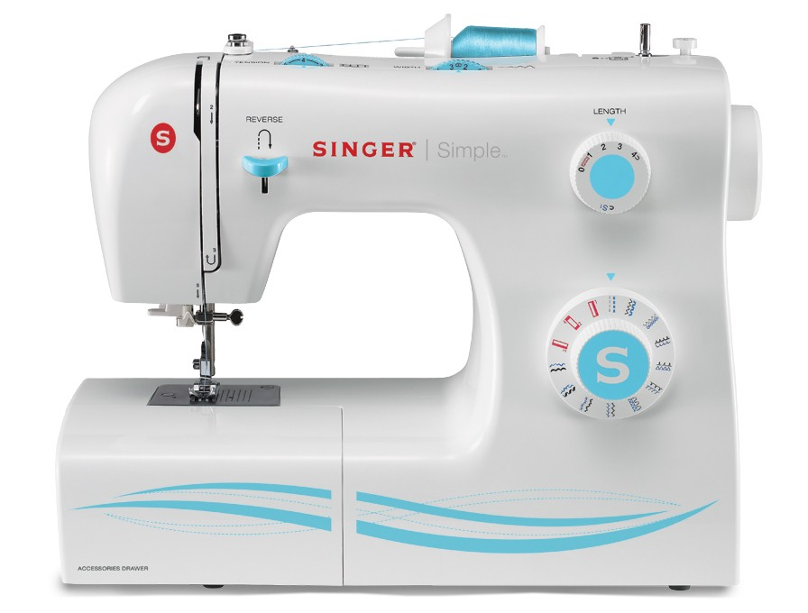
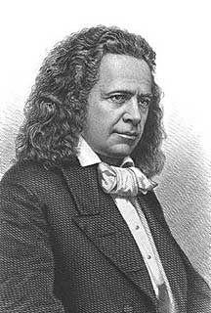
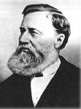
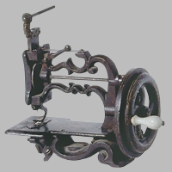
#3 Elias Howe & Isaac Singer
1840s Sewing Machine

Slide 25
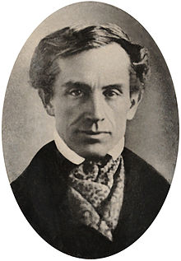
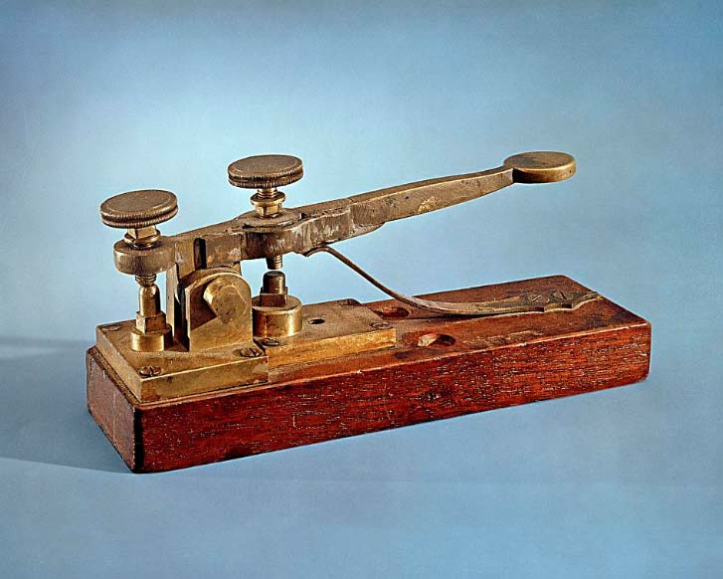
#4 Samuel Morse’s telegraph (1823)
System of dots and dashes to send messages across long distances electronically through a wire.
It connected the different hemispheres of the world, allowing for more communication between people.

Slide 26
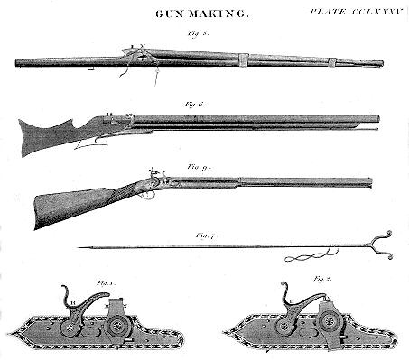
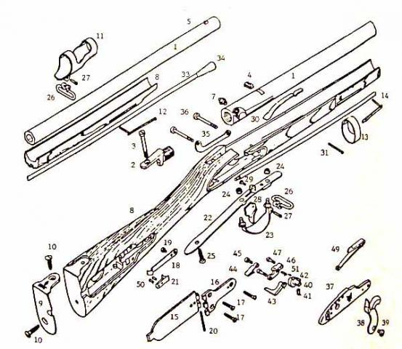
#5 Eli Whitney’s 1st Critical Invention
Standardized parts which are all identical and thus, interchangeable.
Introduced Interchangeable Rifle Parts

Slide 27
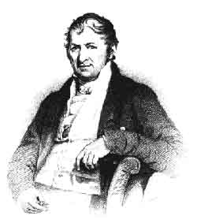
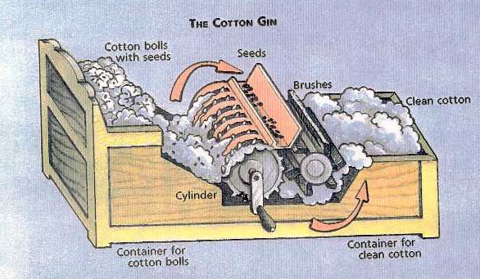
#6 Eli Whitney’s OTHER critical invention = Cotton Gin (1793)
Actually invented by a slave!

Slide 28
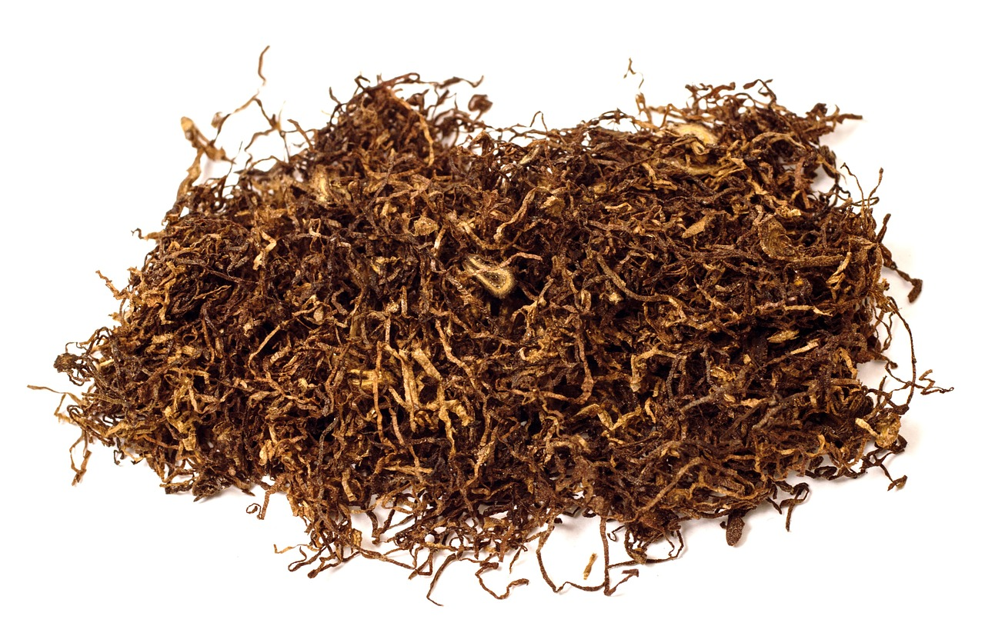
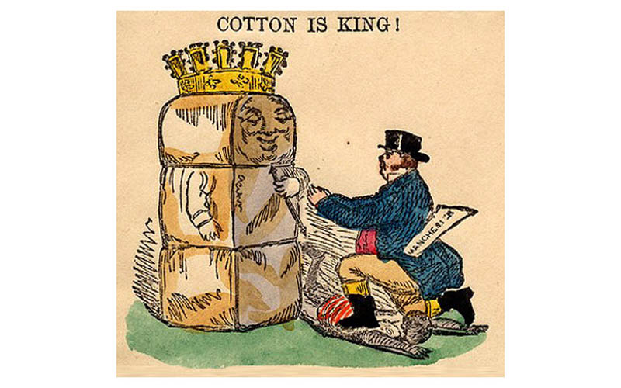
Cotton and the South
Cotton gin transformed agriculture…
Cotton > tobacco and indigo
Capital spent on slaves and new land
Sold most cotton to British textile factories
S. Carolina & Georgia >> AL, MISS, LOU, TX
“KING COTTON” = economic dominance of the Southern cotton industry
"You daren't make war against cotton! ...Cotton is king!"

Slide 29
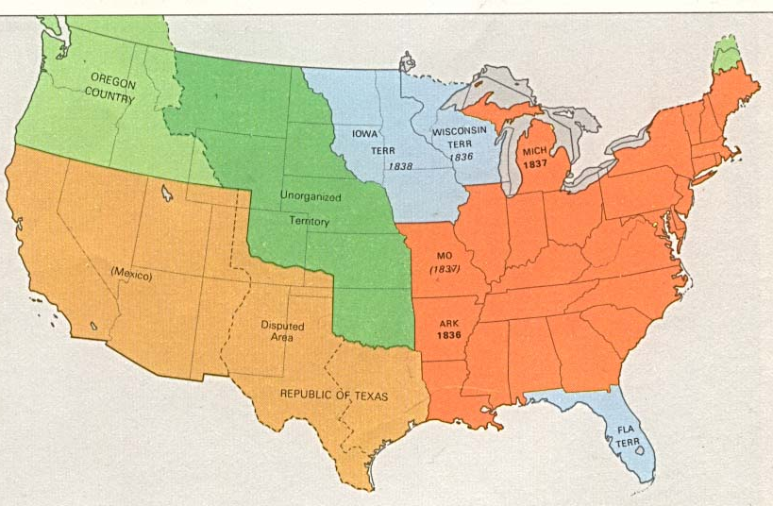
America in 1840
The Antebellum South
Cotton production divided society in the Deep South:
Large plantations with lots of slaves made good money
Poor yeoman (family farm with few or no slaves) mixed commercial & subsistence farming

Slide 30
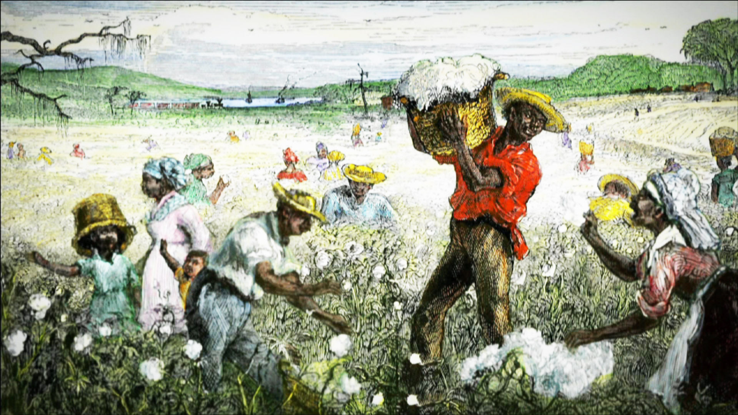
America the Story of US
“The Cotton Gin”
Take notes on slave life/conditions
What were THREE impacts of the expansion of the cotton industry?
VIDEO

Slide 31
Slave Population, 1820
Slave Population, 1860
Slave Population, 1840

Slide 32
Cotton boom = increase in # of slaves (1 million in 1800 to nearly 4 million in 1860)
Many were smuggled…slave trade wasn’t allowed since 1808!
Deep South – slaves = 75 % of population
1860 - 250,000 African Americans in the south were FREE! HOW?!
American Rev
Mulatto- liberated by white fathers
Self-purchase freedom (wages from side work)
Constantly show papers that they were free

Slide 33
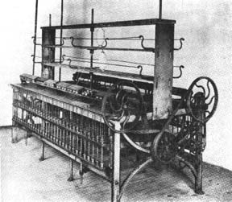
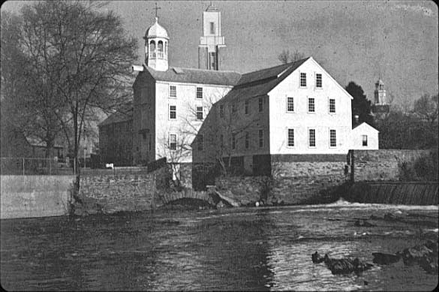
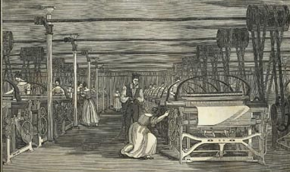
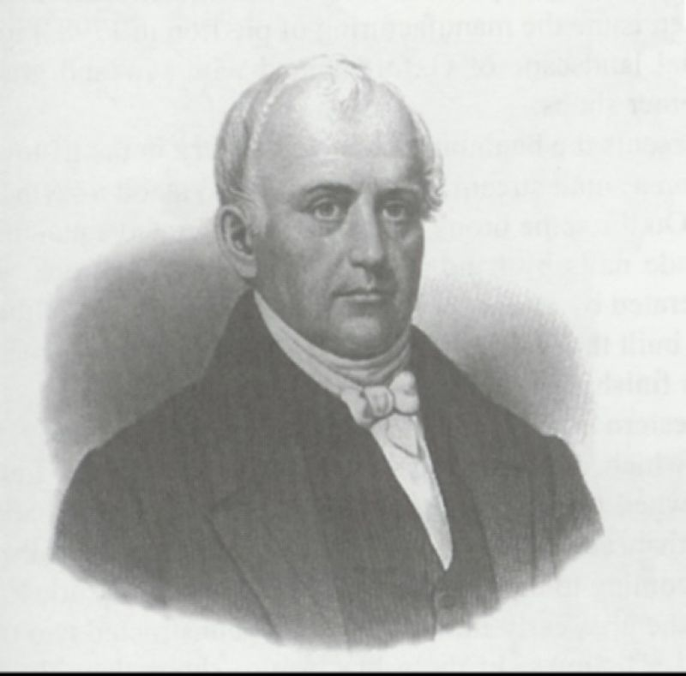
Early Textile Loom
Samuel Slater (“Father of the Factory System”)
Slater - first US factory (1791)
Cotton-spinning secrets from Britain

Slide 34
EFFECTS of the Market Revolution on WOMEN
1815: 65% of all U.S. clothing was made by women at home in the “putting out” system
production of goods in private homes under the supervision of a merchant who "put out" the raw materials
1840: textile manufacturing grew, especially in New England, due to a series of new textile-linked inventions…
The most famous factory was the Lowell Mill in Boston
Brought families extra income

Slide 35
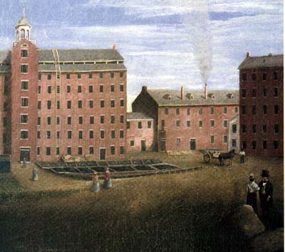
Lowell Boarding Houses
The Lowell System: The 1st Dual-Purpose Textile Plant
Francis Cabot Lowell’s town - 1814

Slide 36
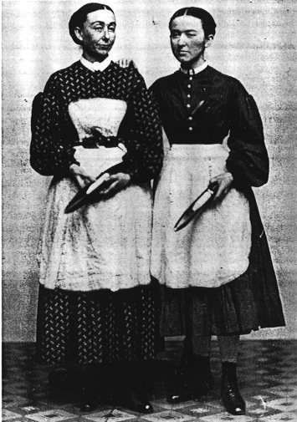
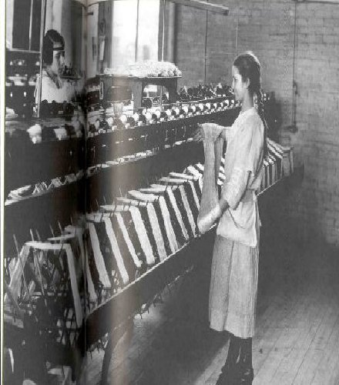
Lowell Girls
END of self-sufficient households
Young farm women (no longer needed on farms working next to men)
Domestic service OR teaching in cities
Mostly single women – having less children
Still NO real legal/political rights
DOCUMENT ANALYSIS: What was their typical “profile?”

Slide 37
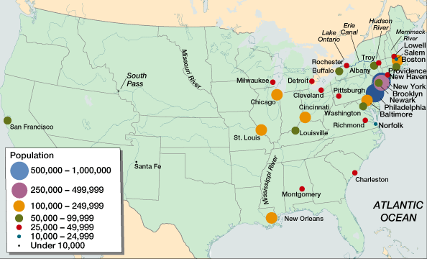
American Population Centers in 1820
American Population Centers in 1860

