Slide 1
Today’s AIM: How did the arguments of Federalists and Anti-Federalists eventually lead to the ratification of the Constitution?
EQ:
What roles did the Federalists and Anti-Federalists play in ratification?
Should there be a Bill of Rights? Is it needed?

Slide 2
PERIOD 3: 1754-1800
Key Concept of Today’s Lesson:
3.2 (II) E) In the debate over ratifying the Constitution, Anti-Federalists opposing ratification battled with Federalists, whose principles were articulated in the Federalist Papers. Federalists ensured that ratification of the Constitution by promising the addition of a Bill of Rights that enumerated individual rights and explicitly restricted the powers of the federal government.

Slide 3
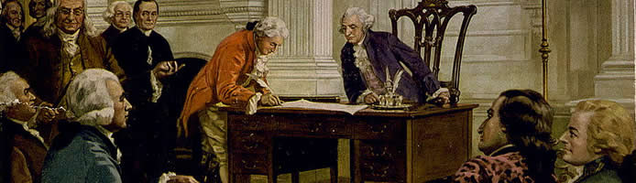
After 17 weeks of debating, the convention approved a draft of the Constitution to submit to the states for ratification.

Slide 4
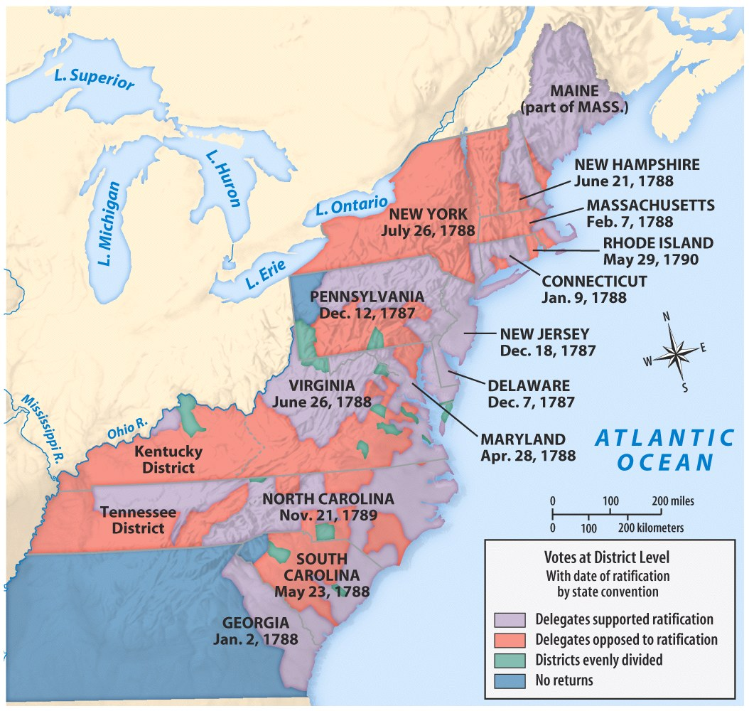
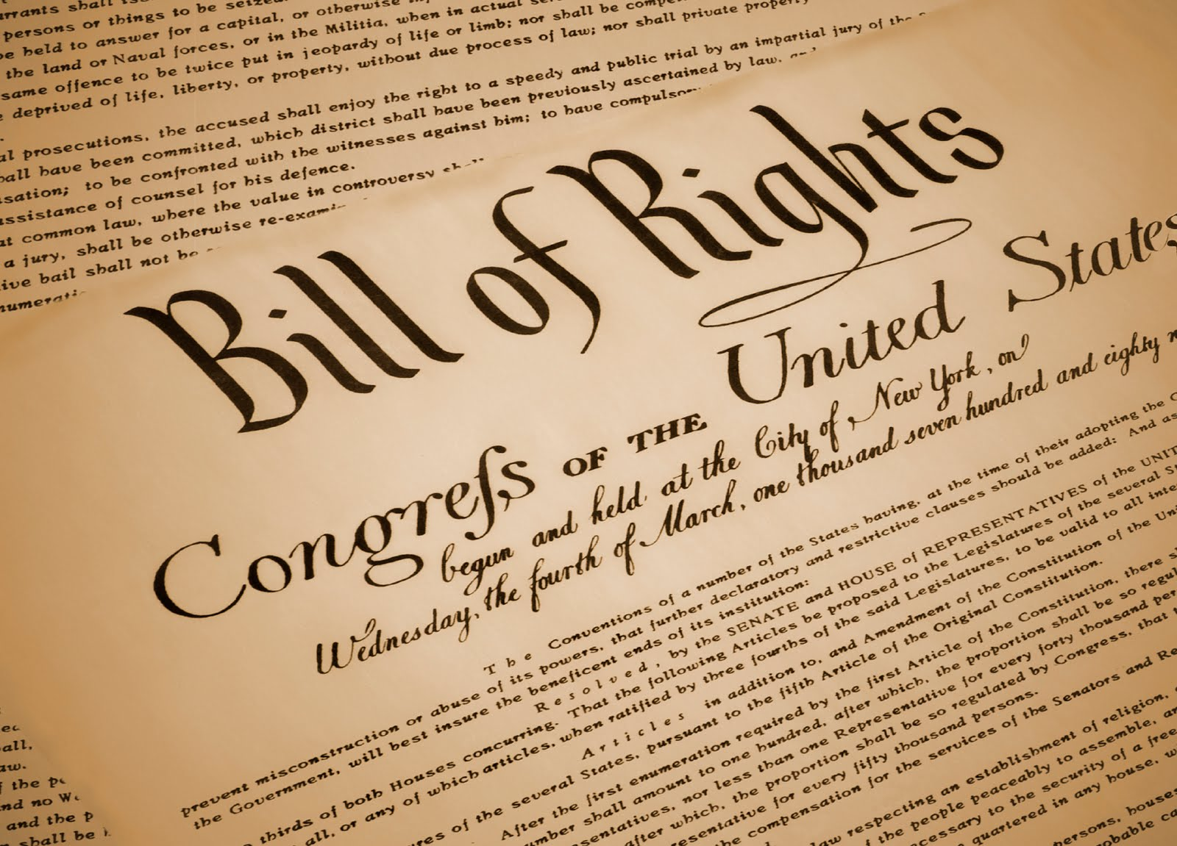
RATIFICATION
9 of 13 states had to ratify the Constitution
September 17, 1787 = draft sent to states for ratification:
WE’RE REALLY CLOSE to getting this document passed…
1 LAST DOCUMENT was going to change EVERYTHING

Slide 5
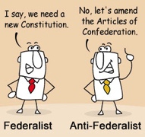
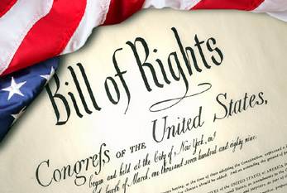
Was it necessary for people’s rights to be listed in the Constitution? Is it necessary today?
VIDEO
Argument FOR (Anti-Federalists):
Adding it protected Americans against tyrannical central government
Argument AGAINST (Federalists):
Better to assume all rights than make a limited list of them (they’re going to back off!)

Slide 6
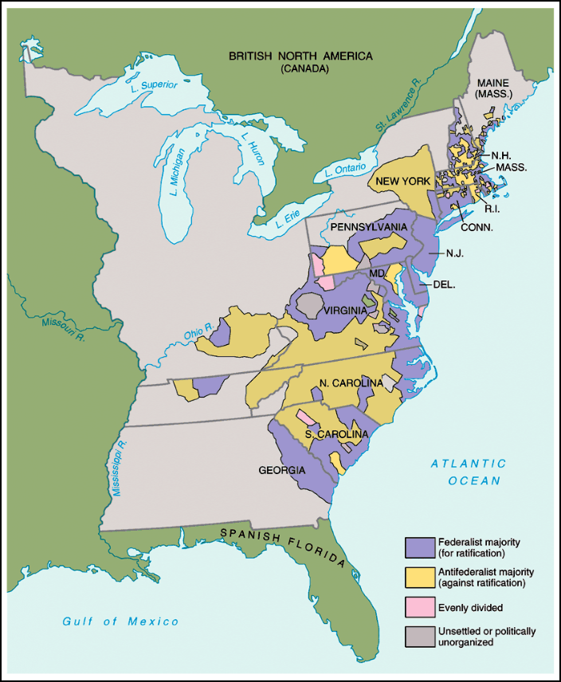
Federalists & Anti-Federalists
Federalists
Leaders = Washington, Franklin, Madison, Hamilton
Arguments = stronger central government needed!
Strategy = emphasized weaknesses of Articles
Advantages = strong leaders, organized
Disadvantages = Constitution was NEW and untried
Anti-Federalists
Leaders = Mason and Henry (VA), Hancock (MA), Clinton (NY)
Arguments = stronger central gov’t would destroy work of revolution
Strategy = Constitution gave gov’t more power than British had!
Advantages = appealed to popular distrust of gov’t
Disadvantages = Poorly organized, slow responses
Anti-Federalists argued for more protection of individual liberties
“The Constitution is itself a Bill of Rights”
Notes:
26

Slide 7
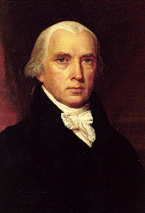
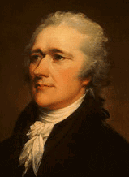
The
Federalist
Papers
The Federalist Papers
series of 85 essays written by Hamilton, Madison and Jay
Supported the Constitution and a strong central government

Slide 8
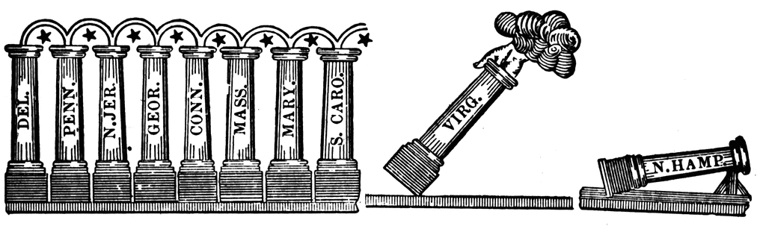
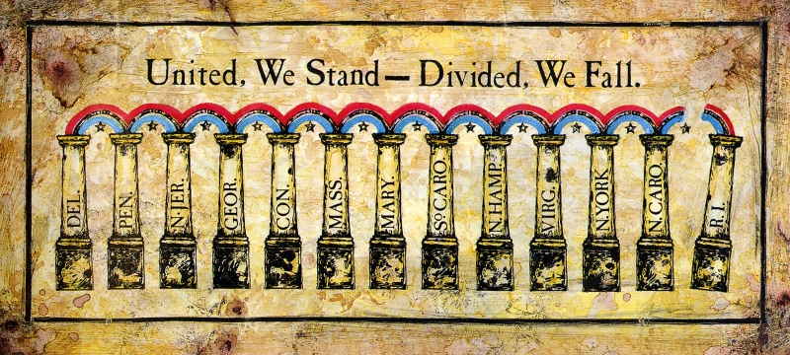
Ratification of the Constitution
Once a Bill of Rights was added, the rest of the states ratified!
If 1776 was the 1st American Revolution…1787-88 was the 2nd American Revolution…

Slide 9
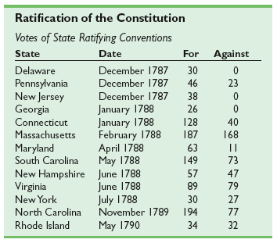
RATIFICATION

Slide 10
Today’s AIM: To what extent was George Washington a successful 1st President of the United States?
EQ:
Is it important that Washington established a cabinet?
Why did Washington choose a policy of neutrality for the U.S.?

Slide 11
Key Concept 3.2.III
PERIOD 3: 1754-1800
A) During the presidential administrations of George Washington and John Adams, political leaders created institutions and precedents that put the principles of the Constitution into practice.

Slide 12
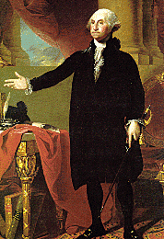
George Washington
“About ten o’clock I bade adieu [farewell] to Mount Vernon, to private life, and to domestic felicity [happiness]; and with a mind oppressed with more anxious and painful sensations than I have words to express, set out for New York… with the best dispositions [intentions] to render service to my country in obedience to its call, but with less hope of answering its expectations.”
- From, The Diaries of George Washington
Based on this quote, how does Washington feel about becoming the president?

Slide 13
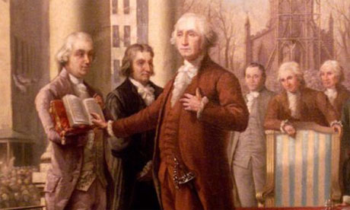
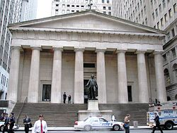
“The preservation of the sacred fire of liberty, and the destiny of the republican model of government, are justly considered deeply, perhaps as finally, staked on the experiment entrusted to the hands of the American people.”
Federal Hall, NYC (temporary capital)
April 30, 1789
UNANIMOUS choice for president (obviously!)
John Adams = VP
George Washington’s
Inauguration

Slide 14
Presidential Rankings: C-Span Survey, 2009
Abraham Lincoln Franklin Roosevelt George Washington Theodore Roosevelt Harry Truman John Kennedy Thomas Jefferson Dwight Eisenhower Woodrow Wilson Ronald Reagan Lyndon Johnson James Polk Andrew Jackson James Monroe | 15. Bill Clinton 16. William McKinley 17. John Adams 18. George H.W. Bush 19. John Quincy Adams 20. James Madison 21. Grover Cleveland 22. Gerald Ford 23. Ulysses Grant 24. William Taft 25. Jimmy Carter 26. Calvin Coolidge 27. Richard Nixon 28. James Garfield
29. Zachary Taylor
30. Benjamin Harrison
31. Martin Van Buren
32. Chester Arthur
33. Rutherford Hayes
34. Herbert Hoover
35. John Tyler
36. George W. Bush
37. Millard Fillmore
38. Warren Harding
39. William Harrison
40. Franklin Pierce
41. Andrew Johnson
42. James Buchanan

Slide 15
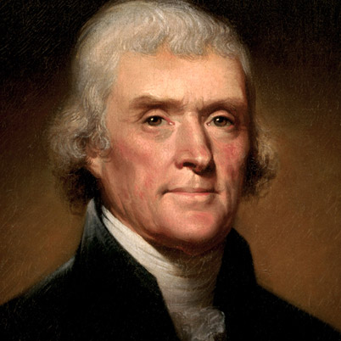
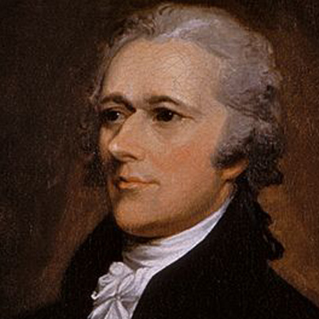
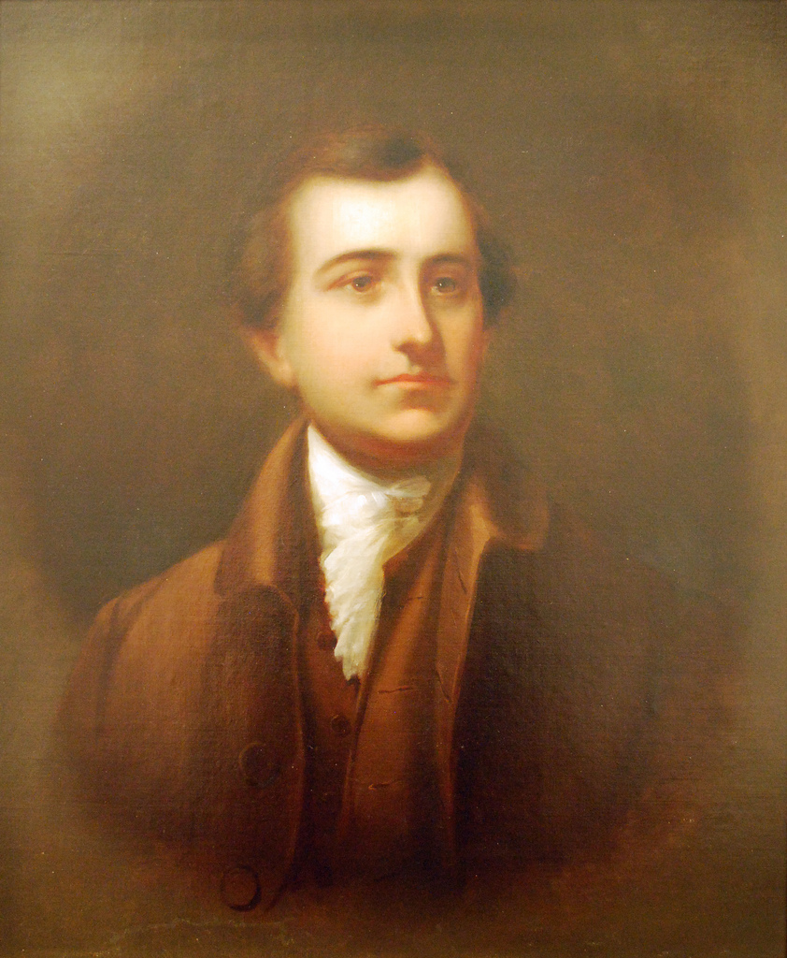
Washington’s Presidency
“We are in a wilderness without a single footstep to guide us.” – James Madison
Established in Article II, Section 2 of the Constitution, the Cabinet's role is to advise the President on any subject he may require relating to the duties of each member's respective office.
Have to be approved by the Senate
The 1st Cabinet:
Secretary of State =
Thomas Jefferson
Secretary of the Treasury =
Alexander Hamilton
Secretary of War =
Henry Knox
Attorney General =
Edmund Randolph

Slide 16
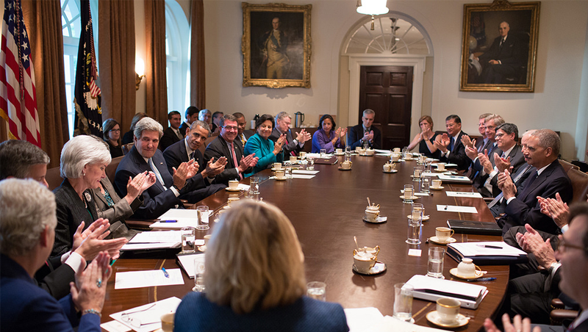
Obama’s Cabinet
Today, the Cabinet includes the Vice President and the heads of 15 executive departments — the Secretaries of Agriculture, Commerce, Defense, Education, Energy, Health and Human Services, Homeland Security, Housing and Urban Development, Interior, Labor, State, Transportation, Treasury, and Veterans Affairs, as well as the Attorney General.

Slide 17

Foreign Problems and Solutions
The French Revolution! - Should the USA pick a side?
Had an alliance with French monarchy…also sympathized with revolution
2. Washington’s advice: Neutrality
The Proclamation of Neutrality (1793)
“The duty and interest of the United States require, that they should with sincerity and good faith adopt and pursue a conduct friendly and impartial toward the belligerent [warring] Powers” – George Washington
Why neutrality?

Slide 18
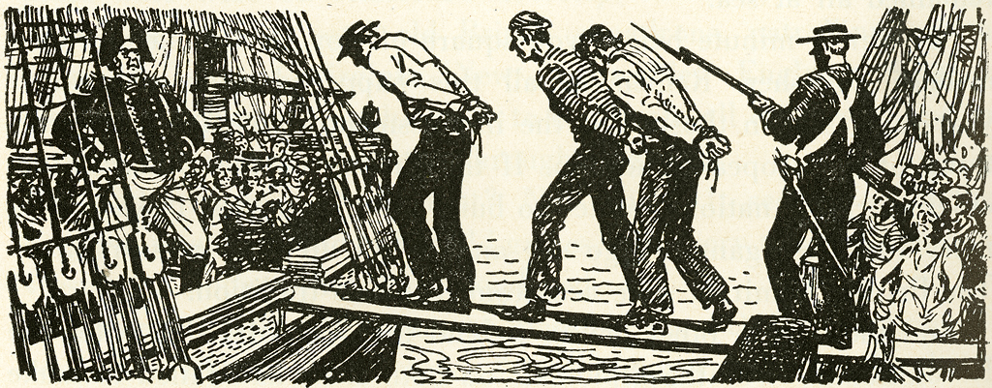
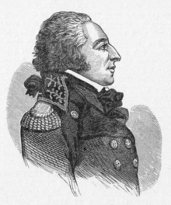
Foreign Problems and Solutions
3. “Citizen” Genet
French minister to US
Appealed directly to the American people to support the French revolutionary cause
OFFENSIVE, REMOVE HIM! – TJ and GW
4. The Jay Treaty (1794)
John Jay
STOP SEIZING! STOP IMPRESSMENT!
Britain evacuates West, treaty didn’t address seizure!
UNPOPULAR! Why?
Kept neutrality = PEACE
Angered supporters of France

Slide 19
Domestic Problems and Solutions
1. The Debt!
Foreign and domestic debts
2. Alexander Hamilton created a National Bank
This created a strong and sound [good] financial plan for the country
3. Created excise taxes (tax on luxury goods)– to raise money for the gov’t
Led to the Whiskey Rebellion
This tested Washington’s presidency – Did he pass the test?

Slide 20
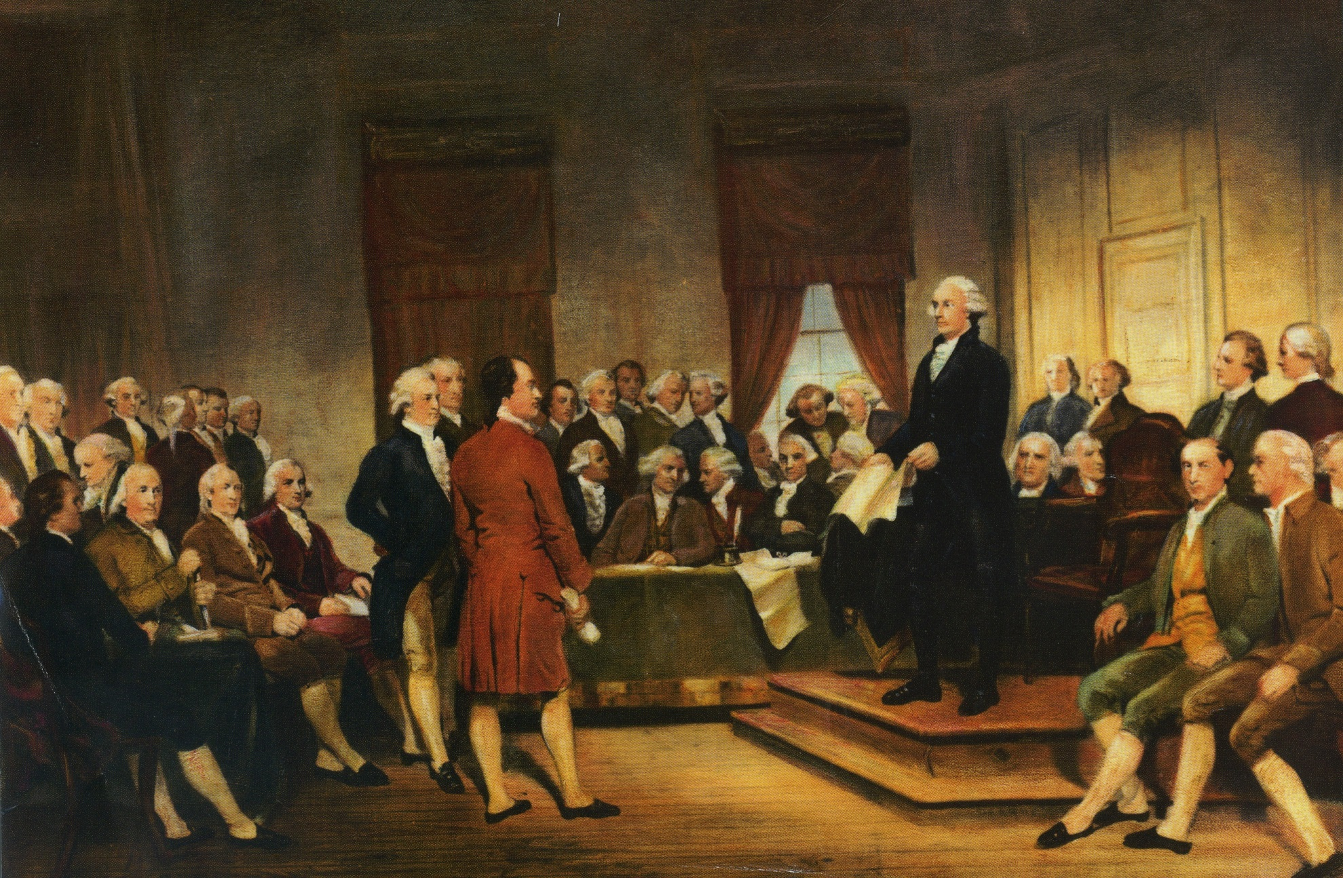
DEBATES
IDK…but how are we going to CHOOSE HIM?
TBH, a chief executive should hold office for LIFE!
PLZ NO MORE KING!

Slide 21
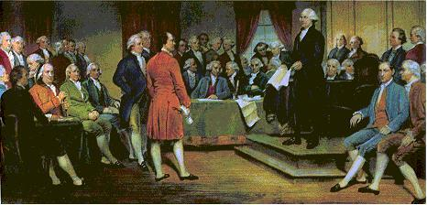
Creating an EXECUTIVE
GIVE HIM POWER = VETO acts of Congress
FOUR year term limit (no limit to # of terms if reelected)
Electoral College
Should the electoral system be CHANGED or REMOVED? WHY?

Slide 22

ELECTORAL COLLEGE
Historical Background
Why was the Electoral College created by the Framers?
  Created as an alternative to either popular election or Congress electing the President.
  Each state chose electors---based on the number of representatives each states has in Congress.
2. Electoral vote was state to state --- each elector voted for two candidates…. One vote per candidate.
  Electors vote with the “will” of the people from the state they represented……….but not required.
  Candidate with the most votes became President; runner-up became Vice President.
3. In case of a tie, the House of Representatives elected the President.

Slide 23
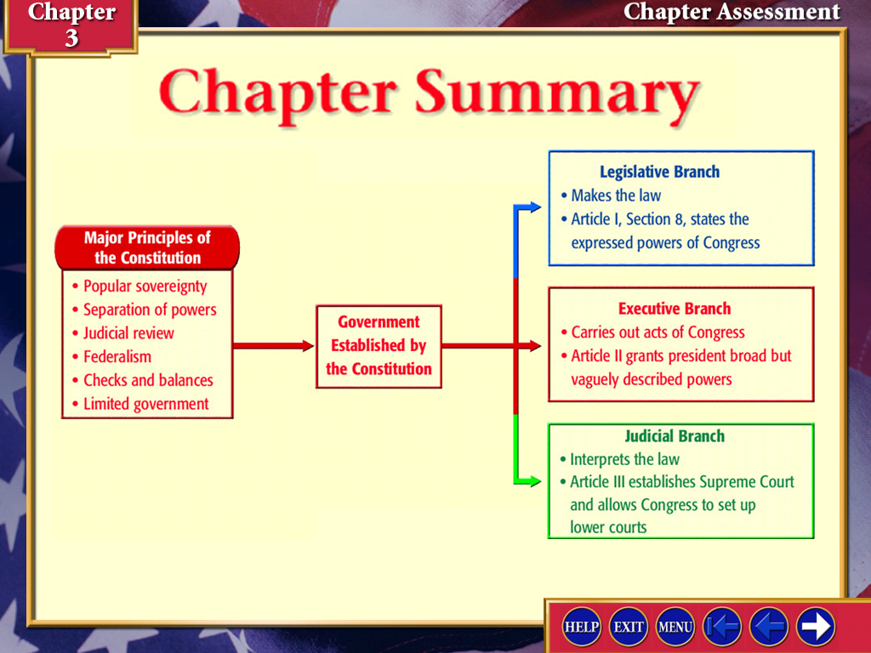
Key Ideas of the Constitution
1. Popular Sovereignty: the people have power by voting for leaders
2. Limited gov’t:
stronger national gov’t, but peoples’ liberty still protected
3. Federalism:
the national gov’t shares power with state gov’ts

Slide 24

DELEGATED/ ENUMERATED POWERS | CONCURRENT/ SHARED POWERS | RESERVED POWERS
National government | National & State | State governments
1. Control foreign affairs | 1. Taxation | 1. Providing education
2. Provide national defense | 2. Borrowing $$ | 2. Establishing marriage laws
3. Regulate trade BETWEEN states | 3. Establish courts | 3. Drivers Licenses/Elections
The supremacy clause says the Constitution (not the states) is the "the supreme law of the land"

Slide 25
Key Ideas of the Constitution
4. Separation of powers: three branches with defined powers
5. Checks and Balances: prevent one branch from exerting too much power

Slide 26
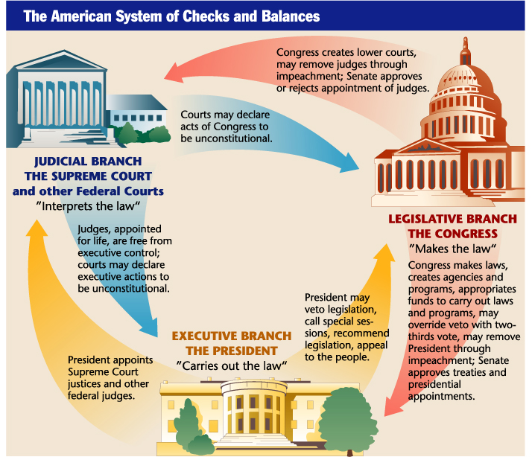
Is the system of checks and balances an effective way to organize the powers of government? WHY or WHY NOT?

