Slide 1
Aim: To what extent were labor unions successful in achieving their goals in the late 1800’s?

Slide 2
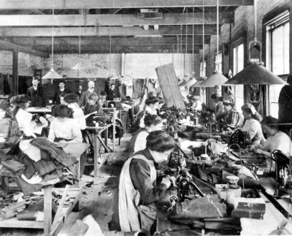
Workers have to adjust
Don’t Copy!
Before the Civil War, many factories were SMALL and run by families…
Workers could bargain with their bosses for wages.
By the late 1880s, the relationship between workers and their bosses DECLINED...
Workers stood all day next to machines.
Factories were crowded and noisy.
SWEATSHOPS were created...
Poor conditions, low pay
Most workers were immigrants, young women, and children.

Slide 3
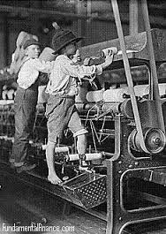
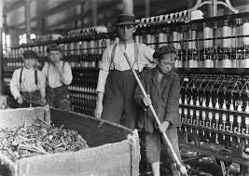
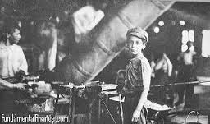
Child Labor
1900 census - 2 MILLION children under the age of 15 at work throughout the country.
Boys and girls worked in DANGEROUS textile mills, tobacco factories, and garment sweatshops.
In coal mines, children picked stones out of the coal for 12 hours a day, 6 days a week.
Asked to work so they could be paid LESS!
Don’t Copy!

Slide 4
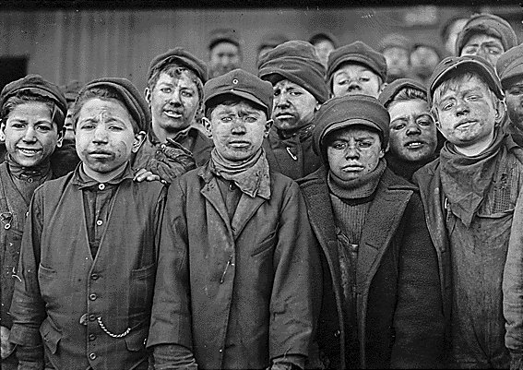
Young boys work in a coal mine

Slide 5
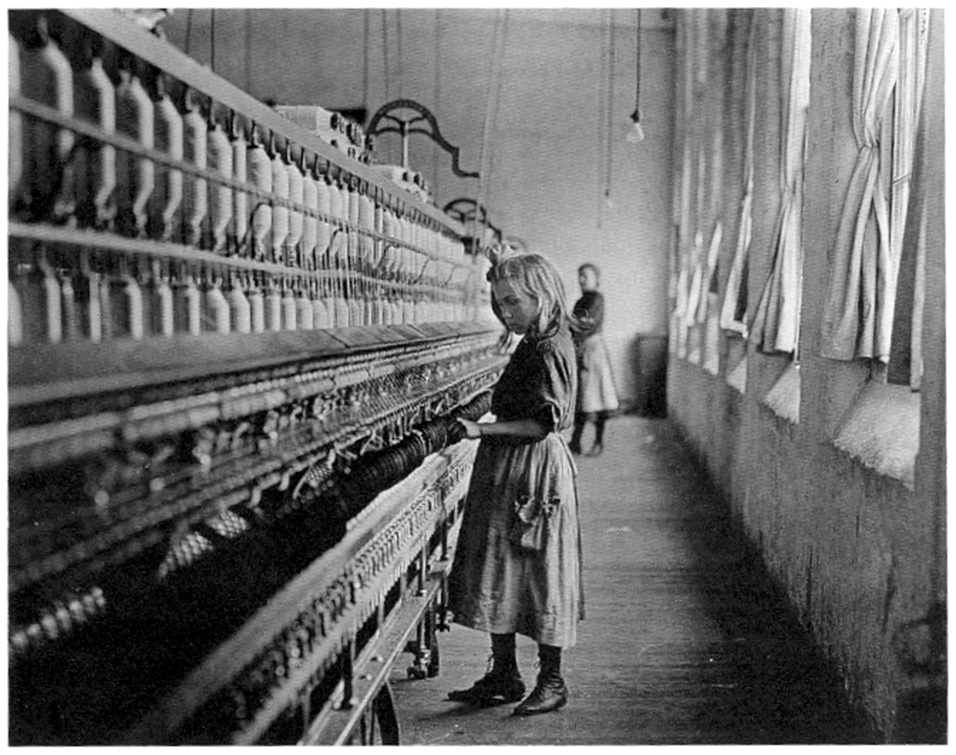
Young girls work with heavy machinery

Slide 6
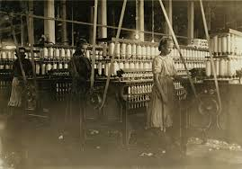
Don’t Copy!
Dangerous Conditions
Lung-damaging dust filled the air of textile mills.

Slide 7
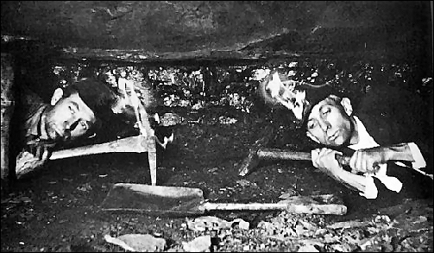
Don’t Copy!
2. Cave-ins and gas explosions
plagued mines.

Slide 8
Triangle Factory Tragedy
While you watch:
What were the CAUSES and EFFECTS of the Triangle Factory Tragedy?
VIDEO

Slide 9
Triangle Tragedy
Don’t Copy!
1911: fire breaks out in Triangle Shirtwaist Factory (sweatshop in NY city)
Exits are locked (lockouts for union employees)
No doors push out (body blocks)
Fire truck ladders can’t reach windows
Fire hoses not long enough
Elevators didn’t work (no one knew)
Poor/ overwhelmed communications don’t transfer
Windows on lower floors have bars on them
Only option….JUMP!
150 people die
Result: new safety laws

Slide 10
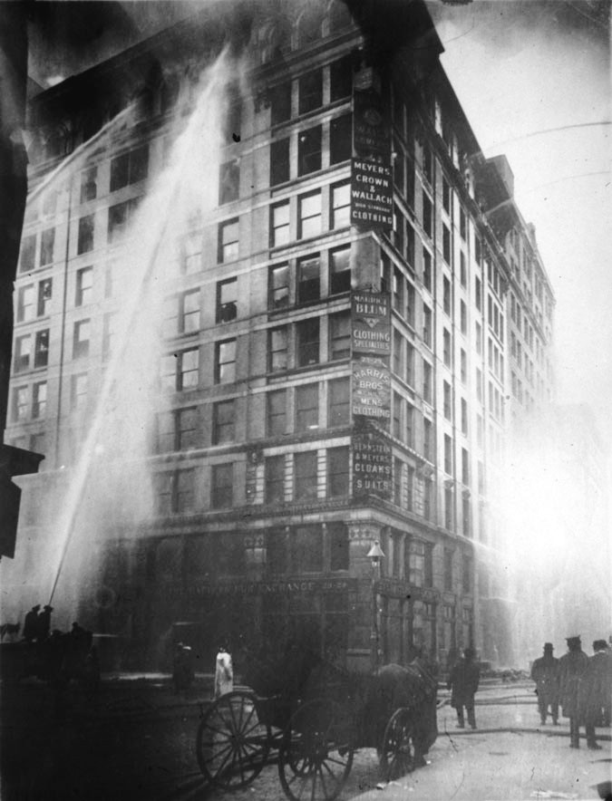
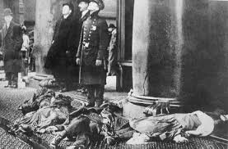
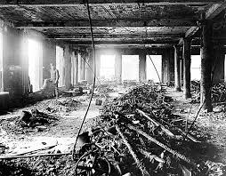
Triangle Factory Fire

Slide 11
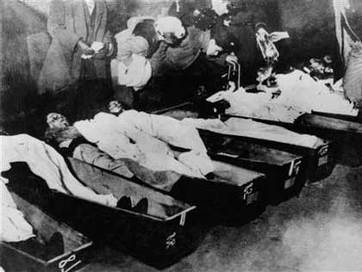
“As I looked up there at a window, a young man was helping girls to leap out. Suddenly one of them put her arms around him and kissed him. Then he held her out into space and dropped her. He jumped next. Thud…dead. Thud…dead” – NY Times March 26th 1911
Biggest travesty to hit NY until 9/11/2001

Slide 12
“We meant to make things over.
We’re tired of toil for naught,
With bare hands enough to live upon
And never an hour for thought.
We want to feel the sunshine,
And want to smell the flowers,
We’re sure that God has willed it
And we mean to have eight hours.
From the shipyard, shop and mill;
Eight hours for work, eight hours for rest,
Eight hours for what will!”
Source: Herbert Gutman “Who Built America”, 1992.
What did workers want from employers? Why?
How did child labor weaken the labor movement?

Slide 13
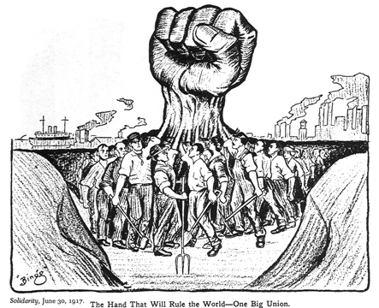
Collective bargaining
Using elected union officials to negotiate with employers for changes in the workplace
In response to the low wages, long hours, and dangerous working conditions, many workers joined LABOR UNIONS to collectively bargain for improvements

Slide 14
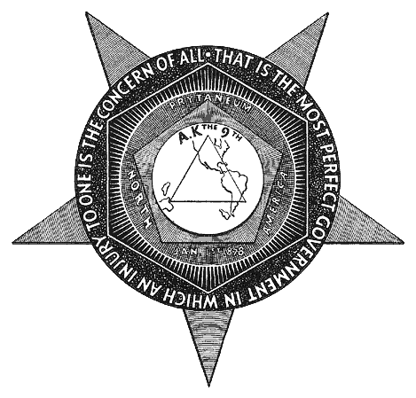
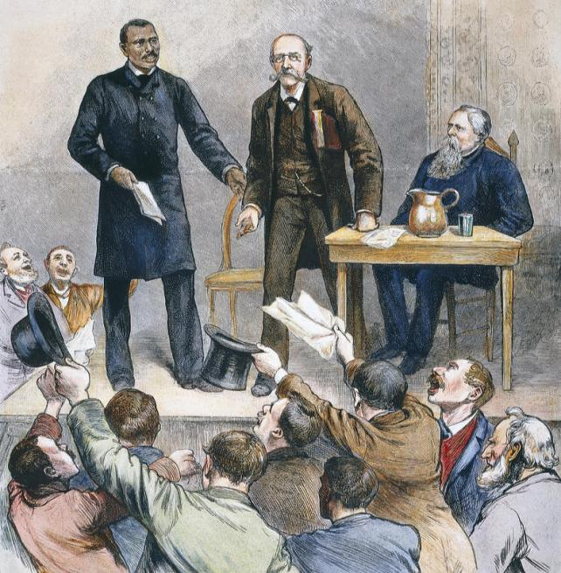
Among the first labor unions in America was the Knights of Labor (1869) – Terence V. Powderly
The Knights of Labor was open to ALL workers regardless of race, gender, or skill
Began as a secret society

Slide 15
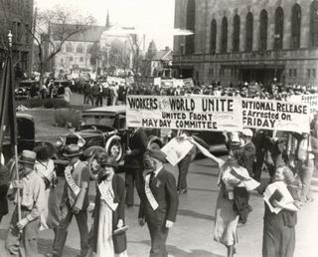
The Knights of Labor held rallies in favor of…
Shorter workday
End to child labor
Equal pay for men and women
Workers and employers share ownership & profits
1885: 700,000 people join KOL
TAKE A PIC!

Slide 16
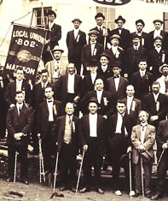
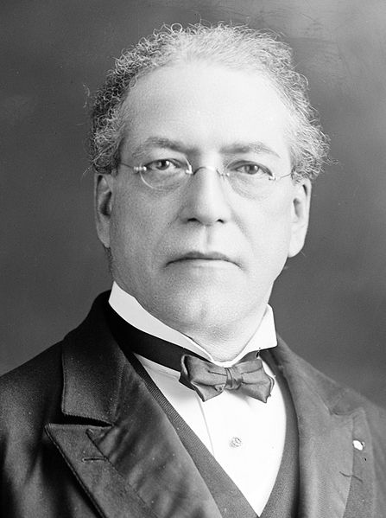
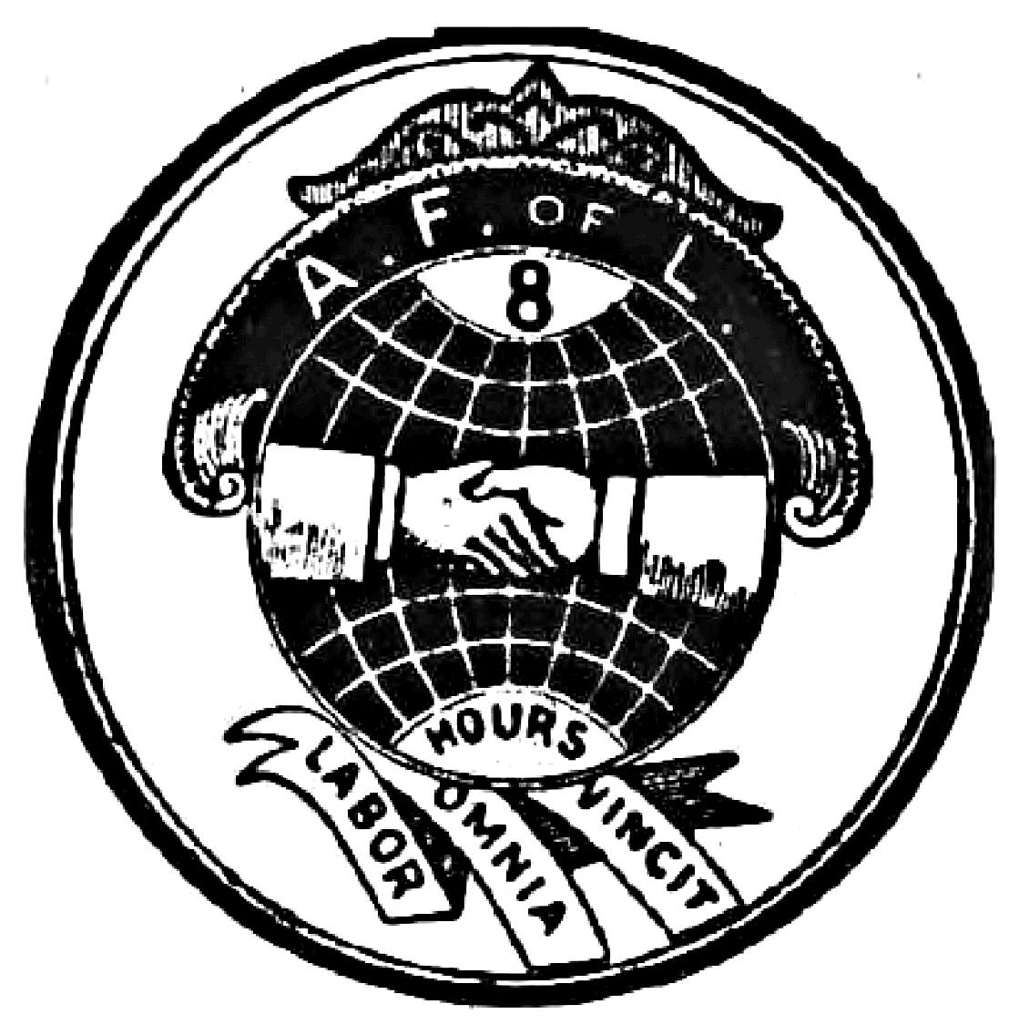
The most successful union was the American Federation of Labor (AF of L) led by Samuel Gompers (1886)
The AFL only included skilled workers, but it used collective bargaining to gain better pay, shorter hours, and better working conditions for its union members
Most workers were unskilled and ineligible to join the AFL

Slide 17
Goals of Labor Unions
“Wherever trades unions have organized and are most firmly organized, there are the rights of the people most respected. A people may be educated, but to me it appears that the greatest amount of intelligence exists in that country or that state where the people are best able to defend their rights, and their liberties as against those who are desirous of undermining them. Trades unions are organizations that instill into men a higher motive-power and give them a higher goal to look to....”
Samuel Gompers, speech, What Does the Working Man Want?
Why did Gompers believe that unions were necessary?
How do the working man’s wants compare and contrast to those of today?

Slide 18
One of the tactics used by unions was to STRIKE: Strikes were designed to stop production in order to force management to accept union demands
During some strikes, violence broke out

Slide 19
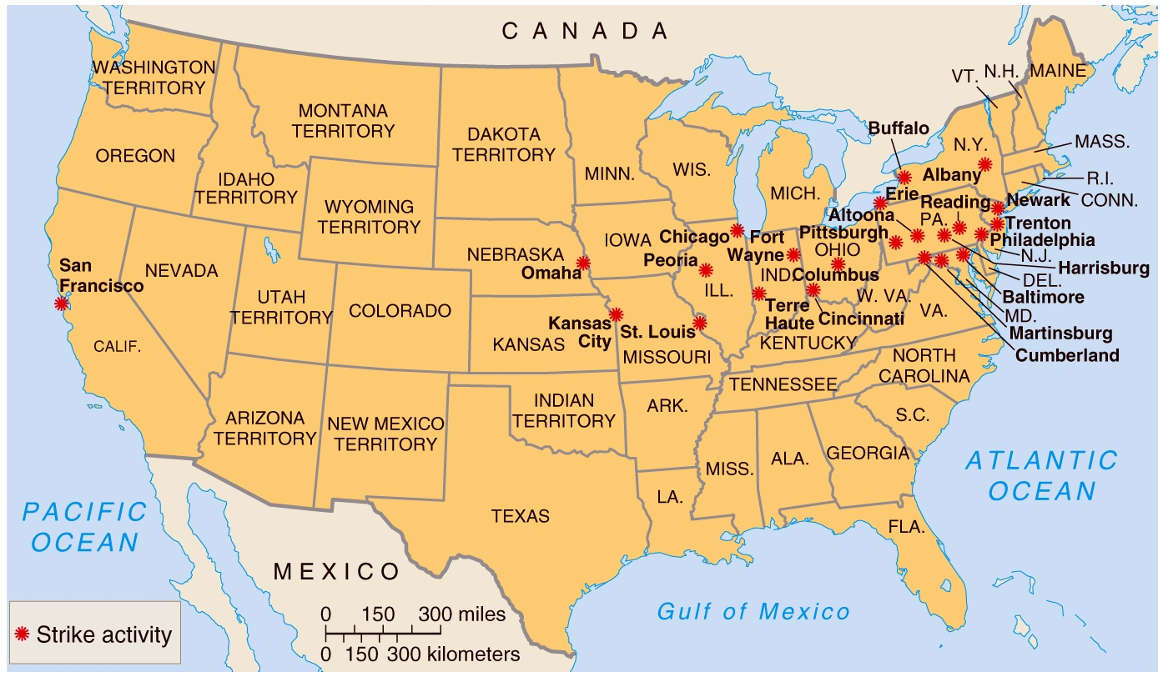
Great Railroad Strike (1877)
Railroad workers on the Baltimore and Ohio Railroad began to strike due to wage cuts.
Joined by 500,000 other industrial workers.
SPREAD across 11 states.
Shut down 2/3 of the nation’s rails.
President Hayes sent in troops to stop the strike.
100 people died
First time a president used troops to stop labor violence!
Some employers loosened their wage cuts, others kept busting workers’ organizations!

Slide 20
Pullman, both the man and the town, is an ulcer on the body politic. He owns the houses, the schoolhouses, and churches of God in the town he gave his once humble name. The revenue he derives from these, the wages he pays out with one hand—the Pullman Palace Car Company, he takes back with the other—the Pullman Land Association. He is able by this to bid under any contract car shop in this country. His competitors in business, to meet this, must reduce the wages of their men. This gives him the excuse to reduce ours to conform to the market. His business rivals must in turn scale down; so must he. And thus the merry war—the dance of skeletons bathed in human tears—goes on, and it will go on, brothers, forever, unless you, the American Railway Union, stop it; end it; crush it out.
Source – Statement of Pullman Strikers, June 1894
1. Read the excerpt above
2. With a partner, complete a HIPPO analysis of the source
H = historical context
I = intended audience
P = point of view
P = purpose
O = outside information connected to the document

Slide 21
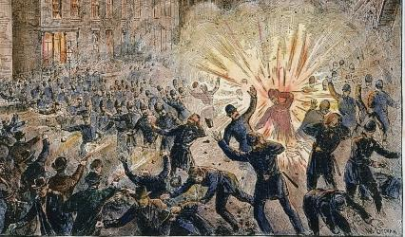
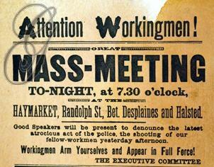
WHILE YOU WATCH: What were the causes and effects of the Haymarket Strike?
The Chicago Haymarket Strike (1886)
unionists demanded an 8-hr day; violence broke out, public opinion turned against unions, viewing them as violent and “un-American”

Slide 22
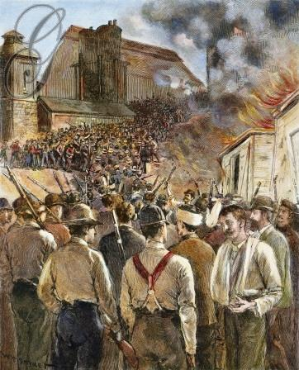
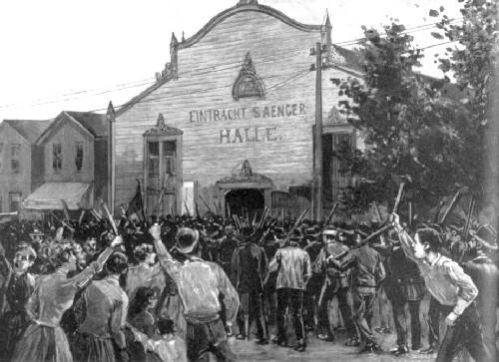
WHILE YOU WATCH: How did business leaders like Carnegie respond to strikes?
Violence erupted in the Homestead Strike (1892)
at Carnegie’s steel plant; Federal troops were called to re-open the factory with replacement workers

Slide 23
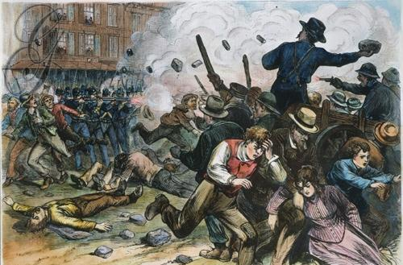
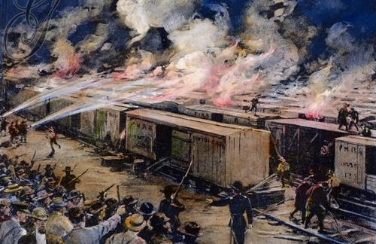
Railroad workers led the Pullman Strike (1894) against cut wages by 50%...
…President Grover Cleveland sent the army to end the strike; Strikers in 27 states resisted & dozens died

Slide 24
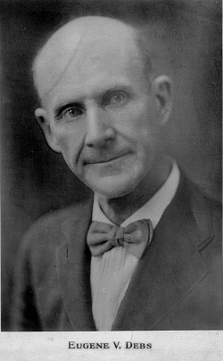
Before the Pullman Strike occurred…
Head of the American Railway Union and director of the Pullman strike
Don’t handle any trains with Pullman cars! (boycott)
Imprisoned along with his associates for ignoring a federal court injunction to stop striking…
While in prison, he read Socialist literature and emerged as a Socialist leader in America.
Eugene V. Debs

Slide 25
Response to Labor Unions
How did big business leaders feel about labor unions?
“Workers will not be cared for by labor agitators but by the Christian men to whom God has given the property interest of this country.” (Baer, spokesman for mine owners)
TAKE A PIC!
Surplus of cheap labor = management held a lot of power!
Strikebreakers/Scabs (desperate unemployed)
The lockout = closing a factory to break a labor movement
Blacklist = pro-union workers names circulated among employers
Yellow-dog contracts = sign a job contract to NOT join a union
Private guards and state militia
Court injunctions against strikes

Slide 26
By 1900 – only 3% of American workers belonged to unions…

