Slide 1
DO NOW:
In your notebook, finish the following prompt in 3 or more sentences:
To me, home is…
Is the home that you are envisioning the physical place where you currently reside or does something else come to mind?
What feelings, thoughts, and images come to mind when you think of home?
Where is home for you?

Slide 2
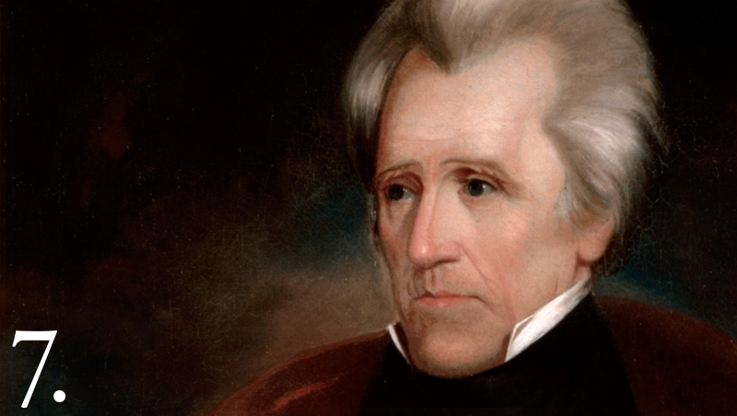
Aim: How did Andrew Jackson’s policies and concept of democracy affect Native Americans throughout the US?
Essential Question: What incidents led to the Trail of Tears and what is your perspective of this event?

Slide 3
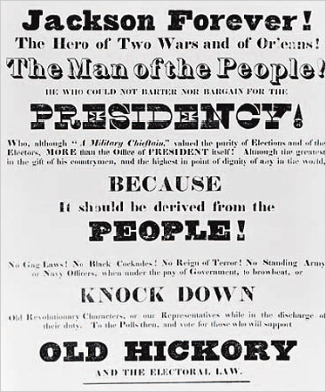
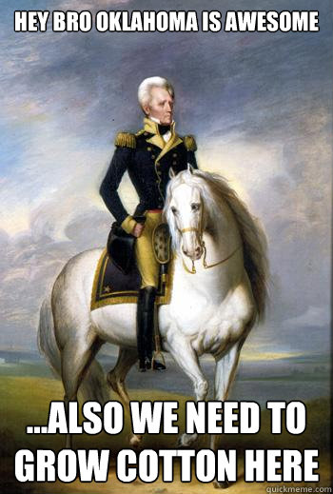
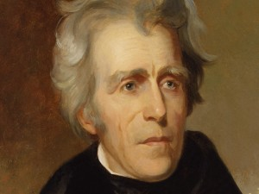
“Are you an impatient, land-hungry American? If so, then I’m your man! There is PLENTY of open land out west [previously owned by Native Americans] that is perfect for the taking!”
“We can just make the natives leave their traditional homelands and settle west of the Mississippi…”

Slide 4
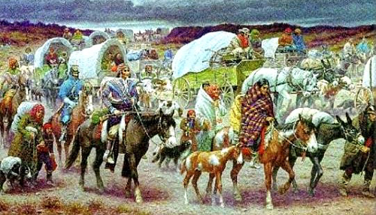
Indian Removal Begins
Jackson’s Goal?
Expansion into the southwest for southern planters…
1830: Indian Removal Act
5 Civilized Tribes (forced removal to lands west of the Mississippi River in exchange for their homelands):
Cherokee Creek Choctaw
Chickasaw Seminole
MOTIVES?
Cherokee land was coveted for agricultural production - demand for farmland was high
Gold was discovered in the region and many whites were eager to mine it

Slide 5
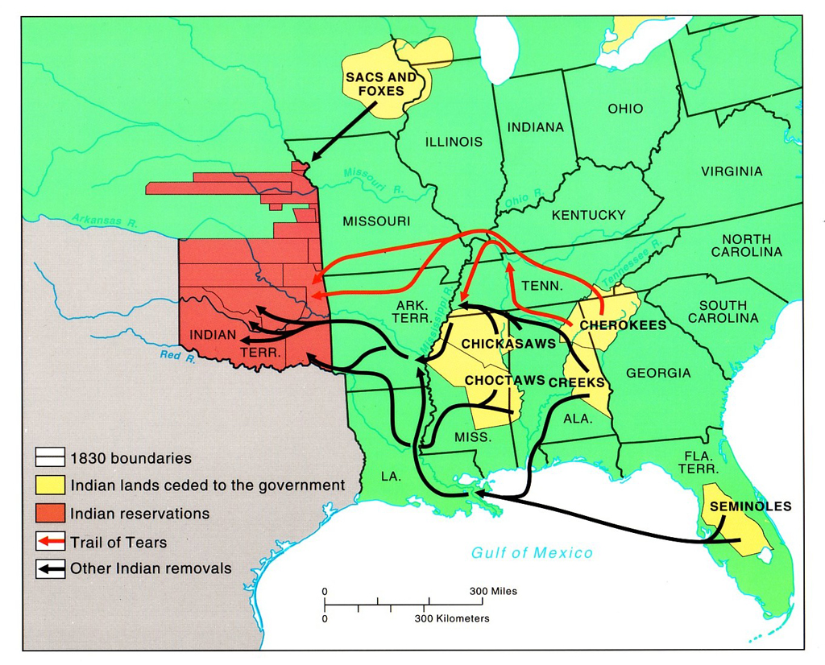

Slide 6
President Jackson outlined his Indian removal policy to Congress on December 6, 1830
"It gives me pleasure to announce to Congress that the benevolent policy of the Government, steadily pursued for nearly thirty years, in relation to the removal of the Indians beyond the white settlements is approaching to a happy consummation. Two important tribes have accepted the provision made for their removal at the last session of Congress, and it is believed that their example will induce the remaining tribes also to seek the same obvious advantages."
Jackson’s tone?
Your reaction?

Slide 7
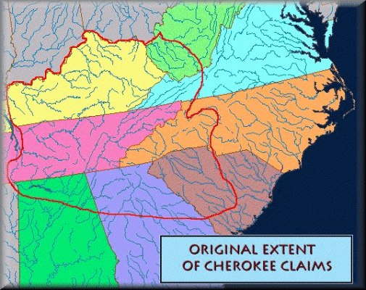
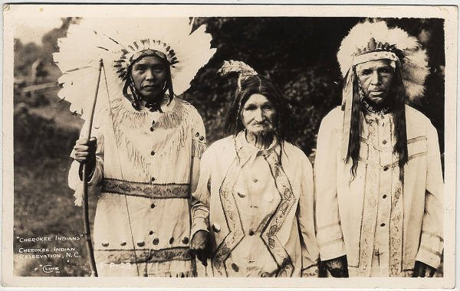
Many Native Americans were given money to relocate, and they did. Most moved, but not the Cherokee of Georgia.
They hired lawyers to sue the State of Georgia.
The Treaty of 1791 = Cherokees’ right to a portion of northeastern Georgia
Farmed the land, raised cattle, grew cotton, and even owned slaves to work their plantations
Missionaries established schools and helped the Cherokees in their new lives
Sequoyah: Cherokee syllabic alphabet of 85 characters so that his people could write down and preserve their thoughts
Their own newspaper, The Cherokee Phoenix

Slide 8
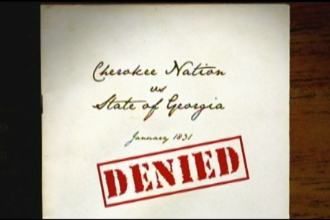
Cherokee Nation v. Georgia (1831): John Marshall
Cherokee thought they were THEIR OWN NATION in Georgia
“an unquestionable right” to their lands, but that they were "not a foreign state, in the sense of the Constitution”
Court says they were a “domestic, dependent nation” of Georgia
Chief Justice John Marshall wrote, "their relation to the United States resembles that of a ward to his guardian. They were a domestic dependent nation."

Slide 9
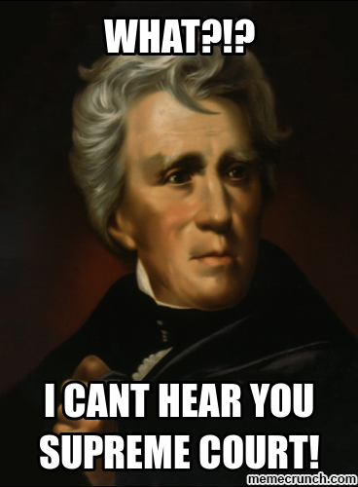
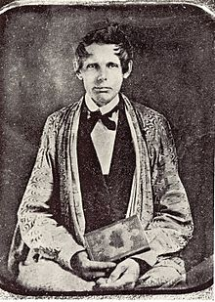
Worcester v. Georgia (1832): John Marshall
TRIBAL SOVEREIGNTY
Marshall – Cherokee tribes were “distinct political communities, having territorial boundaries…”
Cherokee tribes NOT subjected to state laws, ONLY federal laws
Jackson – disobeys the court, tells Georgia to ignore, and continues removal of Indians
So, Cherokees win case, but still lose land…
Samuel Worcester – missionary to the Cherokee, defender of sovereignty, wasn’t allowed on Cherokee land without a license

Slide 10
Cherokee Removal
VIDEO

Slide 11
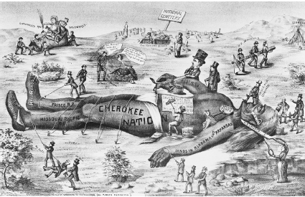
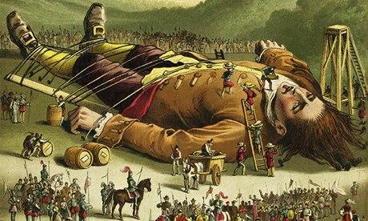
Look familiar?
Worcester
v. Georgia
Gulliver’s
Travels

Slide 12
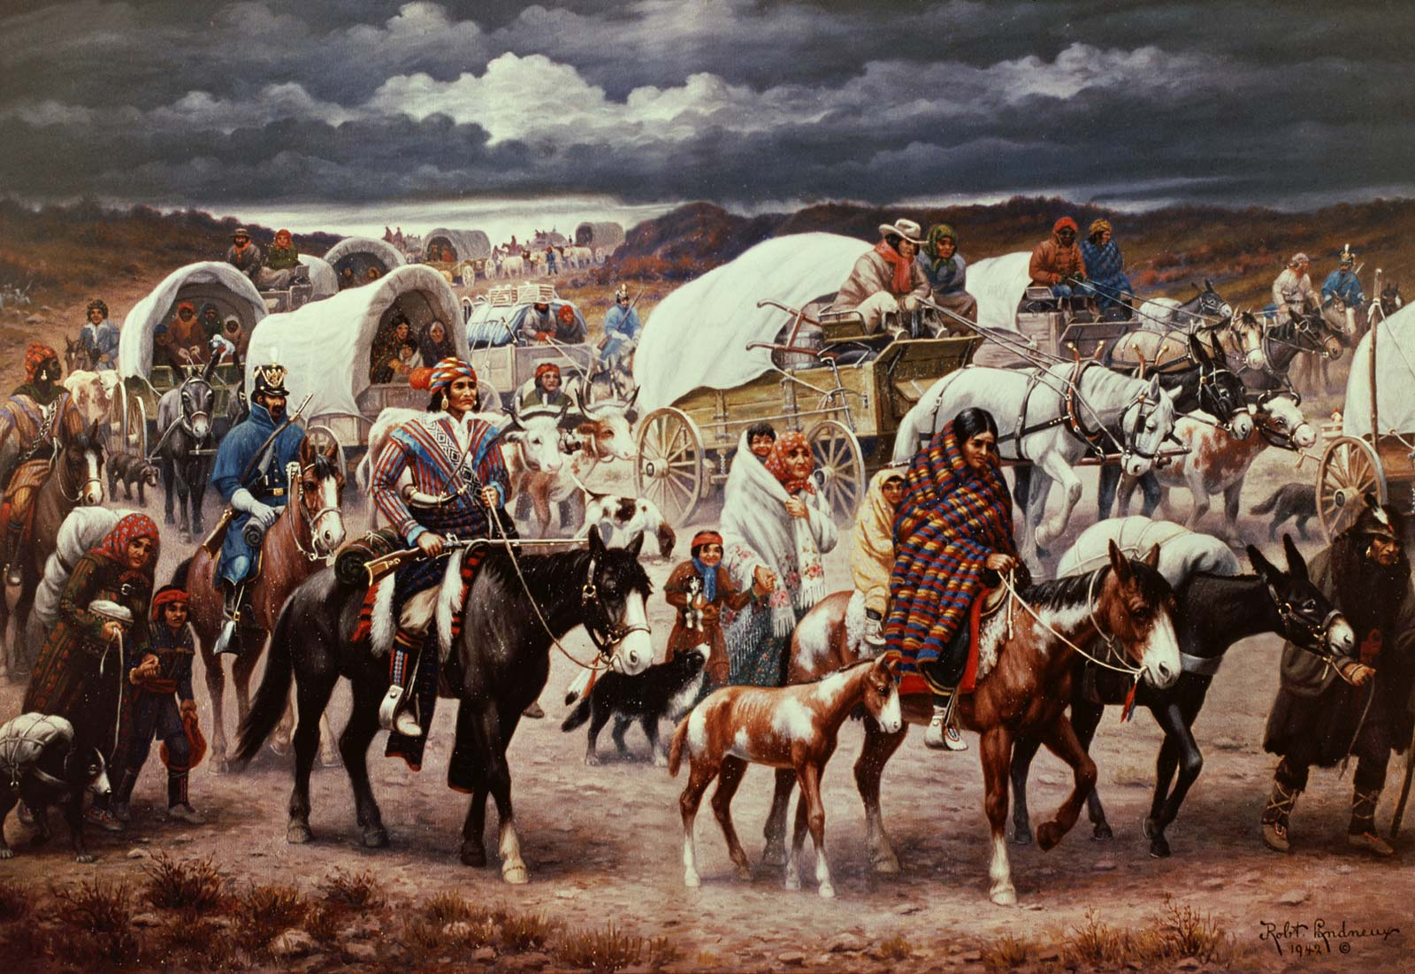
What do you see?
The Trail of Tears, Robert Lindneaux

Slide 13
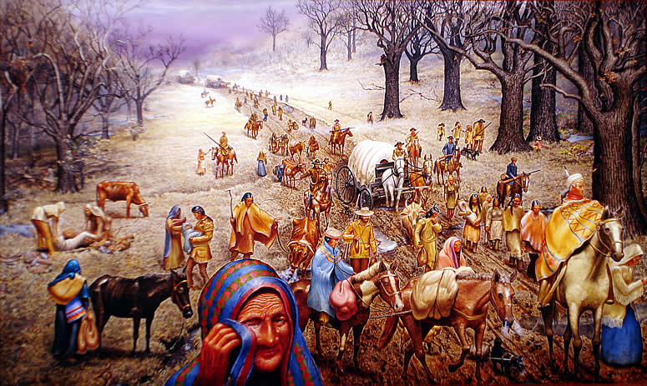
Document Analysis
What was life like along the Trail of Tears?
Read documents #4-7, and answer the questions that follow

Slide 14
TRAIL OF TEARS
“Our conduct toward these people is deeply interesting to our national character….Our ancestors found them the uncontrolled possessors of these vast regions.
By persuasion and force they have been made to retire from river to river and from mountain to mountain, until some of the tribes have become extinct and others have left but remnants to preserve for awhile their once terrible names.”
Who said it?

Slide 15
TRAIL OF TEARS
“Surrounded by the whites with their arts of civilization, which by destroying the resources of the savage doom him to weakness and decay, the fate of the Mohegan, Narragansett, and the Delaware is fast overtaking the Choctaw, the Cherokee, and the Creek.
That this fate surely awaits them if they remain within the limits of the States does not admit of a doubt.
Humanity and national honor demand that every effort should be made to avert such a calamity.”

Slide 16
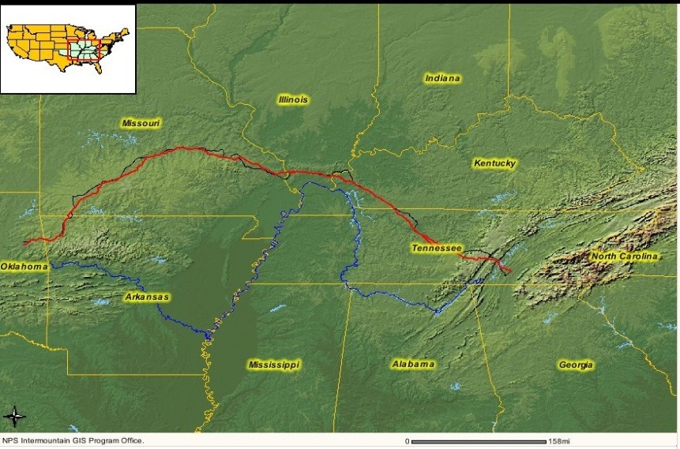
The term "Trail of Tears" refers to the ten years in which over 70,000 Indians were forced to give up their homes and move to areas assigned to tribes within Oklahoma.
The tribes were given a right to all of Oklahoma except the Panhandle.
The government promised this land to them "as long as grass shall grow and rivers run."
This lasted until about 1906 when they were forced to move to other reservations.

Slide 17
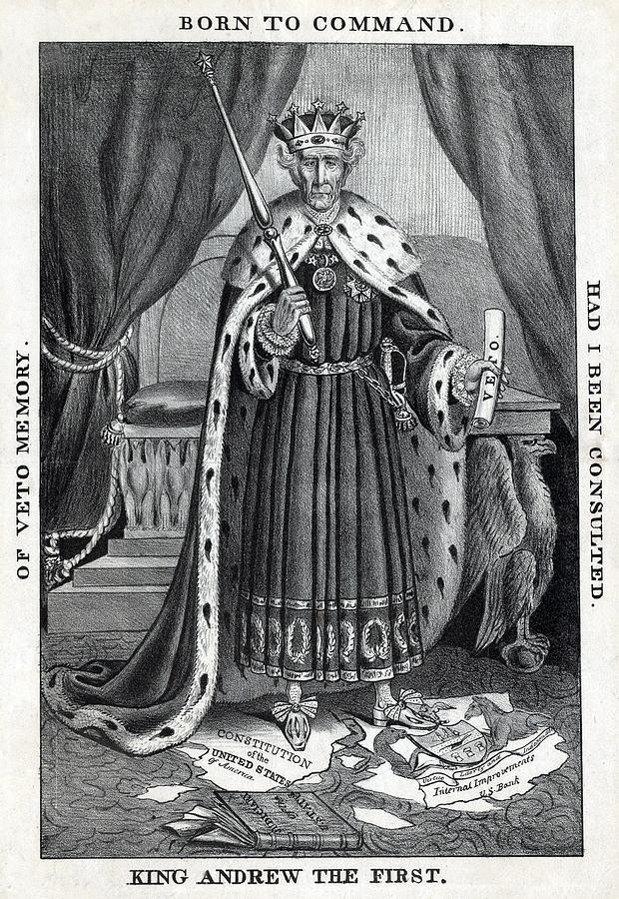
Jackson’s Legacy
Southern states threaten secession over the Tariff
Jackson responds by threatening to use force to keep the union together and get the tariff paid
Considered a success because the union (country) is kept together – for now…
Destroys the Bank of the US…federal money into pet banks...pays off ALL U.S. DEBT
Indian Removal Act 1830
Forced relocation of over 100,000 Native Americans
Trail of Tears resulted, over 4,000 people died
Native Americans forced onto reservations
Jackson did it to protect white American interests in the lands the Native Americans owned

Slide 18
Was Andrew Jackson more of a champion of the “common man” or “King” Andrew?
Jacksonian Democracy can be seen as “Democratic” or “Undemocratic”
Which one do you think it is?
Read through the list of claims and counterclaims to consider the arguments
Discuss the arguments with your pair partner
Write a response to the Aim question in your own notebook.
Let your pair partner read your response and then allow them to comment on your answer.

