Slide 1
AIM: What effects did the Great Depression have in America, and how did President Hoover respond?

Slide 2
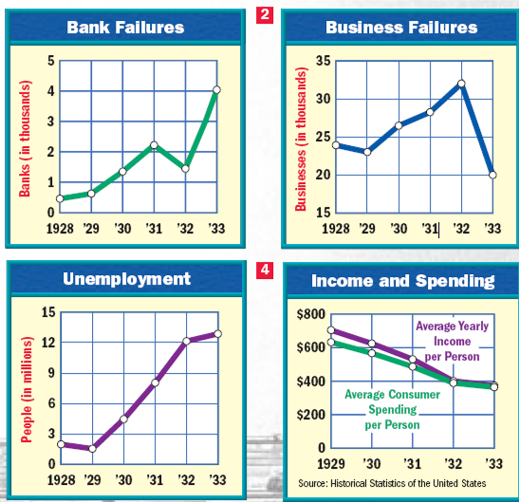
The Great Depression led to a collapse
of the American financial system by 1933
Americans lost confidence in banks as 25,000 banks failed; The lack of banking meant there was no money for investment
The lack of spending and stock market crash led to failure of 90,000 businesses
Unemployment peaked at 25% of all Americans; People lost their homes, farms, and businesses
The USA had record poverty and suicide rates and healthcare declined; Charities offered soup kitchens and breadlines to help

Slide 3
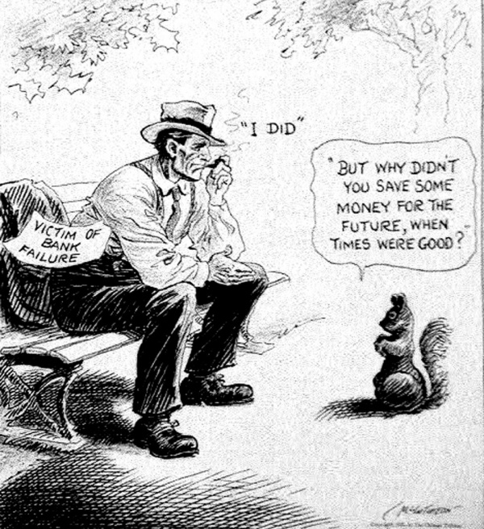
Stop and Think: Analyze this cartoon
(purpose/context/point of view)

Slide 4
Primary Source Activity: “Brother, Can You Spare a Dime,” by Bing Crosby
They used to tell me I was building a dream, and so I followed the mob, When there was earth to plow, or guns to bear, I was always there right on the job.
They used to tell me I was building a dream, with peace and glory ahead, Why should I be standing in line, just waiting for bread?
Once I built a railroad, I made it run, made it race against time. Once I built a railroad; now it's done. Brother, can you spare a dime?
Once I built a tower, up to the sun, brick, and rivet, and lime; Once I built a tower, now it's done. Brother, can you spare a dime?
Once in khaki suits, gee we looked swell, Full of that Yankee Doodly Dum, Half a million boots went slogging through Hell, And I was the kid with the drum!
Say, don't you remember, they called me Al; it was Al all the time. Why don't you remember, I'm your pal? Buddy, can you spare a dime?
Once in khaki suits, gee we looked swell, Full of that Yankee Doodly Dum, Half a million boots went slogging through Hell, And I was the kid with the drum!
Say, don't you remember, they called me Al; it was Al all the time. Say, don't you remember, I'm your pal? Buddy, can you spare a dime?
1. Why do you think this song was written, and for what audience was it written for?
2. List two things that this song tells you about life in the country at the time it was written.

Slide 5
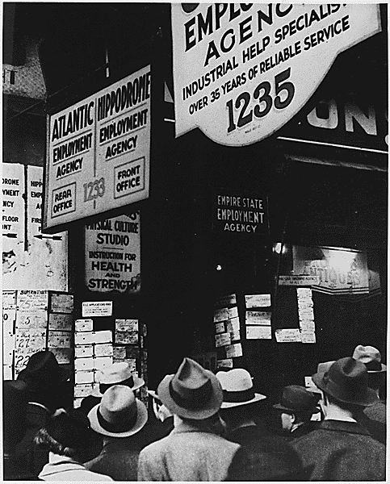
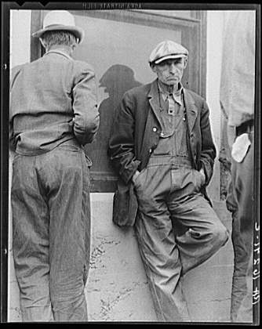
Employment Agencies &
Relief-Check Lines

Slide 6
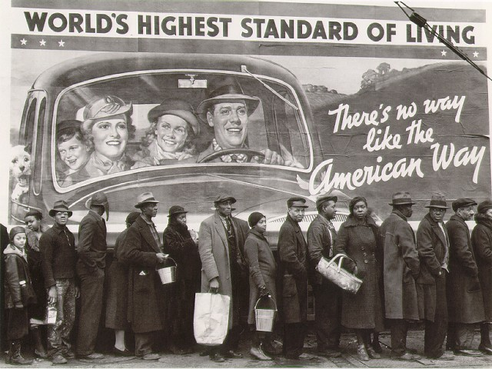
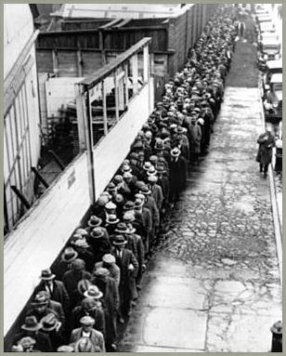
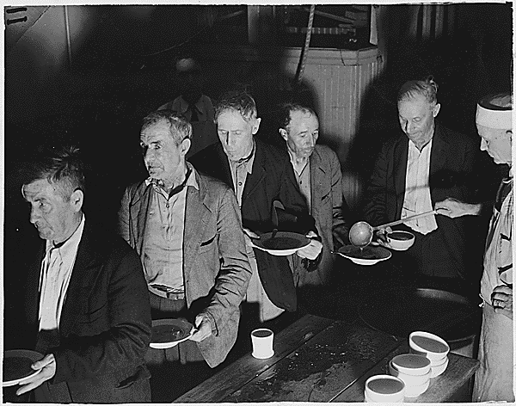

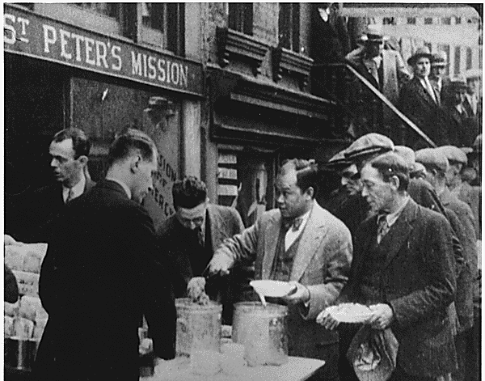
Soup Kitchens & Breadlines

Slide 7
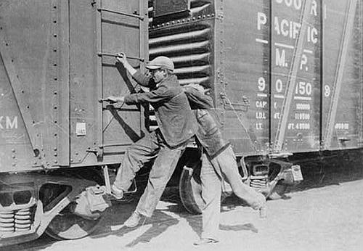
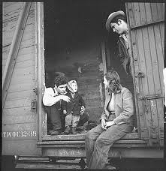
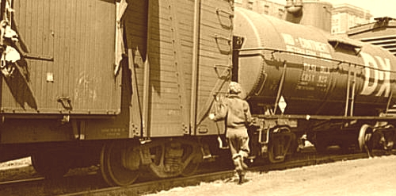
“Train
Hopping”

Slide 8
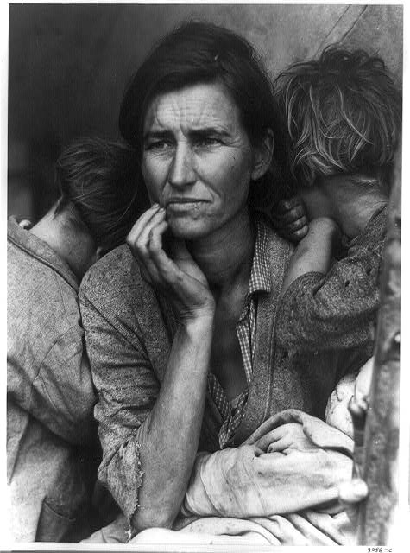
Dorothea Lange's "Migrant Mother”
A pea-picker is a derogatory reference to poor, migrant workers during the Great Depression. These people were unskilled, poorly educated workers, employable only in menial jobs, such as harvesting crops and, as such, received poor wages for working long hours under dreadful conditions.By the end of the decade there were still 4 million migrants on the road.

Slide 9
More effects of the Great Depression
African-Americans: laid off
Mexican immigrants: deportation (Mexican-American Repatriation Act)
Middle class:
  Many lost their homes
  Health care declined; doctor & dentist visits became “luxuries”
The Immigration and Naturalization Service targeted Mexicans because of "the proximity of the Mexican border and the physical distinctiveness of mestizos…”

Slide 10
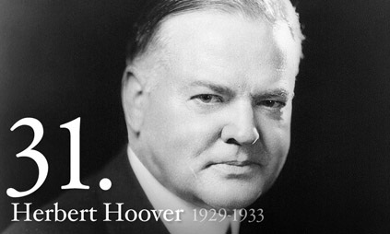
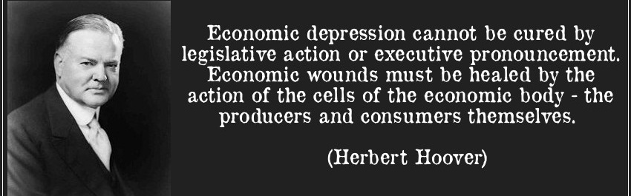
When the Great Depression began,
Republican President Herbert Hoover tried
to solve America’s economic problems
HOOVER: America could overcome the depression through “rugged individualism” (using hard work and perseverance)
Hoover private charities to help (“volunteerism”)
PEOPLE give back to help each other
HOOVER: encouraged business growth, keep taxes low, and AVOIDED direct gov’t involvement
Notes:
Woody Guthrie

Slide 11
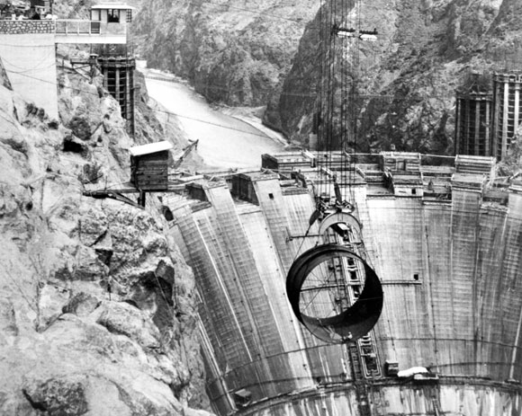
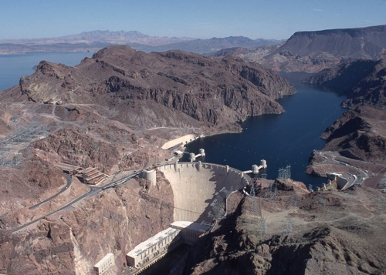
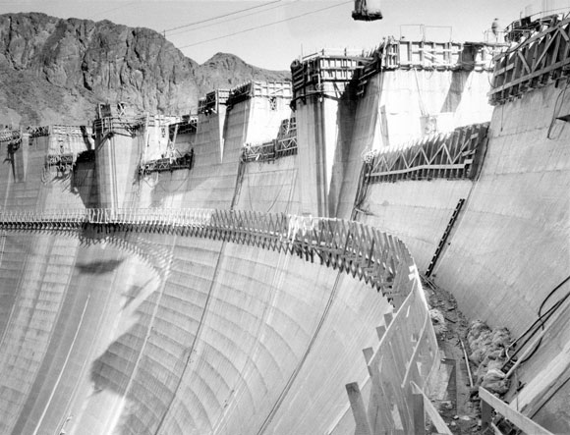
Congress approved new building projects
to put Americans to work like the Hoover Dam

Slide 12
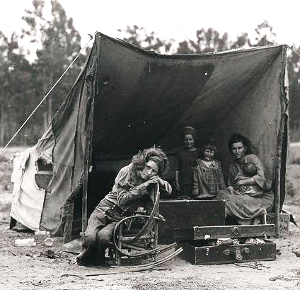
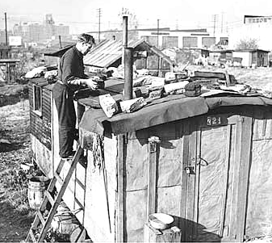
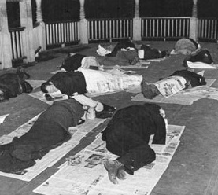
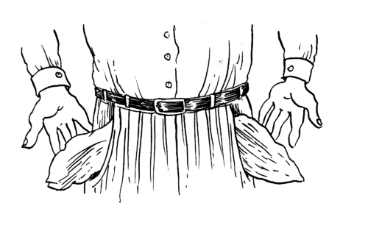
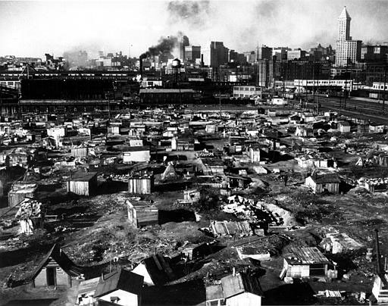
Americans who lost their homes, lived in shantytowns nicknamed “Hoovervilles”
“Hoover Hotels”
“Hoover Blankets”
“Hoover Flags”
“Hooverville”

Slide 13
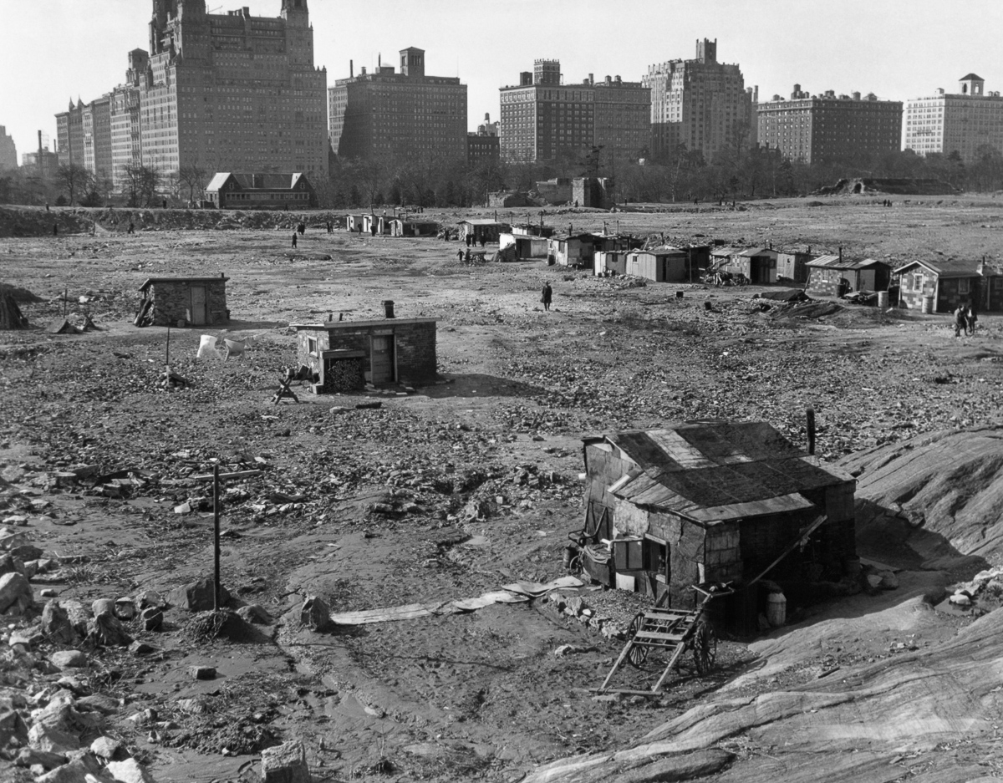
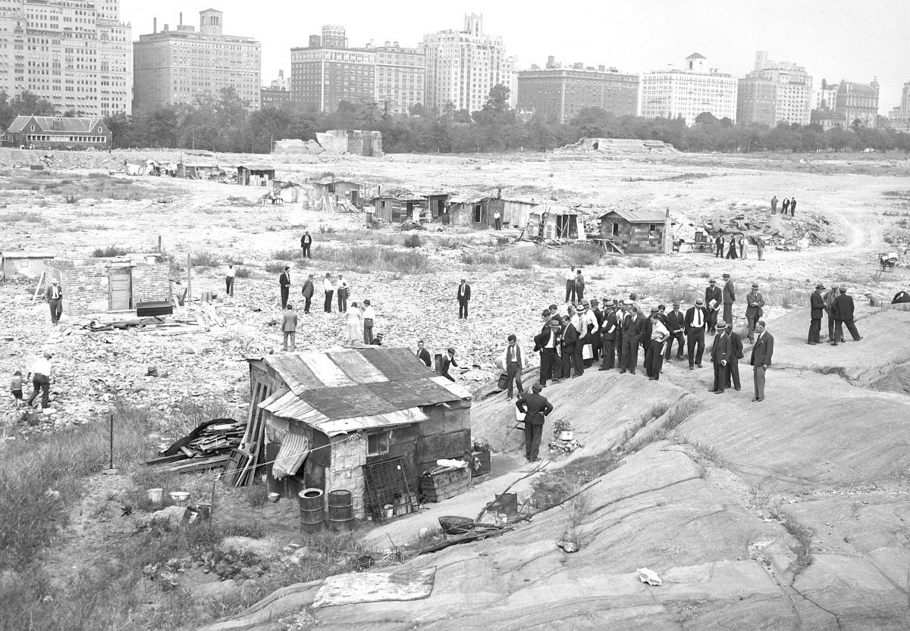
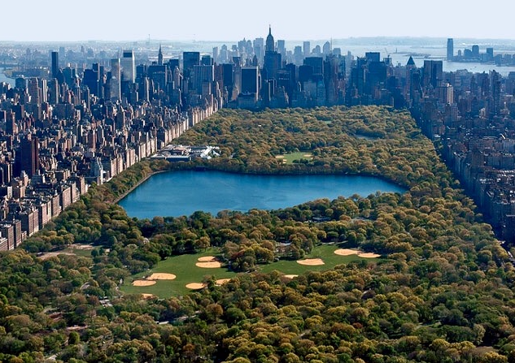
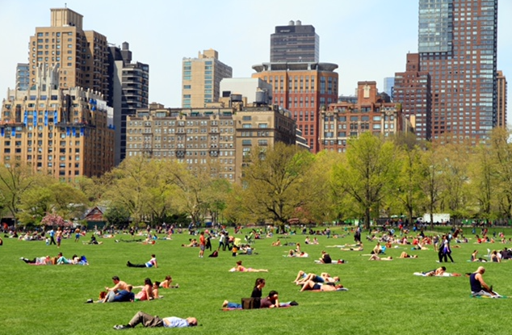
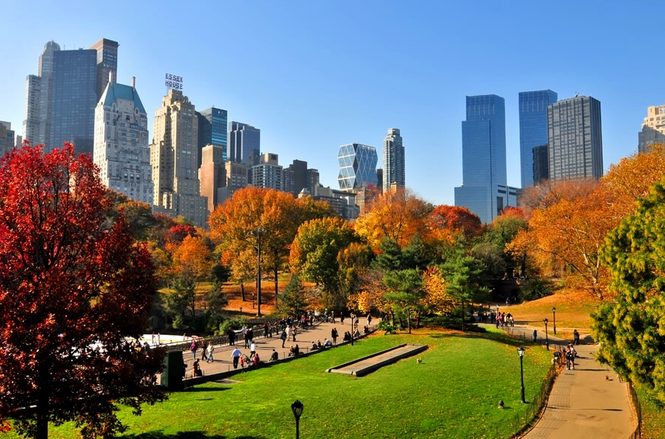
Where is this?
Central Park, 1937
What does the building material reveal about the nature of these structures or their inhabitants?
How does the date of this photograph reveal the lasting effects of the depression?

Slide 14
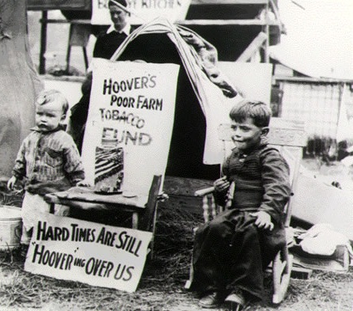
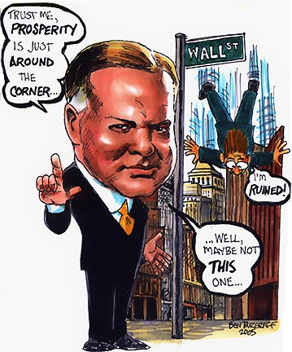
These efforts did not end the depression and
many citizens lost faith in President Hoover

Slide 15
Annie: We’d Like to Thank You, Herbert Hoover
How does this song represent the feelings towards Hoover’s relief programs?

Slide 16
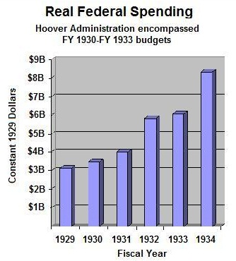
As the depression worsened, Hoover called for more direct government action to ease peoples’ suffering
Under Hoover, the gov’t issued relief checks to help the unemployed
Congress: Reconstruction Finance Corps (RFC) - loan money to save failing businesses

Slide 17
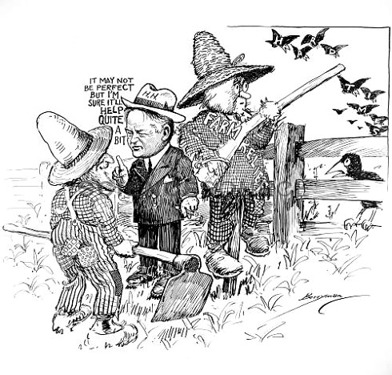
“Farm Relief”
Stop and Think: Analyze this cartoon
(purpose/context/point of view)

Slide 18
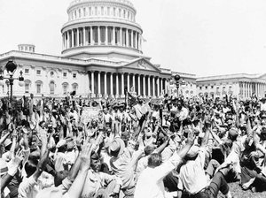
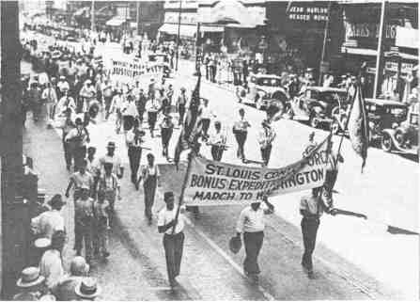
1932: Hoover’s presidency suffered two final blows:
  BONUS ARMY: 22,000 war veterans (Bonus Expeditionary Force) marched to the capital to demand their WWI bonus checks early, Hoover ordered them to be forcibly removed … veterans wouldn’t collect bonuses until 1945
VIDEO

Slide 19
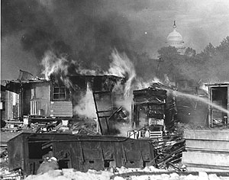
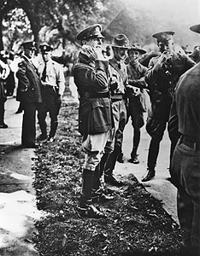
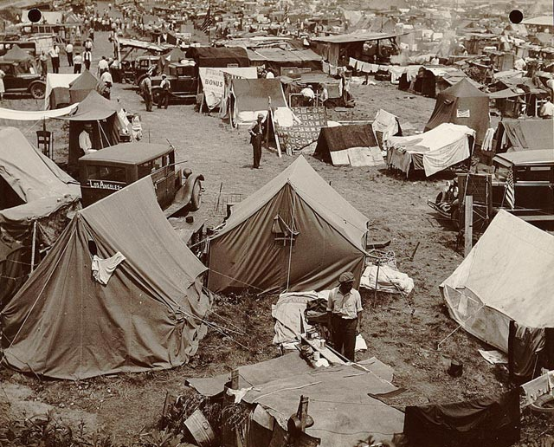
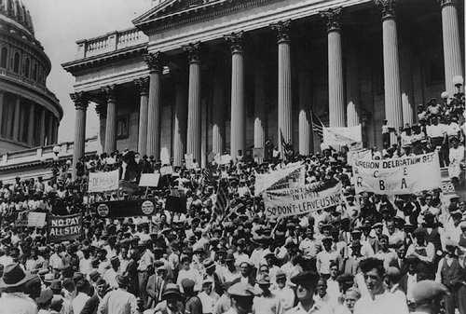
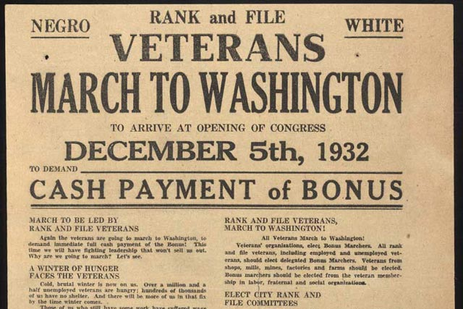
Bonus Army
Douglas MacArthur
Dwight Eisenhower

Slide 20
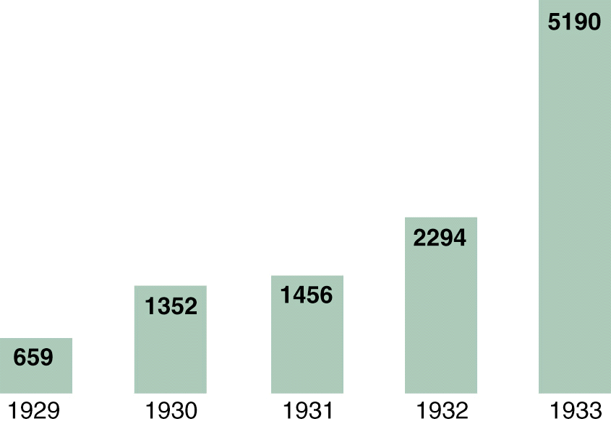
Bank Failures, 1929-1933
  2. BANK FAILURES: led to a complete collapse of the U.S. banking system

Slide 21
What happens to farmers if there is a prolonged period of drought?
That is what happened in the 1930s in Oklahoma and other areas in the Great Plains region. There was a drought so severe that the soil blew away, and it was called the Dust Bowl.
America the Story of Us
18:52

Slide 22
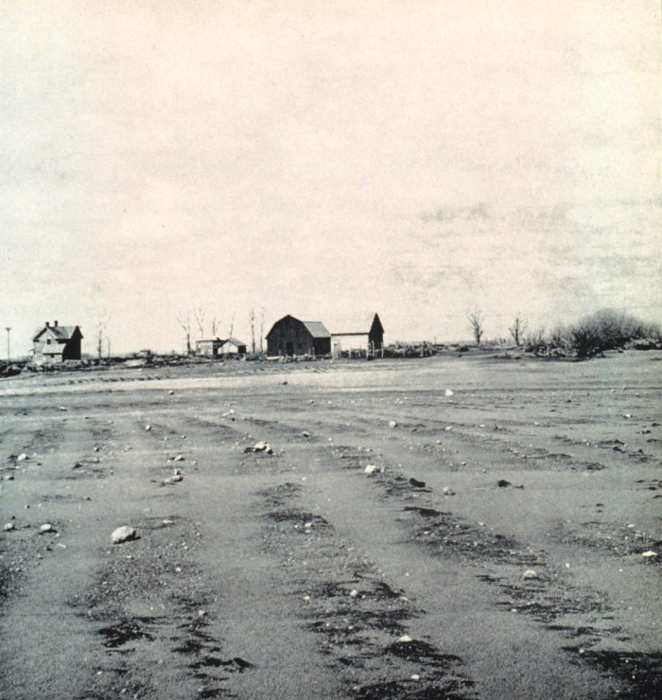
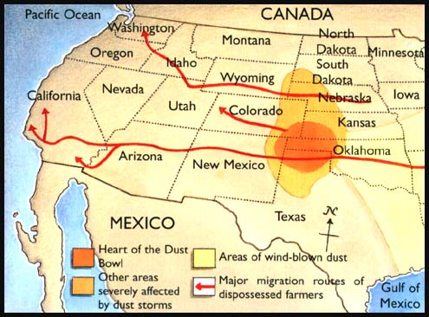
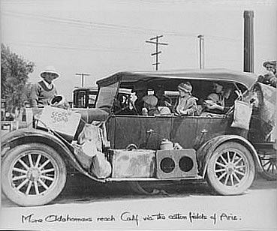
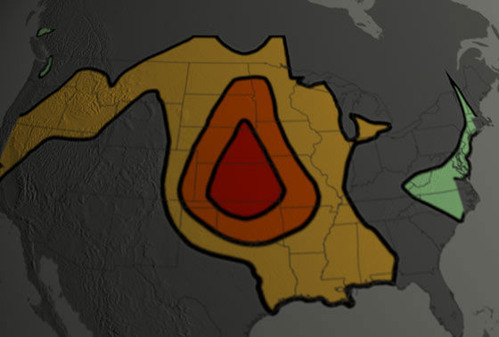
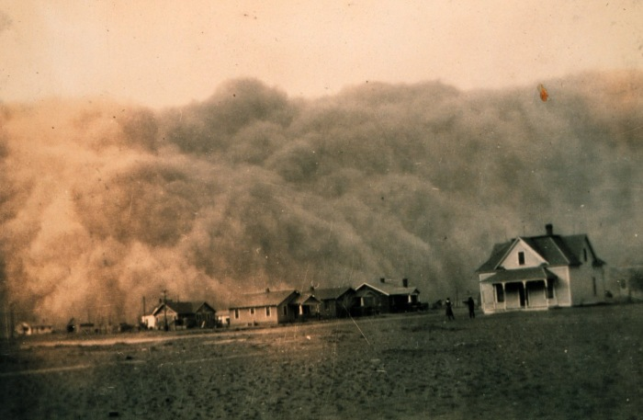
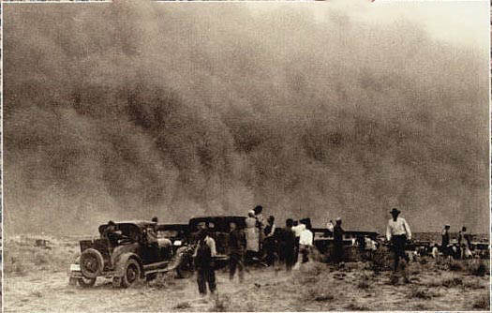
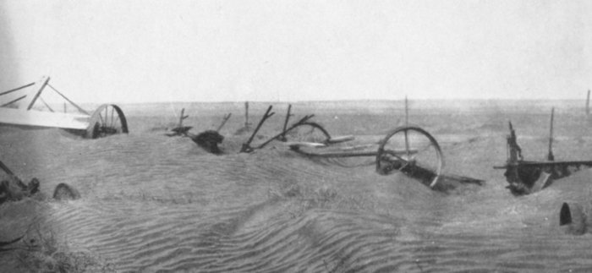
The Dust Bowl (1931-1939) worsened the effects of the Depression
“Okies” & “Arkies”
Areas Affected by the Dust Bowl drought
Notes:
Woody Guthrie

Slide 23
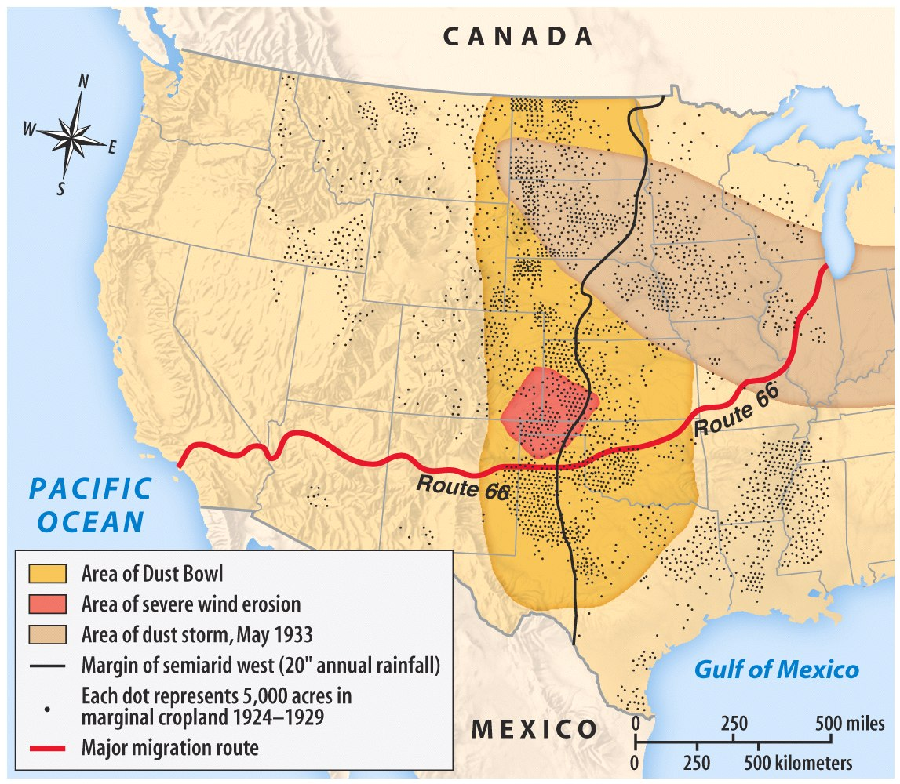

Slide 24
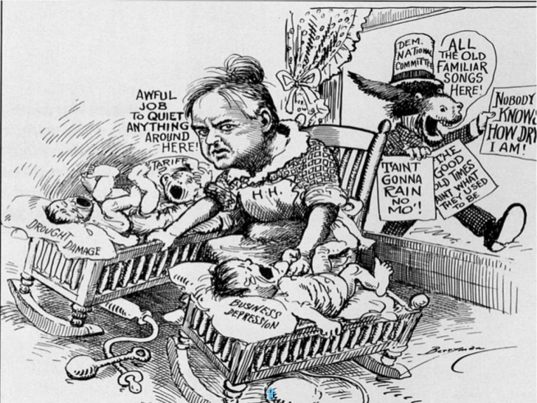

Slide 25
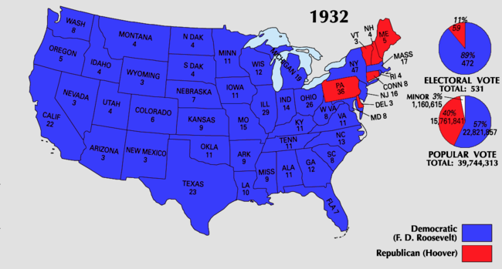
Where do we go next?
The inability of Republicans to resolve the economic depression opened the door for a Democratic takeover in politics
Once in power, Democrats succeeded in relieving some suffering, while also restoring hope
“I voted for Herbert Hoover in 1928,” she wrote. “God forgive me and keep me alive at least until the polls open!”

