Slide 1
Aim: How did Native Americans and farmers suffer in the frontier during the late 1800’s?

Slide 2
Post-Civil War Growth of Agriculture
Don’t Copy!
Gov’t inspires the movement – and which laws?
Homestead Act 1862
Pacific Railway Act 1862 – gave land to railroads (helped build the Transcontinental Railroad)
More Americans were farmers than any other profession!

Slide 4
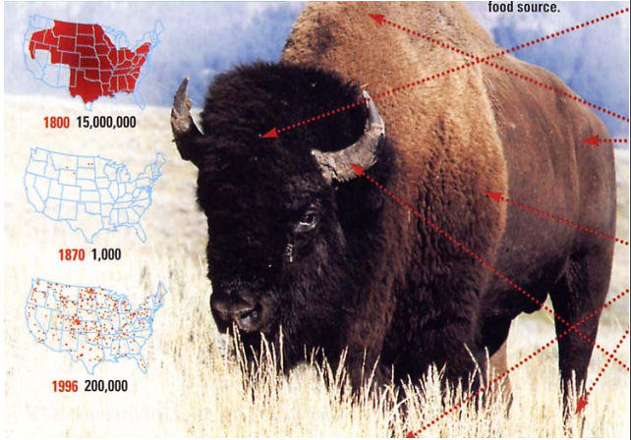
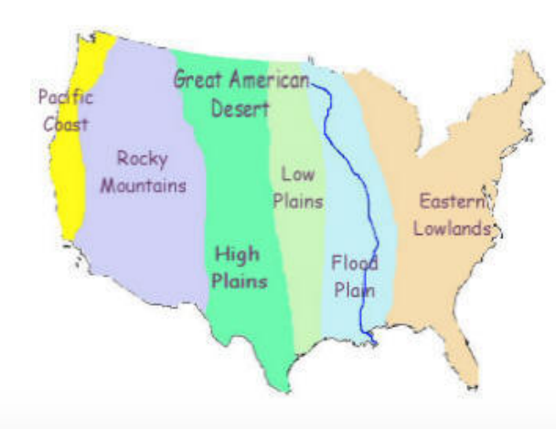
Life on the Western Frontier
Life for the Plains Indians had dramatically changed
Heavily reliant on hunting bison
European introduction of horse, firearms, alcohol, & disease
Increasing pressure on Native life.
Severe decline in the population of bison.
– Challenges Native American resistance
– Demand for buffalo hides
– Impact of railroad expansion
The biggest impact of western expansion will take place upon the lives of Native Americans in the trans-Mississippi west.

Slide 5
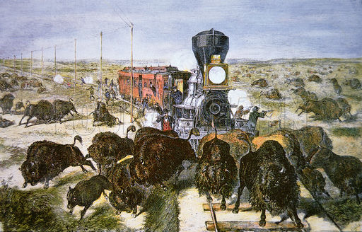
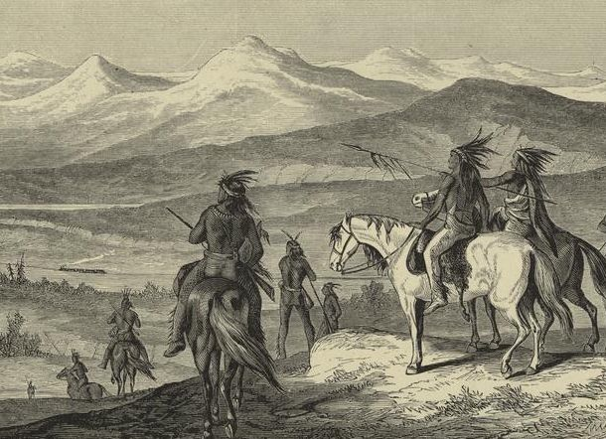
Plains Natives Lifestyle
Buffalo hunt
White hunters decimated buffalo herds for fur, sport, pests
Reservations
Concentrations of tribes through separate treaties
Tribal chiefs selected by white officials
Oklahoma Land Rush (April 1889)
Sooners and Boomers

Slide 6
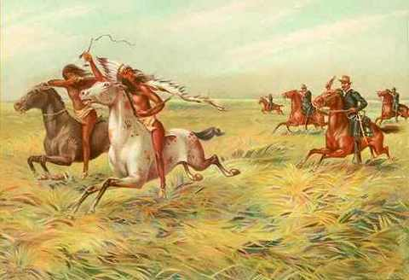
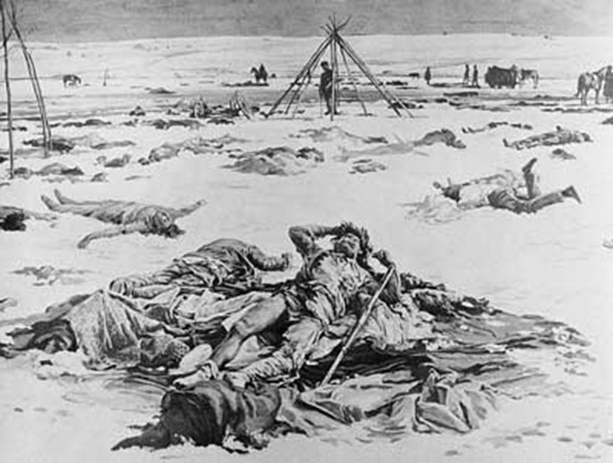
Indian Wars
Don’t Copy!
Native American Leaders and Warriors
Cochise and Geronimo (Apache)
Crazy Horse and Sitting Bull (Lakota)
Chief Joseph (Nez Perce)
Sand Creek Massacre (1864)
Little Big Horn (1876)
“Custer’s Last Stand”
Wounded Knee (1890)
10th Calvary – “Buffalo Soldiers”

Slide 7
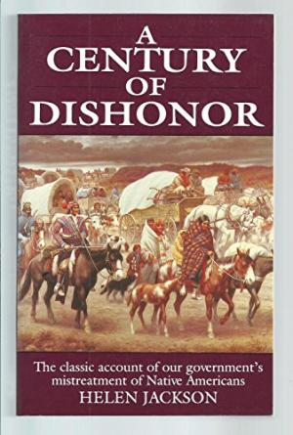
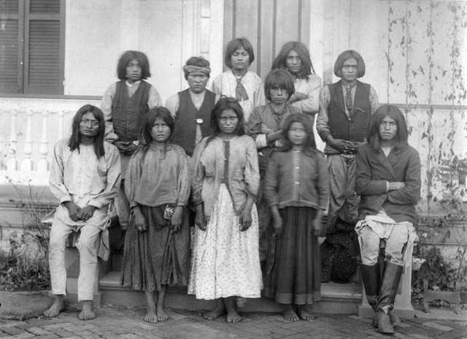
Attempts at Assimilation
Don’t Copy!
Helen Hunt Jackson “A Century of Dishonor” (1881) documented mistreatment by the federal government of Native people
Boarding schools such as Carlisle Indian School were intended to assimilate Native people

Slide 8
How did the Dawes Severalty Act
benefit American Indians?
Section 1: Authorizes the president to allot tribal lands to individual Indians in designated amounts on reservations created by treaty, act of Congress, or executive order. If a treaty or agreement with a tribe was made earlier and provided for larger allotments to members of that tribe, the president is authorized to allot land according to the treaty or agreement.
Section 2: Provides that the Indian allottees themselves make their own selection of land as to accommodate those who had already made improvements or built upon a piece of land. Indian heads of families are authorized to select allotments for their children and Indian reservation agents are authorized to select land for orphans.

Slide 9
How did the Dawes Severalty Act
benefit American Indians?
Section 4: Allows any Indian not residing upon a reservation, or for whose tribe no reservation has been provided, to secure an allotment upon public lands.
Section 5: Provides that after an Indian person is allotted land, the United States will hold the land “in trust for the sole use and benefit of the Indian” (or his heirs if the Indian landowner dies) for a period of 25 years.” (Land held in trust by the United States government cannot be sold or in anyway alienated by the Indian landowner…)
Section 6: After allotments have been made, every member of the bands or tribes to whom allotments have been made are subject to laws of the state or territory in which they reside. Every individual Indian who receives trust patents is bestowed with United States citizenship.

Slide 10
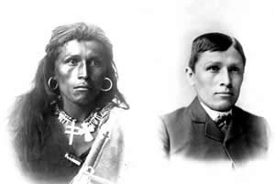
The Dawes Act (1887) “The Americanization of the Indians”
“The Law In Theory”
1. ENDS tribal ownership of land
2. Established Indian Reservations - 160 acres of reservation land as private farms
3. Indians would be taught farming techniques.
4. Natives had the potential to receive citizenship if they lived on land for 25 years and “adopted the habits of civilized life.”
5. Remaining reservation land sold to white settlers (oftentimes the best land)
Take a PIC!

Slide 11
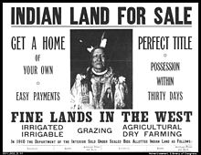
The Dawes Act (1887) “The death of the Indians”
Indians were never given farm equipment or training.
Reservation Conditions: disease, malnutrition, & poor sanitation.
School Teachers taught Indians that there way of life was full of “Idleness, Superstition and Barbarism.”
Nothing was done to improve the Indian’s situation until the Dawes Act was ABOLISHED in 1934...

Slide 12
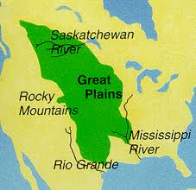

Slide 13
Changes in Agriculture
Don’t Copy!
More farmers = more food!
More food can feed MORE people!
As urbanization increases, so does the need to feed!
Farmers are responsible for feeding the industrial workforce
Increased use of mechanized farming
Therefore, increased production!

Slide 14
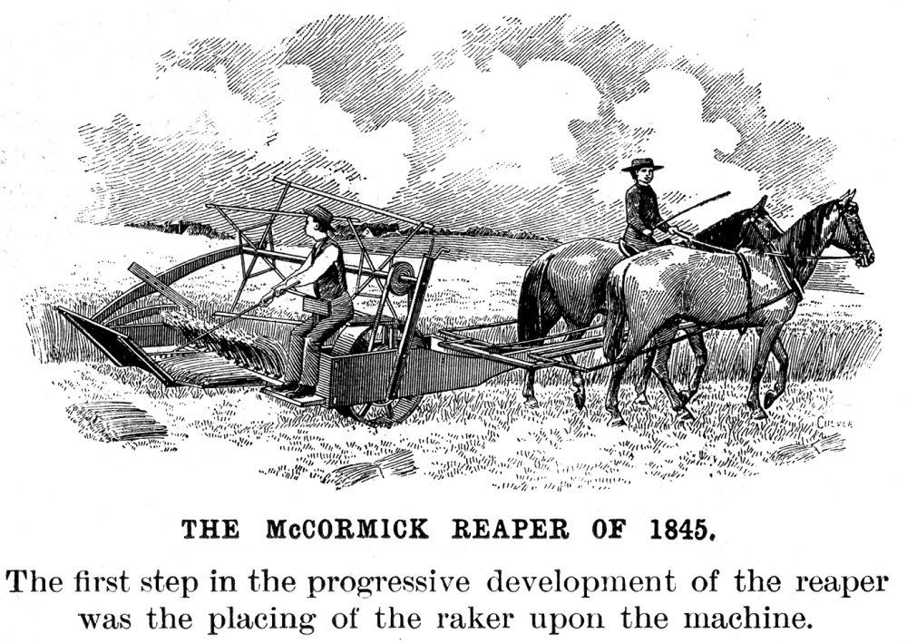

Slide 15
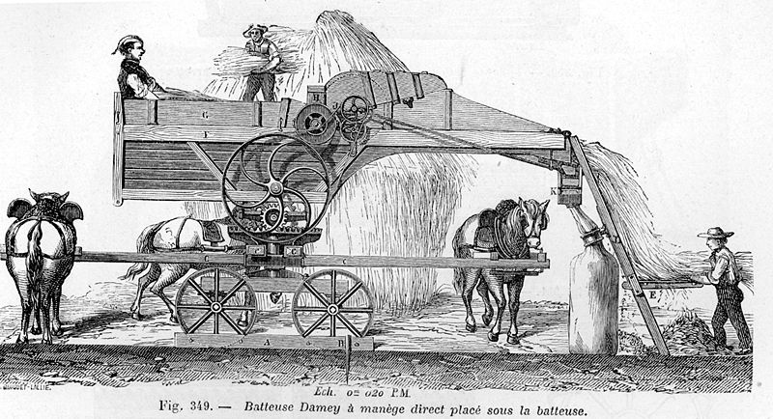
Threshing Machine – separates wheat grains from the husk

Slide 16
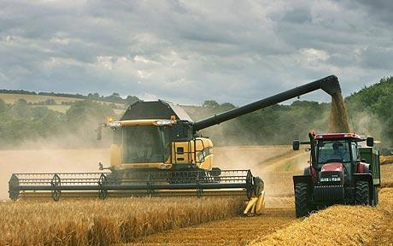
Modern Times = Combine Harvester

Slide 17
The plight of the farmers
As demand increased so did production of food
Unfortunately, farmers OVER-produced the amount needed
Supply was greater than demand (Result??)
The price of the crops DECREASED! (Result??)
Farmers went into DEBT because they couldn’t pay their bills
What bills?
Mortgage on the land, cost for machines and supplies, cost of shipping the crops to cities

Slide 18
So, what will become a major issue?
For a moment Dyke was confused. Then swiftly the matter became
clear in his mind. The Railroad had raised the freight on hops
from two cents to five. All his calculations as to a profit on his little investment he had based on a freight rate of two cents a pound. He was under contract to deliver his crop. He could not draw back. The new rate ate up every cent of his gains. He stood there ruined.
S. Behrman and the clerk watched him from the other side of the
counter. "The rate is five cents," declared the clerk doggedly.
"Well, that ruins me," shouted Dyke. "Do you understand? I
won't make fifty cents. MAKE? Why, I will OWE, I’ll be ruined, do you understand?”
"We don't force you to ship. You can do as you like…”
Source: The Octopus, a farmer’s interview with a railroad agent

Slide 19
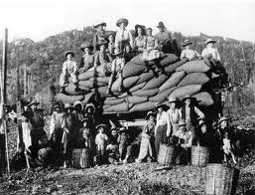
Cost of Shipping Increases TOO!
Railroad companies set their shipping rates
Now, farmers couldn’t afford the rates, but had no choice but to pay!
What happens next?
Read the Folk Song
“The Farmer is the
Man”

Slide 20
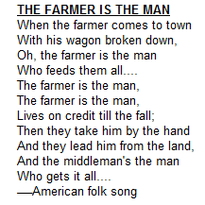
What is the overall message?
A song told of hard times and raw deals for farmers and encouraged the people to STRIKE BACK—politically—at the money-lenders, the middle men, and the corrupt old politicians.

Slide 21
Farmers Demand Change
TAKE A PIC!
Farmers lost their land AND their livelihood!
But the farmers saw a “strength in numbers”
Call on the gov’t to intervene and improve their lives
How? What do they need?
Help with railroad shipping rates
Help so they don’t lose their land
Help so the prices of crops don’t decrease

Slide 22
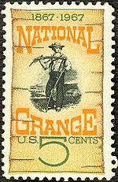
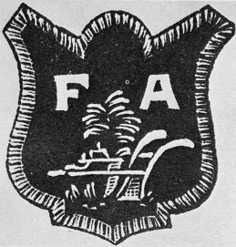
Farmers Organize!
The National Grange Movement (1867)
Midwest
Social and educational organization
Farmers & families
DEFEND against middlemen
Established COOPERATIVES (businesses owned and run by farmers – to X the middleman)
Farmers’ Alliances
Discuss possible government action and control of the railroads
How do people today organize to try to enact change? Is it a successful strategy? Explain.

Slide 23
Munn v. Illinois (1877)
In some midwestern states, farmers worked with state legislatures to pass laws regarding the high rates imposed by big businesses…
The Supreme Court ruled that states could regulate businesses “clothed in the public interest”
Examples: Railroads and grain elevators
Some justices feared too many regulations would impede business and hurt the marketplace

Slide 24
Wabash v. Illinois (1886)
BUT, was it constitutional for individual state laws to regulate railroad rates that crossed state lines?
NO! States could only regulate LOCAL rates. Interstate commerce was a FEDERAL matter controlled by CONGRESS!
Supreme Court REVERSES Munn v. Illinois decision!
ONLY the federal government can regulate interstate trade
Applied the Fourteenth Amendment towards corporations
No state can “deprive any person of life, liberty, or property without due process of the law”
Yet, the court wouldn’t use this amendment to protect the rights of blacks

Slide 25
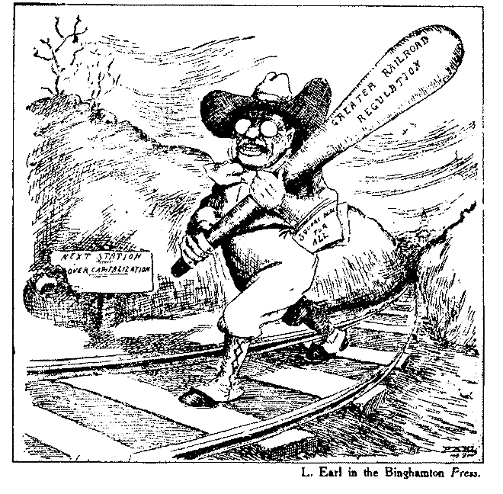
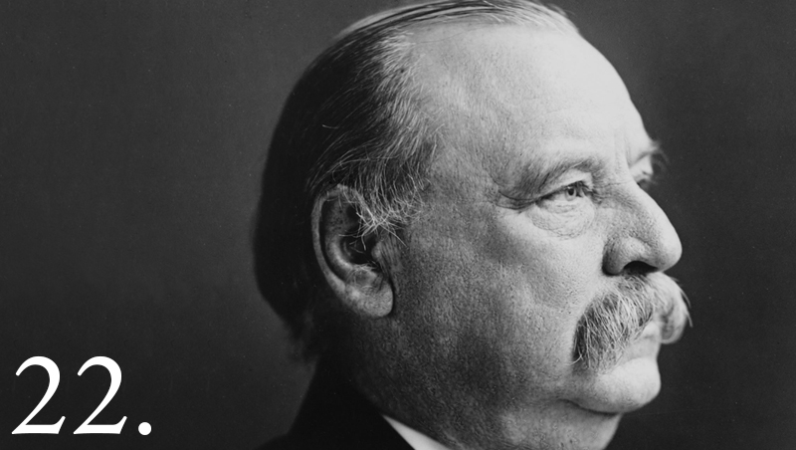
Were the Grangers SUCCESSFUL?
Passage of the Interstate Commerce Act 1887
Allowed for the government to supervise railroad activities
Unfortunately, it was not initially executed by the president so it had little power to help regulate shipping rates
(Teddy Roosevelt will change that in 1906!)

Slide 26
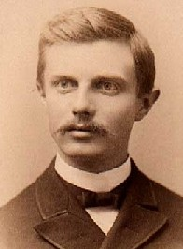
Frederick Jackson Turner’s Frontier Thesis (1893)
According to Frederick Jackson Turner, why has the frontier been an important part of American development?
Settlement of the frontier was an evolutionary process
Began as a wilderness
Started with a hunting frontier
Followed by mining and cattle frontiers
Finished with towns/cities
Frontier was “the meeting point between savagery and civilization.”
EXPANSION was the most important factor in American history
“the existence of an area of free land, its continuous recession, and the advance of American settlement westward explain American development.”

Slide 27
There’s no where left to go!
U.S. Census of 1890 claims American frontier is closed!
"And now, four centuries from the discovery of America, at the end of a hundred years of life under the Constitution, the frontier has gone, and with its going has closed the first period of American history.”
“How will American culture and history develop from this point on?
…will Americans be able to retain that coarseness and strength combined with acuteness and acquisitiveness . . . that dominant ‘rugged individualism’ bred by expansion now that the frontier is closed?!”

