Slide 1
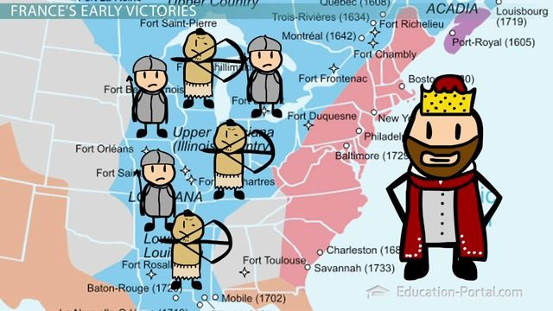
Aim: What were the major causes of the French and Indian War in America?

Slide 2
Essential Questions:
What were the causes of conflict between British and France and American Indians culminating in the French and Indian War?
What were the positive and negative effects of the French and Indian War on the British? French? Colonists?
What were the motivations and the effects of the Proclamation of 1763?
What effects did the French and Indian War have on American Indian groups?
How did the French and Indian War change the relationship between the British and the colonists?

Slide 3
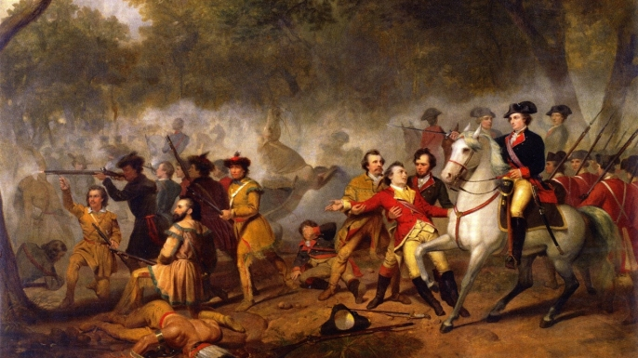
The Colonies Move Towards REVOLUTION

Slide 4
The French & Indian War
(1756 to 1763)
“The Great War for Empire”

Slide 5
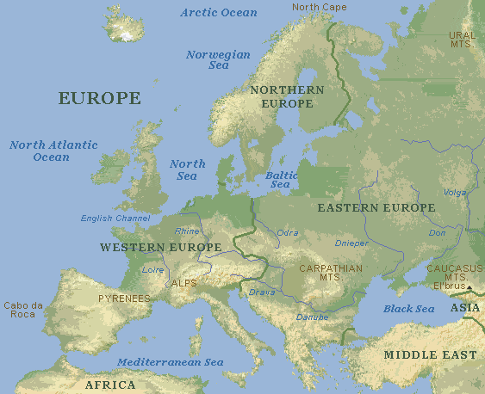
Background
European countries were constantly fighting
European countries tried to control as much land and as much trade as possible

Slide 6
Triangle of Hatred
England
France
Spain

Slide 7
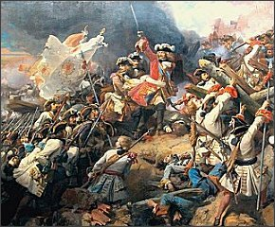
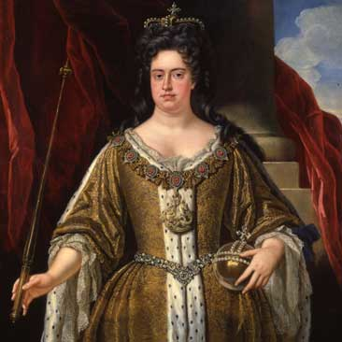
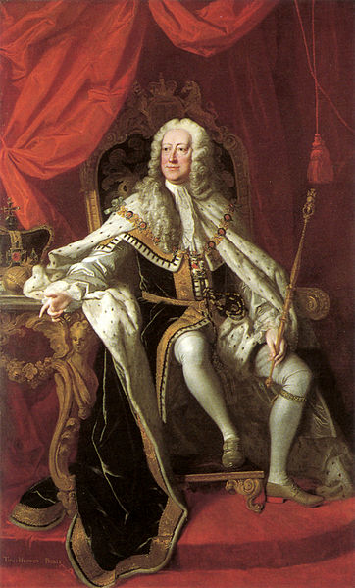
Early Wars for Empire
Sparked by competition for trade & territory in America between Britain, France, & Spain…
King William’s War (1689-1697) & Queen Anne’s War (“War of Spanish Succession” 1702-1713) – failed attempts to take Quebec – Indians side w/ French, British gain Nova Scotia & trade in Spanish America including “asiento de negros”
King George’s War (1744-1748) British vs. France & Spain – limited territorial changes in Americas
New Englanders upset about return of territory to French
Queen Anne
1702-1707
King George II
1727-1760

Slide 8
Colonial Land Grab
Colonists “bumped” into each other.
Colonists explored each others’ land.
Colonists claimed each others’ land.
Native Americans were always caught in the middle.

Slide 9
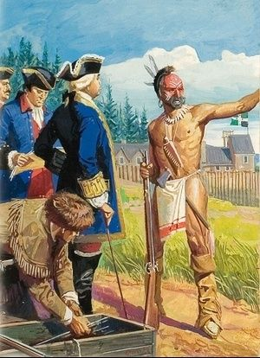
Indian Relations
A. French have better relationships with Indians
B. English just wanted to take the native’s land for farming!
Most French colonists were fur traders and trappers.
C. French only wanted the fur. They didn’t want to stay on the land.
    They lived among the Indians and adopted their ways.
    They learned to make canoes, trap animals, make snow shoes, and etc..
    They learned Native American languages.
    They took Indian brides.

Slide 10
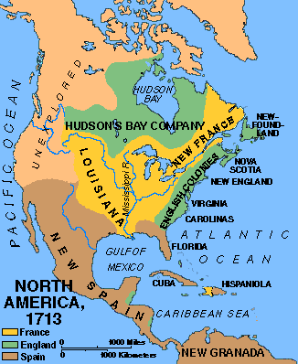
English Possessions In North America

Slide 11
French Possessions In North America

Slide 12
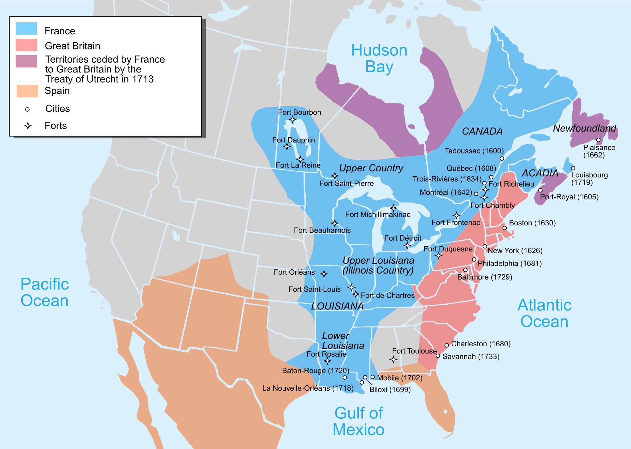
French Foothold in Canada
1608: Colony established at Quebec by Samuel de Champlain
Establish the fur trade----beaver
Friendly relations with Hurons
  French joined Hurons in battle against Iroquois confederation (who in future hampered French settlement because they were allies of British)

Slide 13
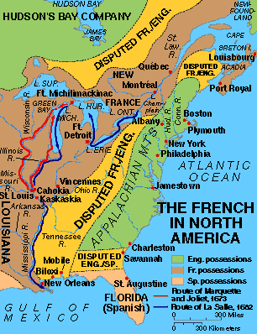
So, based on the map, what do you think was going to be a CAUSE of a war??

Slide 14
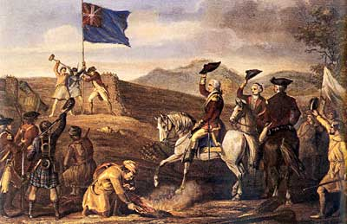
FRENCH AND INDIAN WAR OR SEVEN YEARS OF WAR
CAUSES
CAUSES
English-French rivalry worldwide would erupt into a world war.
England and the 13 Colonies fight together to defend their empire.
War begins over land disputes in the Ohio Valley
Against the French, Indian allies and Spanish
British want part of fur trade and the 2 openings into North America
FOUGHT FOR THE CONTROL OF NORTH AMERICA
George Washington starts this war

Slide 15
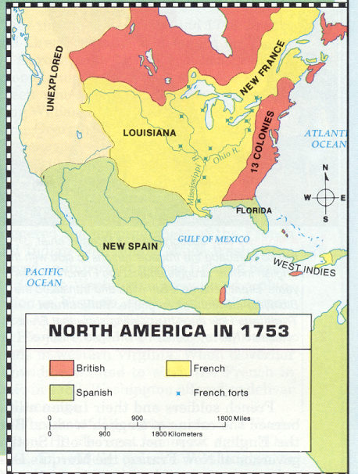
French forts in the Ohio Valley angered the English.

Slide 16
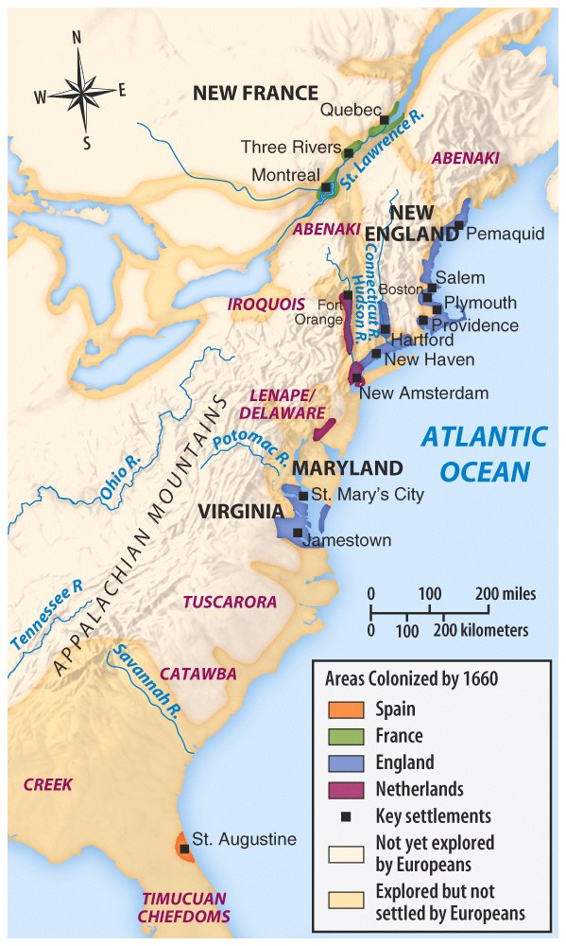
French were not here to take over the land and colonize (the British WERE)
They set trading posts for the fur trade and developed working relationships with the Indian tribes (the British DIDN’T)

Slide 17
THE FRENCH AND INDIAN WAR was a four phase conflict…
    1754-55 - American frontier in Ohio River Valley - beginnings of a decisive imperial clash
    1756-58 – several British defeats; the rise of William Pitt and the mobilization of colonial resources
      the tipping point - 50,000 people are mobilized on the British side including native Americans, colonists, and British Regulars vs. the entire population of Canada and New Orleans
      British have a 20:1 population ratio/advantage over the French
    1759-60 - The conquest of Quebec and final British victory in North America
    1761-63 - British triumphs in a world-wide war
Notes:
The 1759 Battle of Quebec ranks as one of the most significant engagements in British and American history, and when Montreal fell in 1760, that was the last time French flags would fly on American soil.
In the peace treaty at Paris in 1763, Britain got all of Canada, but the French were allowed to retain several small but valuable sugar islands in the West Indies and two never-to-be-fortified islets in the Gulf of St. Lawrence for fishing stations.
France’s final blow came when they gave Louisiana to Spain to compensate for Spain’s losses in the war.
Great Britain took its place as the leading naval power in the world, and a great power in North America

Slide 18
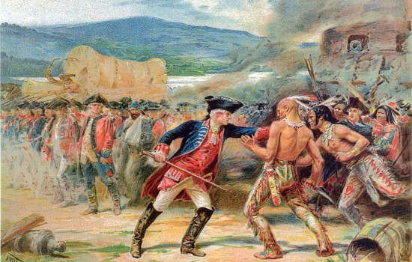
We know the British had a STRONG military (navy too)…if the British had such a manpower advantage, then why did the war last so long?
The Native Americans were the great equalizing factor in the war…

Slide 19
Soon, a war was going to begin between England and France…
Which side would YOU choose?
The English & English Colonists… | The French & French colonists…
Want to use your land for fur trading and farming Think that Native Americans are “savages” Want to expand their territory further to the West Have a steadily growing population in America | Want to use your land for fur trading Have married Native Americans and raised families with them in America Have many missionaries living in the west that try to convert Native Americans to Christianity Have a relatively small population in America

Slide 20

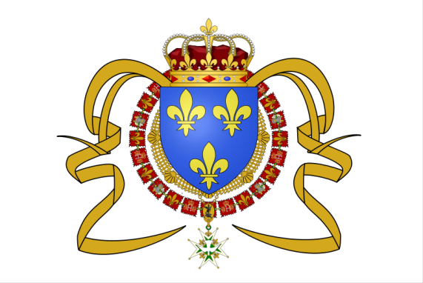

England
France
Franc
Large Population (1,485,000) Small Population (75,000)
Organized Colonial Militias Few Troops in Canada
Colonies are Self-Supporting Relied Heavily upon Imports
Navy Controlled Trade Routes Smaller navy Defends Europe
13 Separate Governments Single Colonial Government
Few Indian Allies (Iroquois) Strong Alliances with Indians
Does this change your mind?

Slide 21
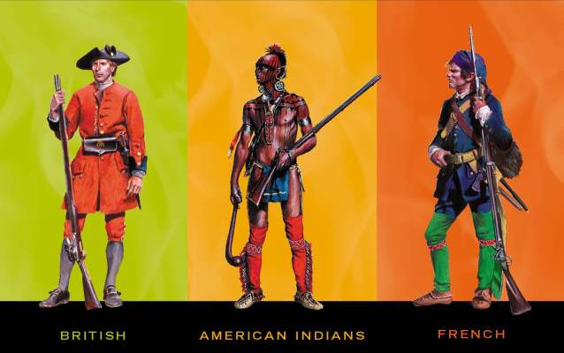
Iroquois
Algonquins and
Hurons

Slide 22
What was the Native American role in the French & Indian War?
Prior to 1756 - The Delaware and some Northern Canadian Iroquois are allied with the French
1756 - Mohawks (Iroquois) - due to conflicting alliances, pull out of the war
  The Iroquois are behaving as neutrals - resulting in a deadlock war (they control access to Great Lakes and Rivers as a British launching point to invade French territory. This evens the playing field for the French and the English despite much larger British fighting force)
  1758 - British break the deadlock - by getting the Delaware to pull away from the French and ally with the Pennsylvanians.

Slide 23
What was the Native American role in the French & Indian War?
1759-60 - The Iroquois ally themselves with Britain and create the conditions for British victory, The English are able to invade French Canada using the Great Lakes regions. The Iroquois diplomatic parties, encourage other groups to break away from the French alliances as it is not in their best interests)
1760 - Native alliances backing away from the French enable the British Army to take the City of Montreal without Bloodshed (this is part of the Native American preference to avoid battles when possible)

Slide 24
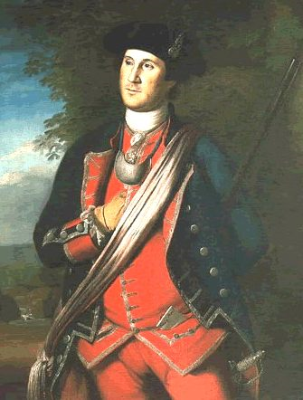
Now lets get into
FRENCH vs. BRITISH
Does anyone know
who this man is?

Slide 25
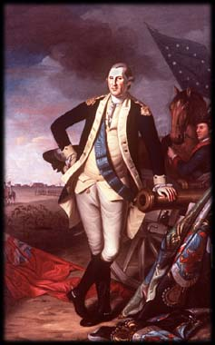
George’s First Command
Virginia (BRITISH) wanted to claim western PA too!
George Washington was a wealthy planter and member of Virginia militia (volunteer soldiers)
Governor Dinwiddie sent Washington and militia to build a road through the mountains
The road from VA to PA would help “claim” the land for VA

Slide 26
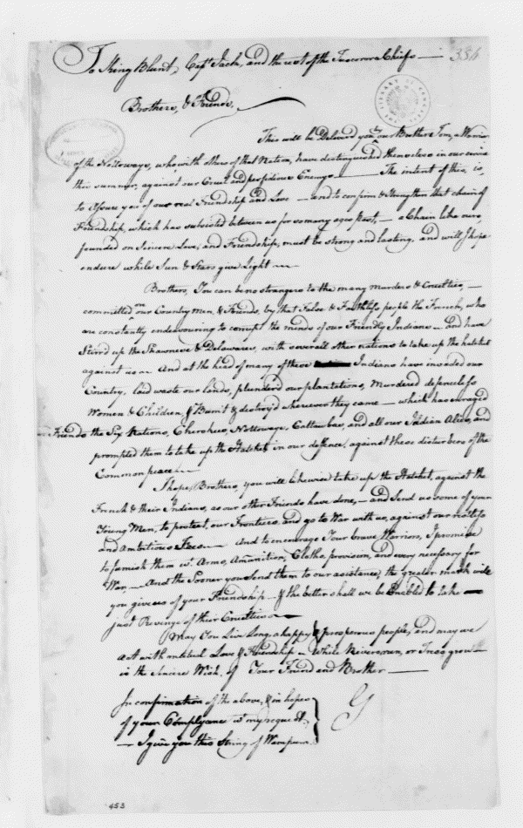
George’s First Orders
Dinwiddie then ordered Washington to tell the French to leave (November-December, 1753)
After reviewing Dinwiddie's letter, the French calmly wrote a reply stating that the French king's claim to the Ohio Valley was "incontestable”
  How would you feel as a 21 year old doing this?

Slide 27
Dinwiddie’s Next Orders
Dinwiddie (FED UP with the French) then ordered Washington to begin raising a militia to hold the “Forks of Ohio” near present-day Pittsburgh, a site Washington had identified as a fine location for a fortress…
Then, without asking the House of Burgesses for permission, Dinwiddie issued a captain's commission to have his men raise a small force and immediately begin construction of a fort in the Ohio valley…
What do you think happened next??

Slide 28
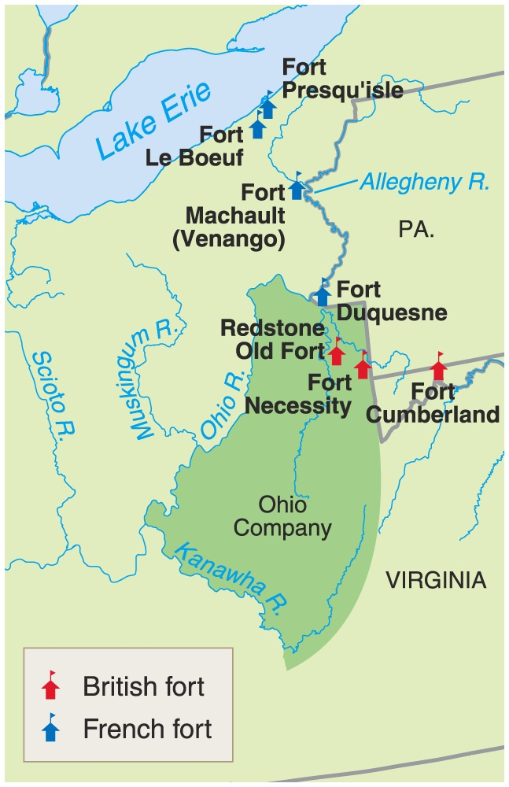

1754 → The First Clash
The
Ohio Valley
British
French
Fort Necessity Fort Duquesne
* George Washington * Delaware & Shawnee
Indians

Slide 29
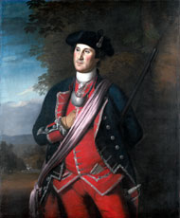
George’s First Command
Washington and his men build Fort Necessity
Washington’s militia attacks and kills a French “ambassador” by mistake!
French forces hear about this and outnumbered Washington and his militia at Fort Necessity
Washington is captured and sent home embarrassed.
VIDEO

Slide 30
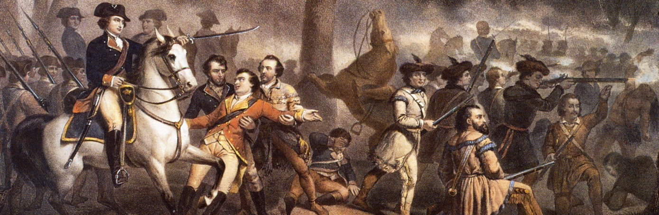
Aim: How did the results of the French and Indian War cause friction between Parliament, King George III and the American Colonists?

Slide 31
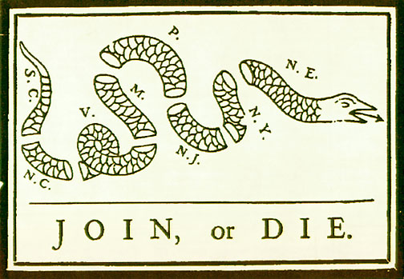
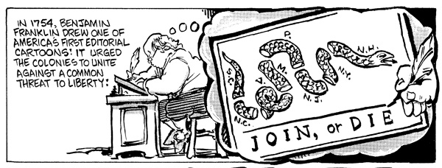
The Plan of Albany 1754
What is the main message of the cartoon?
?
Why would this plan be rejected by the colonists?
Colonies were too independent of each other and still too dependent on Britain.
Notes:
The Plan called for the general government to be administered by a President General appointed and supported by the Crown, and a Grand Council to be chosen by the representatives of the colonial assemblies. Many objections and difficulties were debated, addressed, and resolved whereupon the plan was unanimously adopted by the delegates of the Albany Congress. Copies were then sent to the Colonial Assemblies and the British Board of Trade in London.[2]
The Plan was promptly rejected by both sides. "The colonial assemblies and most of the people were narrowly provincial in outlook, mutually jealous, and suspicious of any central taxing authority."[3] Many in the British government, already wary of some of the strong-willed colonial assemblies, disliked the idea of consolidating additional power into their hands. Instead, they preferred that the colonists' focus remain on the forthcoming military campaign. The Board of Trade never sought official approval for the Plan from the Crown. Instead, they proposed that colonial governors, along with some members of their respective councils, order the raising of troops and building of forts, using money from Treasury of Great Britain which would later be repaid by an Act of Parliament laying a tax on America.[4]
The proposed Galloway Plan that was proposed at the First Continental Congress bore striking resemblance to the Albany plan.[5] It was submitted by conservative loyalists and quickly rejected in favour of more radical proposals.
In the aftermath of the Revolutionary War, the Albany Plan of Union served as an inspirational primer for the writing of the Articles of Confederation.

Slide 32
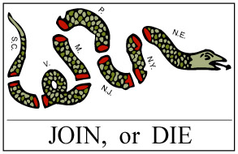
The Albany Plan
1754: Albany Congress – convened by British, led by Franklin ~ 1st attempt at colonial unity ~ only 7 of 13 colonies there
Purpose: keep Iroquois loyal, bolster defense against France through colonial unity
Franklin sponsored plan for colonial home rule, unanimously adopted by delegates
  Colonies rejected: not enough independence
  London rejected: too much independence

Slide 33
Small Group Activity:
The Colonies Need YOU!
In a group of 3-4 students, design a political cartoon on a poster, just like Benjamin Franklin’s, that attempts to BRING THE COLONIES TOGETHER FOR WAR!
On your poster, make sure to include:
A slogan to help the colonies UNITE!
A picture/visual to help motivate the colonists in all of the colonies to come together AS ONE!
DUE TOMORROW

Slide 34
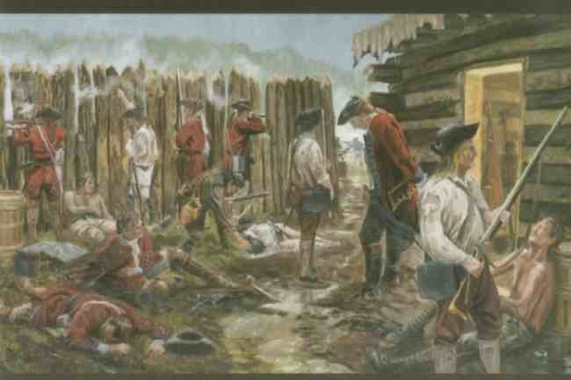
July 17, 1754: Washington's resignation Blamed for Fort Necessity, Washington resigns. He will later return as a volunteer under British authority.

Slide 35
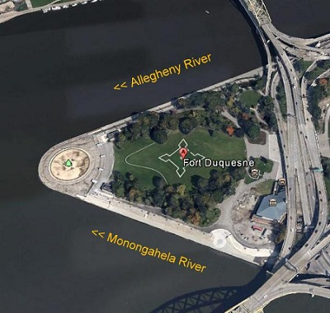
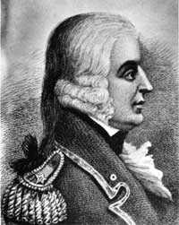
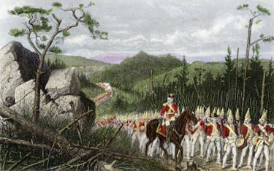
The Fighting Continues…
In late 1754, Britain sent professional soldiers to America commanded by General Edward Braddock.
July 9, 1755: The Battle of the Wilderness
In June 1755, Braddock led nearly 2000 British soldiers and some colonial militia to the French Fort Duquesne, PA. (near Pittsburgh, PA today)
British General Braddock's forces are DEFEATED near Fort Duquesne, leaving the backwoods of British territory undefended!

Slide 36
1756 → War Is Formally
Declared!
Lord
Loudouin
Marquis
de Montcalm
Native American tribes
exploited both sides!

Slide 37
British-American Colonial Tensions
Colonials
British
Methods of
Fighting:
Indian-style guerilla
tactics.
March in formation or bayonet charge.
Military
Organization:
Col. militias served
under own captains.
Br. officers wanted to control colonials.
Military
Discipline:
No mil. deference or
protocols observed.
Drills & tough
discipline.
Finances:
Resistance to rising
taxes.
Colonists should pay for own defense.
Demeanor:
Casual,
non-professionals.
Prima Donna Br.
officers with servants
& tea settings.

Slide 38
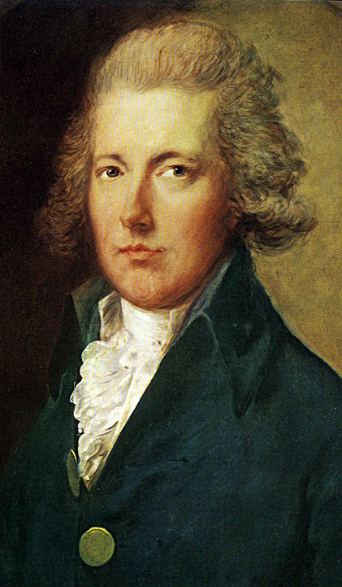
You da man William Pitt!
William Pitt becomes the Prime Minister of Great Britain and promises that he will win the war for the crown.
PLAN:
Says the British will pay. Sends money (A LOT of it = DEBT!)
Sends soldiers. Helps local economy.
Negotiates with Iroquois and gains their favor.
HE TURNS THE TIDE!

Slide 39
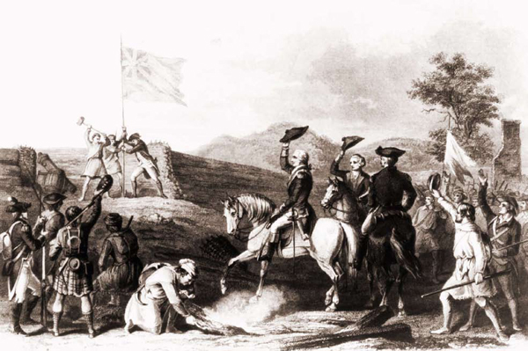
November 26, 1758: The British recapture Fort Duquesne It is renamed "Pittsburgh."

Slide 40
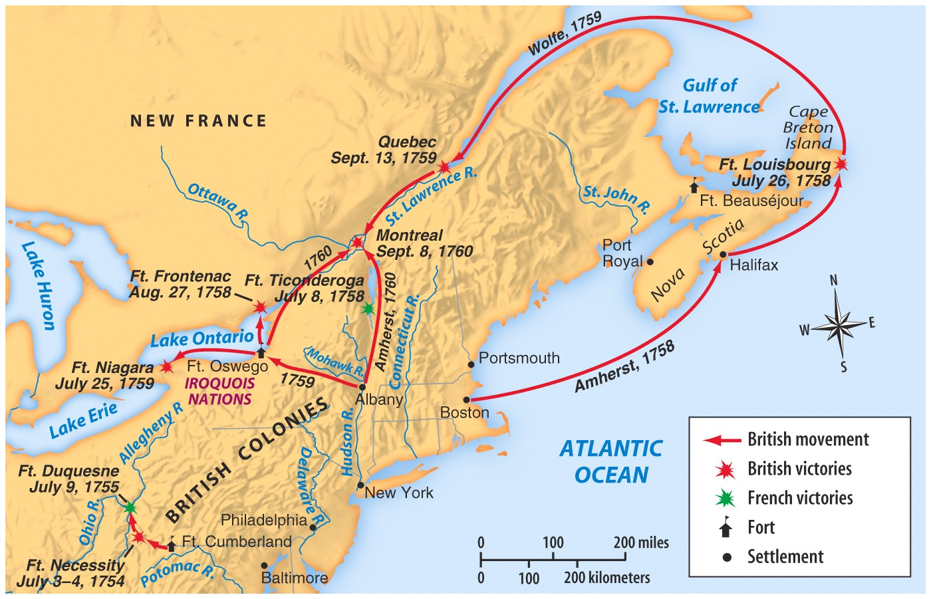
How are the British going to WIN?

Slide 41
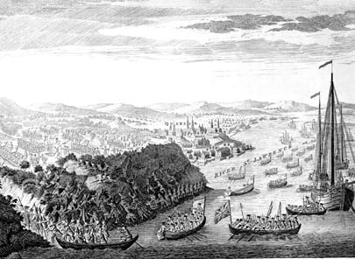
Battle of Quebec (1759)
Turning Point of the war
British approach Quebec by sea and climb cliffs-surprise attack
French caught off guard.

Slide 42
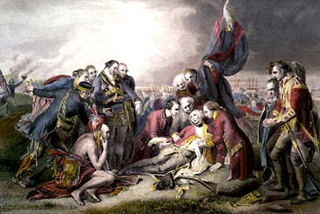
Battle of Quebec (1759)
Commanders of both armies die in battle
British claim victory
French surrender in America a year later on September 6, 1760
British General- James Wolfe’s death at Quebec

Slide 43
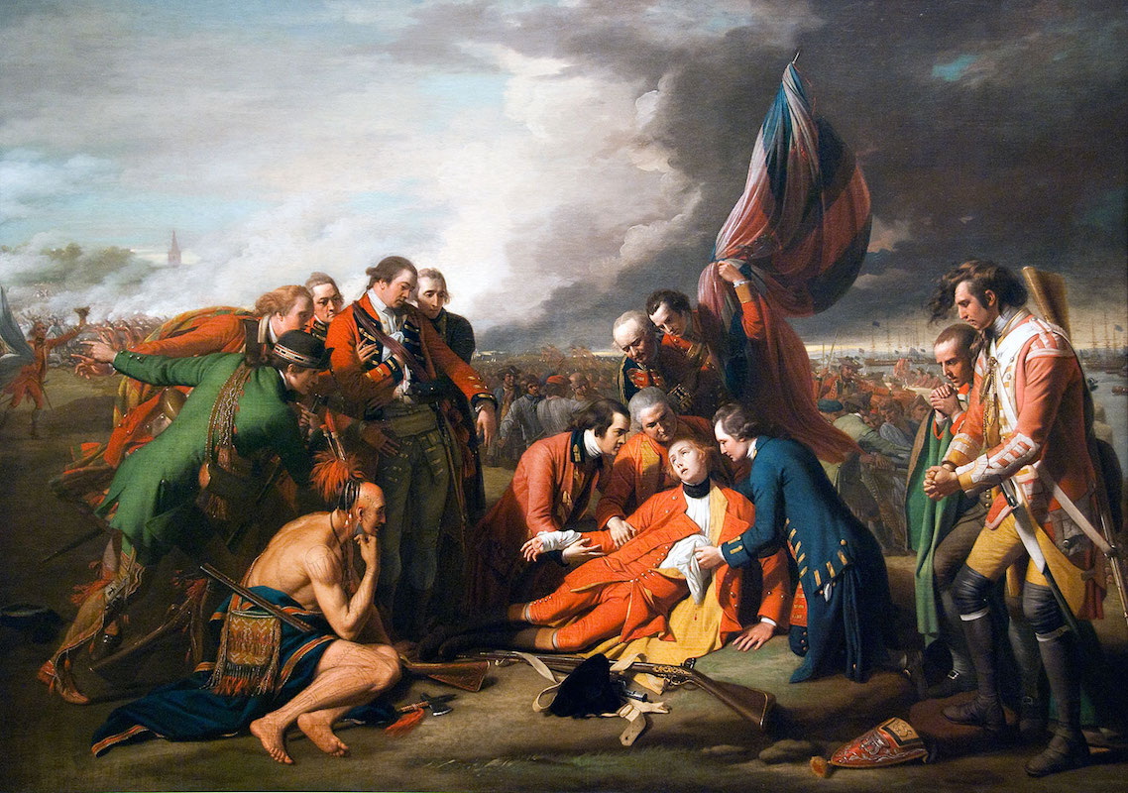
What was the motive
behind this painting?

Slide 44
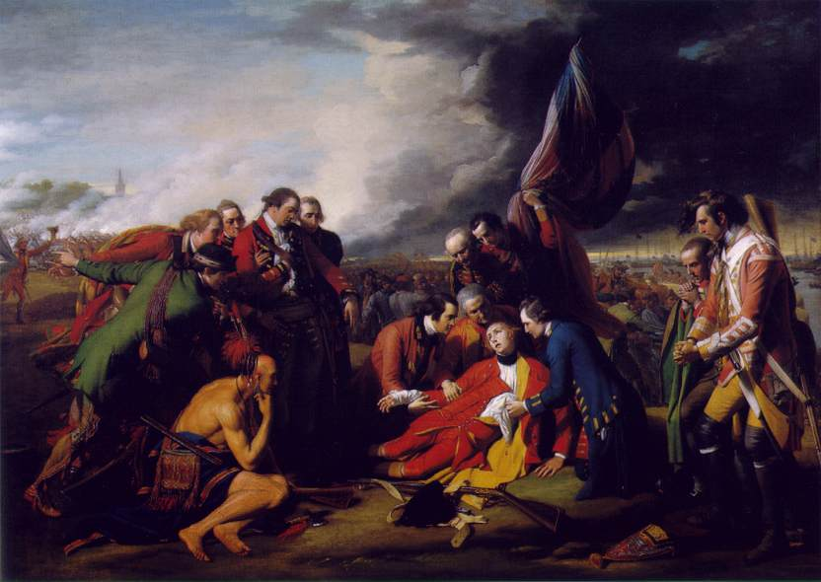
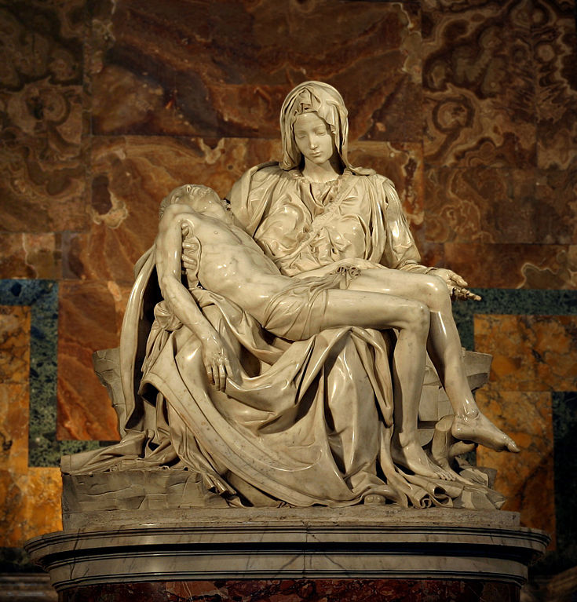
The Death of General Wolfe, 1771 (Benjamin West)
- the first major English painting in which the people are wearing modern garb
- during the Battle of Quebec
- various regiments of soldiers that represent different aspects of the British Empire
The ships, the sailors (British Navy), Scottish Highlanders, Colonial Soldiers
Regimental soldier, Native Americans (Mohawk Warrior), priests, doctors, other
Officers and their aids, etc.
- demonstrates this moment as the Birth of a Great Empire, a climactic moment of the 7 years war.
What’s the significance?
Notes:
Later earning the title of “Organizer of Victory,” William Pitt soft-pedaled assaults on the French West Indies, assaults which sapped British strength, and concentrated on Quebec-Montreal.
In 1758, Louisbourg fell after a blistering siege.
32 year-old James Wolfe, dashing and attentive to detail, commanded an army that boldly scaled the cliff walls of a part protecting Quebec, met French troops near the Plains of Abraham, and in a battle in which he and French commander Marquis de Montcalm both died, the French were defeated and the city of Quebec surrendered.

Slide 45
FRENCH AND INDIAN WAR OR SEVEN YEARS OF WAR
EFFECTS
EFFECTS
French lose war and all land in North America
Colonists realize British are not invincible seek independence.
English inherit vast new land holdings in North America
England sees responsibility to defend empire in North America
FOUGHT FOR THE CONTROL OF NORTH AMERICA
Great Britain accumulates huge war debts
King George and Parliament tax the Colonies

Slide 46
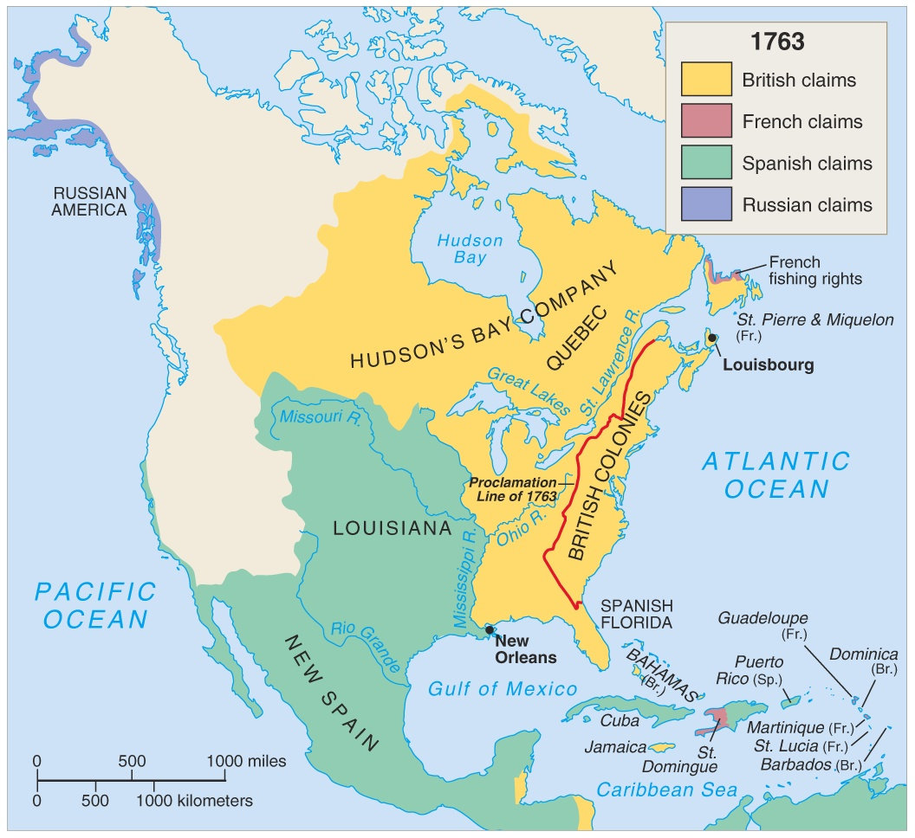
F/I War 1763
Treaty of Paris 1763
England gains French land from Canada to Florida and Appalachians to the Mississippi River.
England gains Florida from Spain.

Slide 47
1763 → Treaty of Paris
France --> lost her Canadian possessions,, and claims to lands east of the Mississippi River.
Spain --> got all French lands west of the Mississippi River, New Orleans, but lost Florida to England.
England --> got all French lands in Canada, exclusive rights to Caribbean slave trade, and commercial dominance
in India.

Slide 48
Results of the F & I War
British:
acquired more land
became a world-wide “super power”
grew resentful of colonial “blundering” and the cost of defending the colonies

Slide 49
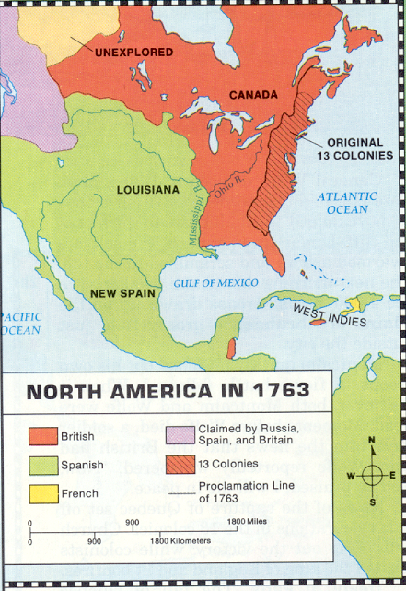
Results of the F & I War
French:
lost almost all land in North America
no longer important in American development
Native Americans:
continued to lose control over land in North America

Slide 50
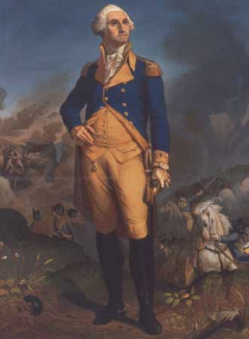
Results of the F & I War
Colonists:
acquired land to expand
gained valuable military experience
found their first “American” hero…Washington
learned how to cooperate
began to think of themselves as “Americans”

Slide 51
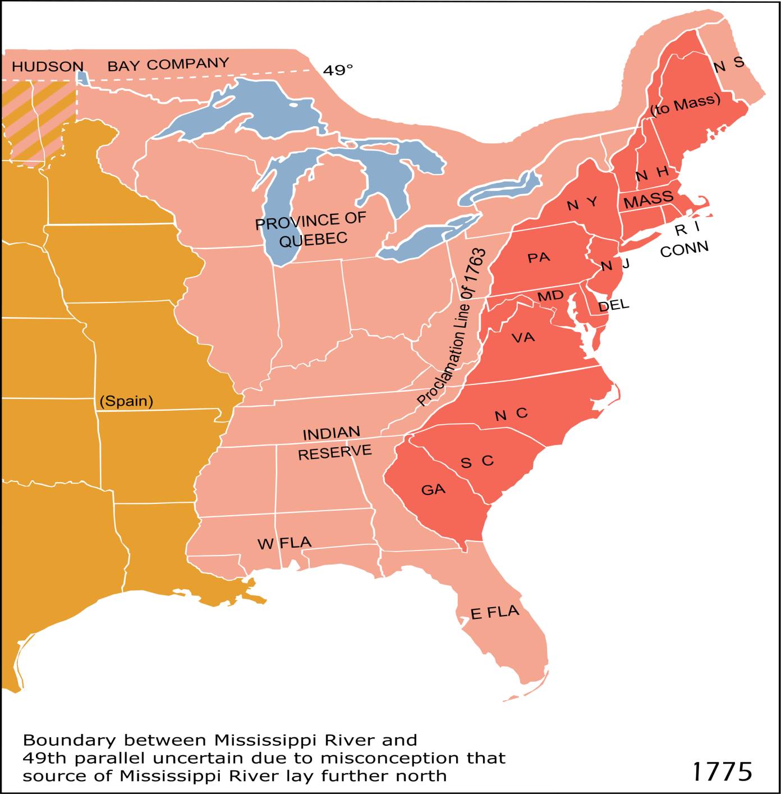
PROCLAMATION OF 1763
British land policy to temporarily create a reserve for Natives.
This must be done to maintain some peace and order. AVOID MORE CONFLICT

Slide 52

Proclamation of 1763
What did the Proclamation of 1763 say? It declared that Appalachian Mountains were the western boundary for all colonies; colonists could NOT cross mountains!
  to separate the colonists from the Indians
  to prevent future wars and expense
10,000 British troops were sent to “police” the border.
Proclamation angered many colonists, especially those who owned shares in land companies, such as the Ohio Company of Virginia.

Slide 53
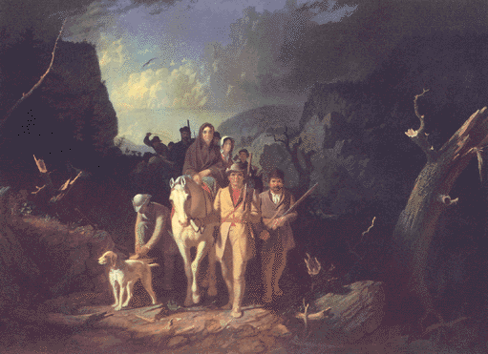
PROCLAMATION OF 1763
British land policy to temporarily keep the colonists out of Indian land until treaties could be negotiated with the tribes.
Colonial pioneers such as Daniel Boone, defied the Proclamation of 1763 and crossed the Appalachians and settled areas in what would become Kentucky.
The belief that the land westward was sacred land, fought and died for and that it was their birthright….It belonged to them.
The “American Dream” could be found out west led many colonists to defy the Proclamation of 1763 and cross the Appalachians.

Slide 54

Proclamation of 1763 creates PROBLEMS
Proclamation of 1763 created tension between Britain and the colonies.
Britain placed additional taxes on the colonists to pay for defending the 13 colonies…this created more tension.
Indians traded with the British and the colonists, but regarded both as enemies.
Colonists migrated across the Appalachian Mountains anyway.

Slide 55
EXIT ASSESSMENT
In your notebook, answer the following:
Think about the results of the French and Indian War…
Who was the biggest “winner” and why?
Who was the biggest “loser” and why?

Slide 56
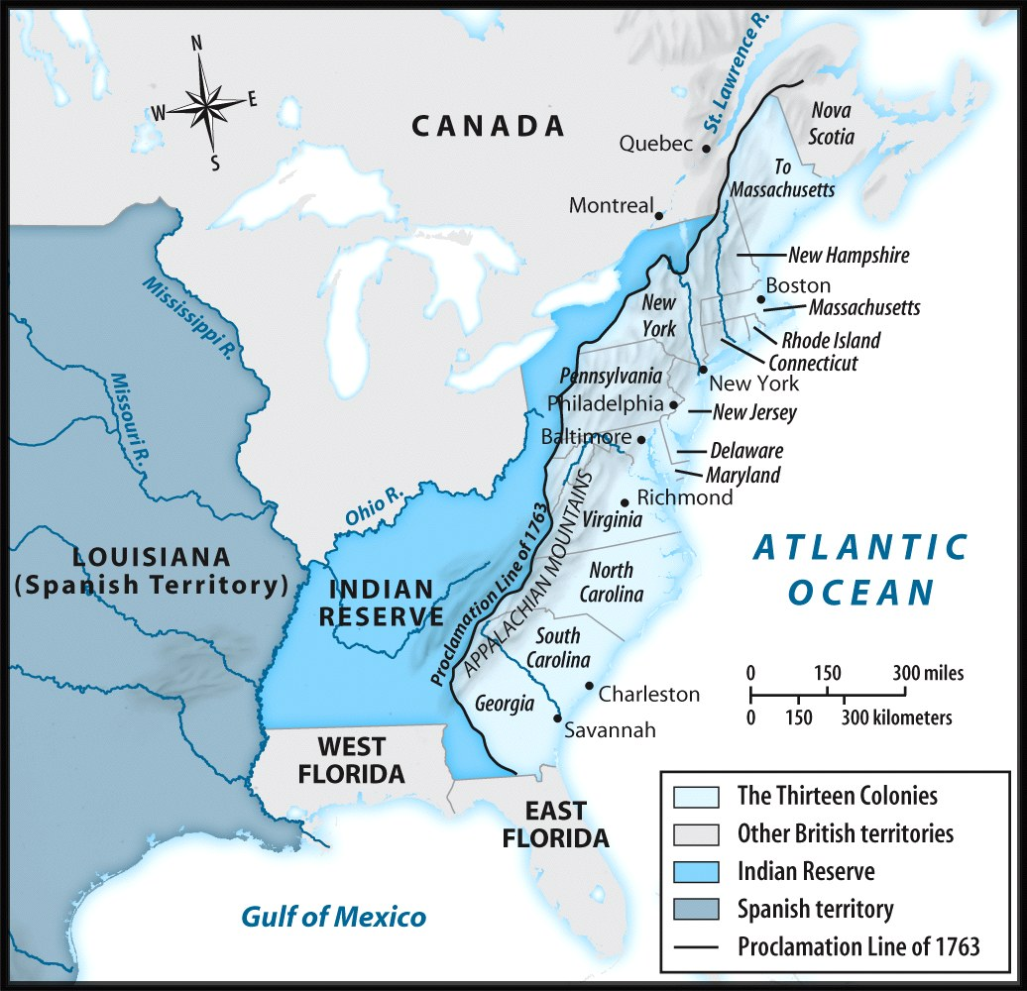
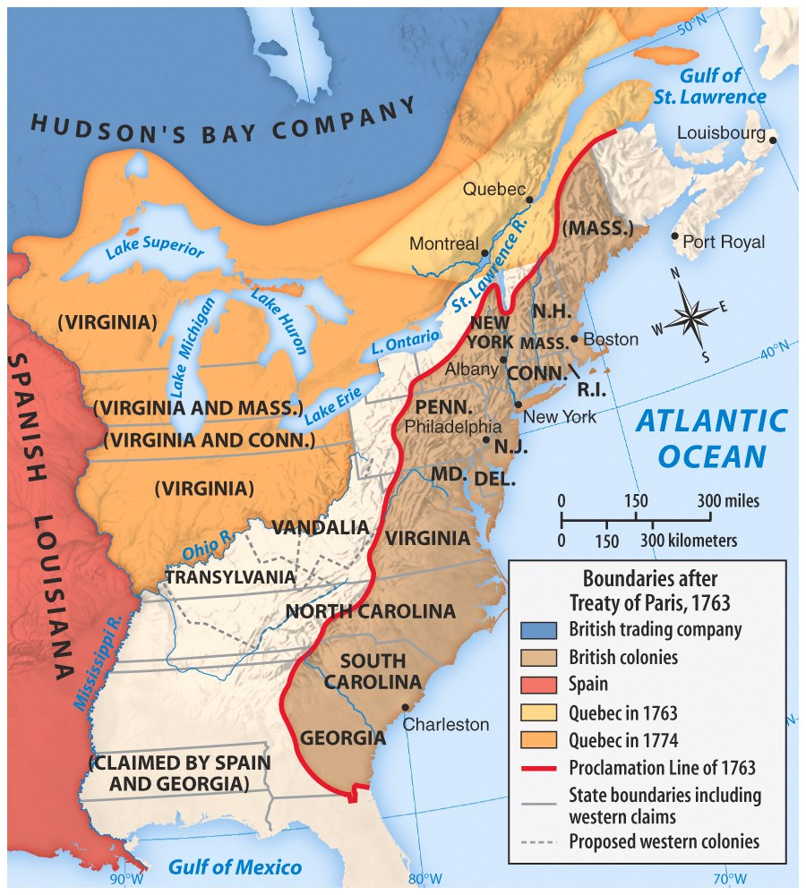
Indian Attacks force British to build forts to protect settlers moving westward
Northwest Territory

Slide 57
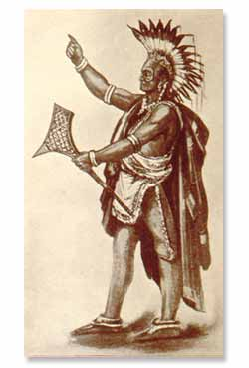
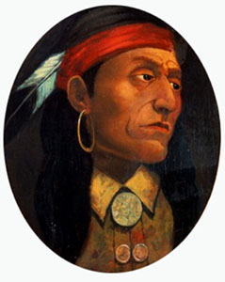
Pontiac
Pontiac's Rebellion
Chief Pontiac was an influential Ottawa leader who encouraged his people not to make peace with white settlers.
He was murdered by those who opposed his political views.

Slide 58
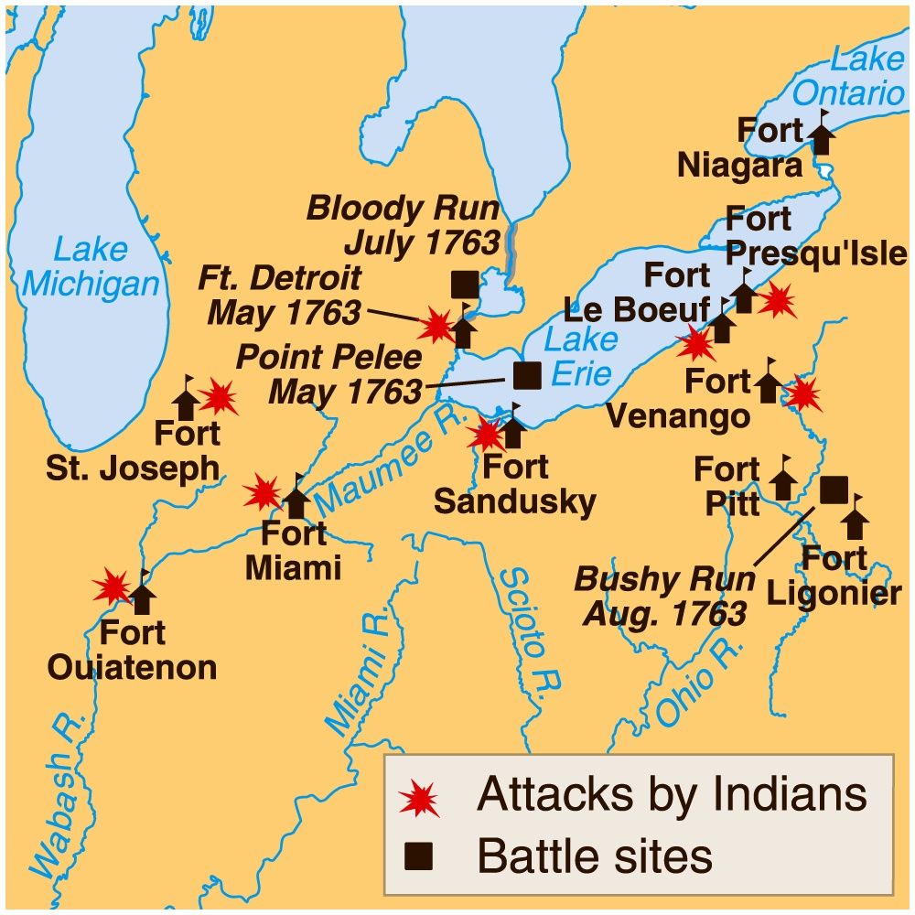
Pontiac's Rebellion
Colonists moved into this new territory causing Indian attacks on their settlements.
Great Britain would prohibit the Colonists from moving westward.

Slide 59
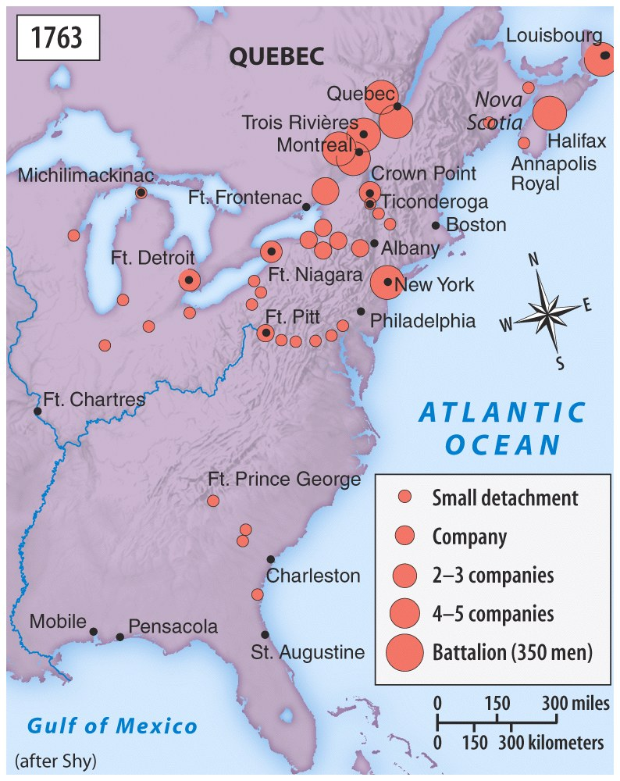
Troops1
British troop movements in response to Chief Pontiac’s resistance to negotiate.

Slide 60
The Power to Tax is
the Power to Destroy
If you have the power to tax, you have the power to take all their wealth from them.
If there is no check upon the people who posses the “power to tax” then they have the power to destroy.
Colonists wanted an “actual” representative elected from them to address their concerns to Parliament.

Slide 61
The Power to Tax is
the Power to Destroy
If a politician wants to have power he needs votes of the people that elect him.
He has to live among those people so he will not use his power to destroy them,
Or, the people may in turn vote him out of power or worse destroy him.
Man’s nature is greedy. Therefore, he cannot be trusted with unchecked power.
Absolute power corrupts, absolutely.

Slide 62
Restless Colonials
Colonials: higher confidence in military ability, but contempt from British (Washington demoted)
British concerned by disloyalty of American shippers in war
Many colonies refused to provide money or troops for war
Colonists wanted rights of Englishmen, but not responsibilities.
Inter-colonial disunity had continued through war (distance, religion, ethnicity, class), but participants in war had found commonality

Slide 63
People of Destiny
Americans felt betrayed, defied Proclamation, bad sign for future of royal power
War gave colonials sense of destiny to conquer continent
War gave British confidence, heavy hand toward colonies
Stage set for conflict

