Slide 1
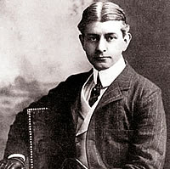
Frank Norris
Author of the book:
“The Octopus” and “The Pit” (grain speculation)
Exposed the ruthless practices and tyrannical power of business monopolies
H.I.P.P.?

Slide 2
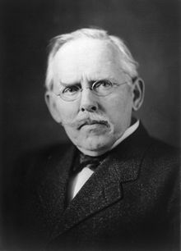
Jacob Riis
Author of the book:
“How the Other
Half Lives” (1890)
Included pictures
and stories of urban
problems
H.I.P.P.?

Slide 3
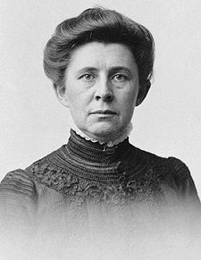
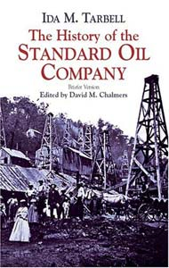
Ida Tarbell
Author of a series of magazine
articles:
“A history of the Standard
Oil Company”
Exposed the wrongful
practices of the oil
monopoly and its destruction
of small businesses
H.I.P.P.?

Slide 4
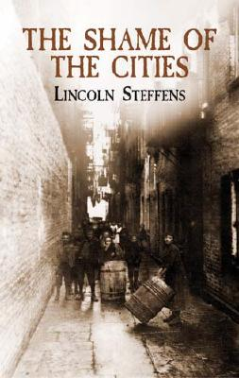
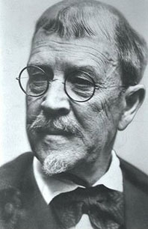
Lincoln Steffens
Author of the book:
“The Shame of
the Cities”
Included stories of
Urban problems and
political corruption
H.I.P.P.?

Slide 5
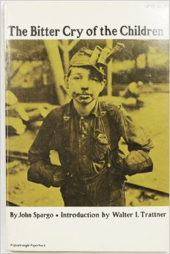
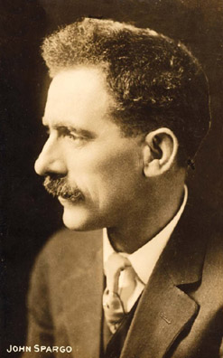
John Spargo
Author of the book:
“The Bitter Cry of the Children”
Describes how rural children live, work, survive, and unfortunately die.
H.I.P.P.?

Slide 6
Aim: How successful were women in achieving the goals of Progressivism?

Slide 7
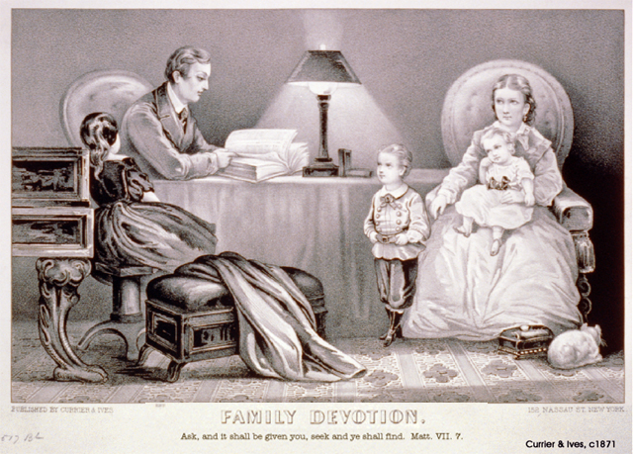
What was a woman’s role in society before the 1900s?

Slide 8
Working Women’s Struggles
But those women who worked outside of the home:
Long Hours
Dangerous
Wages go to men in the house
Worked in Cigar or clothing factories or as laundresses or servants.
Cheated and bullied by employers.
But STILL NO VOTING RIGHTS!!!
DON’T COPY

Slide 9
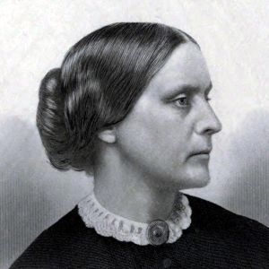
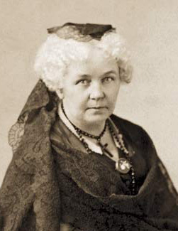
Before 1910…
Women’s suffrage movement SPLITS, but then unites in 1890
National American Woman Suffrage Association (NWSA)
National Association of Colored Women (NACW)
Big leaders: Susan B. Anthony, Elizabeth Cady Stanton
While you watch: What tactics did Susan B. Anthony use to try and increase womens’ influence in society?
Two big strategies:
Win suffrage state-by-state
Try to pass a Constitutional Amendment to give women the right to vote across the nation!
VIDEO

Slide 10
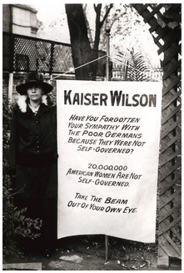
National Woman’s Party (1916)
TAKE A PIC!
Alice Paul led the National Woman’s Party (more aggressive strategies):
Focused on winning support of Congress/president to pass a Constitutional Amendment
Picked up un-ladylike strategies from British suffragists (e.g., heckling politicians, picketing)
Refused to support President Wilson if he wouldn’t support woman suffrage
NWP members were arrested for picketing in front of the White House; they were put in jail, went on a hunger strike and were force-fed

Slide 11
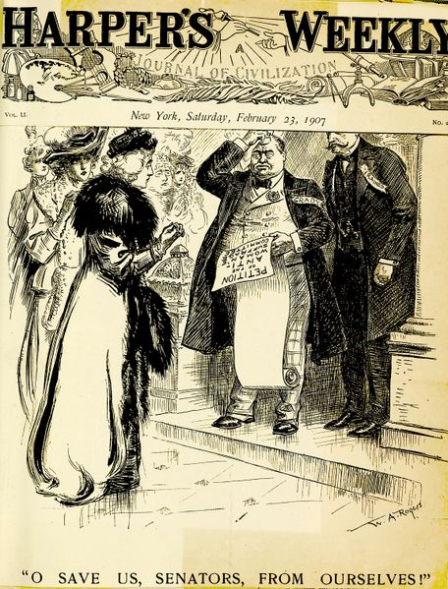
H.I.P.P.?

Slide 12
...The question of woman suffrage should be summed up in this way: Has granting the ballot to women in Wyoming where they have had it for forty years brought about any great reforms or great results? No...
Have the slums been done away with? Indeed no.
Are the streets better cleaned in the states where women vote? No, they are quite as bad as in New York City......
Have women purified politics? No...
Have women voted voluntarily? Some do; but thousands are carried to the polls... otherwise they would not vote.
...Are there laws on the statute books that would give women equal pay for equal
work? No, and never will be.
Are women treated with more respect in the four suffrage states than else
where? Not at all-certainly not in Utah.
Source: Mrs. Gilbert E. Jones, A Women Assails Woman Suffrage (1910)
What were TWO arguments against granting women the right to vote?

Slide 13
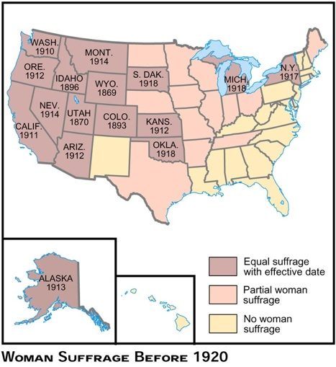
Name one state that gave women the right to vote
before 1920.
Name one state
that didn’t give
women the right to vote before 1920.

Slide 14
Arguments of Anti-Suffragists:
TAKE A PIC!
Women were high-strung, irrational, emotional
Some women believed they were not smart or educated enough
Women should stay at home
Women were too physically frail; they would get tired just walking to the polling station
Women would become masculine if they voted

Slide 15
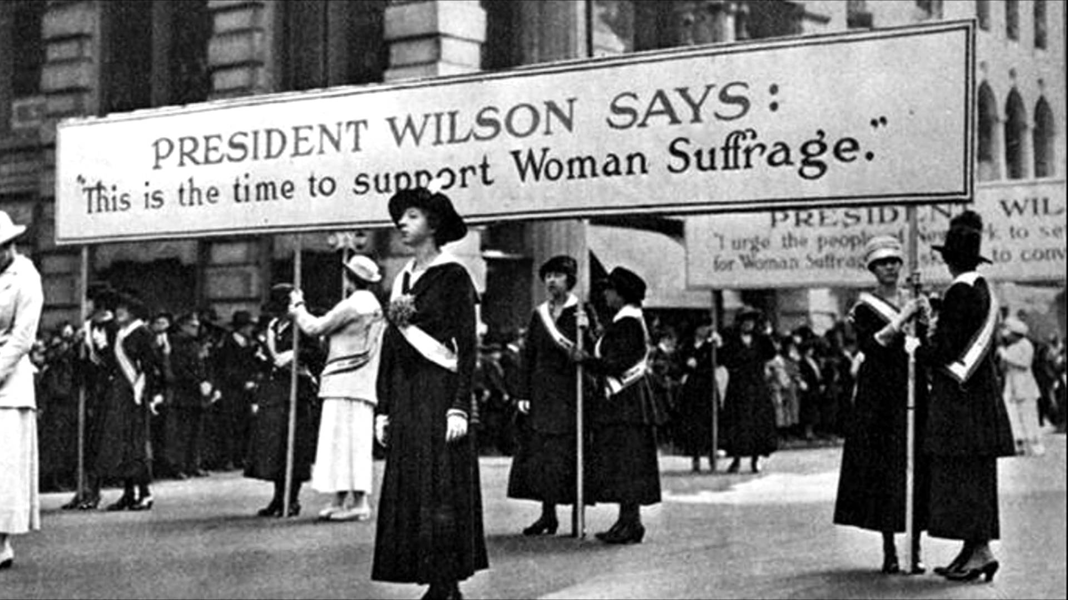
The Next Generation
Elizabeth Cady Stanton died 1902
Susan B. Anthony died 1906
Early 1900s: young middle-class women were going to college and joining the suffrage movement
Working-class women - hoped the right to vote would help improve working conditions

Slide 16
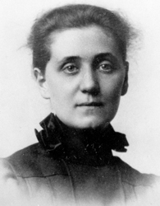
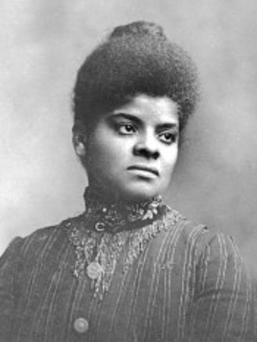
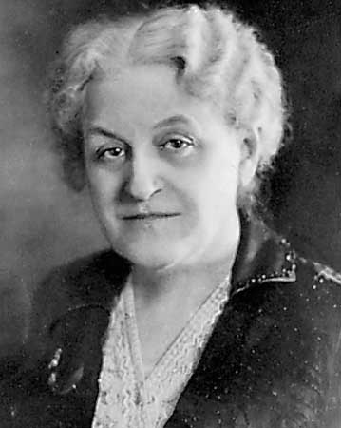
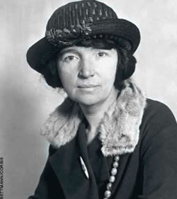
Female Progressive Advocates
Often took up causes that others ignored;
Especially conscience of problems for women, children, and families…
Jane Addams
Ida B. Wells
Carrie Chapman Catt
Margaret Sanger

