Slide 1
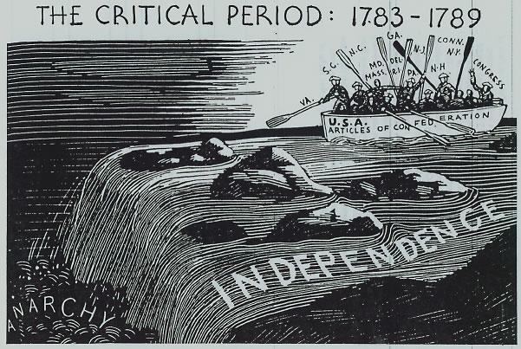
Today’s AIM:
Why were the years from 1781-1789 known as the “Critical Period” in the new nation?

Slide 2
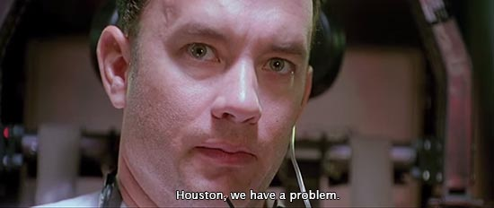
What’s the problem?
The Articles of Confederation served as the framework for the U.S. gov’t from 1781 until 1787:
Early – GOOD – because it eliminated tyranny
Later – BAD – weaknesses kept the gov’t from solving serious national problems

Slide 3
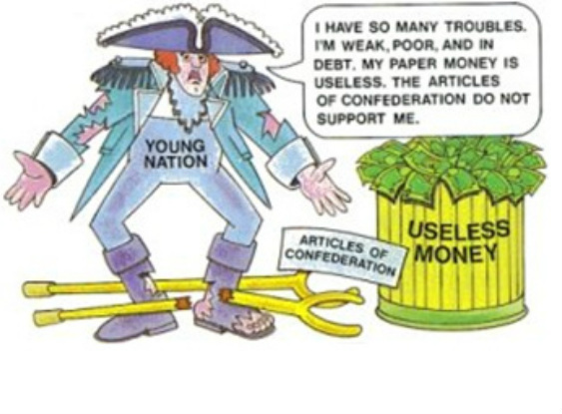
What BAD happened under the Articles of Confederation?
FOREIGN PROBLEMS:
European nations = NO respect for USA (couldn’t pay its debts)
Britain and Spain = want to expand WEST after the war
FINANCIAL PROBLEMS:
Congress = NO TAXING POWER – only by REQUEST
War debts = UNPAID
To other countries (France, Spain)
To their OWN SOLDIERS
States AND Congress = issued WORTHLESS paper money = INFLATION

Slide 4
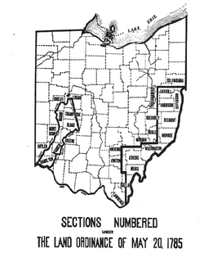
What GOOD happened under the Articles of Confederation?
Land Ordinance 1785
Settlers could purchase farmland in the undeveloped west.
NOW, land sales = revenue for Congress!

Slide 5
What GOOD happened under the Articles of Confederation?
Set rules for creating new states between Great Lakes and Ohio River
Westward expansion
MOST significant achievement of the A of C
Similar to the Land Ordinance of 1785, but this one was MORE POLITICAL

Slide 6
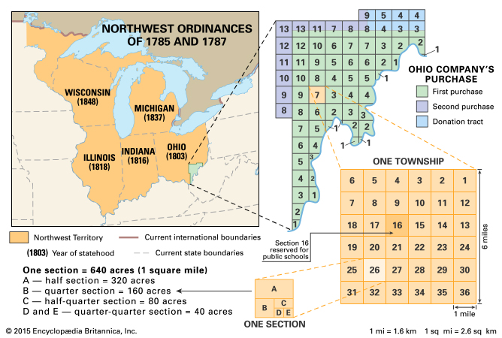
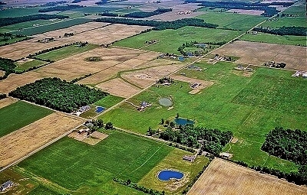
Ohio
Orderly way of preparing the land to eventually sell…
60,000 people = create a constitution and apply for statehood (who cares about native’s land claims!)
Granted limited self-government in the territory
Slavery forbidden in this territory

Slide 7
AP MC REVIEW
The effects of the Northwest Ordinance included all of the following except to
forbid slavery in the Northwest Territory
permit the citizens of a territory to write a state constitution and apply to Congress for admission as a new state
remove Native Americans and guarantee white settlers the right to buy land in the territory
encourage the development of new states which would enter the Union as equals with the original 13 states

Slide 8
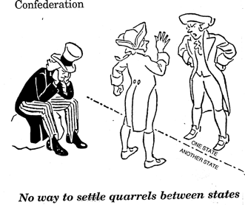
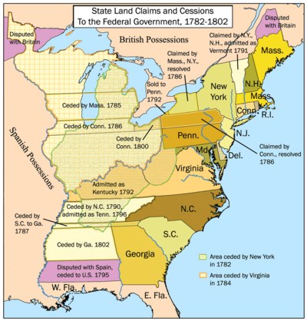
One last problem puts it over the edge…
Domestic Problems:
US lacked military power to defend itself
States acted as individual countries = RARELY agreed!
Example: Connecticut and Virginia almost went to war over land claims!

Slide 9
While you watch: What led to this
“gathering” of men?

Slide 10
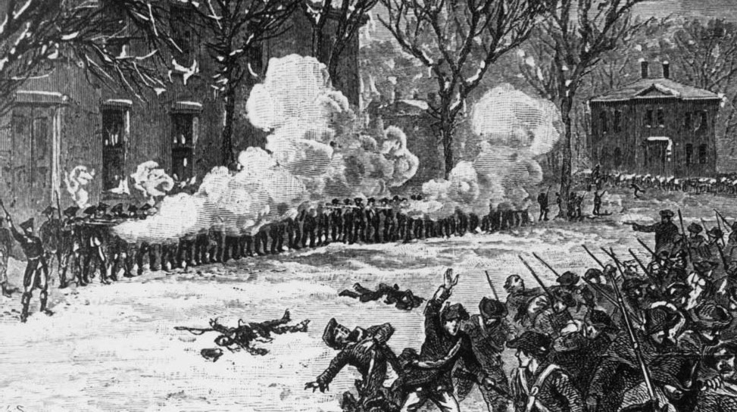
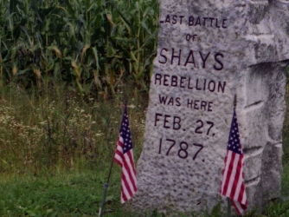
Domestic problems under the Articles
SHAY’S REBELLION (1787)
Daniel Shays (war veteran)
Farmer uprising vs. high state taxes, imprisonment for debt, lack of $$
Rebels stopped collection of taxes, forced closing of courts
Rebellion stopped by Massachusetts state militia (no $$ for army)
Washington said: “What a triumph for our enemies… to find we are incapable of governing ourselves.”

Slide 11
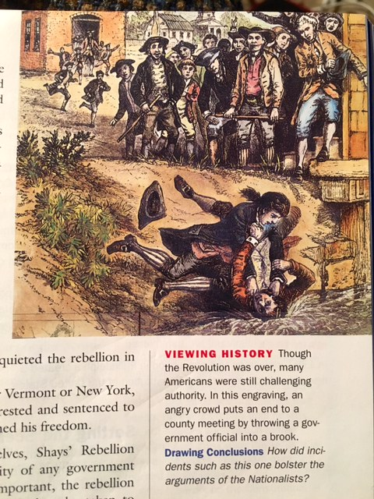
What does it mean to be a “nationalist”?
Where do we see examples of nationalism in our lives TODAY?
Examine the image.
How did incidents such as this one bolster the arguments of the Nationalists in the US?
The nationalists argued that democracy was giving way to violence and threatening order without a strong central government.

Slide 12
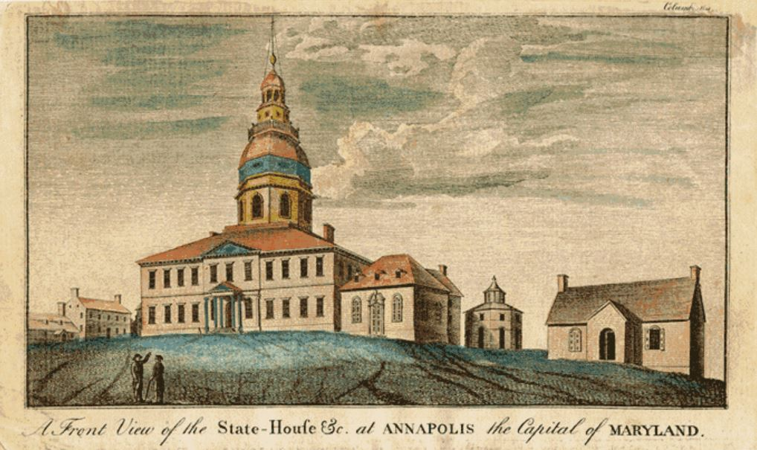
The Annapolis Convention
1786 – Held in Annapolis, Maryland...
5 states sent delegates
PLAN = regulate interstate and foreign trade
What did they find out? Another BIGGER convention MUST BE HELD!

Slide 13
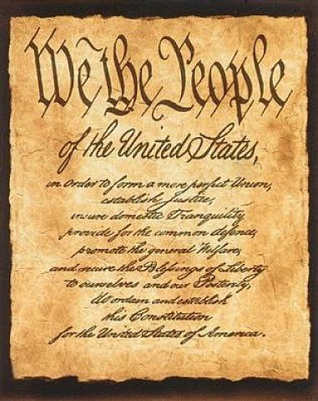
So, what needs to change ASAP?
For the USA to survive, it needs:
Stronger National Government
Avoid CIVIL WAR!
More branches to share power
A NEW CONSTITUTION at a NEW CONVENTION!
“Decide forever the fate of republican government.”

